Slide 1
Protecting our most important assets.
Matt Farrow
DDSAnalytics

Slide 2
“First Who ... Then What. We expected that good-to-great leaders would begin by setting a new vision and strategy. We found instead that they first got the right people on the bus, the wrong people off the bus, and the right people in the right seats—and then they figured out where to drive it. The old adage “People are your most important asset” turns out to be wrong. People are not your most important asset. The right people are.”
- Jim Collins
Good to Great: Why Some Companies Make the Leap... and Others Don't

Slide 3
The Data
Initial Data
Cleaned Data
870 observations
36 variables
Addressed natural attrition
Removed unhelpful variables
Converted appropriate variables to factors
16.1% attrition rate
Notes:
Unhelpful:
employee_count
employee_number
over_18
standard_hours

Slide 4
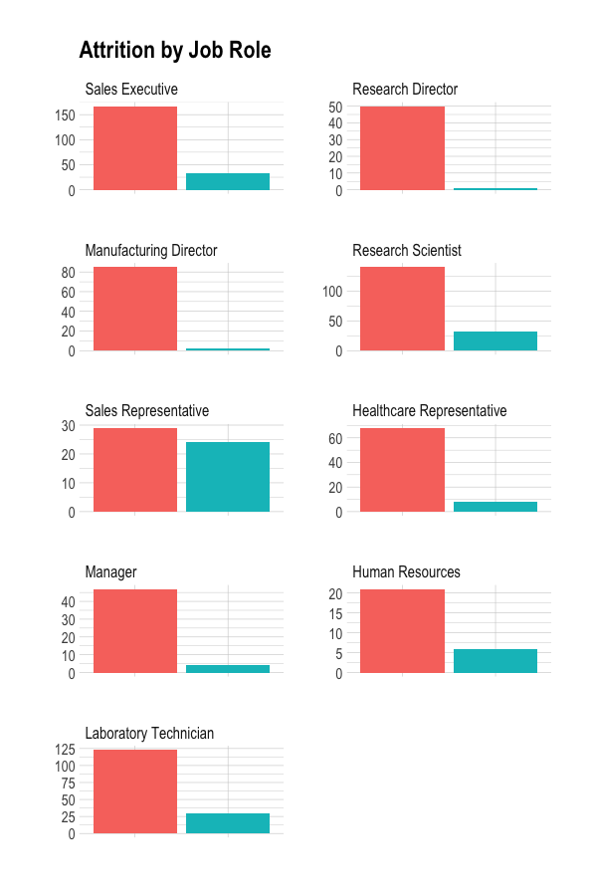
Attrition by Role
Director-level positions have the smallest levels of attrition (~ 2%)
Sales representatives have a 45% attrition rate
Human resources, laboratory technicians, and research scientists are around 20%.

Slide 5
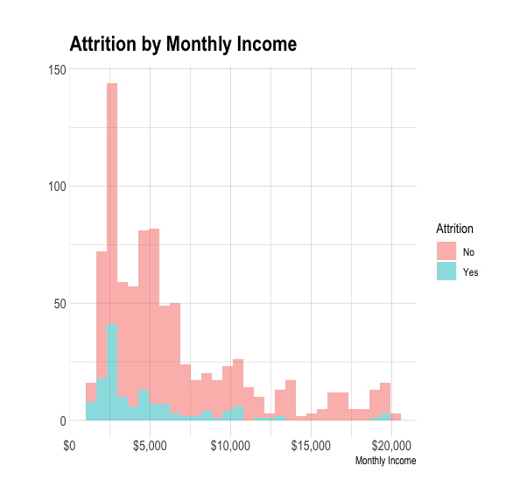
Monthly Income
Right-skewed, as expected
95% confident that the mean difference in monthly income between groups is between $1,220 and $2,654 per month

Slide 6
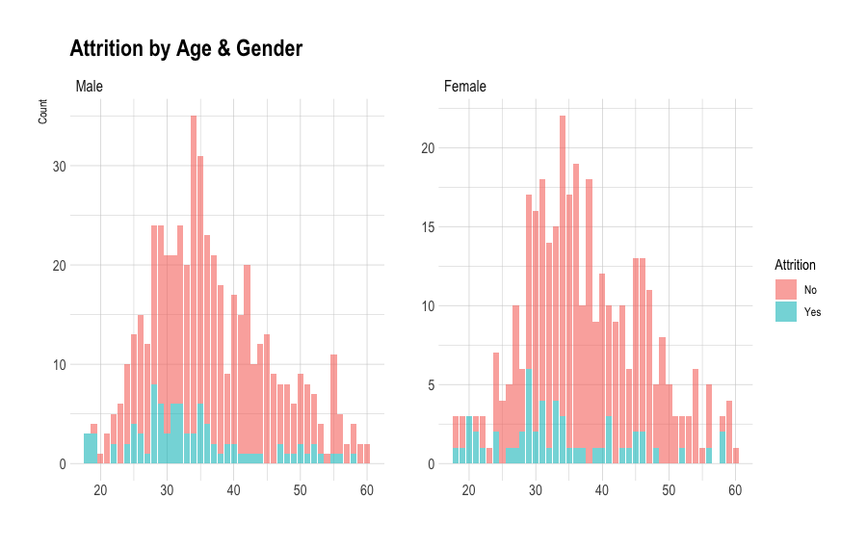
Age & Gender
Both males and females follow similar attrition trends by age
More females tend to remain with the company in the 50-60 years old range

Slide 7
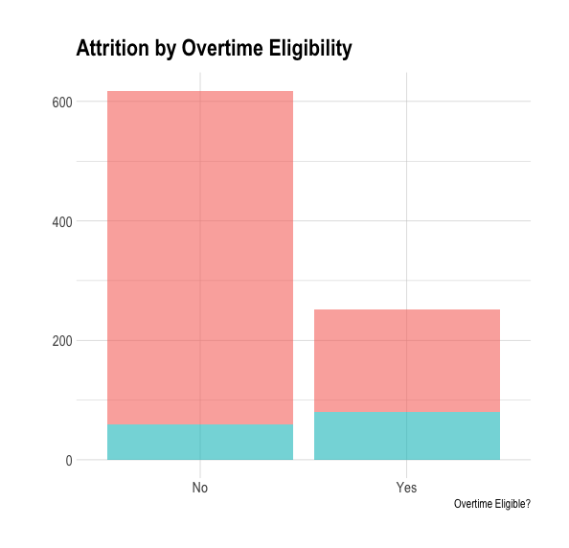
Overtime
32% of non-exempt staff
10% of exempt staff

Slide 8
Attrition Model
The best performance for attrition came from the Naïve Bayes model using all the available variables.
78%
76.96%
Sensitivity
Model Accuracy
71.43%
Model Accuracy

Slide 9
ATTRITION MODEL
 | NO | YES
NO | 142 | 10
YES | 40 | 25
71% Attrition
78% Non-Attrition

Slide 10
Salary Model
Linear model using log-transformed monthly income.
$1,367
RMSE
Predicted error of monthly income in the model.
91%
R-Squared
Variation of monthly income explained by the model.

Slide 11
Final Results
Factors Most Likely Contributing to Attrition
1
2
3
Job Role
Monthly Income
Overtime

