Slide 1

This game show that has been on the air for more than 37 years and is known for its late, beloved host and having players answer clues in the form of a question?
WHAT IS

Slide 2
Analyzing Jeopardy! Data
M. Ball,
M. Farrow,
J. Harrison

Slide 3
What is a game show that has been on the air for more than 37 years and is known for its late, beloved host and having players answer clues in the form of a question?

Slide 4
J! Archive
A fan-created archive of Jeopardy! Games and players

Slide 5
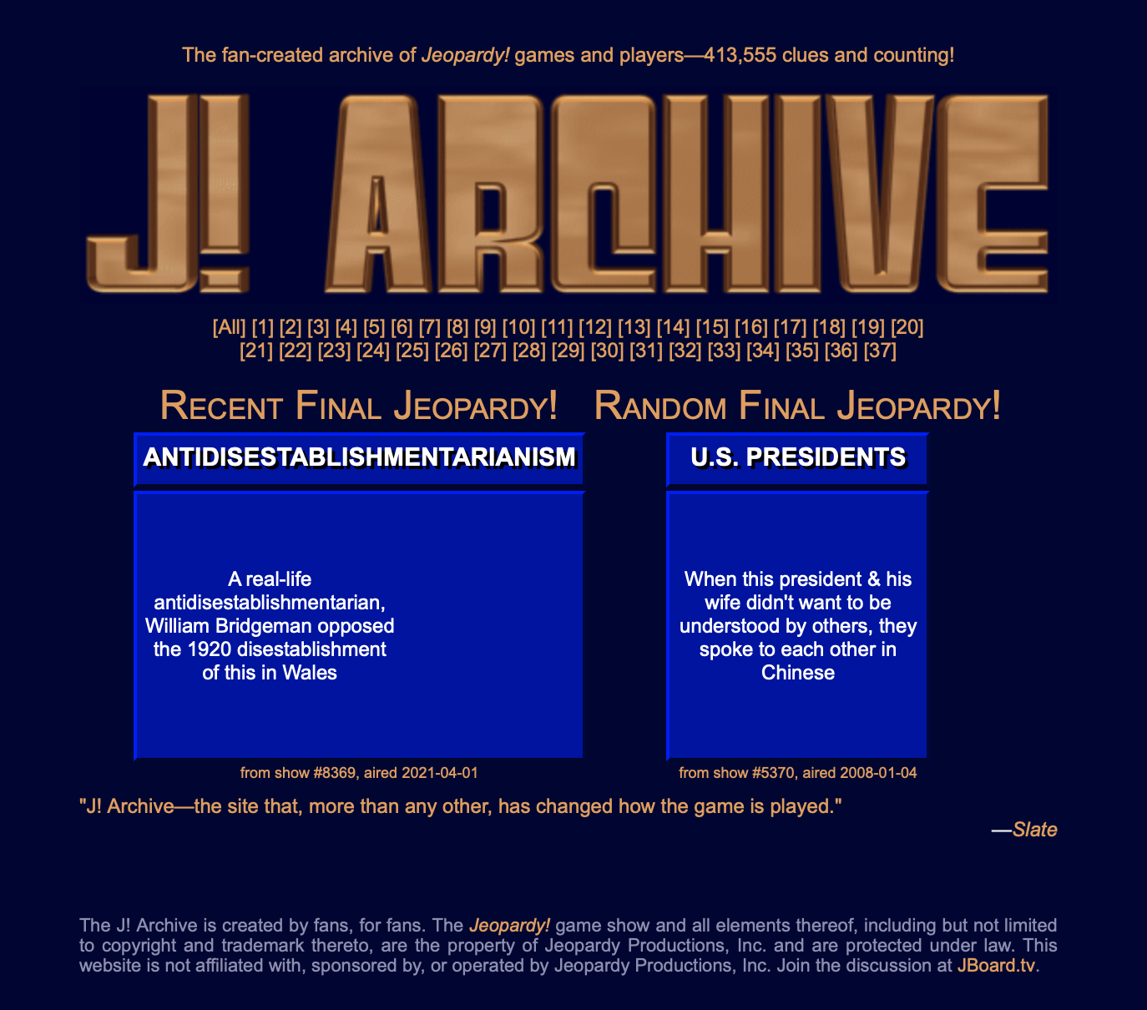
J! Archive

Slide 6
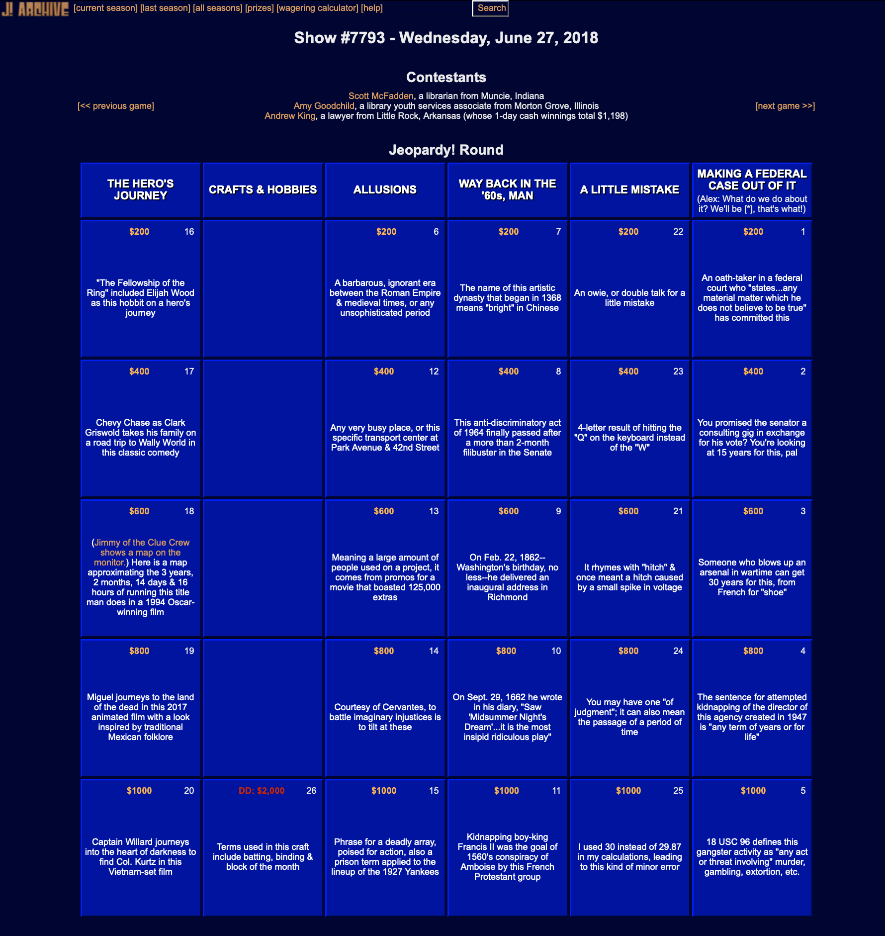
Information Collected
Air Date
Contestants
Categories
Clues
Responses
Daily Doubles
Final Scores

Slide 7
Data Collection
Whatr package

Slide 8
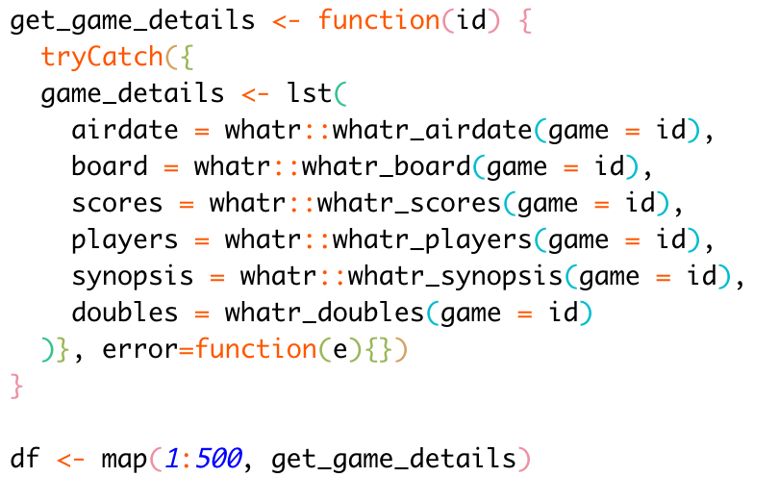
Data Collection
whatr package developed by Kiernann Nicholls
Created a function to get all details for a specific game ID
Used purrr to iterate over all of the games and create a master list

Slide 9
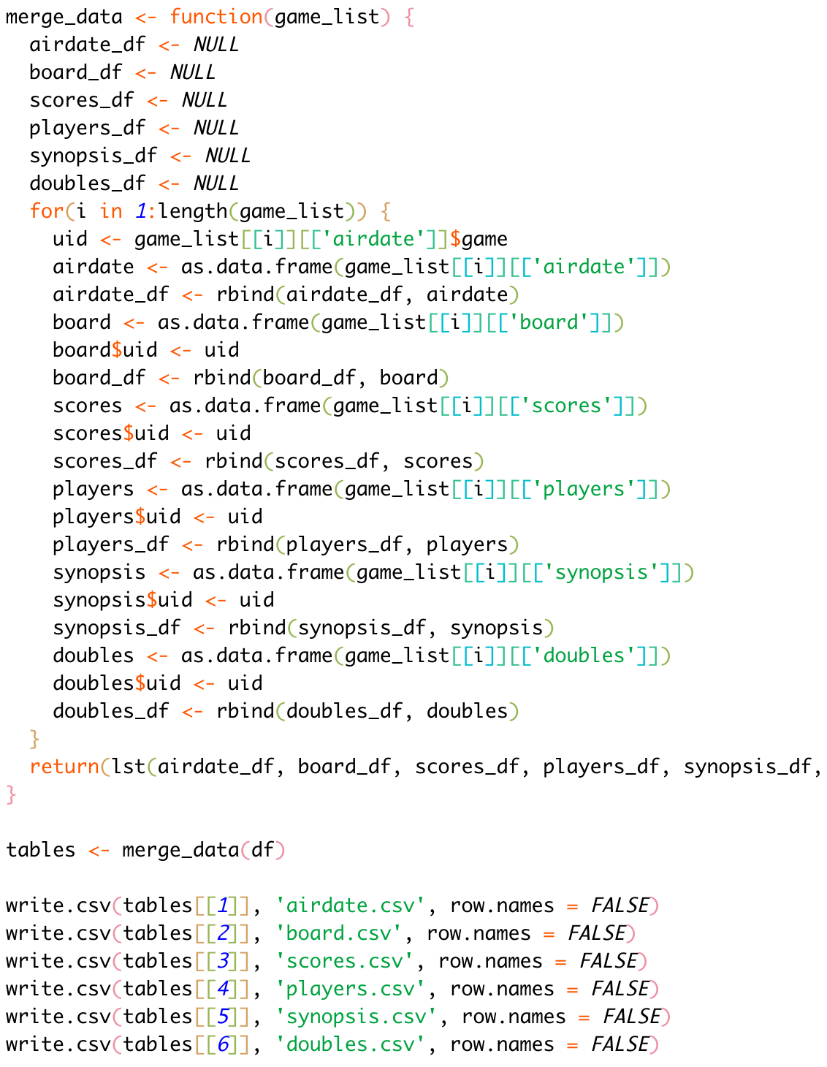
Data Collection
Created a separate function to iterate over each game and combine the data of each type into a single data frame
Split data out into standalone CSVs for import into MySQL Workbench

Slide 10
MySQL Workbench

Slide 11
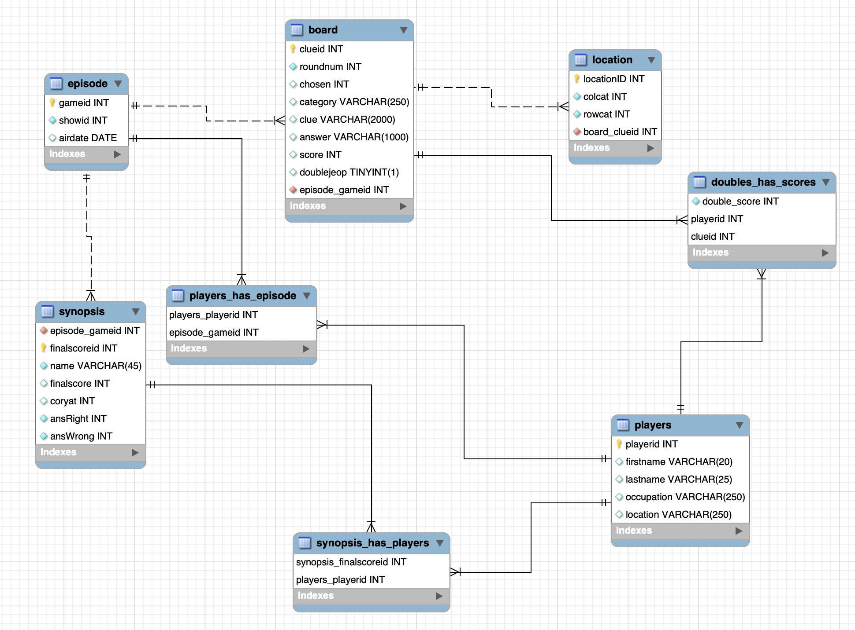
EER Diagram

Slide 12
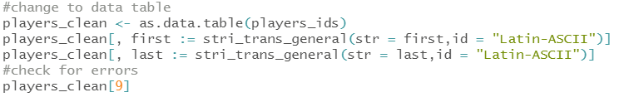
Database challenges
A significant portion of our data included special characters – as part of someone’s name or a clue
This prevented us from effectively using the data import wizard within MySQL workbench of our csv files we had just created
Our script required modification to clean up the special characters to allow for import without errors

Slide 13
Challenges continued…
Another challenge we ran into was some missing data when trying to pull the players who had won the most daily doubles – the winner was missing!
We had to go back to our database design and add in doubles_has_scores to link up the clue to the player

Slide 14
DATA INSIGHTS

Slide 15
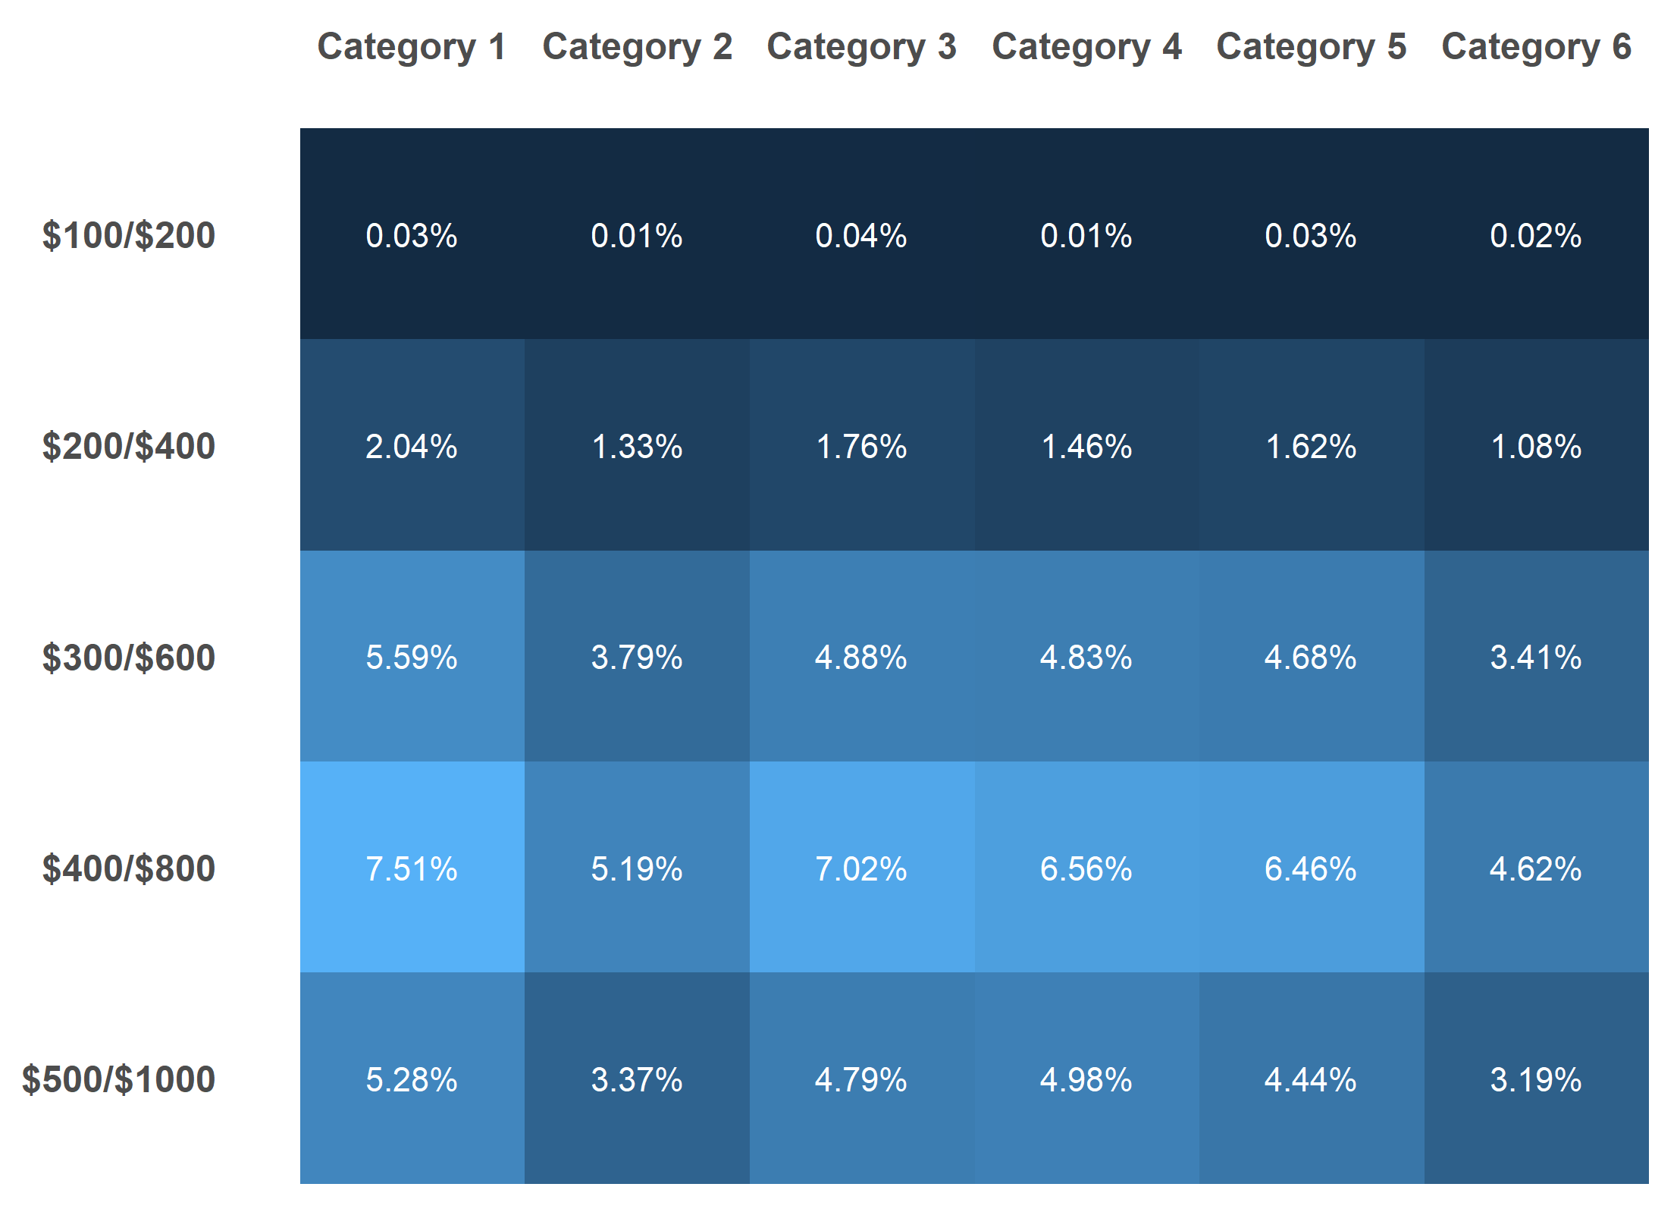
Where is the daily double?

Slide 16

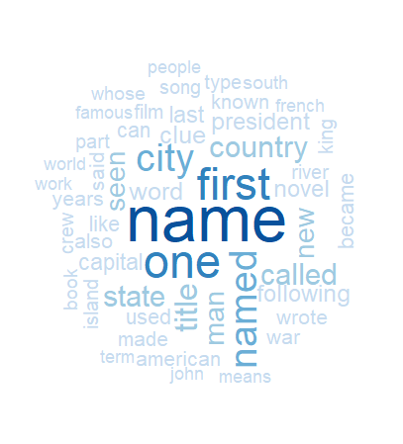
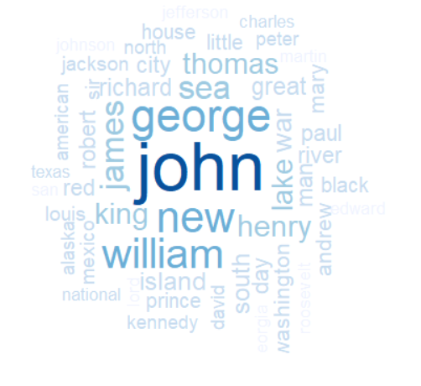
Daily Double KEYWORDS
What are the most common daily double
clues?
categories?
answers?

Slide 17
Rshiny App Demo
Jeopardy.site

Slide 18
Future opportunities
In creating our database, we chose not to include who got each regular Jeopardy! clue correct as it meant we would have duplicate entries. Future improvements could be made to incorporate this into a new normalized table to join up with each player so get this information
Although the database is not all that large, an area for future development could be to host the database on the cloud so that you would not have to store it locally to access the data. This would allow us to then…
Recreate each game into an interactive app for people to play and to practice for a future appearance on Jeopardy!
BUT WAIT! Someone DID make an app like that… (but not with a database)

