Slide 1
Analyzing Jeopardy! Data
M. Ball, M. Farrow, J. Harrison

Slide 2

What is a game show that has been on the air for more than 37 years and is known for its late, beloved host and having players answer clues in the form of a question?

Slide 3
J! Archive
A fan-created archive of Jeopardy! Games and players

Slide 4
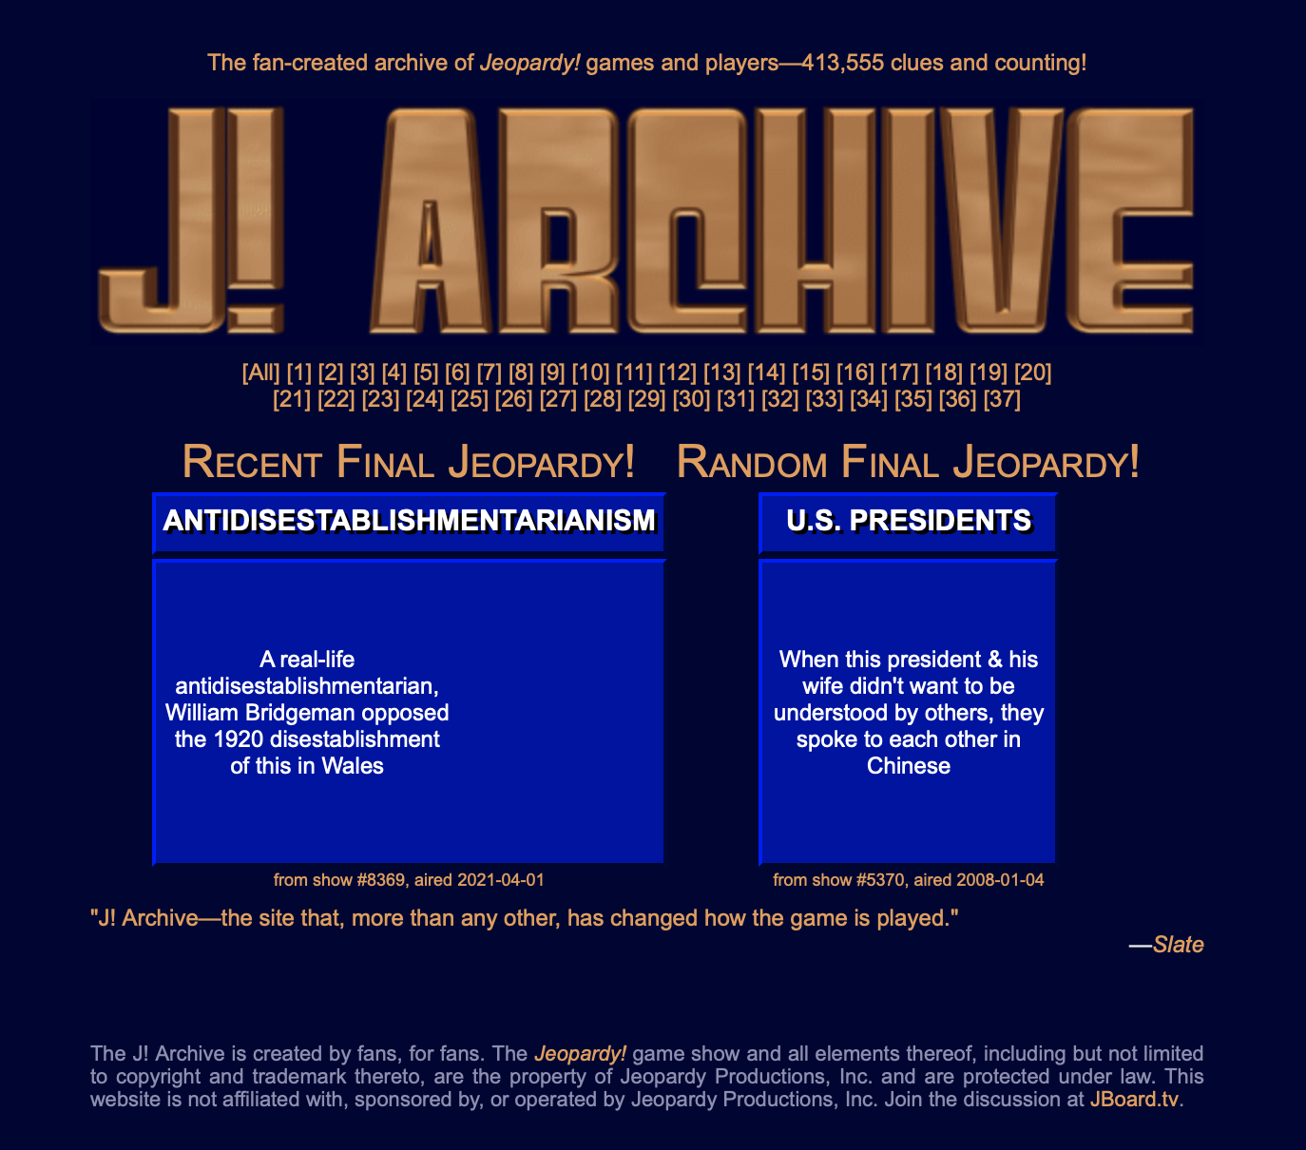
J! Archive

Slide 5
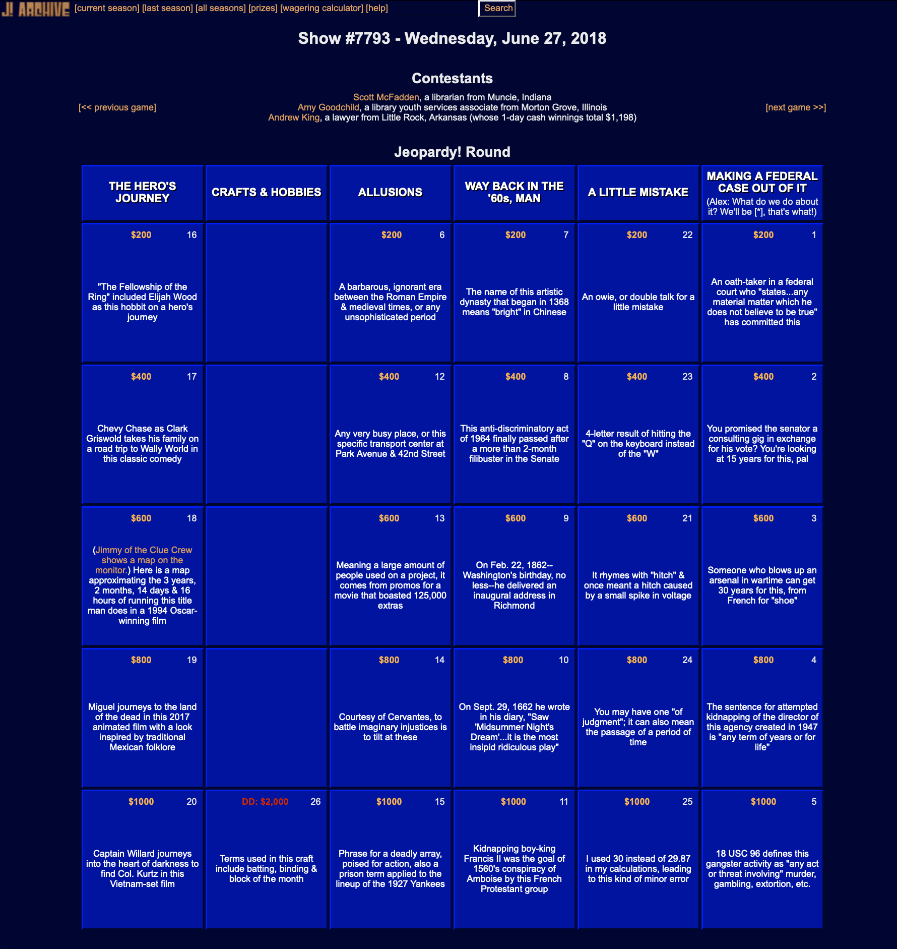
Information Collected
Air Date
Contestants
Categories
Clues
Responses
Daily Doubles
Final Scores

Slide 6
Data Collection
Whatr package

Slide 7
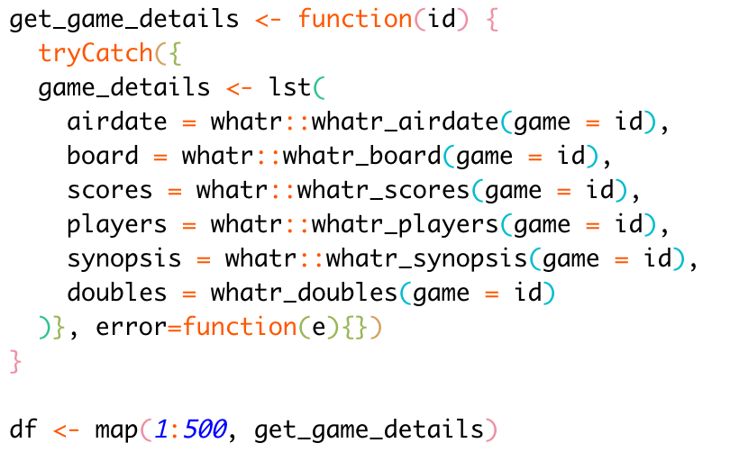
Data Collection
whatr package developed by Kiernann Nicholls
Created a function to get all details for a specific game ID
Used purrr to iterate over all of the games and create a master list

Slide 8
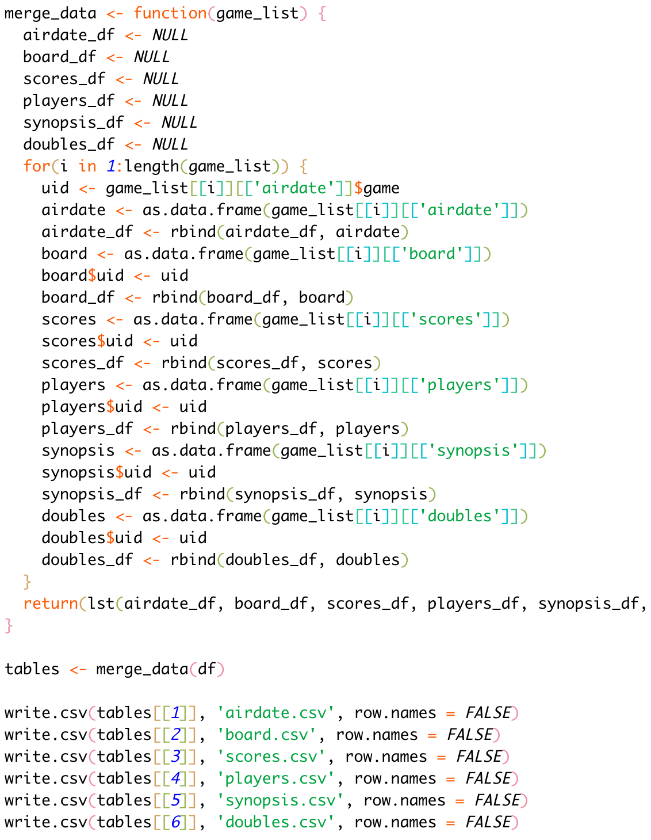
Data Collection
Created a separate function to iterate over each game and combine the data of each type into a single data frame
Split data out into standalone CSVs for import into MySQL Workbench

Slide 9
MySQL Workbench

Slide 10
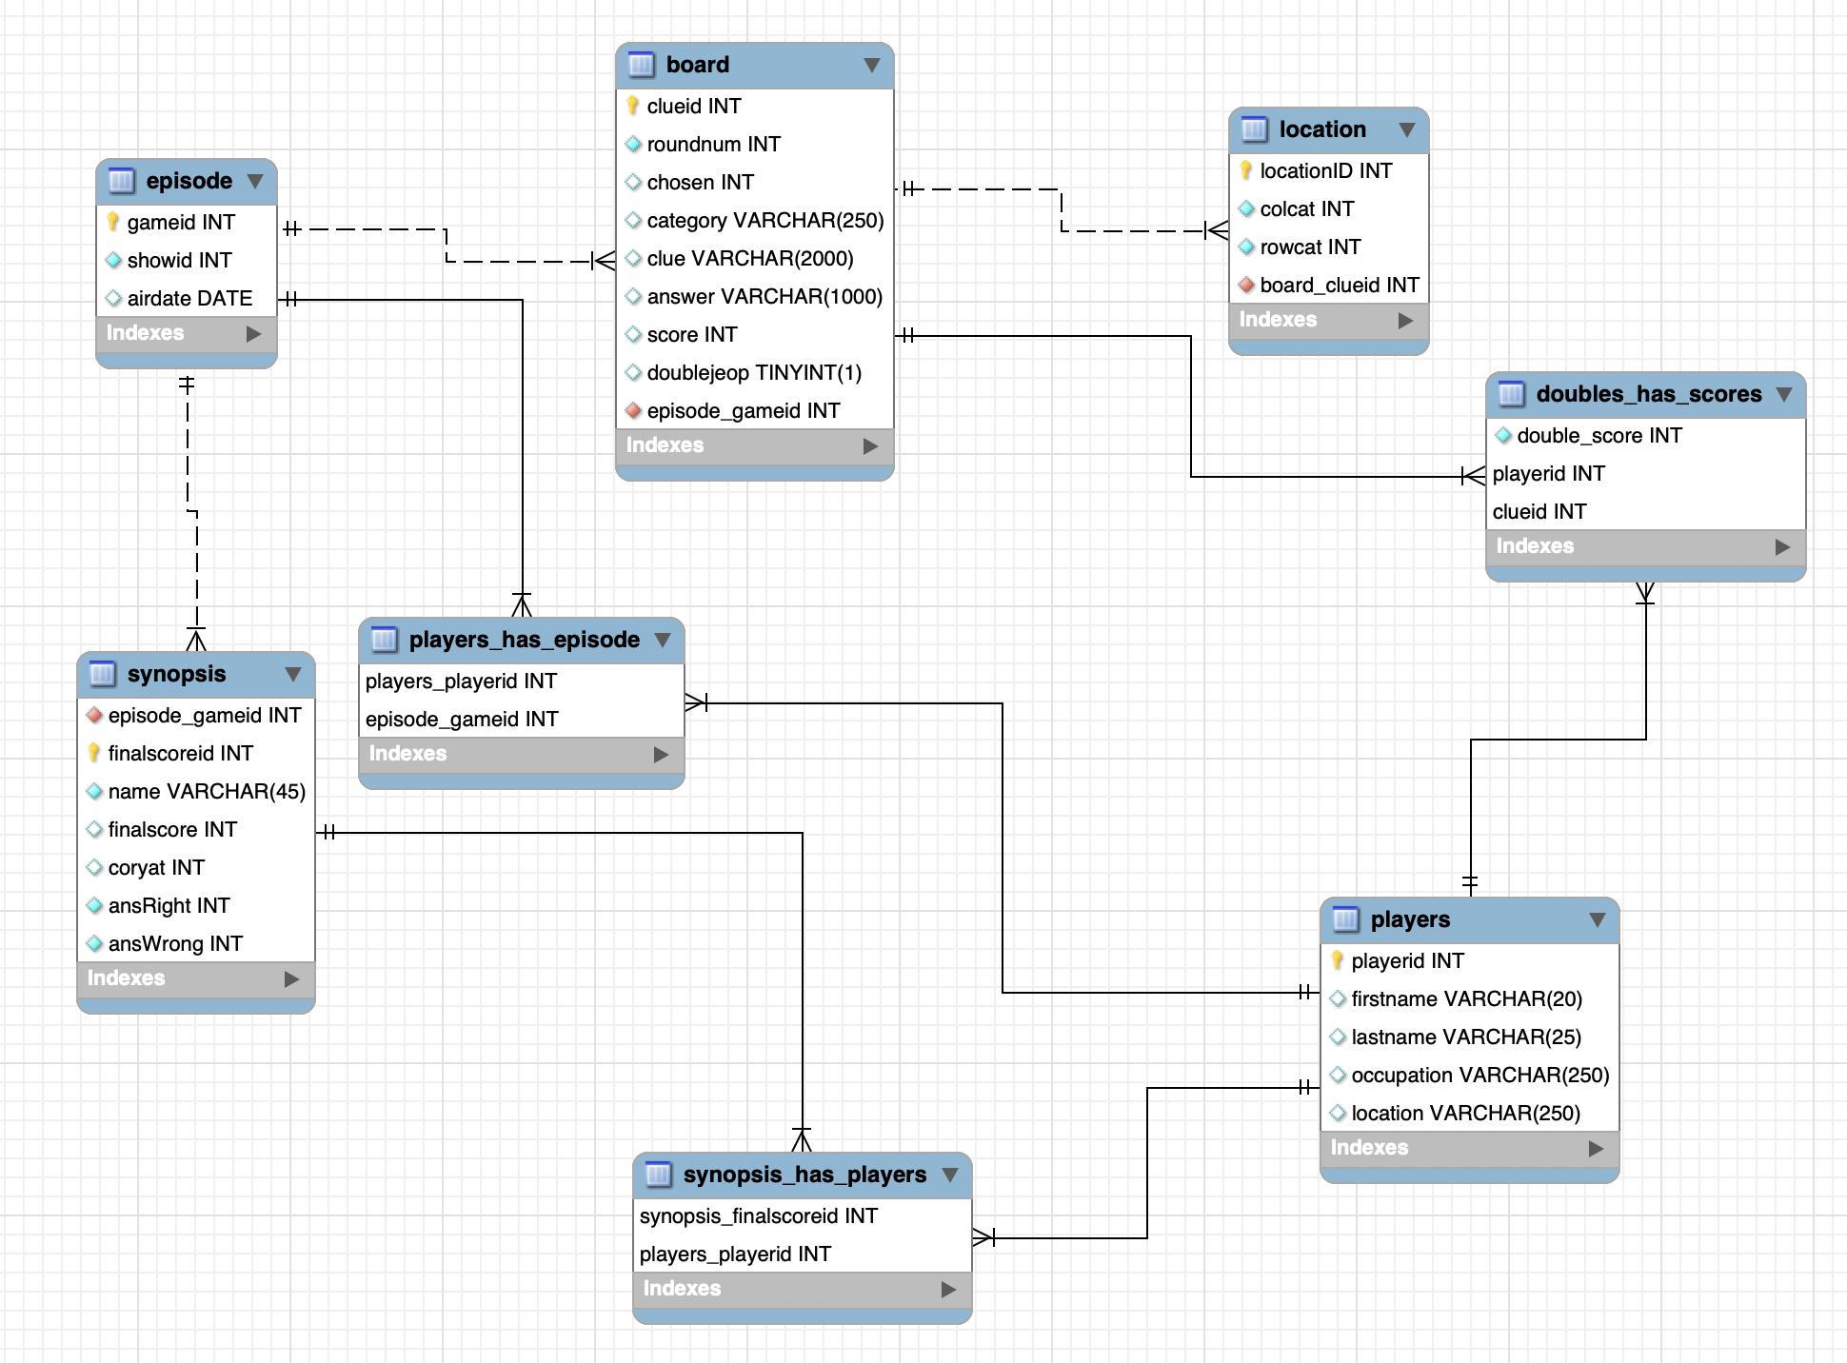
EER Diagram

Slide 11
Overview

Slide 12
Challenges

Slide 13
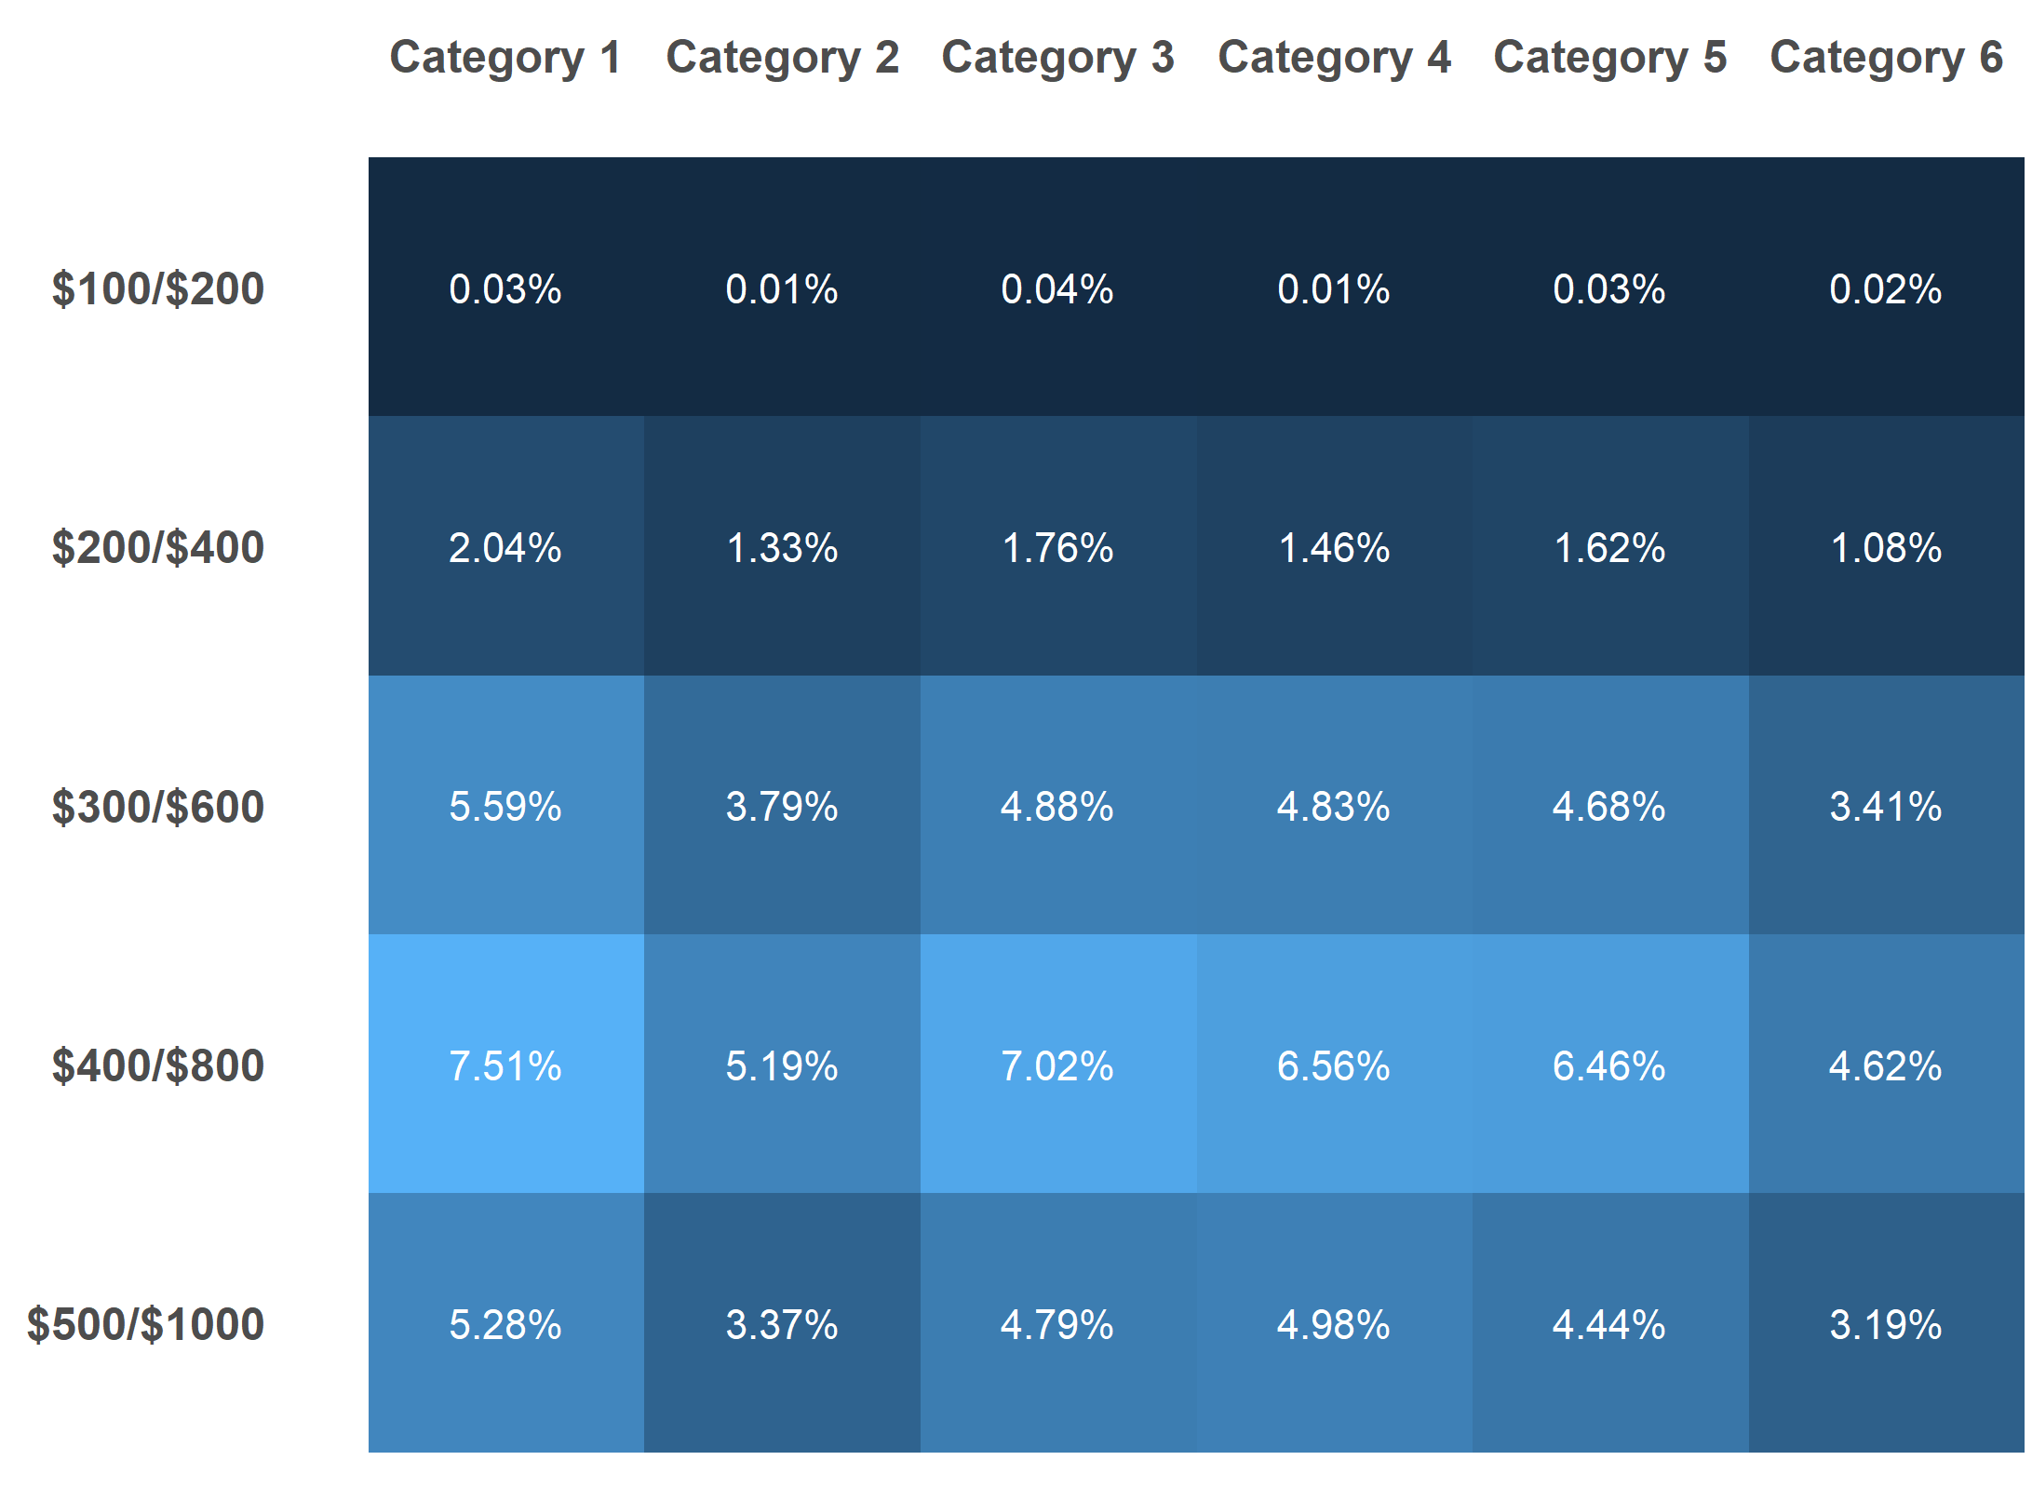
Where is the daily double?

Slide 14

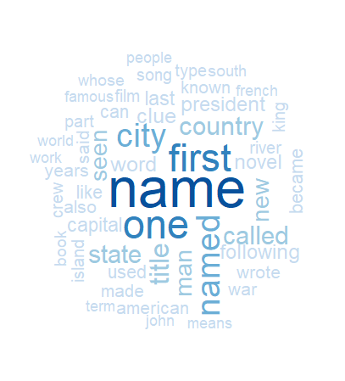
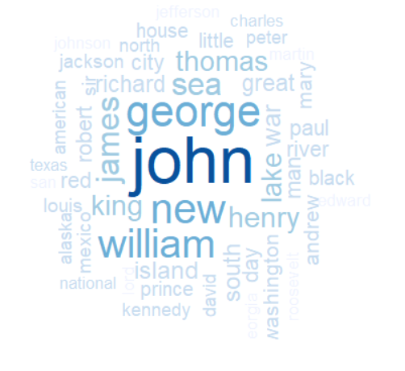
Daily Double Insights
What are the most common daily double clue categories?
What are the most common daily double clue clues?
What are the most common daily double clue answers?

Slide 15
Player Stats

Slide 16
Rshiny App Demo

