Slide 1
Rosetta Basics: IO and Navigating Rosetta
Shannon Smith
Graduate Student | Meiler Lab
Shannon.t.smith.1@Vanderbilt.edu

Slide 2
Goals for this Talk
1. General Rosetta Concepts:
How do I run basic Rosetta applications?
Input/Output: file types, options, etc.
2. Learn where things are in Rosetta
Your working directory is independent of these Rosetta directories
(AKA your data is stored outside of Rosetta)
QUESTIONS ARE ENCOURAGED!

Slide 3
This talk is located in: ~/rosetta_workshop/tutorials/short_talks/navigating_rosetta_IO.pptx Example files are located in: Files for this talk are in ~/rosetta_workshop/tutorials/short_talks/RosettaIO/
Notice these files are located outside of Rosetta--you do NOT want to store your input/output files in the Rosetta directories
Tip: Open each file in your favorite text editor (gedit, vi, emacs, etc.) as we introduce them through the talk

Slide 4
How do I get Rosetta?
https://www.rosettacommons.org/software/license-and-download
Weekly Releases: (e.g. “2020.07”)
Latest version of the code, released roughly every week
Every revision passes scientific performance tests
Numbered Releases (e.g. “3.12”)
A weekly release that’s relabeled, released roughly every 6 months
All tutorials use version 3.12
Links to documentation, forum and demos:
https://www.rosettacommons.org/docs/latest/Home
https://www.rosettacommons.org/demos/latest/Home
Notes:
Double check version

Slide 5
General Workflow
Structure/Sequence
Input Files
Options
Application-Specific
Score_jd2
Applications
RosettaScripts
Structures
Output Files
Scores
Analysis Scripts
Scientific Results

Slide 6
How do I run a Rosetta command?
Every command has the same basic layout:
<path_to_rosetta>/main/source/bin/<app_name>.default.linuxgccrelease –arg1 –arg2
Arguments consist of multiple things:
Point to input files
Point to where you want output files to go
Other arguments are protocol-dependent
Path to the Rosetta application
Arguments/flags/options

Slide 7
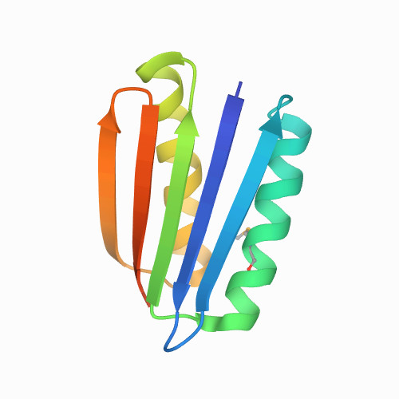
Your first Rosetta command:
cd ~/rosetta_workshop/short_talks/RosettaIO/
Scoring 1qys (https://www.rcsb.org/structure/1QYS)
Crystal structure of Top7: A computationally designed protein with a novel fold
<path_to_rosetta>/main/source/bin/score_jd2.default.linuxgccrelease –in:file:s 1qys.pdb -out:pdb > 1qys_score.log
Inputs:
Running score_jd2 application, which simply scores in the input protein
-in:file:s 1qys.pdb : tells Rosetta we’re inputting the 1qys.pdb PDB file
-out:pdb argument tells Rosetta that we want to save the output PDB file of the scored protein
> 1qys_score.log : print terminal output to file called 1qys_score.log
Outputs:
1qys_0001.pdb : output PDB
score.sc : default name for output scorefile
1qys_score.log: tracer of run AKA what is output to the terminal screen when running command
Kuhlman B, Dantas G, Ireton GC, Varani G, Stoddard BL, Baker D. Design of a novel globular protein fold with atomic-level accuracy. Science. 2003;302(5649):1364-1368. doi:10.1126/science.1089427

Slide 8
Reading structures into Rosetta
PDB files | Silent files
International standard Readable by PyMol, MOE, Chimera, etc One line per atom Useful for small number of structures www.wwpdb.org/documentation/file-format | Specific to Rosetta Compact One line per residue Useful for archiving many structures Binary silent files: more compact, but not human-readable https://www.rosettacommons.org/docs/latest/rosetta_basics/file_types/silent-file
Notes:
mmCif?

Slide 9
Common command line arguments
Common input options:
-in:file:s example.pdb ## input a PDB structure file
-parser:protocol example.xml ## RosettaScripts XML file
-in:file:fasta example.fasta ## input a FASTA sequence file
-in:file:silent example.silent ## input a Rosetta silent file
-nstruct 42 ## produce 42 outputs
Common output options:
-out:file:silent example_out.silent ## output structures to silent file
-out:file:scorefile example_out.sc ## output scorefile for run

Slide 10
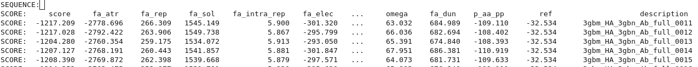
Examples of output: the scorefile
score.sc
One output per line—name of output is in the very last column
Each column defines a specific score term for the respective output structure
Second column is the “total_score”
The following columns are individual scoreterms (described in detail in later talk)
Excerpt of example scorefile here, but recommend you look at your own score.sc output file

Slide 11
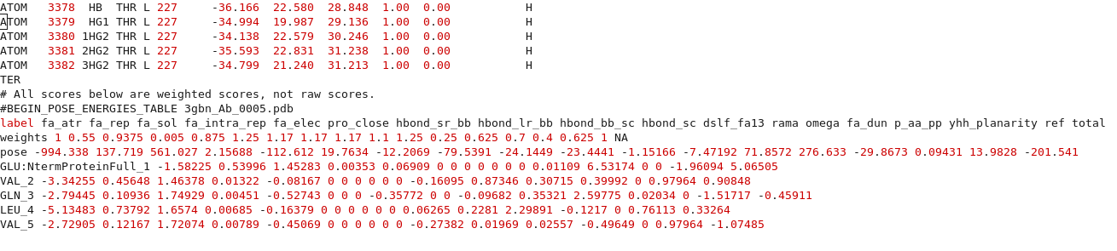
Examples of output: the output PDB
1qys_0001.pdb
One atom/line just like normal PDBs
Scroll to the bottom and there is per residue score information

Slide 12
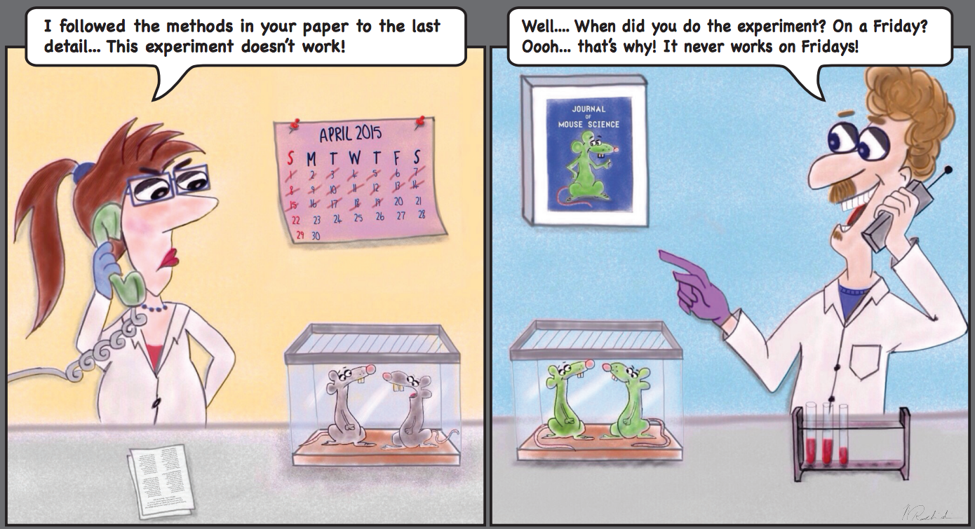
Examples of output: Tracer output (log files)
1qys_score.log
Shows exactly the command line you are running at the beginning
Which databases are being used, calling protocols, warnings, errors, etc.
Very useful for debugging to figure out where problems are coming from
Makes your protocol reproducible!!

Slide 13
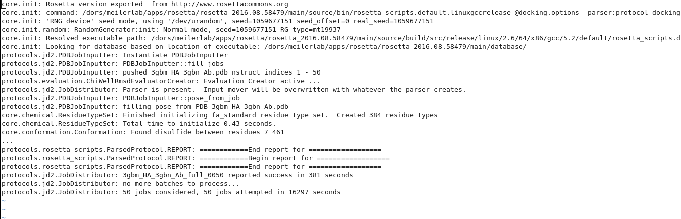
Examples of output: Tracer output (log files)
1qys_score.log
Options to control tracer output *these files can get very long!*:
Silence certain tracers:
-mute core.chemical.ResidueTypeSet
Change verbosity level (Error/Warning/Info/Debug/Trace)
-out:levels all:Warning core.init:Info

Slide 14
Other files: application-specific
Span File: Defines which residues are in the membrane
Loops File: Identifies the loop residues for loop closure
Params File: Custom parameters for small molecules or non-canonical amino acids
Constraint File: Experimentally derived restraints
Fragment File: Short protein segments used for comparative modeling and de novo folding
Res Files: Indicates which residue positions should be designed

Slide 15
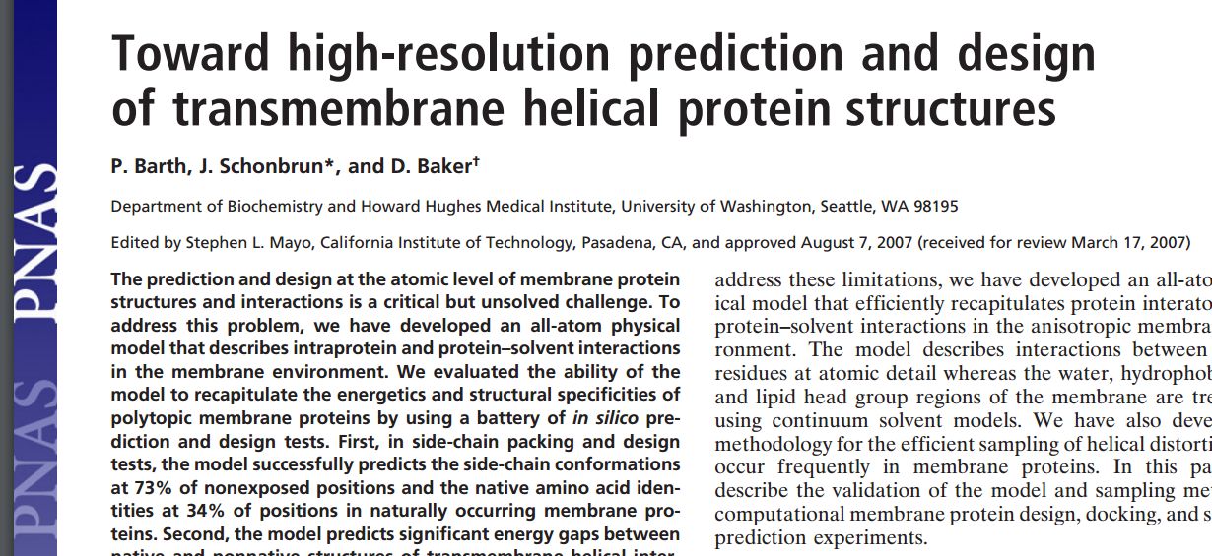
Protocols can get complicated…
$ROSETTA/main/source/bin/AbinitioRelax.linuxgccrelease -database ../../rosetta_database -in:file:fasta ./input_files/1elwA.fasta -in:file:native ./input_files/1elw.pdb -in:file:frag3 ./input_files/aa1elwA03_05.200_v1_3 -in:file:frag9 ./input_files/aa1elwA09_05.200_v1_3 -abinitio:relax -relax:fast -abinitio::increase_cycles 10 -abinitio::rg_reweight 0.5 -abinitio::rsd_wt_helix 0.5 -abinitio::rsd_wt_loop 0.5 -use_filters true -psipred_ss2 ./input_files/1elwA.psipred_ss2 -kill_hairpins -out:file:silent 1elwA_silent.out
-nstruct 10
OR
$ROSETTA/main/source/bin/AbinitioRelax.linuxgccrelease @options.txt

Slide 16
Use an options file for your runs
Why?
Easier to read/organize
Reproducibility!
$ROSETTA/main/source/bin/AbinitioRelax.linuxgccrelease @options.txt
-in:file
-fasta ./input_files/1e1wA.fasta
-native ./input_files/1e1w.pdb
-frag3 ./input_files/aa1elwA03_05.200_v1_3
-frag9 ./input_files/aa1elwA09_05.200_v1_3
-psipred_ss2 ./input_files/1elwA.psipred_ss2
-abinitio:relax
-relax:fast
-abinitio::increase_cycles 10
-abinitio::rg_reweight 0.5
…
-out:file:silent ./output_files/1elwA_silent.out
-nstruct 10

Slide 17
Any Questions?

Slide 18
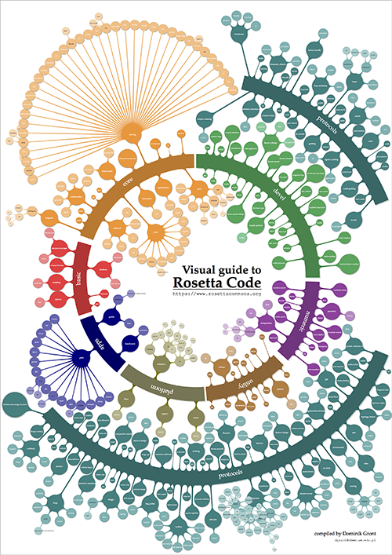


Slide 19
Rosetta Resources for Users:
https://www.rosettacommons.org
Documentation
User guides
Forum
Software Download
Tutorials (meilerlab.org)

Slide 20
Basic Rosetta Structure
cd ~/rosetta_workshop/rosetta/
rosetta/
main/
tools/
demos/
documentation/

Slide 21
~/rosetta_workshop/rosetta/main/
Rosetta/main/source/bin/
Most applications you will run are
calling programs within the bin directory
rosetta_scripts.default.linuxgccrelease
score_jd2.default.linuxgccrelease
relax.default.linuxgccrelease
Rosetta/main/source/scons.py
Used for compiling
Rosetta/main/source/src/
This is where all of the code lives
Rosetta/main/source/scripts/
Some useful scripts live here
(e.g. params file generation)
rosetta/
main/
source/
database/
tests/
Notes:
Database files automatically called
Weights files: these files

Slide 22
~/rosetta_workshop/rosetta/main/database/
Contains pre-defined information that an application needs
— users generally don’t change things here.
Note: Most of the time, applications know where the database is without having to specify it.
Rosetta/main/database/scoring/
Default weights files
Rotamer libraries
Rosetta/main/database/chemical/
Residue information--params files
Atom sets
rosetta/
main/
source/
database/
tests/
Notes:
Database files called when running an application
Weights files: these files

Slide 23
~/rosetta_workshop/rosetta/main/tests/
Rosetta/main/tests/
Tests for Rosetta code (useful for developers only)
rosetta/
main/
source/
database/
tests/
Notes:
It is fun to read through as this is what’s currently being tested by developers

Slide 24
Basic Rosetta Structure
cd ~/rosetta_workshop/rosetta/
rosetta/
main/
tools/
demos/
documentation/

Slide 25
~/rosetta_workshop/rosetta/tools/
rosetta/
tools/
protein_tools/
perl_tools/
hts_tools
And others...
These scripts are incredibly help for smaller, more basic tasks
Used mainly to setup or analyze runs

Slide 26
~/rosetta_workshop/rosetta/tools/protein_tools/scripts/
rosetta/
tools/
protein_tools/
perl_tools/
hts_tools
And others...
Some useful scripts to be aware of:
clean_pdb.py*
Makes a PDB “Rosetta-proof” and used at the beginning of almost any protocol
pdb_renumber.py
Renumbering your PDB starting from 1
score_vs_rmsd.py
Setup for score vs. RMSD plots
top_n_percent.py
Extracts tags (protein names) for top given percent of models based on score term

Slide 27
Basic Rosetta Structure
cd ~/rosetta_workshop/rosetta/
rosetta/
main/
tools/
demos/
documentation/

Slide 28
~/rosetta_workshop/rosetta/demos
rosetta/
demos/
tutorials/
public/
Protocol_capture
tutorials/
Past tutorials
public/
Protocol examples
protocol_capture/
protocols associated with a publication
DISCLAIMER: May be out of date, always check
Wiki/RosettaCommons/forum for latest information!

Slide 29
Basic Rosetta Structure
cd ~/rosetta_workshop/rosetta/
rosetta/
main/
tools/
demos/
documentation/

Slide 30
~/rosetta_workshop/rosetta/documentation/
rosetta/
documentation/
getting_started/
rosetta_basics/
application_documentation
scripting_documentation
Very useful to go through when you’re just getting started in
Rosetta or any structural biology software
Understanding general Rosetta concepts
Where to find FAQs (How long does this run take?)
Options list, file types
Protocols you can use
General structural biology FAQs
How do I do X?
https://www.rosettacommons.org/docs/latest/Home

