Slide 1


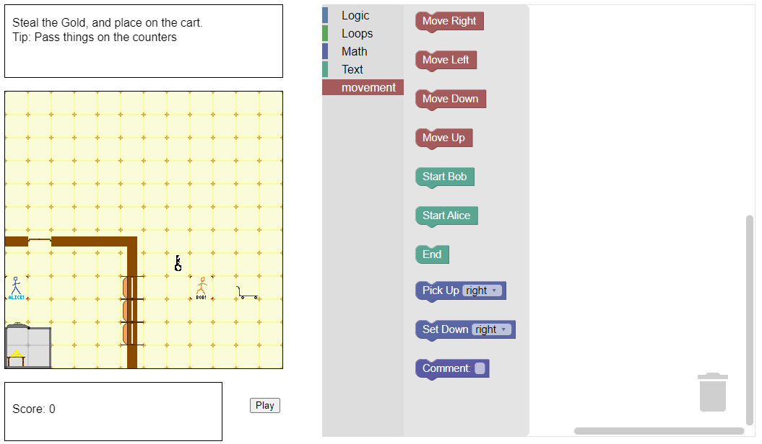
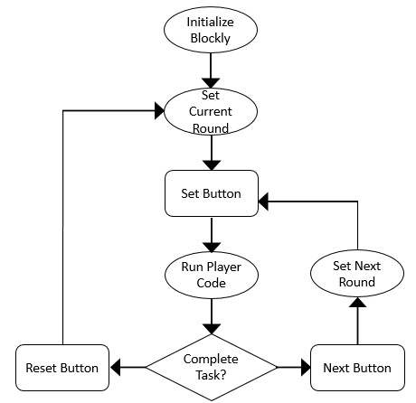
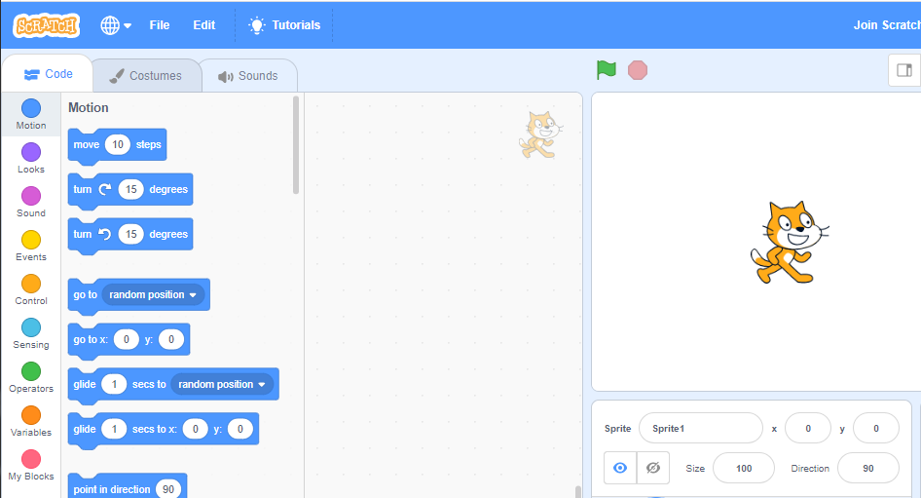



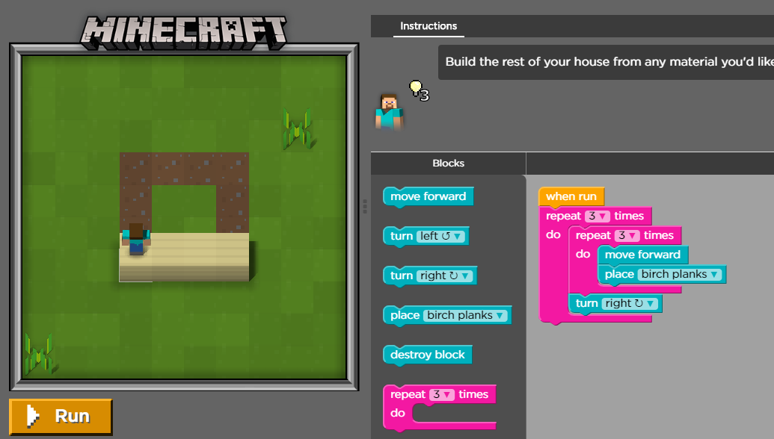
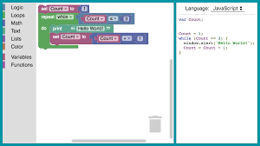
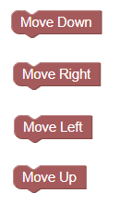
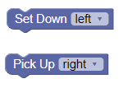
HELPUS: How Entry Level Programmers Use Synchronization
Midn. 1/C Matthew Friedel, Prof. Christian DeLozier, LCDR James Shey
Abstract/Motivation
HELPUS VPL Layout
Gameplay Format
Parallel programming is a powerful tool that can be used to increase performance in most applications, however the skillset required to program in parallel is unavailable to novice programmers. HELPUS is a visual programming language (VPL) that can be configured to directly represent parallel programming models, such as treads and locks in C++. It is presented alongside a series of games that represent various parallel challenges faced in real-world applications. By working through the games using the VPL, novice programmers learn to recognize opportunities for adding parallelism in real-world applications.
Each round, the player is presented with a new challenge as well as a more blocks that were not present in the last challenge but are now necessary. After creating what they think is a functioning code, the player
Game Layout
Voltage Across Zener Diode
Background
The HELPUS VPL follows a similar layout to most VPL games, with a progrent that directly affects a 2D game.
Future Work
Similar VPLs are used to teach basic serial programming in a large number of online games. [1] [2]
Remaining work for the HELPUS VPL includes:
Adding message passing between the characters, including the ability to wait until another character has sent a message.
Adding blocks to represent SOFRITAS API commands.
Creating several new levels to the game to represent various parallel patterns.
Preliminary fielding to novice programmers in the Brigade of Midshipmen.
Final fielding to novice programmers at other universities.
Characters in the game represent different . Their code executes at the same time and is delineated using Start and End blocks.
References
[1] Lifelong Kindergarten Group at MIT Media Lab “Scratch: Get Creative with Coding” scratch.mit.edu
[2] Code. Org Hour of Code project. Code.org/minecraft
[3] C. DeLozier, B. Lucia, A. Eizenberg, J. Devietti. SOFRITAS: Serializ-able Ordering-Free REeions for Increasing Thread Atomicity Scalably University of Pennsylvania, March 2018[
[4] E. Pasternak, R. Fenichel, A. Marshall. Tips for Creating a BlockLanguage with Blockly, Google, 2017
[5] V. Pankratius, A. Adl-Tabatabai, A Study of Transactional Memory vs.Locks in Practice
Character’s positions on the board represent pointers to shared memory. By moving around, characters are able to access shared information between each other.
The items in a character’s hand represent private memory. By picking up and setting down items characters pass data between shared and private memory.
Blockly is an API from Google that allows us to create our own VPL that complies into JavaScript, which can then be run inside of a webpage.
Notes:
Do not change: page size, background color, font size or font type
You may change: section headings as appropriate (e.g. Method might be Algorithm, Design Approach or Analysis) or remove a section if unneeded e.g. Acknowledgments. You may also change the box size.
Tips:
Graphics should be hi res (will be printed large), captioned, and source listed in caption or on graphic if not self generated. Use white outline.
Plots: make sure fonts for axis labels are readable. Consider adding axis labels or annotations in power point rather than generating software.
References: Cited within the body of the text and a complete bibliography is presented that is correctly formatted according to CSE guidelines (http://library.osu.edu/sites/guides/csegd.php; Council of Science Editors).

