Slide 1

Electrical Grid Cyber-Monitoring
CMPT318 Cybersecurity
Group 29
Richard Swann ID 823902440
Matt Fung ID 301329703
Jason Cao ID 200107583

Slide 2
Introduction
Concerns about the vulnerability of the Electrical Grid to cyber attacks is growing. The sophistication of cyber attacks is continuously increasing and the conventional defenses against these attacks are now of questionable value.
Artificial Intelligence plays and will increasingly play an important role in the next generation of defense solutions.
The performance of Hidden Markov Models to detect a cyber incursion and the applicability of Reinforcement Learning to protecting the Electrical Grid are analyzed.

Slide 3
Problem Statement
For a Cyber Attacker, the Modern Electric Grid is a “Target Rich” Environment
Advanced Persistent Threats (APTs) are sophisticated and hard to detect
A Successful Attack on the Electrical Grid will cause Serious Economic and Social Damage
New methods of Detecting and / or Countering Malicious Activity are Urgently Needed

Slide 4
Electrical System Basics
The Energy in a Major Electrical Grid is Enormous
BC Hydro produces energy equivalent to 2 TONS of TNT exploding every Second
The Grid is Complicated and the Configuration Changes Continuously
Large Portions are Centrally Controlled by a Computer System
The System can Damage Itself and most things Connected to it

Slide 5
Principled Component Analysis & Variable Selection

Slide 6
Principal Component Analysis
PC1 Importance
Period | Monday | Tuesday | Wednesday | Thursday | Friday | Saturday | Sunday
00:00 - 03:59 | 0.63 | 0.61 | 0.50 | 0.69 | 0.56 | 0.56 | 0.38
04:00 - 07:59 | 0.79 | 0.79 | 0.63 | 0.76 | 0.77 | 0.75 | 0.54
08:00 - 11:59 | 0.64 | 0.59 | 0.45 | 0.59 | 0.52 | 0.50 | 0.66
12:00 - 15:59 | 0.58 | 0.66 | 0.57 | 0.65 | 0.62 | 0.35 | 0.53
16:00 - 19:59 | 0.76 | 0.66 | 0.80 | 0.82 | 0.64 | 0.70 | 0.76
20:00 - 23:59 | 0.74 | 0.79 | 0.79 | 0.76 | 0.76 | 0.83 | 0.88
PC1 and PC2 Importance
Period | Monday | Tuesday | Wednesday | Thursday | Friday | Saturday | Sunday
00:00 - 03:59 | 0.82 | 0.77 | 0.70 | 0.85 | 0.72 | 0.72 | 0.71
04:00 - 07:59 | 0.89 | 0.91 | 0.81 | 0.91 | 0.89 | 0.89 | 0.73
08:00 - 11:59 | 0.80 | 0.80 | 0.72 | 0.76 | 0.74 | 0.68 | 0.80
12:00 - 15:59 | 0.78 | 0.79 | 0.75 | 0.80 | 0.79 | 0.69 | 0.71
16:00 - 19:59 | 0.90 | 0.91 | 0.88 | 0.91 | 0.79 | 0.89 | 0.91
20:00 - 23:59 | 0.89 | 0.89 | 0.91 | 0.89 | 0.89 | 0.93 | 0.95

Slide 7


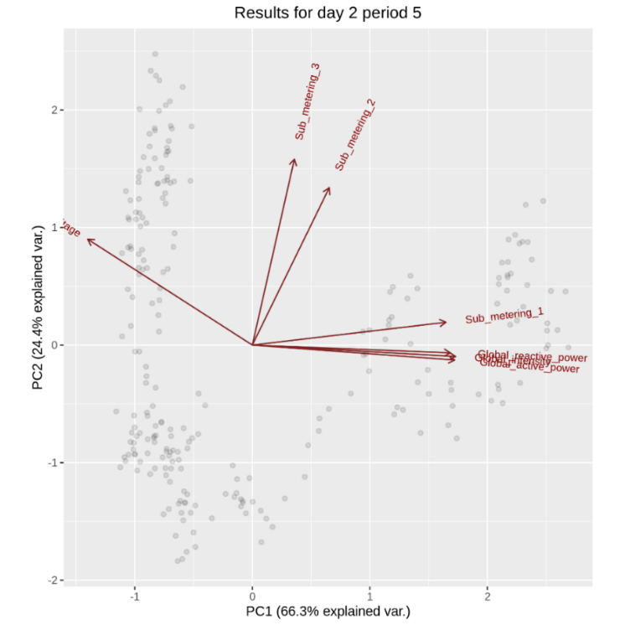
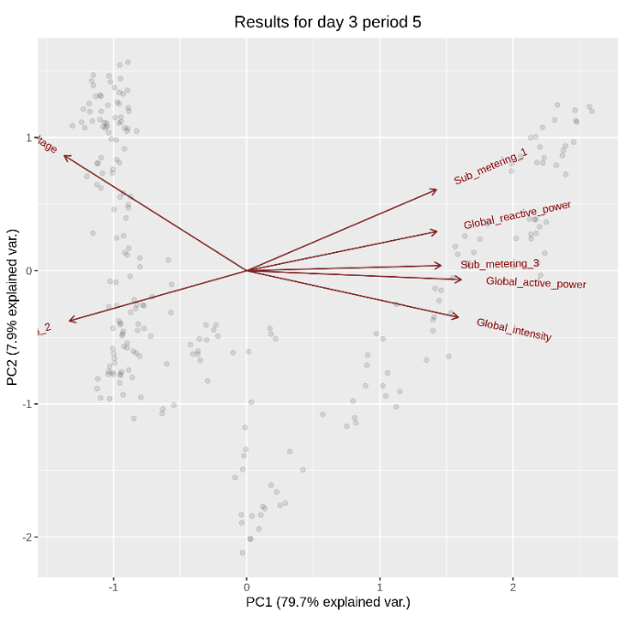
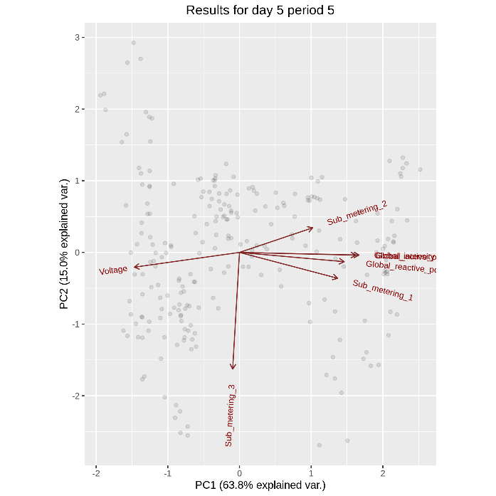



Principal Component Analysis

Slide 8
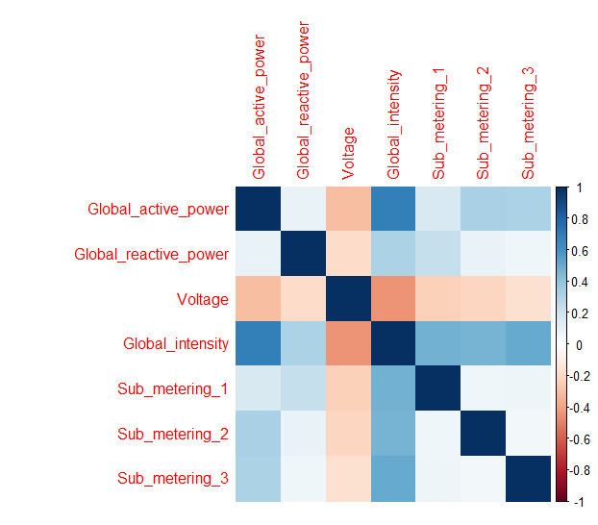
Variable Selection
 | Global active power | Global reactive power | Voltage | Global intensity | Sub metering 1 | Sub metering 2 | Sub metering 3
Global active power | 1.000 | 0.099 | -0.310 | 0.683 | 0.167 | 0.321 | 0.313
Global reactive power | 0.099 | 1.000 | -0.183 | 0.318 | 0.230 | 0.096 | 0.064
Voltage | -0.310 | -0.183 | 1.000 | -0.442 | -0.231 | -0.216 | -0.169
Global intensity | 0.683 | 0.318 | -0.442 | 1.000 | 0.478 | 0.464 | 0.503
Sub metering 1 | 0.167 | 0.230 | -0.231 | 0.478 | 1.000 | 0.065 | 0.071
Sub metering 2 | 0.321 | 0.096 | -0.216 | 0.464 | 0.065 | 1.000 | 0.052
Sub metering 3 | 0.313 | 0.064 | -0.169 | 0.503 | 0.071 | 0.052 | 1.000

Slide 9
Hidden Markov Models

Slide 10
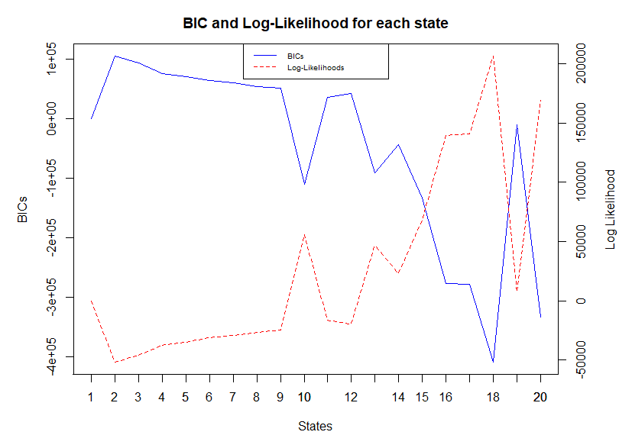
Univariate HMM (Training)
States | BICs | logLik |  | States | BICs | logLik
0 | 0.00 | 0.000 |  | 11 | 34845.01 | -16701.610
2 | 104344.72 | -52136.825 |  | 12 | 41195.84 | -19750.106
3 | 92746.37 | -46302.108 |  | 13 | -91738.29 | 46854.029
4 | 75558.37 | -37662.422 |  | 14 | -44029.70 | 23146.962
5 | 70418.02 | -35036.402 |  | 15 | -133708.37 | 68143.676
6 | 63257.04 | -31389.912 |  | 16 | -276532.39 | 139723.218
7 | 59202.13 | -29286.307 |  | 17 | -278844.19 | 141056.805
8 | 53939.41 | -26568.645 |  | 18 | - 409486.82 | 206565.958
9 | 50761.91 | -24883.433 |  | 19 | -10698.25 | 7369.664
10 | -110999.53 | -56103.896 |  | 20 | -333830.25 | 169143.813
Optimal State: 11

Slide 11
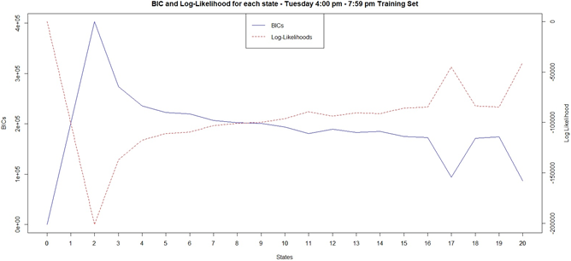
Multivariate HMM (Training)
States | BICs | logLik |  | States | BICs | logLik
0 | 0.00 | 0.000 |  | 11 | 180596.6 | -89465.7
2 | 402762 | -201325 |  | 12 | 189155.9 | -93608.3
3 | 274050.3 | -136924 |  | 13 | 182776 | -90271.1
4 | 235530.1 | -117608 |  | 14 | 184835.2 | -91143.4
5 | 222614.6 | -111084 |  | 15 | 174629.8 | -85873.1
6 | 219574 | -109487 |  | 16 | 172518.4 | -84639.7
7 | 206744.8 | -102987 |  | 17 | 93897.53 | -45141.4
8 | 202457.4 | -100746 |  | 18 | 171227.7 | -83608.5
9 | 200886.6 | -99854.4 |  | 19 | 173858 | -84715.5
10 | 193576.7 | -96082.7 |  | 20 | 86444.6 | -40790.5
Optimal State: 8

Slide 12
Univariate HMM (Testing)
Univariate HMM For Global Intensity: State = 11
Train Model logLik: -21598
Test Model logLik: -22155
Difference in logLik value: 557

Slide 13
Multivariate HMM (Testing)
Multivariate HMM For Global Intensity, Sub metering 2, Sub metering 3: State = 8
Train Model logLik: -99725
Test Model logLik: -98729
Difference in logLik value: 996

Slide 14
Anomaly Detection

Slide 15
Anomaly Detection With Univariate HMM

Slide 16
Anomaly Detection With Multivariate HMM
Dataset Containing Anomalies 1 | Dataset Containing Anomalies 2 | Dataset Containing Anomalies 3
Train Model logLik: -99725 | Train Model logLik: -99725 | Train Model logLik: -99725
Anomalies 1 logLik: -123153 | Anomalies 2 logLik: -118665 | Anomalies 3 logLik: -120200
Difference in logLik value: 23428 | Difference in logLik value: 18940 | Difference in logLik value: 20475

Slide 17
Anomaly Detection With Multivariate HMM and Different Time Periods
Test | Train 16:00 – 19:59 Test 20:00 – 23:59 | Train 20:00 – 23:59 Test 20:00 – 23:59
Reference Test - difference | 3679 | 12631
Anomaly 1 - difference | 16195 | 10317
Anomaly 2 - difference | 48071 | 15376
Anomaly 3 - difference | 37257 | 13291

Slide 18
Reinforcement Learning

Slide 19


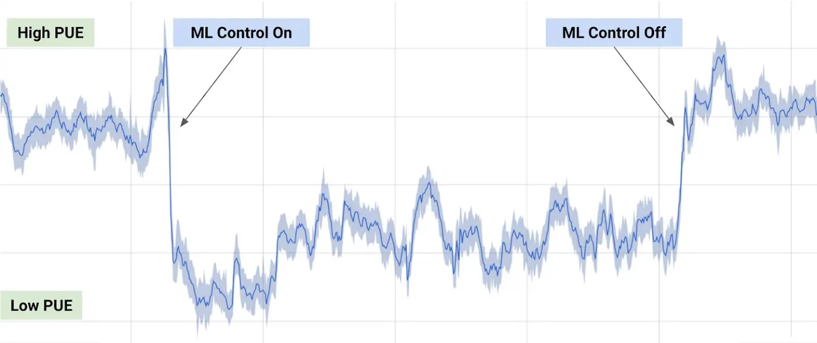
Gaming Strategies
Autonomous Driving
Energy Conservation
Notable Applications
Consistent 40 percent reduction in the
amount of energy used for cooling

Slide 20
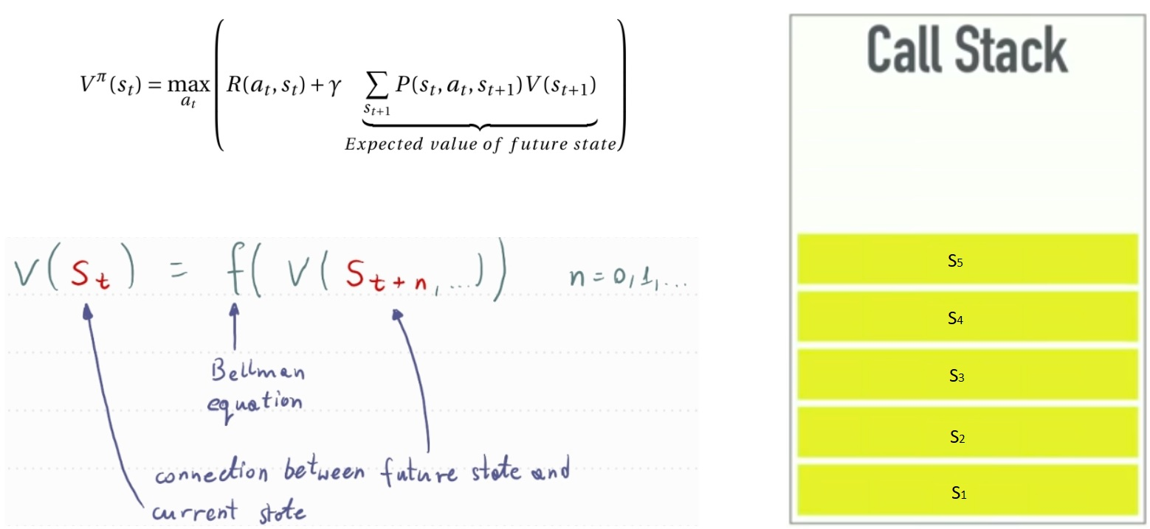
Historical Context of RL: Bellman Equation
1. Optimal Control Problem
2. Learning by Trial & Error

Slide 21
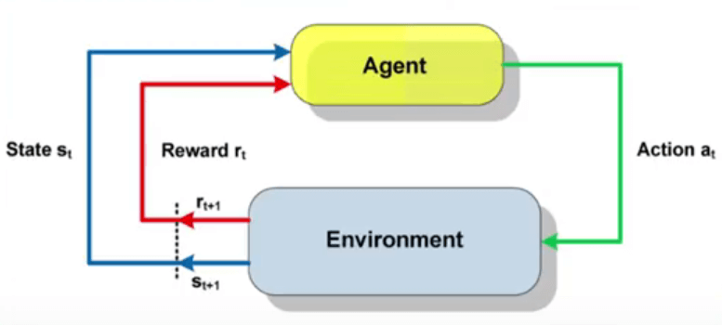
What is Reinforcement Learning?
Notes:
RL Diagram: https://theaisummer.com/assets/img/posts/Reinforcement_learning/RL.jpg

Slide 22
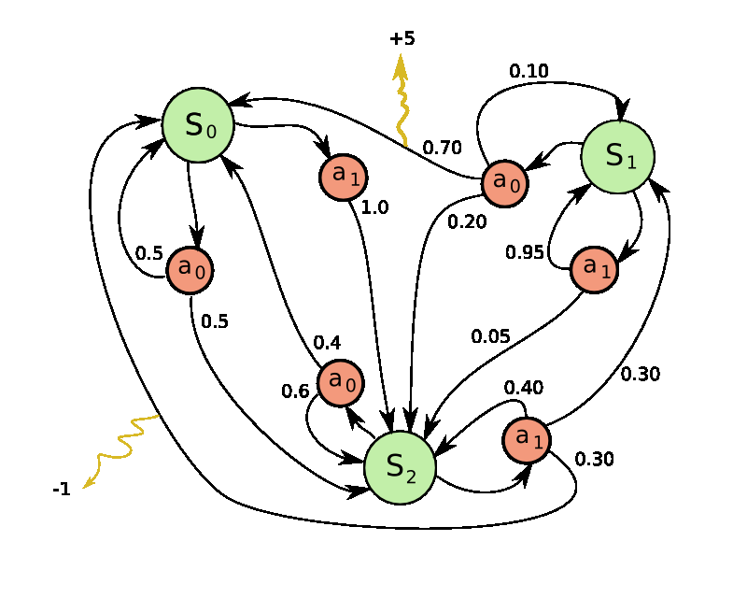
Markov Decision Process (MDP)
Two Key Characteristics:
The Markov Property
The Markov Chain
Notes:
MDP Diagram: https://towardsdatascience.com/reinforcement-learning-demystified-markov-decision-processes-part-1-bf00dda41690

Slide 23
Reinforcement Learning Training
Notes:
RL Diagram: https://theaisummer.com/assets/img/posts/Reinforcement_learning/RL.jpg

Slide 24
Anomaly Detection
Notes:
RL Diagram: https://theaisummer.com/assets/img/posts/Reinforcement_learning/RL.jpg

Slide 25
Conclusions
Hidden Markov Models can Reliably Detect Anomalies
Success Requires a Good Understanding of the Data
Generally, HMMs provide Retrospective Alerts
Reinforcement Learning could allow Near Real-Time Alerts

Slide 26
Questions

Slide 27
Thank You For Listening

