Slide 1
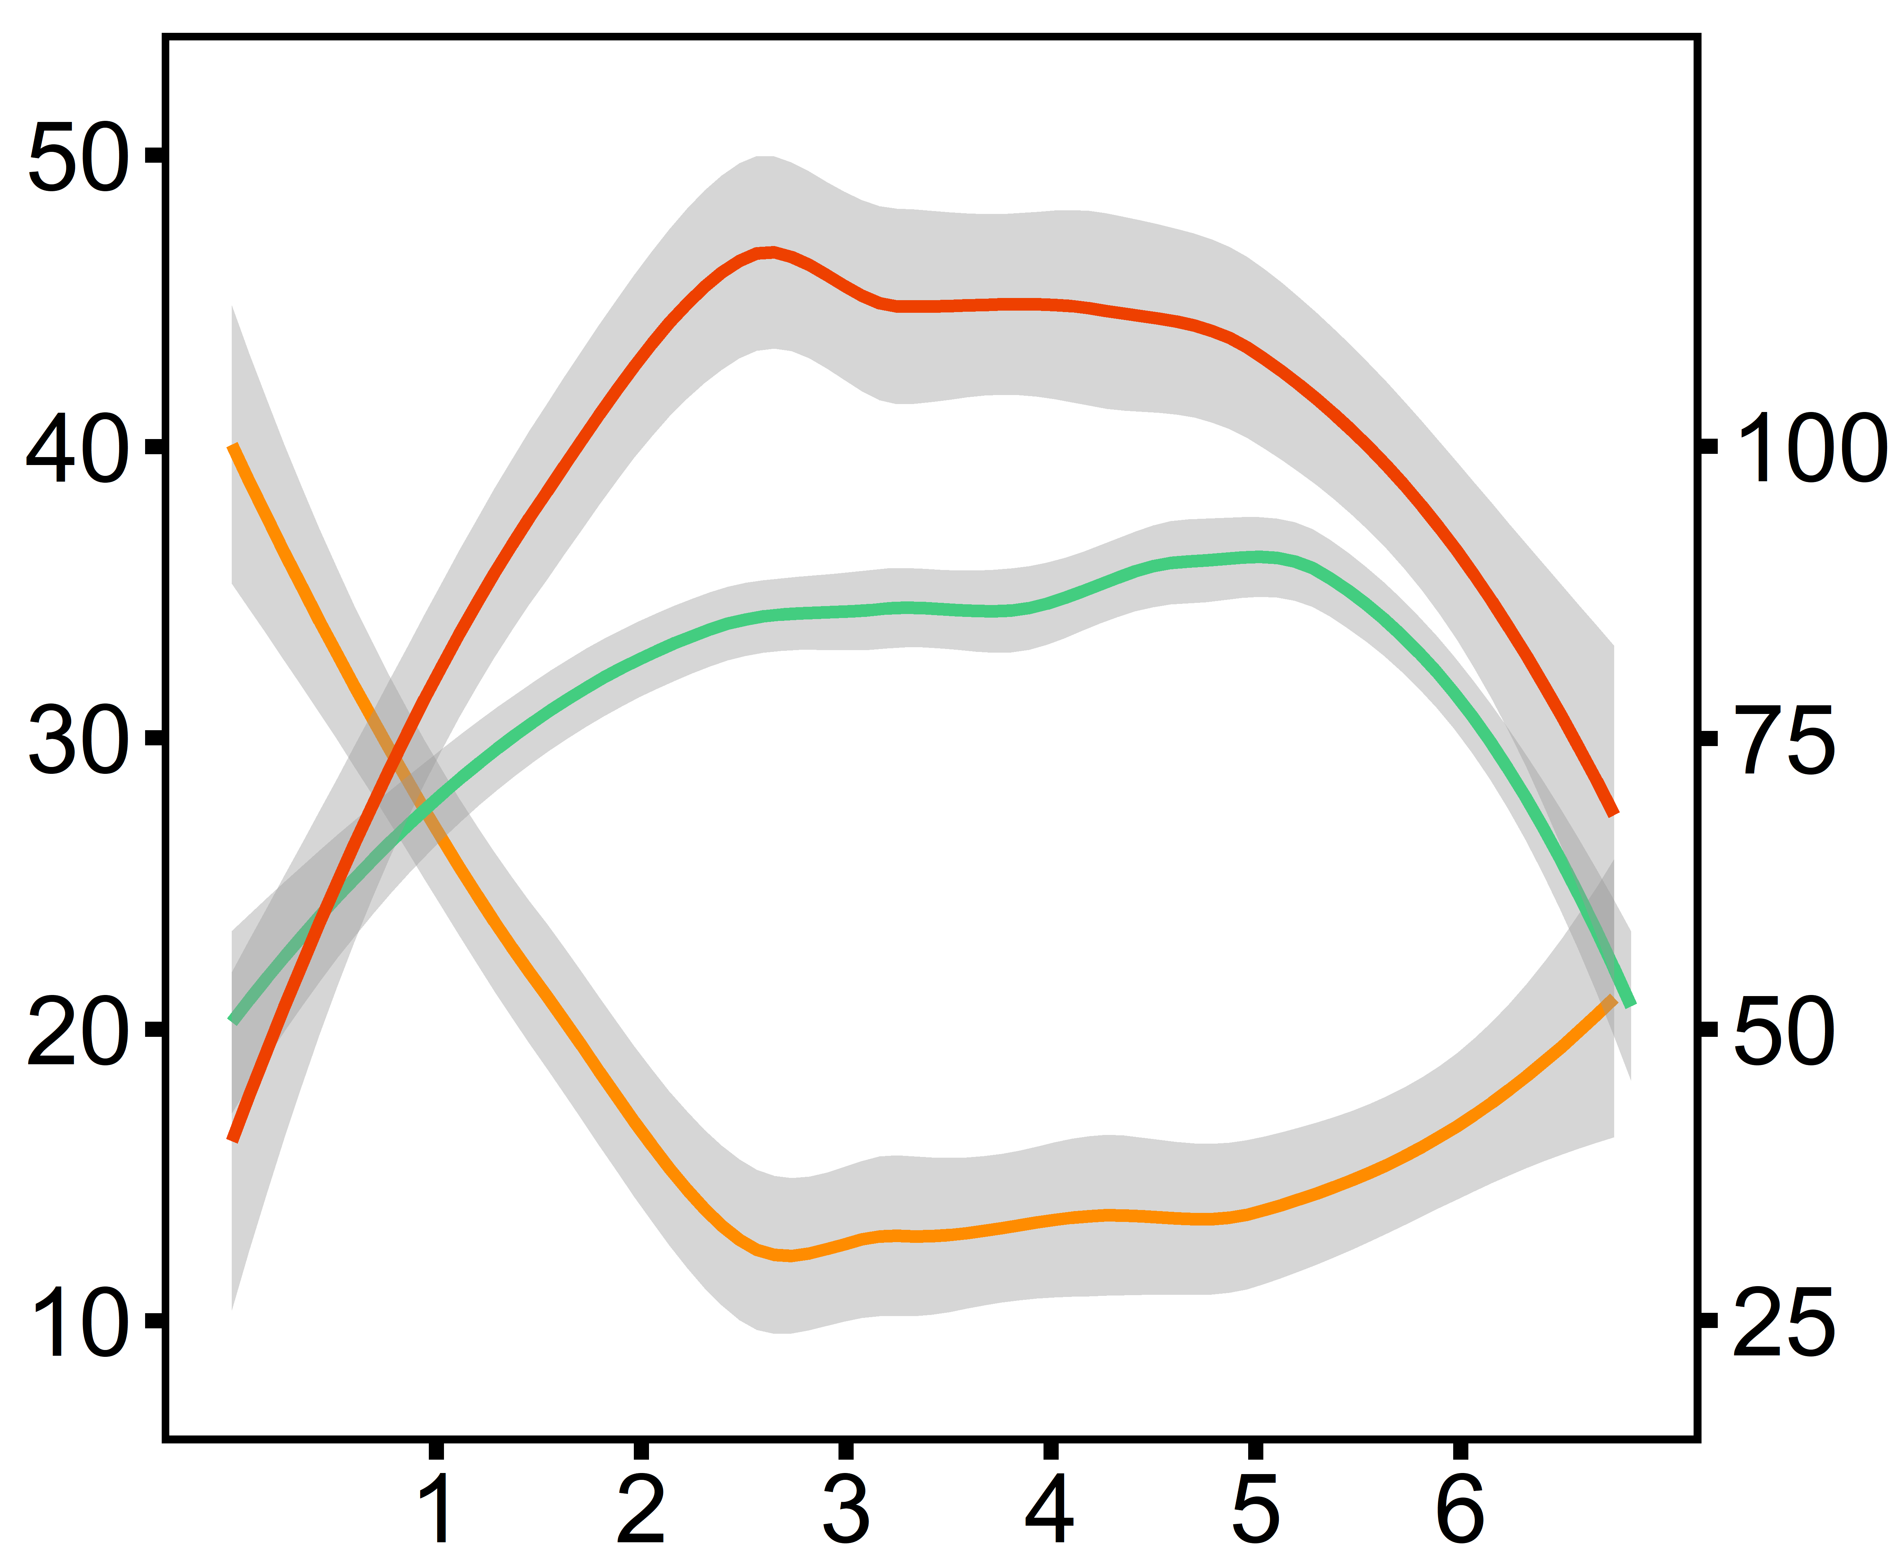
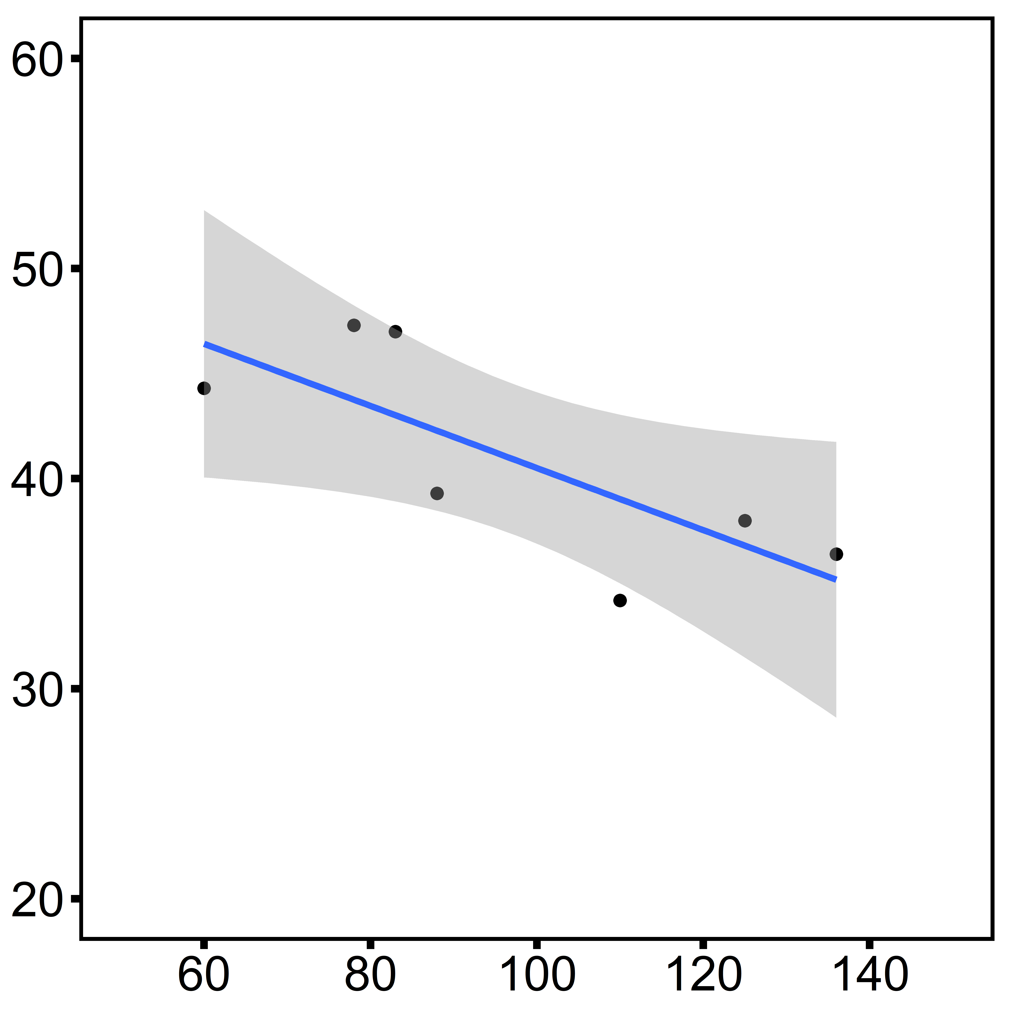
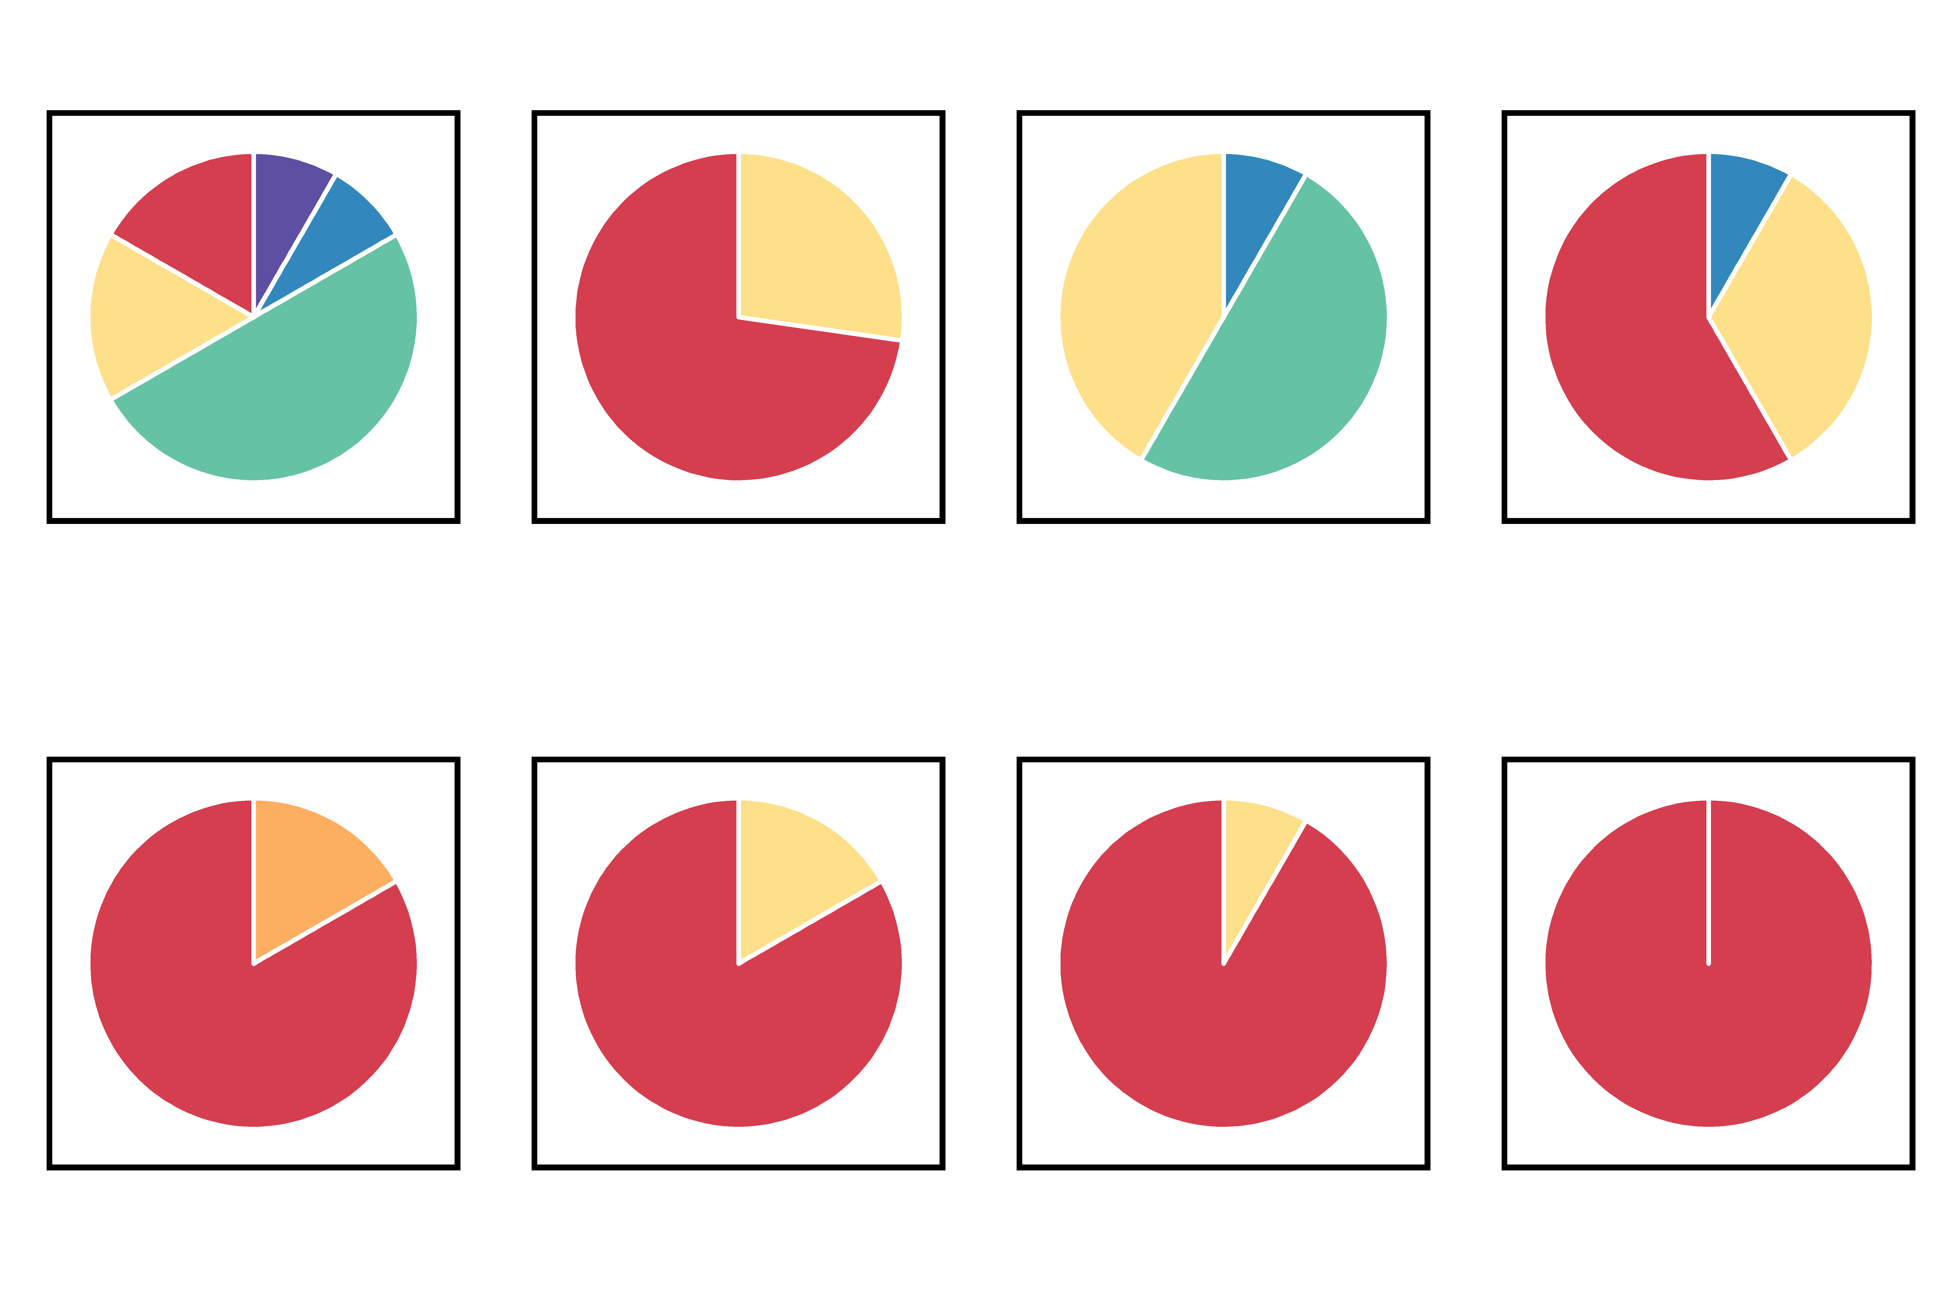
A
Start
(1) Control
End
B
Measurement
Chamber air temperature
-30d
-10d
(2) Single Stressor
Chamber humidity
Laboratory Acclimation
Temperature (°C)
1d
(3) Multi-stressor
Relative Humidity (%)
Internal oyster temperature
SW temperature ramp to 30°C
2d
5d
10d
30d
Desiccation stress applied (4h, 44°C)
Hour
C
D
Before exp. control
After exp. control
Single stressor
Multi-stressor
R² = 0.59
Gonad Stage
Stage 0
Stage 1
Diploid
Stage 2
Maximum internal oyster temperature (°C)
Stage 3
Stage 4
Unknown
Triploid
Shell volume (cm³)

