Slide 1
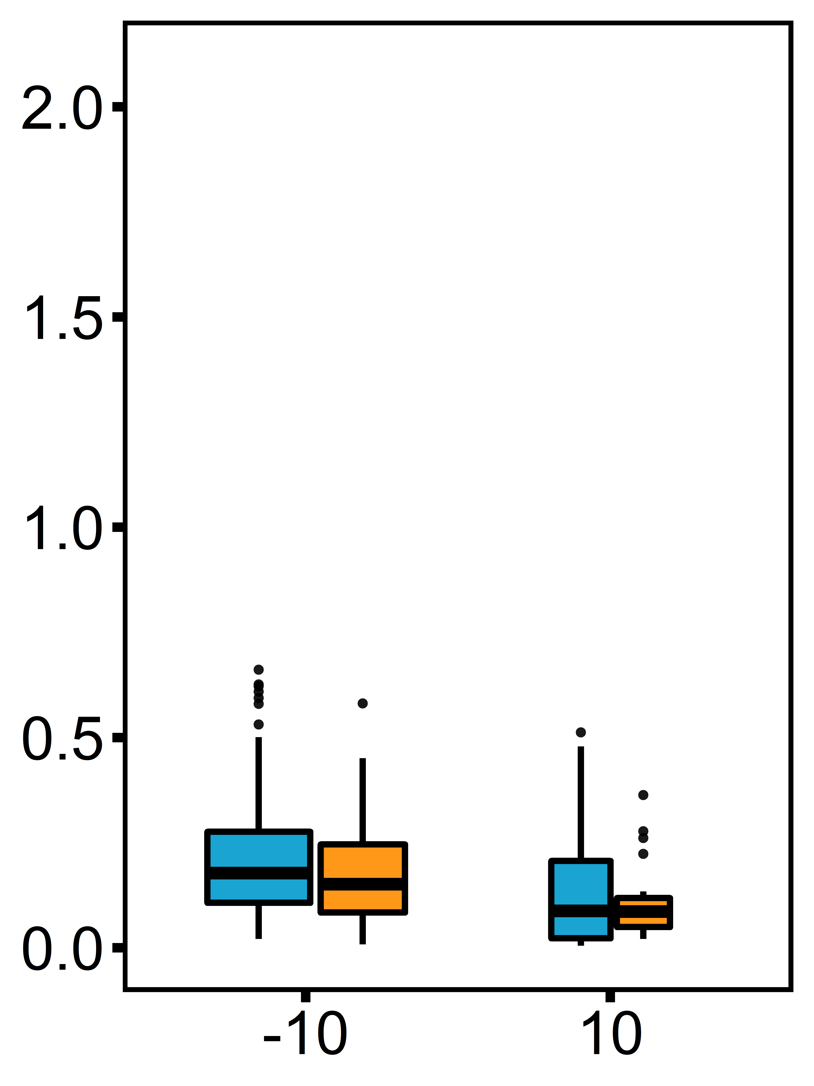
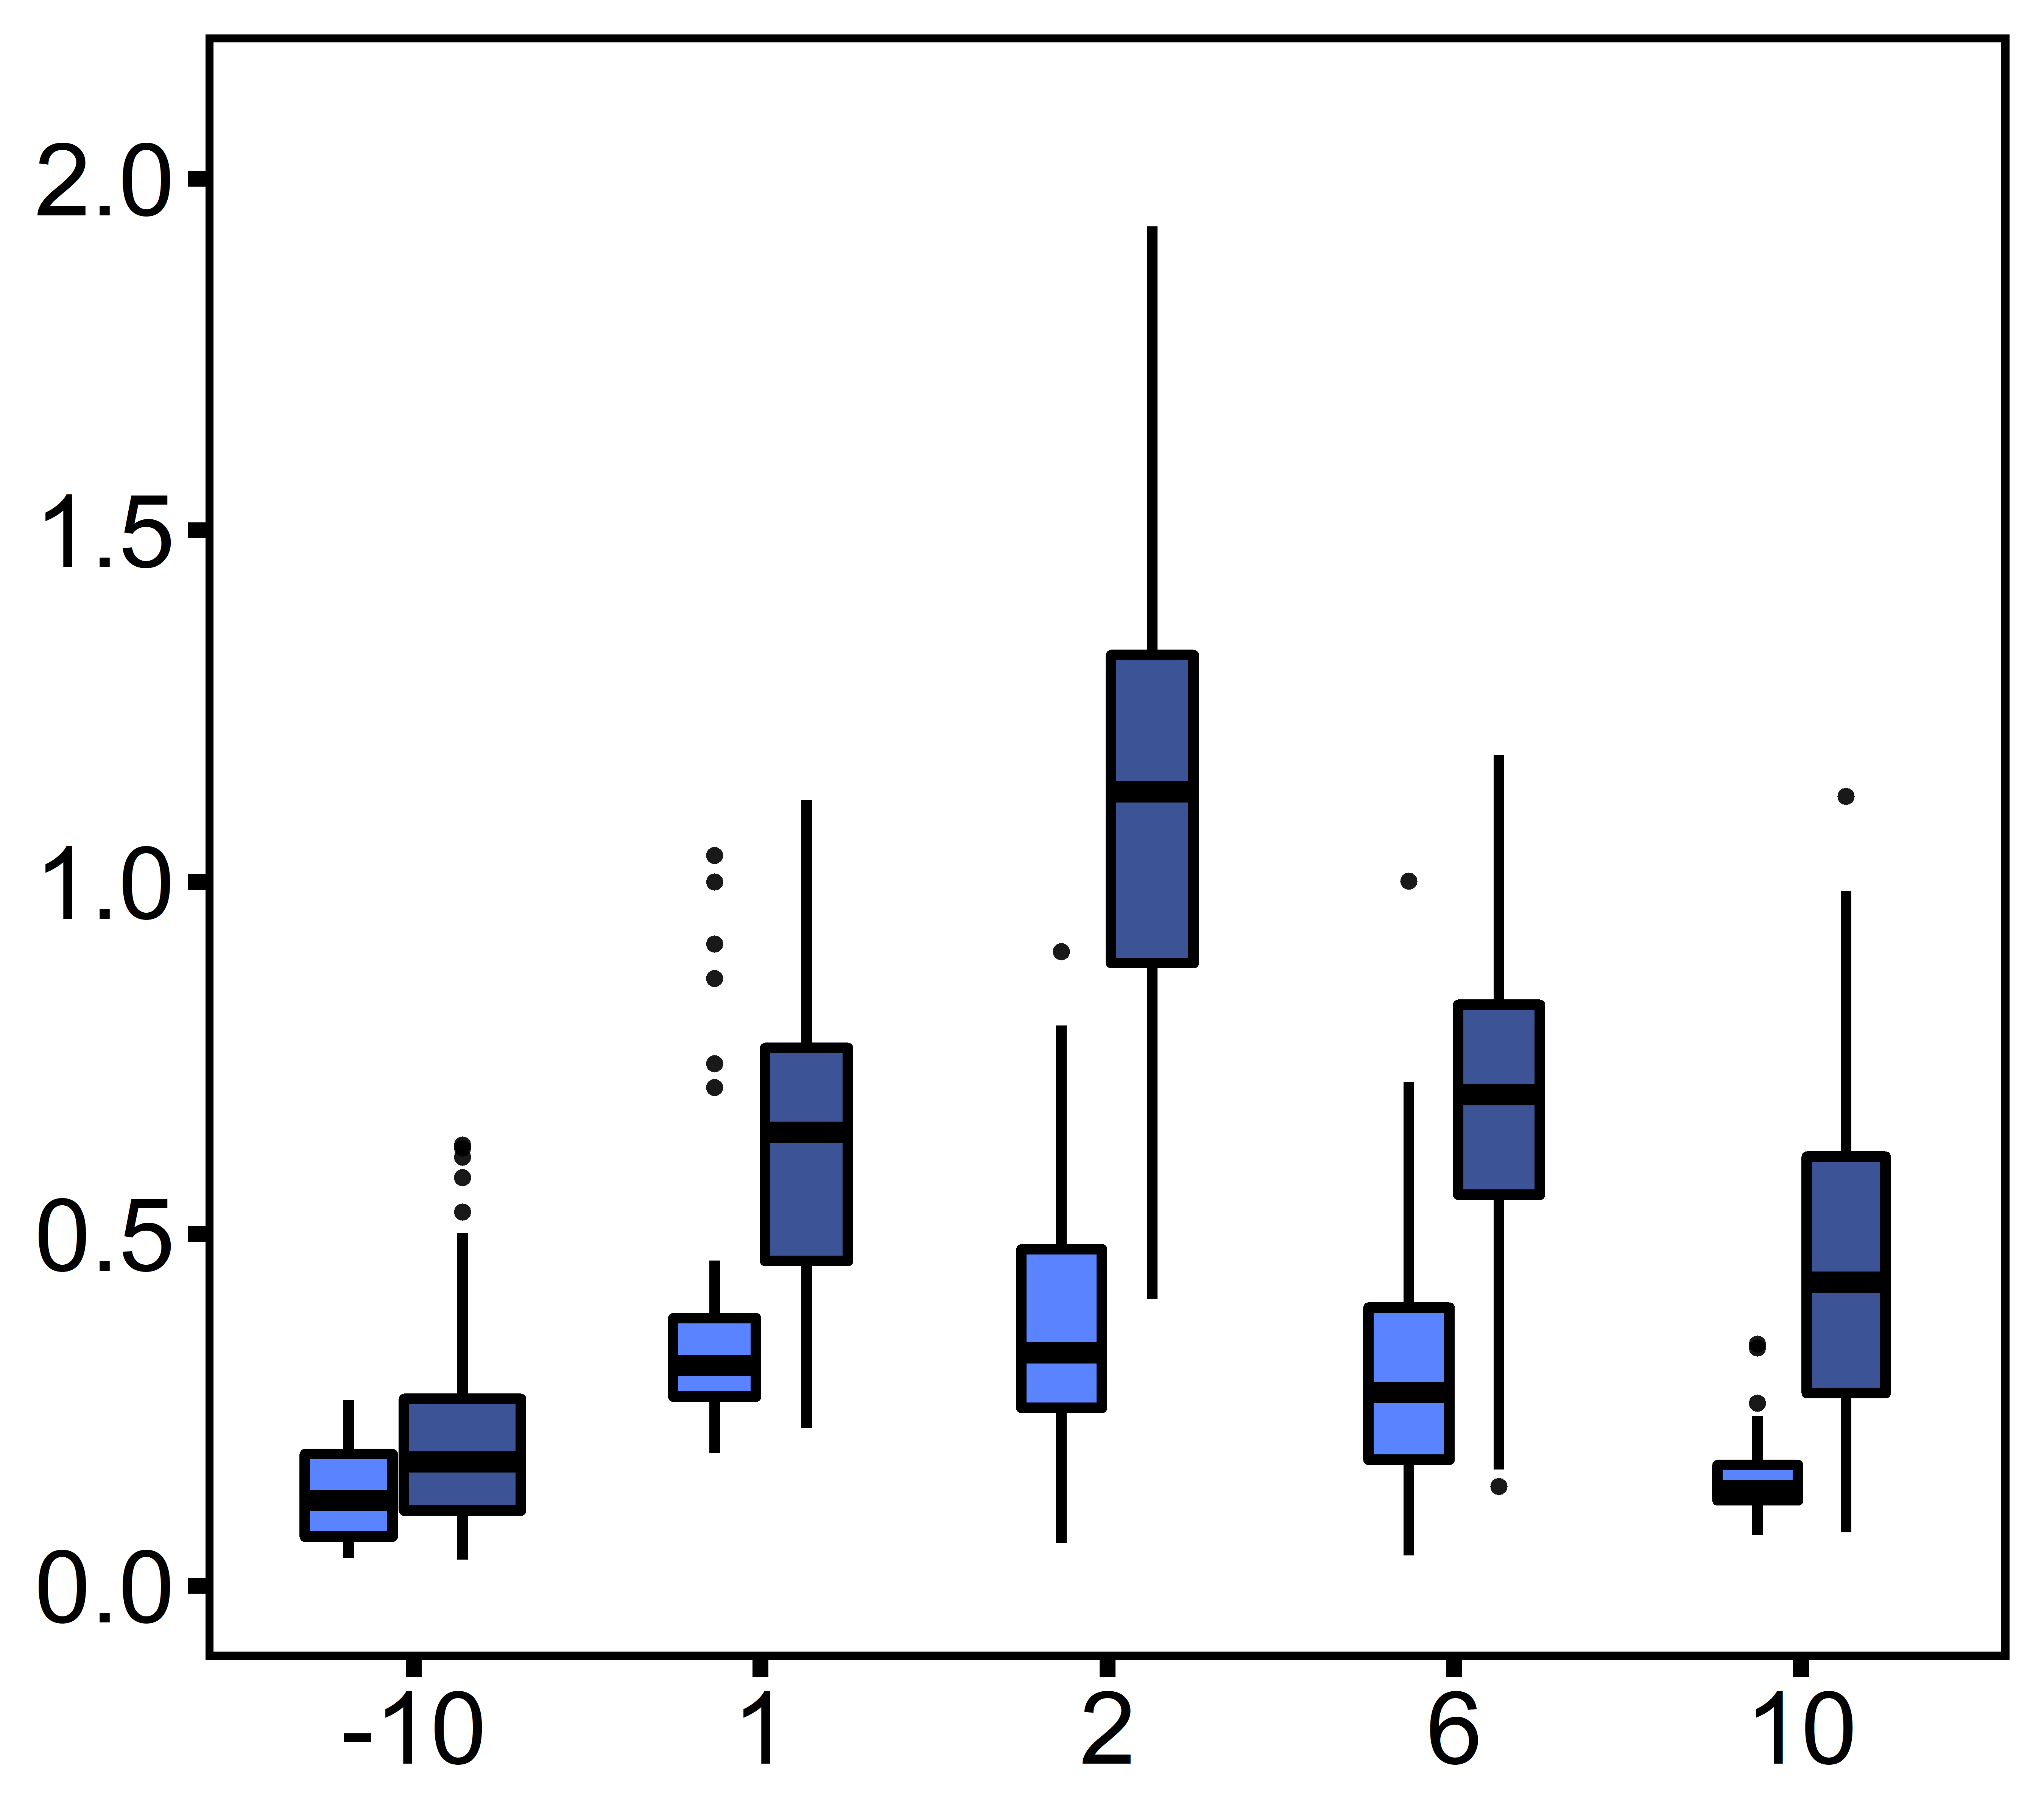
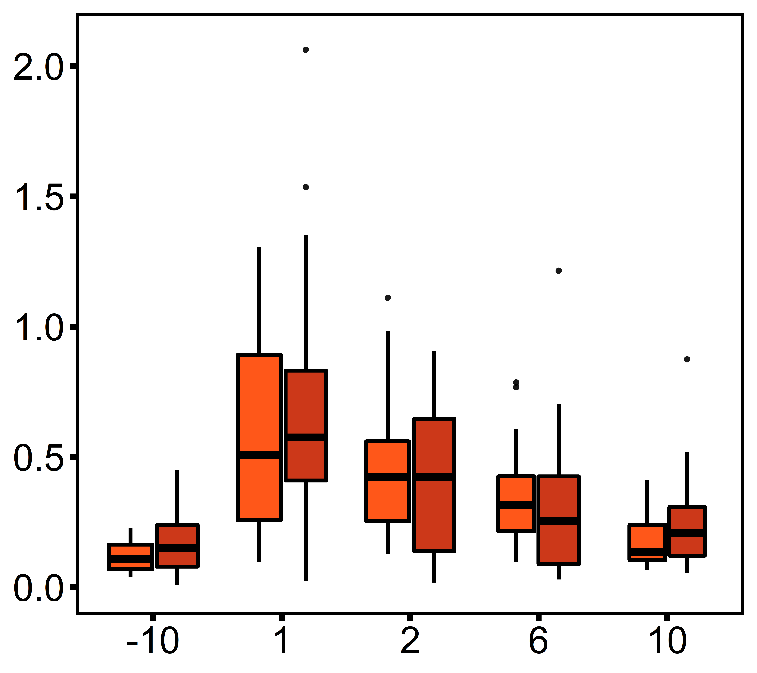
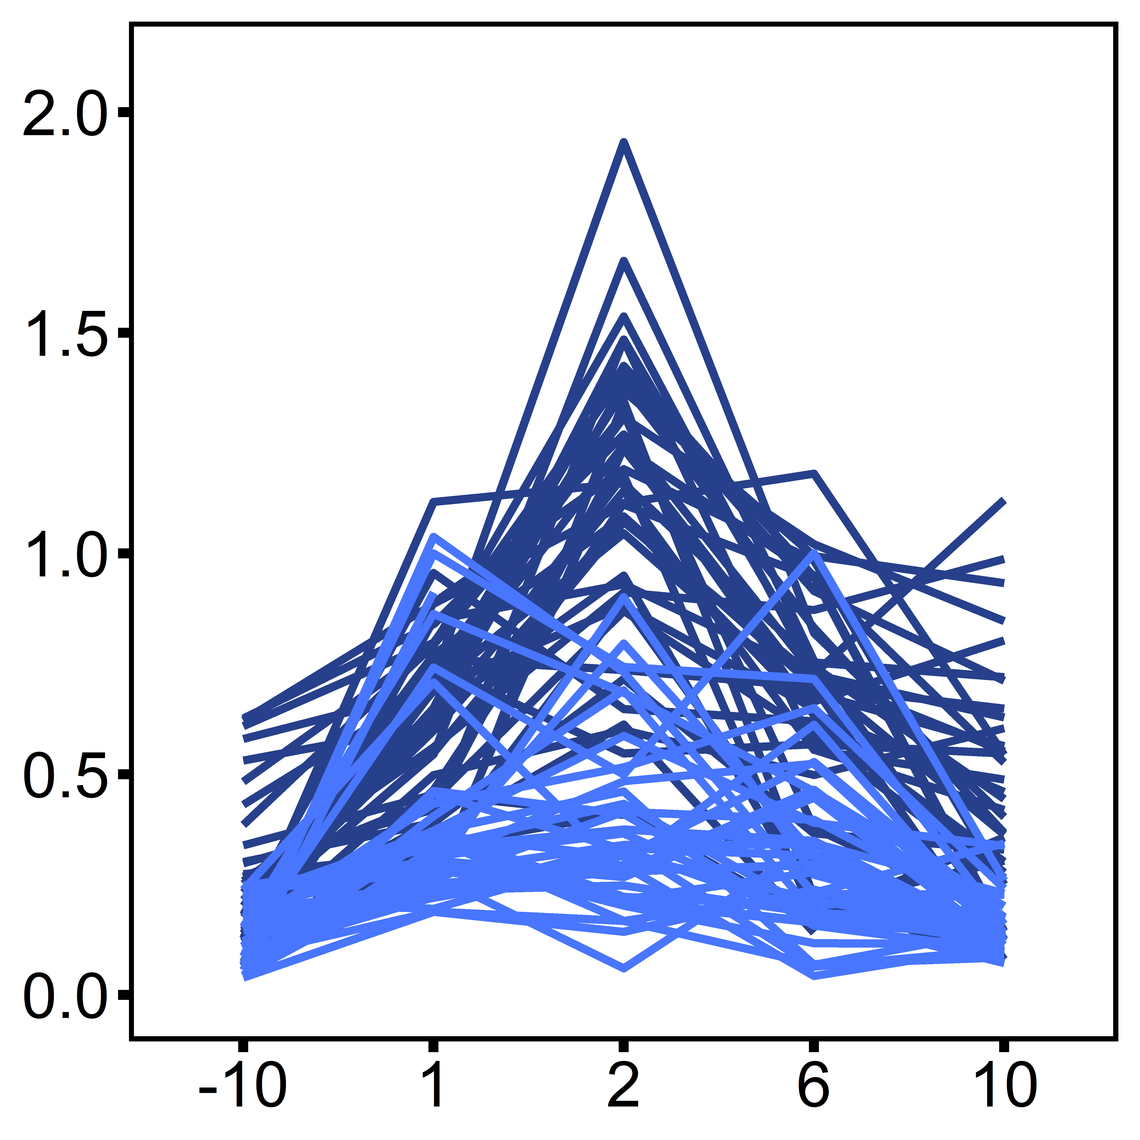
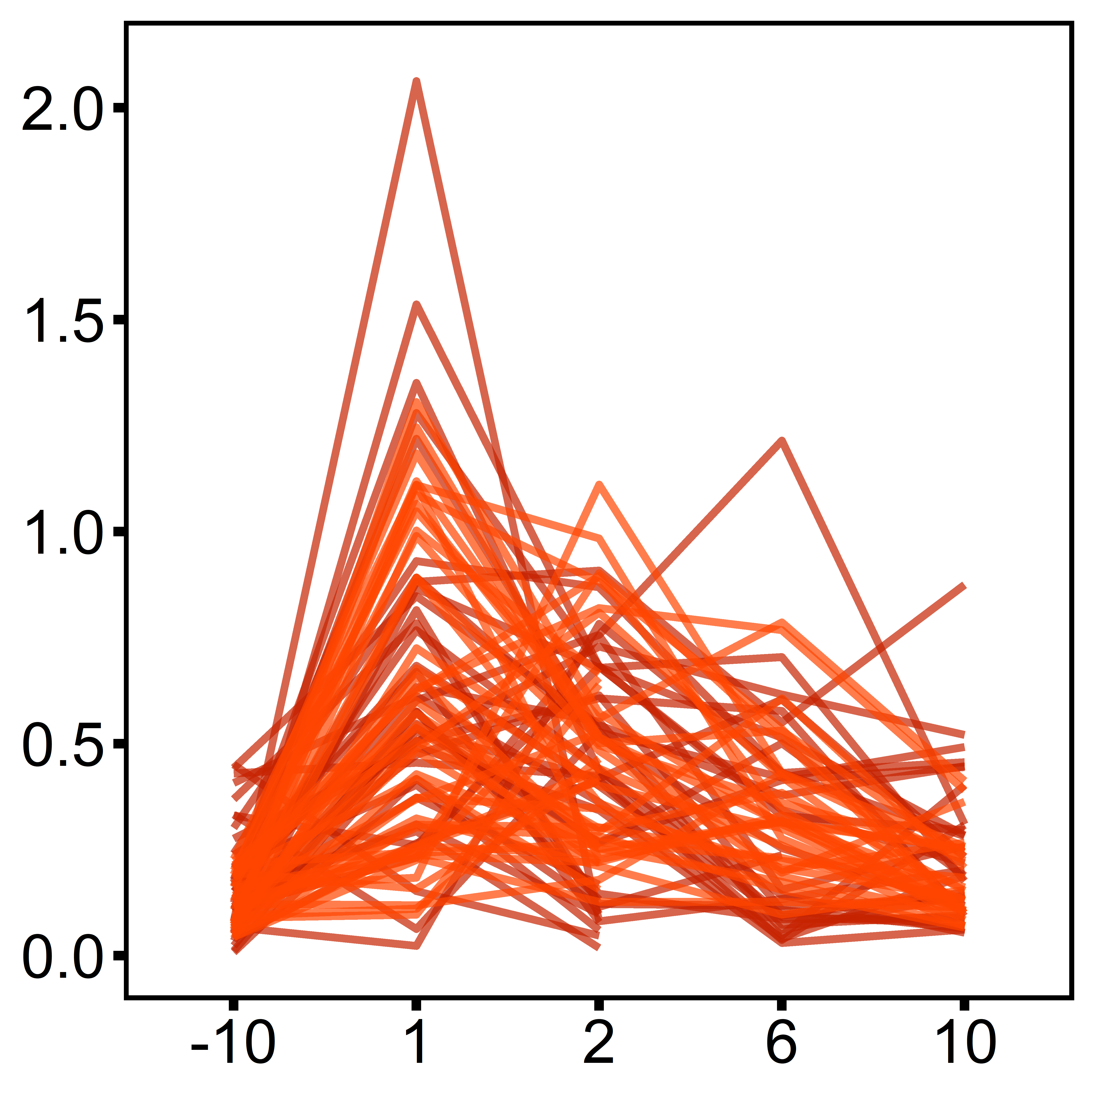
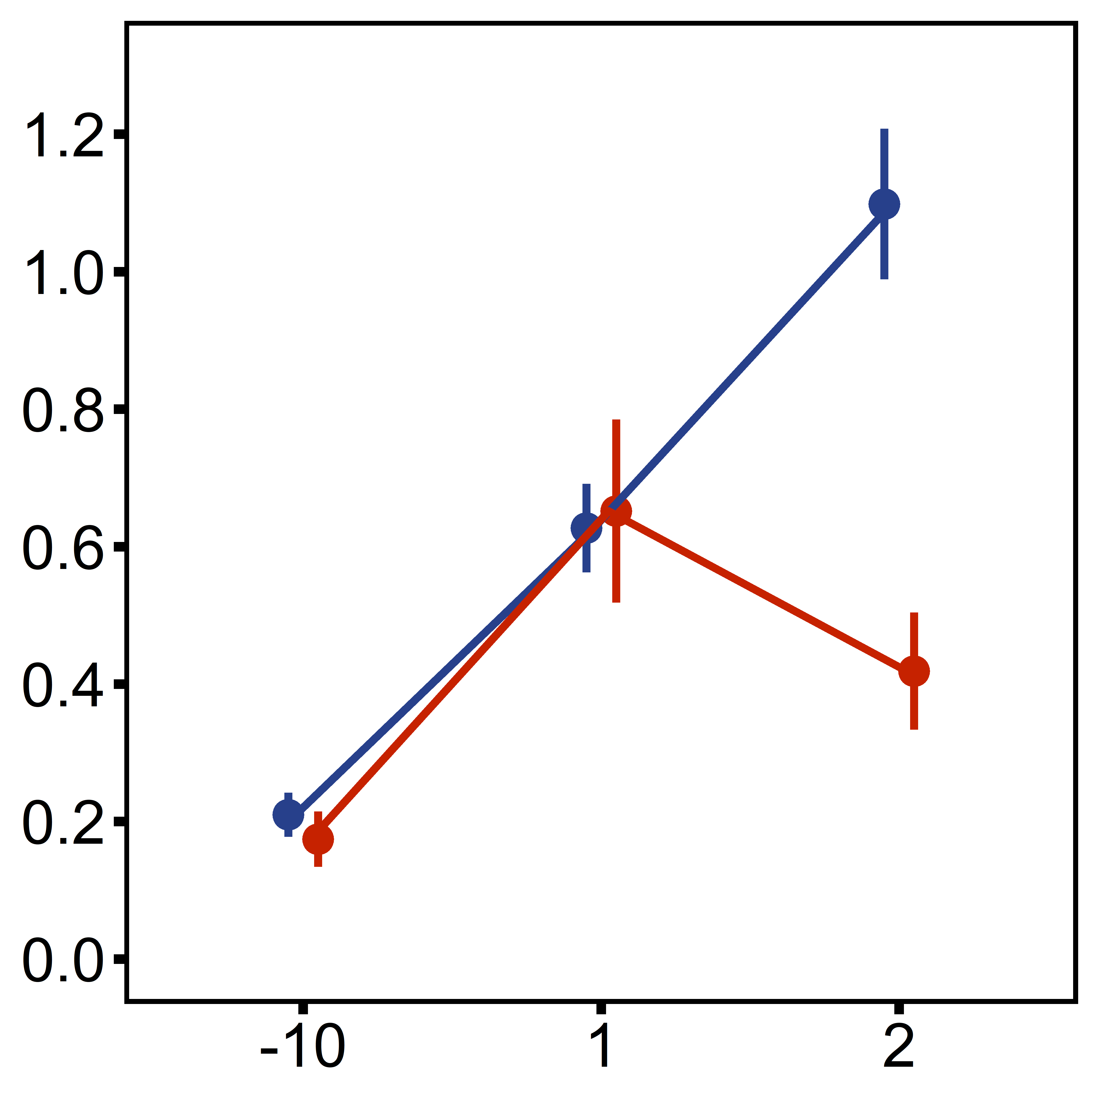
D
E
F
2°C d⁻¹ ramp
Desiccation
(4 h @ 44°C)
A
20°C
B
20°C
30°C
30°C
C
controls
*
diploids
triploids
Ploidy, Treatment
diploid, control
diploid, single stressor
Metabolic Rate (mg O₂ h⁻¹ g⁻¹)
*
*
diploid, multi-stressor
triploid, control
triploid, single stressor
triploid, multi-stressor
before exp.
after exp.
Stress exposure (days)
Stress exposure (days)
D
E
F
diploids
triploids
Metabolic Rate (mg O₂ h⁻¹ g⁻¹)
Control
20
Single stressor
Multi-stressor
Stress exposure (days)
Stress exposure (days)

Slide 2
controls
diploids
triploids
gh
efg
h
def
gh
fg
efg
Metabolic Rate (mg O₂ h⁻¹ g⁻¹)
abc
ab
a
a
efg
efg
efg
cde
def
bcd
abcd
ab
ab
abcd
ab
abc
ab
before exp.
after exp.
ctrl
d1
d2
d5
d10
ctrl
d1
d2
d5
d10
diploids
triploids
multi-stressor
Metabolic Rate (mg O₂ h⁻¹ g⁻¹)
ctrl
d1
d2
d5
d10
ctrl
d1
d2
d5
d10
ctrl
d1
d2
d5
d10

