Slide 1
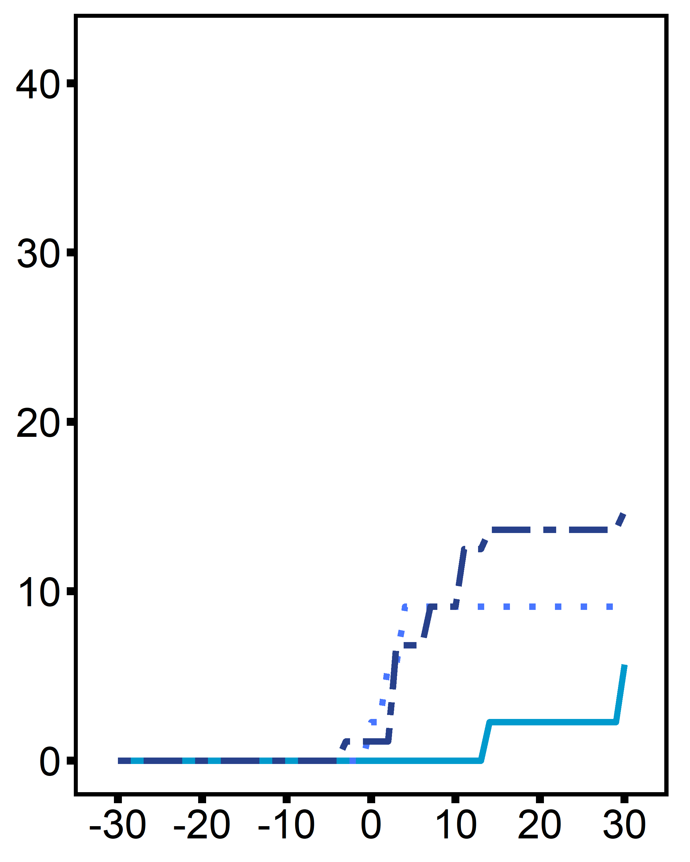
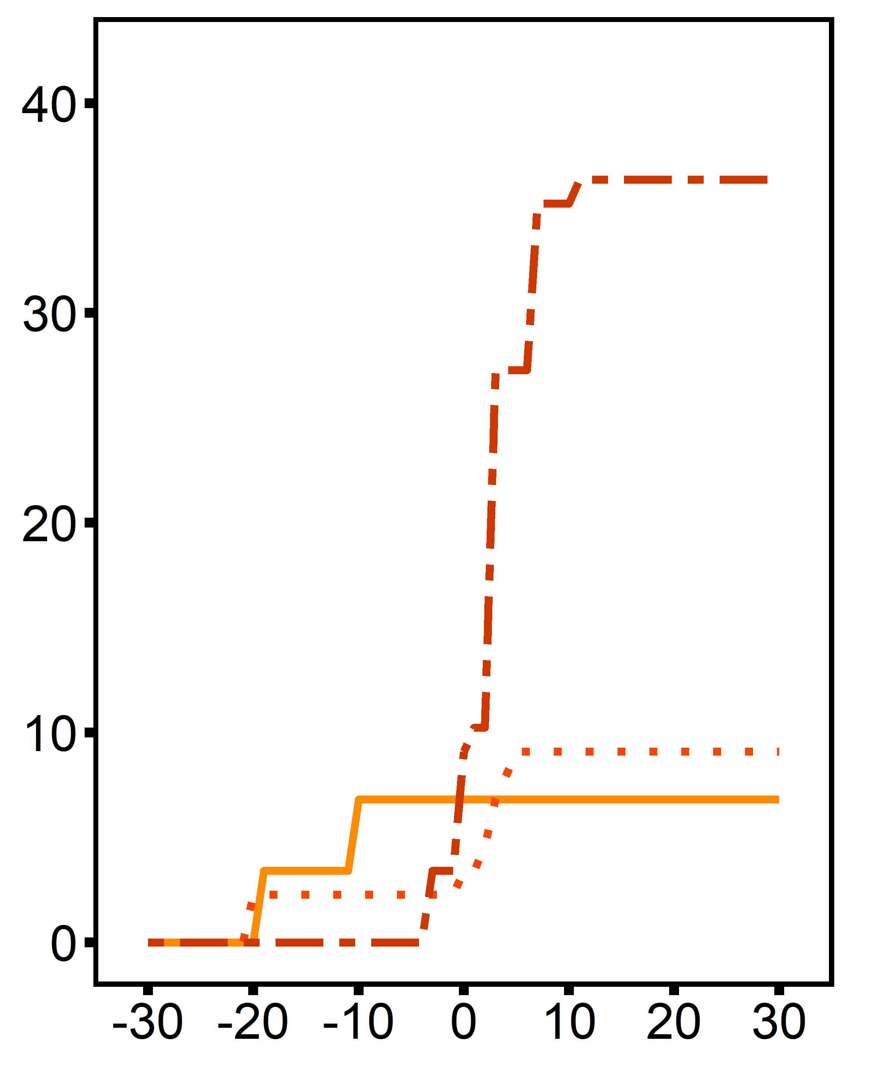

A
B
diploids
triploids
diploid, control
diploid, single stressor
diploid, multi-stressor
triploid, control
triploid, single stressor
Cumulative Mortality (%)
Cumulative Mortality (%)
triploid, multi-stressor
Length of stress exposure (days)

