Slide 1
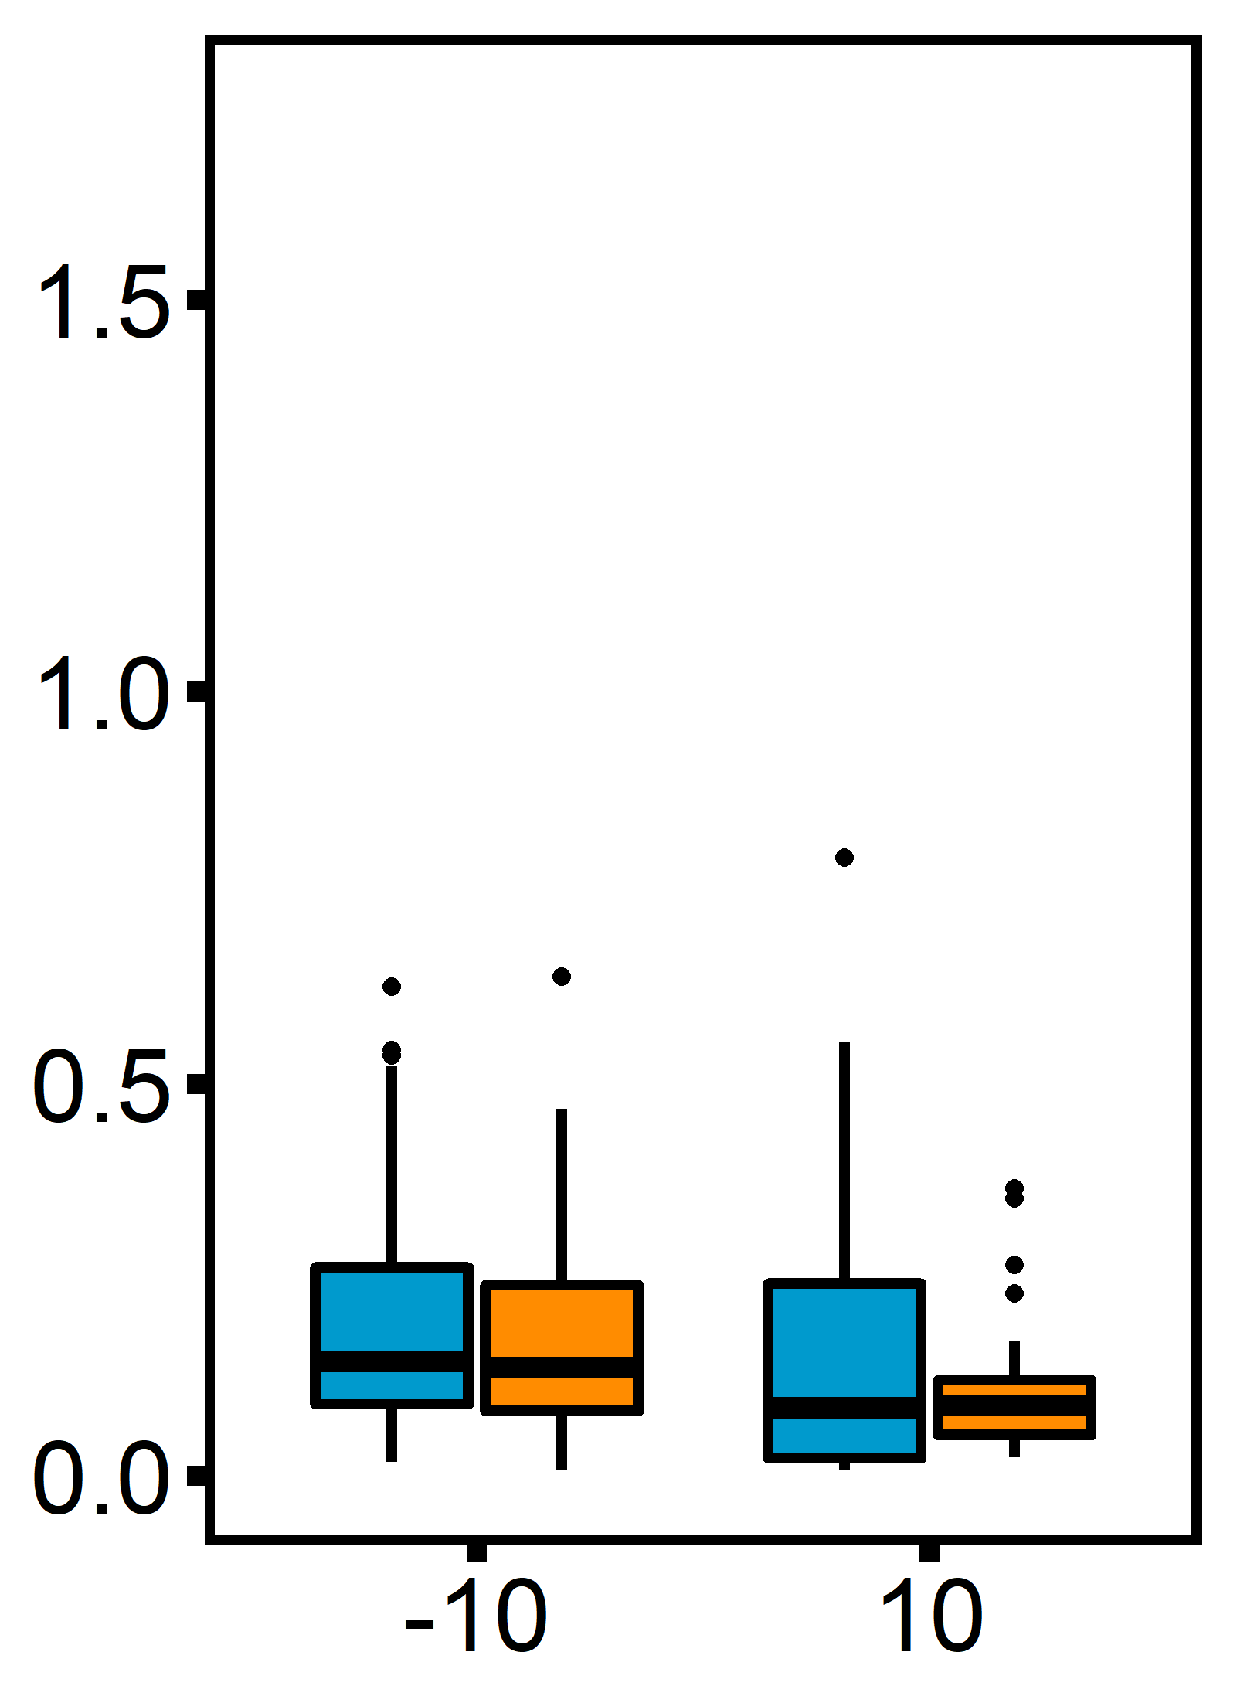
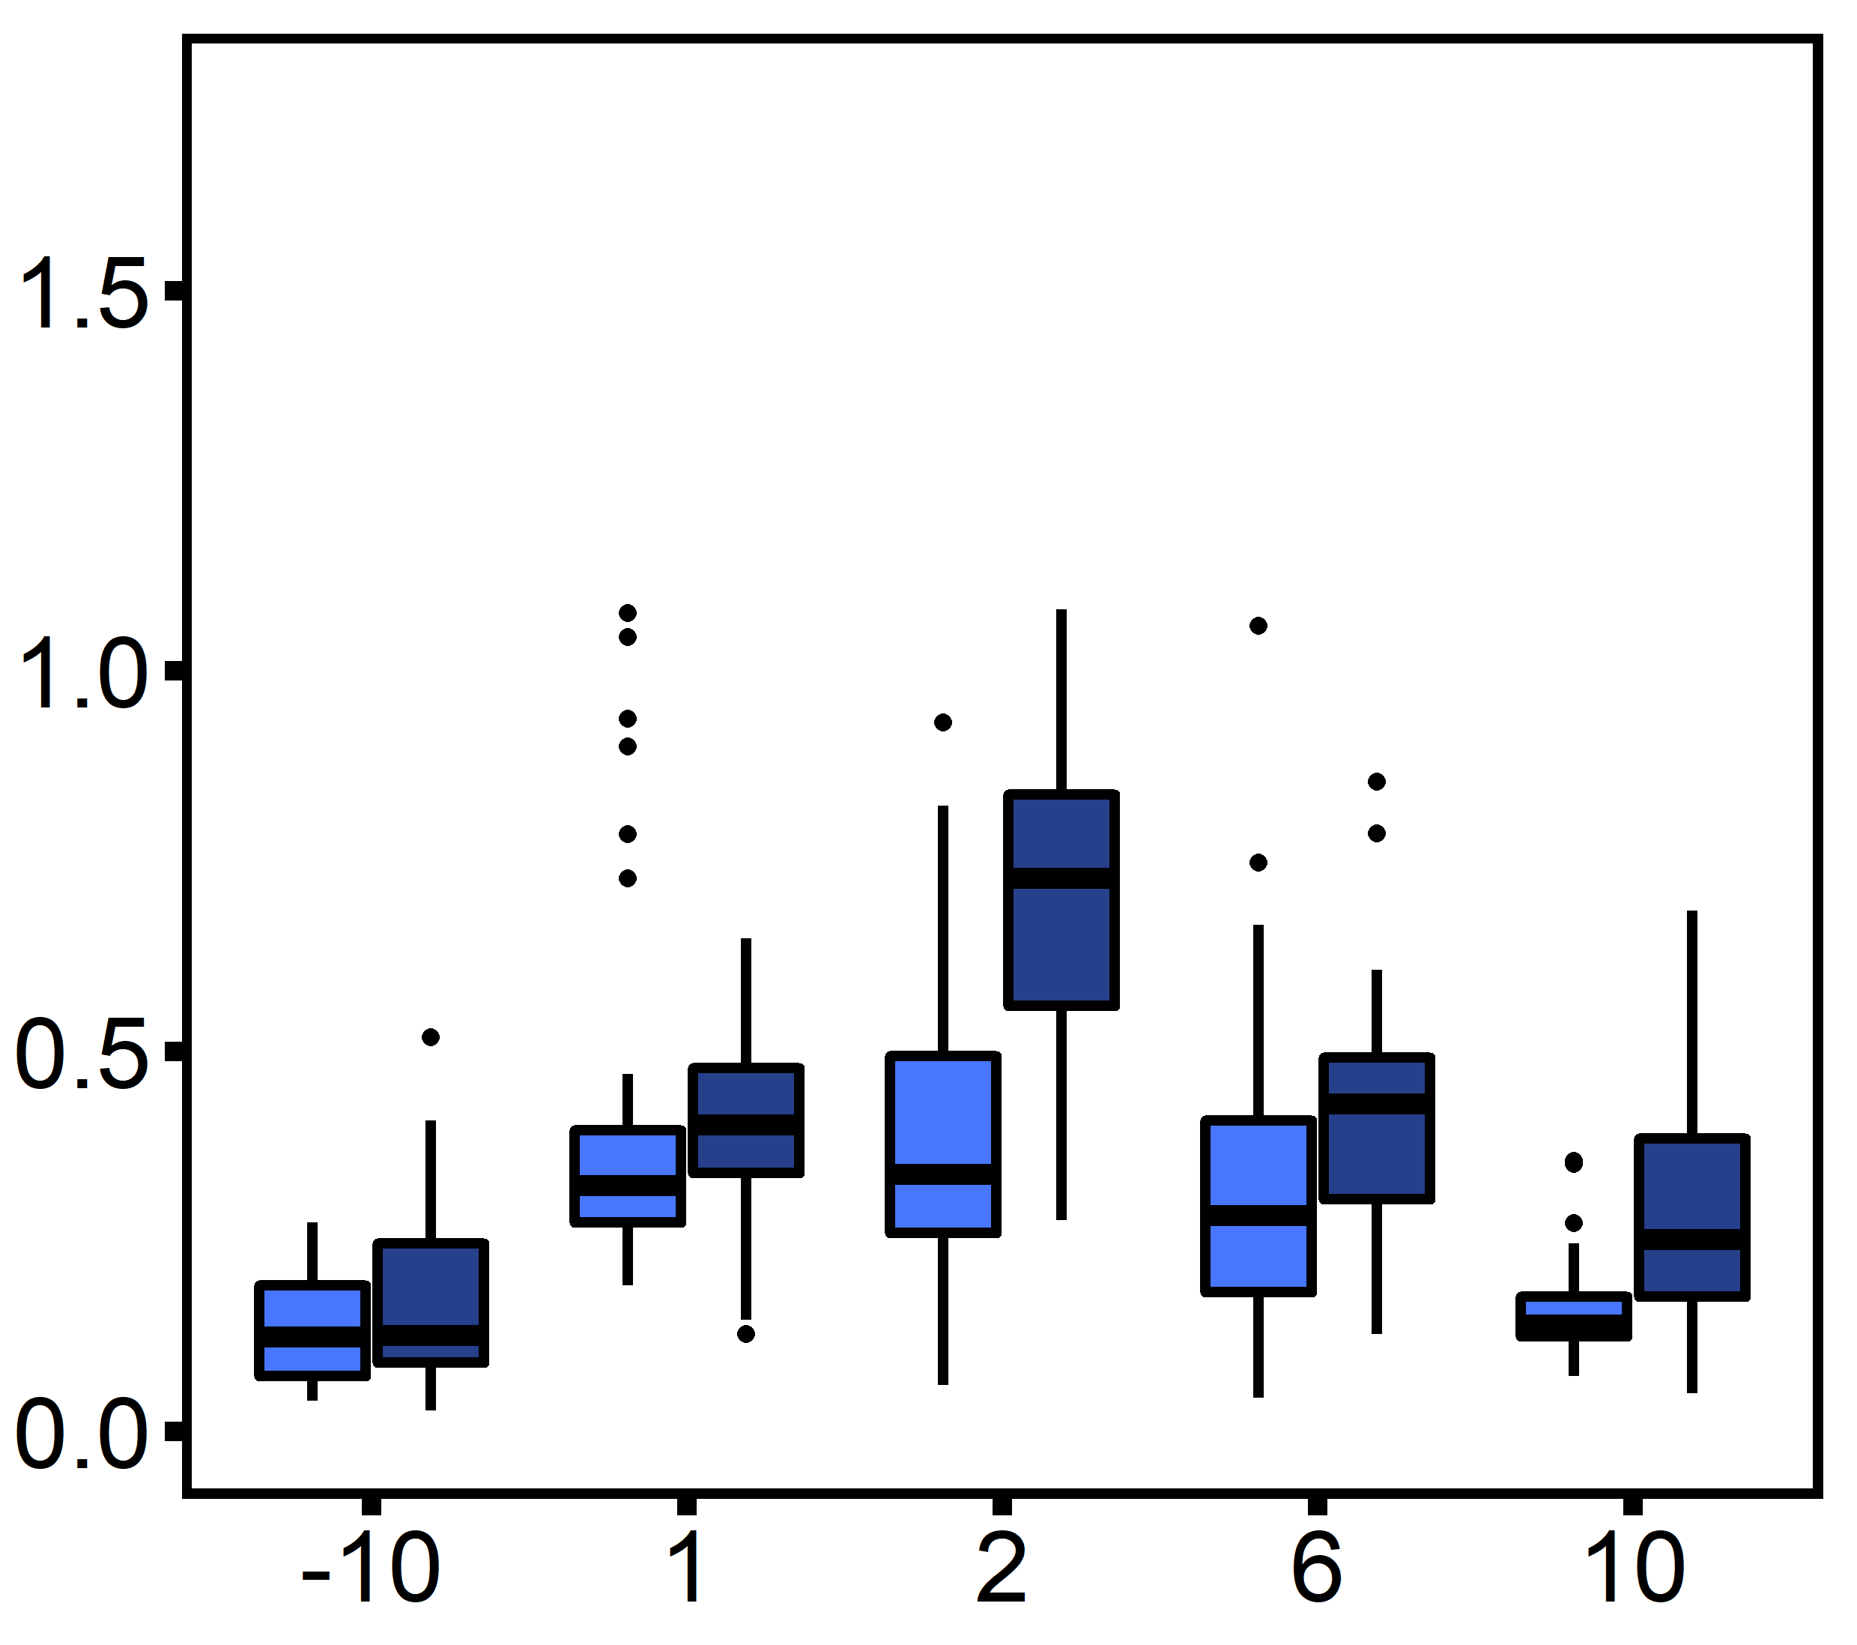
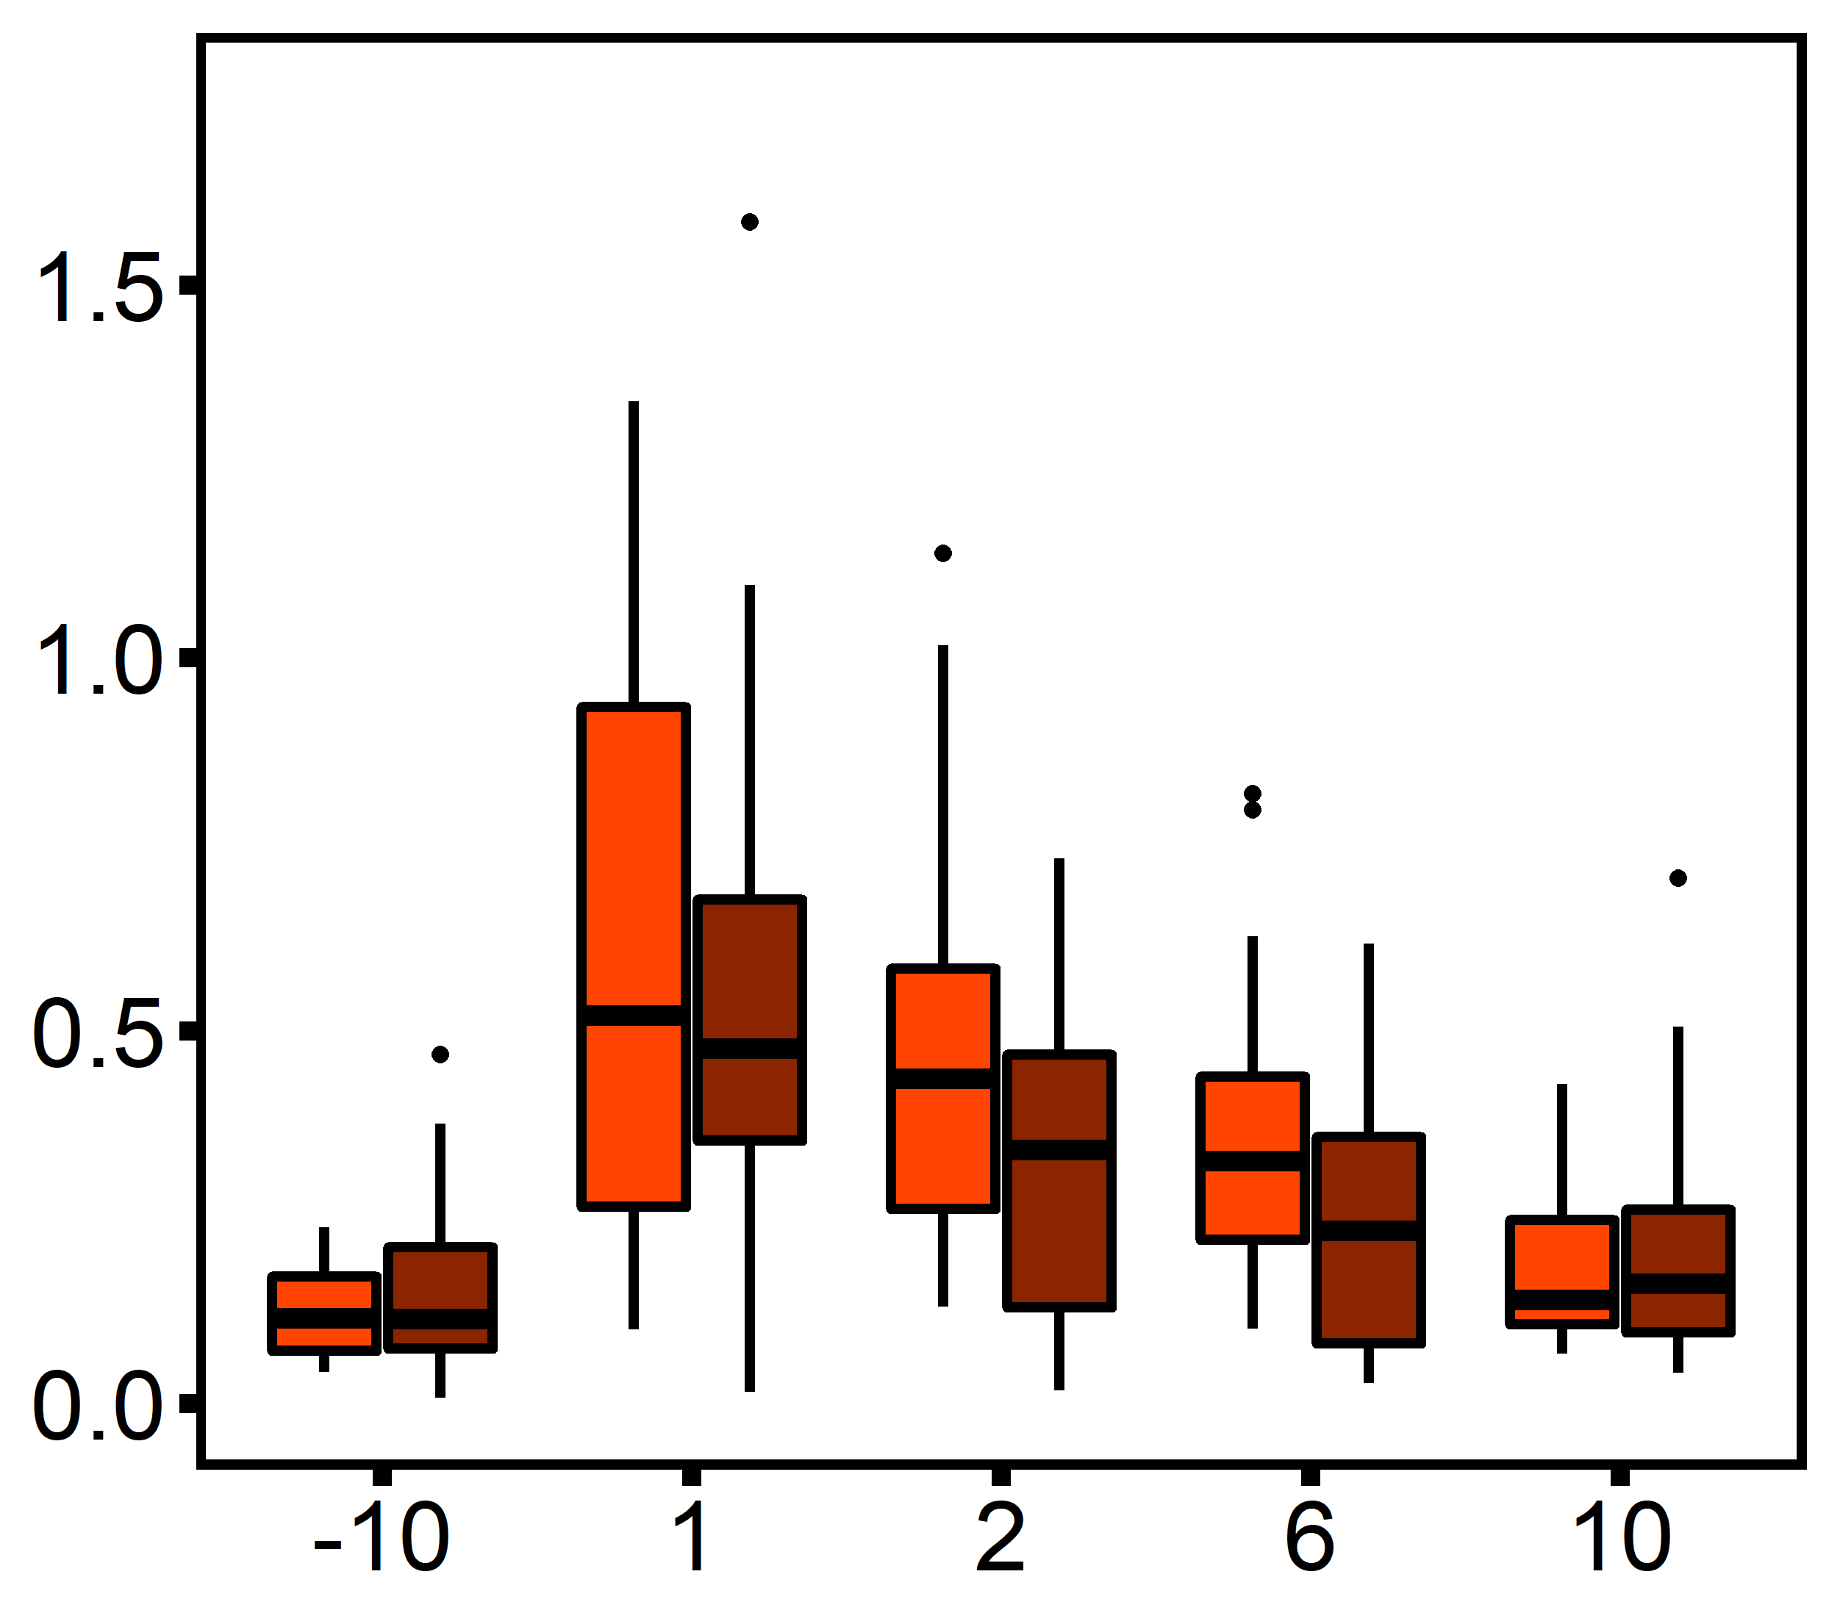
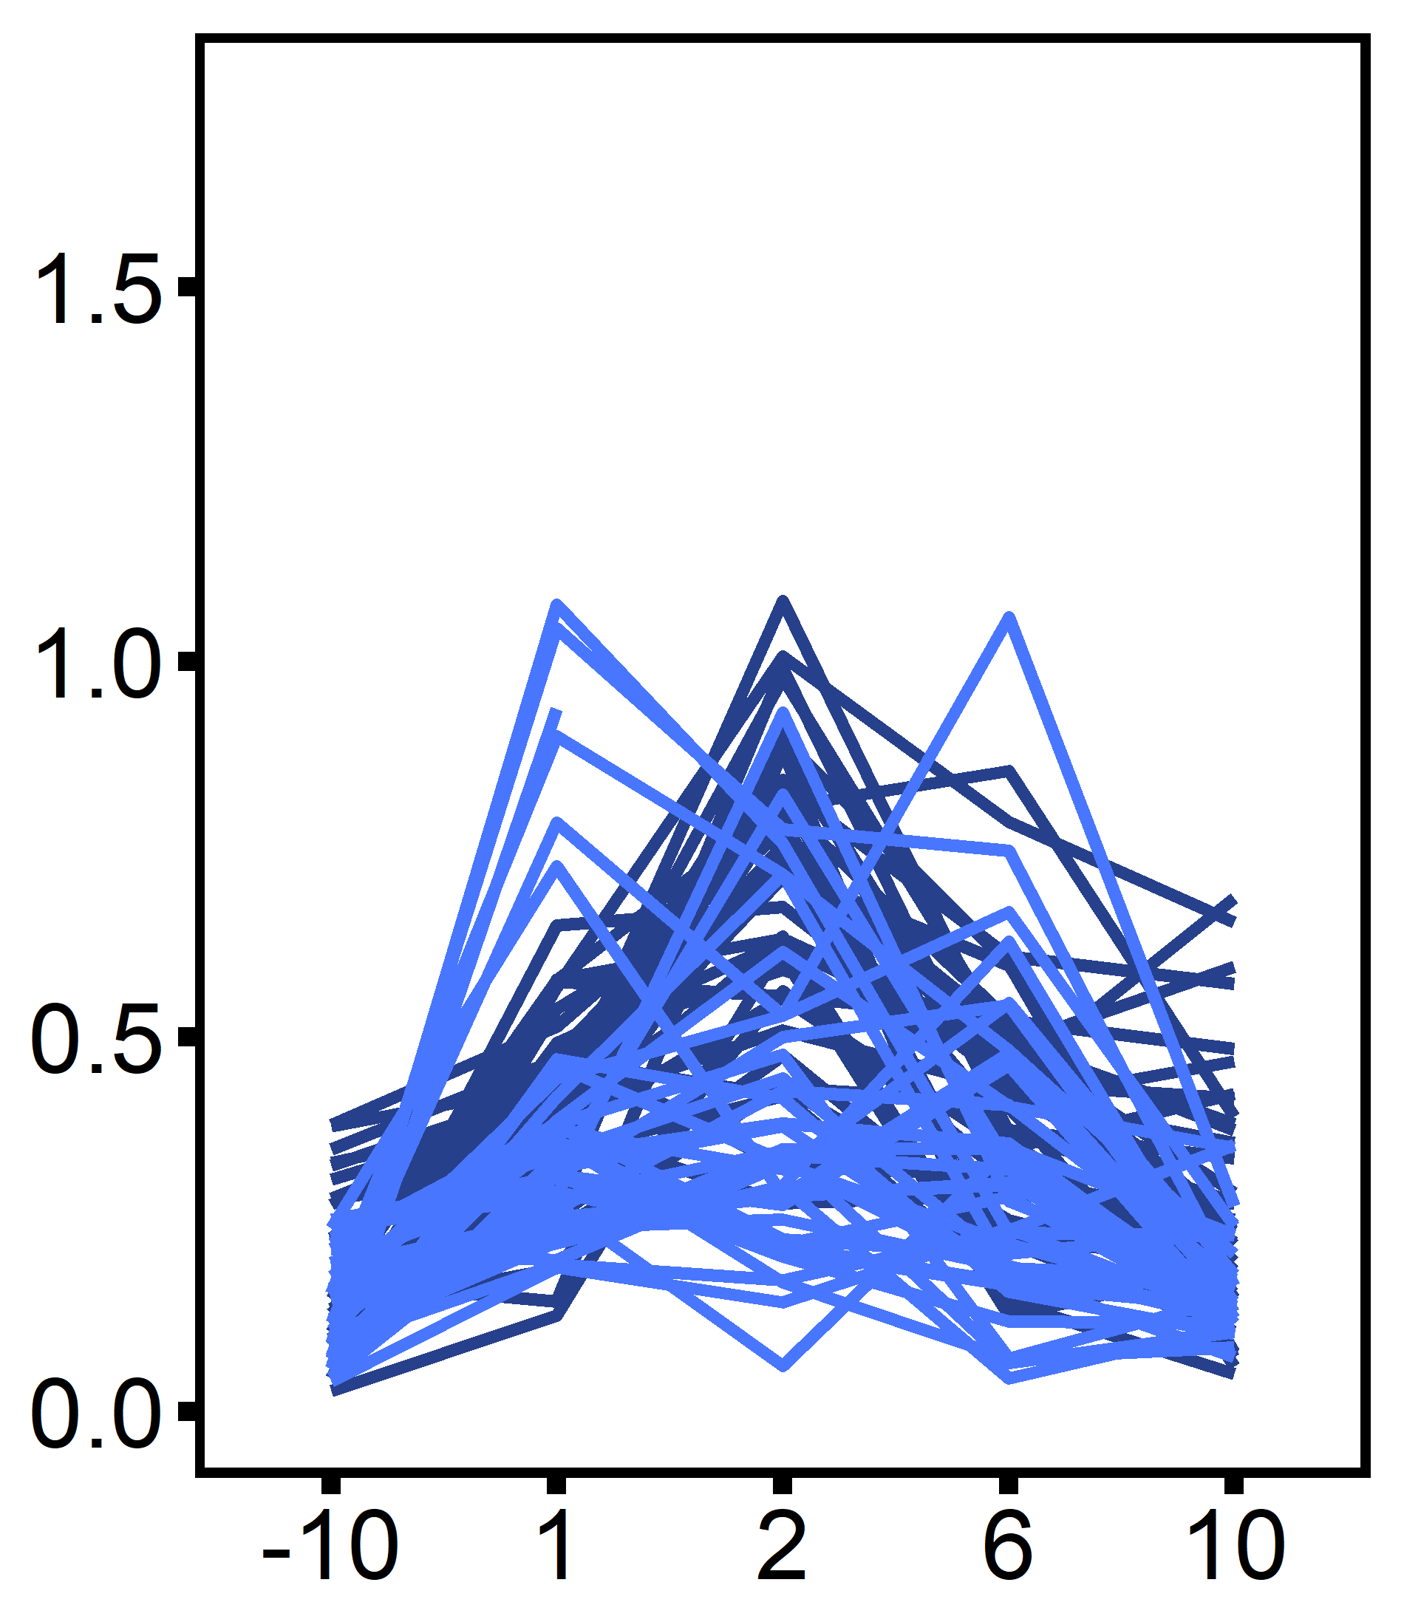
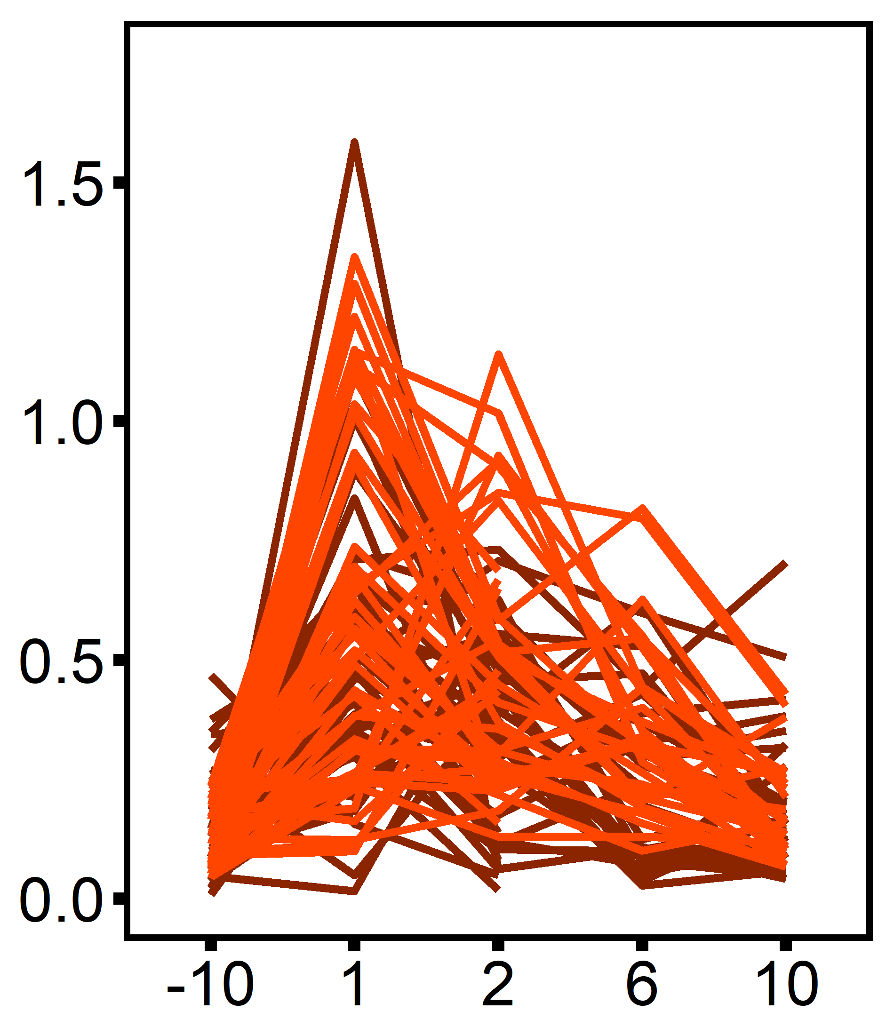
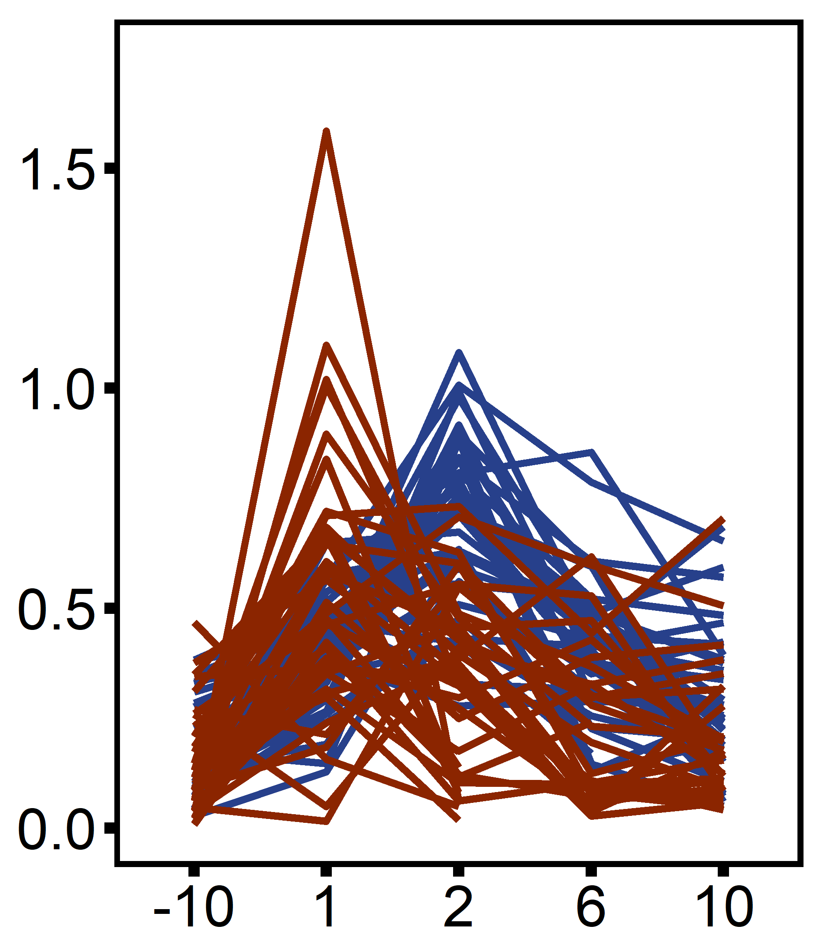
A
B
C
controls
diploids
C
triploids
Metabolic Rate (mg O₂ h⁻¹ g⁻¹)
D
diploids
E
triploids
F
multi-stressor
diploid, control
diploid, single stressor
diploid, multi-stressor
Metabolic Rate (mg O₂ h⁻¹ g⁻¹)
triploid, control
triploid, single stressor
triploid, multi-stressor
Length of stress exposure (days)

