Slide 1
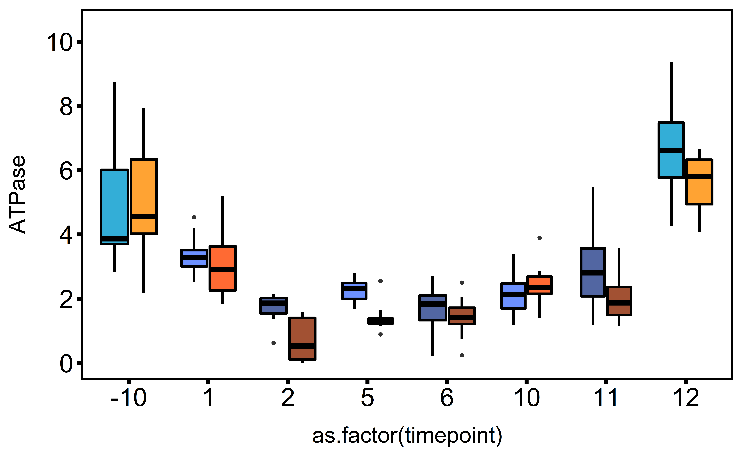
Ploidy, Treatment
ab
diploid, control
a
a
diploid, single stressor
ab
diploid, multi-stressor
bc
cd
Na⁺/K⁺ ATPase Activity (µmol ADP mg protein⁻¹ h⁻¹)
bc
cde
triploid, control
cde
e
cde
triploid, single stressor
cde
e
e
de
f
triploid, multi-stressor
before exp.
single stressor
multi-stressor
d5
d10
after exp.

