Slide 1
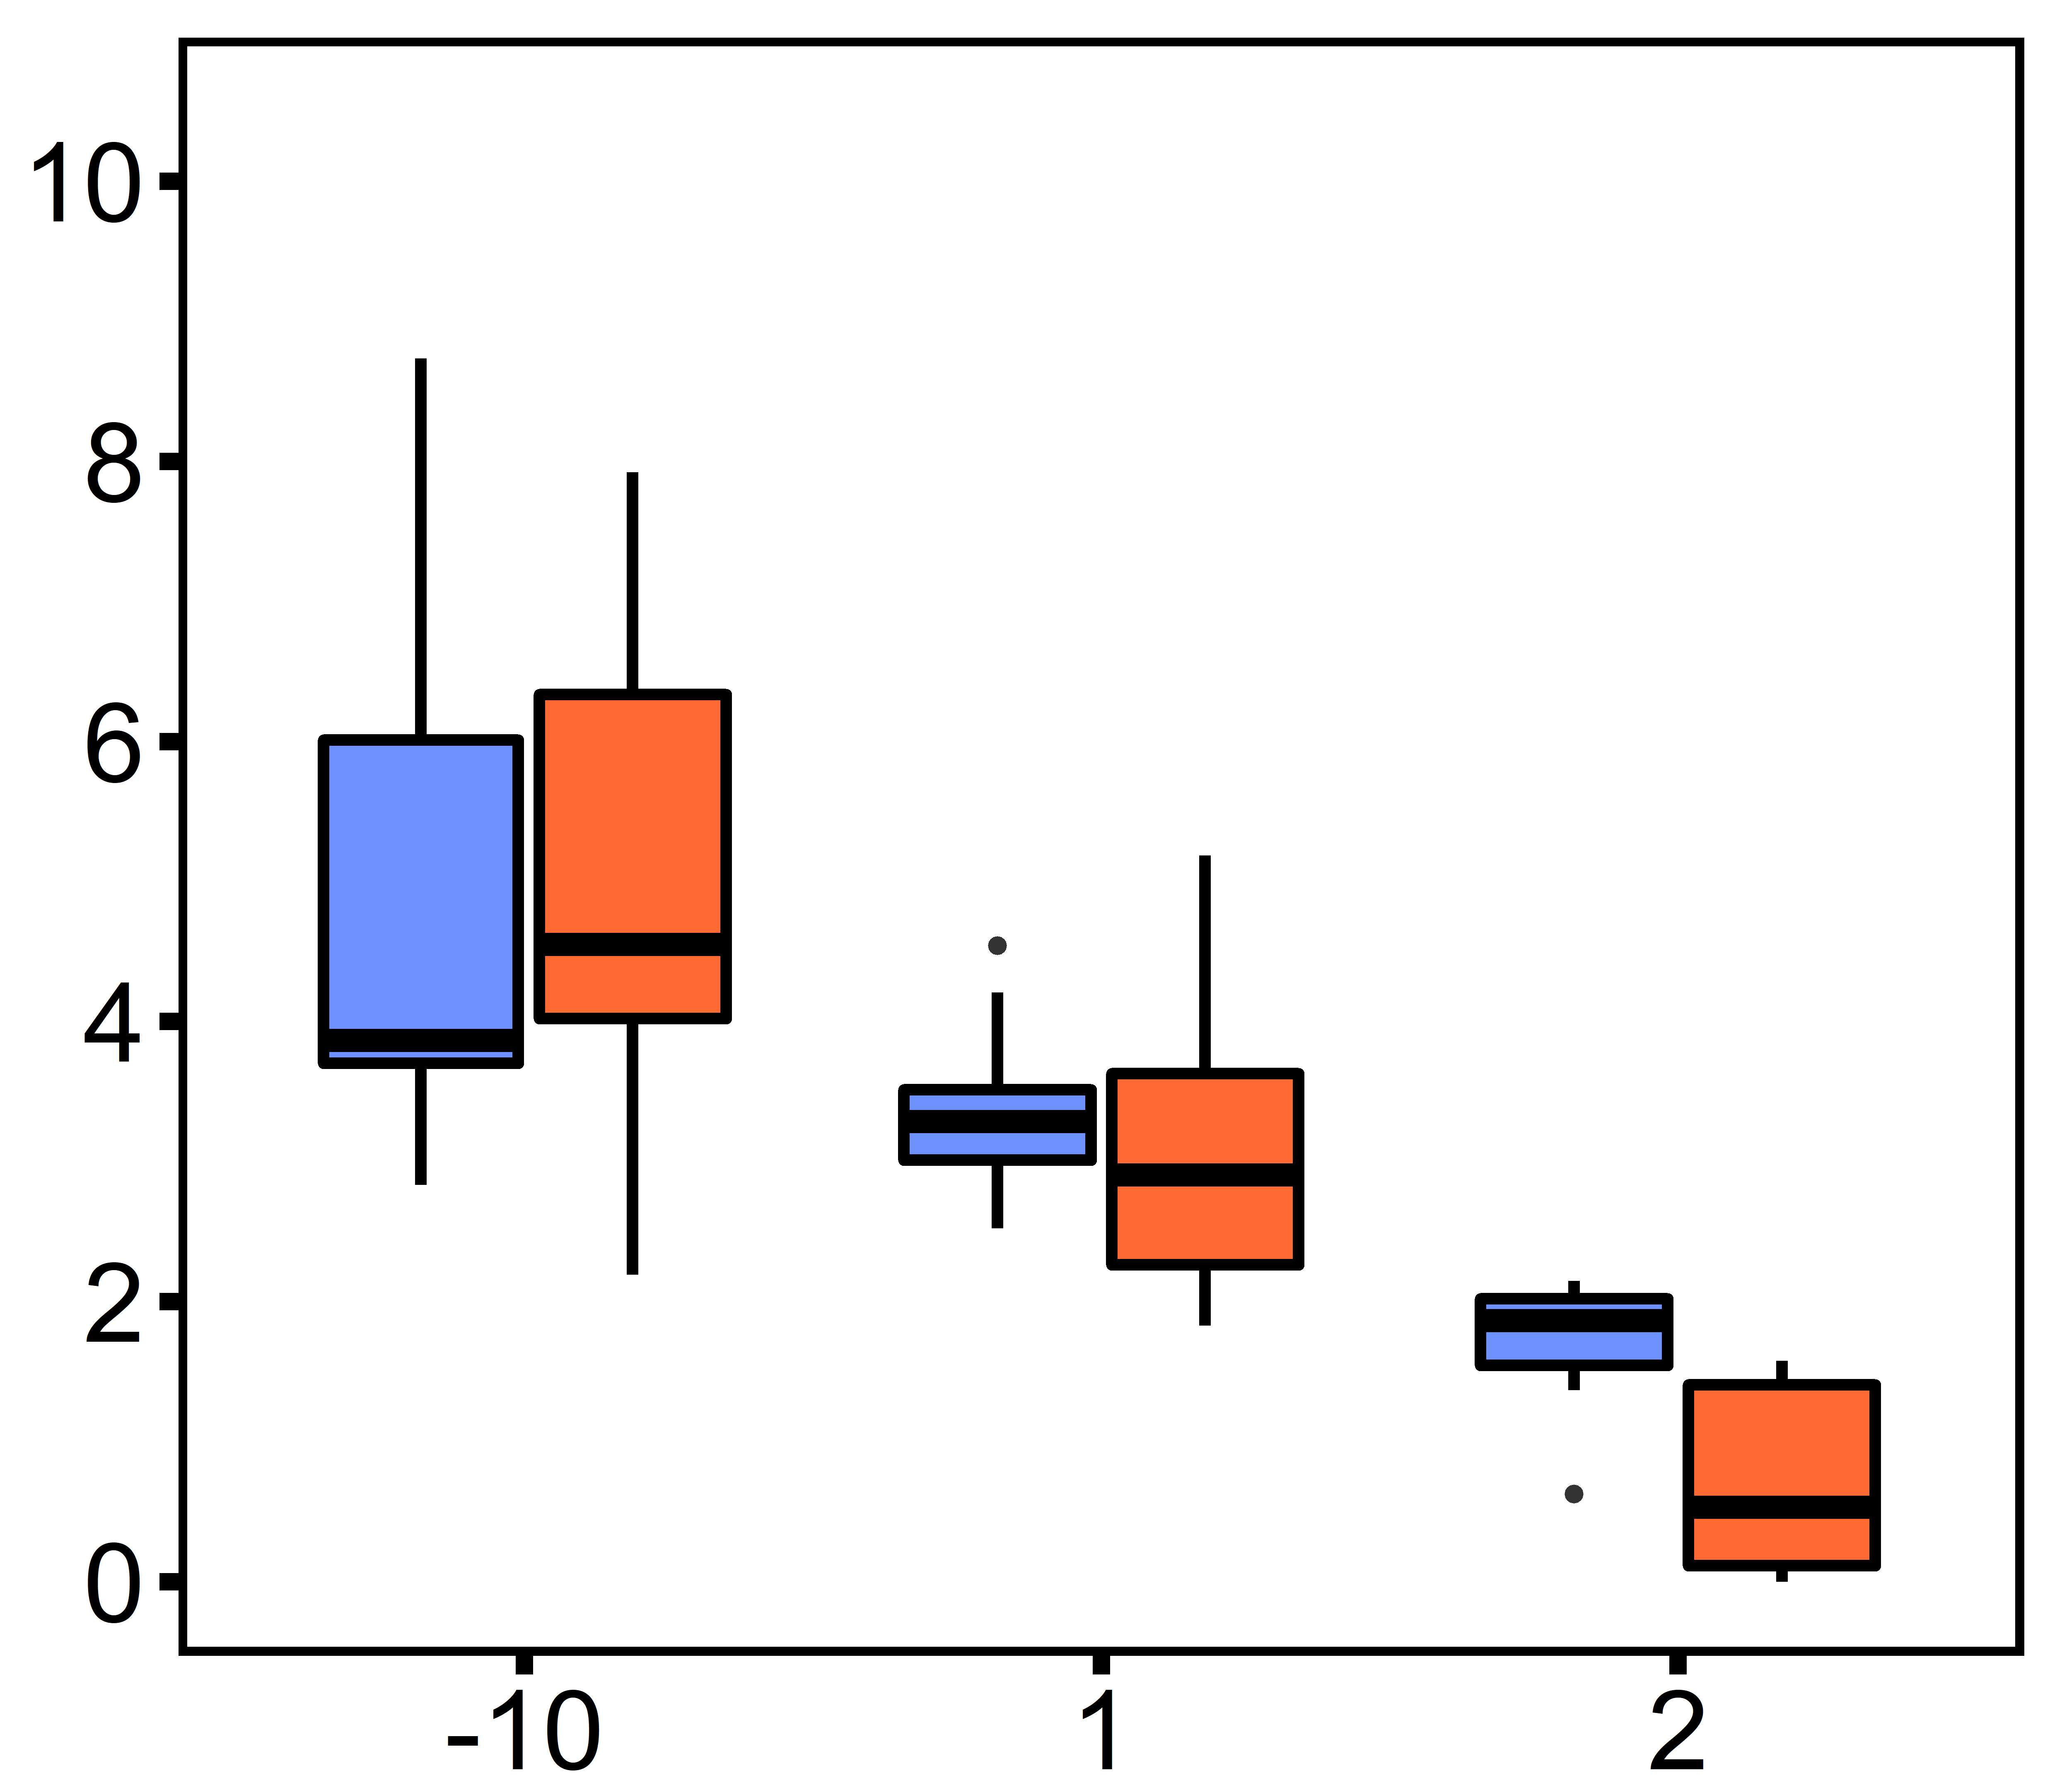
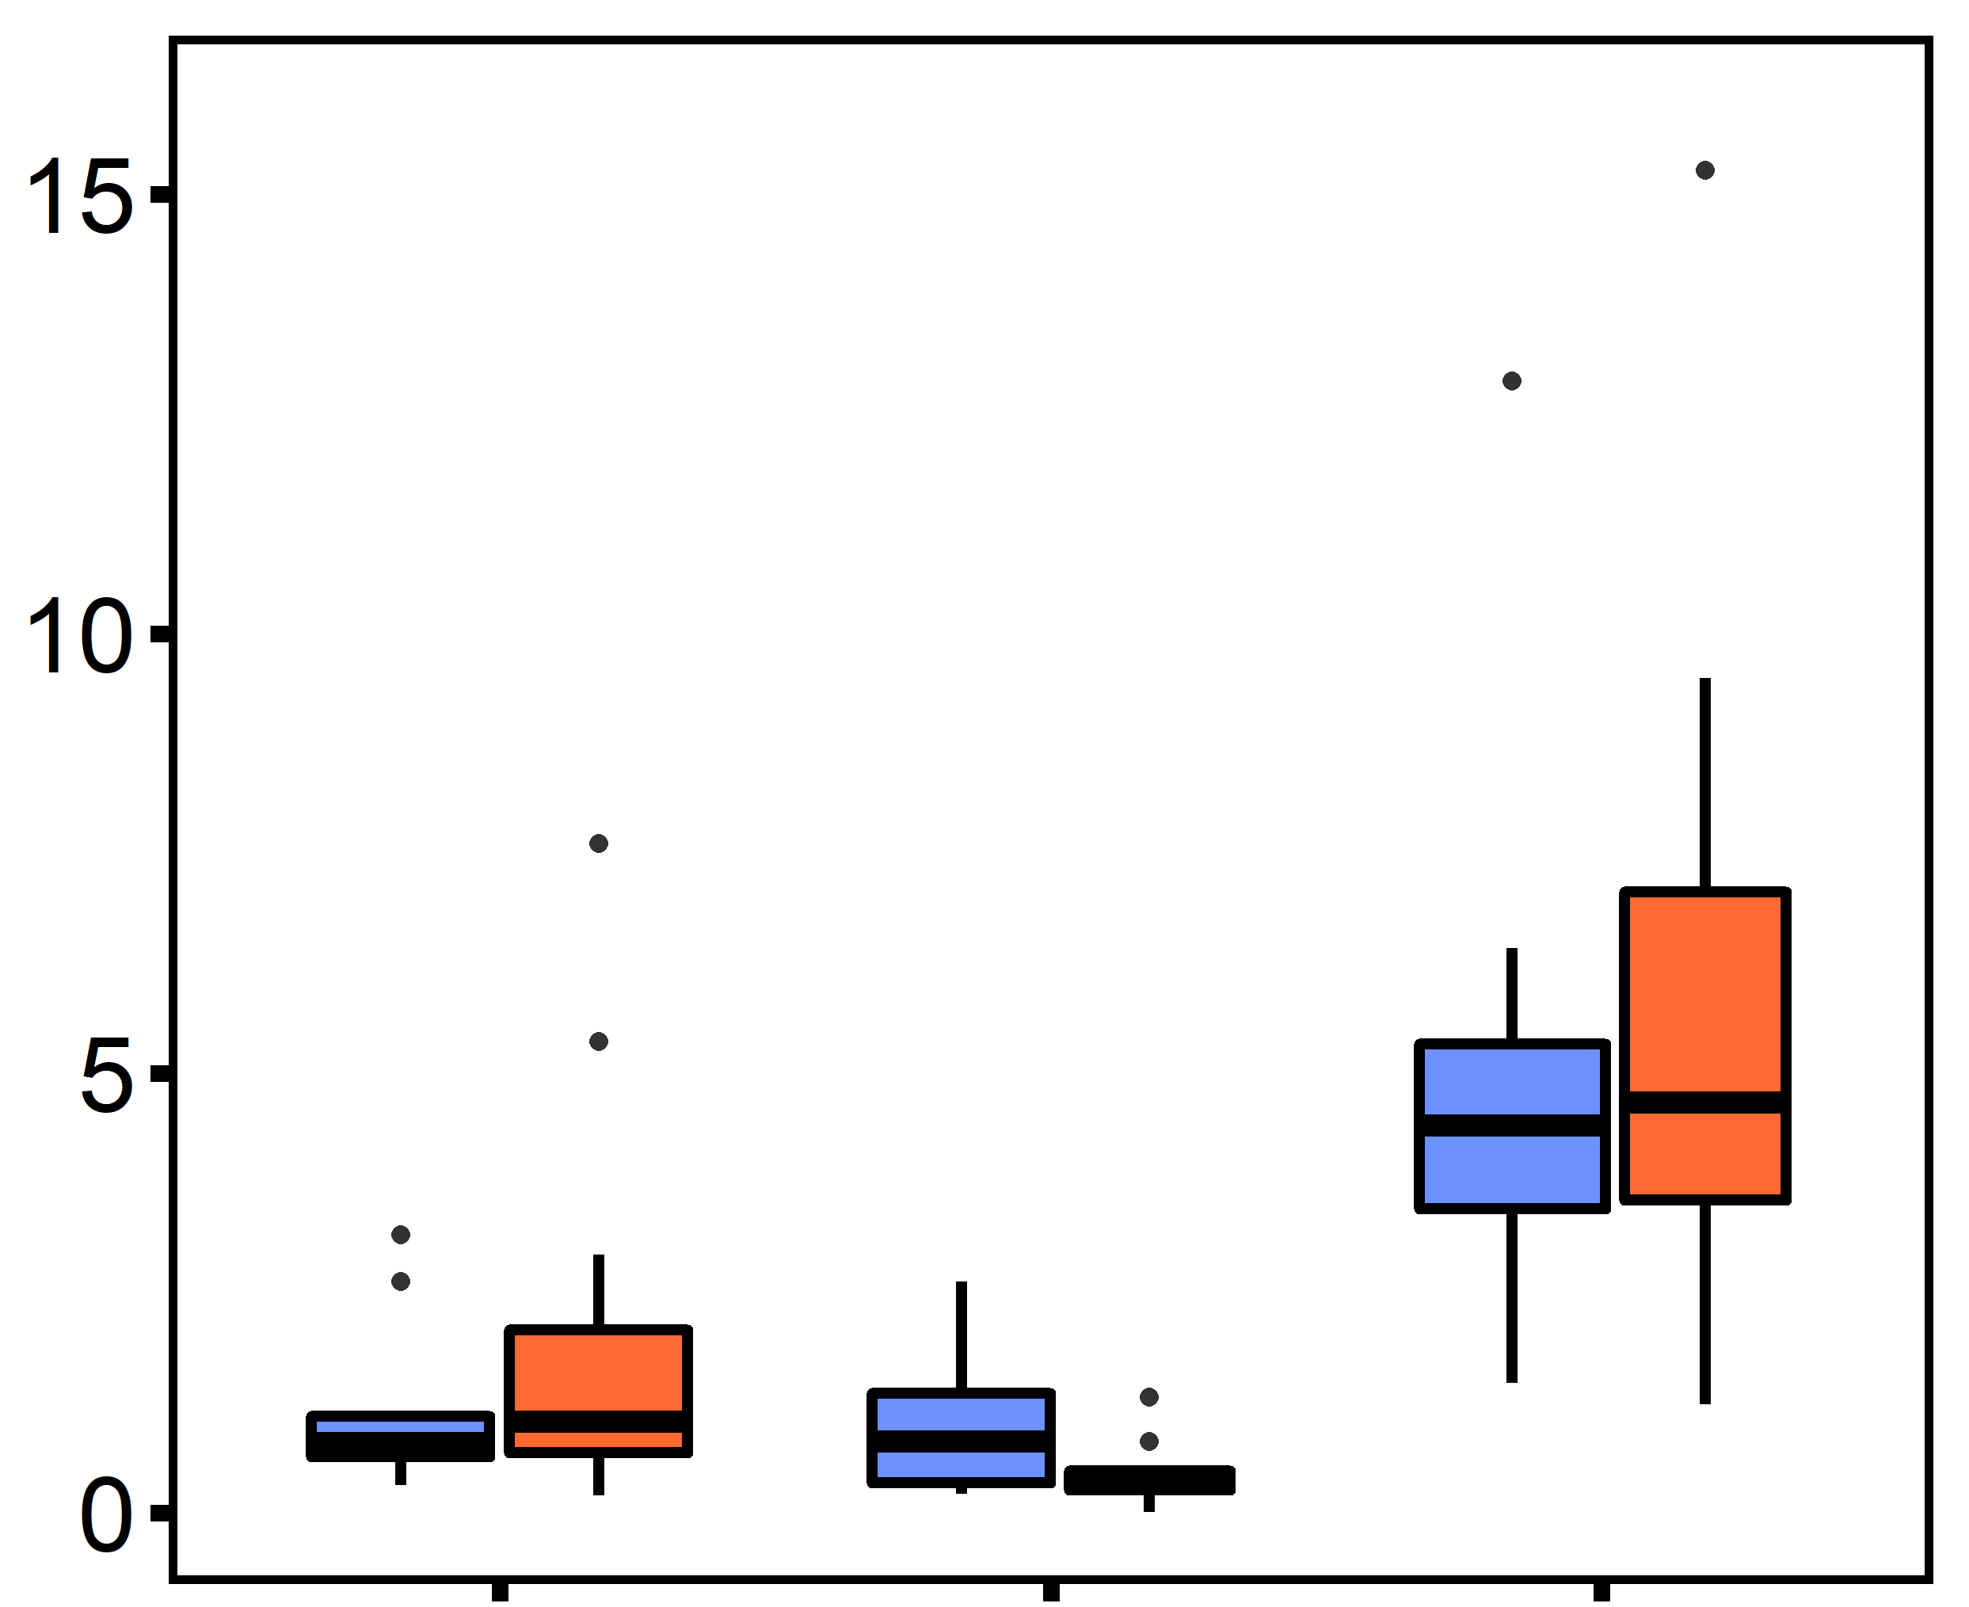
A
B
Ploidy
a
diploid
a
c
triploid
Na⁺/K⁺ ATPase Activity (µmol ADP mg protein⁻¹ h⁻¹)
b
Citrate Synthase Activity (nmol min⁻¹ mg protein⁻¹)
a
ab
c
c
ab
ab
d
b
control
single stressor
multi-stressor
control
single stressor
multi-stressor

