Slide 1
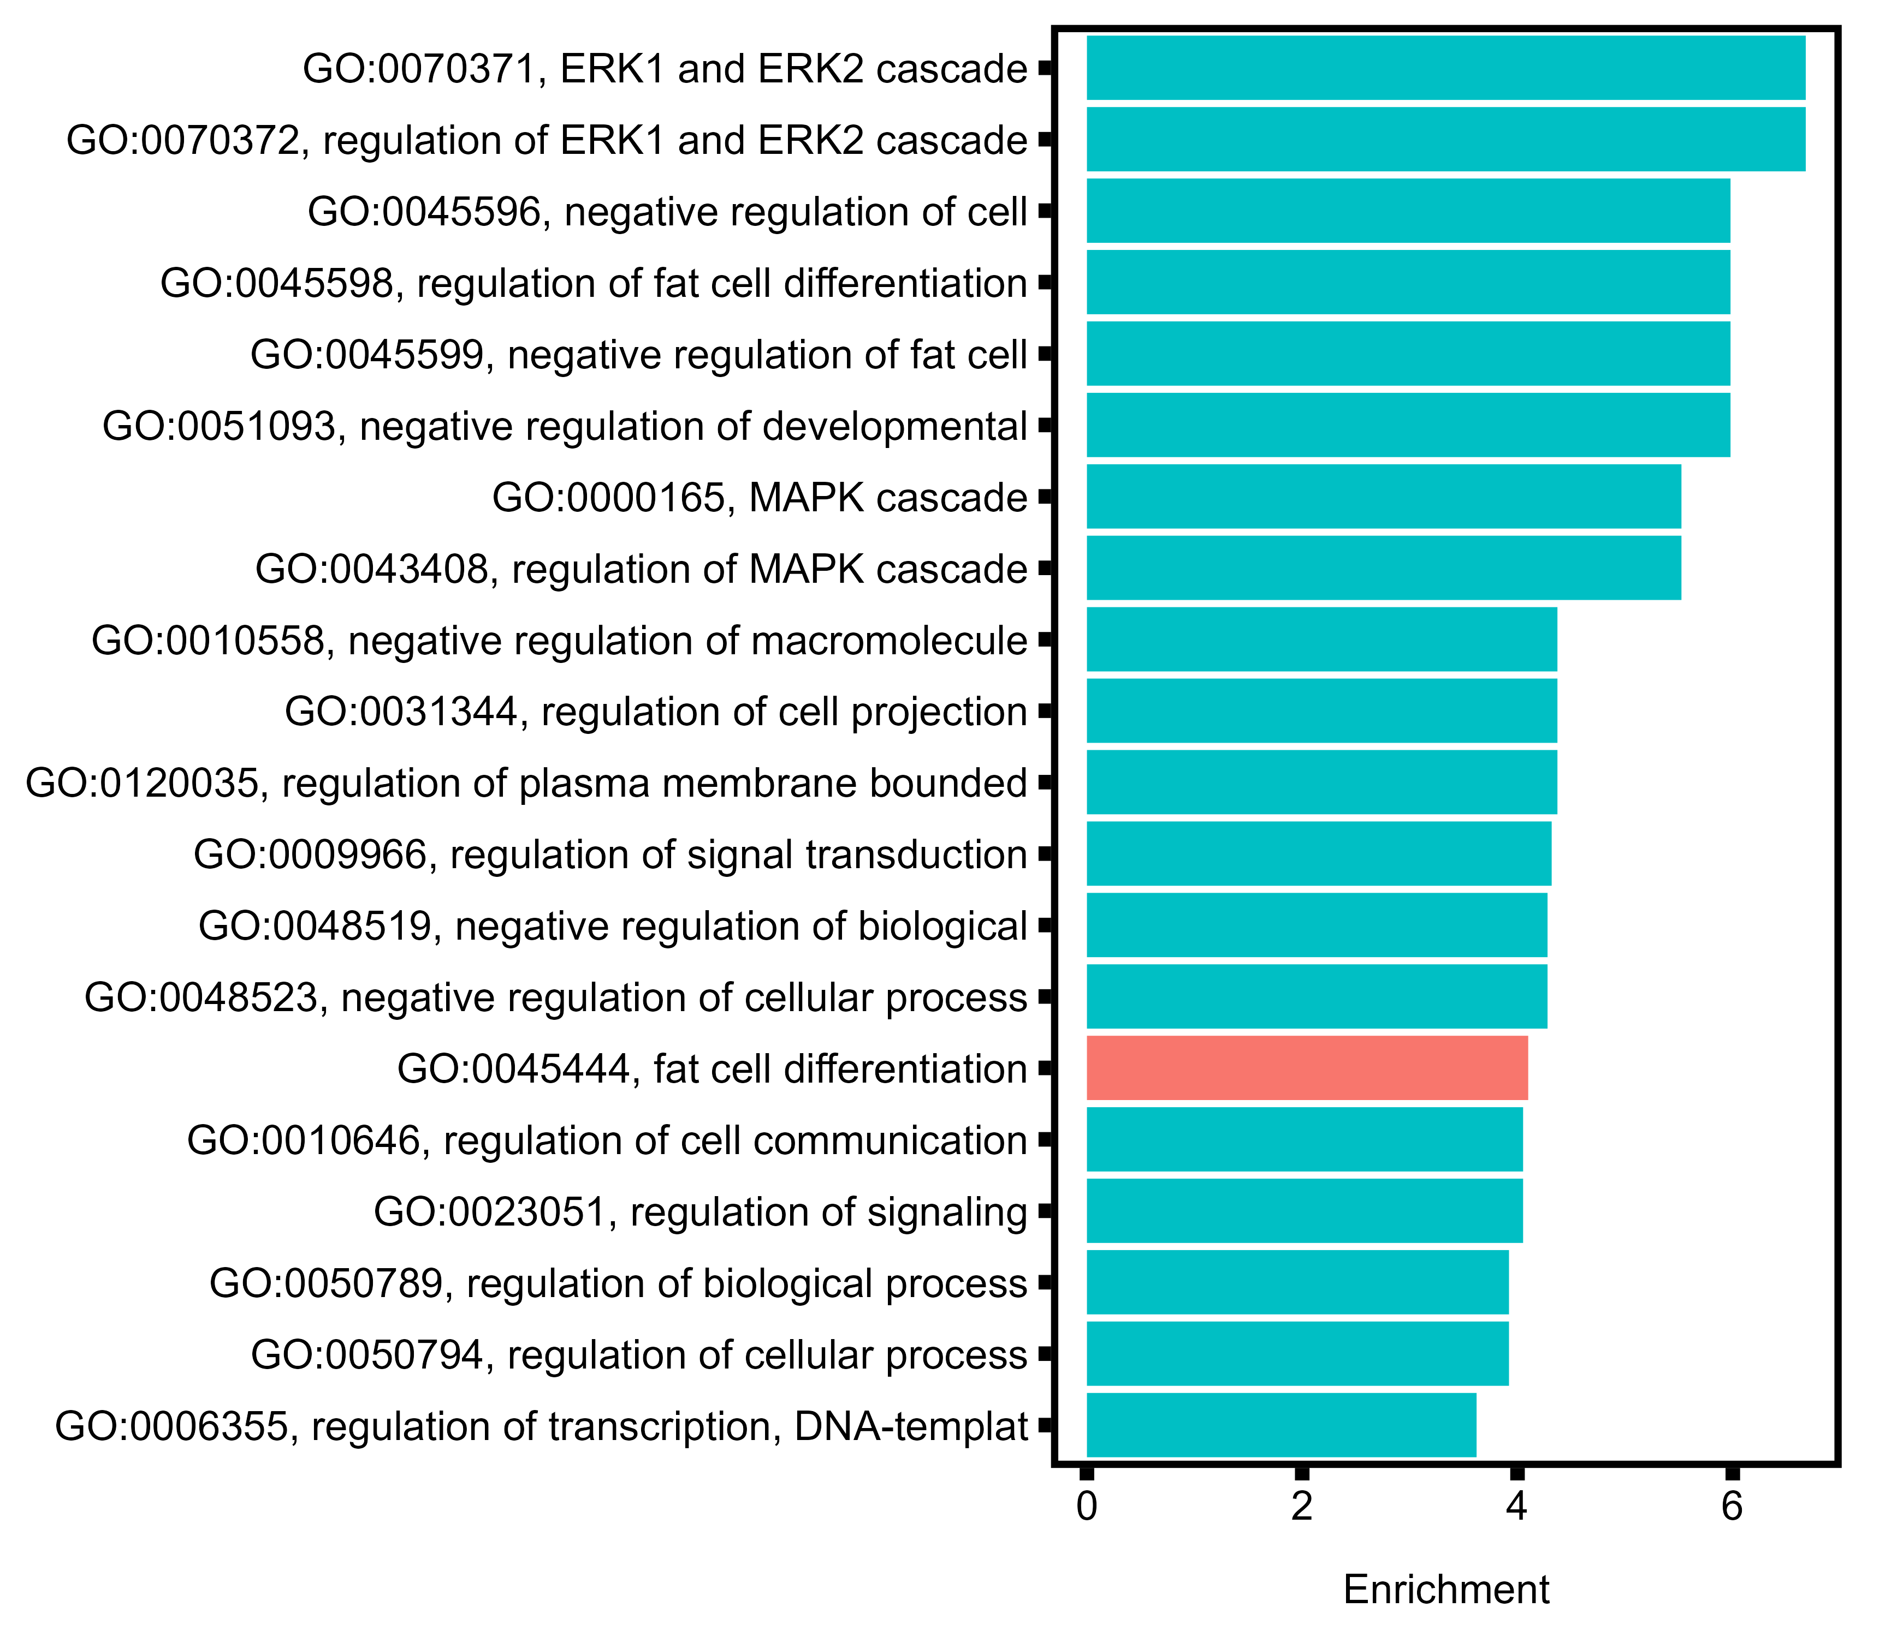
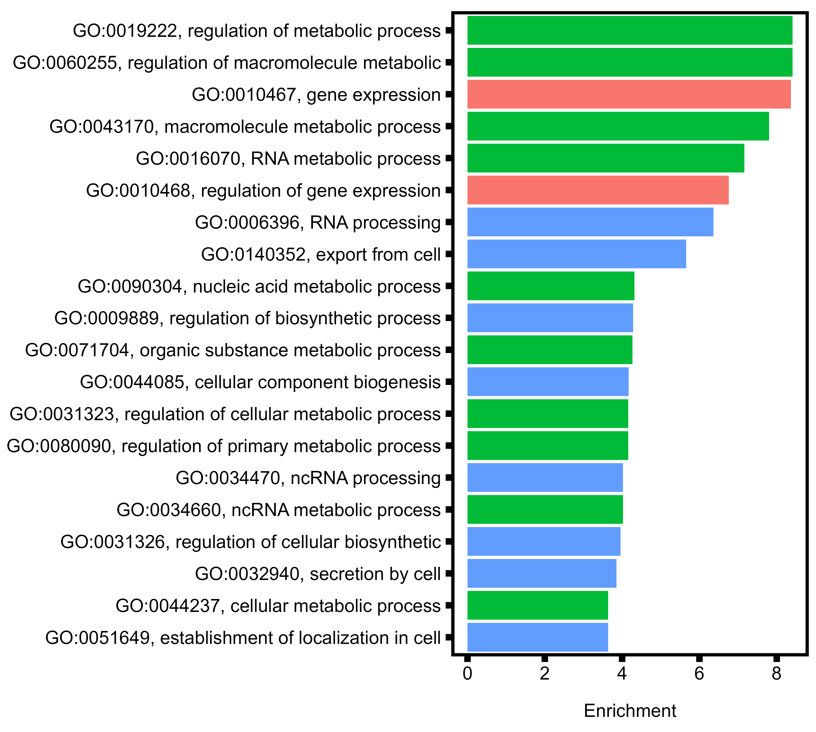
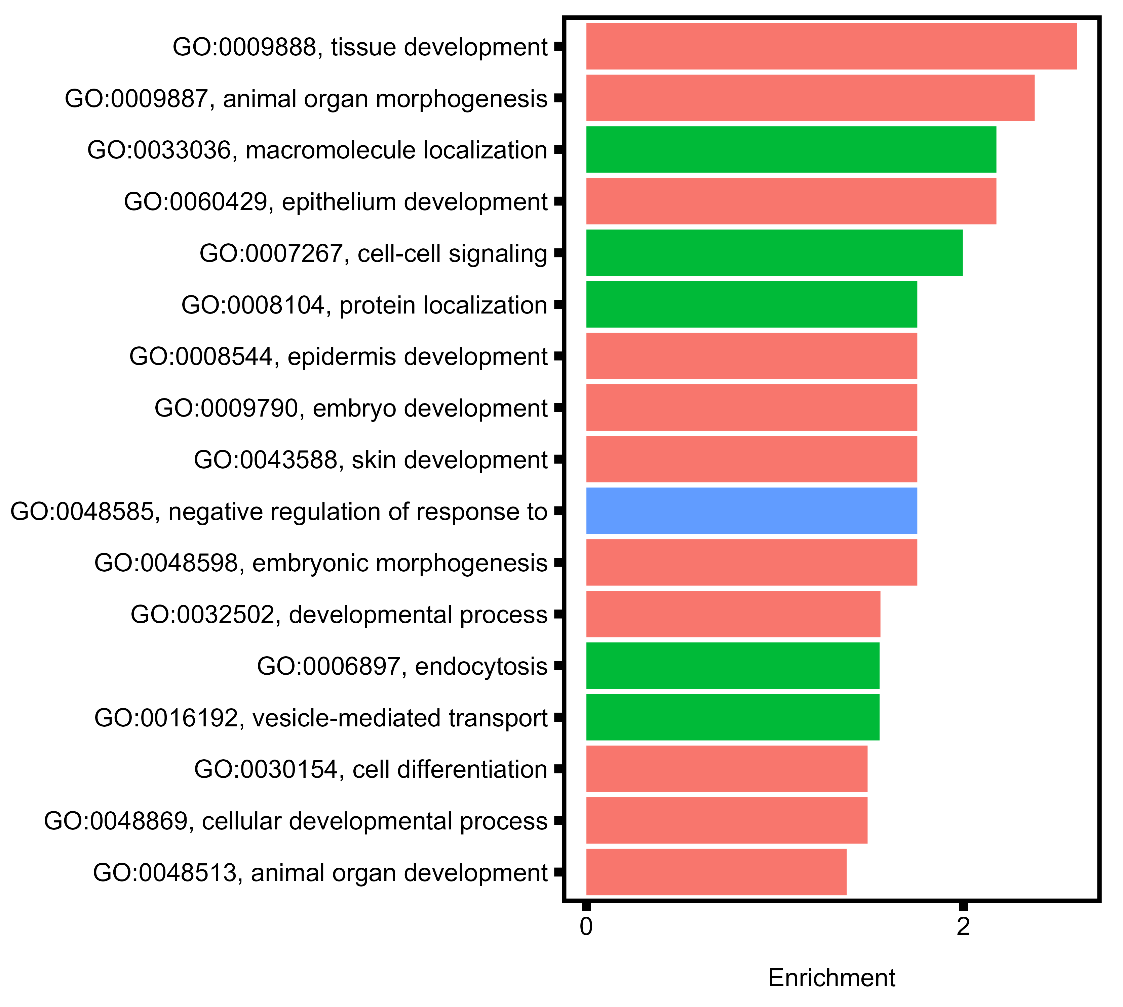
A
B
C
diploid:triploid, Ctrl
diploid only, SS:Ctrl
diploid:triploid, MS
20°C
C
Regulation
Metabolism
Development

