Slide 1
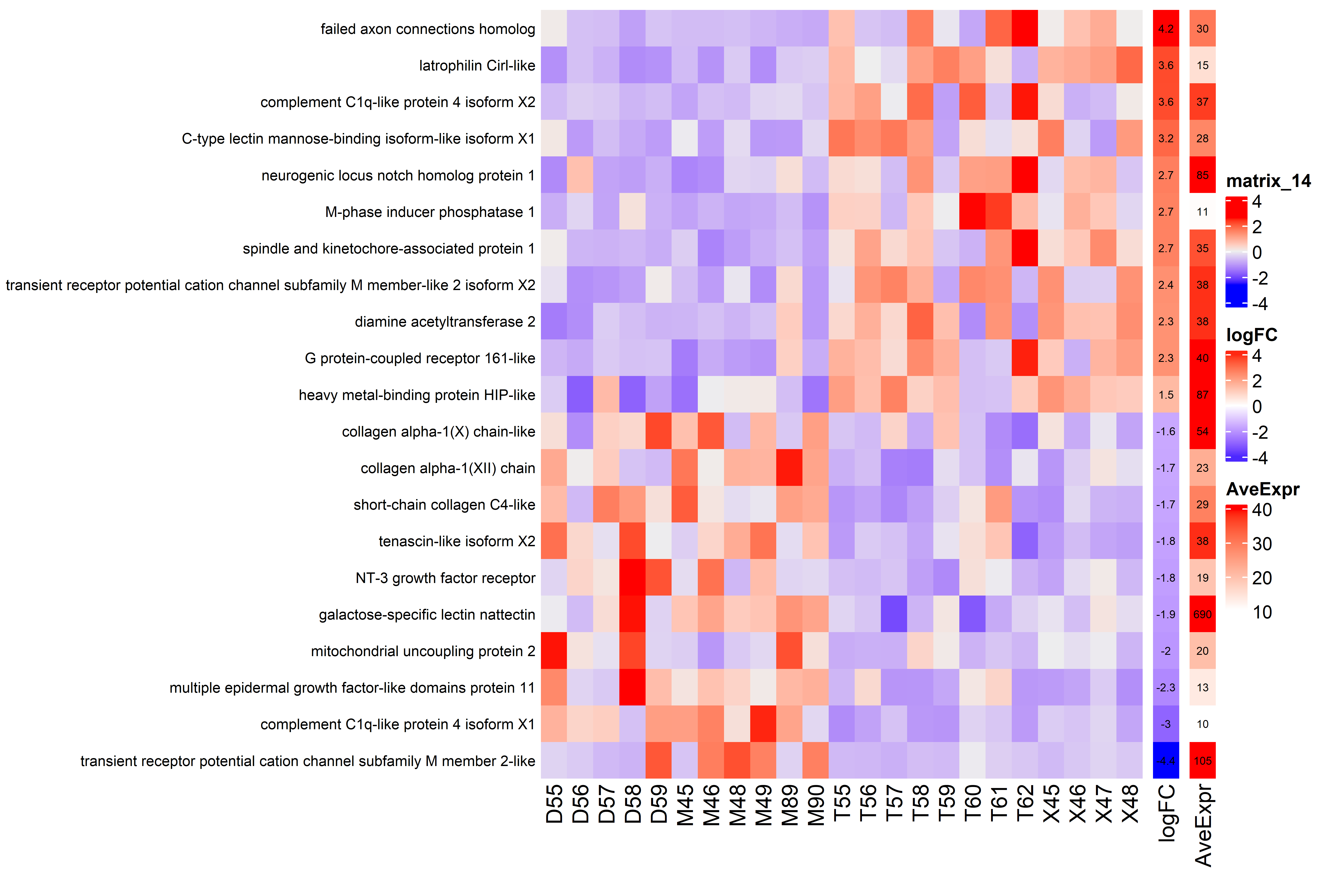
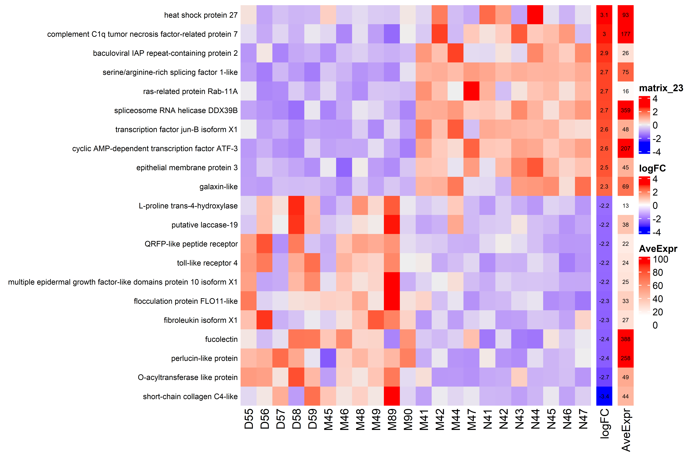
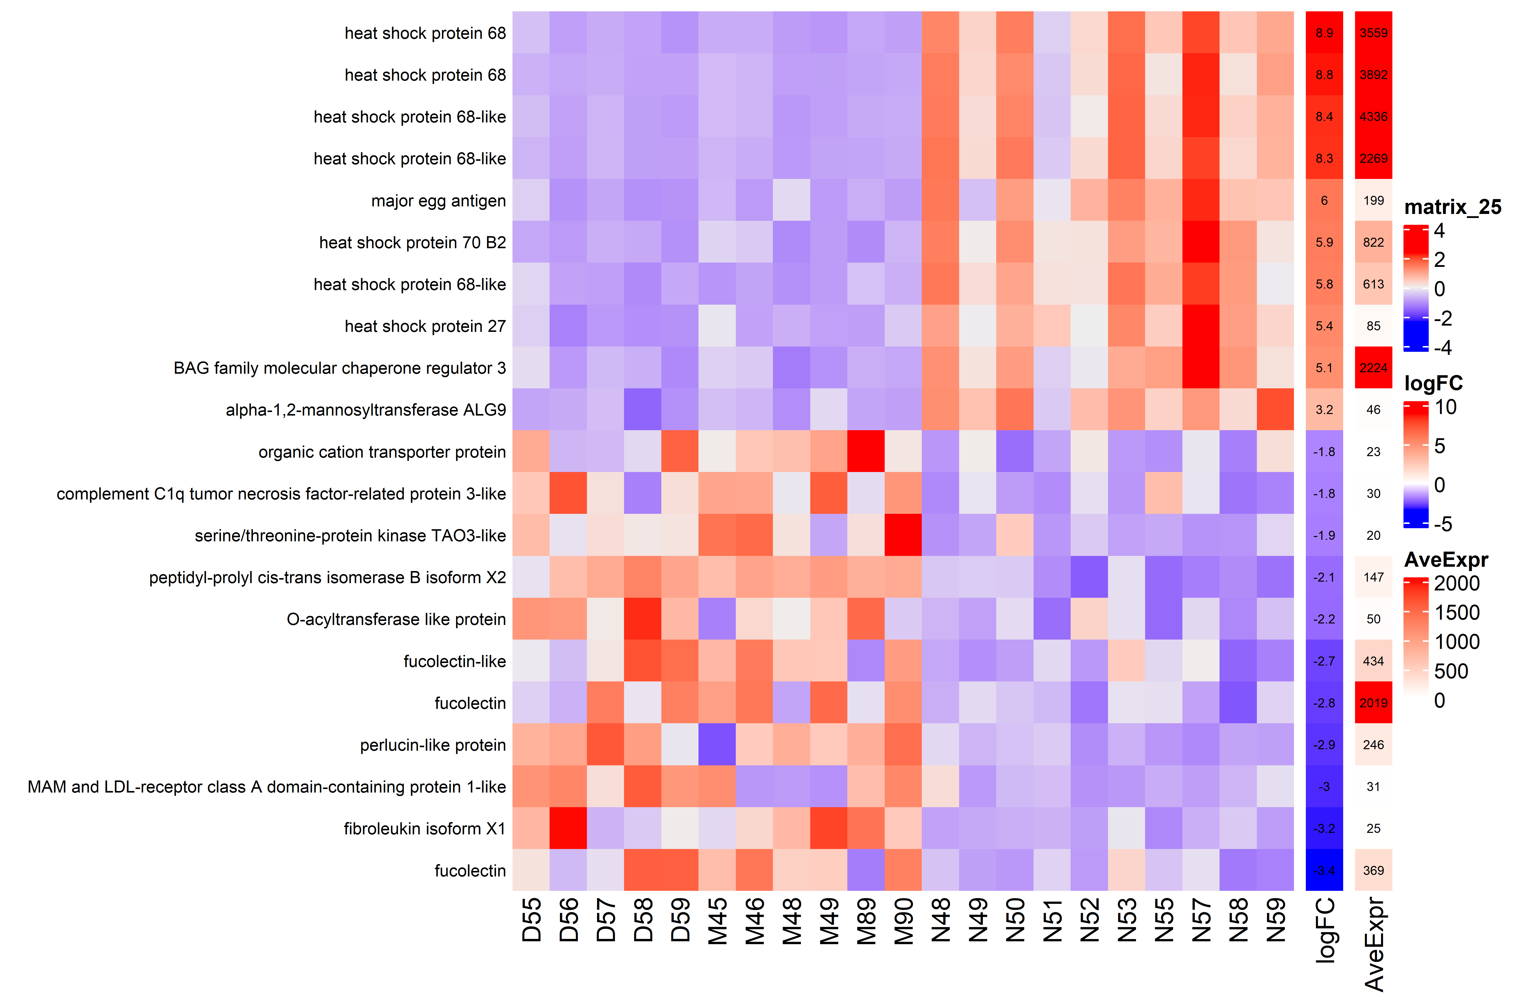
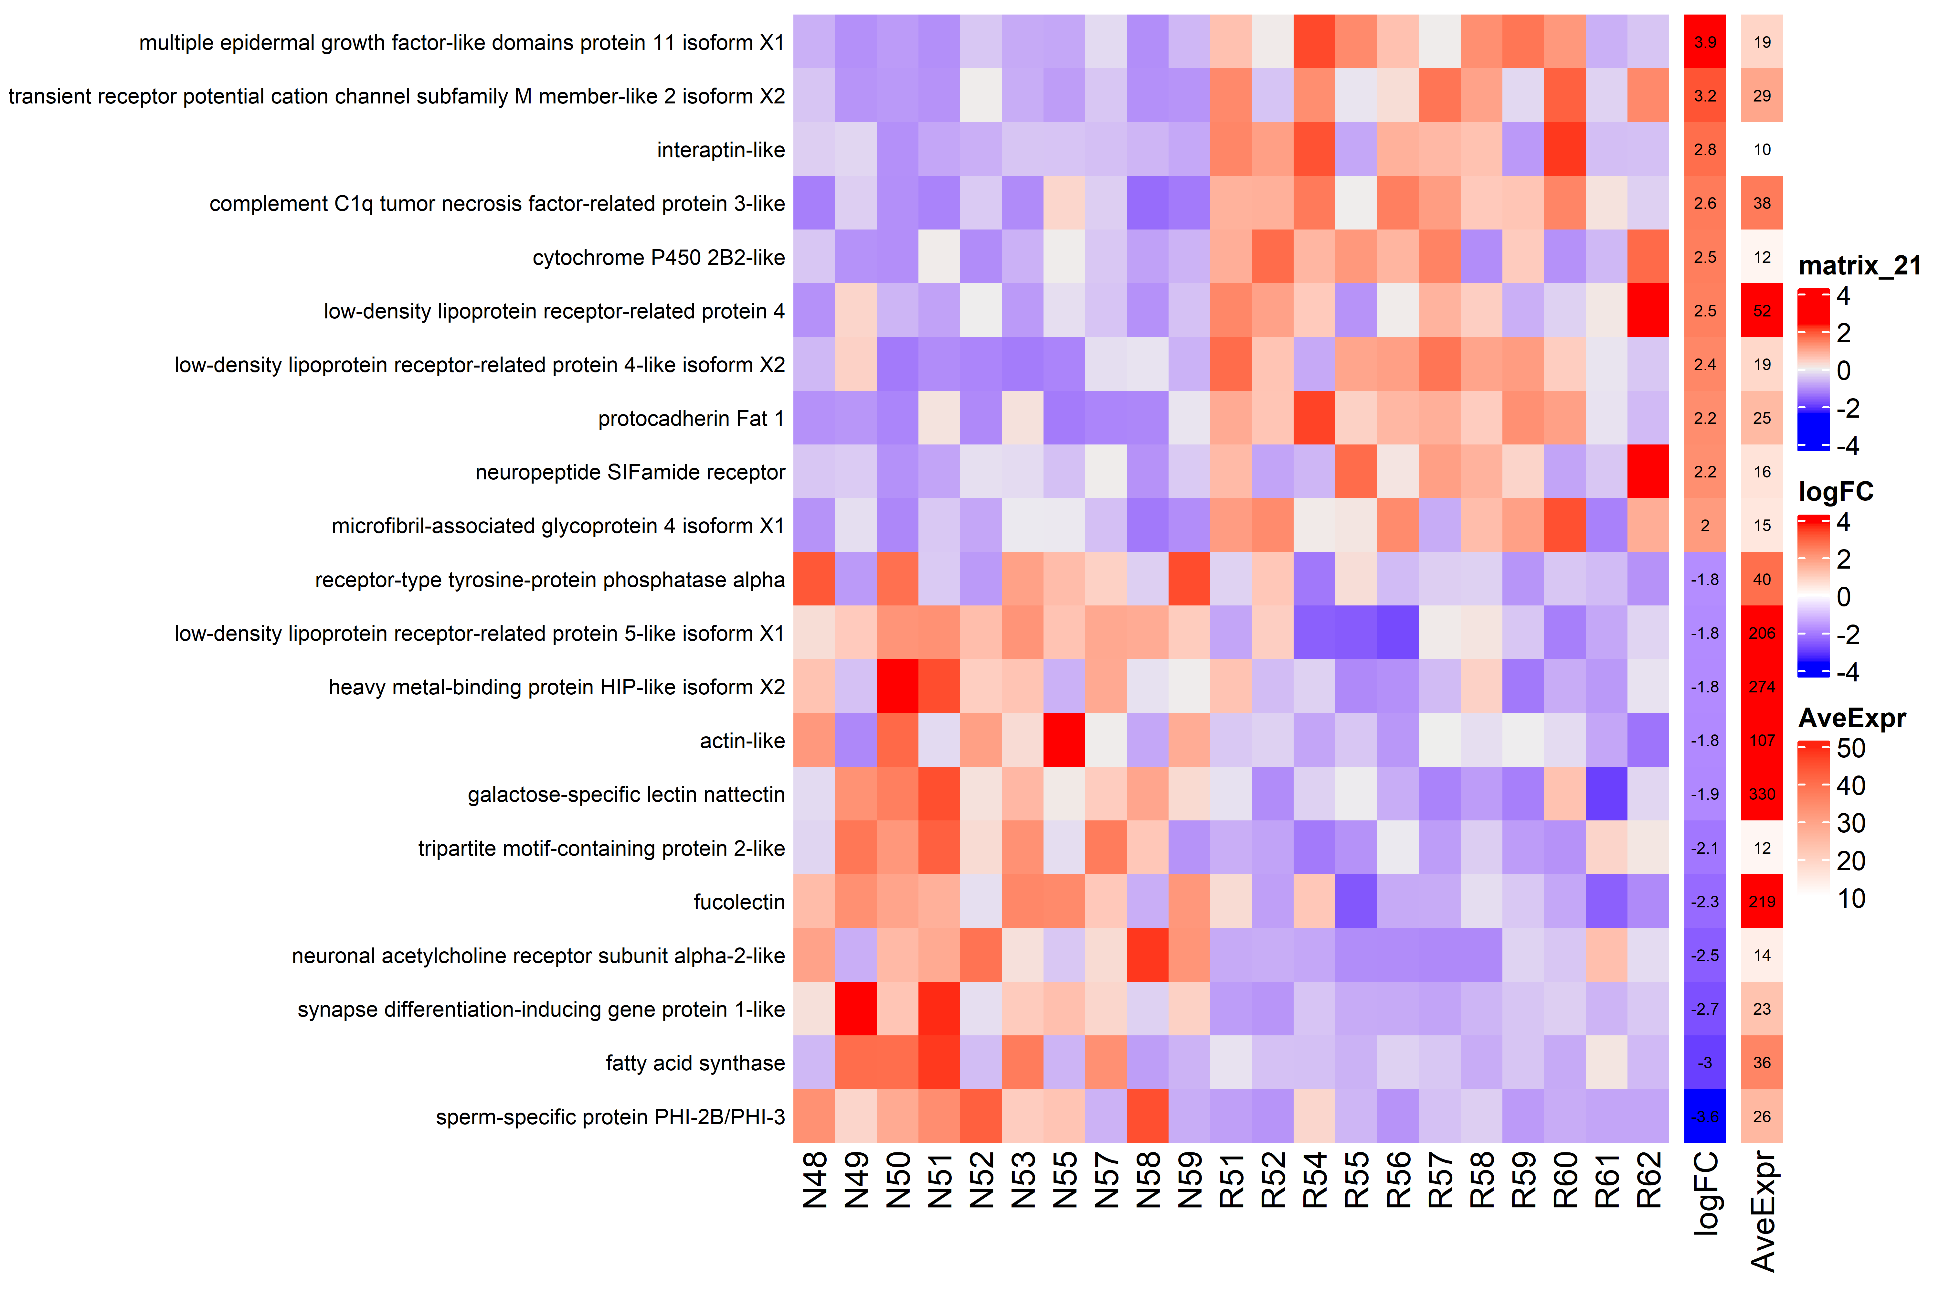
A
B
diploid:triploid, Ctrl
diploid, SS:Ctrl
diploid
triploid
control
single stressor
C
triploid, MS:Ctrl
D
diploid:triploid, MS
control
multi-stressor
diploid
triploid

