Slide 1
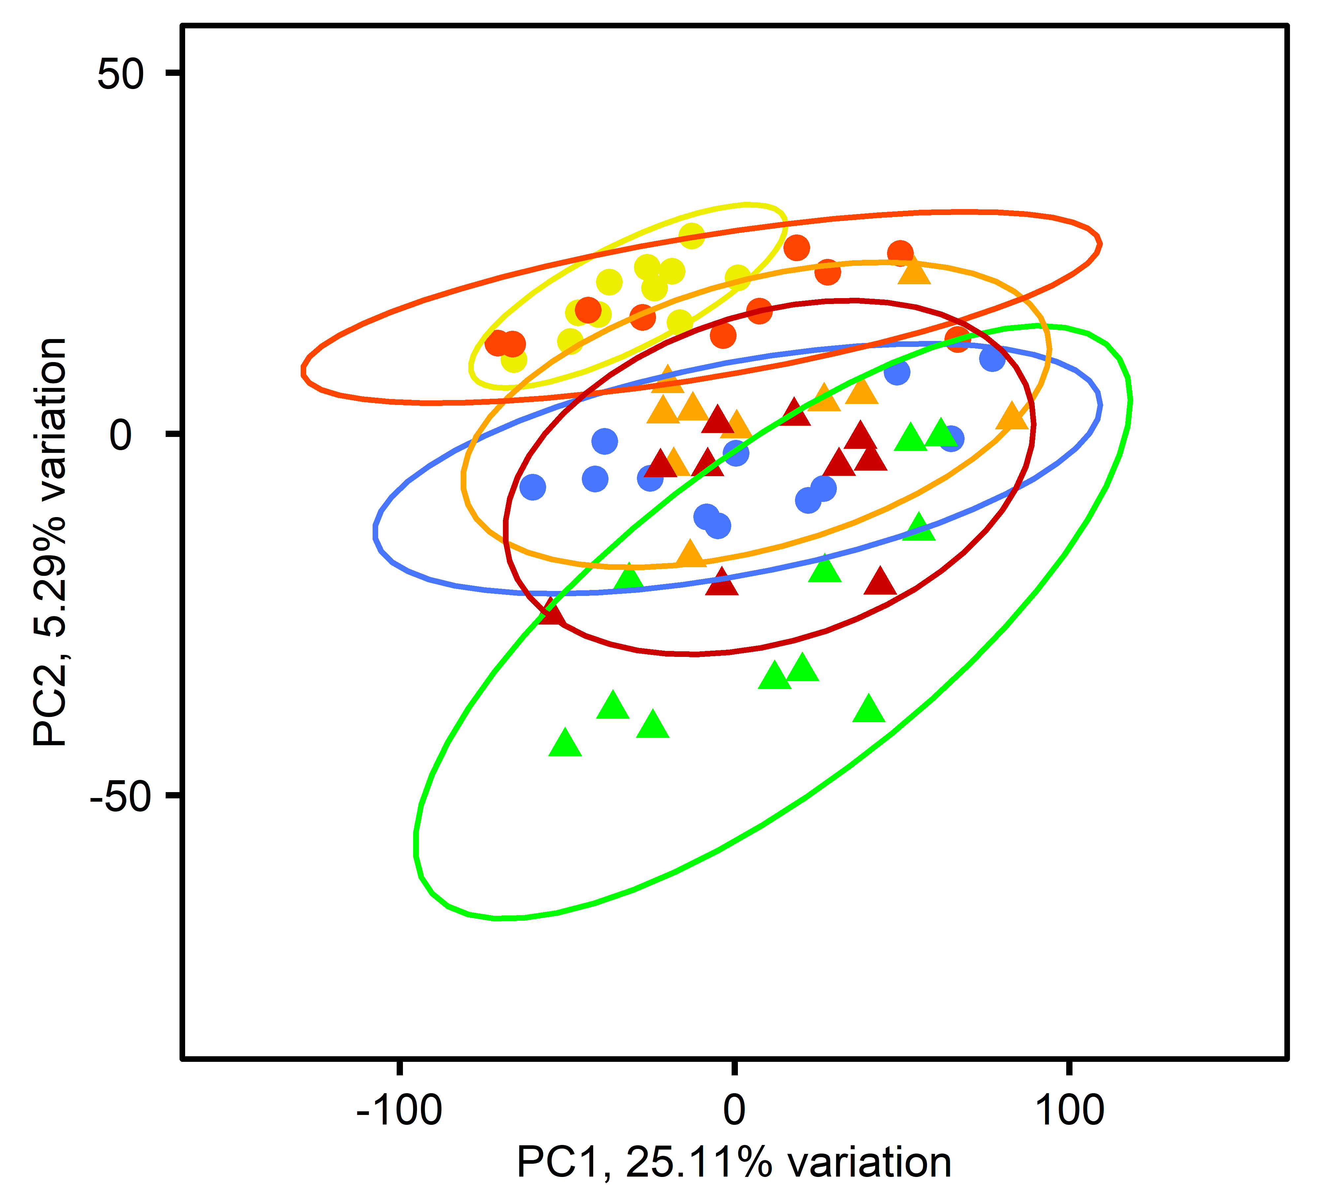
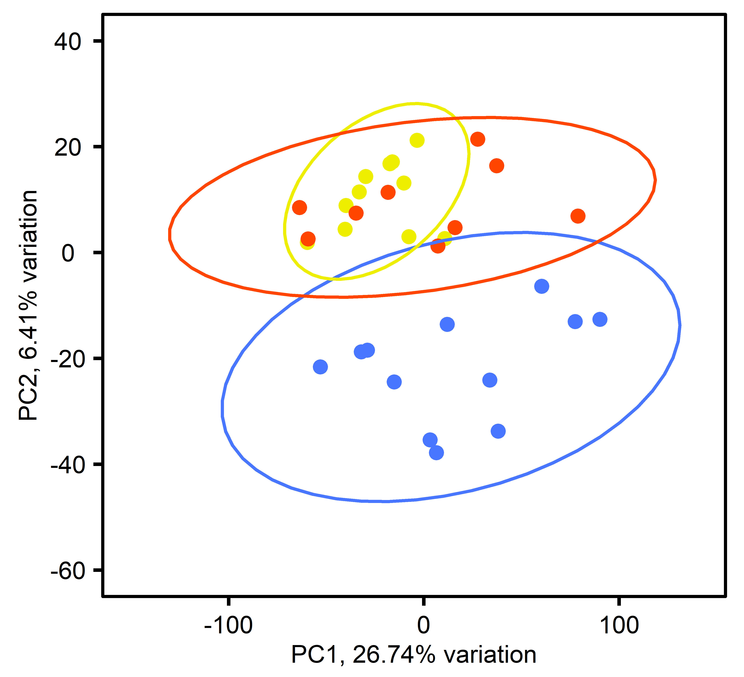
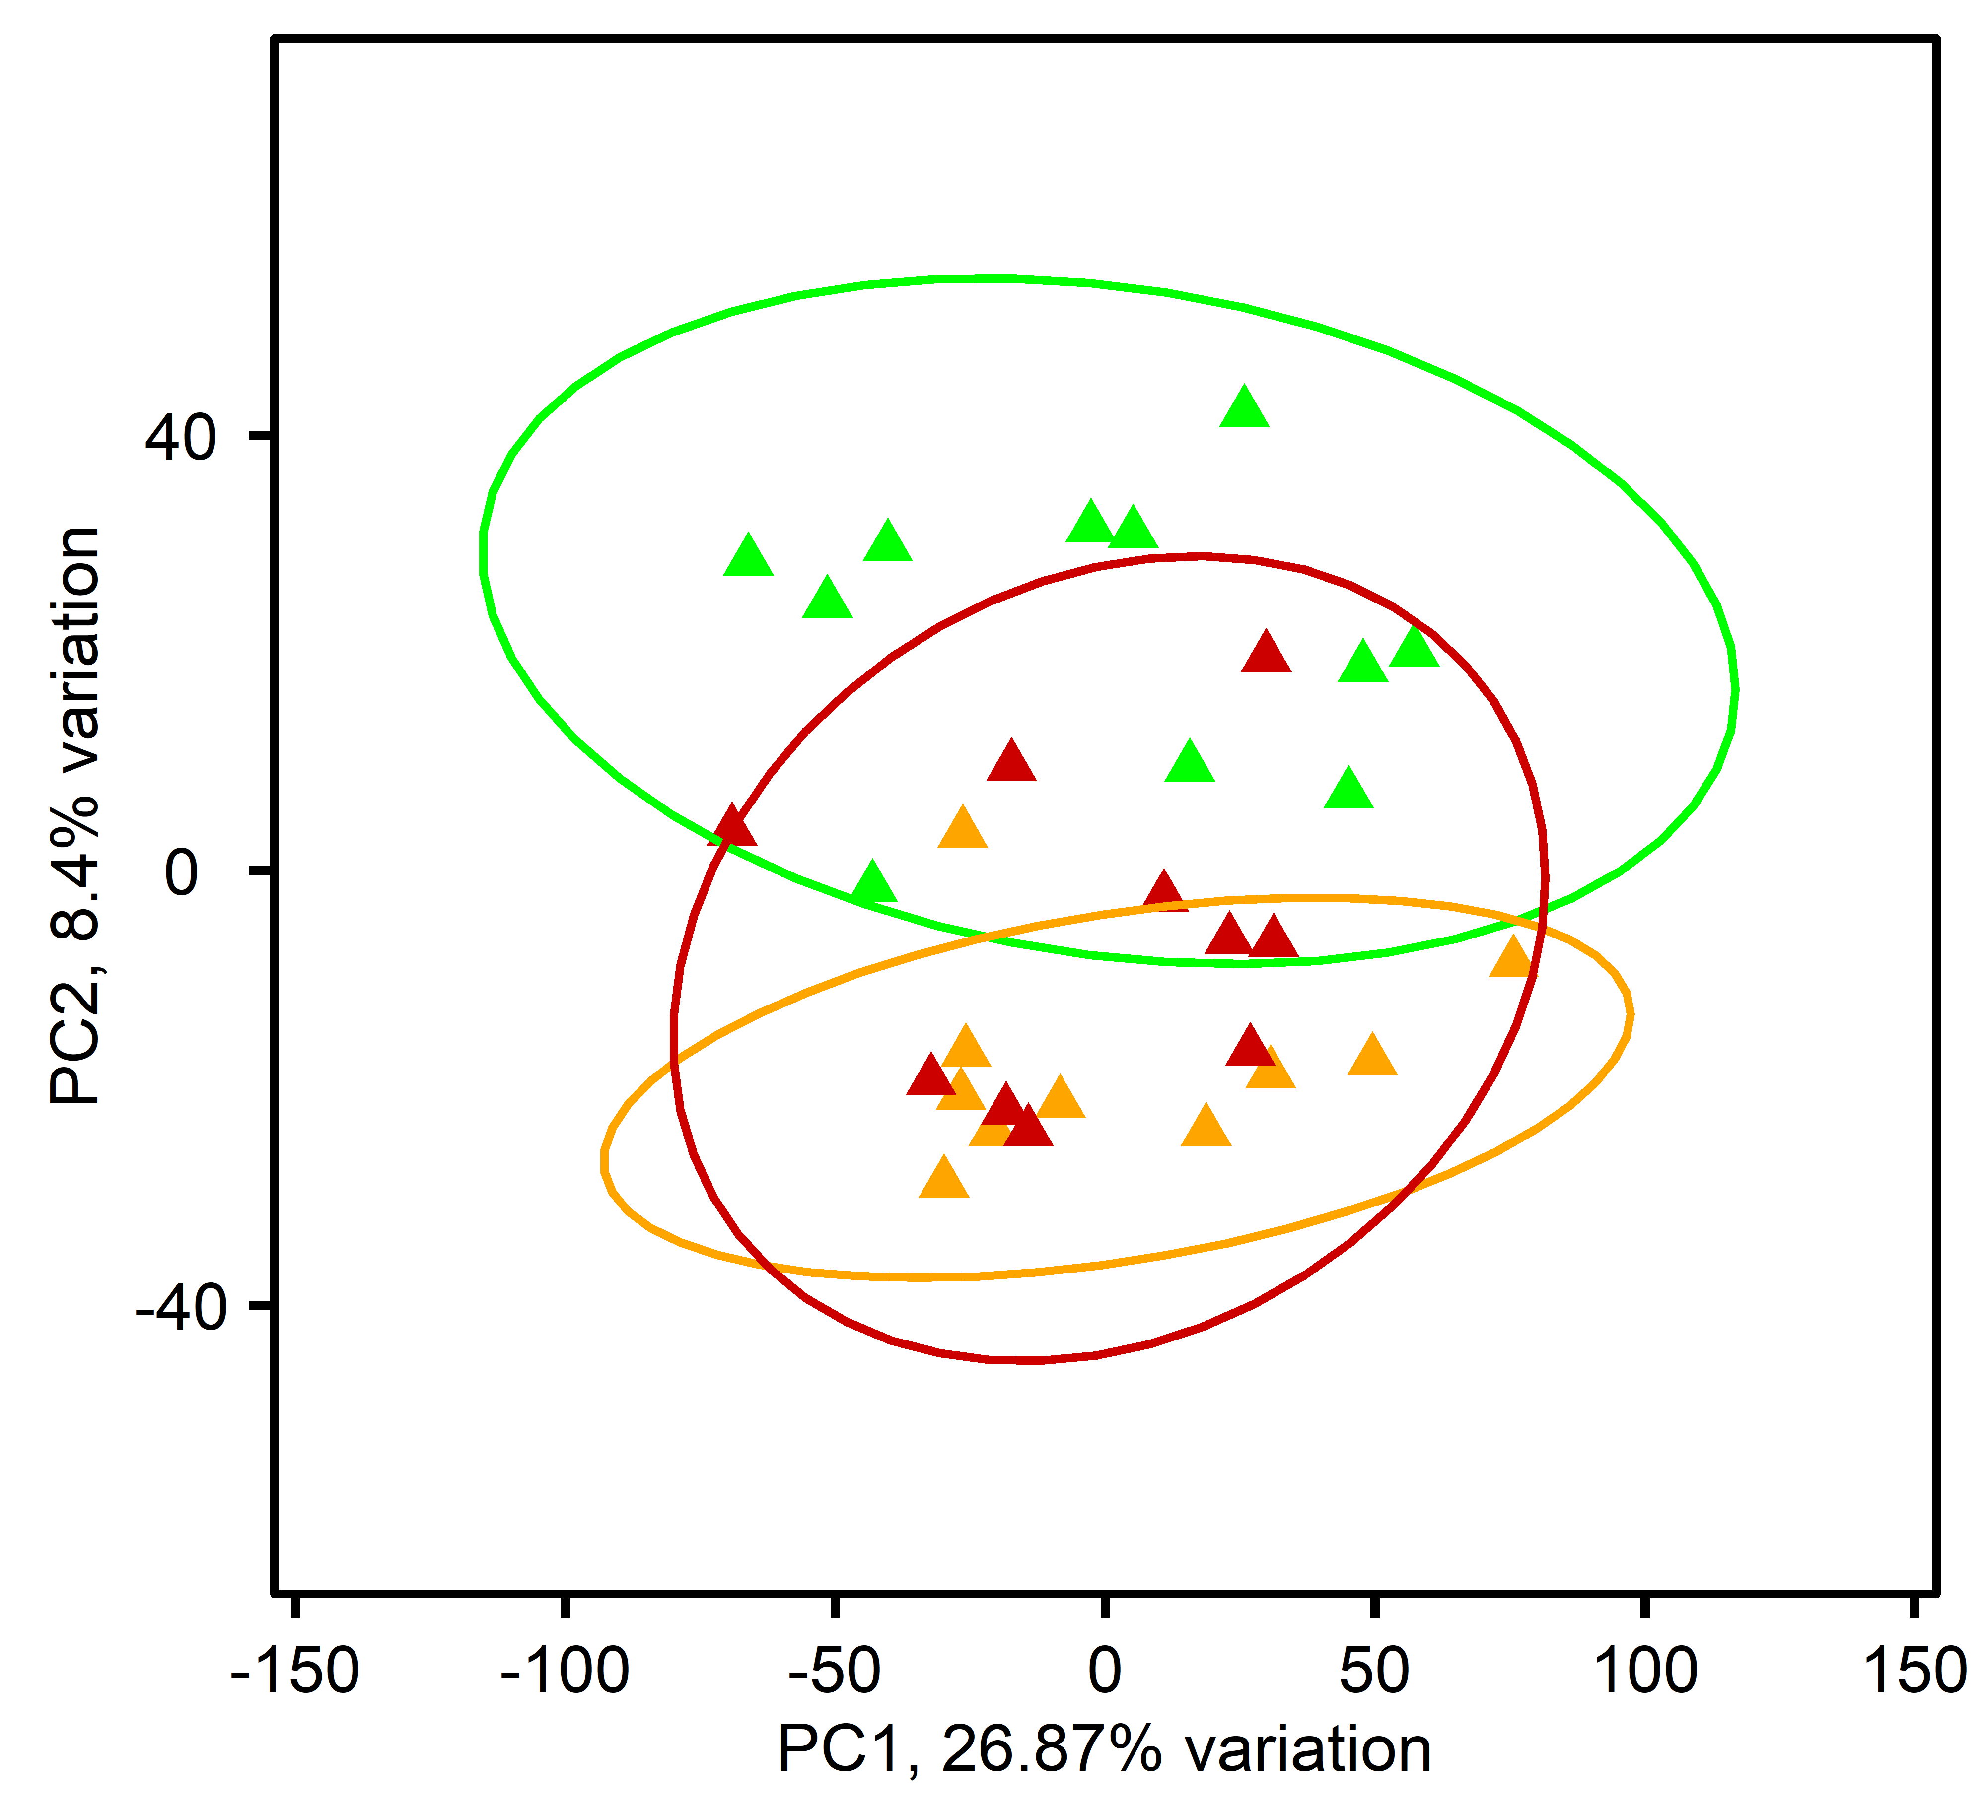
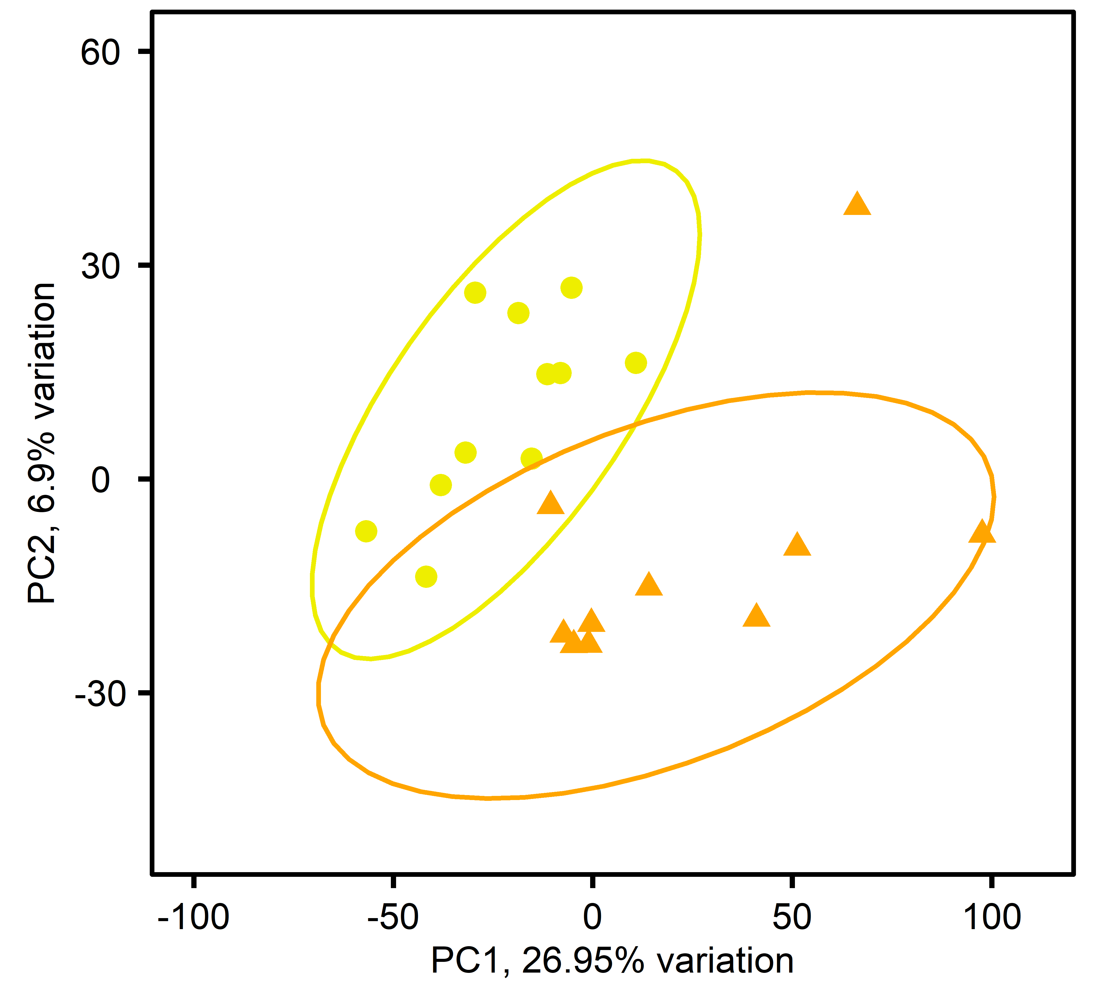
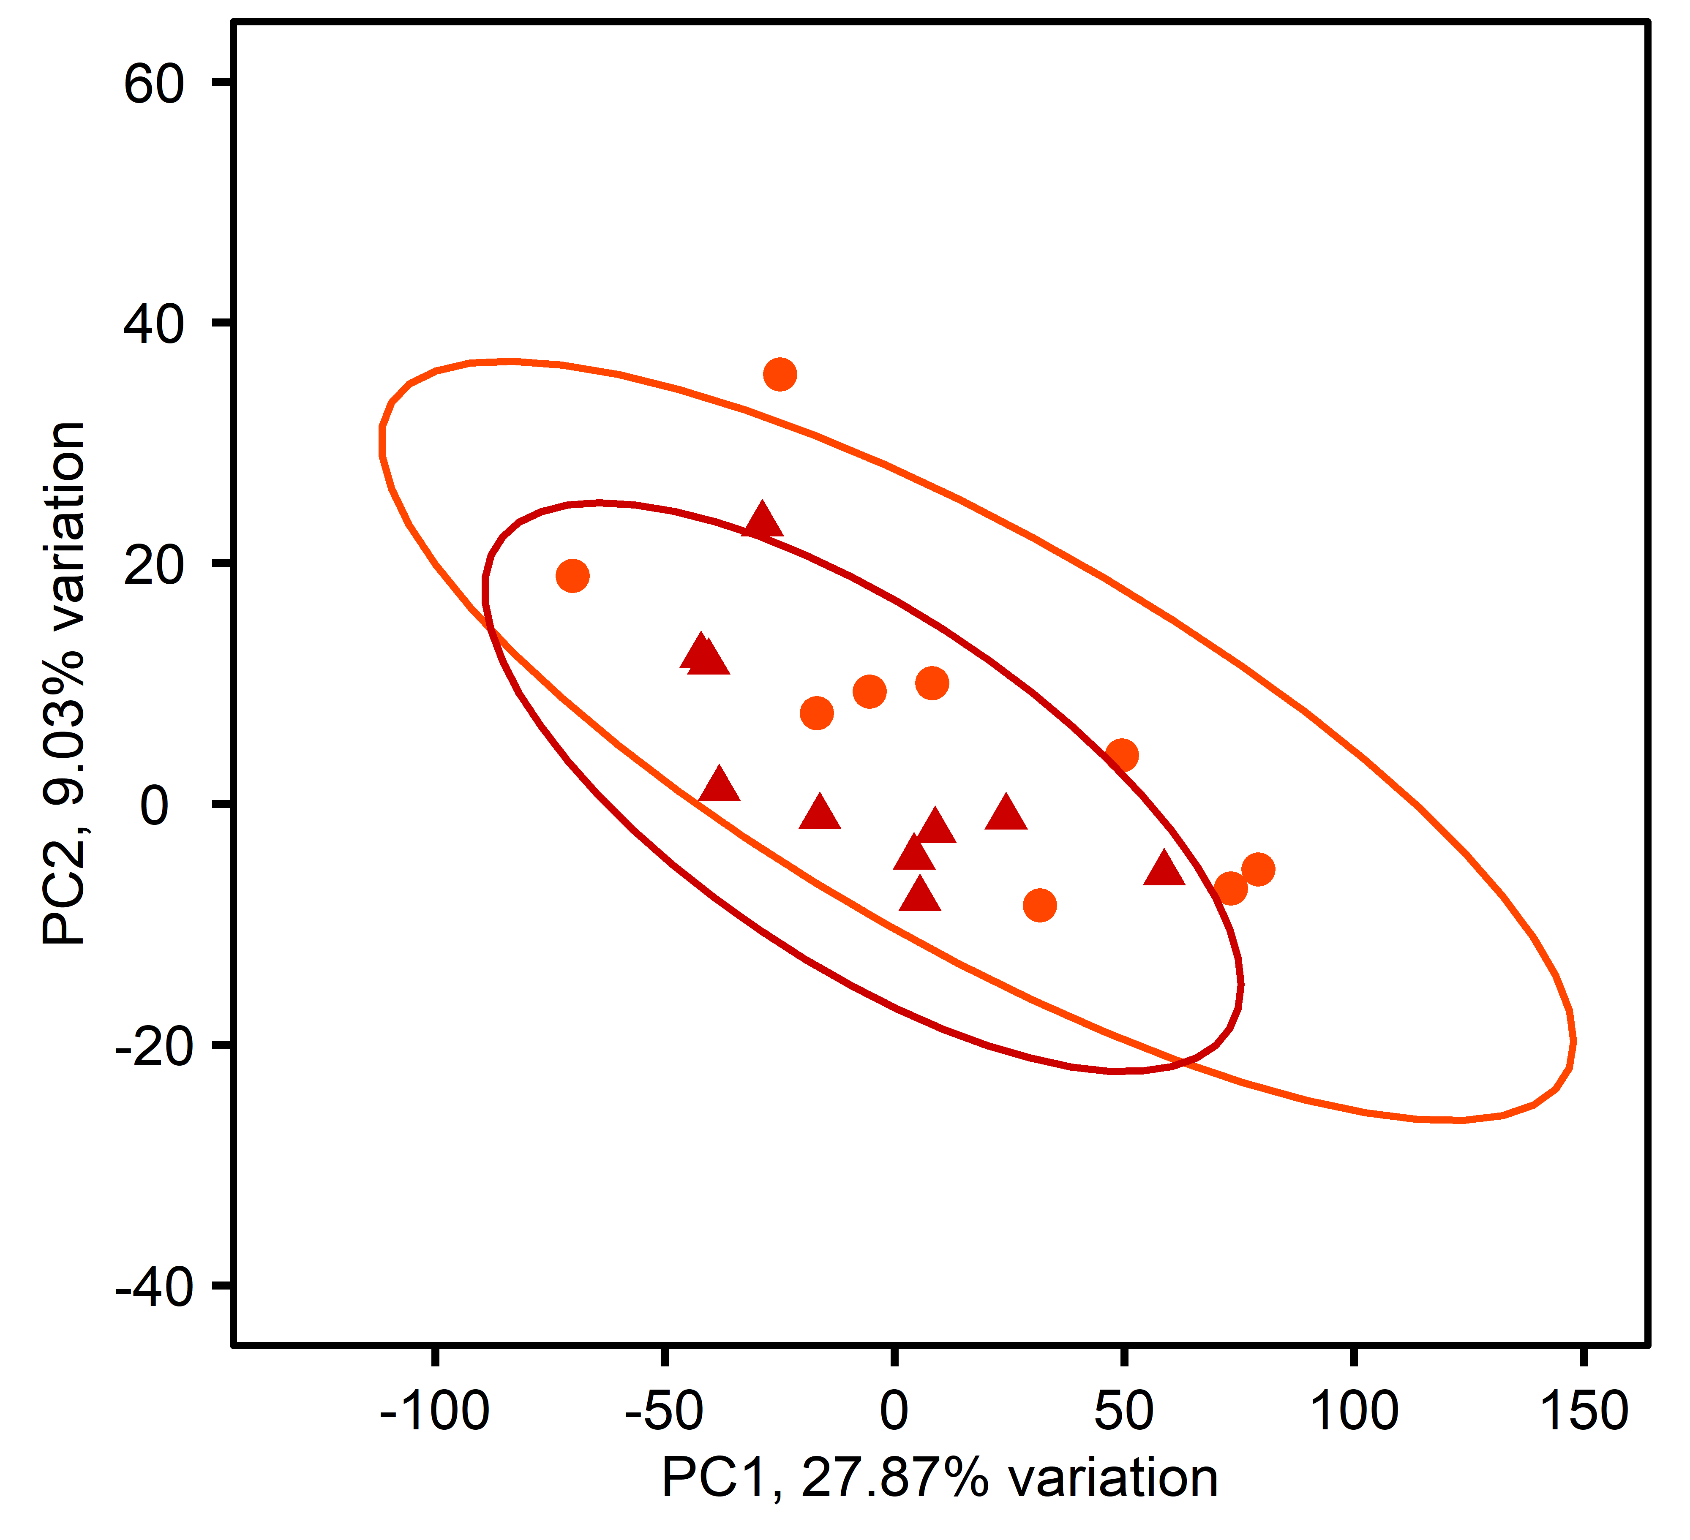
A
all samples
B
diploids
C
triploids
D
single stressor
E
multi-stressor
Ploidy, treatment
diploid, control
diploid, single stressor
diploid, multi-stressor
triploid, control
triploid, single stressor
triploid, multi-stressor

