Slide 1
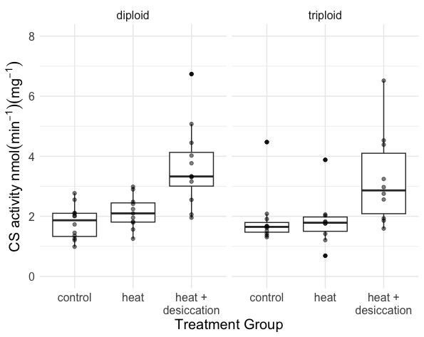
a
ab
c
bc
c
c

Slide 2
