Slide 1
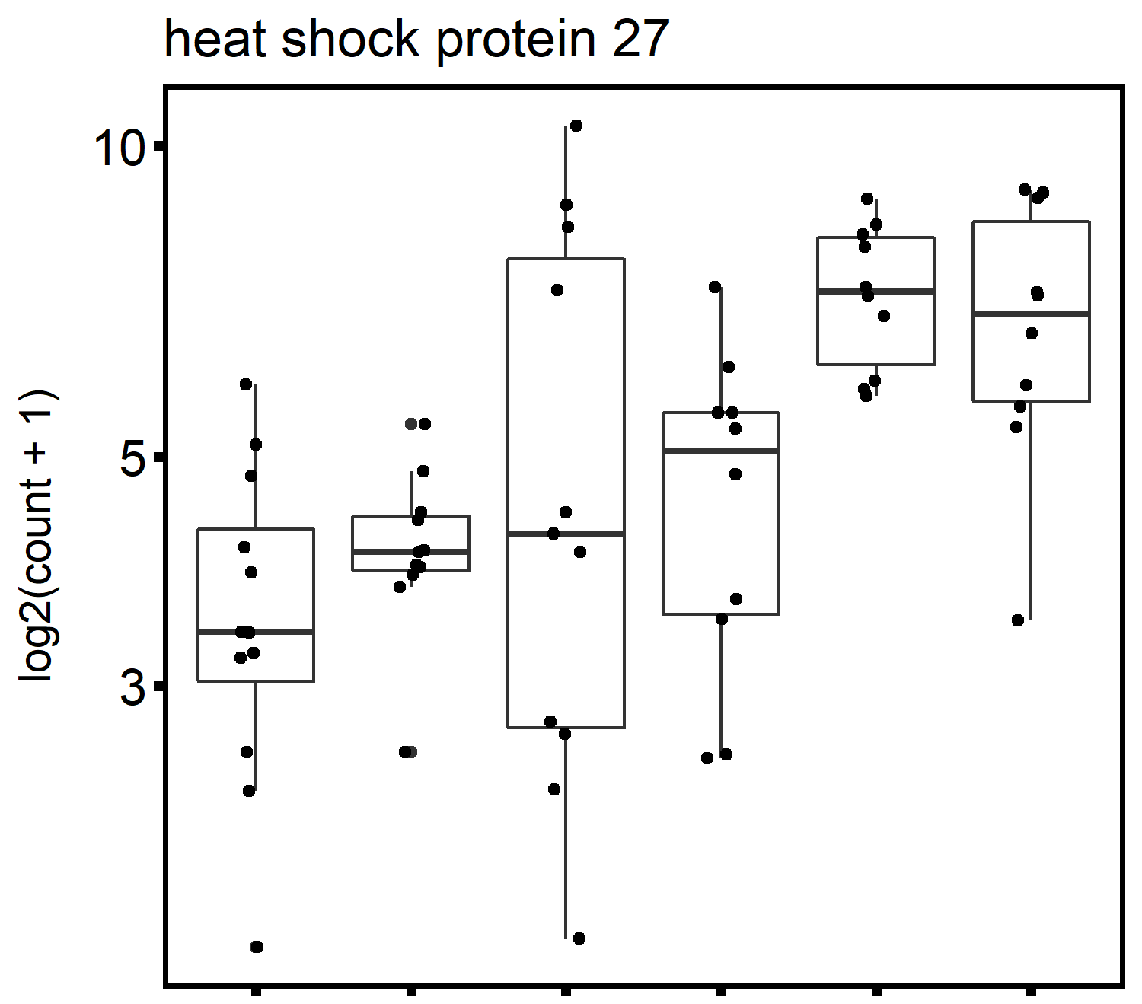
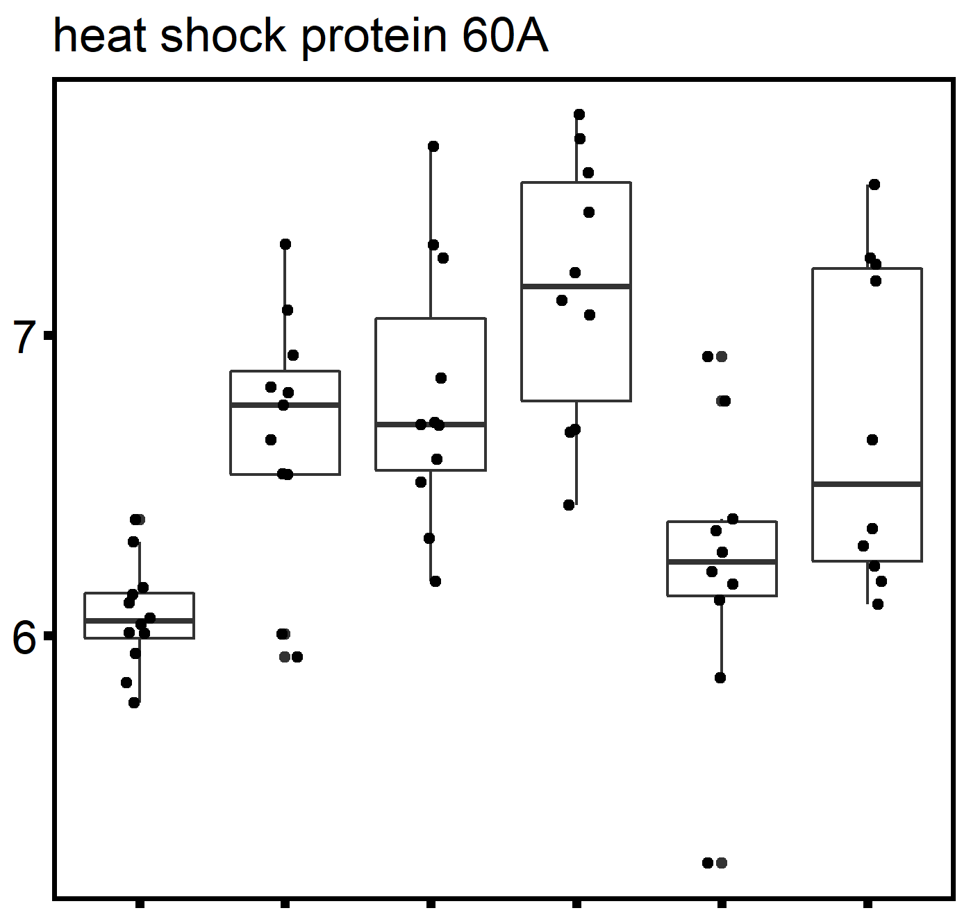
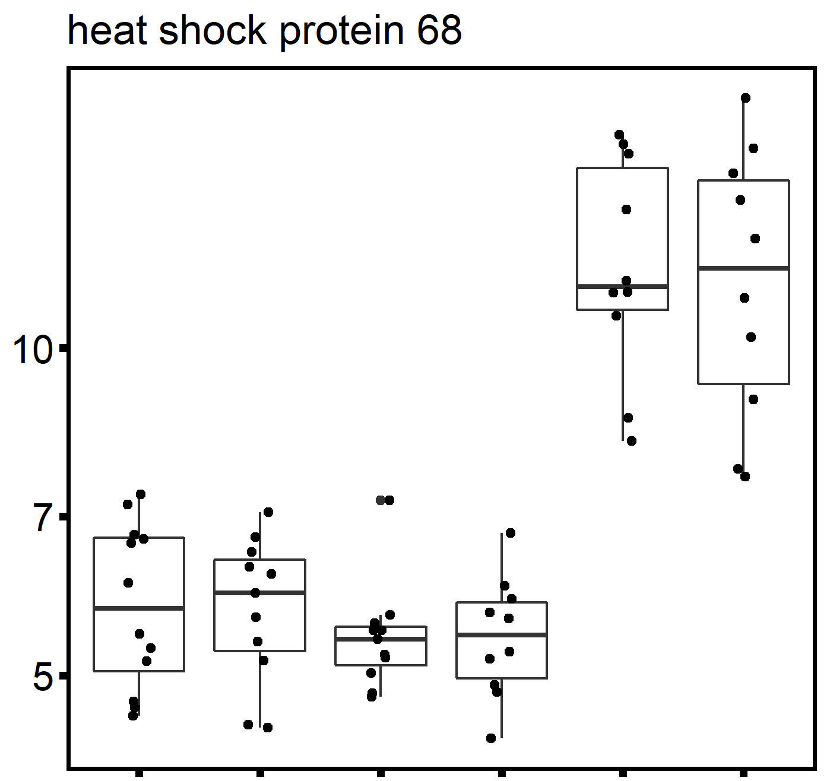
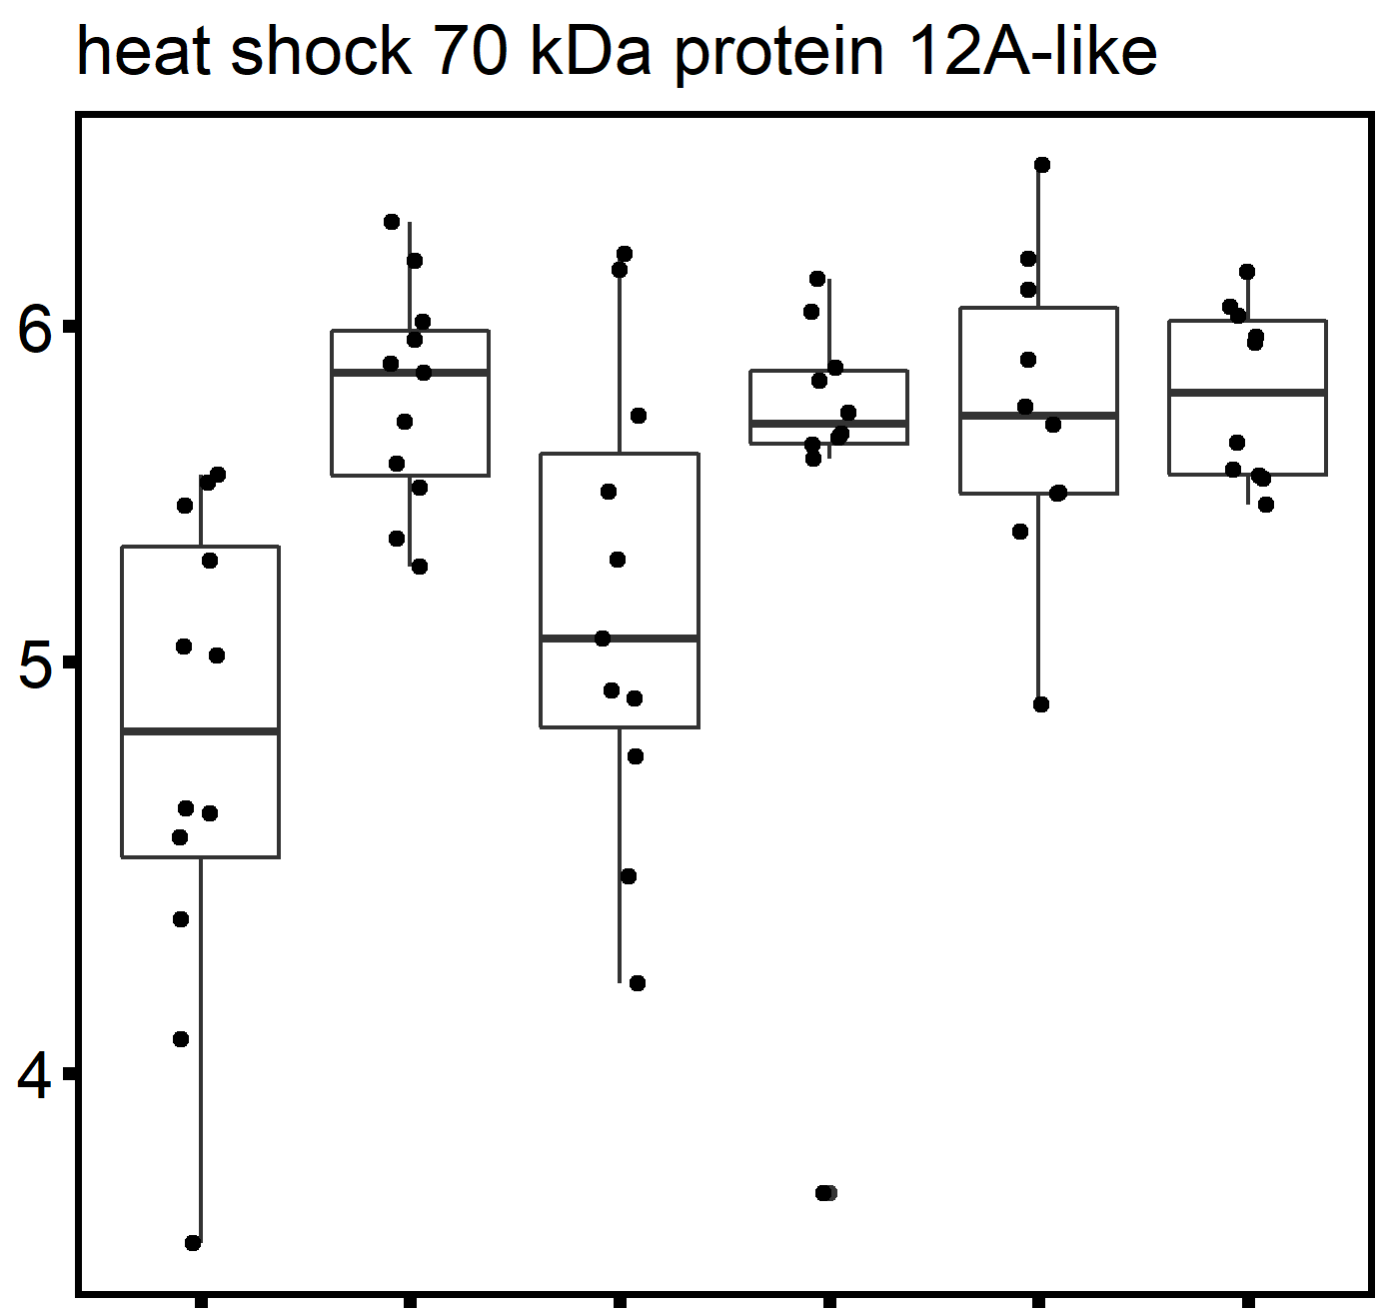
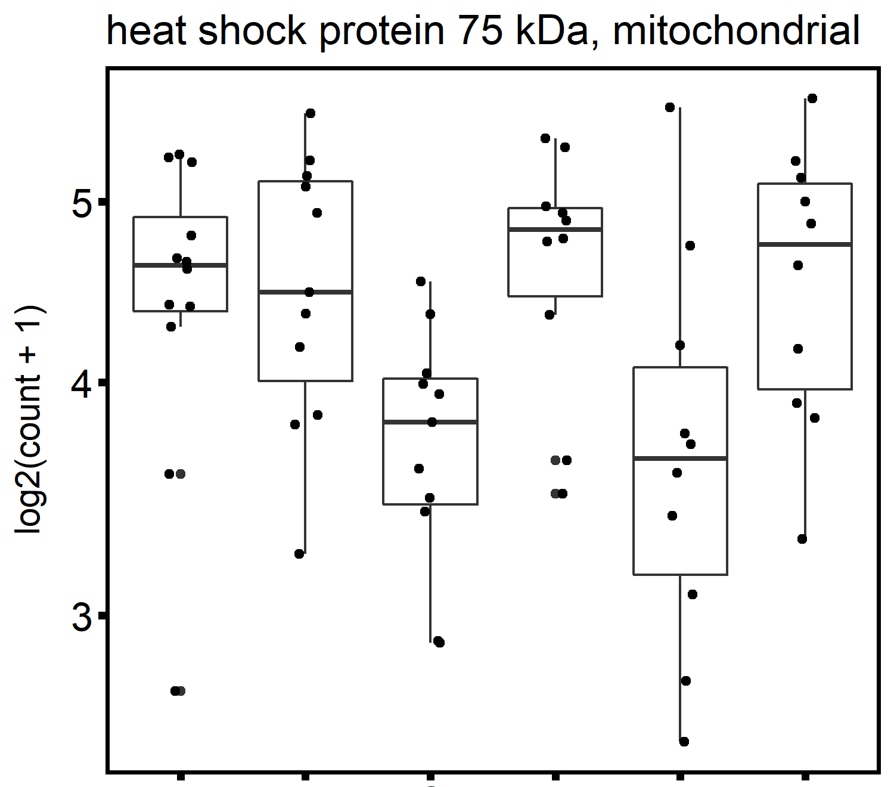
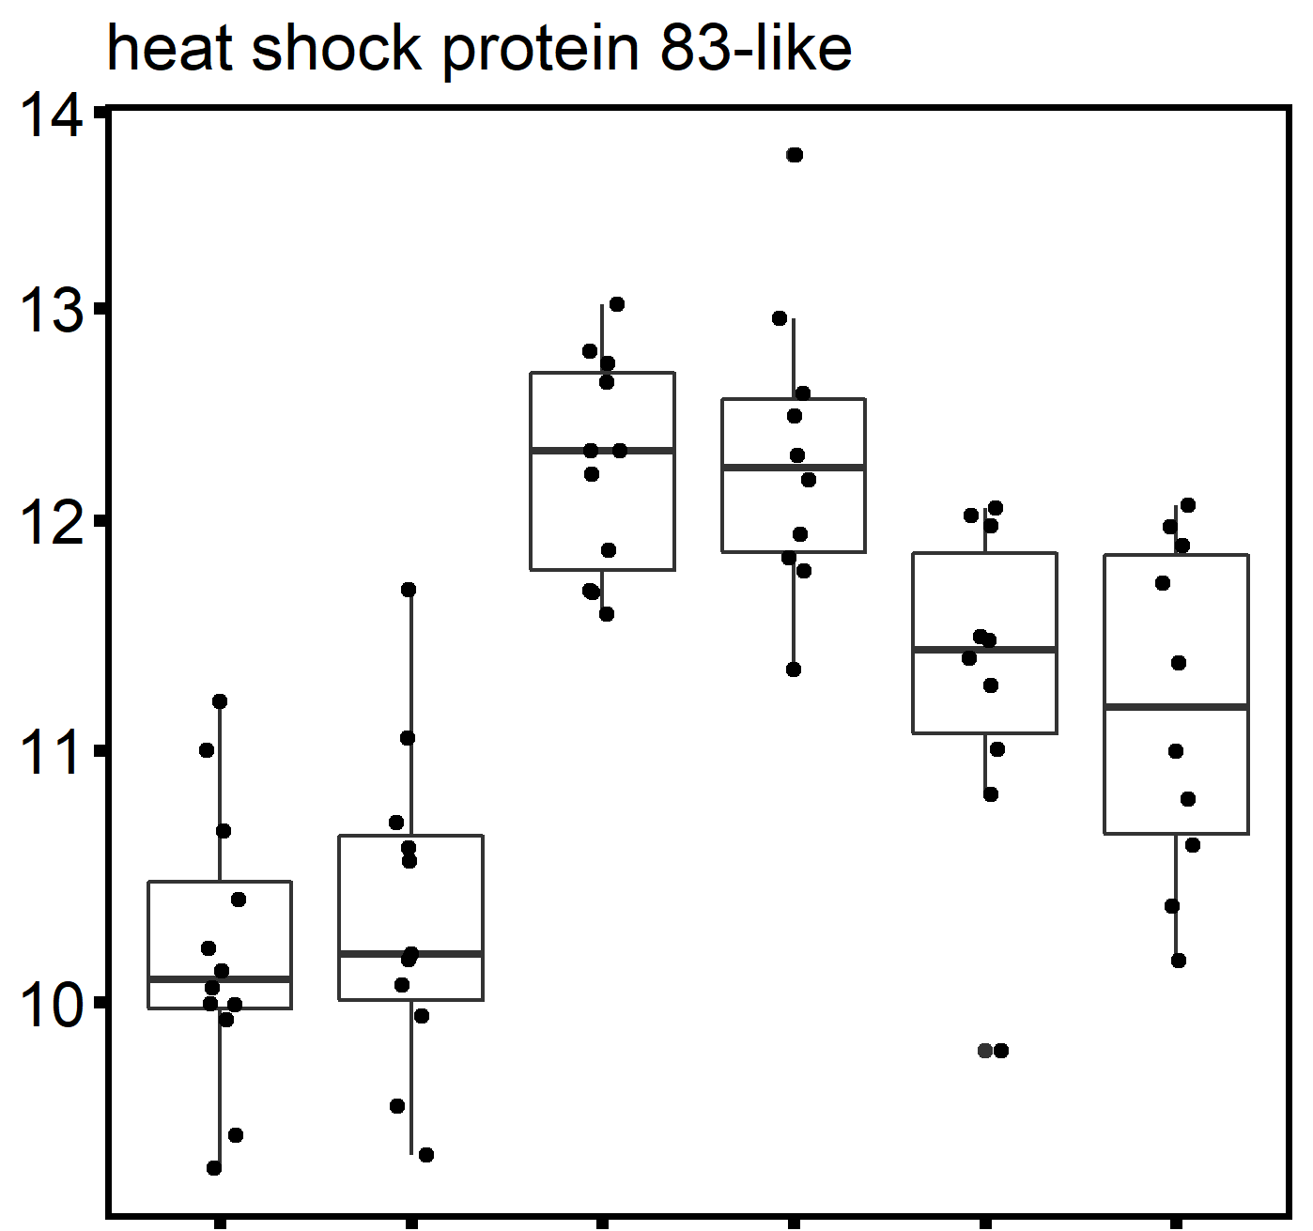
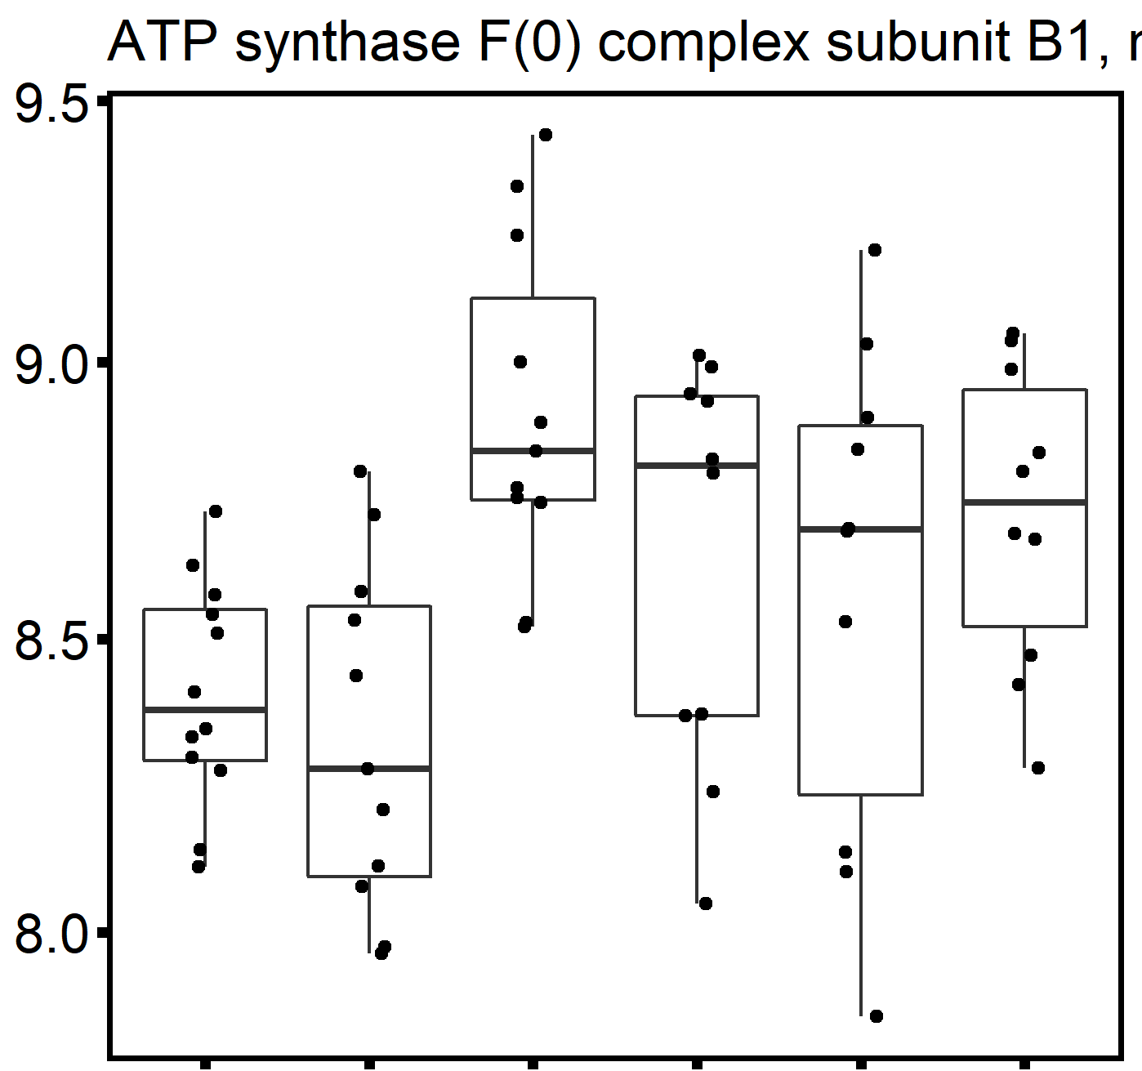
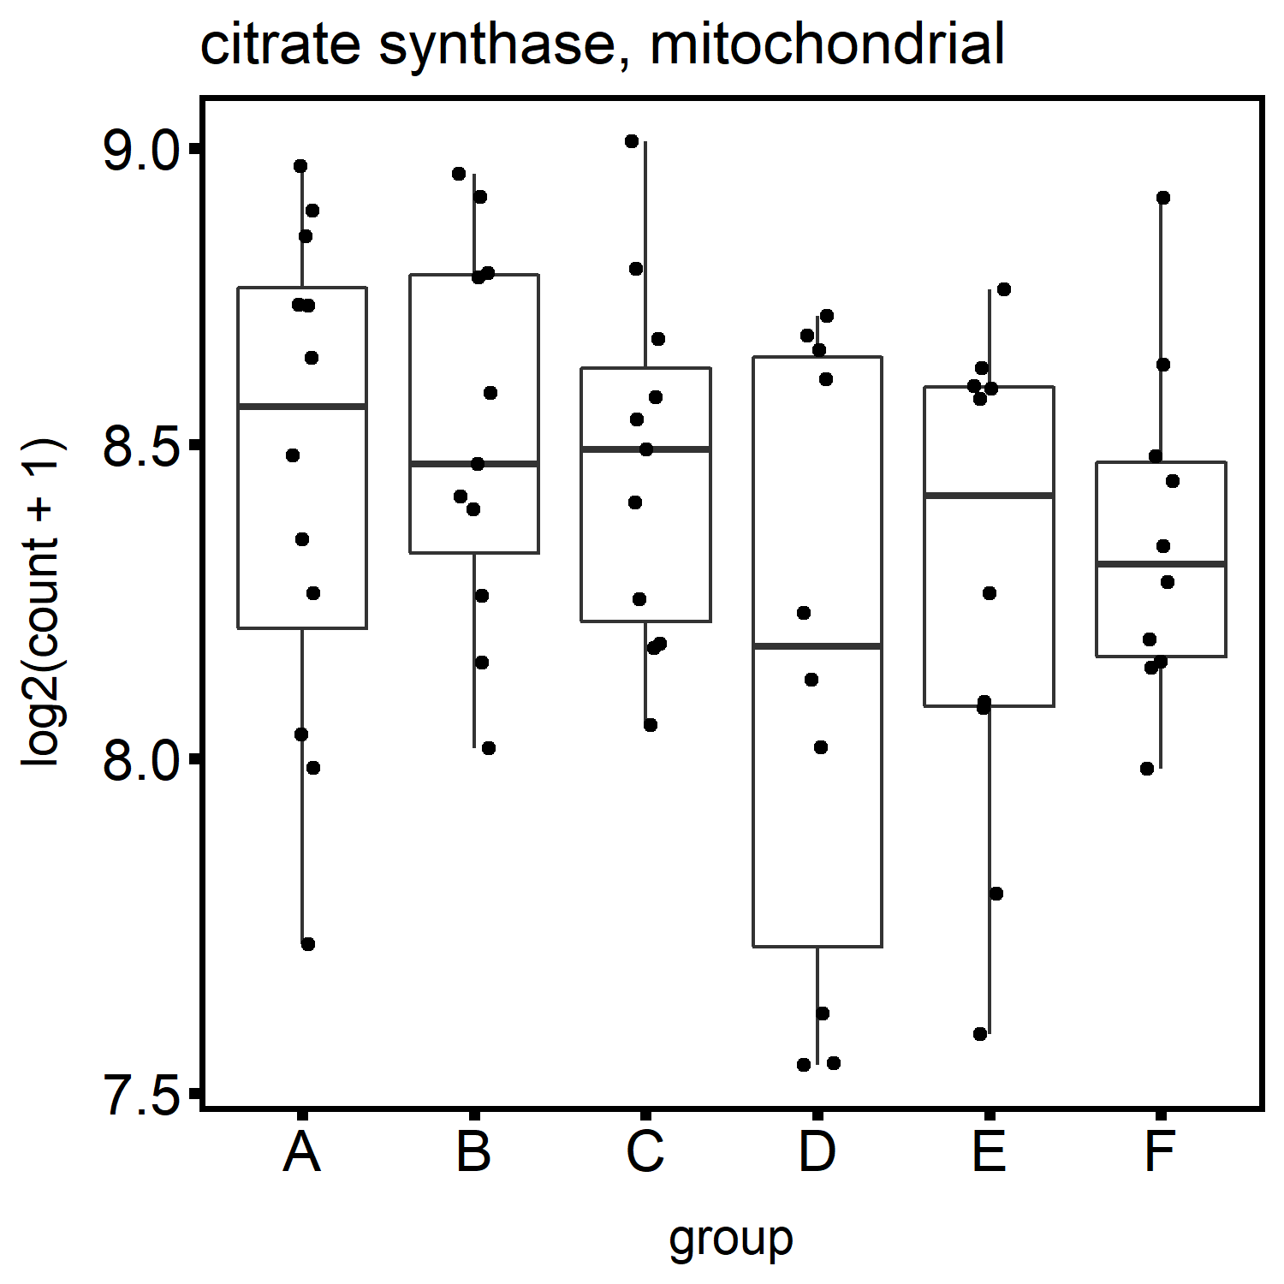
A
a
b
b
B
bc
c
bc
C
b
b
D
b
ab
b
b
b
a
bc
a
a
ab
a
a
a
a
a
a
LOC105343216
LOC105348623
LOC105334510
LOC105320601
2n-C
3n-C
2n-SS
3n-SS
2n-C
3n-C
2n-SS
3n-SS
2n-C
3n-C
2n-SS
3n-SS
2n-C
3n-C
2n-SS
3n-SS
2n-MS
2n-MS
3n-MS
3n-MS
2n-MS
3n-MS
2n-MS
3n-MS
E
F
G
H
LOC105321567
LOC117680291
LOC105324755
LOC105328869
2n-C
3n-C
2n-SS
3n-SS
2n-C
3n-C
2n-C
3n-C
2n-C
3n-C
2n-SS
2n-MS
3n-SS
3n-MS
2n-SS
2n-SS
2n-MS
3n-SS
3n-SS
3n-MS
2n-MS
3n-MS
2n-MS
3n-MS

