Slide 1
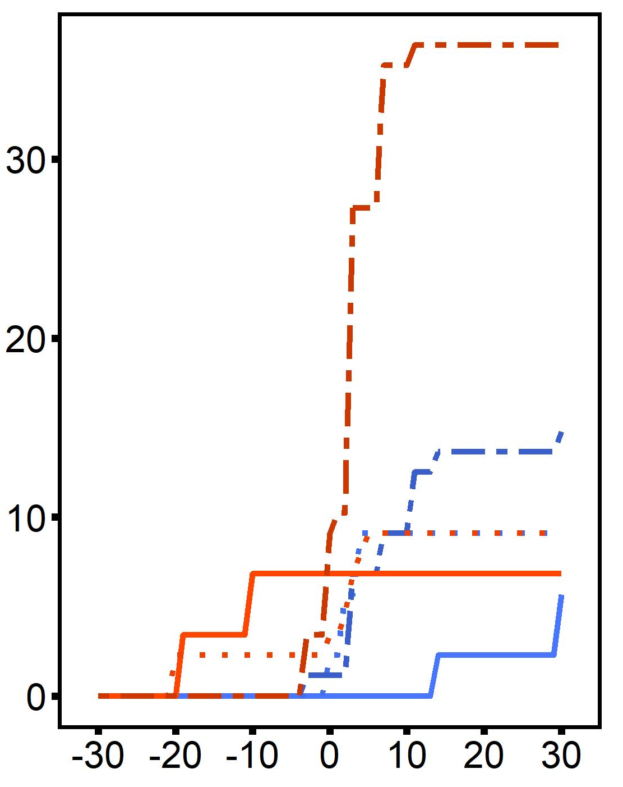
A
B
C
D
2n - control
2n - heated
Mortality (%)
2n - heated +
desiccation
3n - control
3n - heated
ploidy
3n - heated +
desiccation
desiccation
interaction
difference threshold (%)
E
F
G

