Slide 1
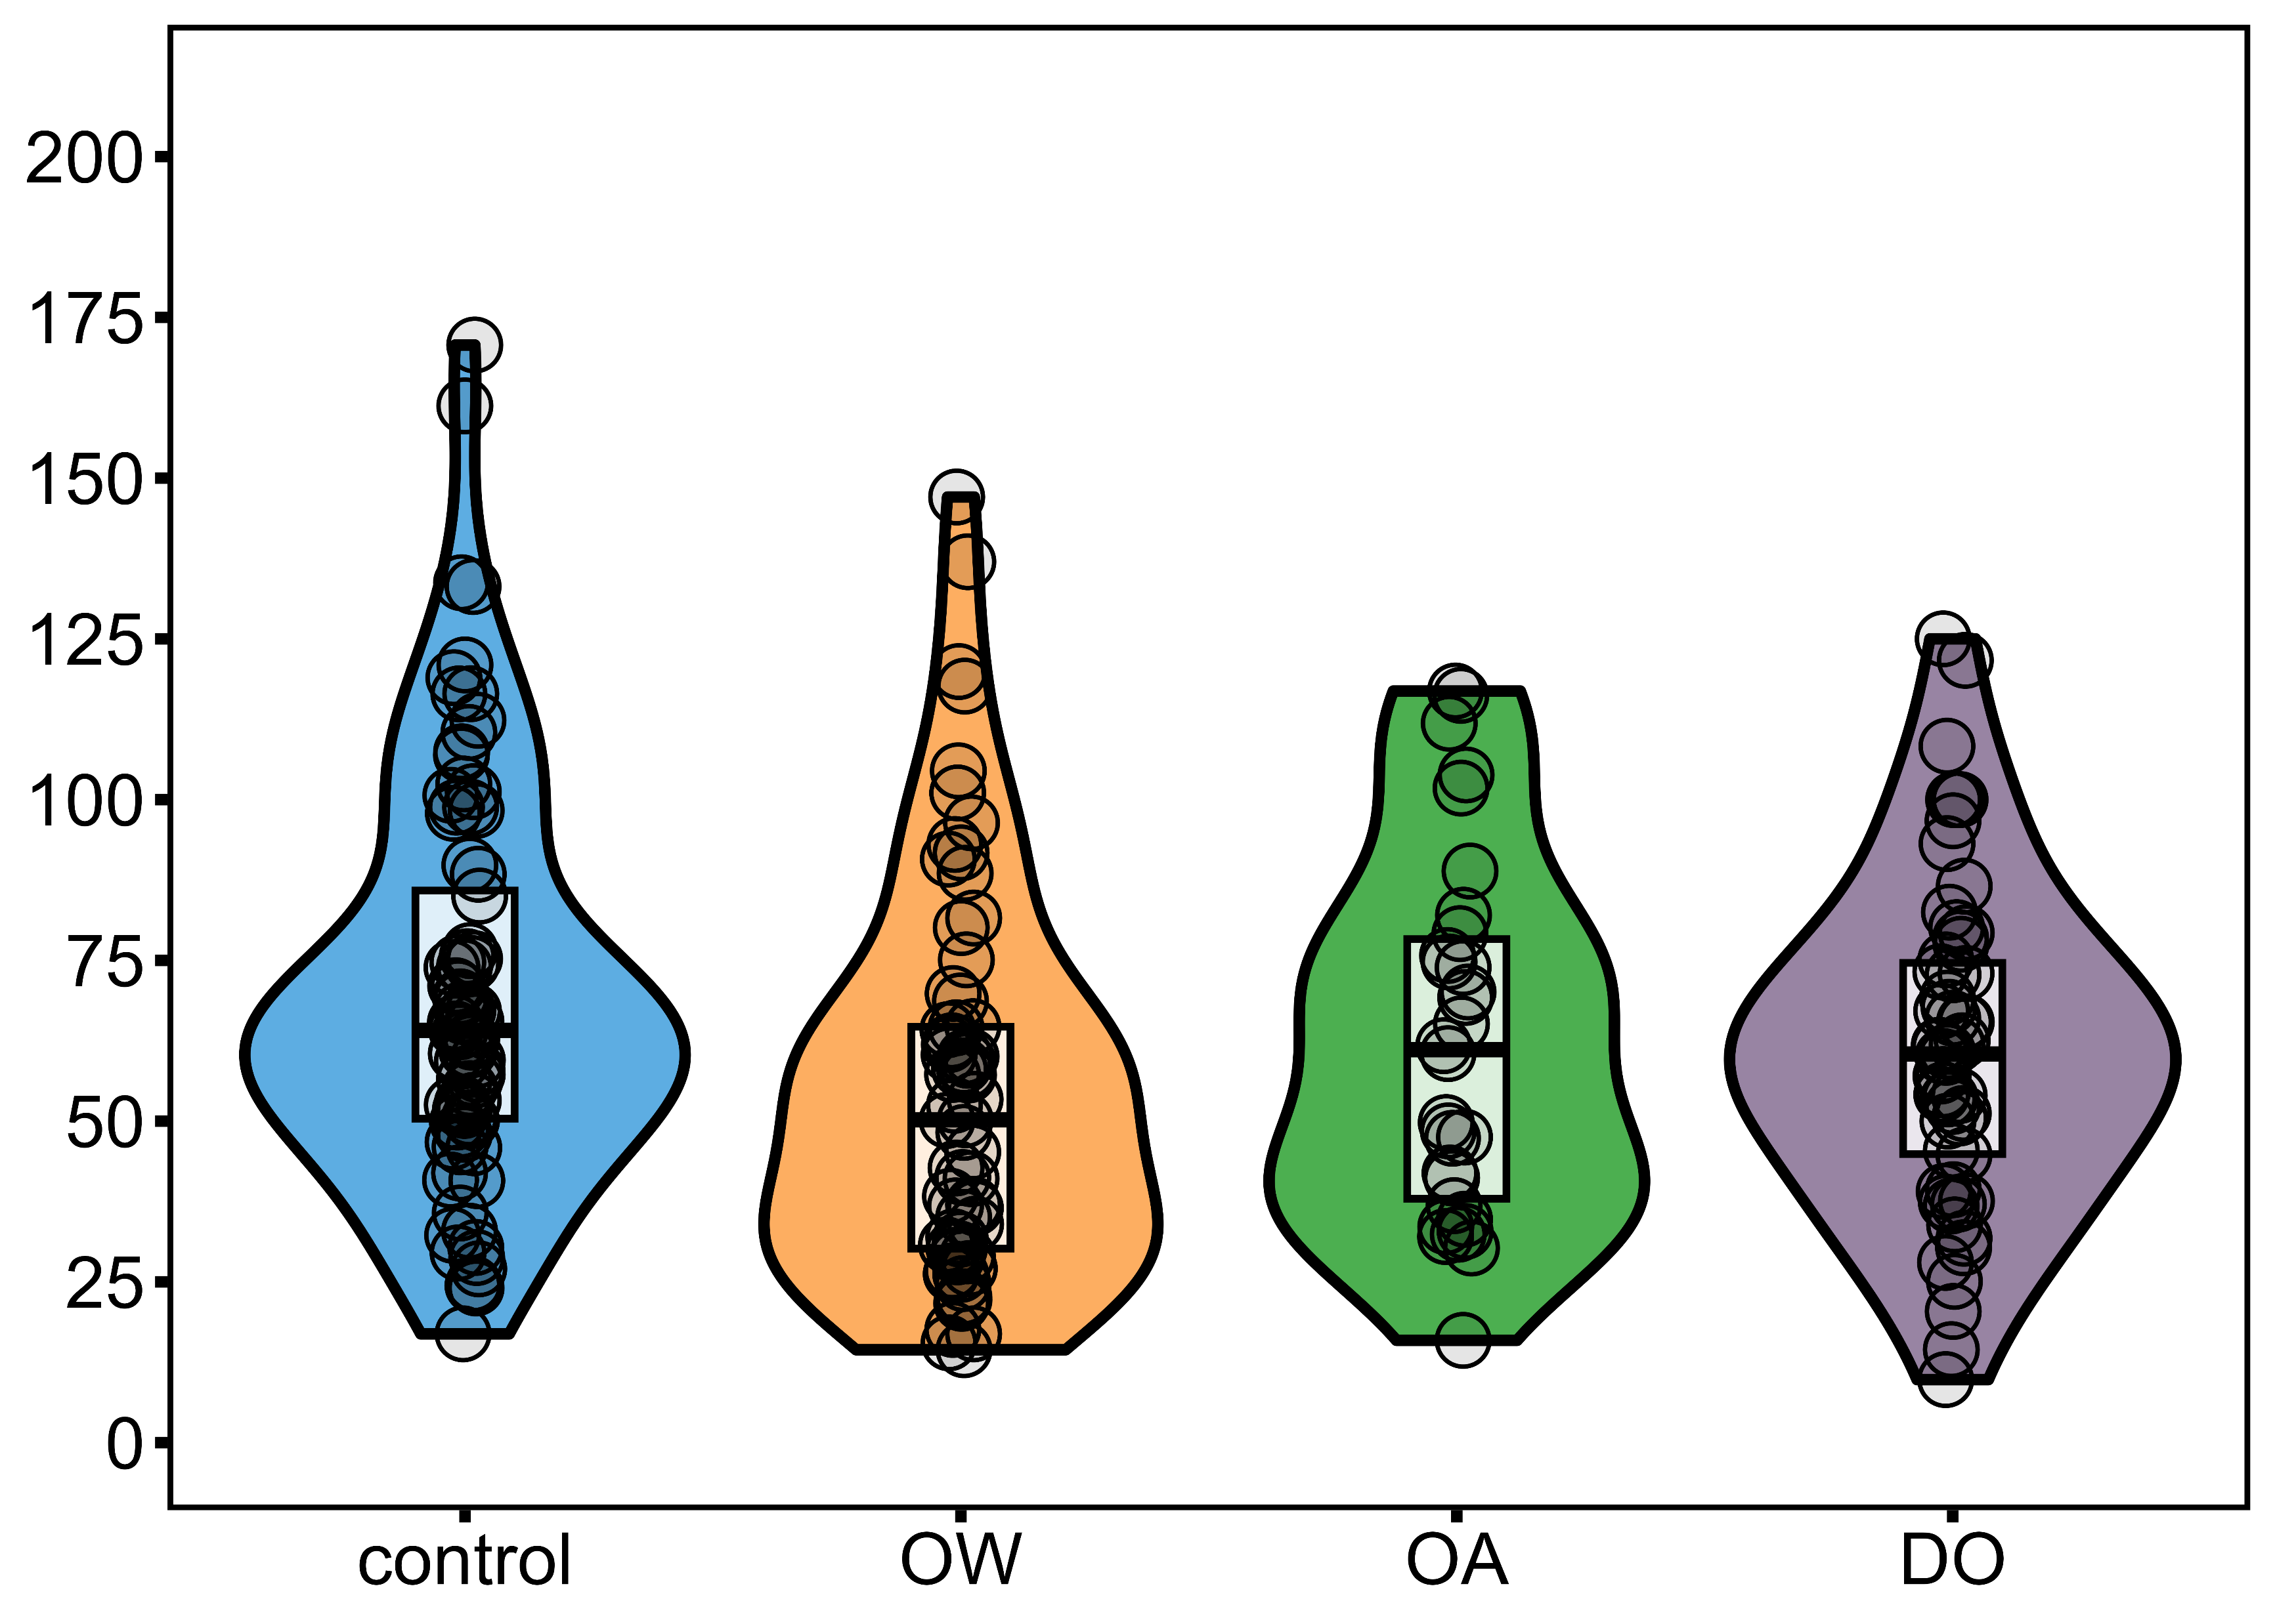
Treatment: p = 0.010
a
b
ab
ab
Plaque attachment strength (KPa)

