Slide 1
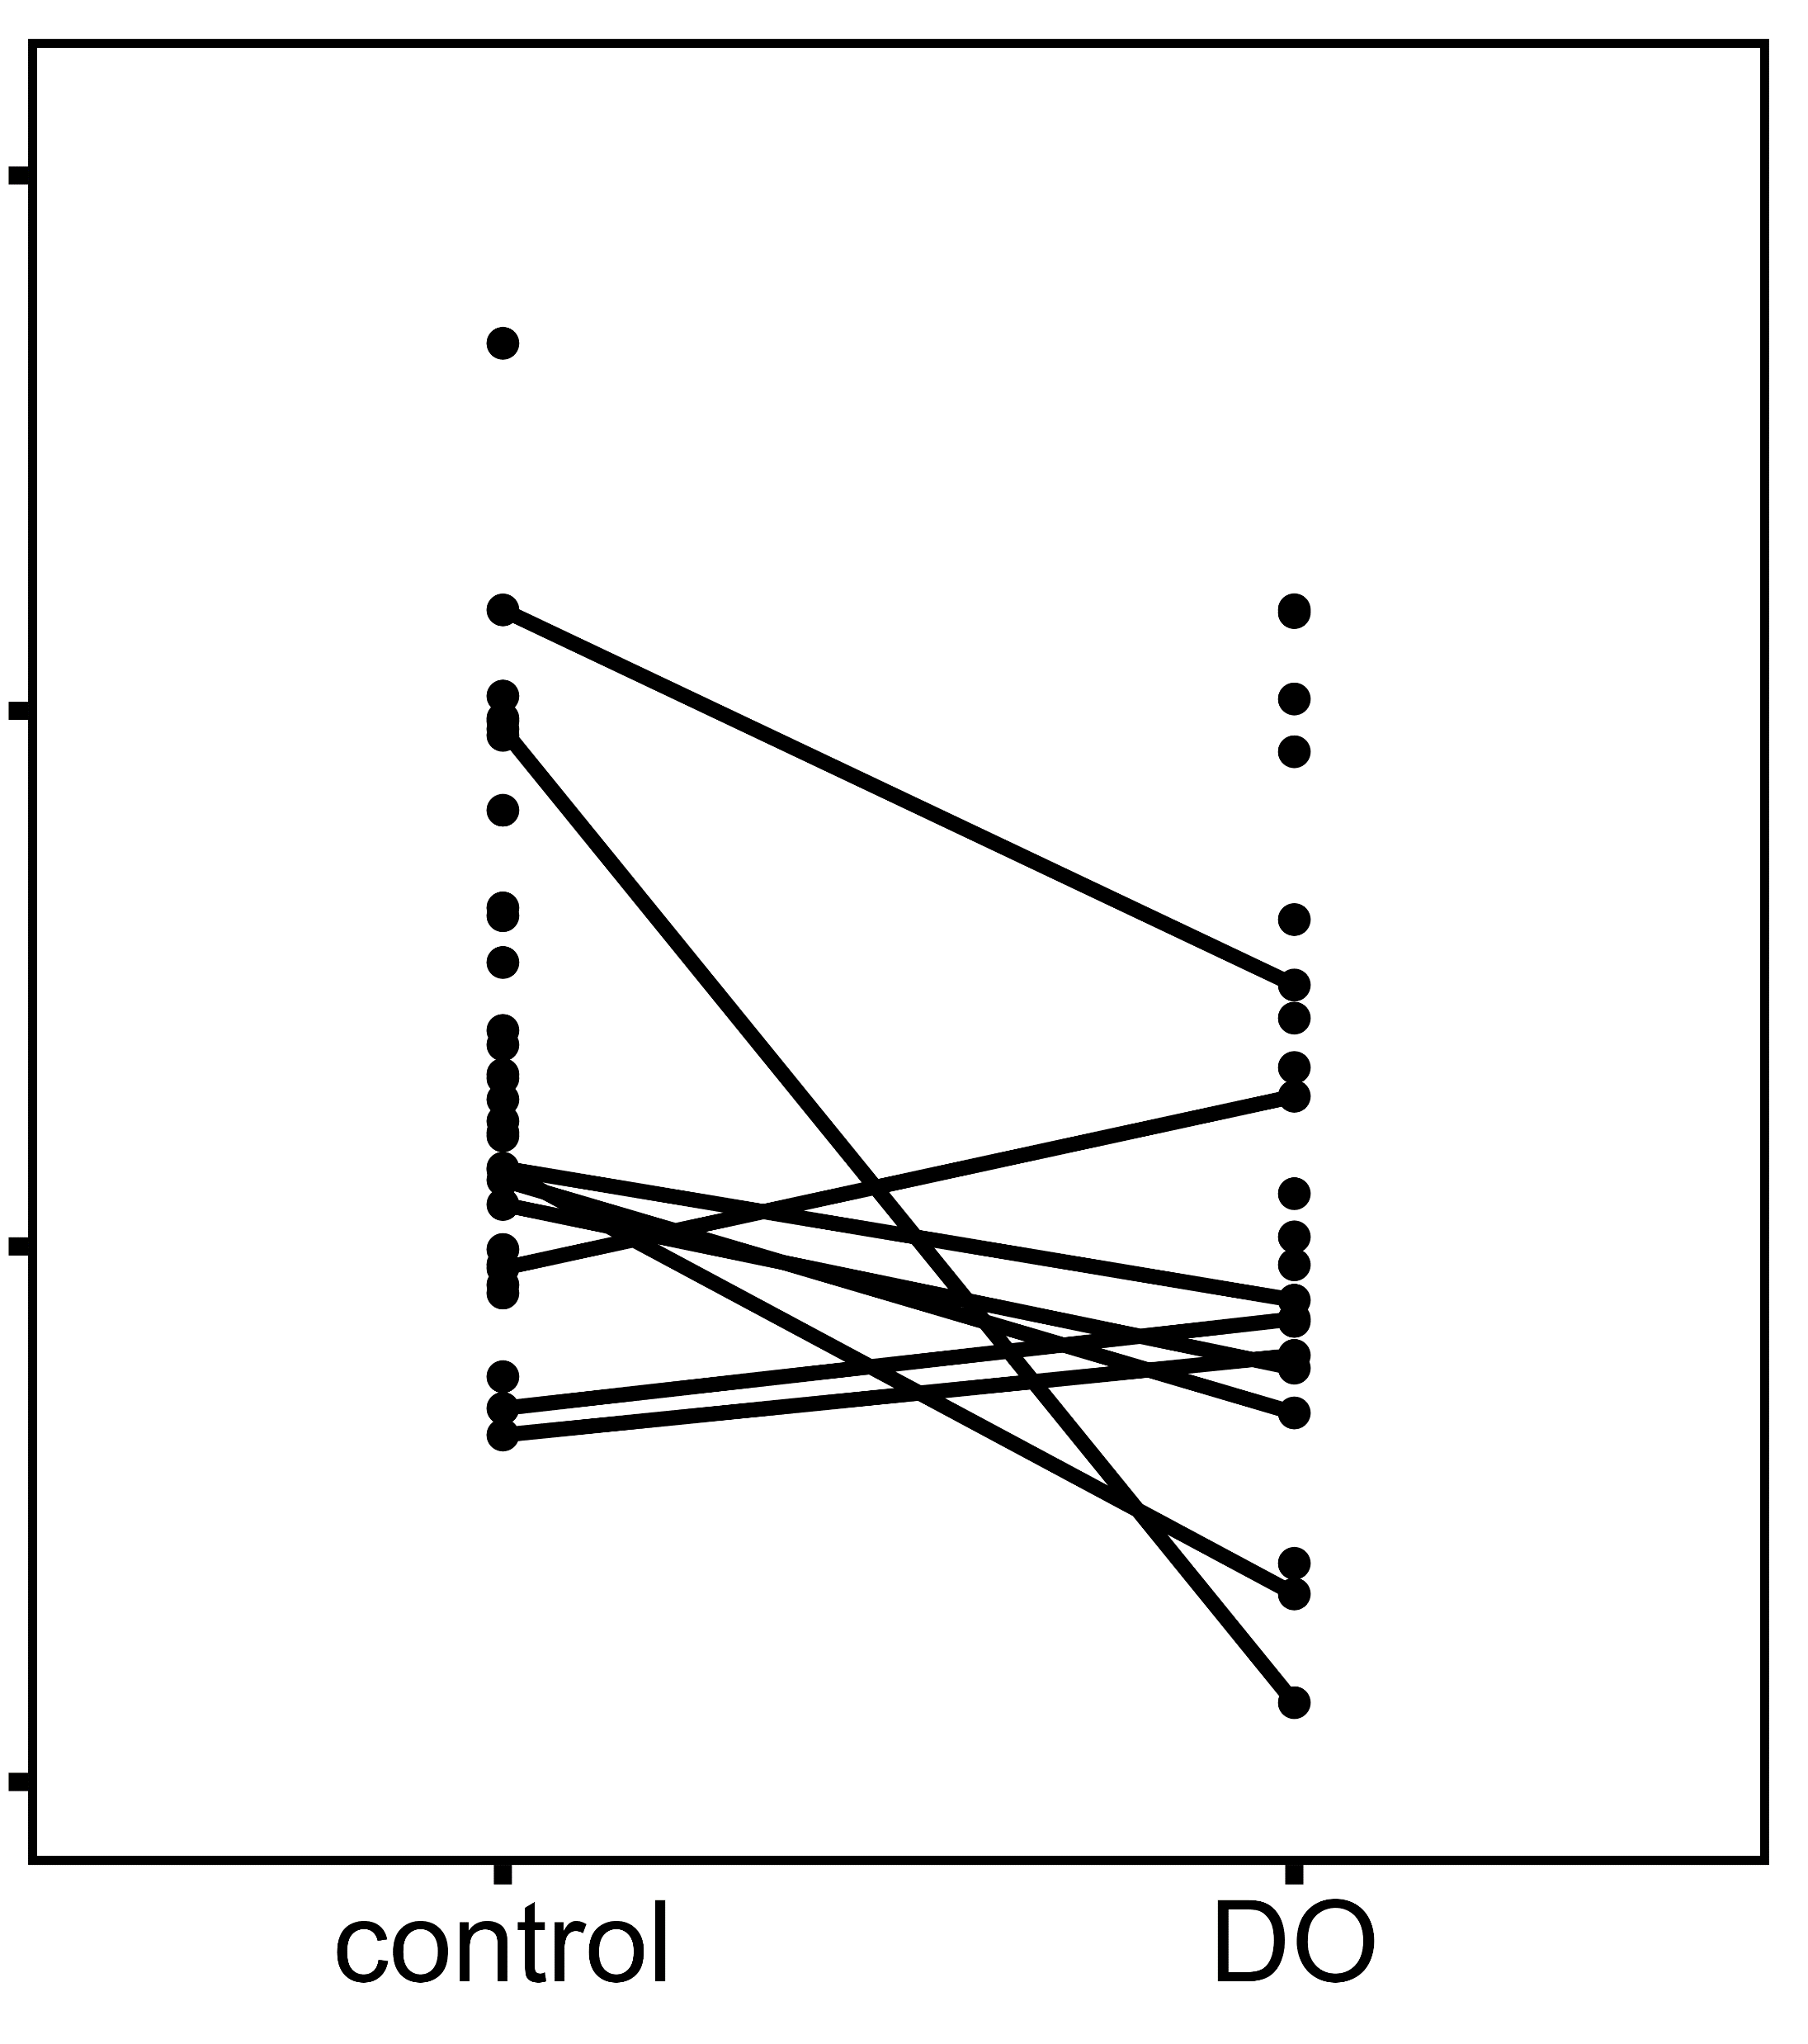
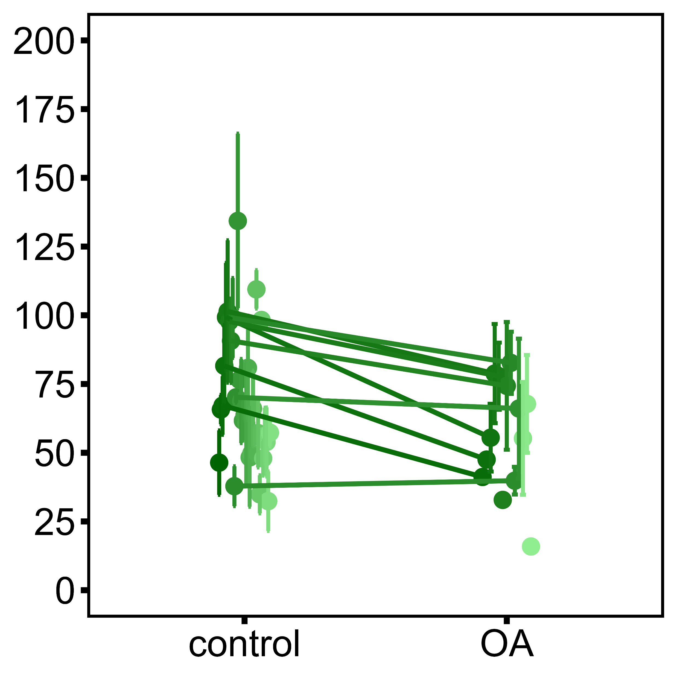
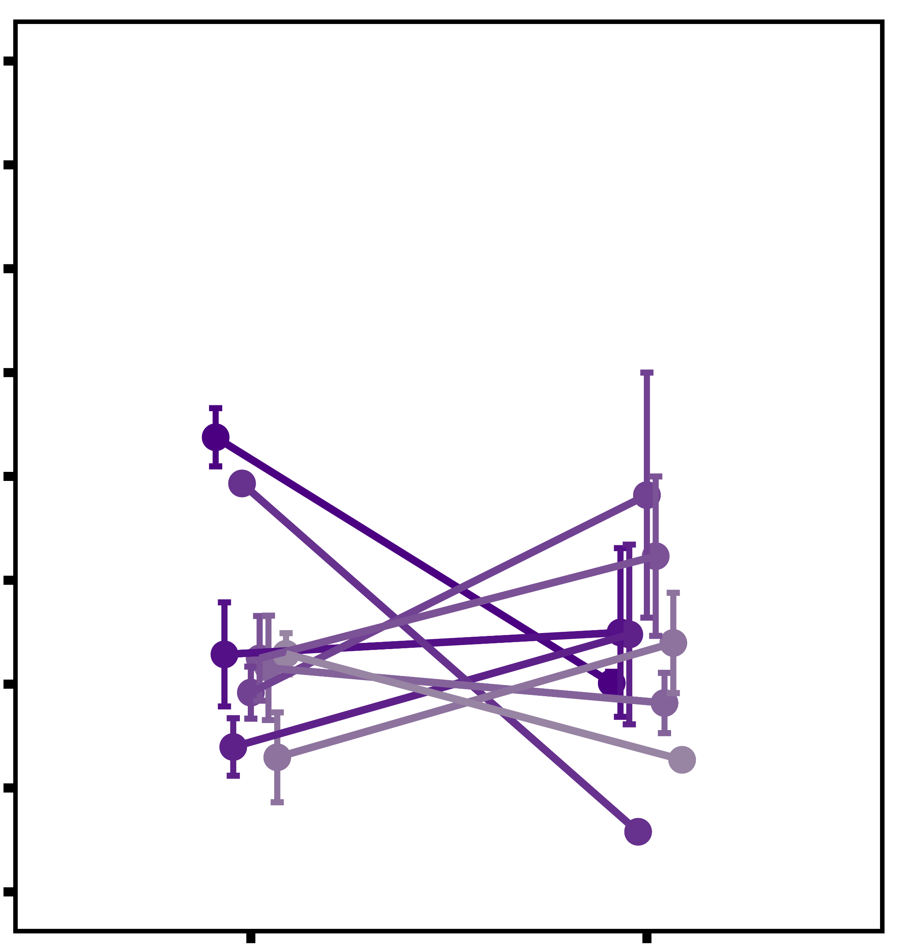
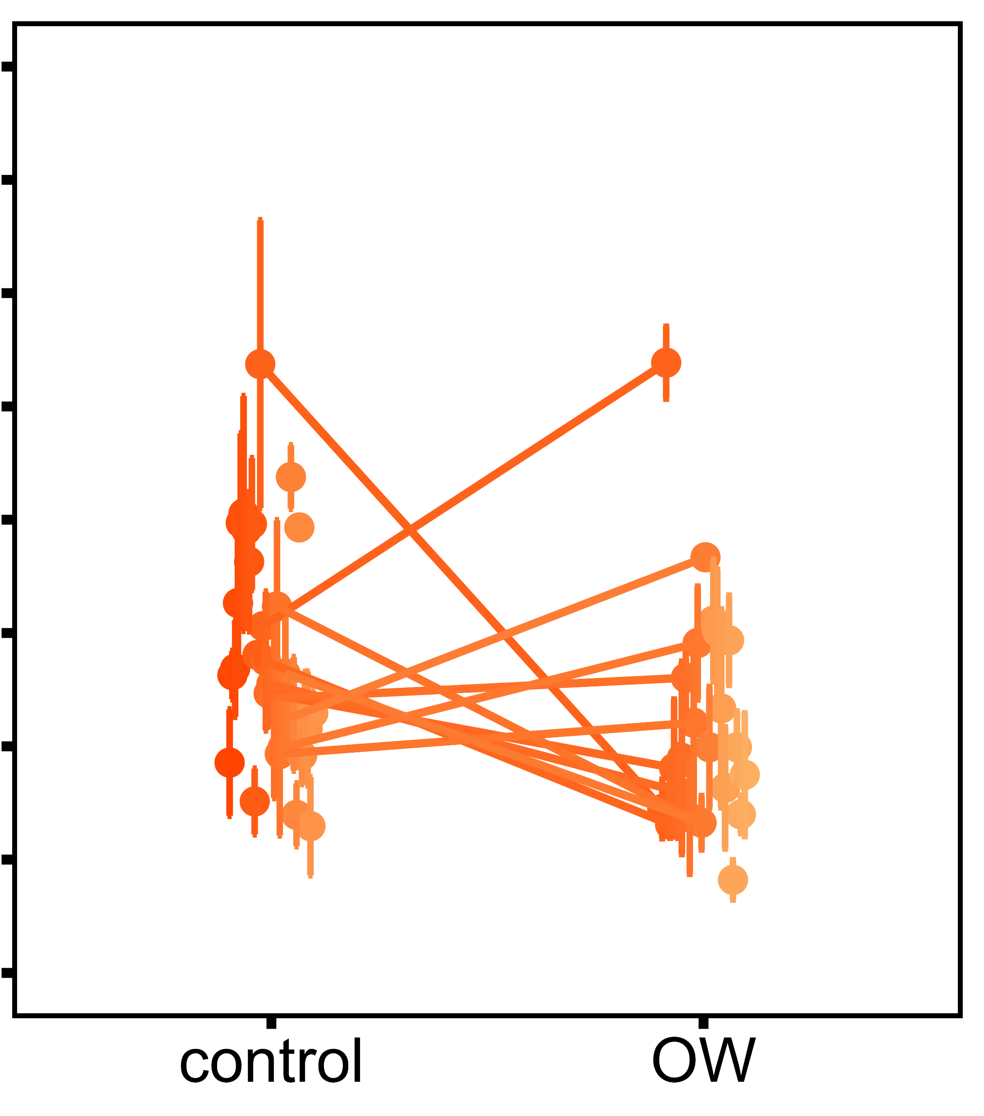
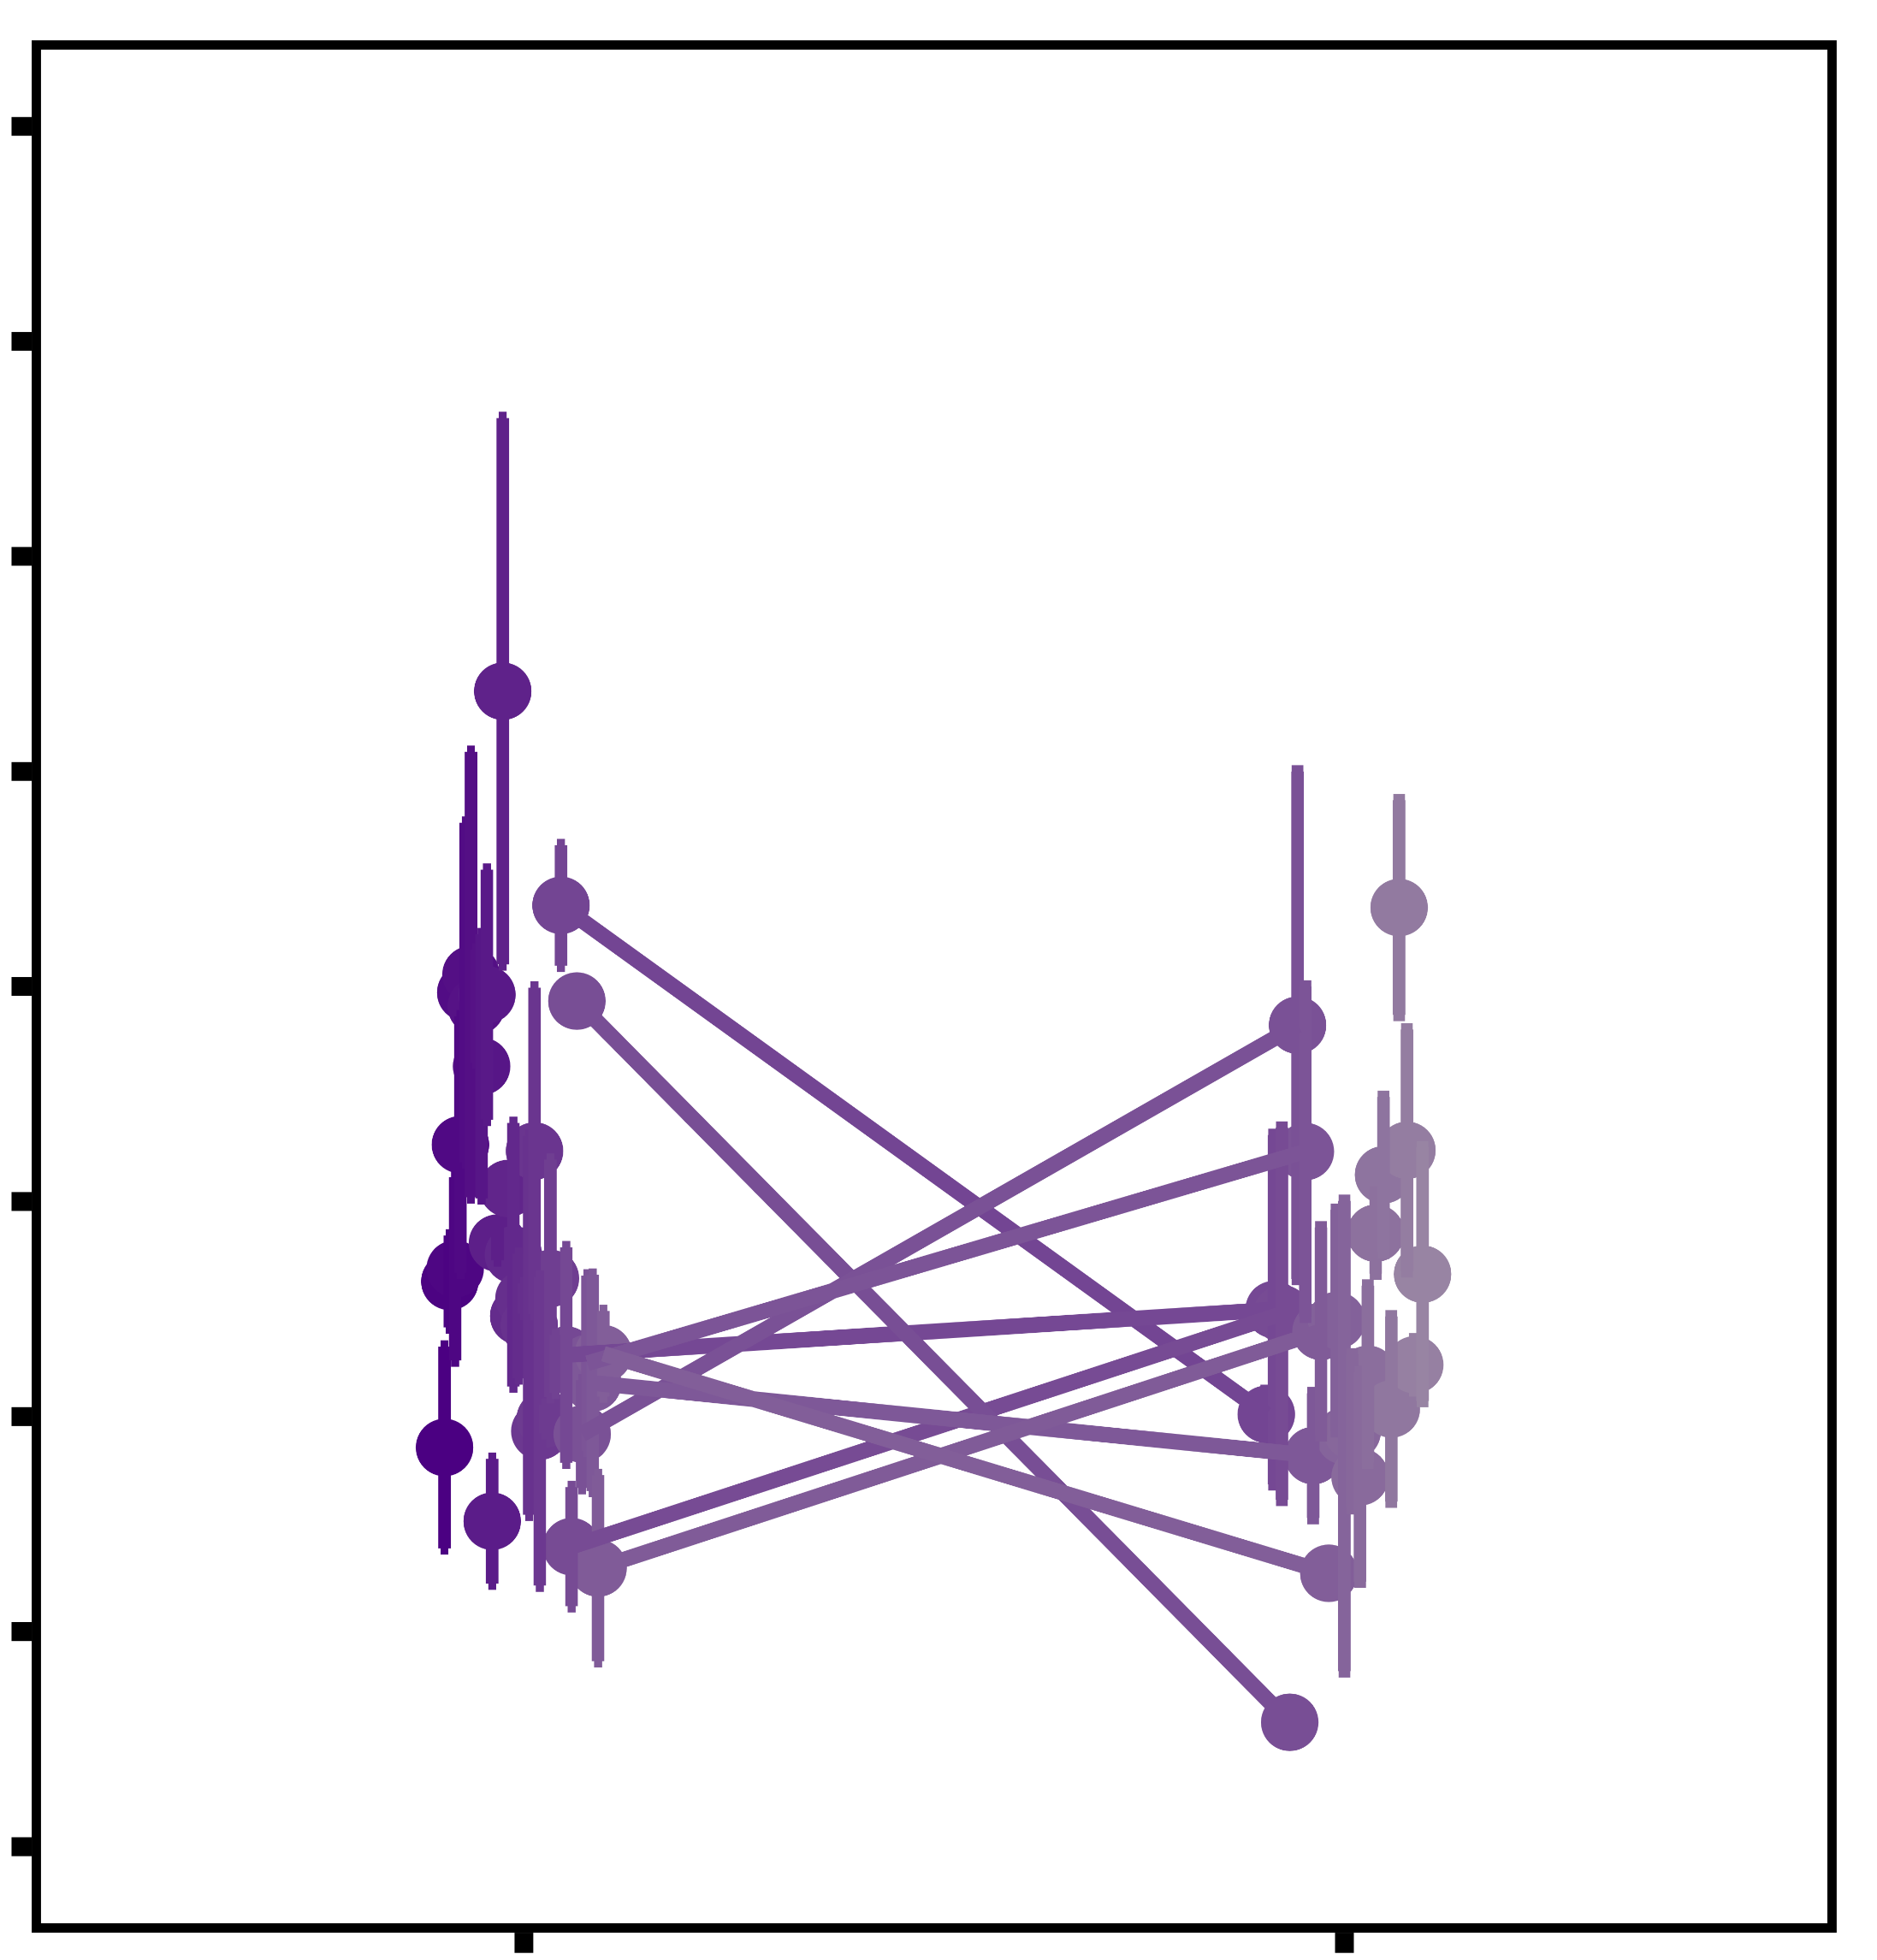
Ocean Acidification (OA)
Ocean Warming (OW)
Hypoxia (DO)
A
B
C
p = 0.034
Between: p = 0.687
Within: p = 0.009
Between: p = 0.001
Within: p = 0.020
Between: p = 0.796
Within: p = 0.742
Within: p = 0.753
Plaque attachment strength (KPa)
before treatment
after treatment
before treatment
after treatment
before treatment
after treatment

