Slide 1
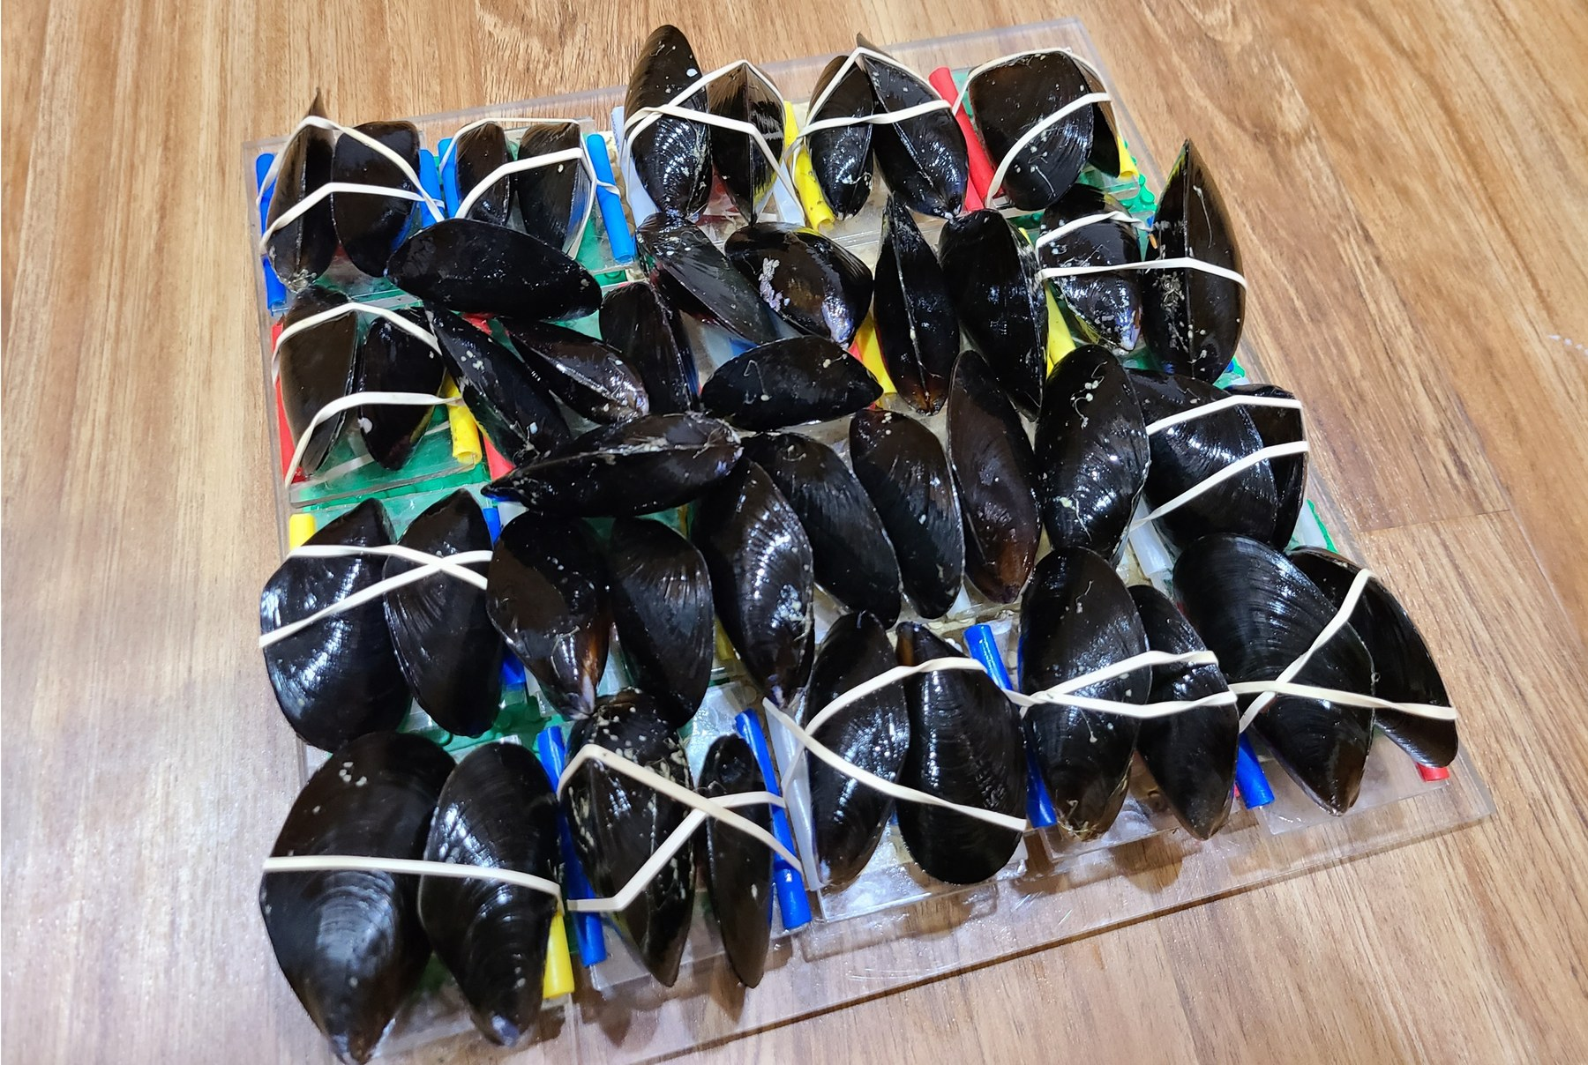
PSMFC MYTILUS BYSSUS PILOT
Byssal attachment under acidification, warming and hypoxia
Thread mechanics and tissue transcriptomes in Mytilus trossulus
Matt George · [affiliation] · [meeting, date]
Notes:
Title (30 s). Introduce yourself and the pilot: a PSMFC-funded study asking whether short ocean-stress exposures change how well mussels hold on, and whether the transcriptome of the foot, the tissue that builds the thread, tells us why. Replace the bracketed affiliation and meeting placeholders before presenting.

Slide 2
Why byssal threads
Mussels hold on with byssal threads. Each thread ends in an adhesive plaque, and the animal is only as secure as those plaques.
QUESTION 1
Does a three-day exposure change thread strength, and where in the thread does the change sit?
Attachment failure means loss from culture lines and wild beds. Three stressors expected to intensify in coastal waters, acidification, warming and hypoxia, could each act on the thread, on the plaque, or on both.
QUESTION 2
Does the foot transcriptome, or the gill’s, predict how an individual animal’s attachment responds?
Notes:
Why threads (1 min). Set up the two questions. Question 1 is mechanical: does a short exposure weaken attachment, and is the effect in the thread’s force, in the plaque’s footprint, or both. Question 2 is molecular: with expression from the same animals whose threads we pulled, can we link the two. Keep the background short; the audience knows what a mussel is.

Slide 3
Experimental design: two controls and a paired timeline
Day 0
Day 1
Day 3
Baseline pull: 61 animals, threads built in the shared holding system
Laboratory control
3-day exposure in separate flow-through tanks
12 animals pulled at day 0, never enter the system. Reference for what holding and handling do to threads.
Treatment control
11 animals paired
Day-3 pull, same animals
12.2 °C · pH 7.94 · 9.9 mg O₂/L
Every animal is pulled again after exposure, then foot and gill are sampled for Tag-seq. The treatment control experienced the same handling and tank change without a stressor.
Acidification
12 animals paired
pH 7.01
Warming
12 animals paired
20.1 °C
Hypoxia
12 animals paired
3.8 mg O₂/L
Neither control moved: lab reference 77.0 kPa (day 0), baseline 77.3 kPa (day 1), treatment control 79.5 kPa (day 3); Welch p = 0.97 and 0.76 on per-animal means. The stressor effects are therefore judged against a control trajectory that is flat.
Notes:
Design (1.5 min). Walk the timeline. Day 0: a laboratory control group of twelve animals is pulled and never enters the experimental system; it tells us what the holding system and handling do to threads on their own. Day 1: every experimental animal is pulled once in the shared holding system, giving each its own baseline, and is then assigned to one of four tanks. The treatment control tank has control conditions but gets the same tank change and handling as the stressor tanks. Day 3: the same animals are pulled again and tissues are sampled. Two controls, two questions: the lab control asks whether the system itself changes threads, and the answer is no, 77 kilopascals at day 0 versus 77 at day 1 versus 80 in the day-3 control. The treatment control asks whether the stressors change threads relative to a concurrent, identically handled group. Give the exposure levels while you point at the lanes.

Slide 4
Paired observations: what they buy us statistically
Control (n = 11)
Acidification (n = 12)
Warming (n = 12)
Hypoxia (n = 12)
Thin lines: individual animals (mean of their threads at each pull); bold line: arm mean.
1. Each animal is its own baseline
2. Baseline imbalance is absorbed
3. Animal-level variance is modelled
4. Where the gain is smaller
The outcome is the change within an animal, so the stressor arms are compared against the control arm’s own trajectory (arm × time interaction), not against a different set of animals.
Arms did not start identical: control animals averaged 89 kPa at baseline, hypoxia 71 kPa (p = 0.19). A day-3-only comparison would carry that difference; the paired design removes it.
A random intercept per animal separates between-animal differences (30 to 60 % of thread-to-thread variance) from thread noise, and paired t-tests give a second, model-free check.
An animal’s adhesion at day 3 is only weakly related to its baseline (r = 0.0 to 0.4 by arm), so pairing sharpens plaque area (repeatability 0.6) more than it sharpens adhesion.
Notes:
Paired observations (1.5 min). The four panels are the raw material: each thin line is one animal, its mean adhesion at the baseline pull and at the day-3 pull; the bold line is the arm mean. Controls scatter around a flat mean, acidification and warming animals mostly drop, hypoxia animals go both ways. Four consequences. One, the unit of comparison is the change within an animal, tested against the control arm’s change, which is the interaction term in the mixed model. Two, the arms did not start identical, the controls happened to start about 15 kilopascals higher, and pairing removes that. Three, the mixed model puts a random intercept on each animal, and the paired t-tests are the simple check that needs no model. Four, be honest about the limit: an animal’s adhesion two days later is only weakly predicted by its baseline, so the variance reduction from pairing is modest for adhesion and larger for plaque area, which is the more repeatable trait. That is also why 47 pairs are enough to see the big effects and not the subtle ones.

Slide 5
What we measured on each animal
Thread mechanics
Before and after
Transcriptomes
380 threads · 86 animals
47 animals paired
2 tissues × 3 contrasts
Tensometer pull test on every thread: peak force (N) and extension at break (mm).
Plaque area (mm²) from a microscope image of the footprint; failure mode scored.
Adhesion = peak force / plaque area (kPa), a derived quantity.
Day-1 baseline threads and day-3 threads from the same animal, usually three per pull.
Paired animals: control 11, acidification 12, warming 12, hypoxia 12.
Arm × timepoint mixed models on the log scale, one random intercept per animal.
Tag-seq of foot and gill at day 3; 129 libraries after QC.
Each stressor vs the day-3 control arm, 12 vs 12 animals (hypoxia 10 to 11); DESeq2 with apeglm shrinkage, padj < 0.05.
45 animals have both foot RNA and paired threads.
Notes:
Measurements (1 min). Three cards. Mechanics: each thread is pulled on a tensometer, giving peak force and extension, and its plaque is photographed for area, so adhesion in kilopascals is force over area. Design: the same animal is pulled before and after, and 47 animals have both, including eleven controls. Transcriptomes: foot and gill Tag-seq at day 3, each stressor against the day-3 controls with twelve animals a side. Say once that adhesion is a ratio; that matters in two slides.

Slide 6
Adhesion fell under acidification and warming, not hypoxia
DAY 3 VS BASELINE, KPA, MODEL ESTIMATE WITH 95 % CI
The arms did not decline in parallel: arm × time interaction p = 0.006.
Arm | Change | 95 % CI | p
Control | -9 % | -30 to +17 | 0.46
Acidification | -36 % | -49 to -21 | < 0.0001
Warming | -45 % | -56 to -32 | < 0.0001
Hypoxia | -14 % | -31 to +7 | 0.18
Paired t-tests on per-animal means agree: OA p = 0.003, OW p = 0.02, DO p = 0.67, control p = 0.28.
Mixed model on log adhesion, all pre and post threads, random intercept per animal; bars are post/baseline ratios with 95 % CI. n = 11, 12, 12, 12 paired animals.
Notes:
Adhesion (1.5 min). This is the conventional readout, adhesion in kilopascals, expressed as the change from each arm’s own baseline. Controls are flat, which is important: three days in a tank and a second handling did not weaken them. Acidification and warming fell by a third and by nearly half. Hypoxia fell 14 percent and the interval includes zero. If we stopped here we would say hypoxia does little. The next slide shows why that would be wrong.

Slide 7
Force and plaque area respond differently to each stressor
Peak force
arm × time p = 3 × 10⁻⁵
Plaque area
arm × time p = 3 × 10⁻¹¹
Control -0 % · Acidification -33 % · Warming -55 % · Hypoxia -46 %
Control +10 % · Acidification +7 % · Warming -18 % · Hypoxia -37 %
Warming and hypoxia animals built smaller plaques that held less force; acidification animals built slightly larger plaques that held a third less force; controls changed neither. Adhesion is force over area, so hypoxia’s two losses cancel in the ratio.
Same mixed model on log peak force and log plaque area; bars are post/baseline ratios with 95 % CI. Adhesion change = force change − area change on the log scale.
Notes:
Decomposition (1.5 min). Same model, same animals, but force and area separately. Left: force. Controls unchanged; acidification down a third; warming and hypoxia down by half. Right: plaque area. Warming and hypoxia plaques shrank, 18 and 37 percent; acidification and control plaques grew slightly. Now the adhesion slide makes sense: for hypoxia, force and area fell together, so the ratio hardly moved. Adhesion is a fine summary for acidification and warming and a misleading one for hypoxia. From here on force and area are the primary metrics.

Slide 8
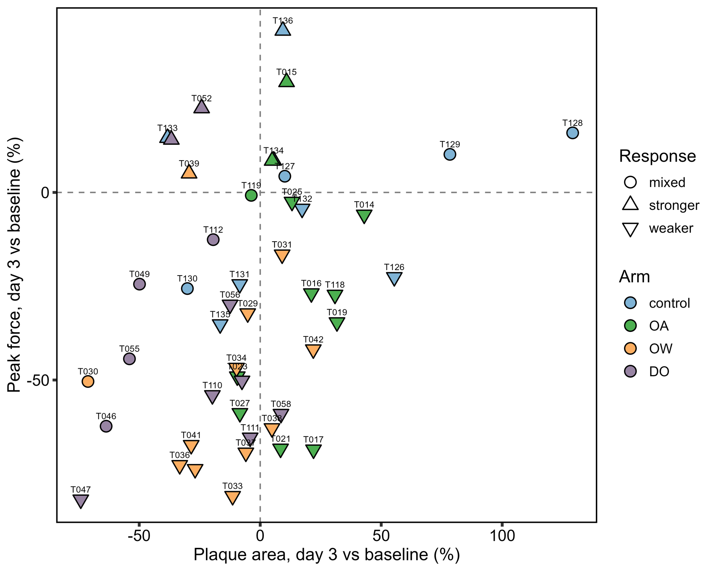
Every paired animal, force against plaque area
Warming and hypoxia animals sit in the lower left, acidification animals in the lower right, controls around the origin.
Animals with | force down | area down
Control | 5 of 11 | 4 of 11
Acidification | 10 of 12 | 3 of 12
Warming | 11 of 12 | 9 of 12
Hypoxia | 10 of 12 | 11 of 12
Per-animal means of threads at each timepoint; triangles point down for animals whose force and adhesion both fell. Blue control, green acidification, orange warming, purple hypoxia.
Notes:
Per animal (1 min). The same result at the level of individuals, so nobody thinks the arm means hide a few outliers. Each point is one animal: change in force on the vertical axis, change in plaque area on the horizontal. Warming and hypoxia animals cluster lower left, smaller and weaker plaques. Acidification animals are lower right, bigger plaques that hold less. Controls scatter around zero. The table gives the counts.

Slide 9
Hypoxia shifts failure toward peeling
Peeling is the weak mode: peeling threads hold 55 kPa on average against 79 kPa for cohesive failures.
Day-3 controls fail cohesively two thirds of the time. Hypoxia threads peel most (49 %) and almost never tear. Composition differs among the day-3 arms, χ² = 18.6, df = 9, p = 0.03.
Failure mode scored per thread from the pull trace and the plaque image; baseline n = 161 threads, day-3 arms n = 34, 39, 67, 41. Means by mode across all 380 threads.
Notes:
Failure mode (1 min). How the thread lets go tells us where the weakness is. Cohesive failure means the plaque stayed put and the thread gave way; peeling means the plaque lifted off the substrate. Controls at day 3 are mostly cohesive. Hypoxia threads peel half the time, and peeling threads hold roughly 55 kilopascals against 79 for cohesive ones. So under hypoxia the plaque-substrate interface is what fails, consistent with the smaller footprint we just saw.

Slide 10
Transcriptional responses are tissue-specific
Foot
Gill
differentially expressed genes vs control
differentially expressed genes vs control
The foot responds most to hypoxia, the gill most to acidification. Gill acidification and gill hypoxia share 123 genes, every one in the same direction; overlap between tissues within a stressor is small (9 to 34 genes).
DESeq2, each stressor vs the day-3 control arm, 12 vs 12 animals (hypoxia 10 to 11); apeglm shrinkage; padj < 0.05, no fold-change threshold. All six lists reproduce exactly from the committed count matrix.
Notes:
DEG counts (1 min). Foot on the left, gill on the right, each stressor against the day-3 controls. The foot’s biggest response is to hypoxia, 351 genes, and its smallest to acidification, 80. The gill is the reverse: 711 genes under acidification. Two things to flag: the gill’s acidification and hypoxia lists overlap by 123 genes, all concordant, so the gill mounts a shared programme for the two; and the foot and gill lists barely overlap for any stressor, so the tissues are doing different things.

Slide 11
What the differentially expressed genes point to
Contrast | Leading genes | Reading
Foot, hypoxia | A low-count copy of Byssal HSP-like protein 1 up 33-fold (log₂FC +5.05, padj 2 × 10⁻¹⁰); phospholipase A2, EGLN1 up; arginase-1, calmodulin, transglutaminase down | The strongest single effect in the study is a foot-specific byssal accessory protein.
Gill, acidification and hypoxia | Glutathione-S-transferases, dual oxidase 1 and its maturation factor, byssal peroxidase-like protein 2 up; ACDC byssal EP-like proteins and metallothionein 10-IV down | A shared oxidative and peroxidase programme; 123 genes in common, all concordant.
Warming, both tissues | Tubulin beta and HMG protein DSP1 down (padj to 10⁻²⁰); HSP90-α modestly up (log₂FC +0.4 to +0.5); cytochrome P450 10 up | Cytoskeletal and chromatin repression with only a modest heat-shock signal.
Across stressors | Amino-acid transporter LAT2 up in foot OA and gill OW and DO; ferric-chelate reductase 1 down in foot OW and DO and gill DO | Amino-acid transport and iron handling recur across arms and tissues.
Top-50 annotated DEG tables per contrast (BLAST / UniProt annotation of the genome-based counts); log₂ fold changes are apeglm-shrunken.
Notes:
Genes (1.5 min). Four rows. First, the headline: a byssal HSP-like protein copy is up 33-fold in the foot under hypoxia, by far the largest effect in the dataset, in the tissue that builds the byssus. Second, the gill’s shared acidification and hypoxia programme: glutathione transferases, the dual oxidase system, a byssal peroxidase-like protein up, and two byssal EP-like proteins down. Third, warming: tubulin and the HMG protein DSP1 repressed in both tissues, with only a modest HSP90 induction. Fourth, recurring genes across arms: the LAT2 amino-acid transporter and ferric-chelate reductase.

Slide 12
Byssal protein transcripts did not respond to any stressor
Foot protein gene | OA log₂FC | OW log₂FC | DO log₂FC | Median CPM
mfp-1, adhesive plaque matrix protein | n.t. | −0.01 | n.t. | 5
mfp-2, plaque matrix protein | 0.00 | 0.00 | 0.00 | 4
mfp-4 | n.t. | 0.00 | 0.00 | 0
preCol-D, byssal collagen | −0.04 | −0.07 | −0.09 | 10
Foot protein 10 | 0.00 | +0.01 | +0.01 | 16
Foot protein 12 | 0.00 | +0.01 | +0.01 | 25
ACDC, byssal EP-like protein 1 | −0.02 | −0.08 | +0.08 | 25
Byssal HSP-like protein 1 | +0.56 (padj 0.09) | +0.07 | +0.62 (padj 0.06) | 1,591
mfp-2 per animal, log₁₀(CPM + 1)
Control
Acidification
Warming
Hypoxia
mfp-2, mfp-4, foot proteins 10, 12 and 15 and tyrosinase-like 1 switch on together (ρ = 0.8 to 0.96) in 10 of 46 animals spread over every arm, controls included, and the module is unrelated to force or plaque area (|ρ| ≤ 0.19): a marker of active thread secretion at sampling, not of stress.
Foot, day 3, stressor vs control (DESeq2, apeglm); no value differs from zero at padj < 0.05; n.t. = below the count filter. Exception: a low-count second copy of Byssal HSP-like protein 1 (+5.05 under hypoxia). Other studies report large stressor effects on these genes [refs].
Notes:
Foot proteins (1 min). The genes people expect to move are the byssal proteins themselves, and other studies have reported large expression differences under stress [add refs]. We did not see them. The table gives eight: the adhesive plaque proteins mfp-1, 2 and 4, the byssal collagen preCol-D, foot proteins 10 and 12, the EP-like protein ACDC and Byssal HSP-like protein 1. Every fold change is essentially zero in every arm. The dot plot shows why: mfp-2 is off in most animals and on at thousands of counts per million in a few, in every arm including the controls, and the same animals switch on mfp-4, foot proteins 10, 12 and 15 and a tyrosinase together. That looks like a marker of whether the animal was secreting a thread at the moment we sampled, not of its stress state, and the module has no relation to how strong its threads were. Bulk foot expression of these genes reports thread-making activity, and stress comparisons that ignore that will be dominated by which animals happened to be building. The next slide shows where the large differences other studies report come from.

Slide 13
Byssal programme: on at day 0, off by day 3 in every arm
mfp-2 per animal, log₁₀(CPM + 1)
Median CPM | Day 0 | Day-3 ctrl | OA | OW | DO
mfp-2 | 7,115 | 37 | 0 | 15 | 57
mfp-4 | 934 | 0 | 0 | 0 | 3
Foot protein 10 | 8,149 | 55 | 0 | 17 | 81
Foot protein 12 | 13,805 | 47 | 1 | 18 | 69
preCol-D | 10,849 | 8 | 11 | 11 | 7
Byssal tyrosinase-like 1 | 355 | 0 | 0 | 2 | 1
The same six genes rise and fall together. "On" = mfp-2, mfp-4, foot proteins 10 and 12 all above 100 CPM.
Against a day-0 reference every byssal gene reads as strongly "down", in the day-3 control as much as in any stressor arm; against the day-3 control none of them moves.
Day-0 lab control
Day-3 control
Acidification
Warming
Hypoxia
on in 10 of 12
on in 2 of 12
on in 2 of 12
on in 4 of 12
on in 2 of 10
The day-0 animals had their byssus cut and were re-attaching when sampled; by day 3 most animals in every tank had re-attached and switched the programme off. Large stressor "effects" on byssal genes depend on which control is the reference.
CPM from the clean count matrix, foot libraries (day 0 n = 12; day 3 n = 12, 12, 12, 10). Lab-control (LC) DESeq2 contrasts call preCol-D, foot proteins 10 and 12 and tyrosinase-like 1 down by 3.5 to 8 log₂ units in the day-3 control vs day 0 (DE/03_analyses/DEG_lists/Foot/FTC_LC_apeglm.csv).
Notes:
Byssal programme, day 0 vs day 3 (1 min). This is where the literature discrepancy comes from. The day-0 laboratory-control animals, sampled the day their byssus was cut, have the whole byssal programme running: mfp-2 at a median of seven thousand counts per million, preCol-D at eleven thousand, ten of twelve animals with the module on. By day 3 the programme is off in thirty-six of forty-six animals, and the day-3 controls are no different from the stressor tanks: two of twelve on. So if you compare stressed animals with a day-0 or freshly handled reference, as many studies do, the byssal genes look strongly down-regulated; our own lab-control contrasts do exactly that, calling preCol-D and the foot proteins down by four to eight log2 units in the unstressed day-3 control. Compared with the concurrent day-3 control, nothing moves. The reading is that these transcripts report whether an animal is building threads at the moment of sampling, and that the reference group decides the answer. One caveat: day 0 and day 3 differ in time in the system as well as in secretion state, so the day-0 comparison confounds the two; the point is that the difference is not a stressor effect, because the controls show it in full.

Slide 14
Does an animal’s transcriptome predict its threads?
WHAT WAS TESTED
No gene or module survives correction in either tissue.
45 foot animals (44 with baselines) and 46 gill animals across the four arms.
58 candidate genes (HIF, heat-shock, peroxidase and antioxidant, byssal, collagen, tRNA ligases) plus the tissue’s 523 or 1,009 DEGs.
Seven metrics: day-3 force, area, adhesion and extension; change from baseline in force, area and adhesion.
Arm-adjusted regressions, Benjamini-Hochberg within metric, a 1,000-draw permutation of the best hit, detection-floor and leave-one-out checks.
Closest leads | q | Permutation p
Foot: phosphodiesterase 8B vs Δ force | 0.070 | –
Foot: HIF-hypoxia module vs Δ plaque area | 0.058 | –
Foot: byssal-collagen module vs Δ plaque area | 0.058 | –
Foot: best single gene, force / area / Δ adhesion | 0.61 / 0.73 / 0.29 | 0.42 / 0.45 / 0.45
Gill: best candidate on any metric | 0.25 | 0.21 to 0.88
With 44 animals a single arm-adjusted correlation needs |r| ≈ 0.4 for 80 % power; only a large per-animal effect could have been detected.
Notes:
Gene-mechanics (1.5 min). The second question, answered honestly. We took every animal with both expression and paired threads, 45 in the foot, and asked whether any candidate gene or DEG predicts that animal’s force, area, adhesion or their change from baseline, after removing the arm effect. Nothing survives correction. The closest leads are a phosphodiesterase against the change in force and the HIF and collagen modules against the change in plaque area, all around q 0.06 to 0.07, and permutation says the best single-gene hits are what chance produces. Say plainly that this is a null result with exploratory leads, and that the power ceiling with 44 animals over four arms is a large effect only.

Slide 15
Mechanical damage and transcriptional response rank the stressors differently
Force lost, day 3 vs baseline
Plaque area change
Foot DEGs
Gill DEGs
Warming
−55 %
Hypoxia
−37 %
Hypoxia
351
Acidification
711
Hypoxia
−46 %
Warming
−18 %
Warming
153
Hypoxia
307
Acidification
−33 %
Acidification
+7 %
Acidification
80
Warming
175
Control
0 %
Control
+10 %
The arms with the most similar gill transcriptomes, acidification and hypoxia, have the least similar plaques: one grew, the other shrank by a third.
Three readings fit: the damage is set by chemistry at the plaque rather than by foot transcription at 72 h; the relevant transcription happened earlier, while the day-3 threads were made; or the coupling is below the power of a 45-animal, four-arm design.
Notes:
Synthesis (1.5 min). Put the two halves side by side. Mechanically, warming is worst for force, hypoxia is worst for plaque size, acidification weakens without shrinking, controls are flat. Transcriptionally, the foot reacts most to hypoxia and the gill to acidification, and the two gill lists that look most alike belong to the arms whose plaques look least alike. So there is a stressor-specific mechanical phenotype that a shared stress programme does not explain. Offer the three readings and say the data cannot separate them.

Slide 16
Functional protein classes by stressor and tissue
Protein class (genes tested, foot / gill) | Foot acidification | Foot warming | Foot hypoxia | Gill acidification | Gill warming | Gill hypoxia
HIF / hypoxia signalling (13 / 11) | 1↑ | 2↑ | 5↑ | – | – | 1↑
Heat-shock proteins / proteostasis (66 / 116) | 3↑ | 4↑ 1↓ | 4↑ | 6↑ 6↓ | 2↑ 1↓ | 4↑ 2↓
Oxidative stress / detox (GST, SOD, Prx, DUOX) (33 / 53) | – | – | 4↑ | 13↑ | – | 4↑
Byssal structural proteins (mfp, preCol, ACDC) (11 / 5) | – | – | – | 3↓ | – | 3↓
Byssal accessory (HSP-like, calumenin, inhibitors) (5 / 4) | – | – | 1↑ | – | – | –
Cross-linking / curing (tyrosinase, LOX, TGM, byssal peroxidases) (15 / 17) | – | – | 1↓ | 2↑ 1↓ | – | 1↑
Collagens and collagen biosynthesis (38 / 42) | – | 1↑ | 2↑ | 3↑ 5↓ | – | 2↑ 2↓
ECM / cell adhesion (laminin, fibronectin, vWF, cadherin) (58 / 97) | – | – | 3↓ | 4↑ 3↓ | 1↑ 1↓ | 3↑
tRNA ligases / translation (83 / 100) | 15↑ | 4↑ | 8↑ | 4↑ 2↓ | 4↑ | 9↑ 1↓
Amino-acid transporters (15 / 20) | 4↑ | 1↑ | 5↑ | 1↑ | 2↑ | 4↑
Mitochondrial OXPHOS (mt-encoded and mt-like loci) (134 / 134) | – | – | – | 116↑ | – | –
Cytoskeleton (tubulin, actin, dynein, cilia) (282 / 340) | 2↓ | 5↑ 3↓ | 7↑ 30↓ | 5↑ 14↓ | 4↑ 5↓ | 6↑ 3↓
Cells: DEGs up↑ / down↓ within the class at padj < 0.05. Shaded and bold = at least 3 DEGs and a DE rate at least twice the contrast’s genome-wide rate (blue: mostly up; orange: mostly down). Genome-wide DE rates: foot 1.0, 1.9, 4.5 %; gill 6.4, 1.6, 2.8 %.
Classes defined by UniProt annotation of the genome (best BLAST hit per gene); counts from DE/03_analyses/DEG_lists/*_TC_apeglm.csv. The OXPHOS class is the 13 mt-encoded genes plus nuclear loci annotated as mt-protein copies, which capture the same transcripts.
Notes:
Functional classes (1 min). One table for the classes we have been discussing, tissue by stressor. Read it by the shaded cells. Byssal structural proteins: nothing in the foot in any arm, and the three gill hits are the ACDC proteins going down. Byssal accessory proteins and the cross-linking enzymes, tyrosinases and byssal peroxidases: essentially nothing, one hit here and there. HIF signalling is engaged in the foot under hypoxia, five of thirteen genes up, and nowhere else. The oxidative and detox class is the gill’s signature under acidification, thirteen up and none down, with a smaller echo under hypoxia in both tissues. Heat-shock proteins move in small numbers everywhere and not in one direction. tRNA ligases and amino-acid transporters go up in the foot under every stressor, most strongly under acidification, which reads as a protein-synthesis and amino-acid supply response rather than a stress-protein one. The mitochondrial class is one signal, not a hundred: the mt-encoded subunits and the nuclear loci that carry the same transcripts all rise together in the gill under acidification and nowhere else. And the cytoskeleton class is the foot’s hypoxia signature on the down side, thirty of 279 genes, mostly tubulins, dyneins and cilia proteins.

Slide 17
TAKE-HOME
Three days of acidification, warming or hypoxia weakened byssal attachment; control animals did not change.
Warming and hypoxia shrink the plaque; acidification weakens it without shrinking it. Adhesion alone misses the hypoxia effect.
Foot and gill transcriptomes respond in tissue-specific ways; byssal protein transcripts mark thread secretion rather than stress, and no expression signal predicted an individual animal’s threads.
Notes:
Take-home (30 s). Three sentences, read them slowly. One: the stressors weaken attachment and the controls do not. Two: where the damage sits differs by stressor, and force and area should be reported rather than adhesion alone. Three: the transcriptomes are informative about the stress response, the byssal protein genes track thread secretion rather than stress, and no expression signal predicts individual attachment.

Slide 18
NEXT STEPS
ACKNOWLEDGEMENTS
Targeted follow-up on the strongest candidates: Byssal HSP-like protein 1, the dual oxidase / byssal peroxidase module, and the ACDC byssal EP-like proteins.
Sample the foot during thread building, not only at 72 h, to test the timing reading.
Report force and plaque area as the primary mechanical metrics, with adhesion derived, in the manuscript.
[Co-authors and affiliations]
[Thread-testing and RNA-extraction team]
[Sequencing facilities]
Funding: Pacific States Marine Fisheries Commission [award number]
Code and data: github.com/mattgeorgephd/PSMFC-mytilus-byssus-pilot
Notes:
Next steps and acknowledgements (30 s). Name the follow-ups: the candidate genes, a time-course during thread building, and the reporting choice for the manuscript. Fill in the acknowledgement placeholders: co-authors, the thread-testing and RNA teams, the sequencing facilities and the PSMFC award number. Then questions.

