Slide 1
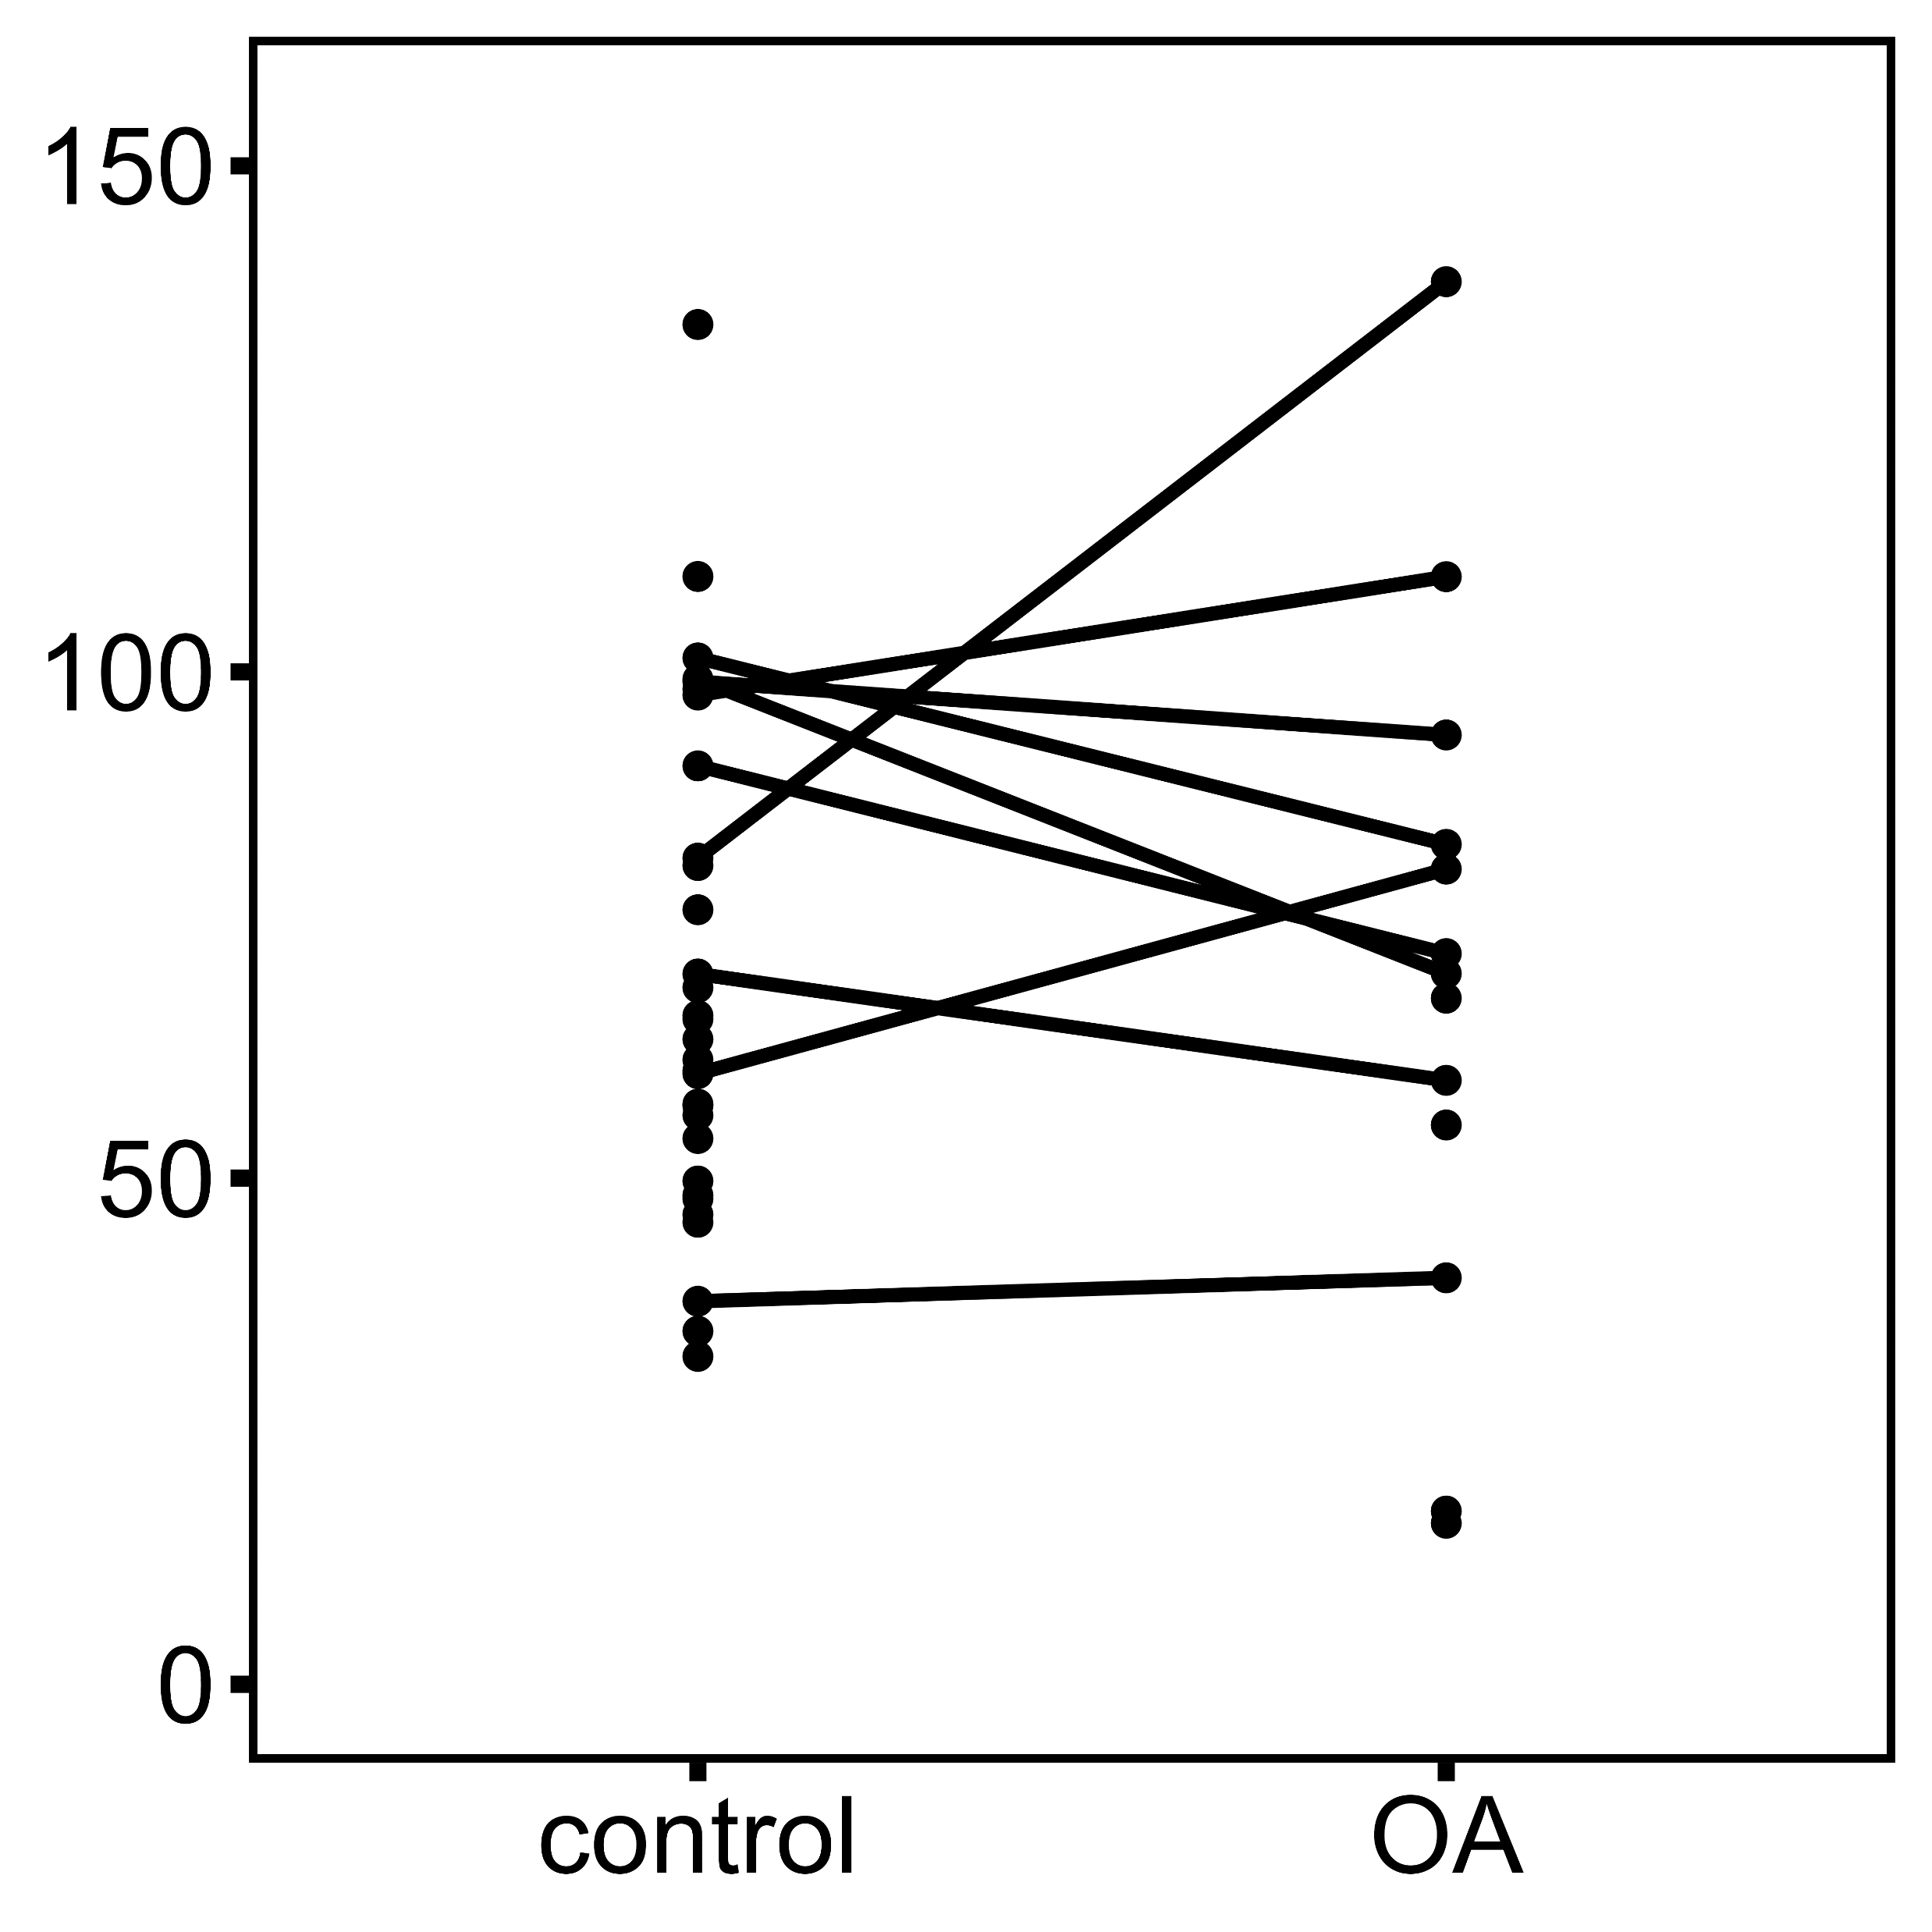
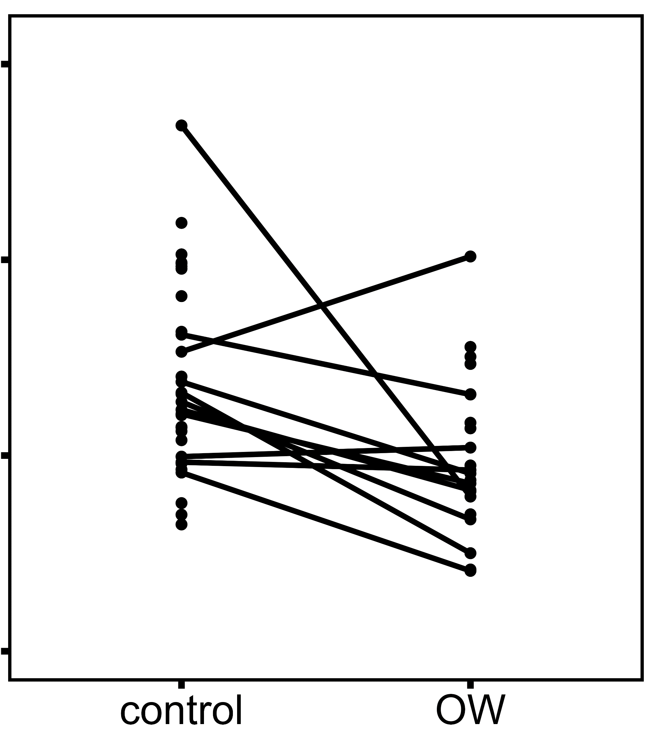
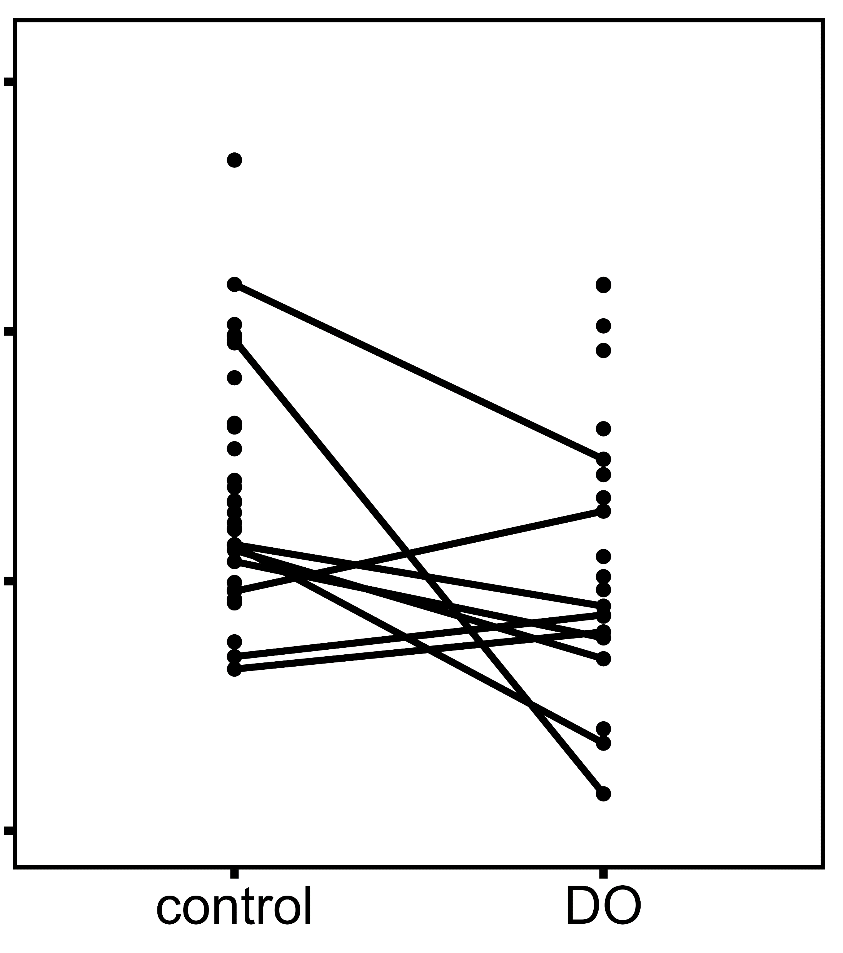
Ocean Acidification (OA)
Ocean Warming (OW)
Hypoxia (DO)
A
p = 0.223
B
p = 0.002
C
p = 0.034
Plaque attachment strength (KPa)
before treatment
after treatment
before treatment
after treatment
before treatment
after treatment

