Slide 1
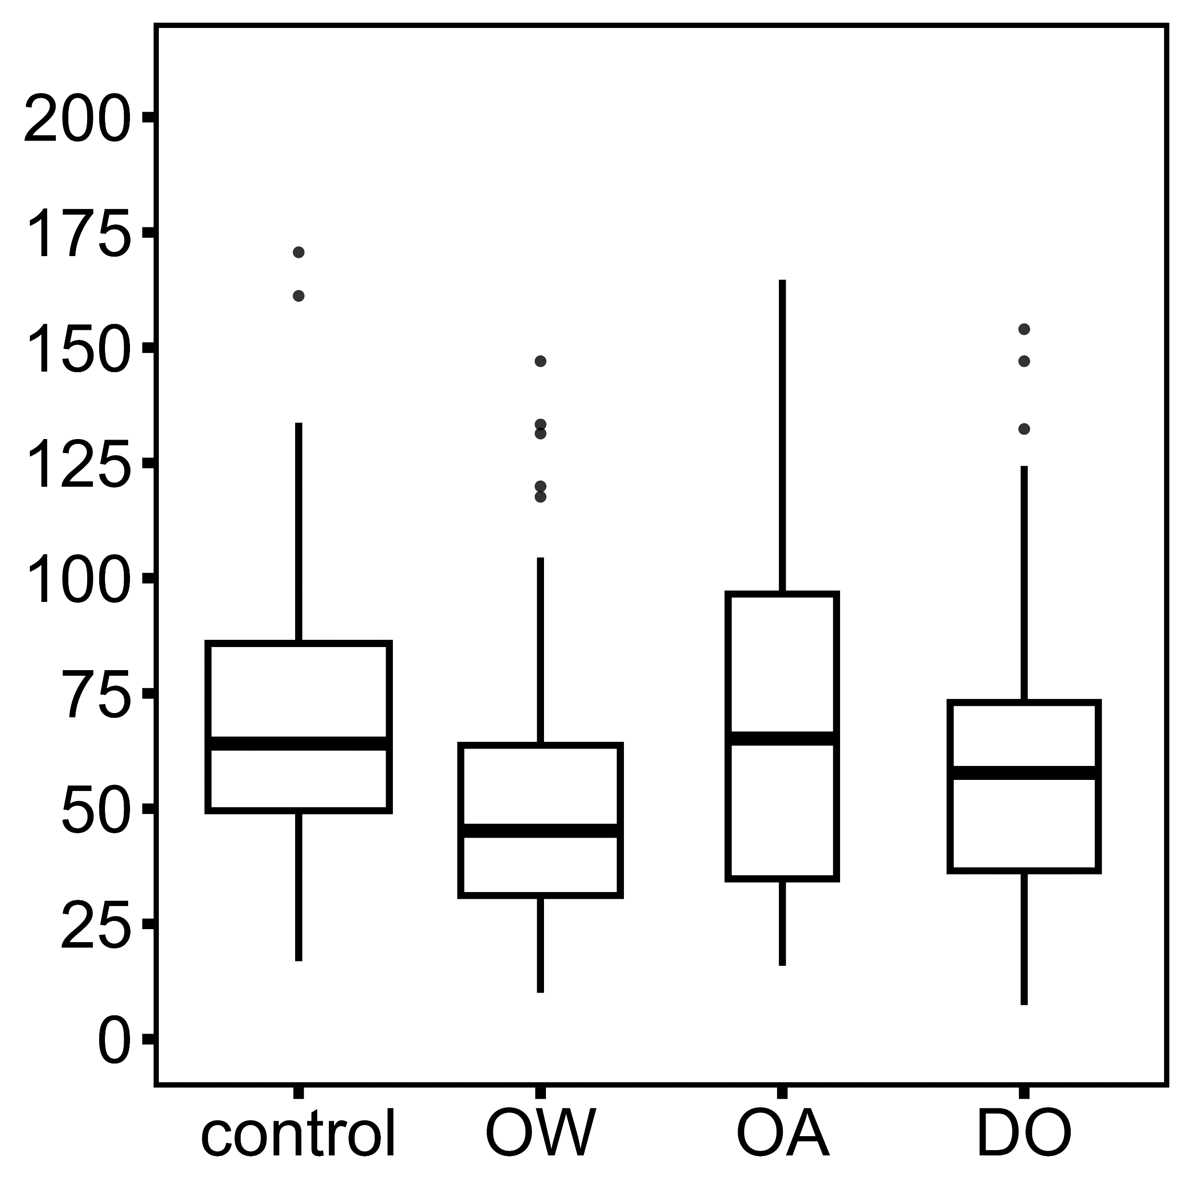
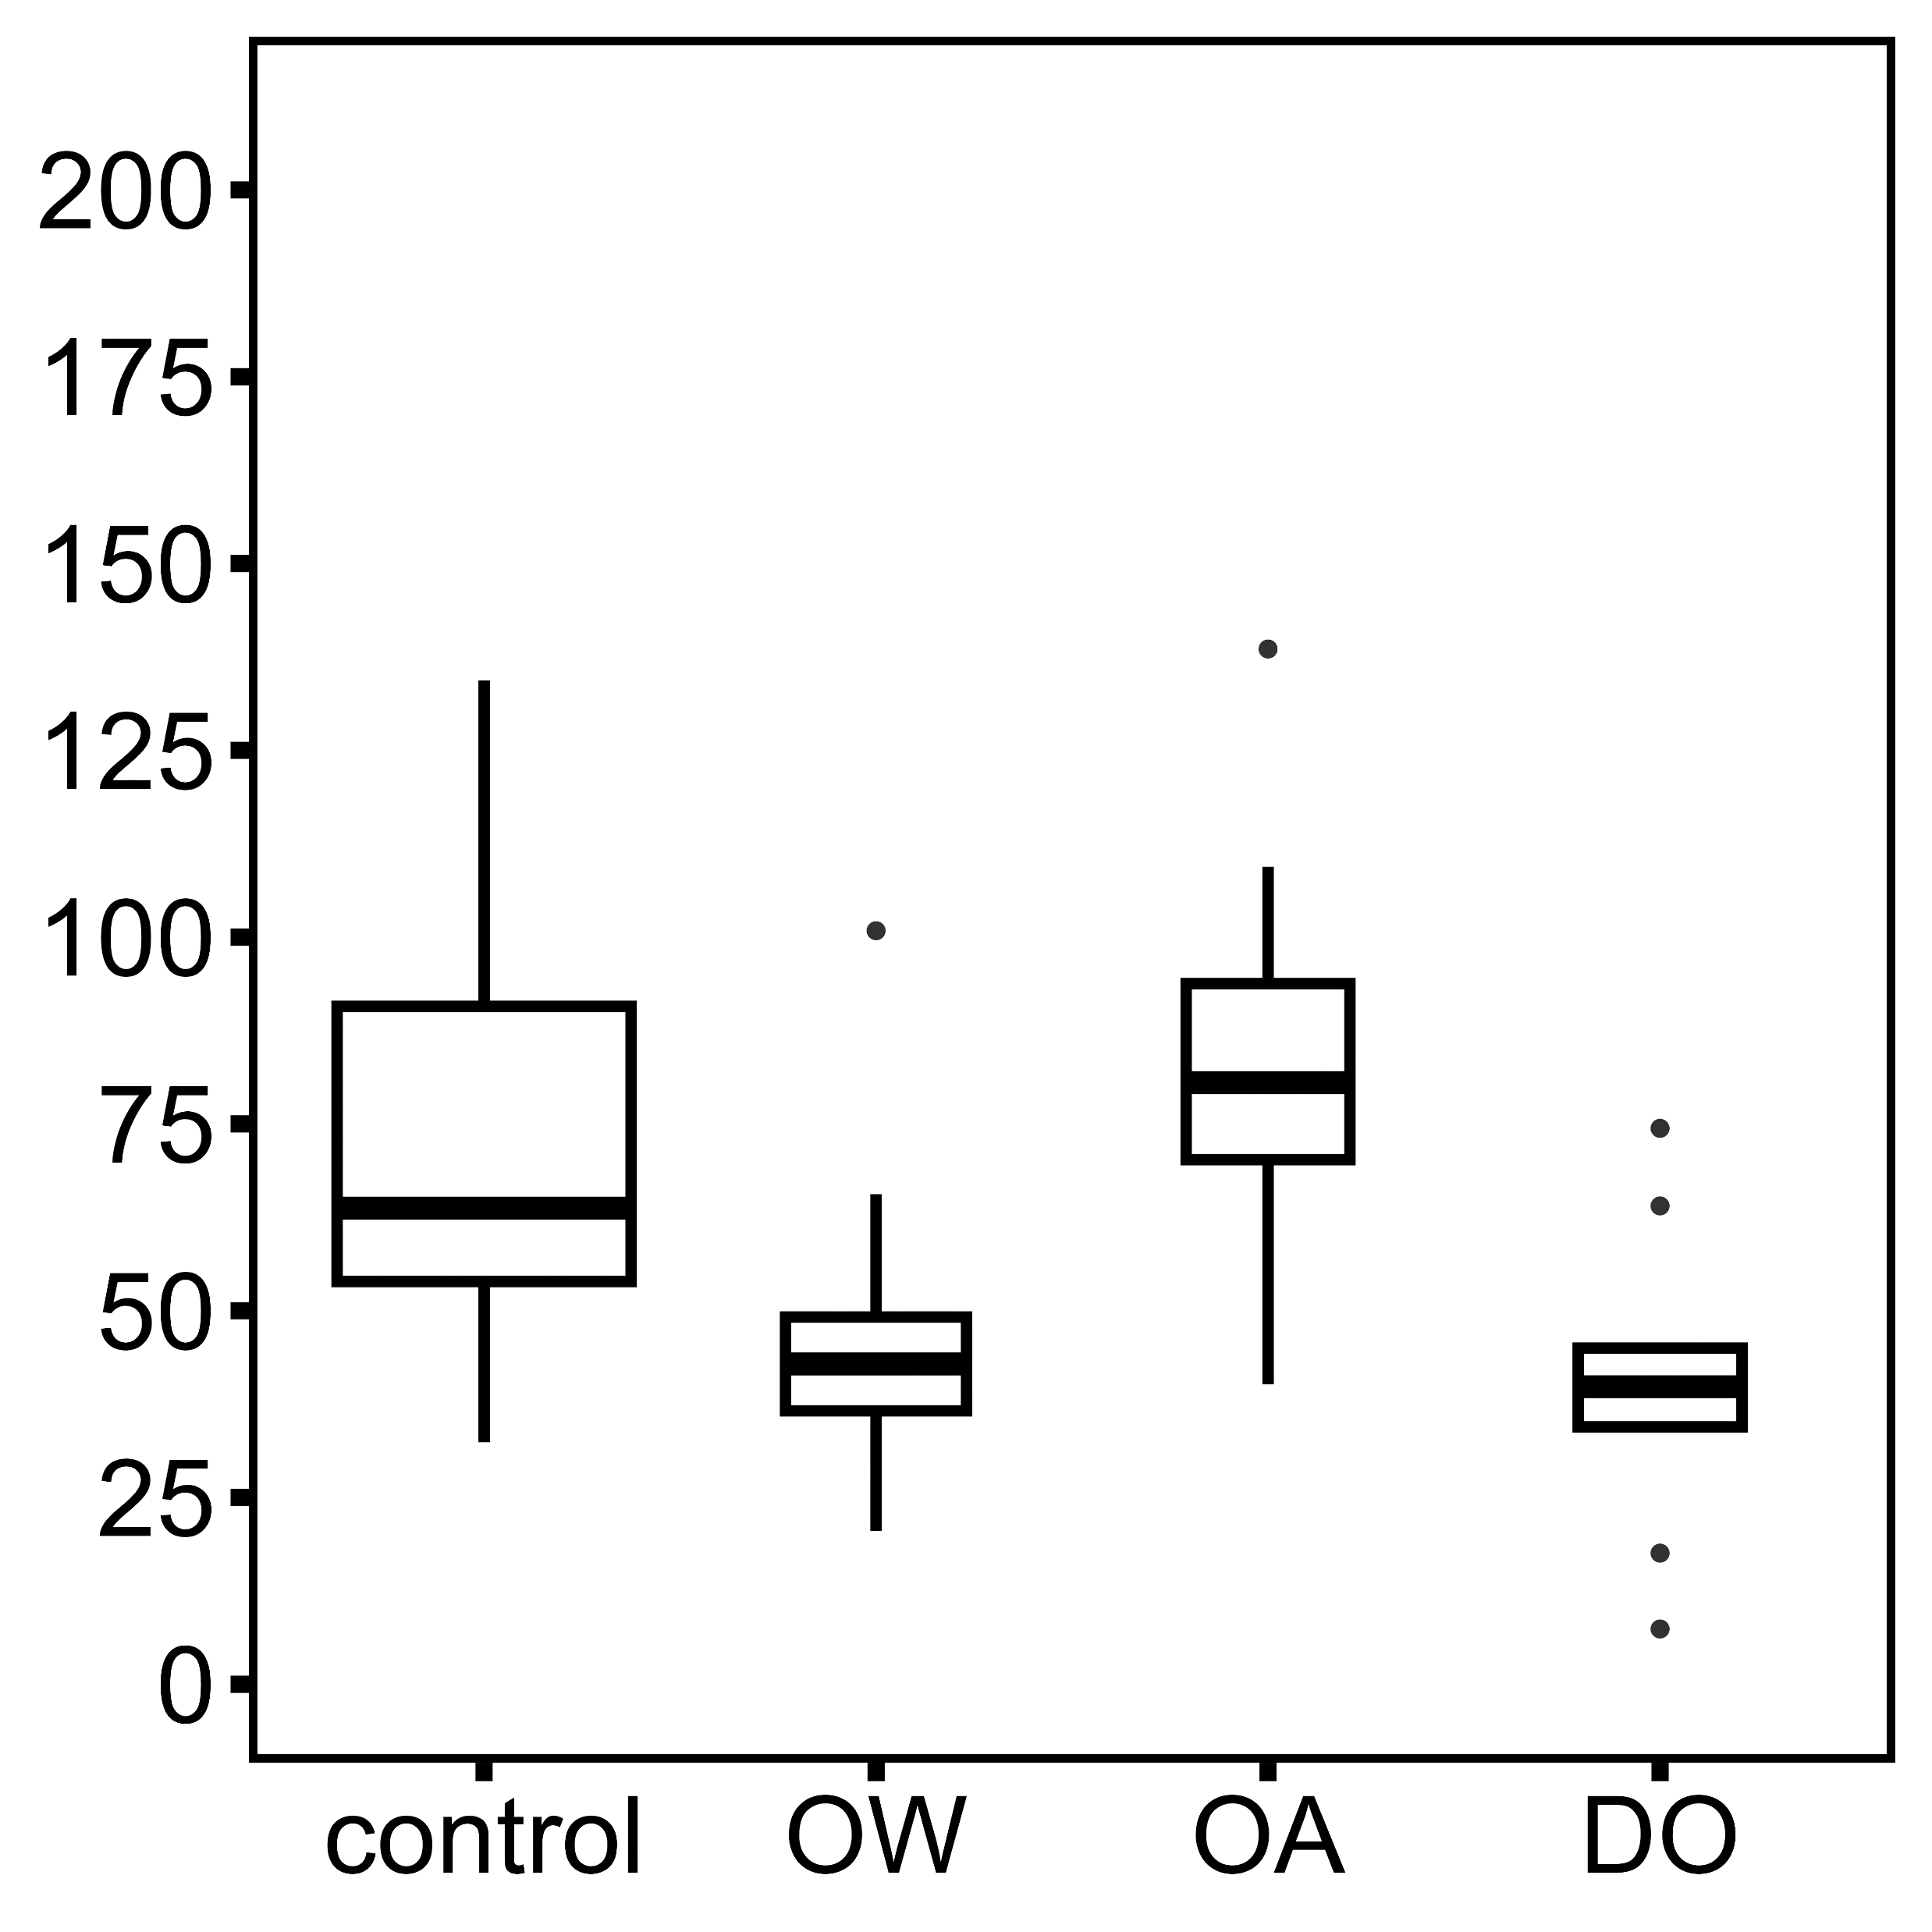
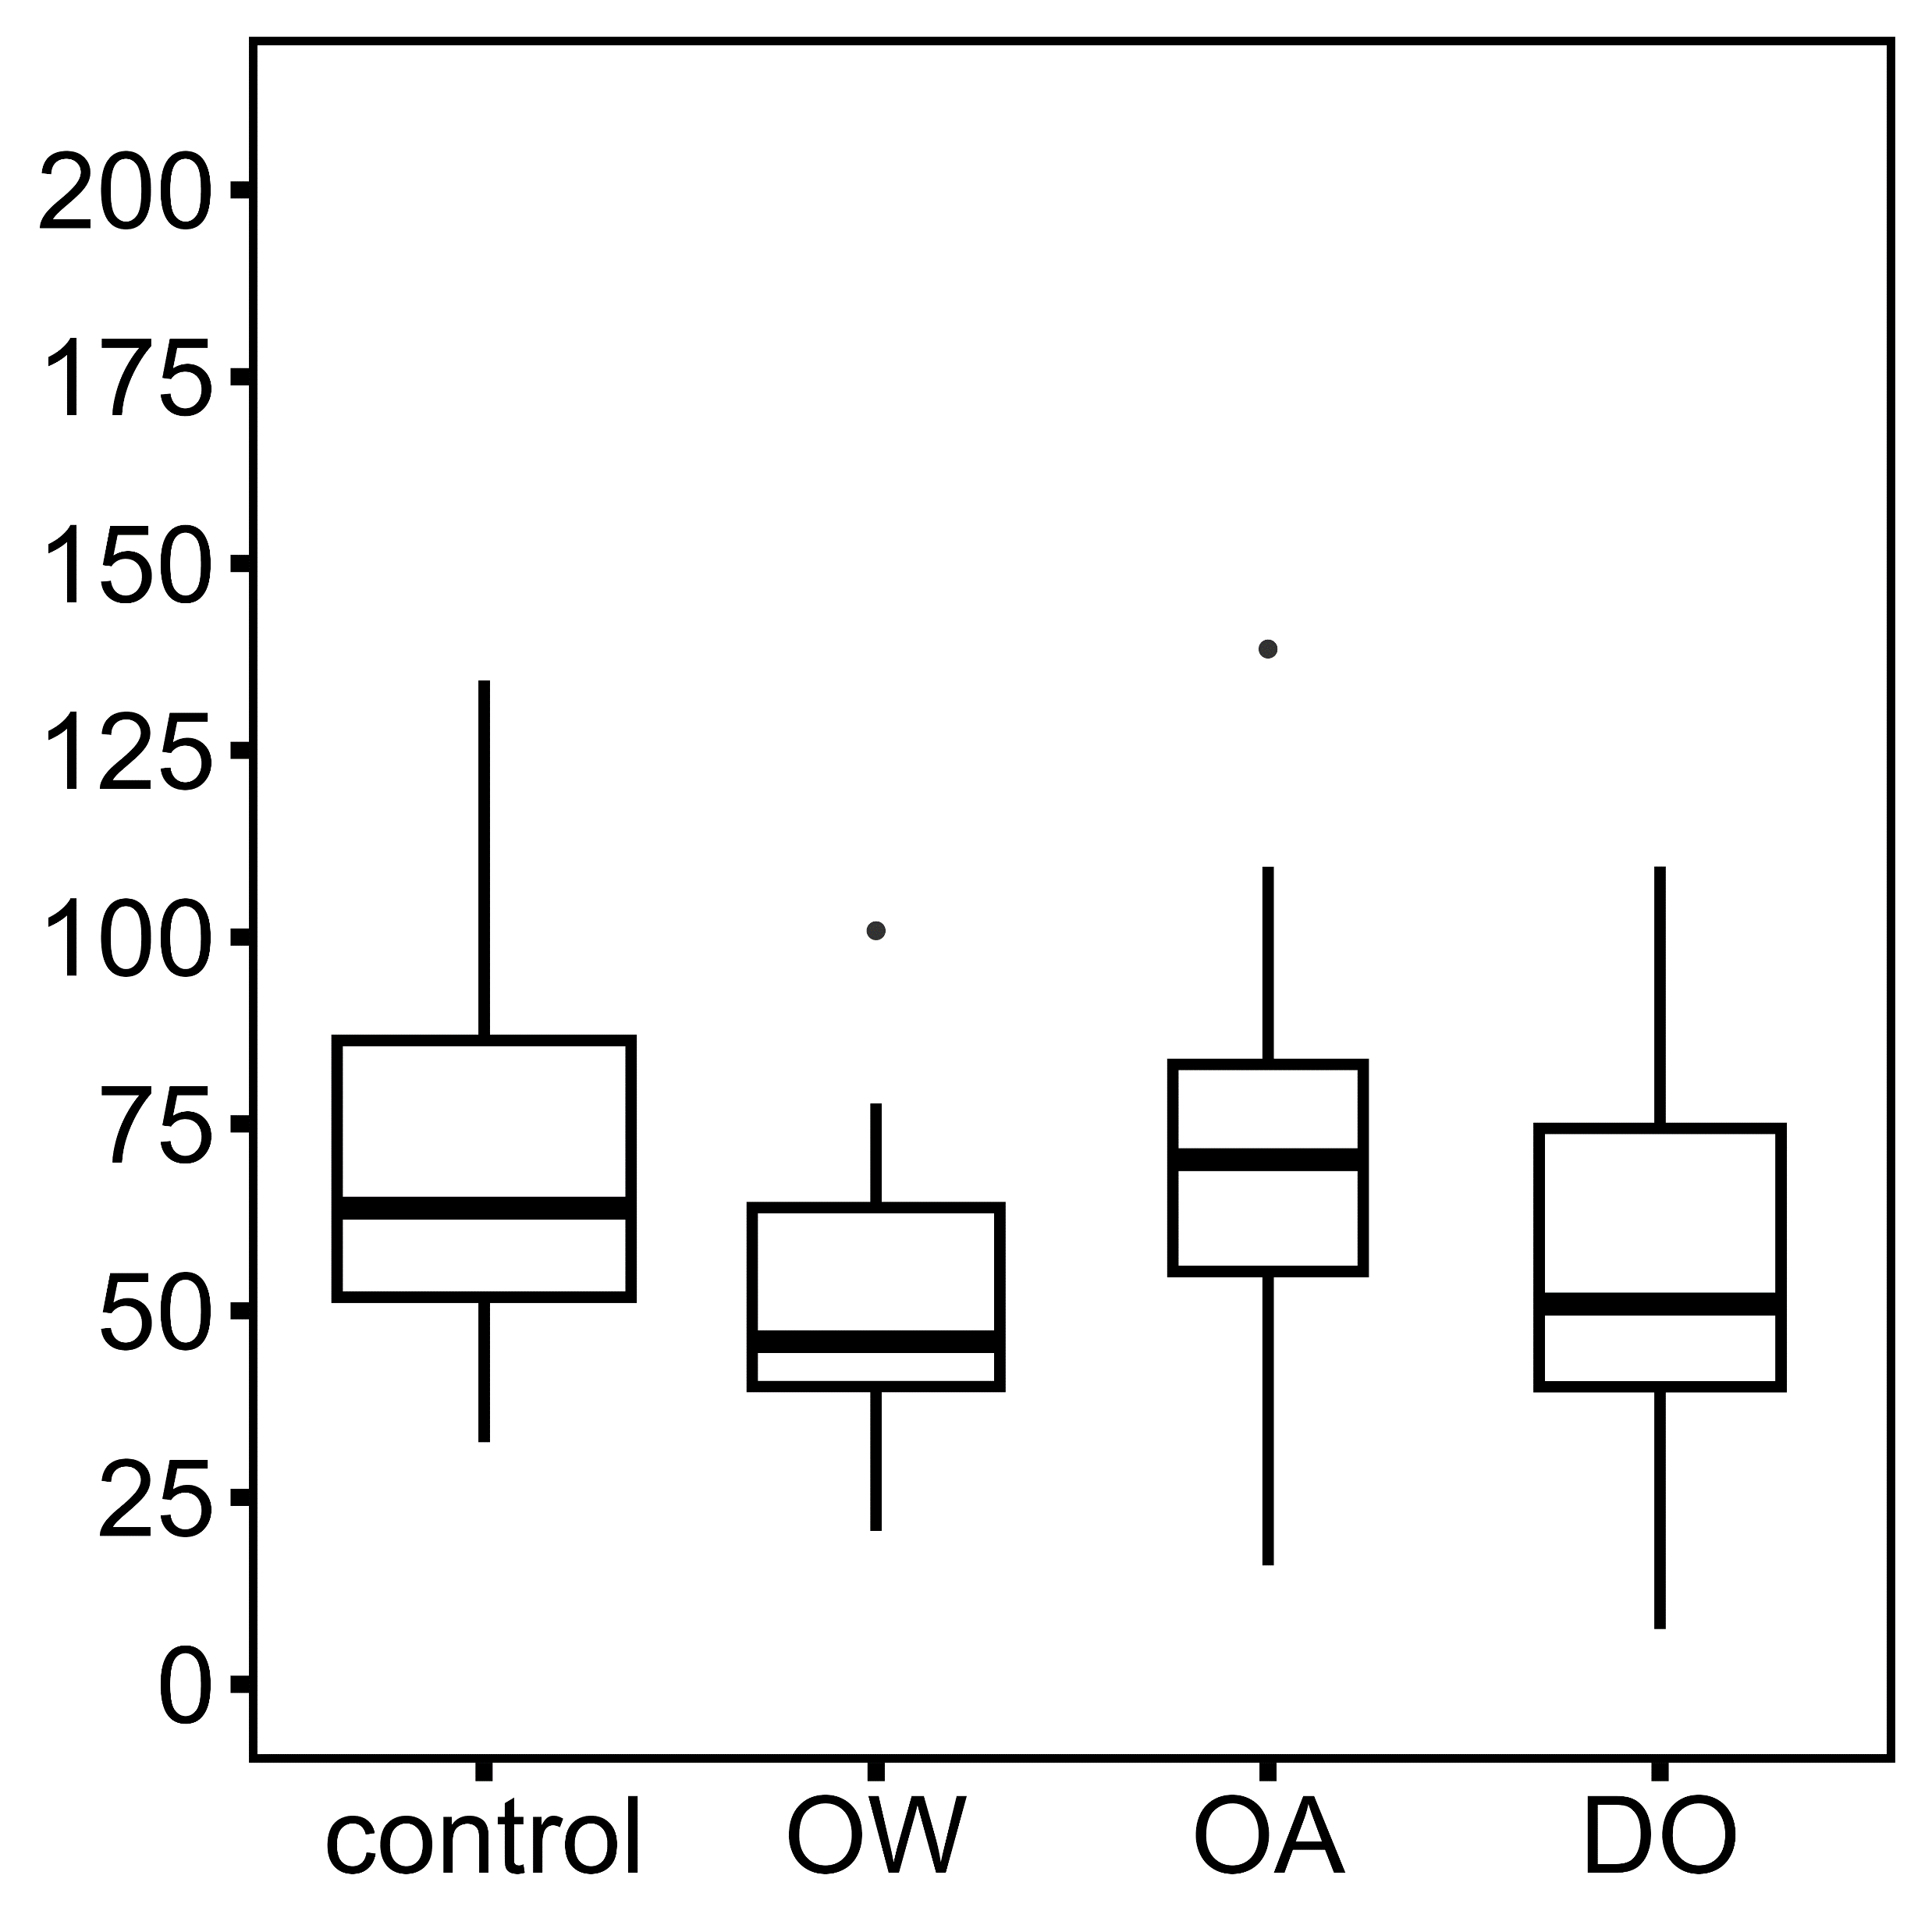
Repeated observations, strength averaged by individual
A
All thread measurements
B
Ocean Acidification
Ocean Warming
p = 0.031
Hypoxia
p = 0.223
p = 0.002
a
a
b
Plaque attachment strength (KPa)
b
before treatment
after treatment
before treatment
after treatment
before treatment

