Slide 1
Climate-Driven Recruitment Dynamics in the Washington Coastal Razor Clam Fishery
Matt George, Ph.D.
Matthew.George@dfw.wa.gov

Slide 2
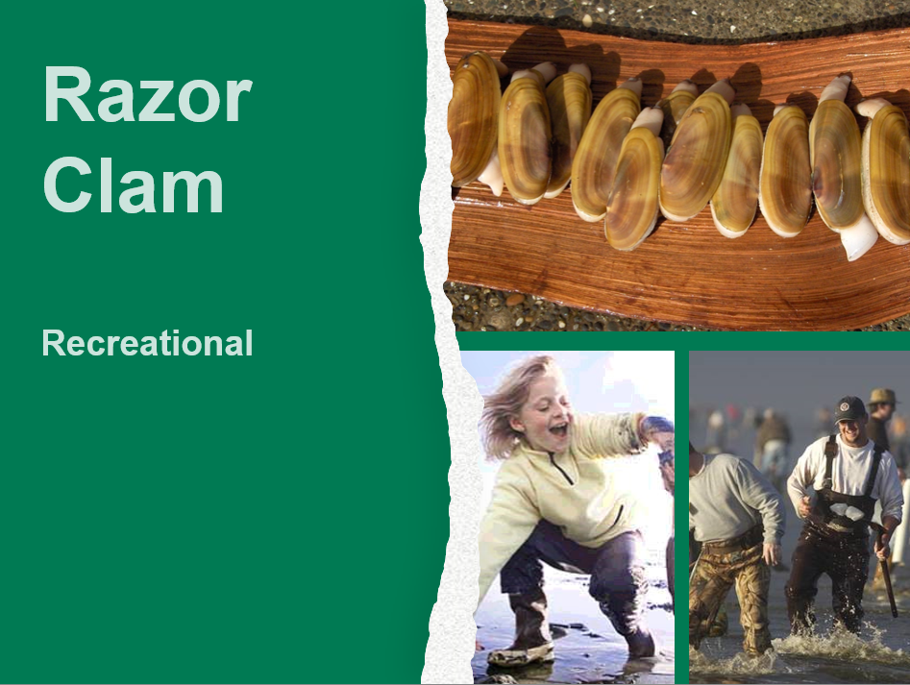
Largest recreational bivalve shellfishery in Washington state

Slide 3
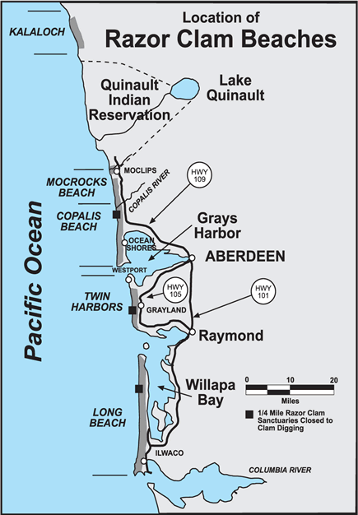
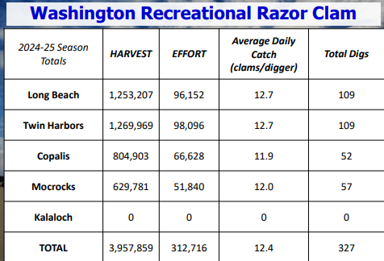
Five Management Beaches
(clams)
(trips)

Slide 4
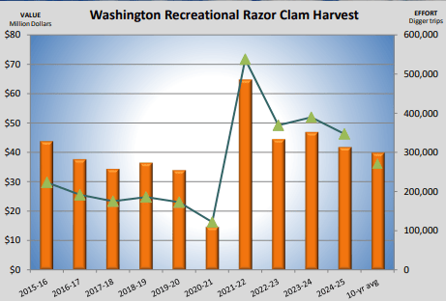

Slide 5
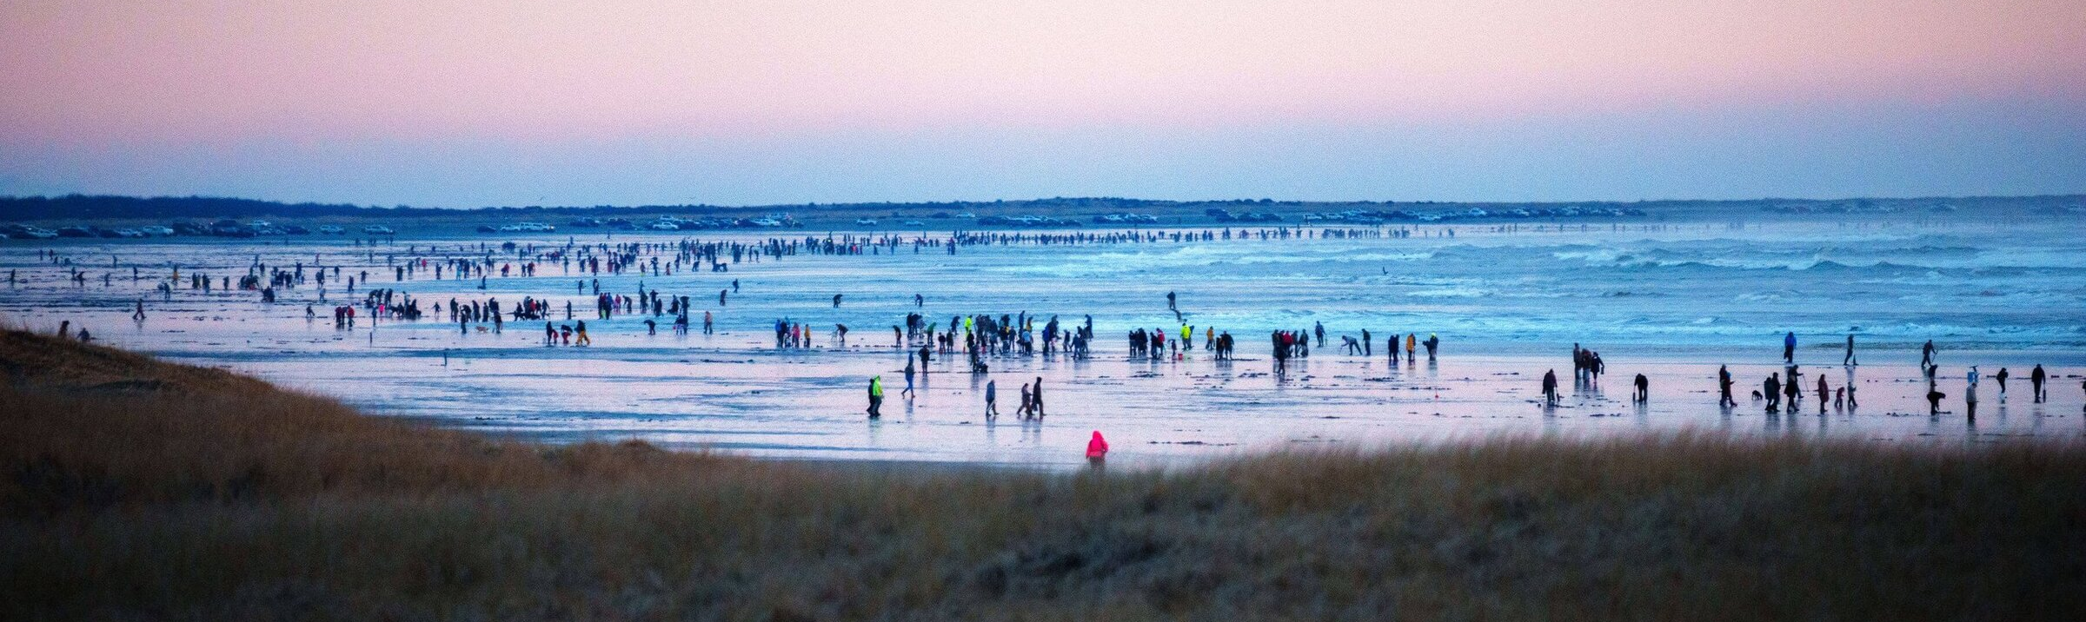
Questions
What trends exist in recruitment across time?
Which environmental variables influence razor clam recruitment across beaches?

Slide 6
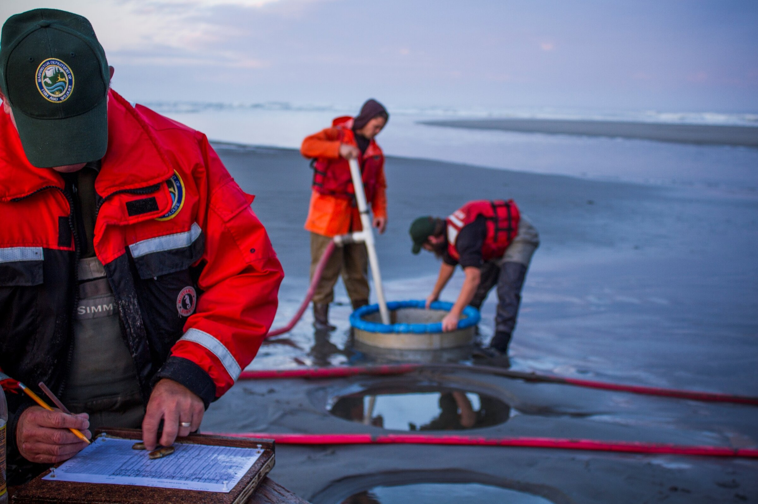
Pumped Area Method
Annual Summer Stock Assessment
Determine Total Allowable Catch (TAC) on each beach

Slide 7
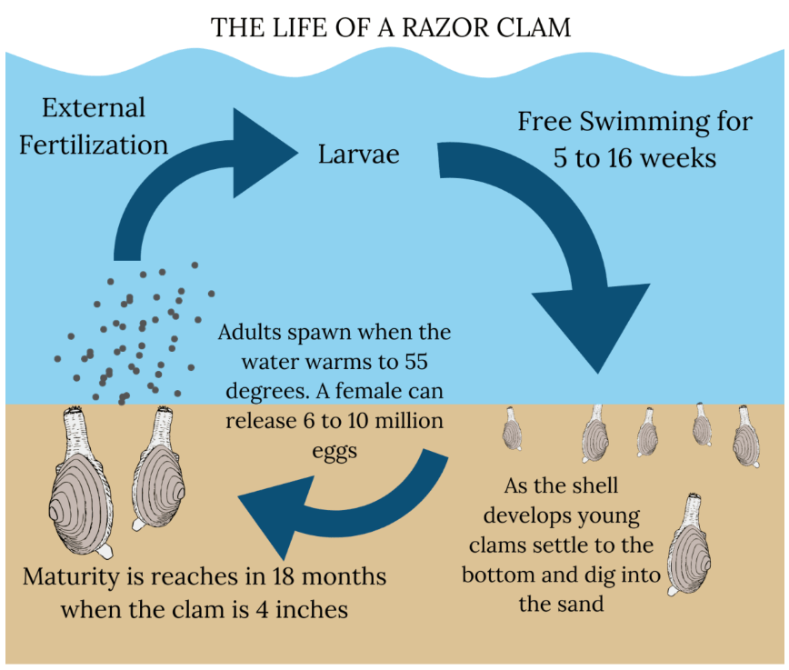
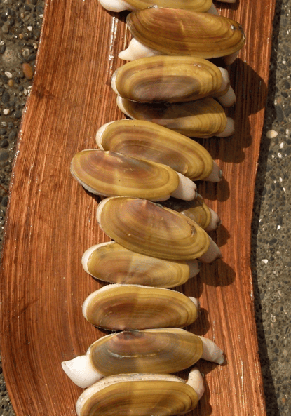
Razor Clam Life Cycle
d

Slide 8
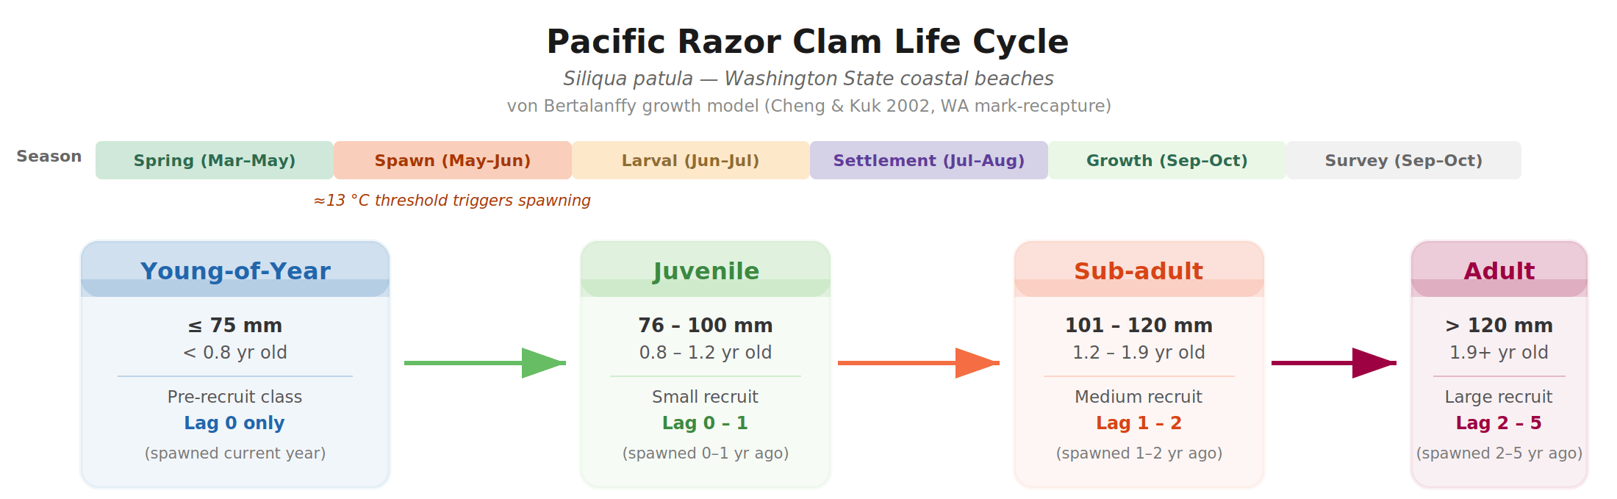
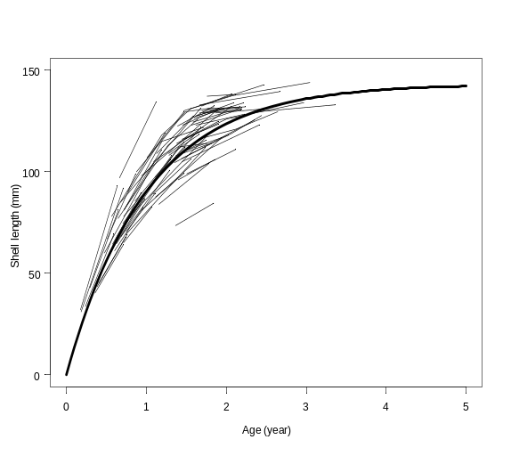
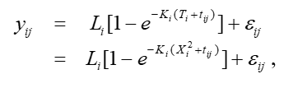
Q1: Recruitment Trends

Slide 9
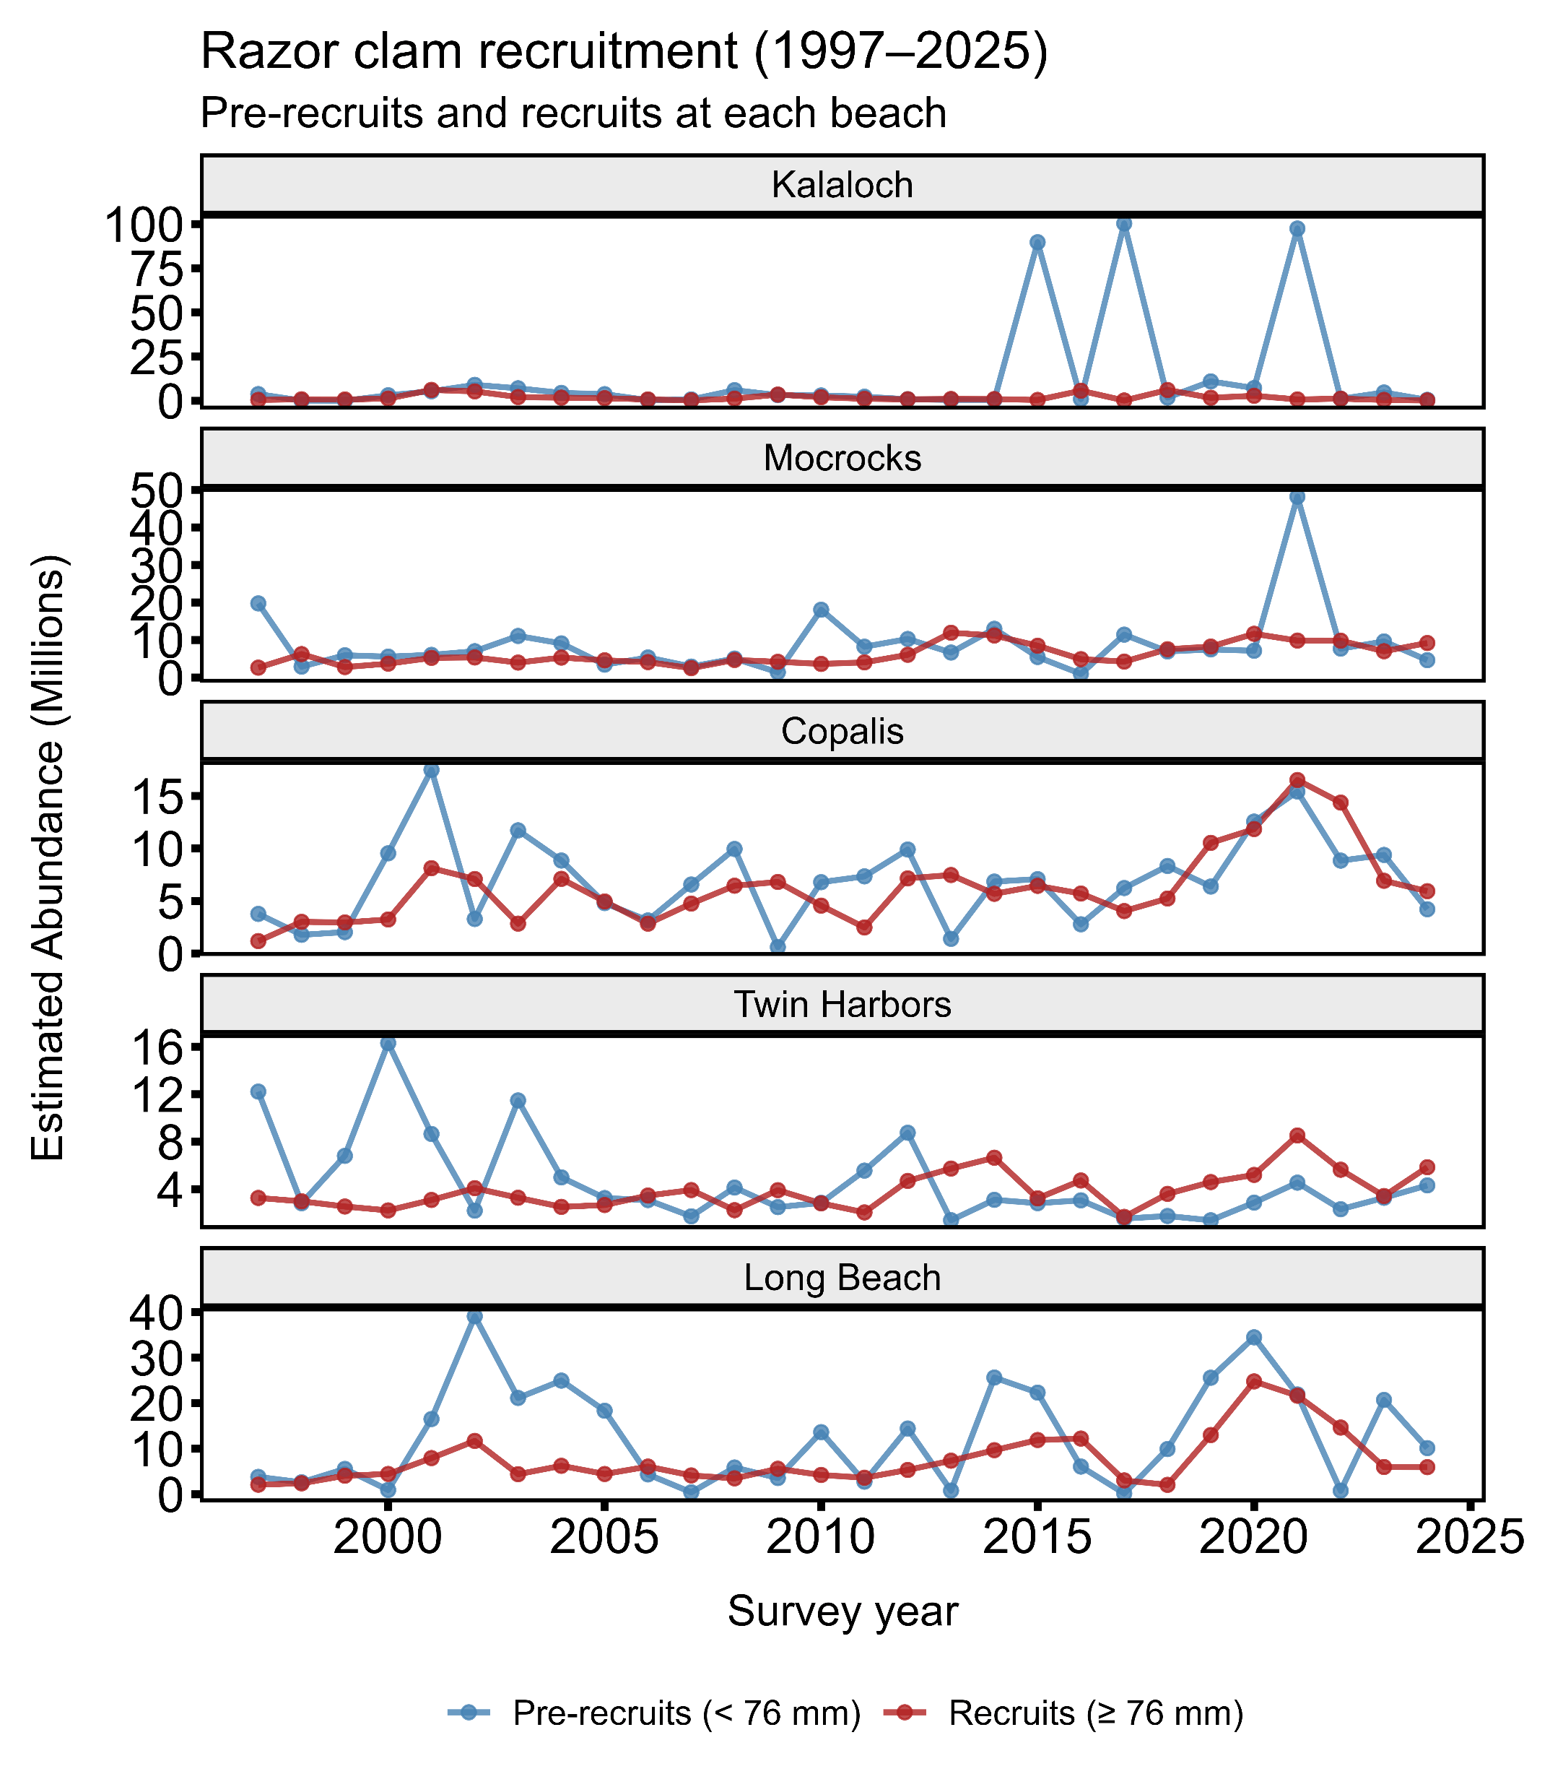
Q1: Recruitment Trends
Razor Clam
Recreational

Slide 10
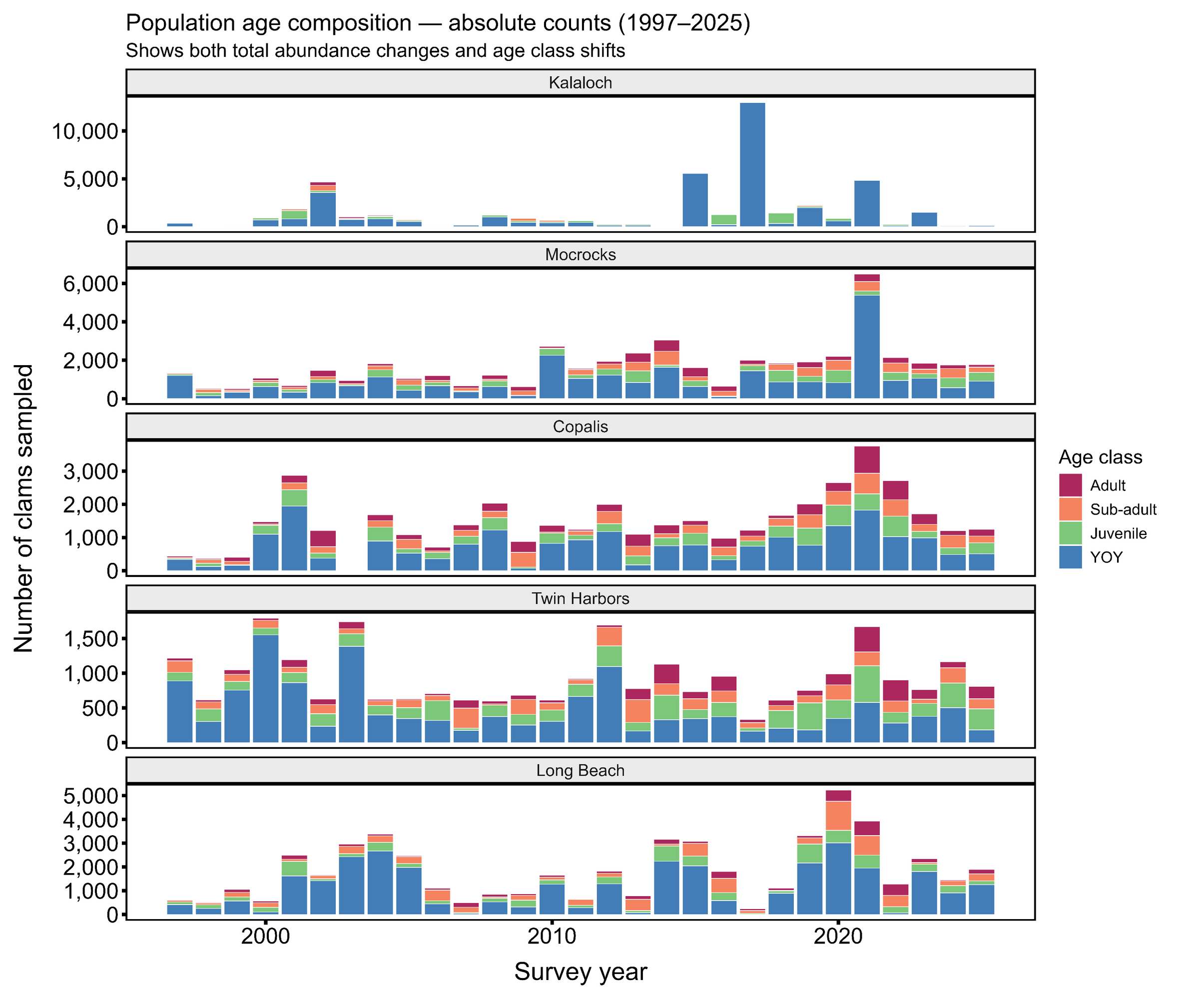
Q1: Recruitment Trends

Slide 11
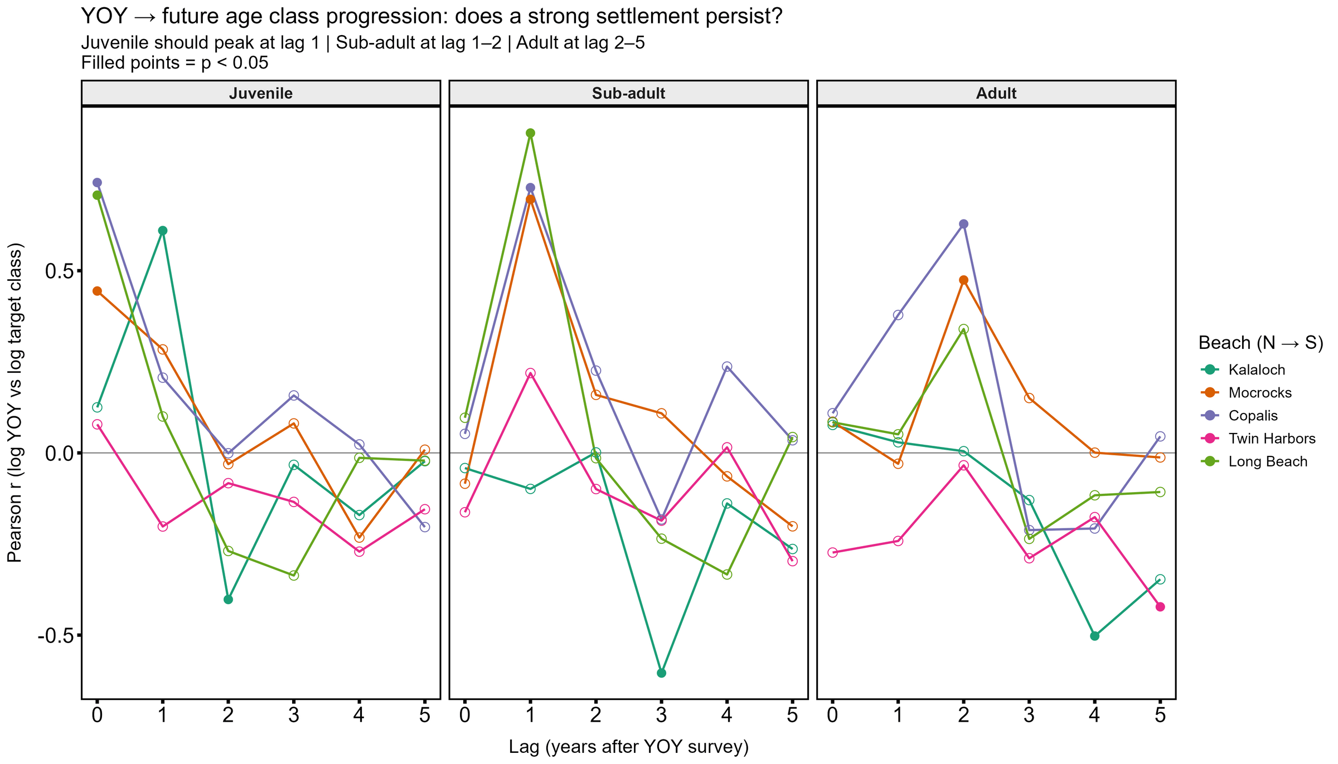
Q1: Recruitment Trends

Slide 12
Questions
What trends exist in recruitment across time?
  Large peaks observed in summer stock assessment associated with settlement (YOY age class)
  Cohort signal evident in following years in juvenile, sub-adult, and adult clams (except at Kalaloch)
Which environmental variables influence razor clam recruitment across beaches?

Slide 13
Questions
What trends exist in recruitment across time?
  Large peaks observed in summer stock assessment associated with settlement (YOY age class)
  Cohort signal evident in following years in juvenile, sub-adult, and adult clams (except at Kalaloch)
Which environmental variables influence razor clam recruitment across beaches?

Slide 14
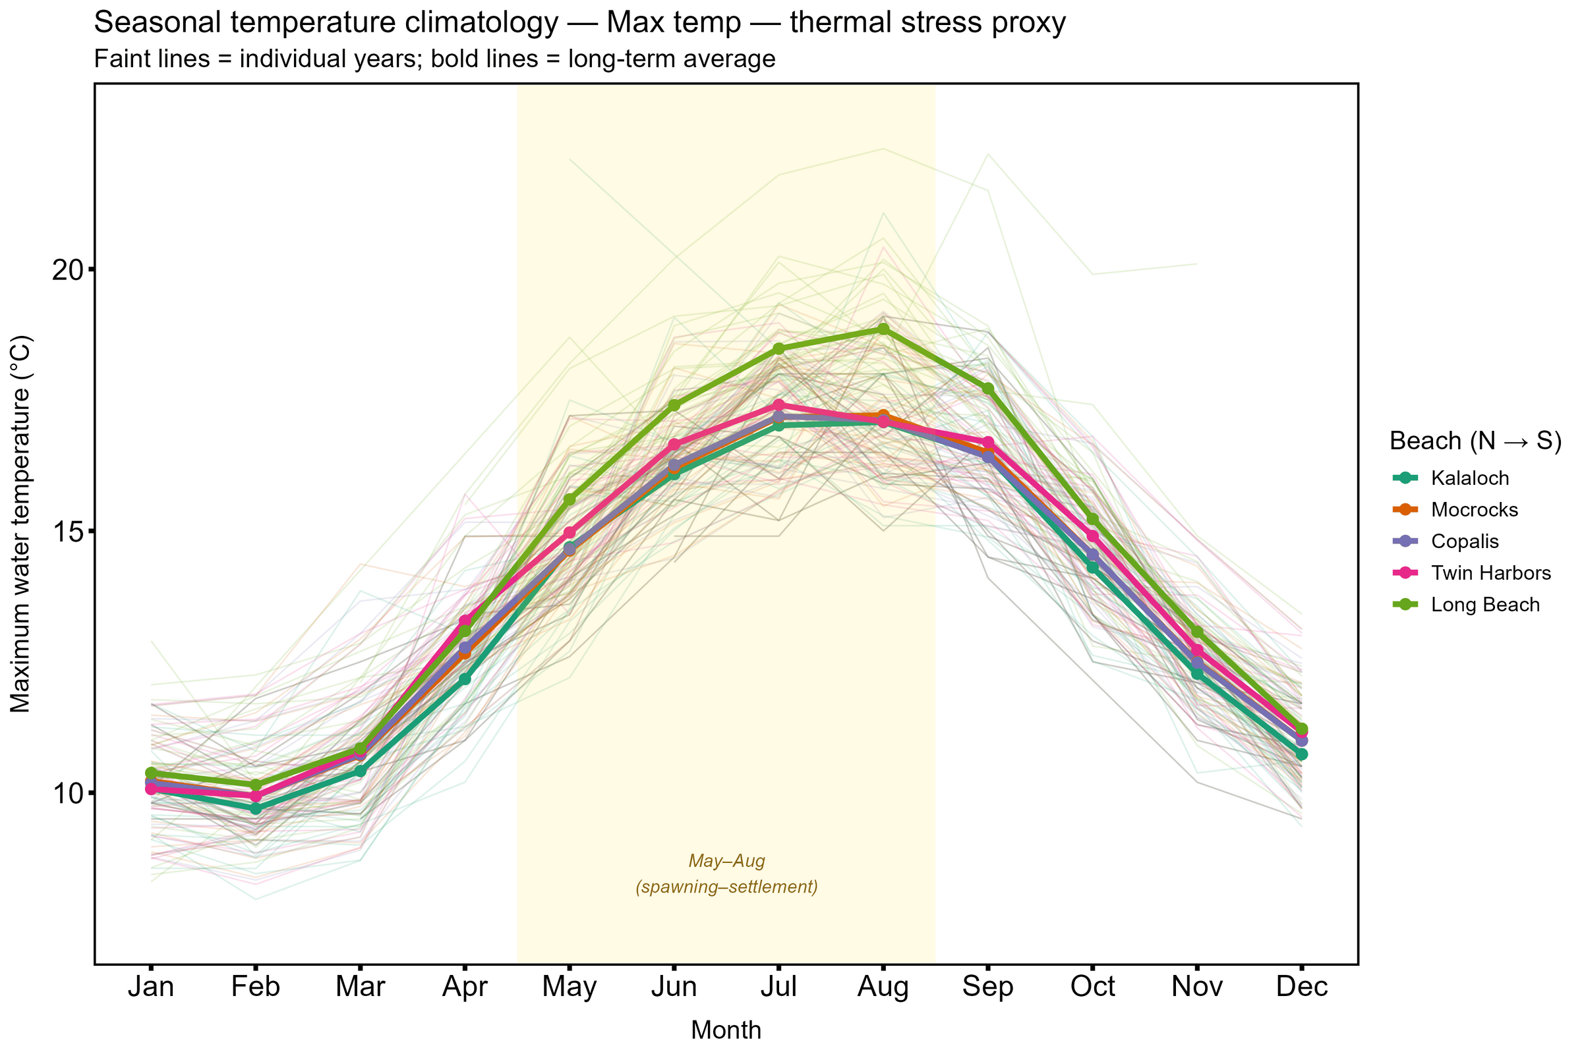
Maximum water temperature
Q2: Environmental Influence
Hypothesis:
Warm temperatures have a negative impact on larvae, but a positive impact on grow in later life stages

Slide 15
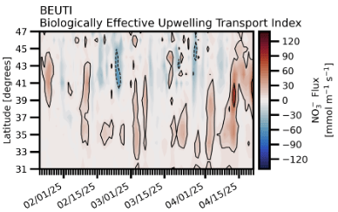
BEAUTI
Q2: Environmental Influence
The Biologically Effective Upwelling Transport Index (BEUTI) estimates vertical nitrate flux in coastal waters
Hypothesis:
Higher nitrate flux increases algal growth, improving food availability across life stages.

Slide 16
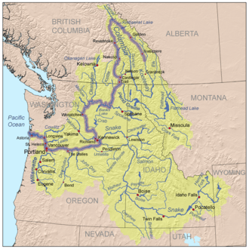
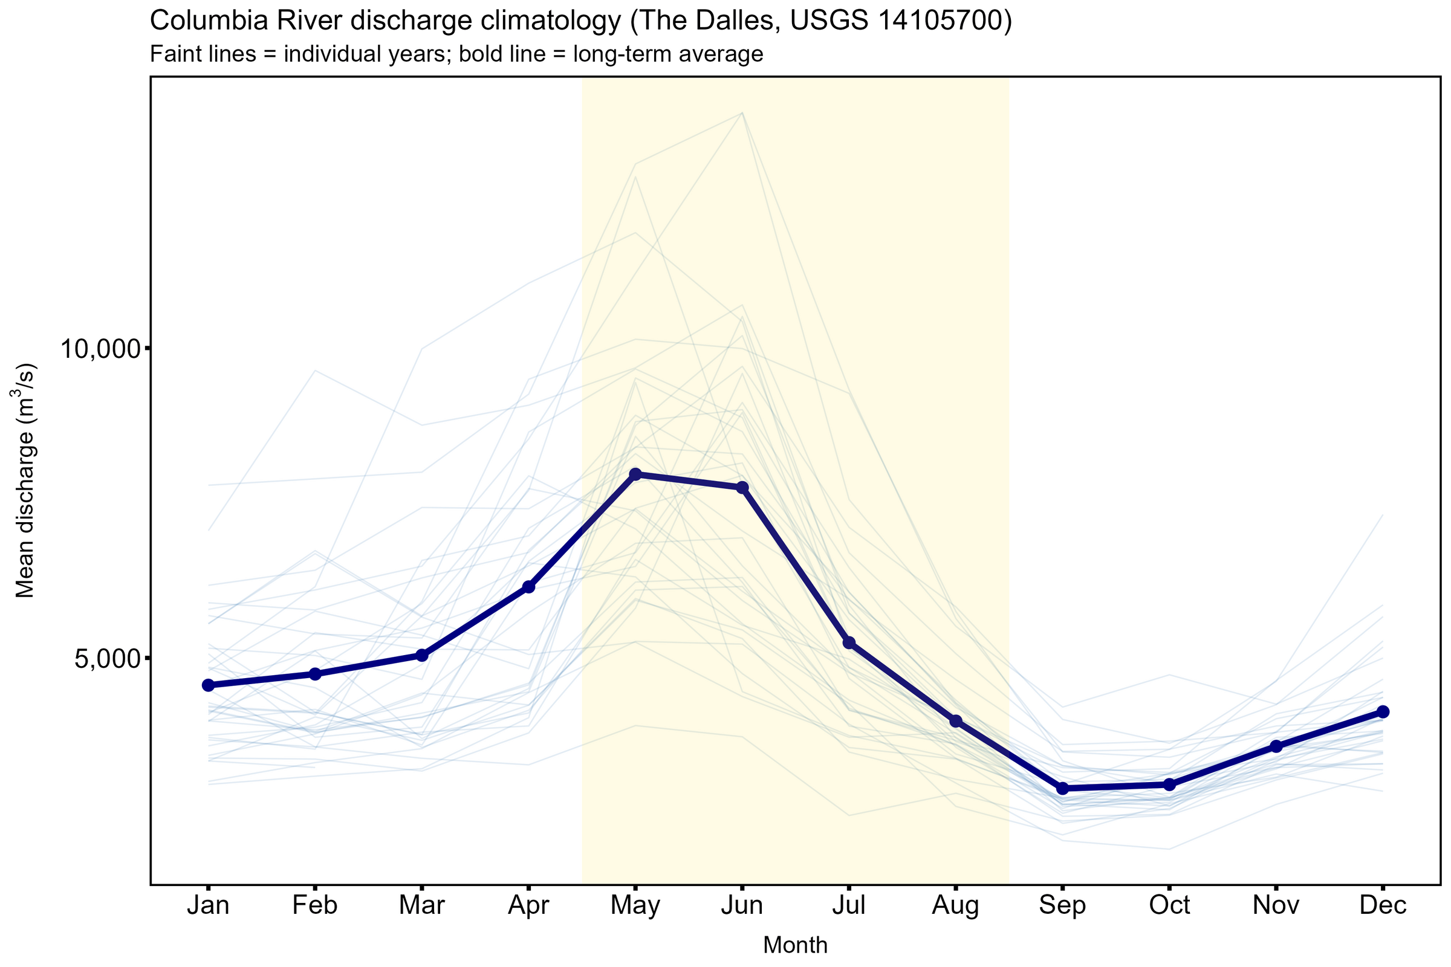
Columbia River Discharge
Q2: Environmental Influence
Hypothesis:
Greater discharge from the CR decreases salinity and imposes a stress on clams. Greater discharge could also increase diatom grow, increasing food availability.

Slide 17
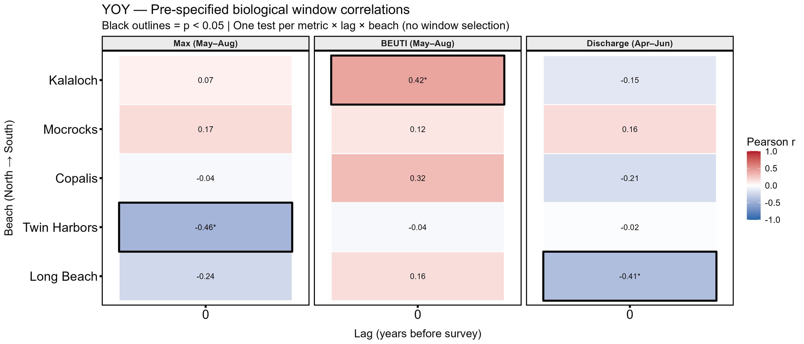
Q2: Environmental Influence
Method:
Calculate Pearson correlations between the abundance of clams at each life stage at each beach and environmental conditions during recruitment.

Slide 18
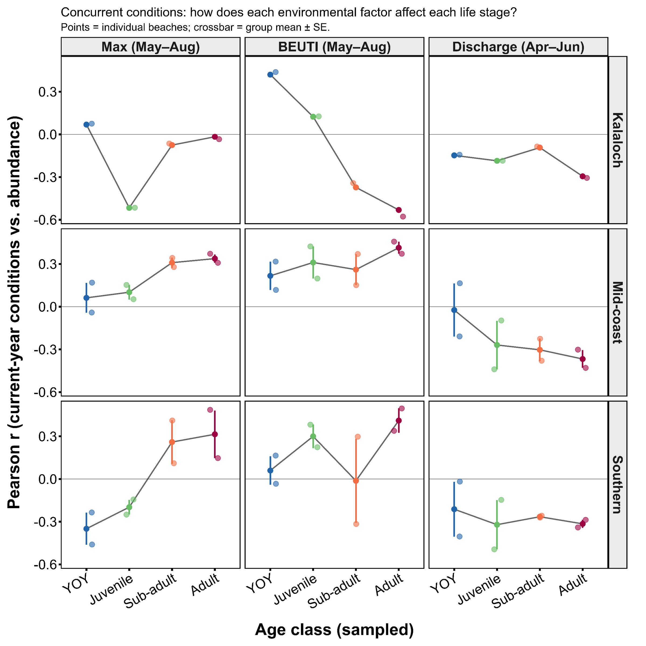
Q2: Environmental Influence
Temperature Stress
Food Availability
Salinity Stress

Slide 19
Q2: Environmental Influence
Temperature Stress
Food Availability
Salinity Stress

Slide 20
Q2: Environmental Influence

Slide 21
Questions
What trends exist in recruitment across time?
  Large peaks observed in summer stock assessment associated with settlement (YOY age class)
  Cohort signal evident in following years in juvenile, sub-adult, and adult clams (except at Kalaloch)
Which environmental variables influence razor clam recruitment across beaches?
  Warm temperatures are negative/neutral for YOY and positive for adults
  BEUTI is the most reliable positive driver of recruitment (except at Kalaloch)
  Discharge is negative across all age classes, but more impactful on southern beaches

Slide 22
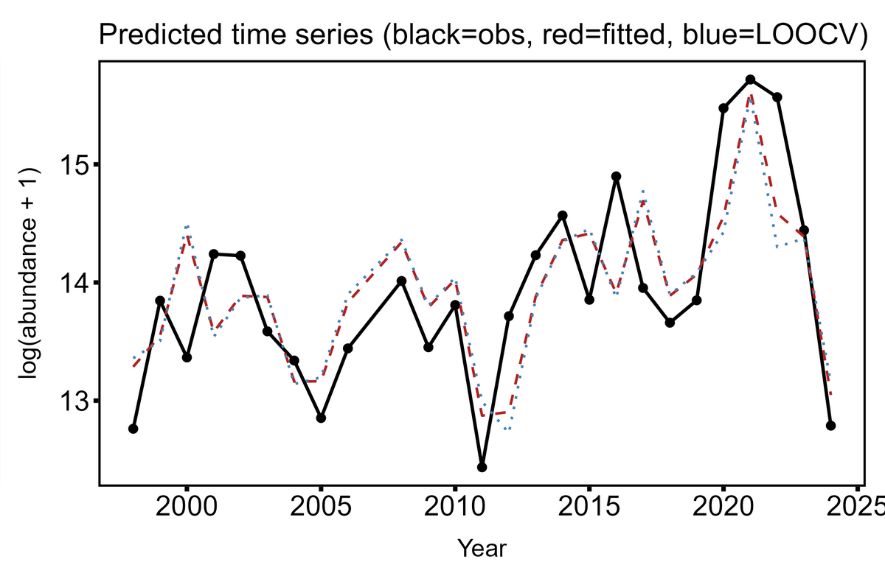




Partners
Future Directions
First attempt for Adults at Long Beach:
Develop beach-specific abundance estimates to project stock health and digging opportunity into the future
WDFW Razor Clam Team
Quinault Indian Nation
Hoh Indian Tribe
Olympic National Park

Slide 23
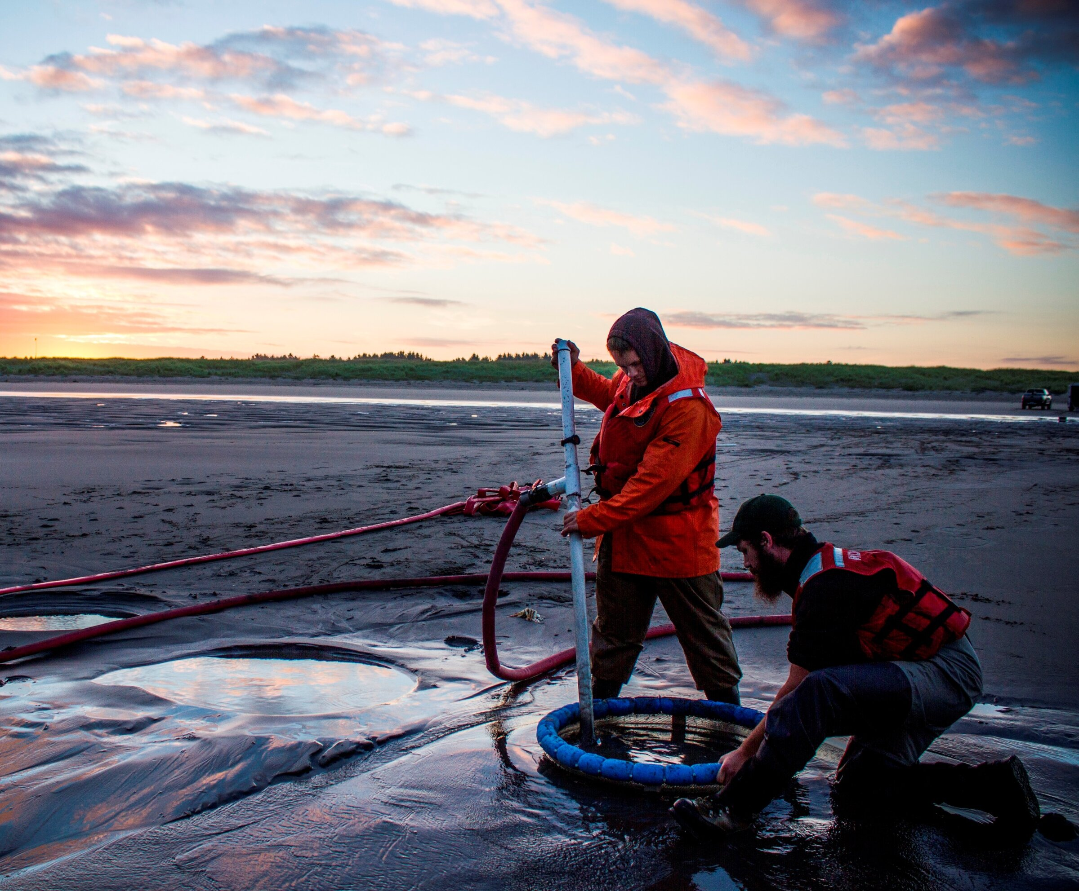
Questions?

