Slide 1
Aligning State Management to Shifting Baselines in Washington's Coastal Dungeness Crab Fishery
Matt George, Ph.D.
Coastal Shellfish Manager
Matthew.George@dfw.wa.gov

Slide 2
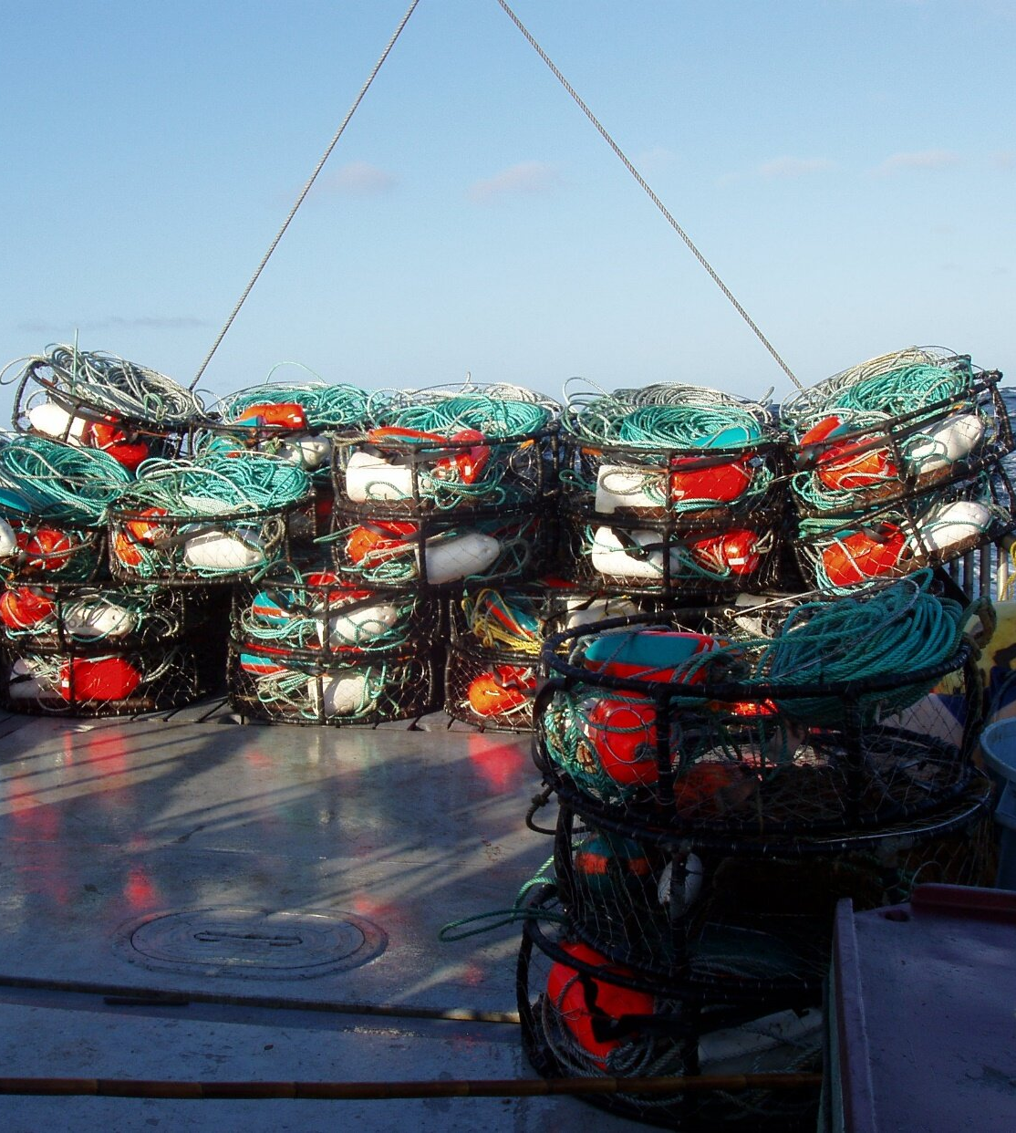
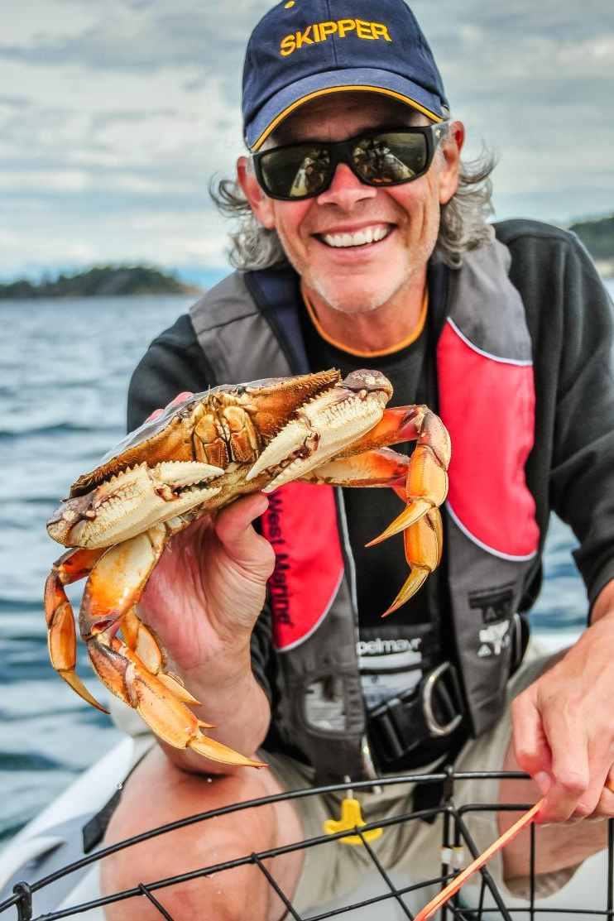
Dungeness Crab
Commercial
Recreational

Slide 3

Washington Coastal Commercial Dungeness Crab Fishery
Fishing Effort
State managed fishery since 1927.
Extends along the entire Washington Pacific coast.
Major ports include Westport, Ilwaco, and Chinook.
Pots are typically set within 80 fathoms

Slide 4
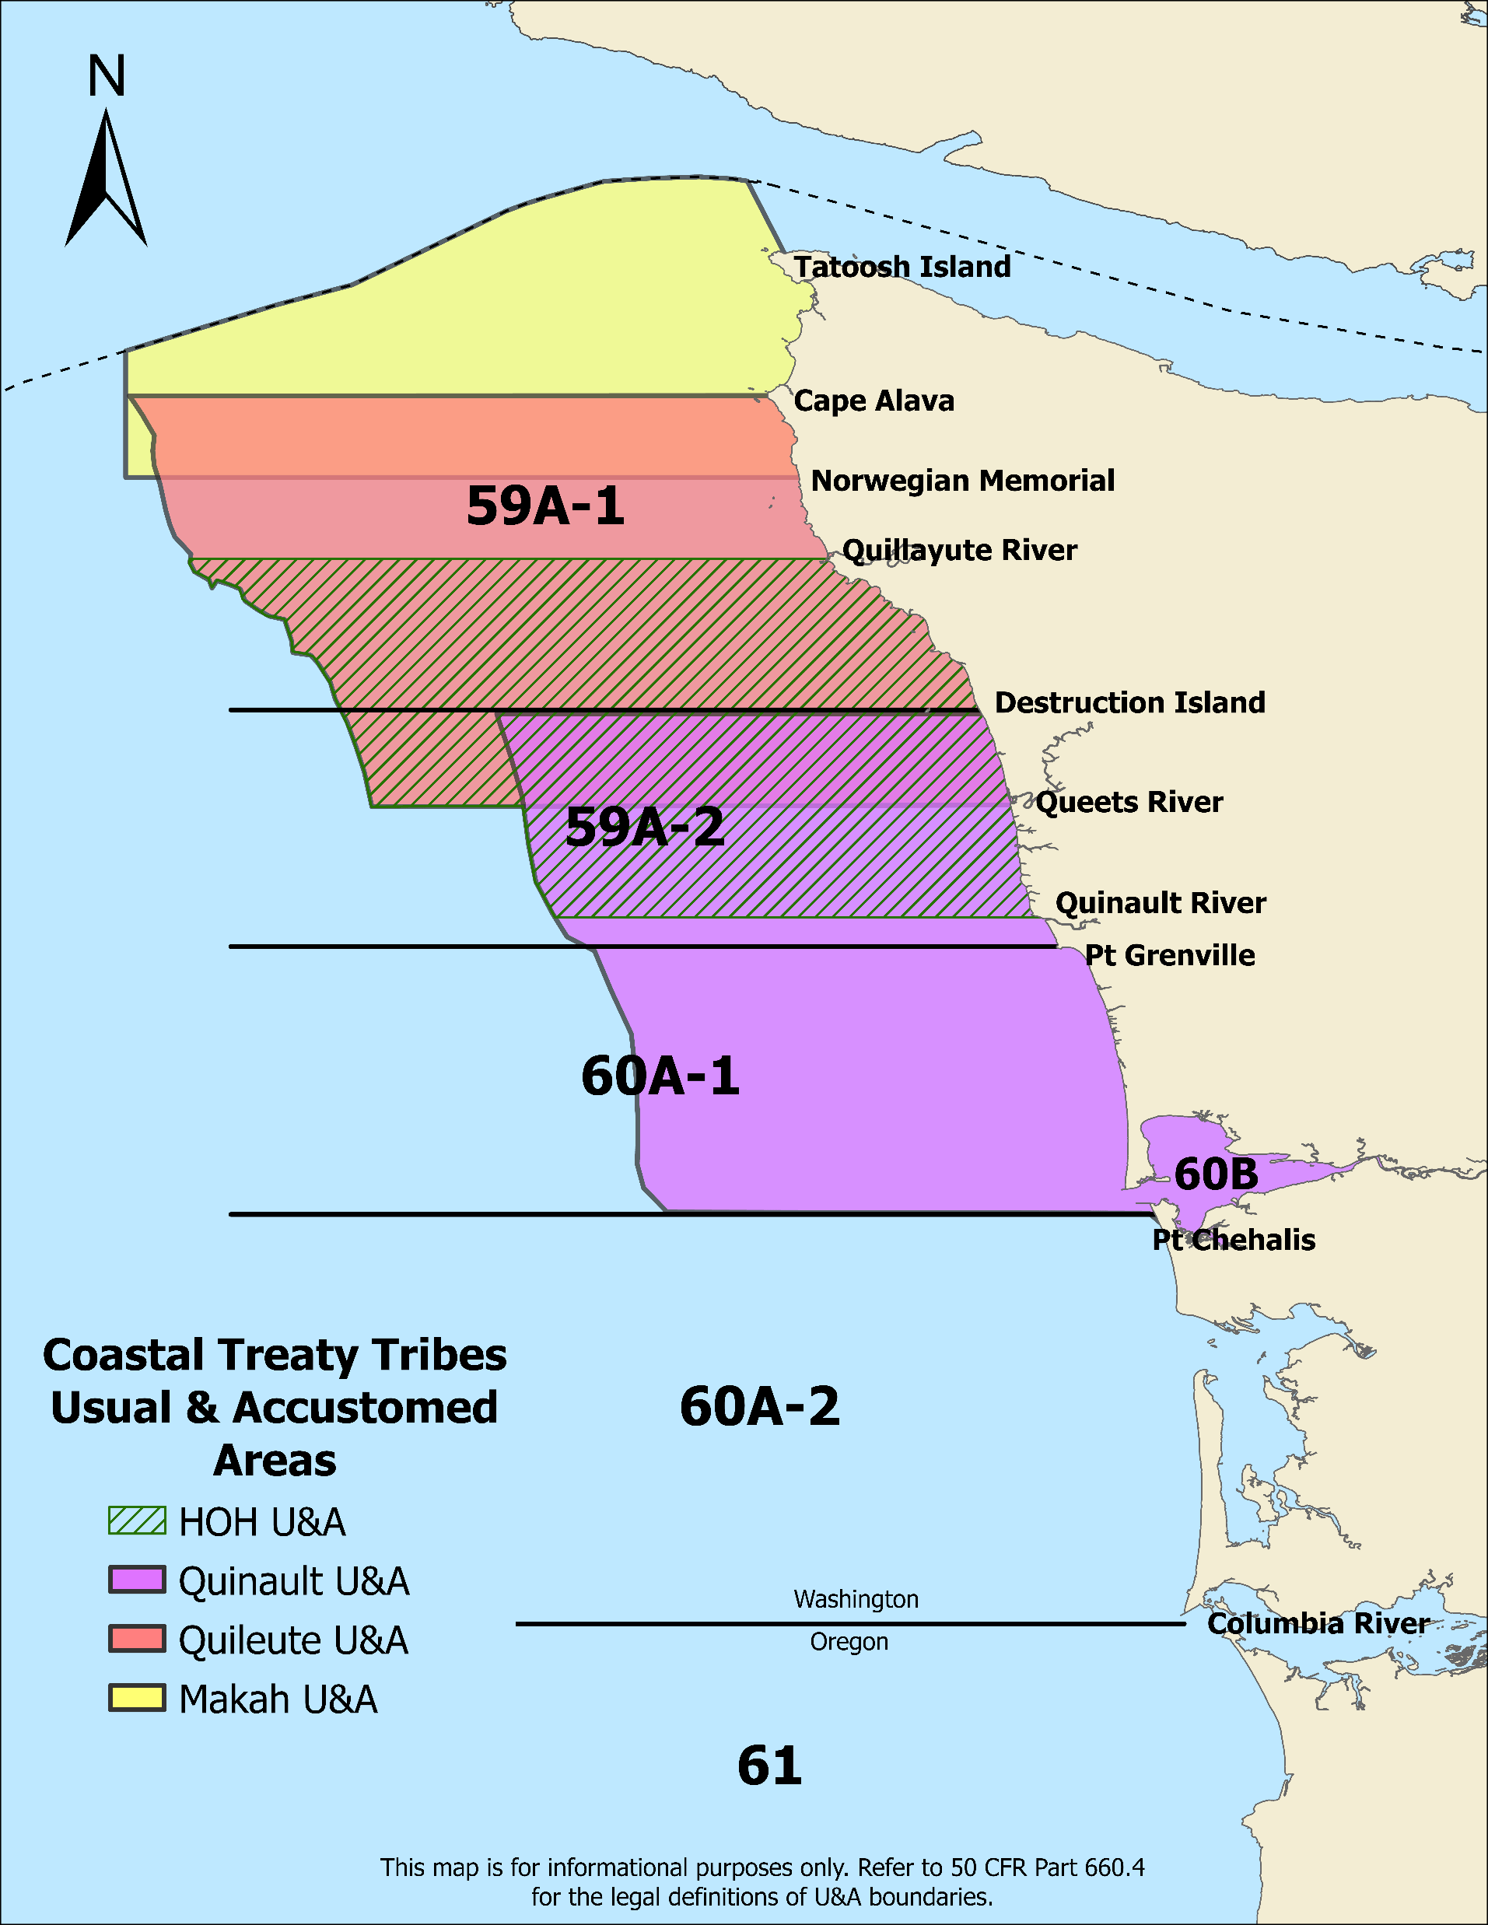
Tribal Co-management
Co-managed with four coastal treaty tribes.
The fishery within tribal U&A are managed through mutually agreed upon annual harvest management plans
Harvest management plans provide the opportunity for treaty tribes to catch 50% of the harvestable crab within their U&A.

Slide 5
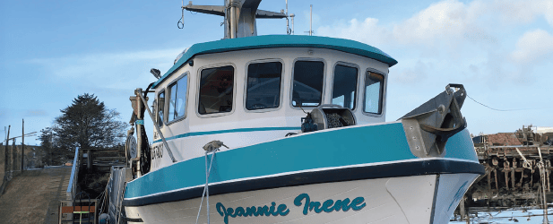
3S Management Strategy
(Size, Sex, Season)
Summer Fishery Management
Derelict Gear Recovery
Preseason testing
Tribal co-management
Fishery Opens
(Dec 1 – Feb 1)
Fishery Closes (Sept 15)

Slide 6
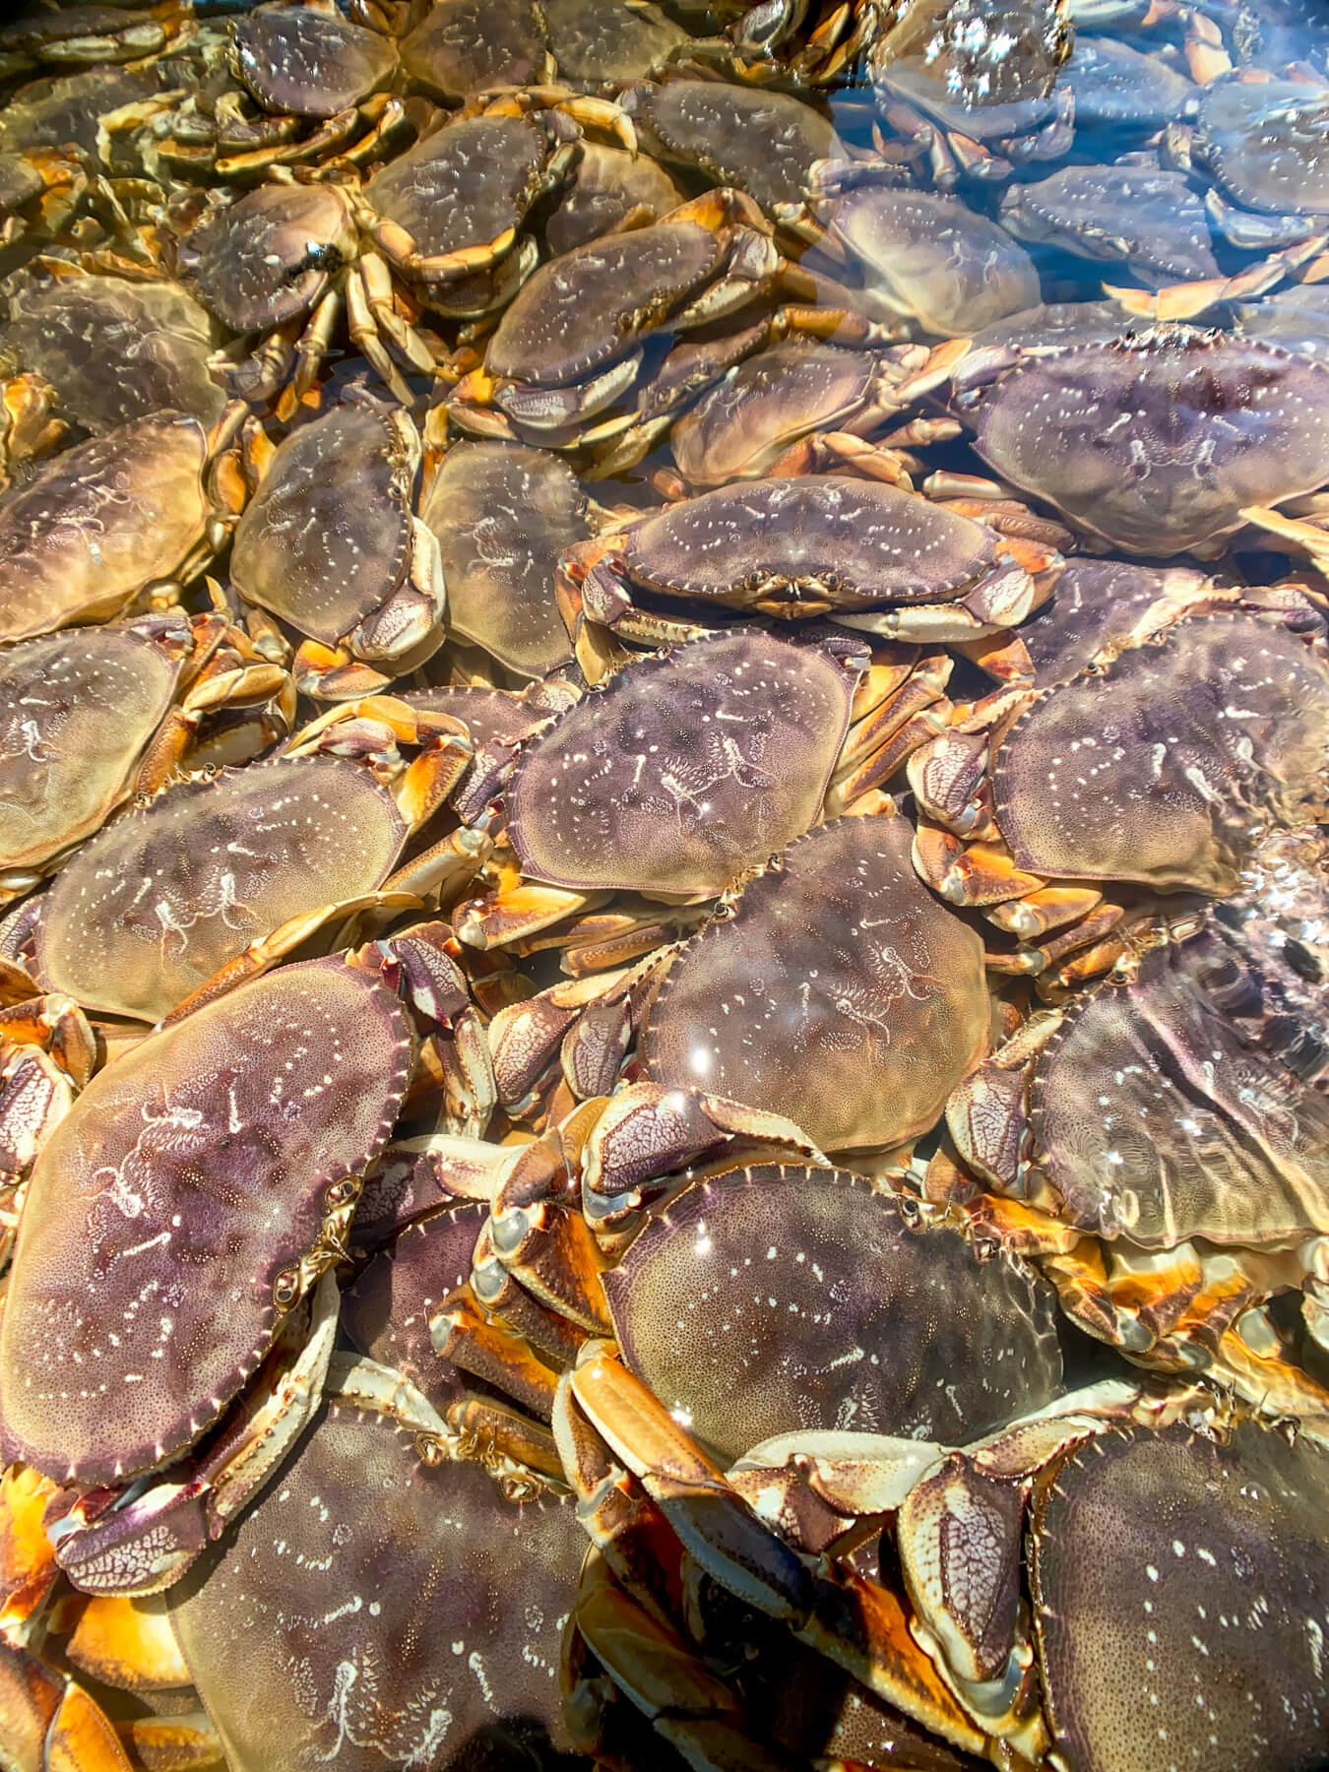
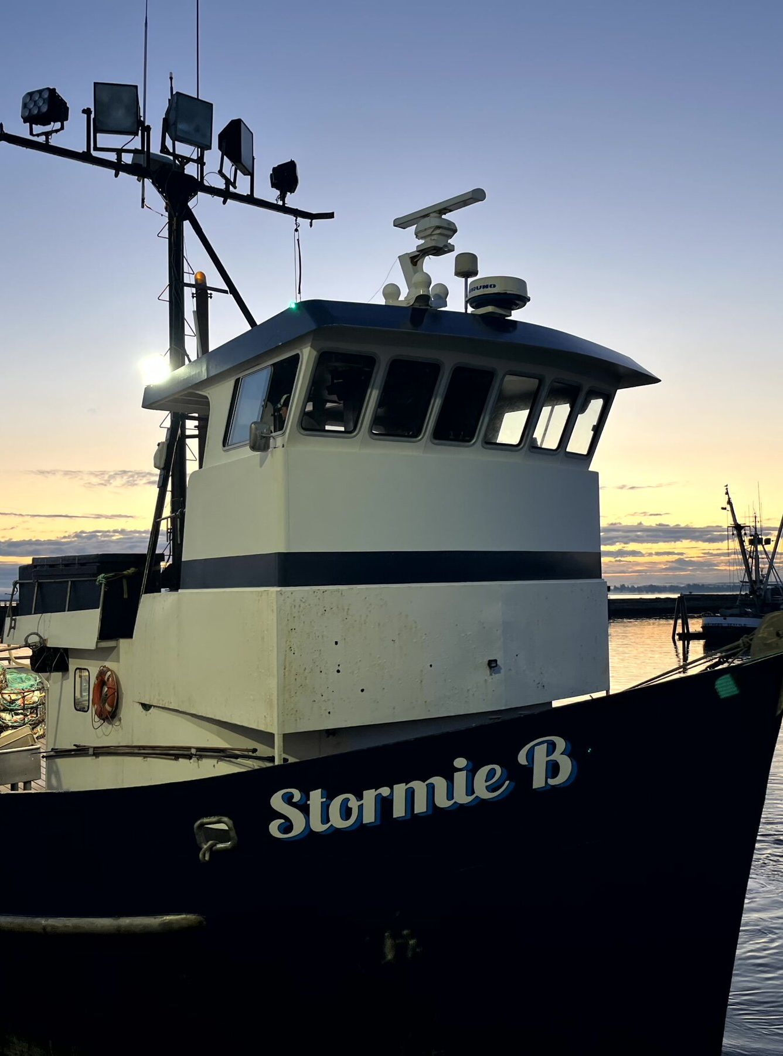
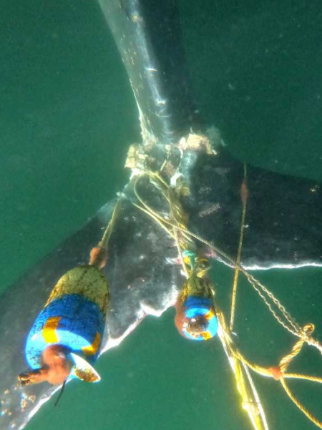

Shifting Baselines
Annual Landings
Season openers
Marine life entanglements

Slide 7
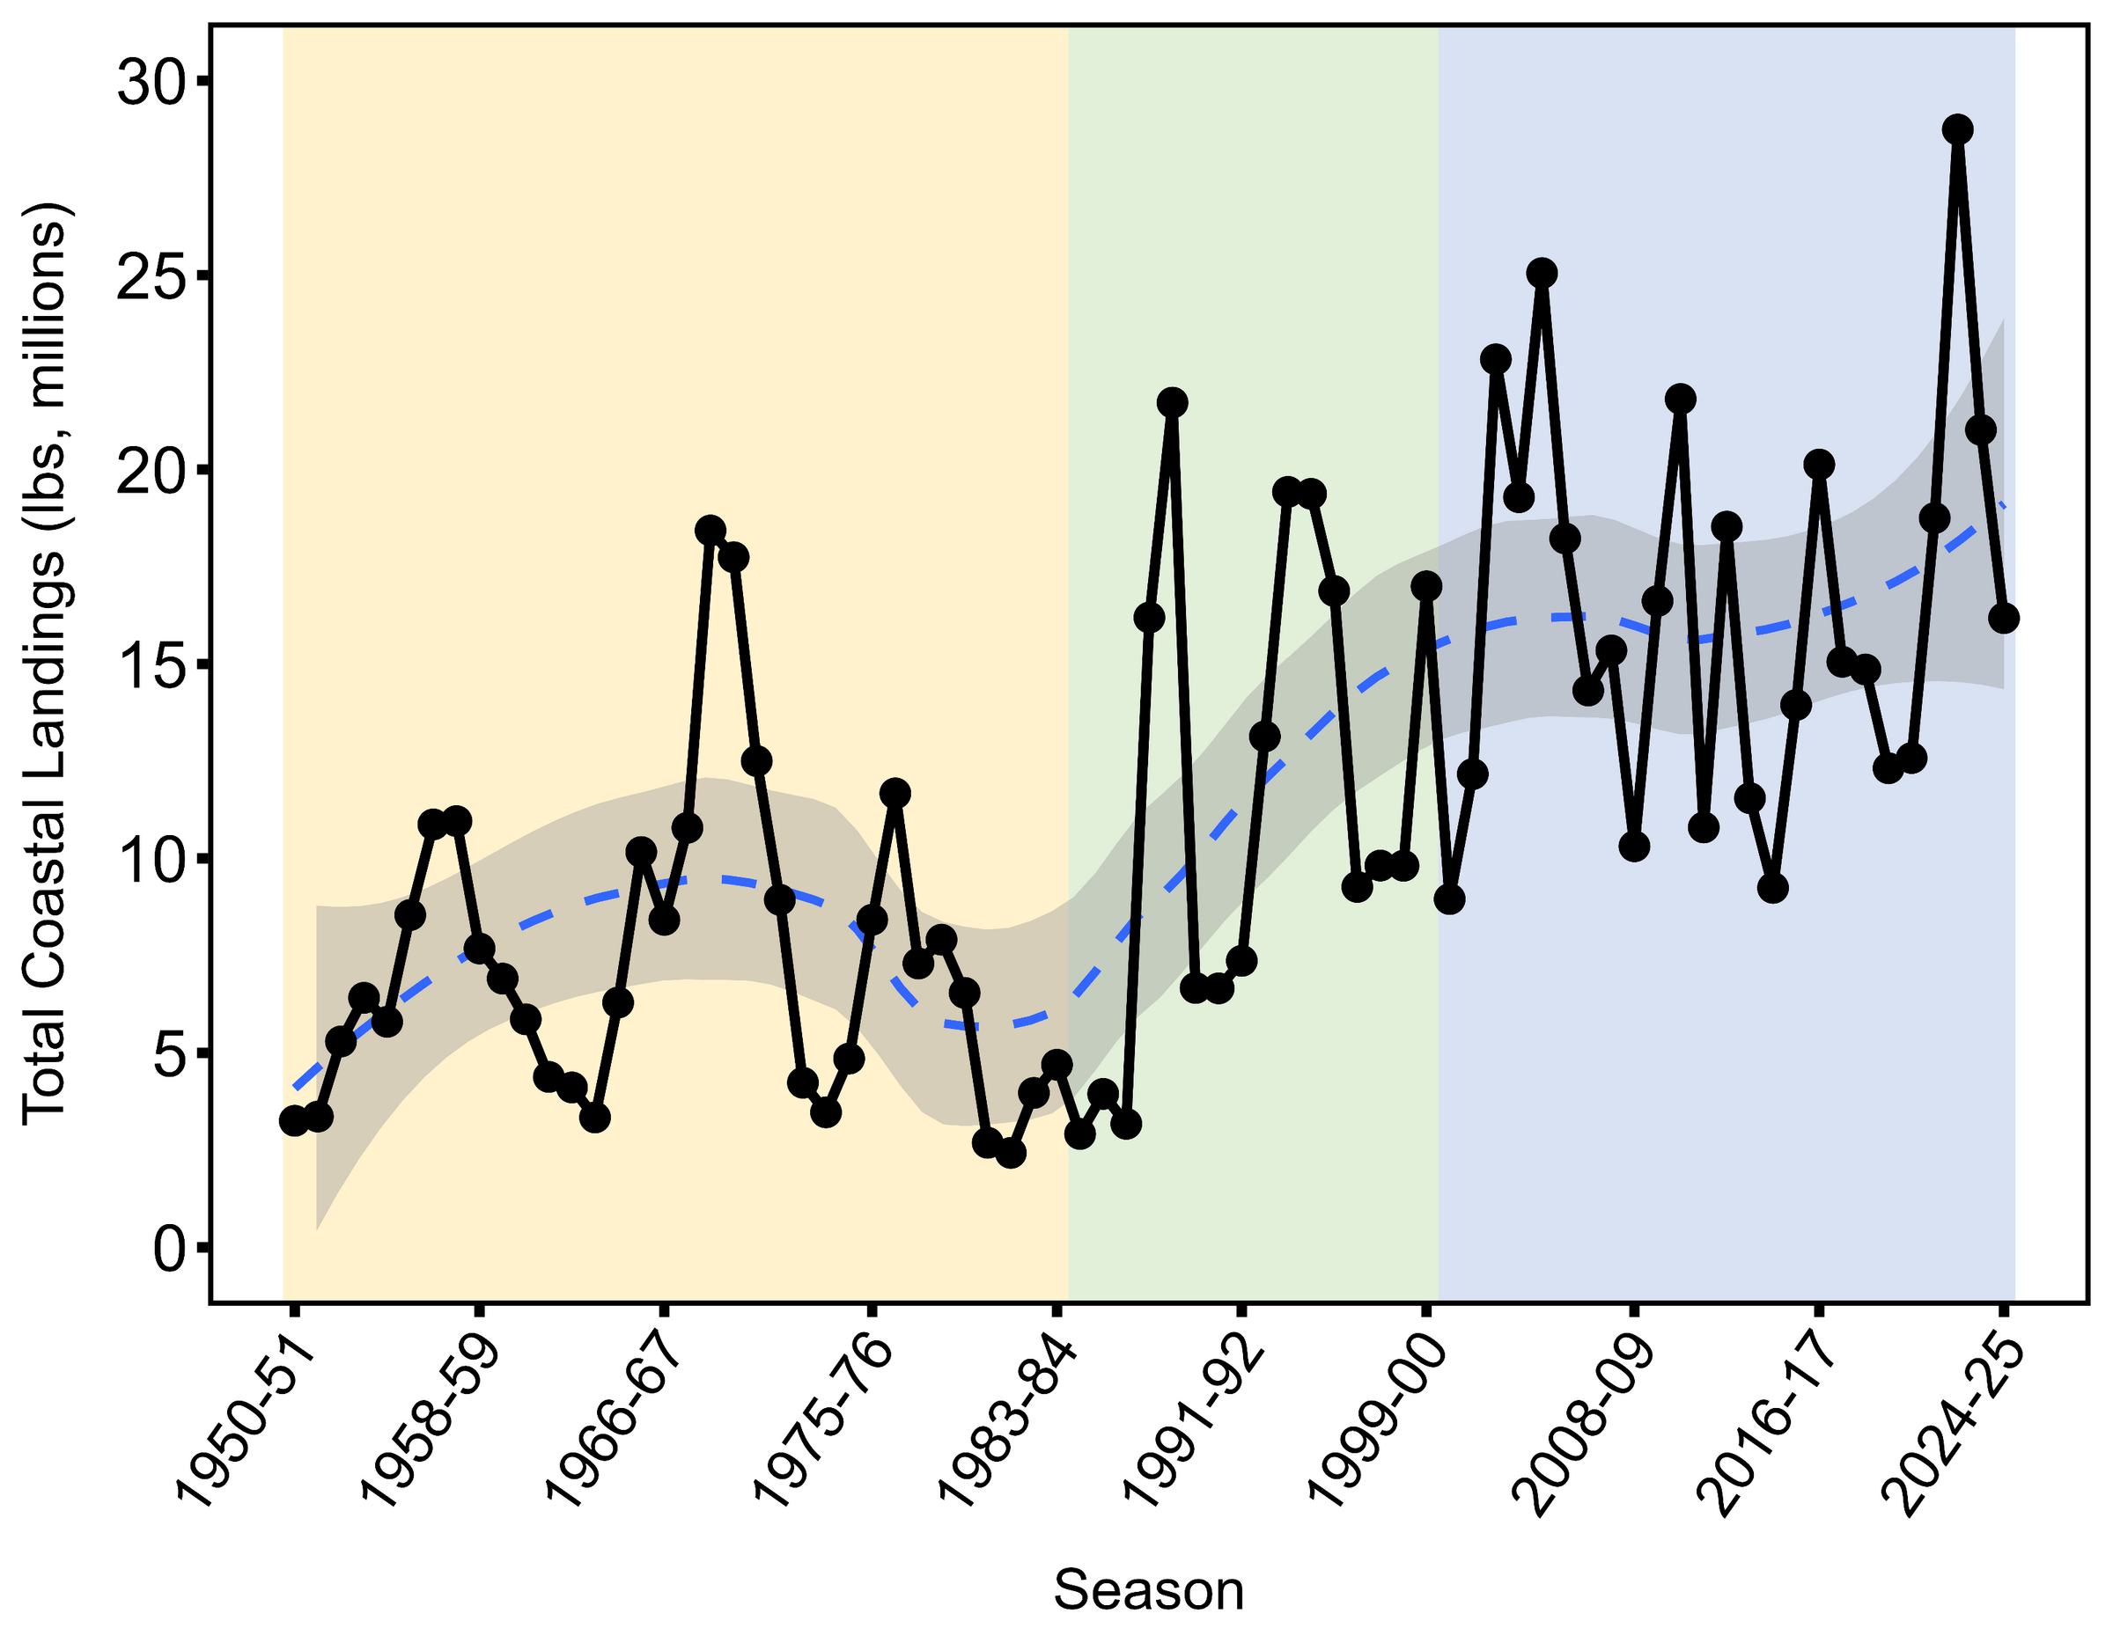
Annual landings are increasing
Effort Expansion
Effort Reduction
Co-management
Modernization
Conservation
Historical Landings have ranged from:
Low: 2.5 million lbs (1980-81)
High: 28.7 million lbs (2022-23)

Slide 8
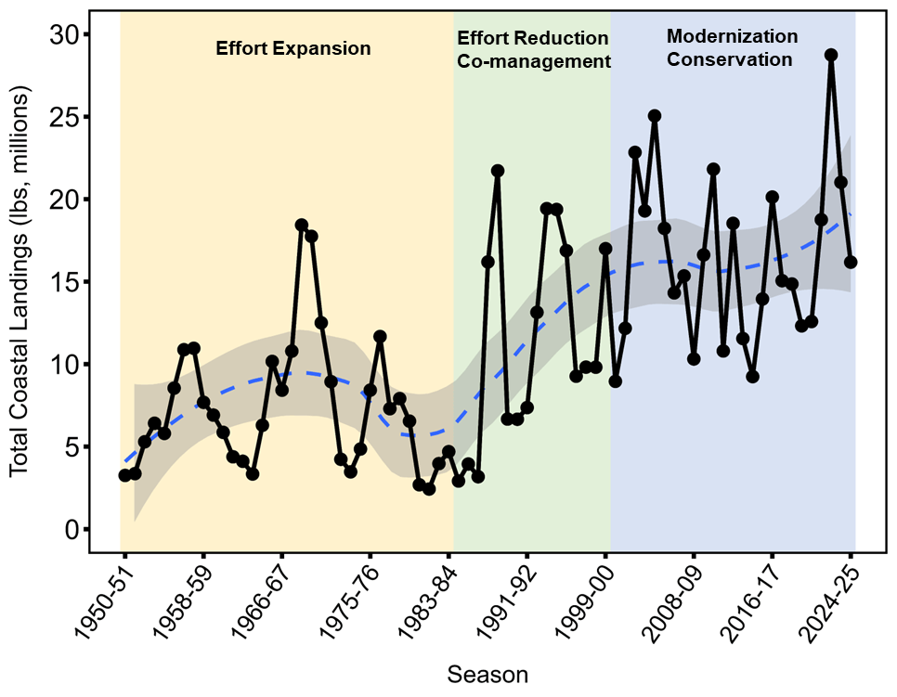
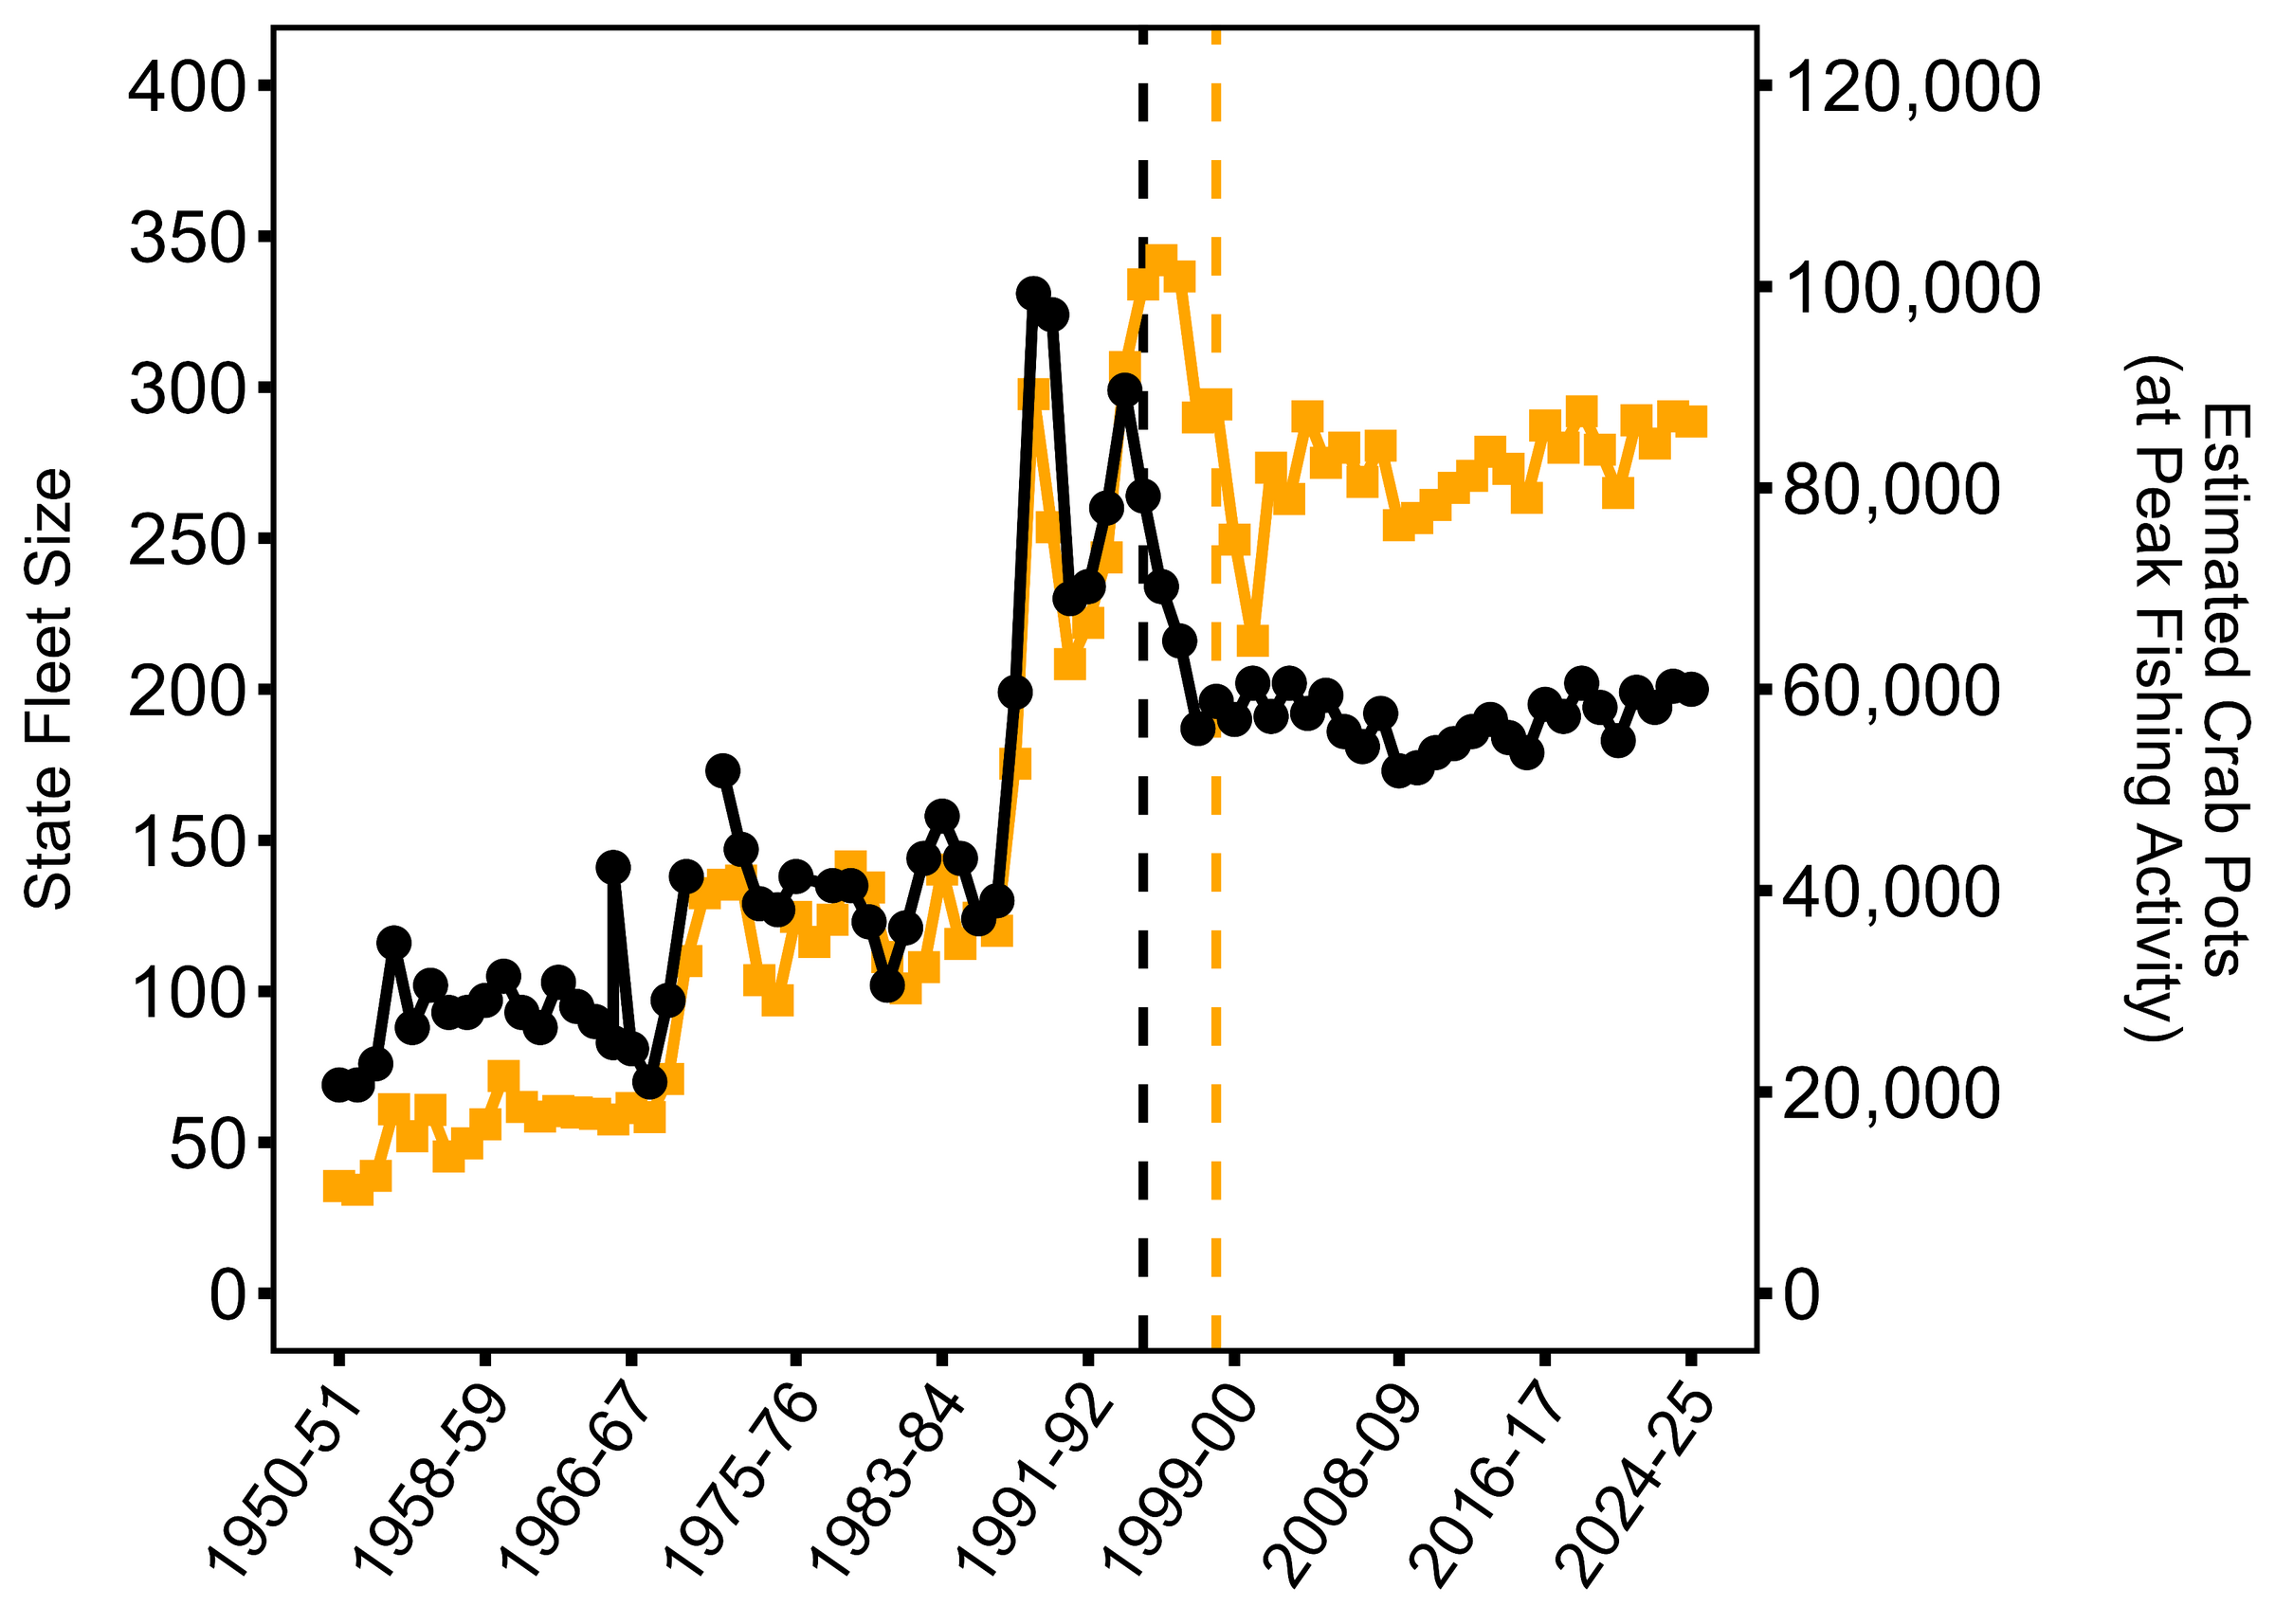
The State fleet has stabilized
Vessels
Crab Pots
Limited entry
Pot limits

Slide 9
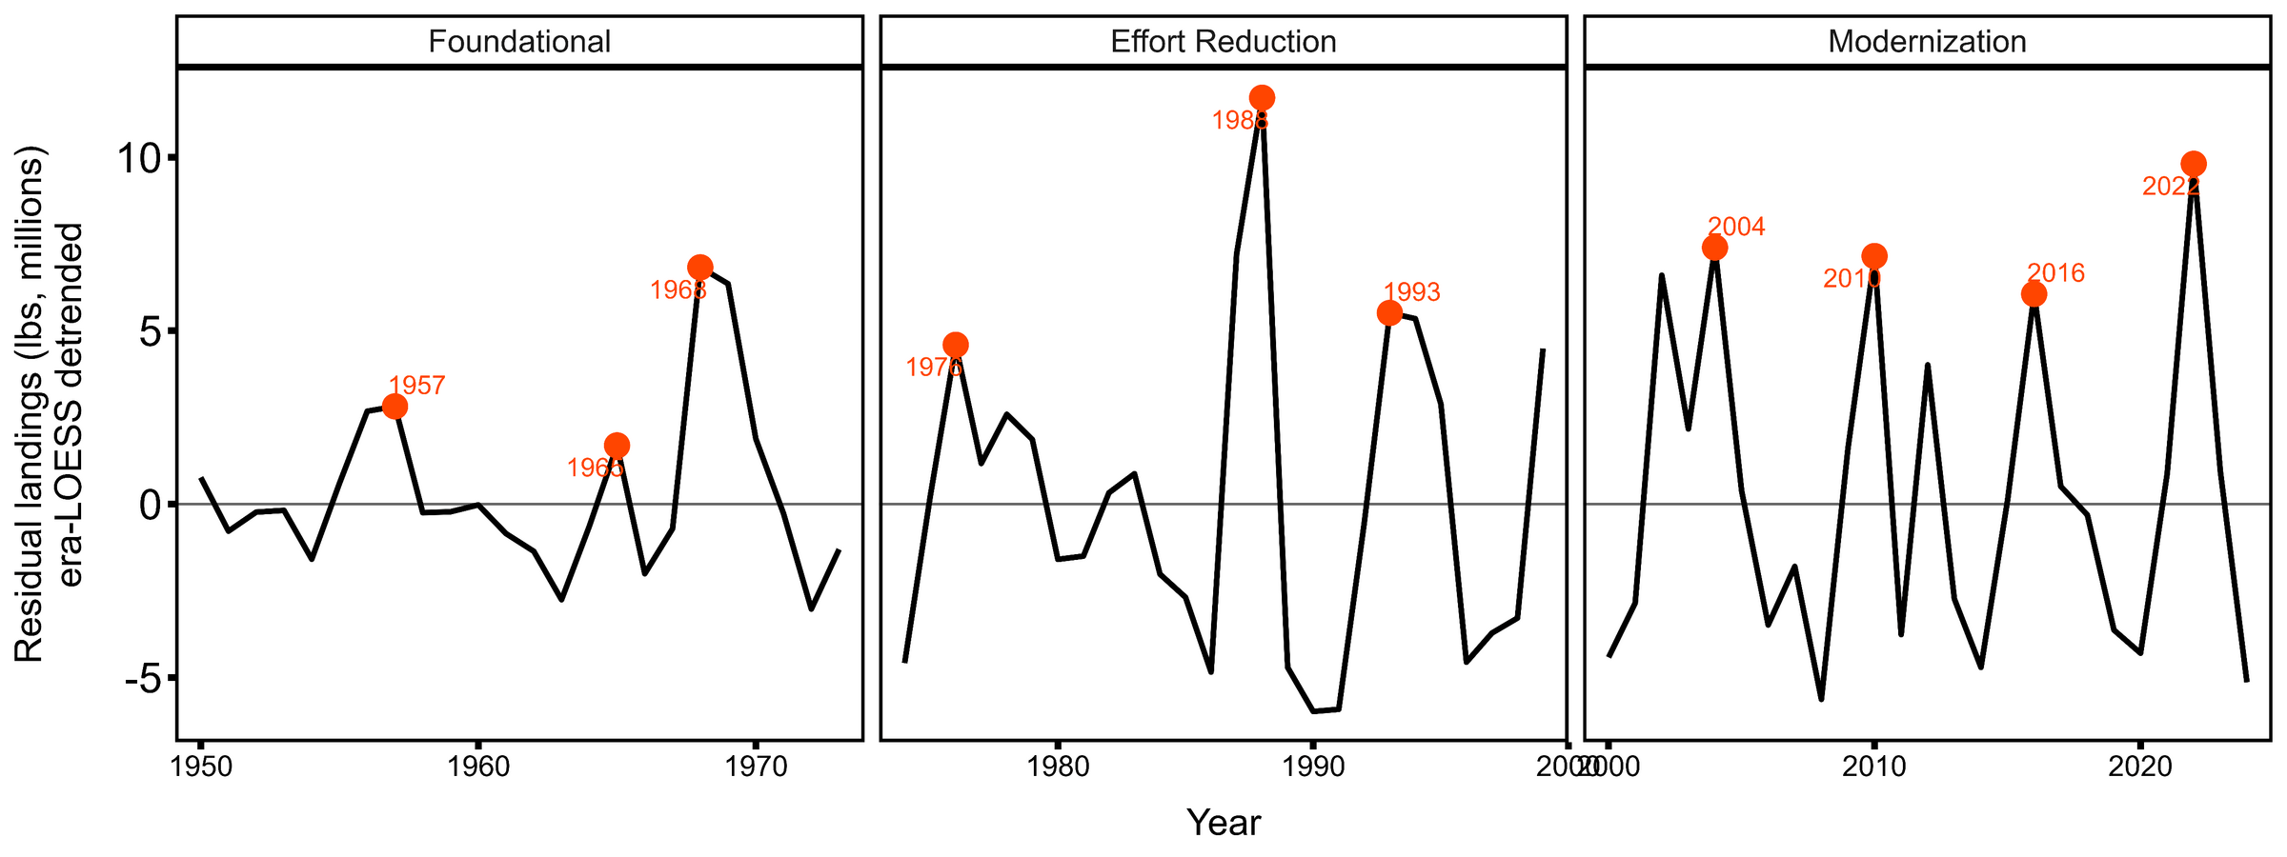
Time between abundance peaks is decreasing
~10 years
~6 years
No trend detected in amplitude of peaks

Slide 10
Season opening structure
The coast opens south to north.
Openers are determined by preseason testing.
Threshold of >23% Meat Recovery Percentage required.
Coordinate season opening structure with Oregon and California.
Zone 3
Zone 2
Zone 1

Slide 11
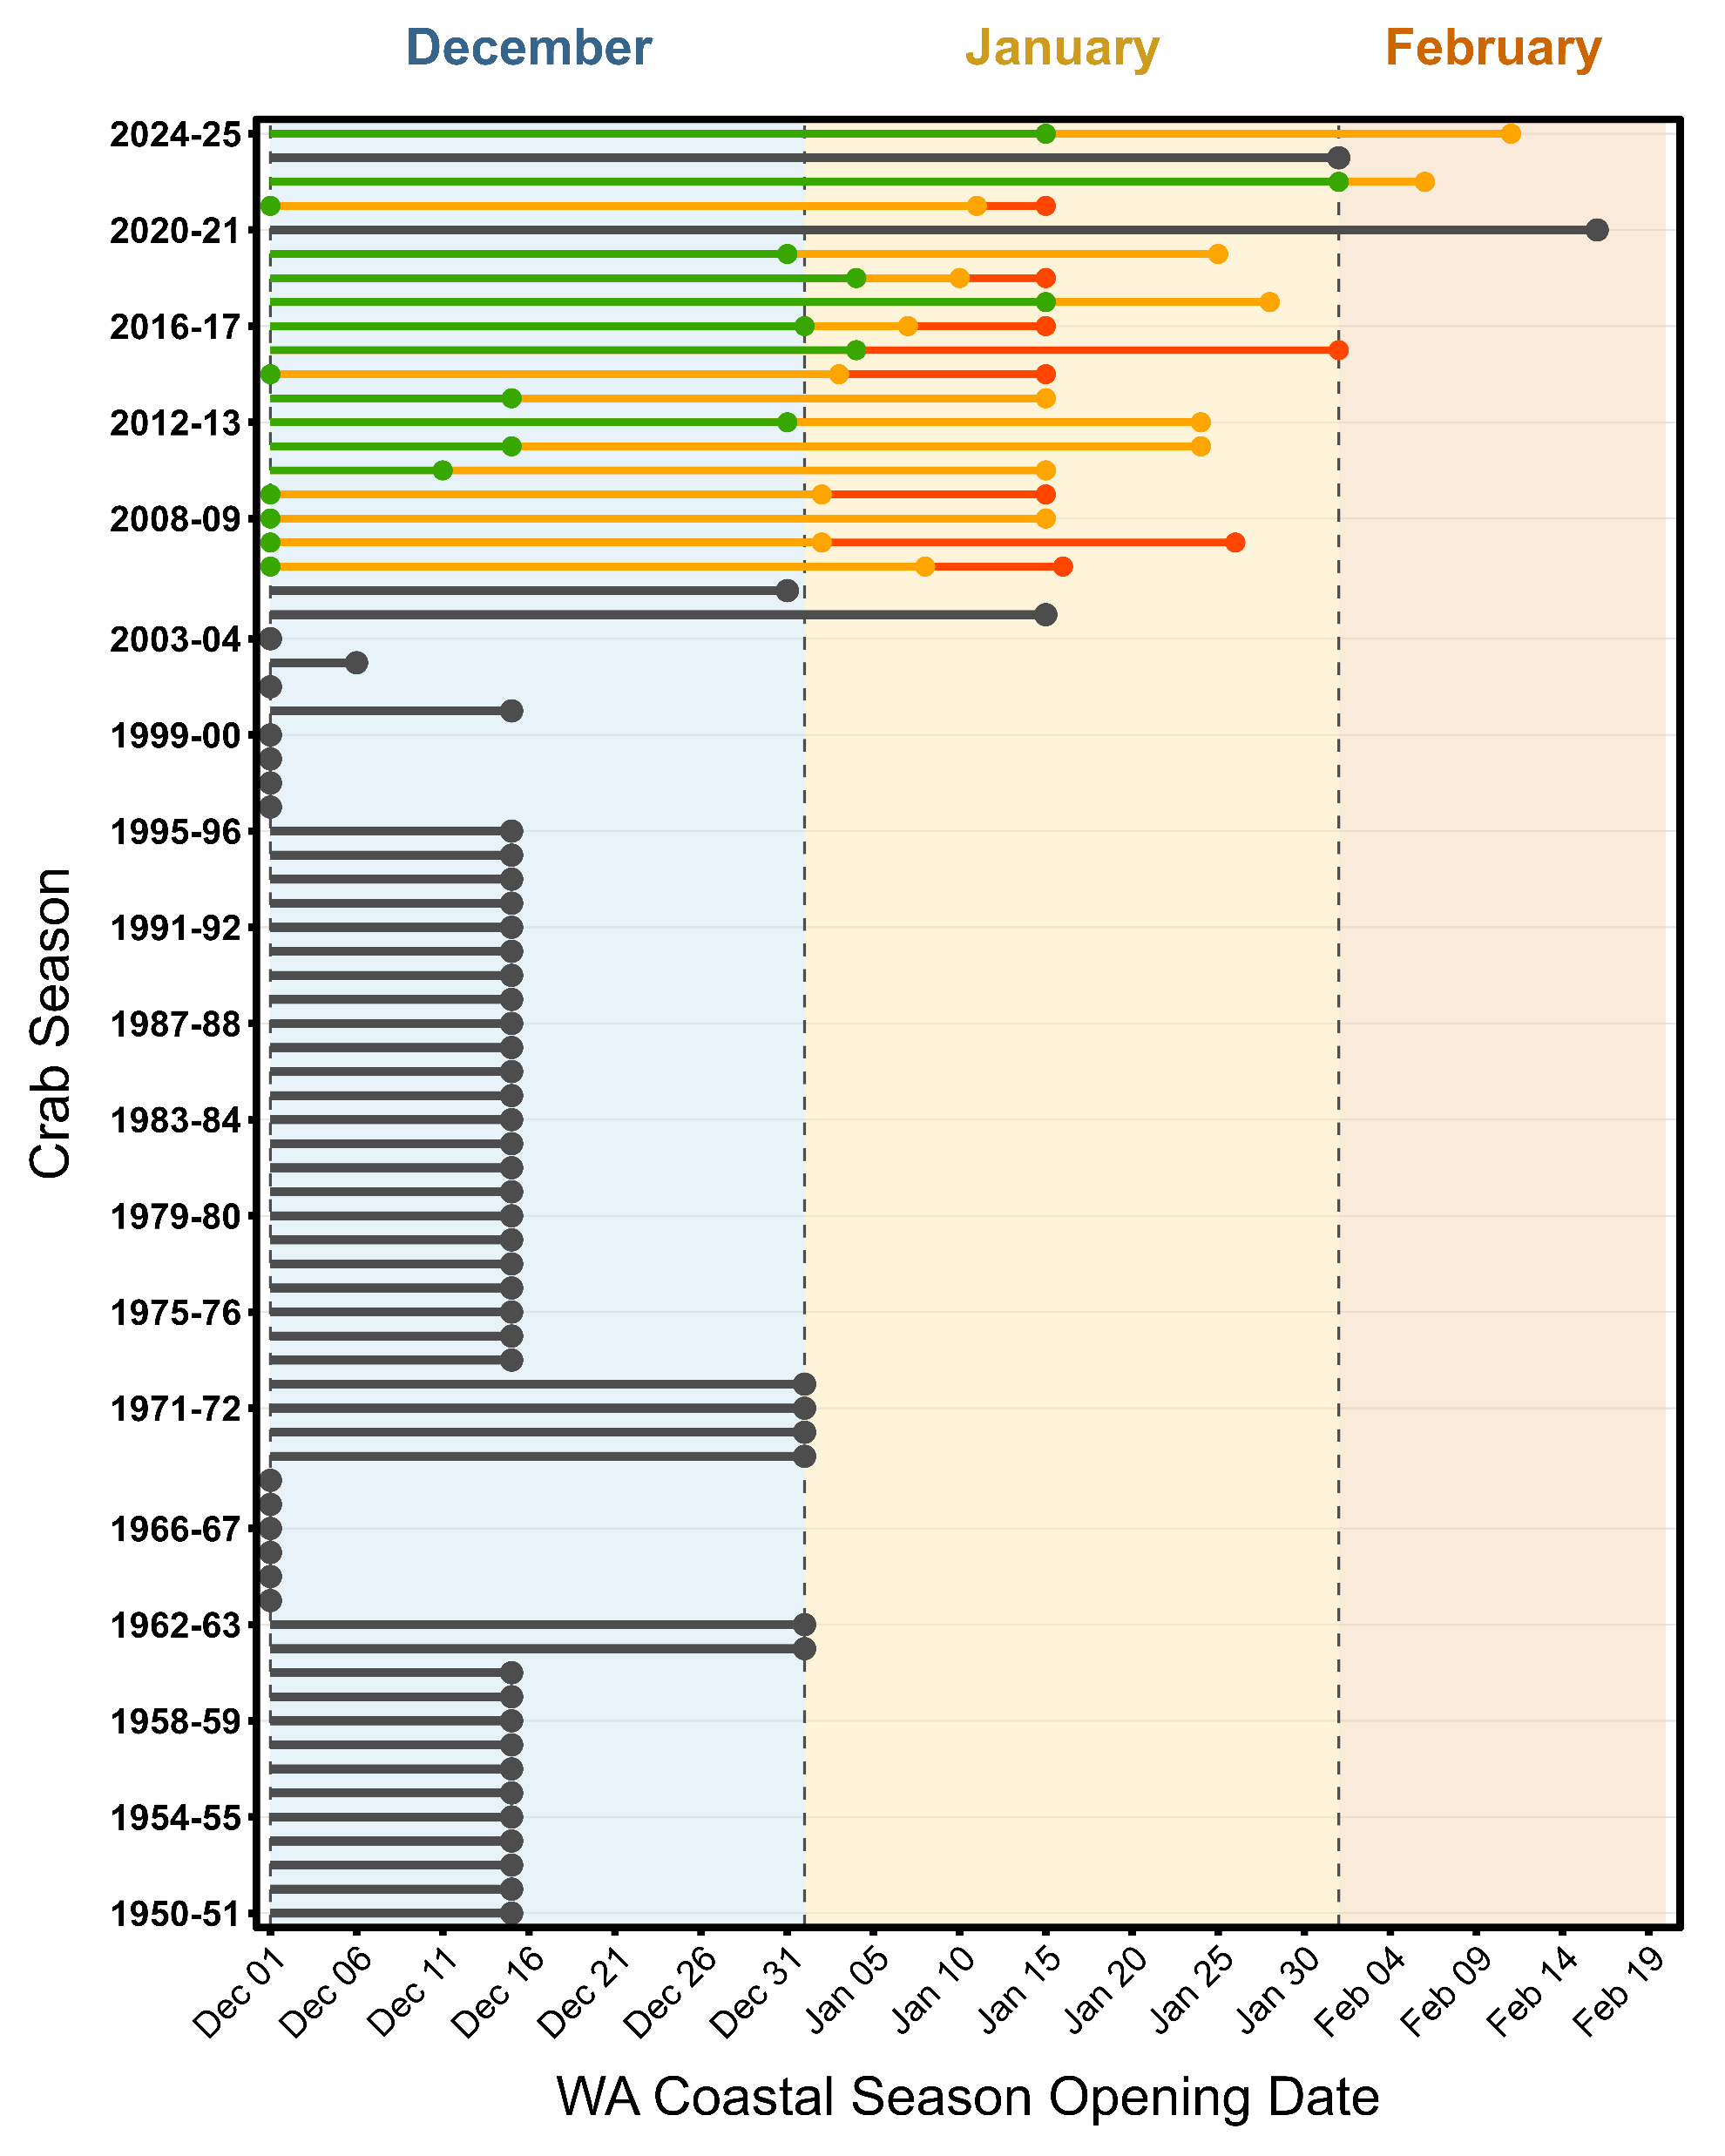
Delayed season openers are becoming more common
Opener
Zone 1
Zone 2
Zone 3
Zone 3
All together
Zone 2
Zone 1

Slide 12
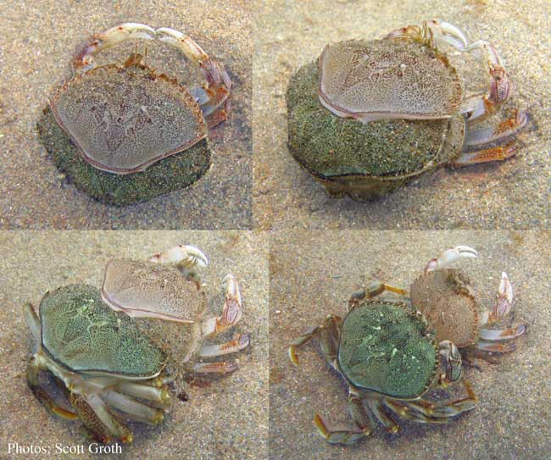
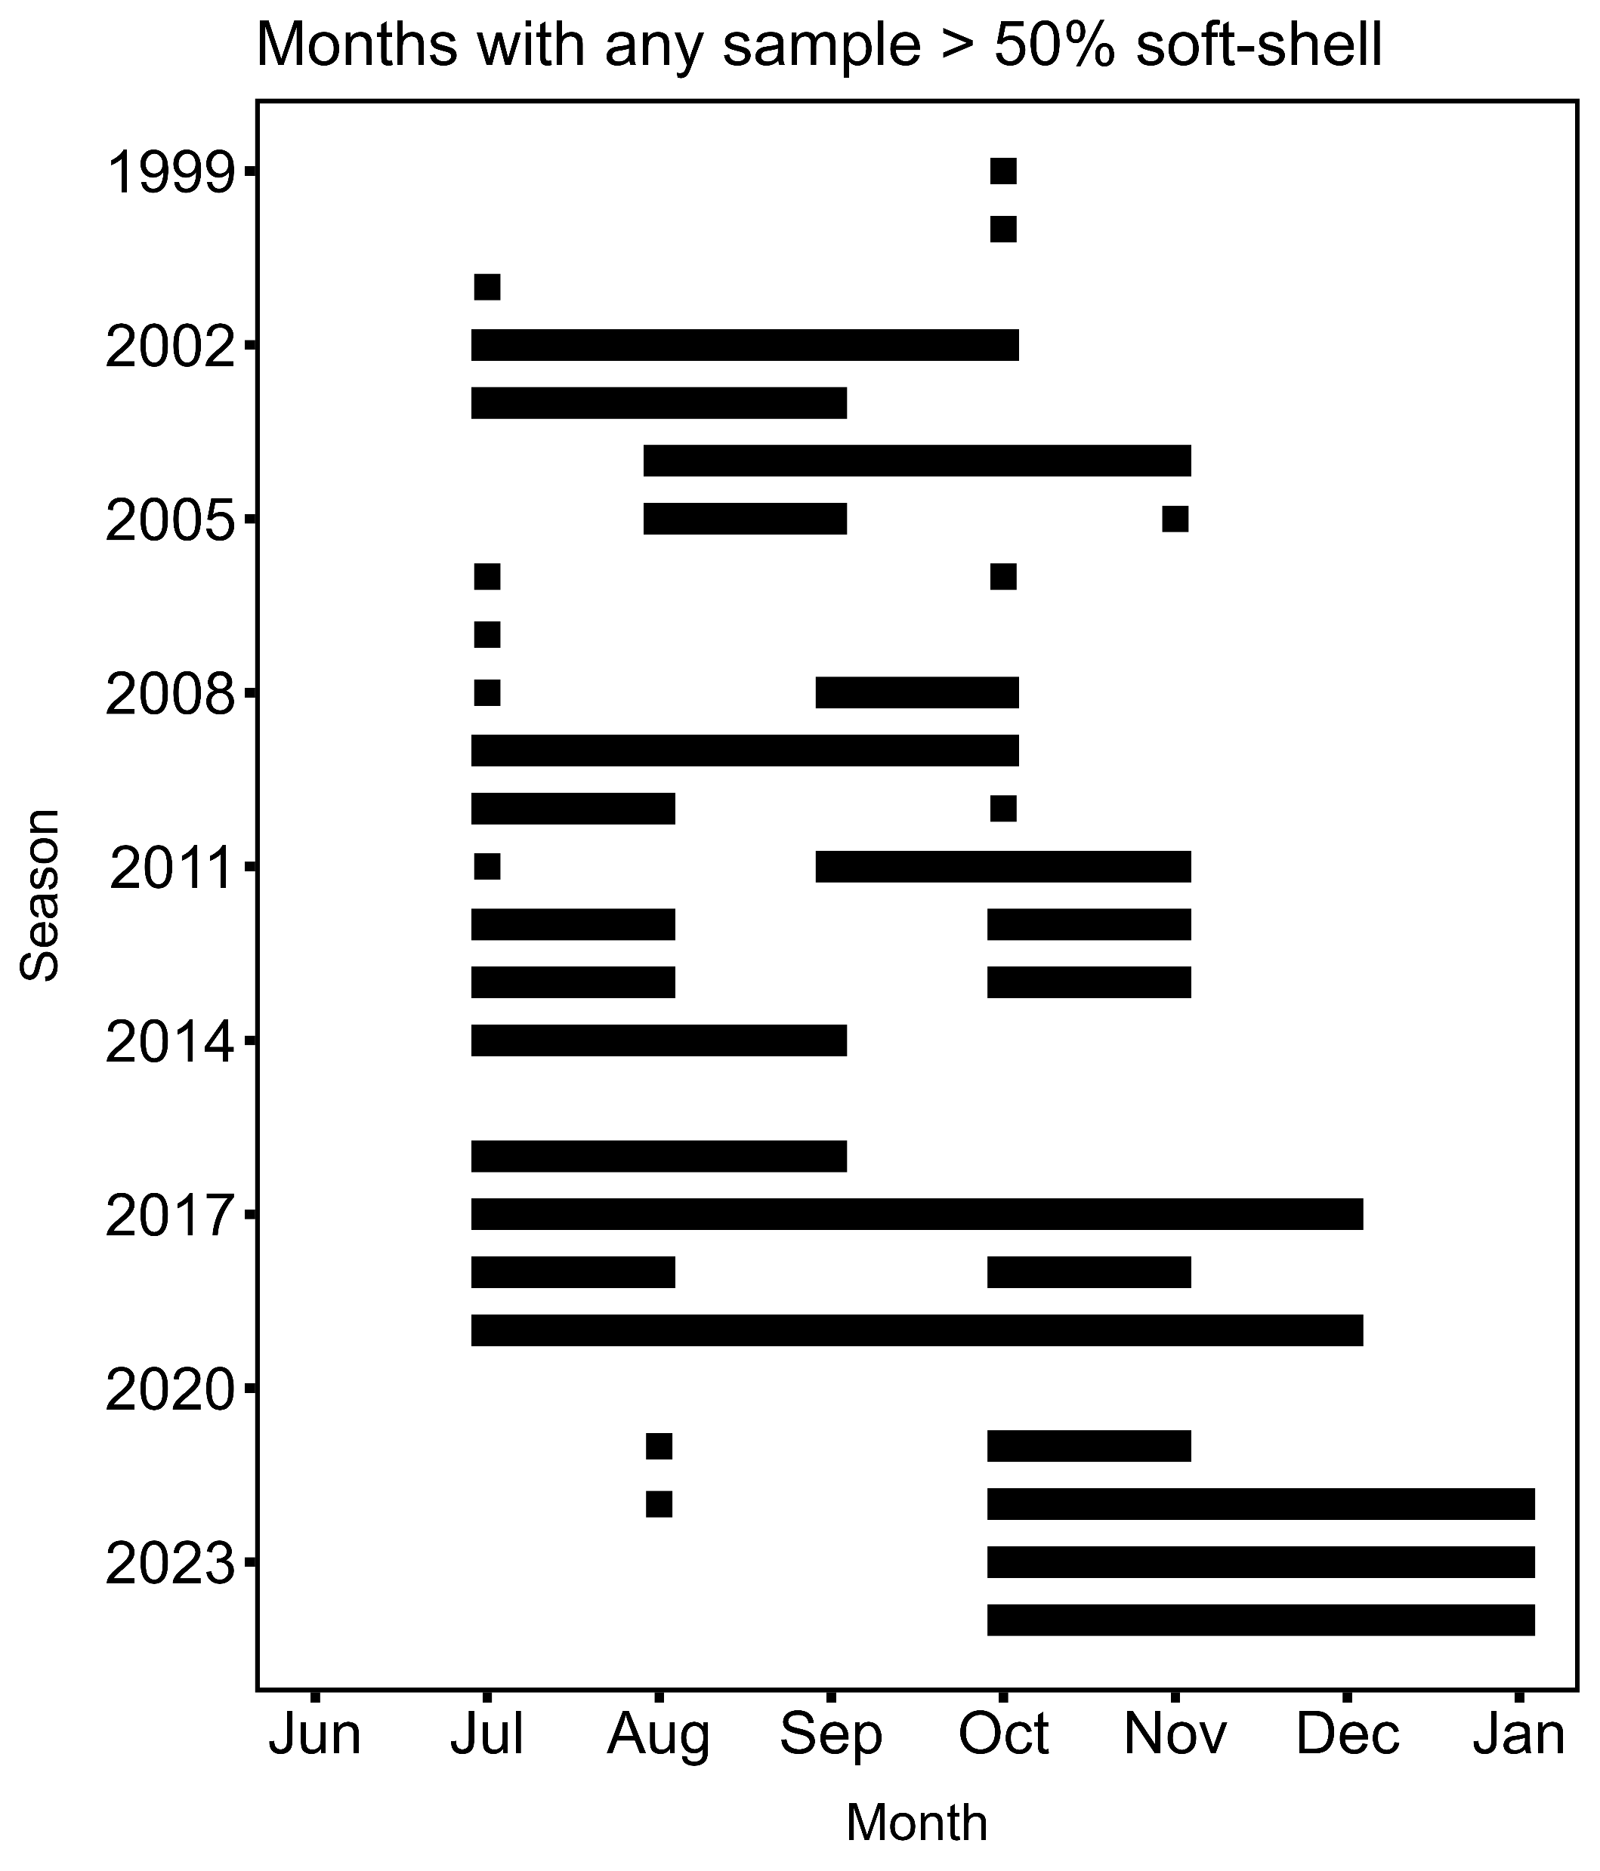
Molt timing may be shifting
WDFW monitors shell condition during:
In-season dockside and shipboard surveys
pre-season test fishery

Slide 13
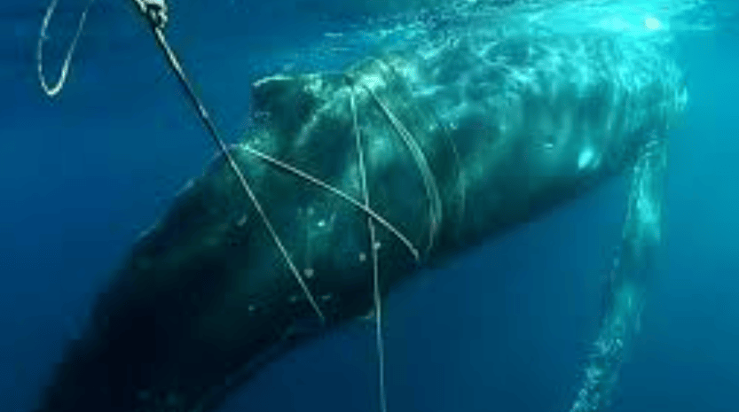
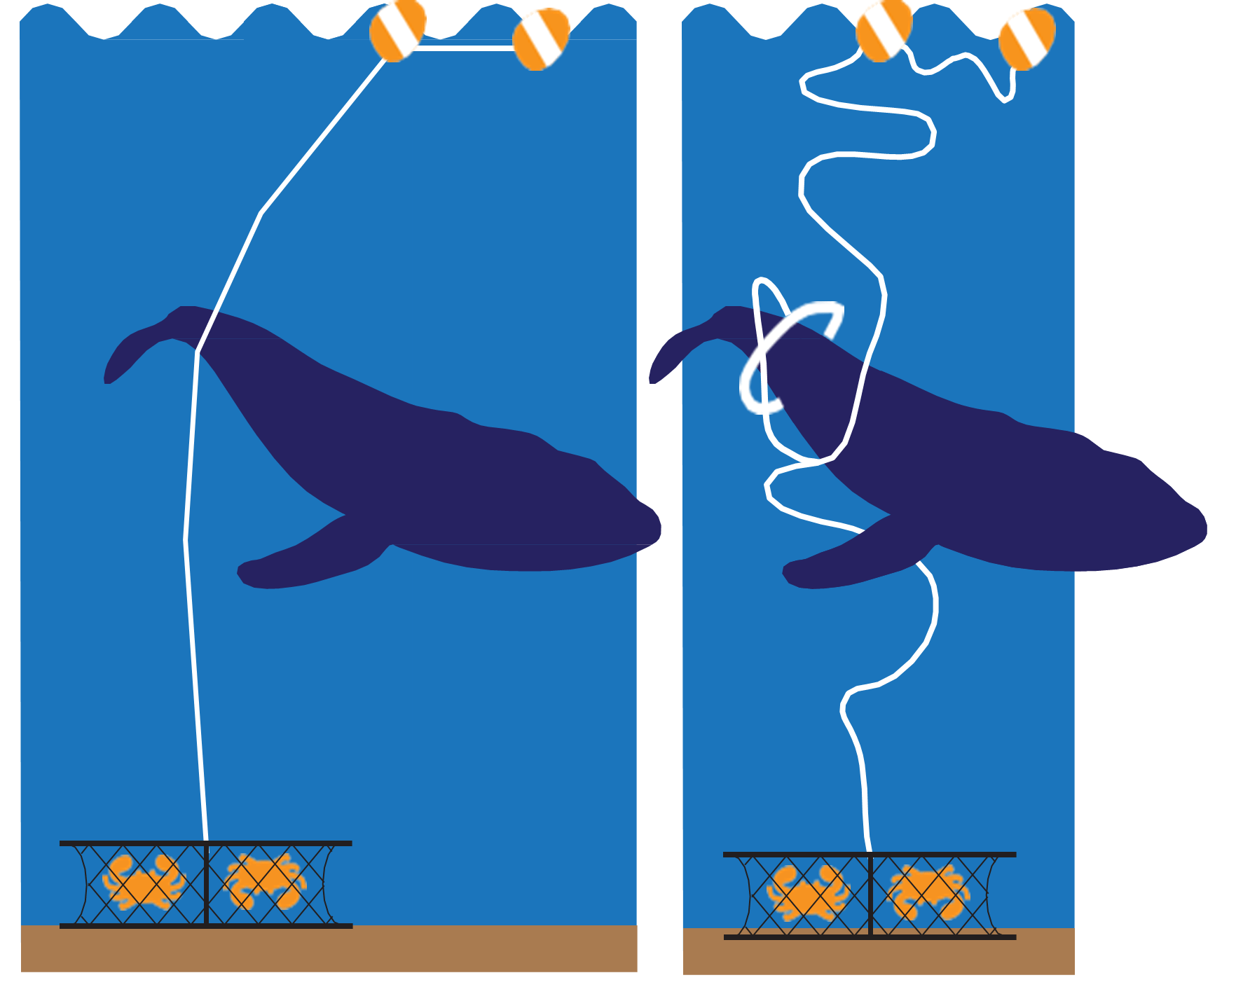
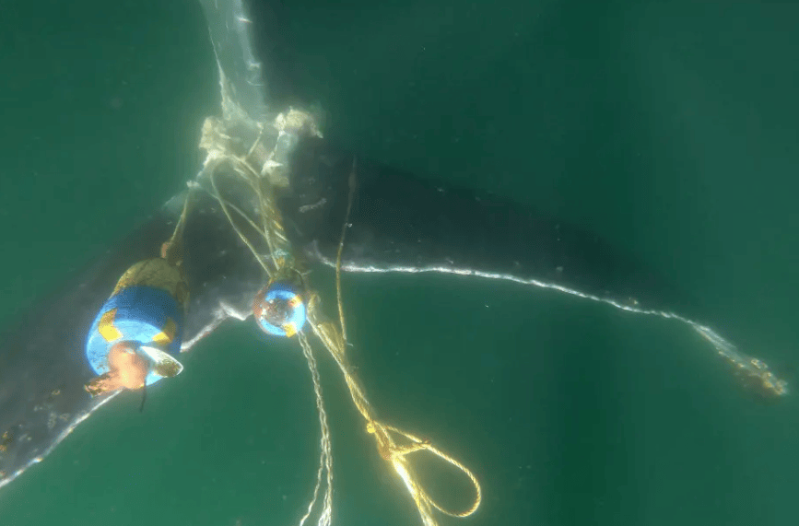
Marine Life Entanglements

Slide 14
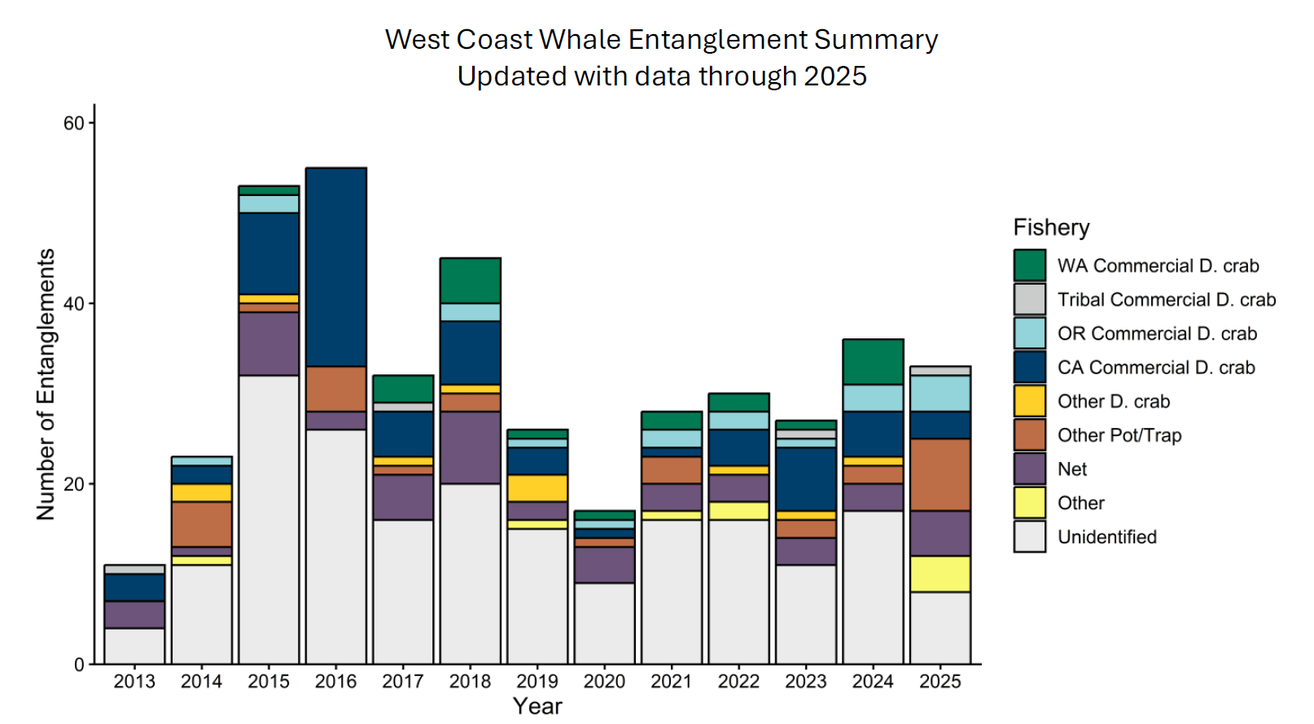
Entanglements have increased

Slide 15
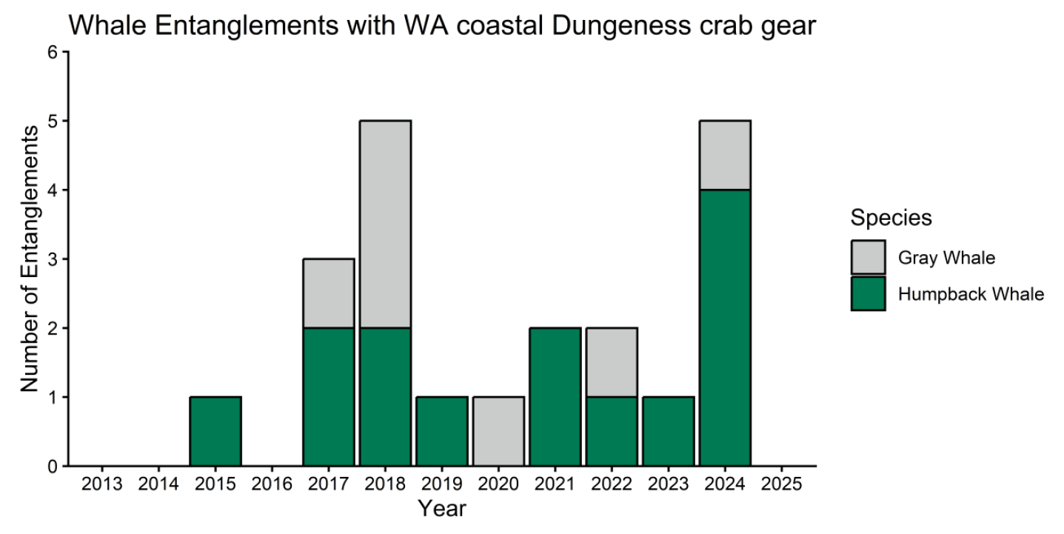
Whale Entanglements with Washington Coast Crab Gear

Slide 16
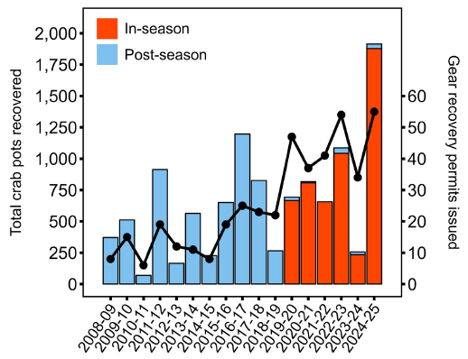
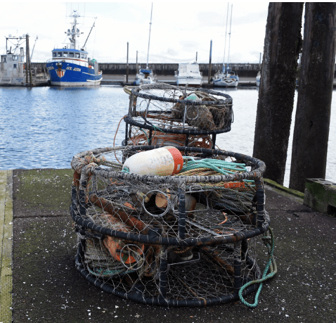
Derelict Gear Recovery

Slide 17
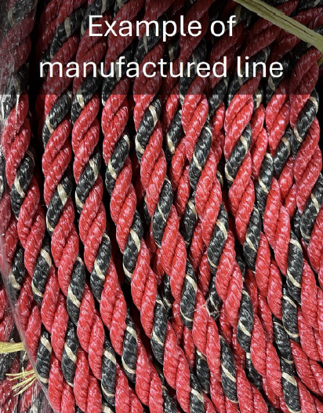
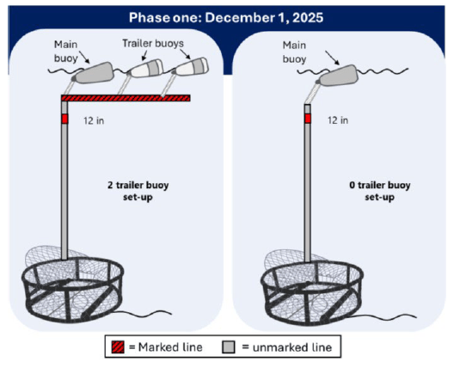
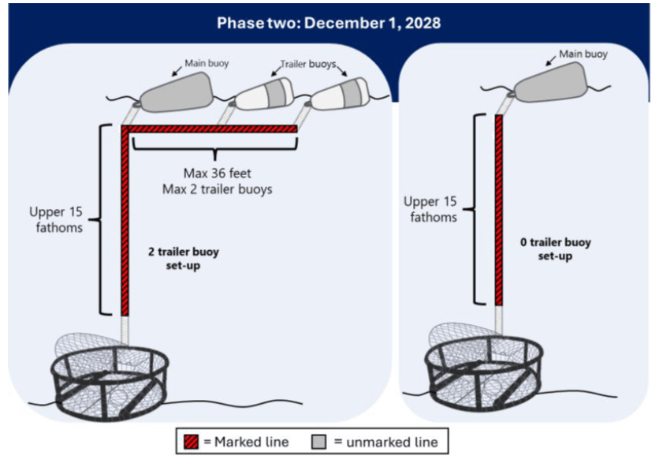
Line Marking

Slide 18
Shifting Baselines
Annual Landings
Season openers
Marine life entanglements

Slide 19
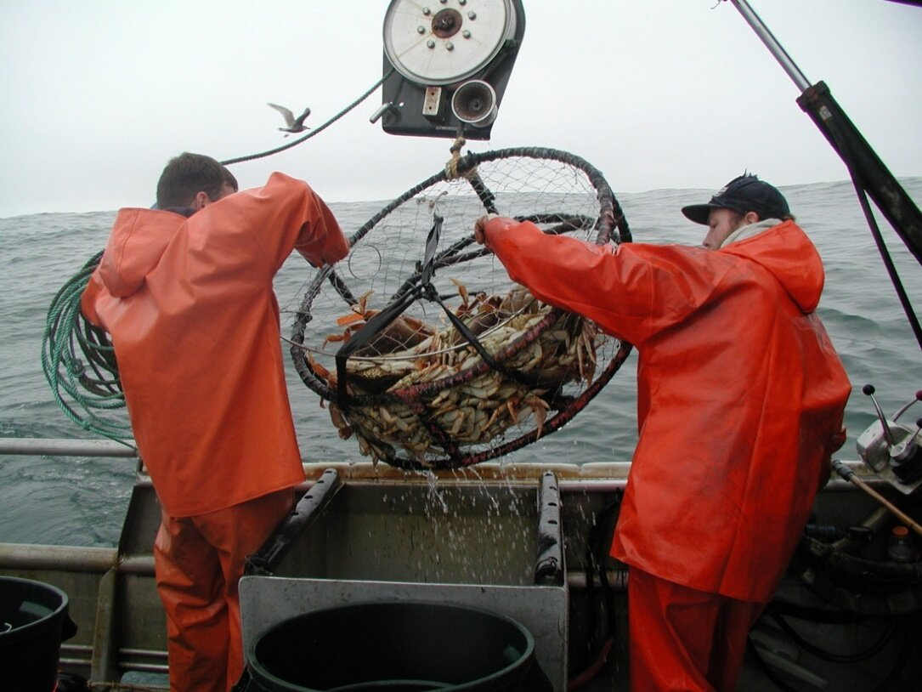
Questions?

