Slide 1
Coastal Dungeness crab Management in a Changing Ocean
Matt George, Ph.D.
Coastal Shellfish Manager
Matthew.George@dfw.wa.gov

Slide 2
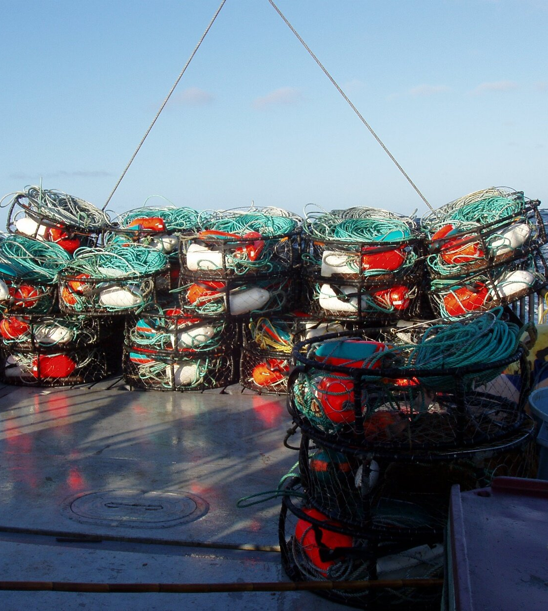
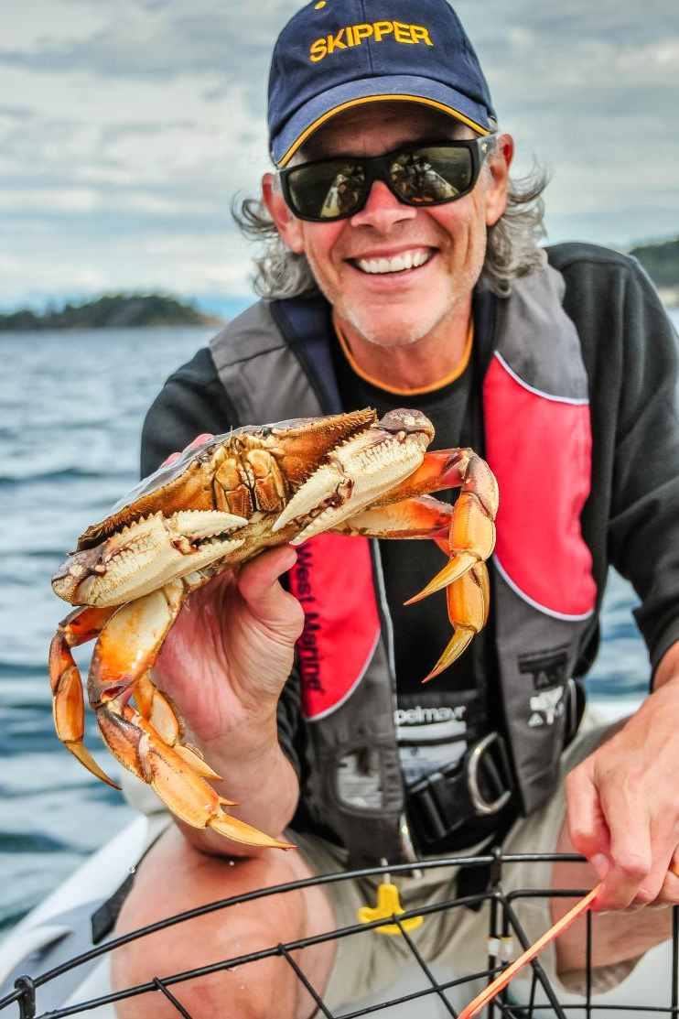
Dungeness Crab
Commercial
Recreational

Slide 3
Ex-vessel value of Washington Coastal Commercial Fisheries Average 2016-2020 (US $ Millions)

Slide 4
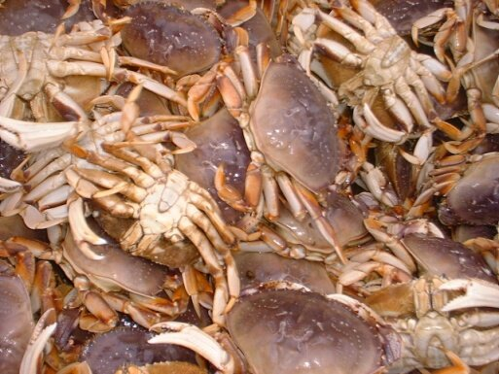
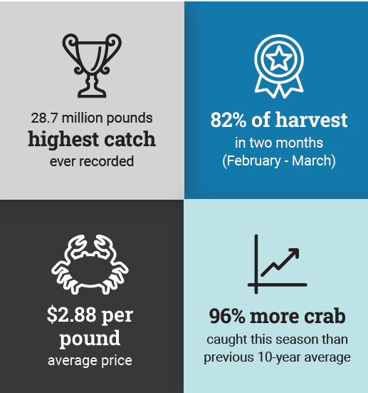
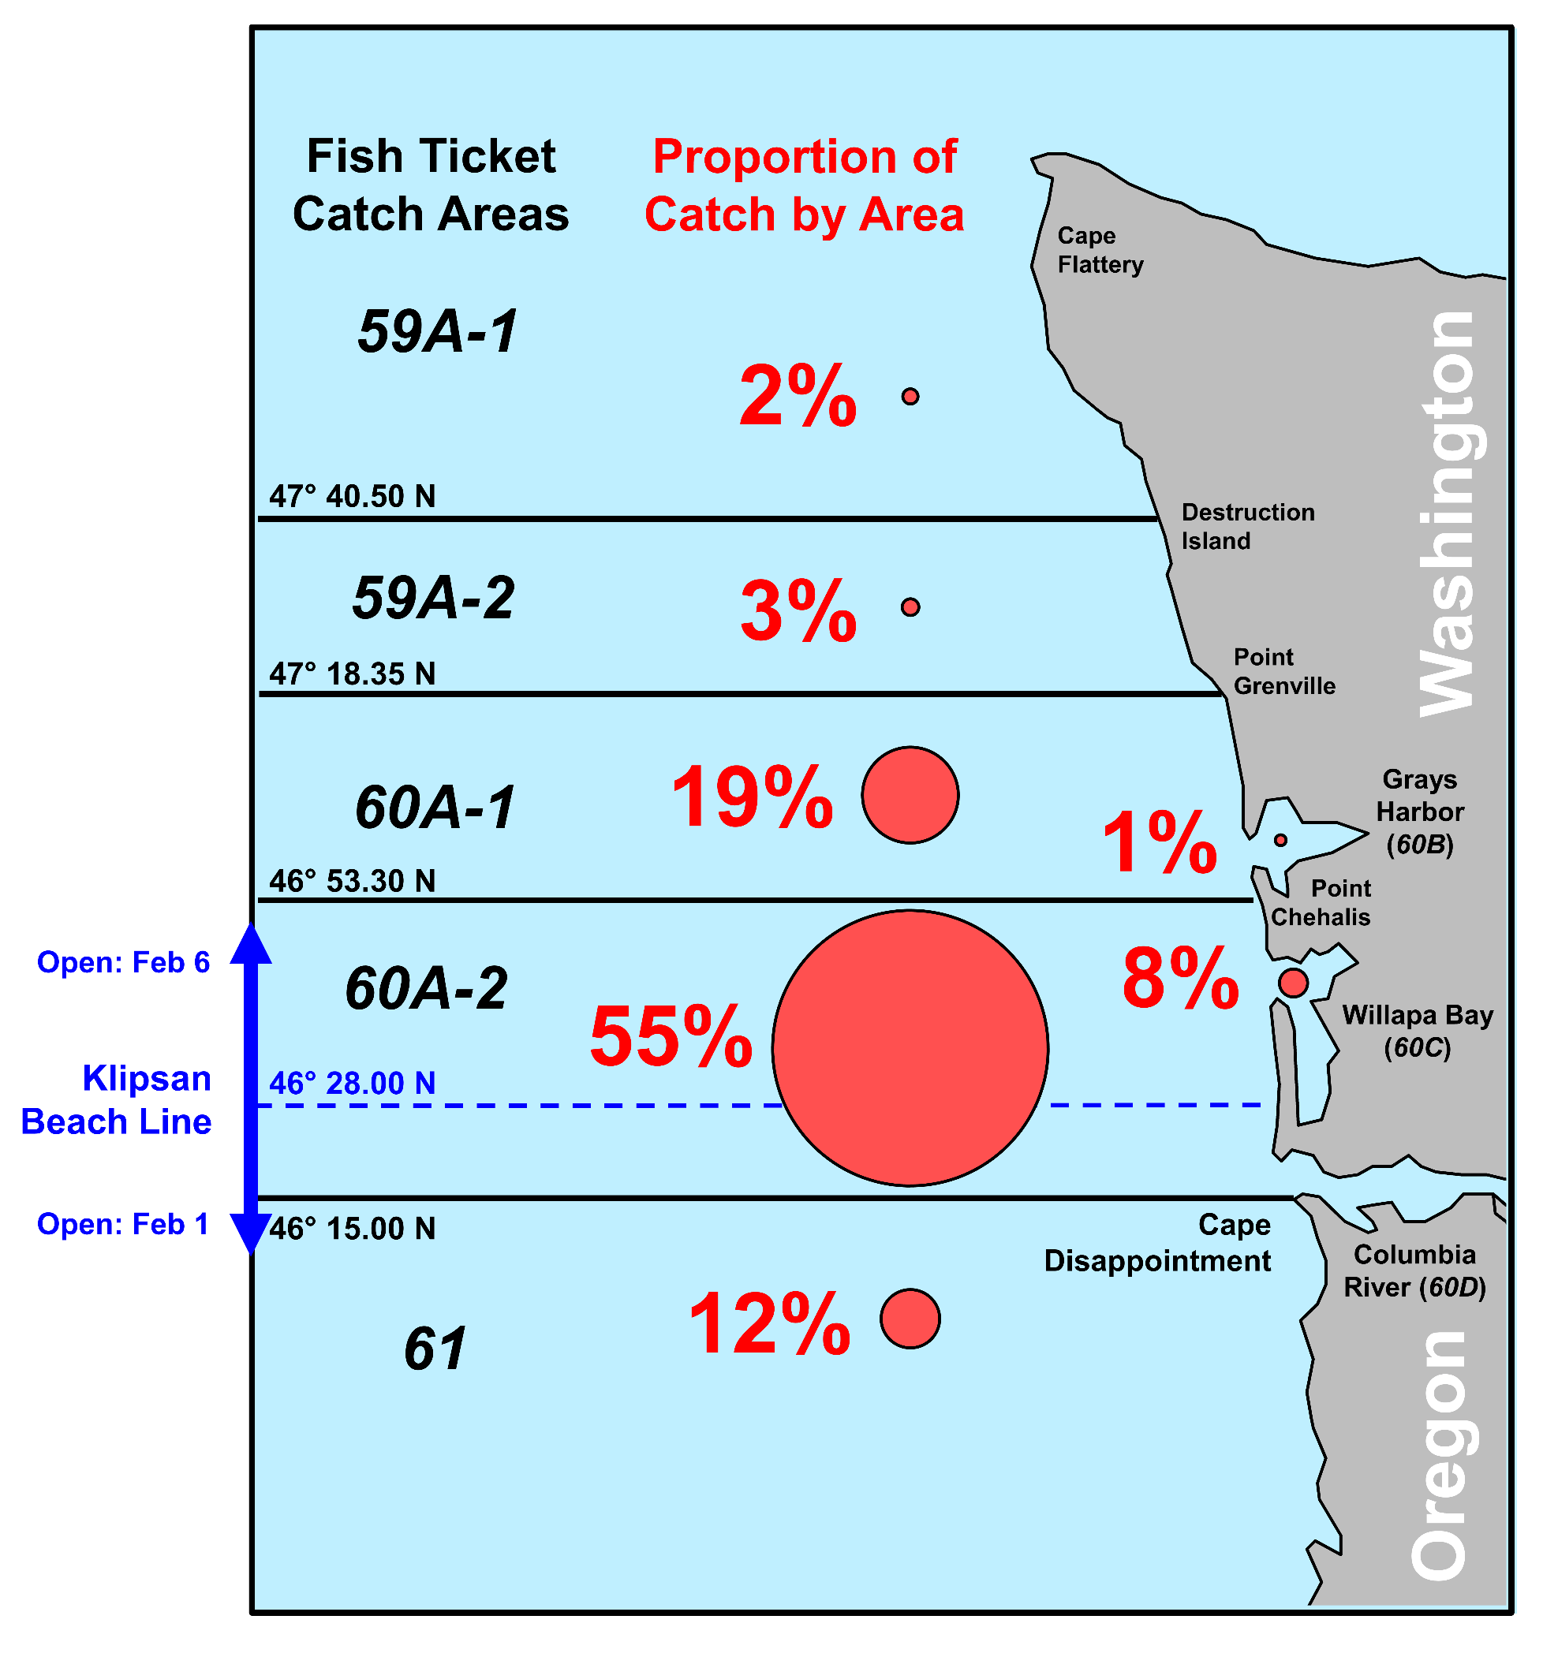
Washington Coastal Dungeness Crab Fishery
22-23 Season Recap

Slide 5
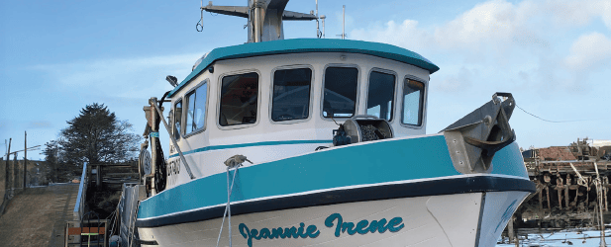
3S Management Strategy
(Size, Sex, Season)
Summer Fishery Management
Derelict Gear Recovery
Preseason testing
Tribal co-management
Fishery Opens
(Dec 15 – Feb 1)
Fishery Closes (Sept 15)

Slide 6
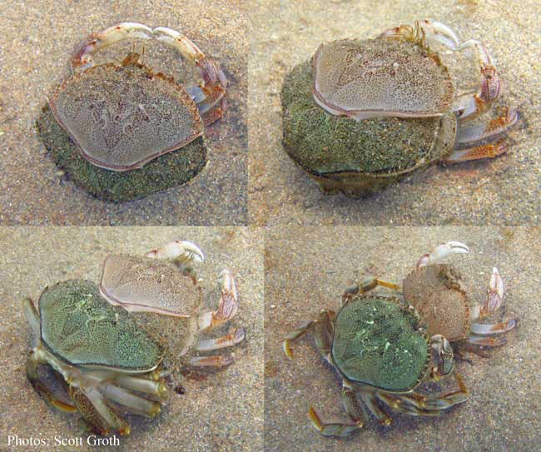
Pre-season Testing
WDFW contracts commercial fishing vessels
Monitor Shell condition
Meat Recovery Percentage (Pick-out)
Coordinate season opening structure with Tri-state Agreement

Slide 7
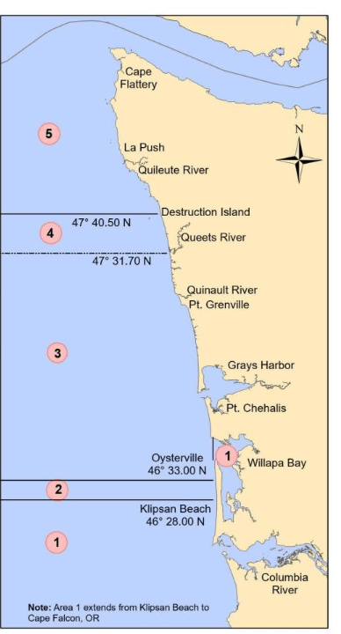
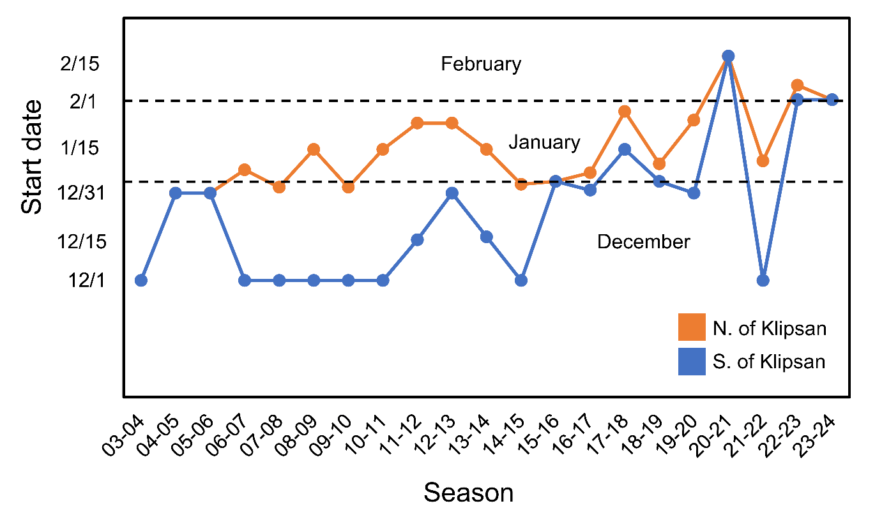
A changing fishery
The WA coastal commercial Dungeness crab fishery opener has been pushed into February in recent years from a typical start of December 1st.

Slide 8
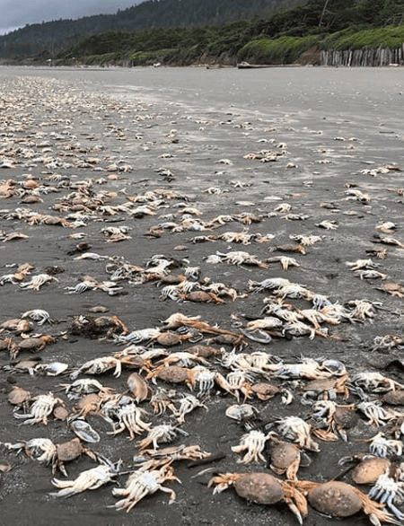
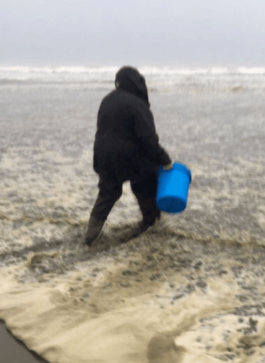
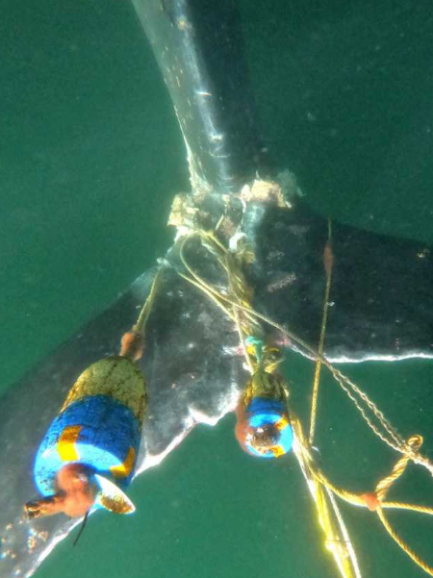

Fishery Challenges
Population forecasting
Environmental stressors
Harmful Algal Blooms (Biotoxins)
Marine life entanglements

Slide 9
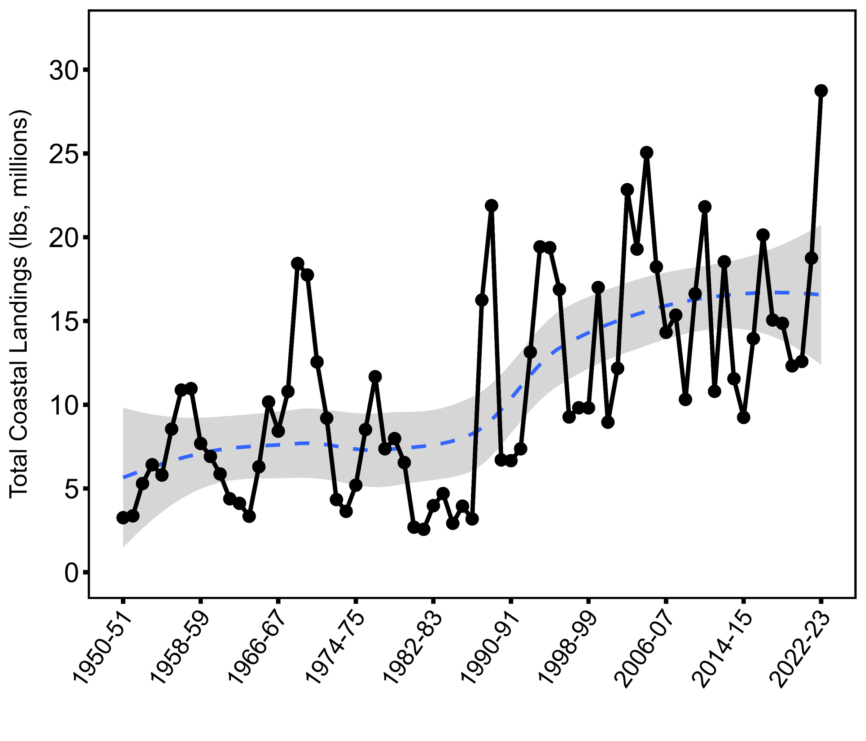
WA Coastal Crab Landings
Population forecasting
Historical Landings have ranged from 2.5 million in 1980-81 to 28.7 million in 2022-23.
We don’t currently have a predictive model for WA coastal Dungeness crab populations.

Slide 10

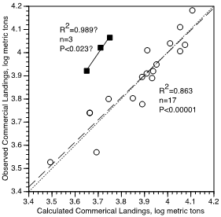
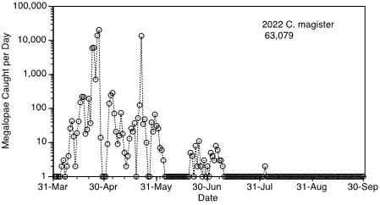
Light Trap Sampling
Population forecasting
Operated a light trap in Newport, OR for more than 20 years.
Megalopae abundance predicts Oregon commercial landings 4-years later.
Megalopae pulses are correlated with a negative PDO and marine heatwaves
Years with marine heatwaves
Dr. Alan Shanks
University of Oregon

Slide 11
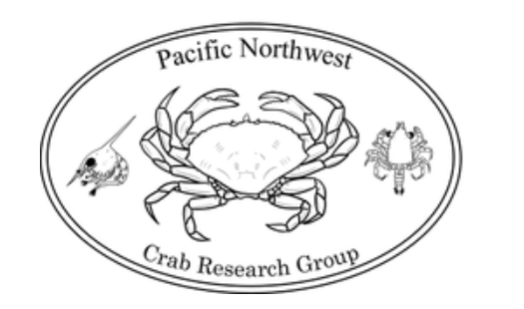
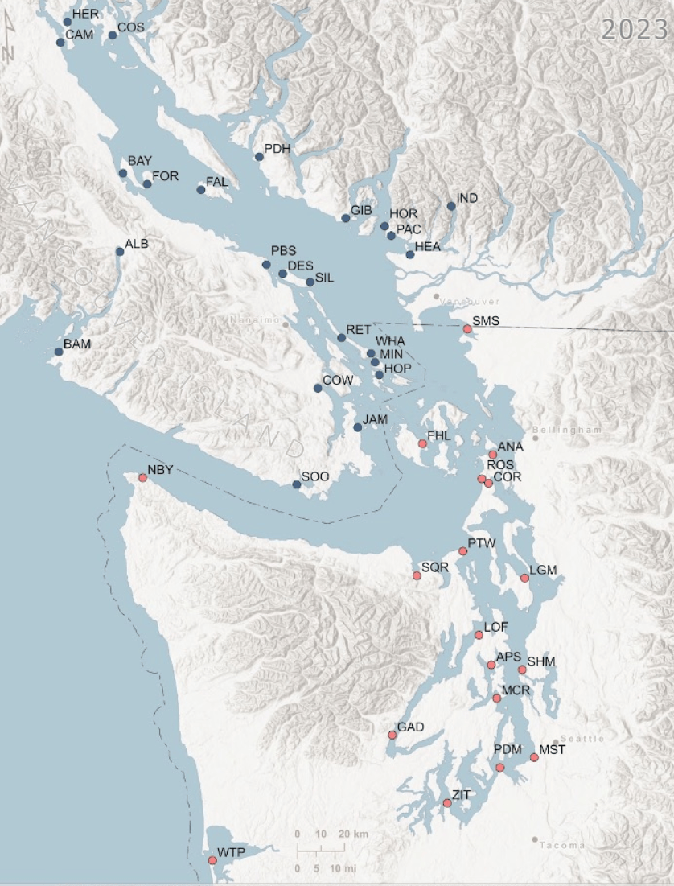
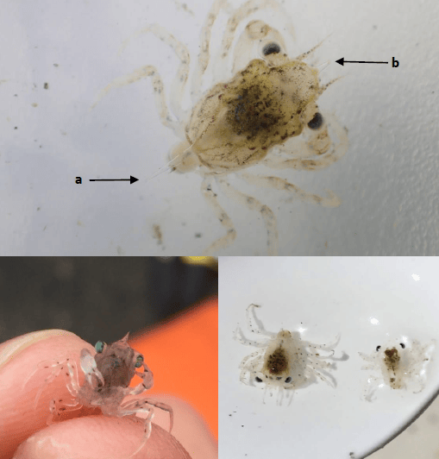
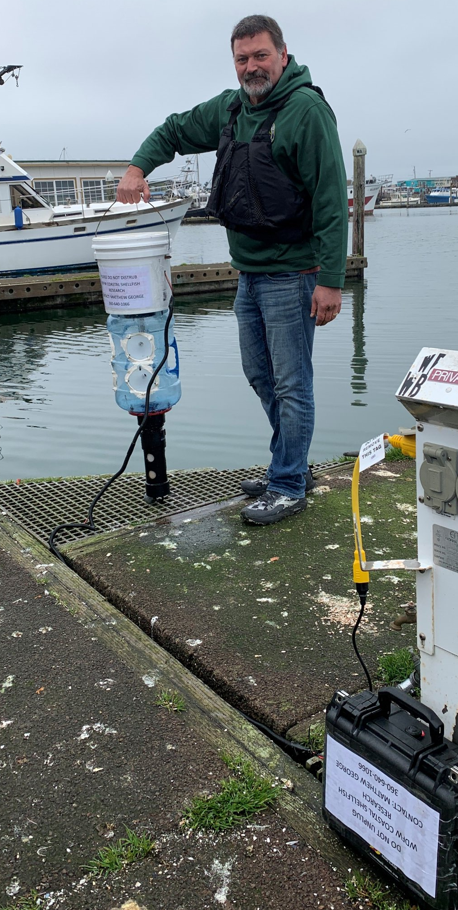
Crab Megalopae Light Trap Sampling
Population forecasting
Westport
Tokeland

Slide 12
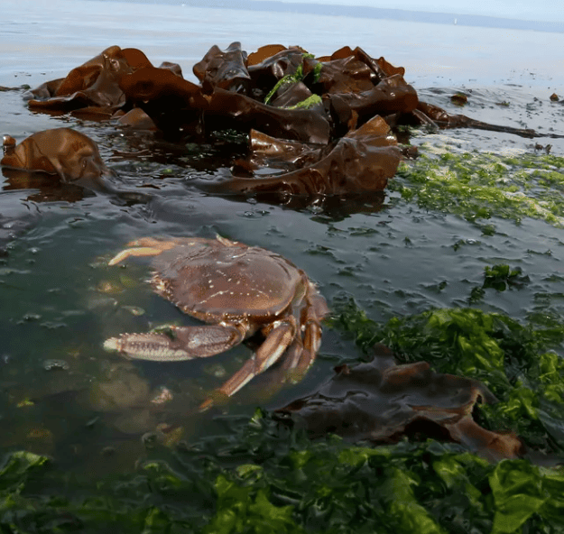
Environmental stressors

Slide 13
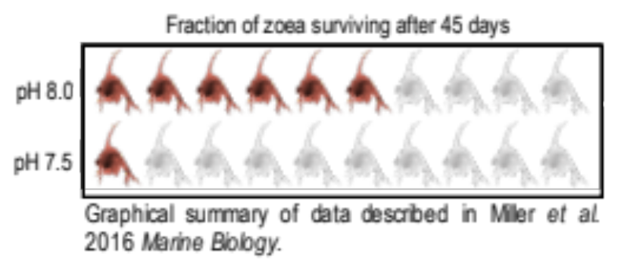
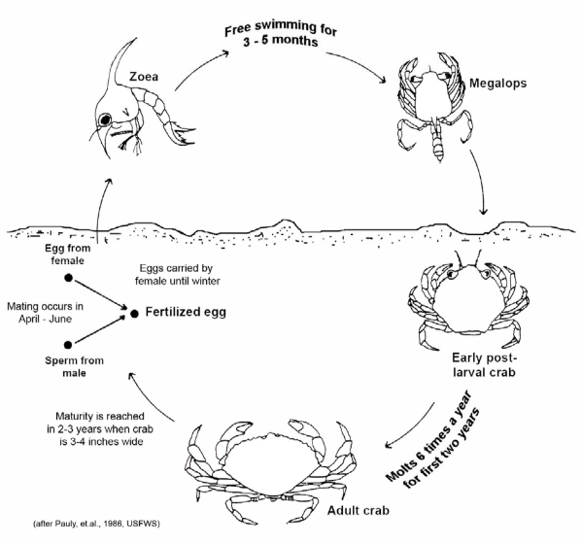
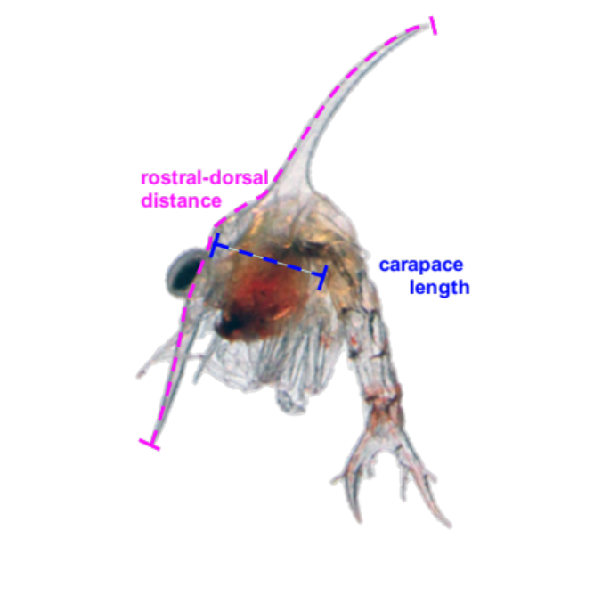
Ocean Acidification
Environmental stressors
Vulnerable Life Stages
More zoea developed to a later stage in the high pH group compared to the low pH group

Slide 14
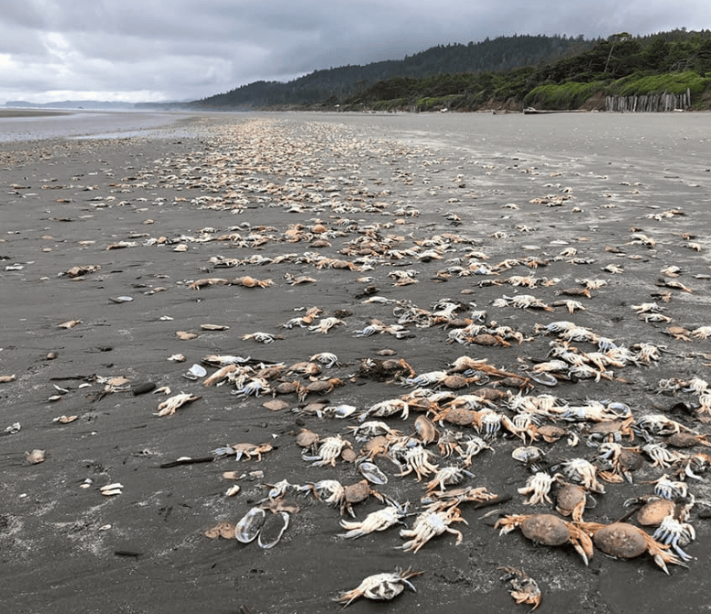
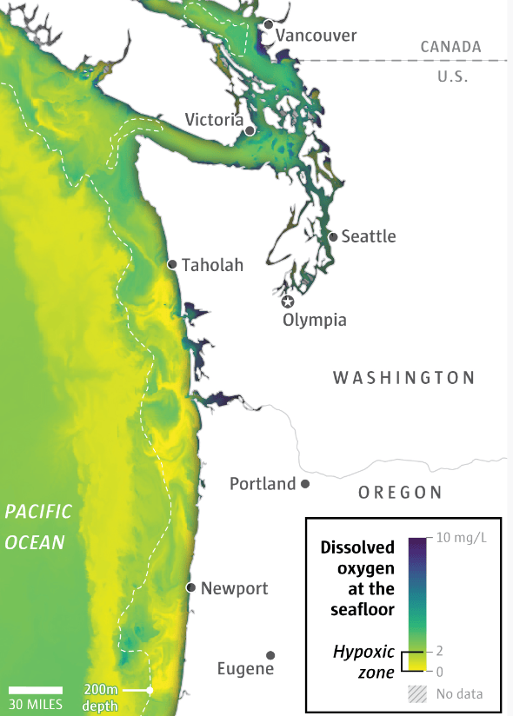
Hypoxia
Environmental stressors
Sept 5, 2021

Slide 15
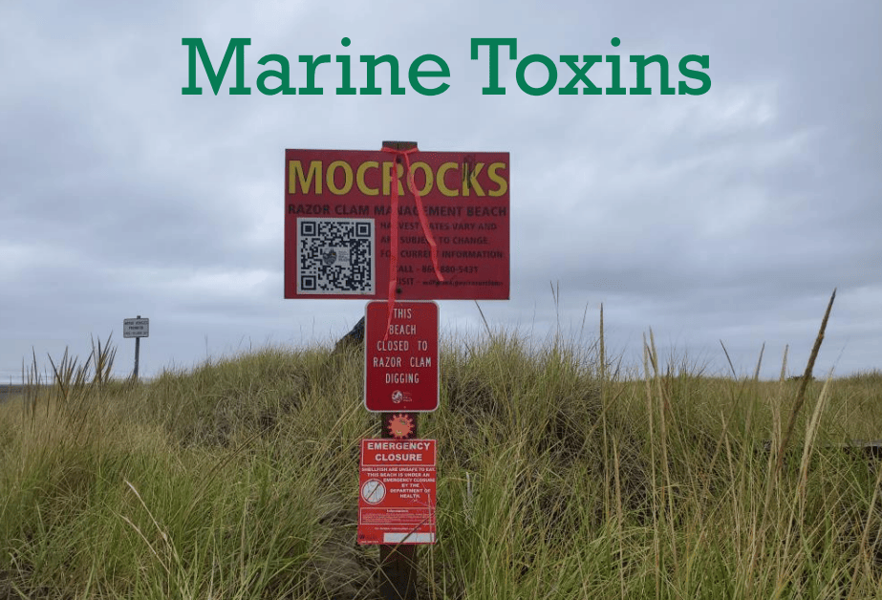

Slide 16
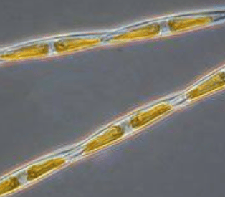
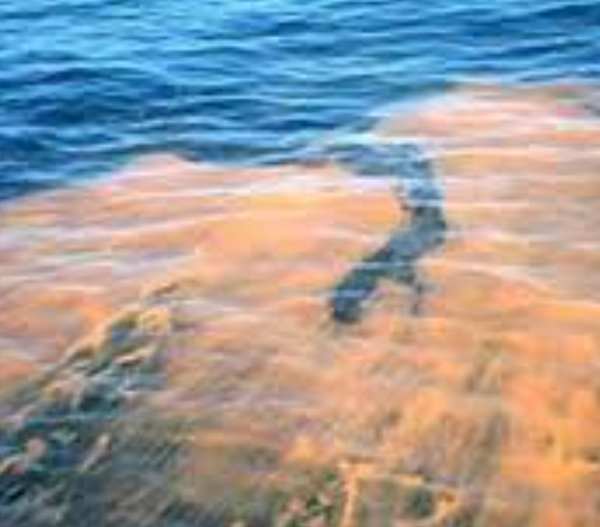
Domoic Acid
Produced by a diatom (Pseudo-nitzschia sp.)
Domoic acid – neurotoxin
Nausea, dizziness, memory loss
Stroke-like symptoms that can lead to death
No antidote
Not destroyed by cooking/freezing
Not easily detected

Slide 17
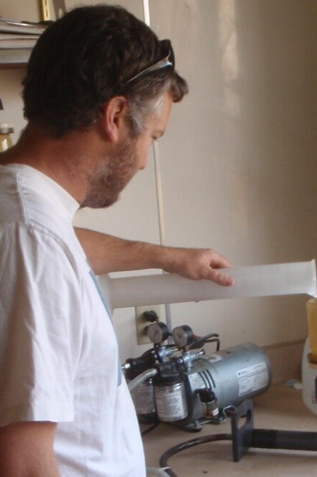
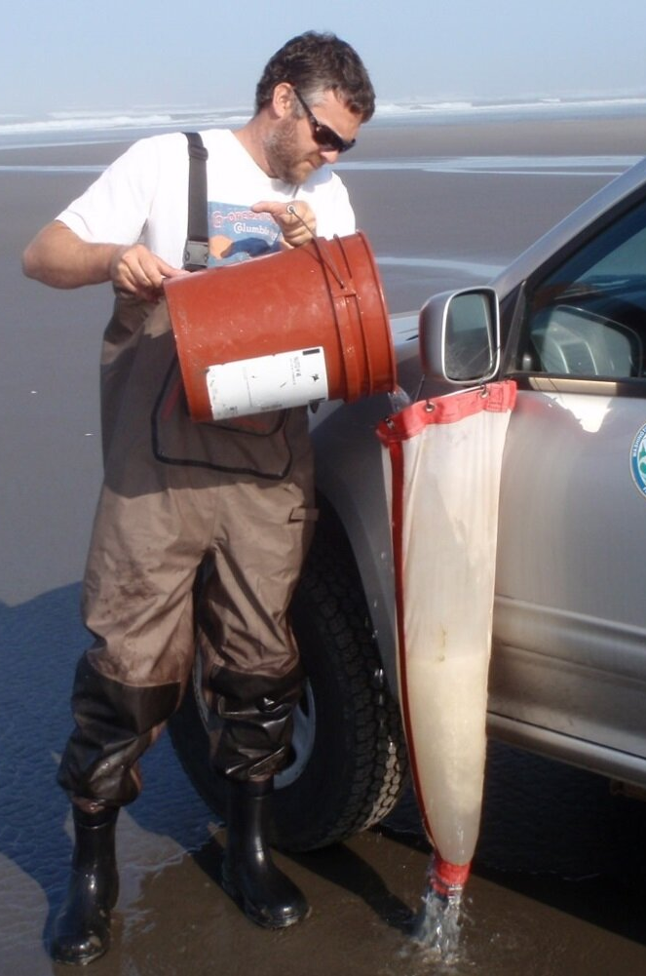
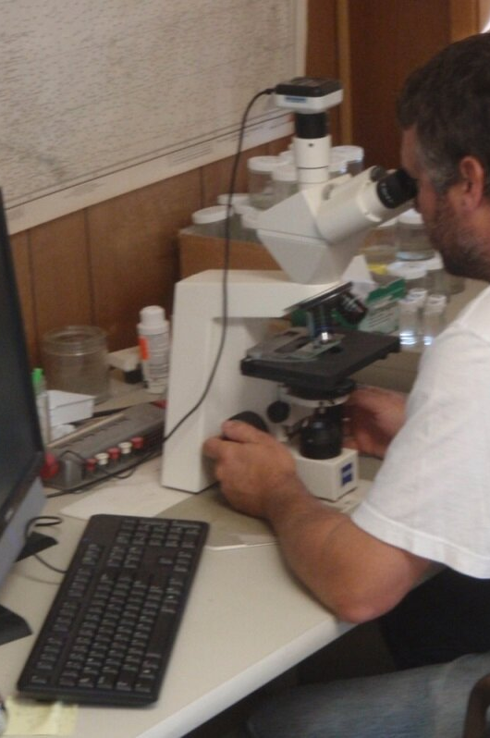
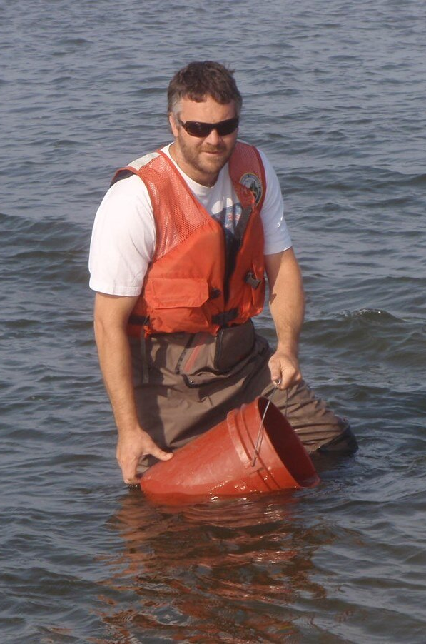
WDFW regularly monitors surf zone plankton, toxins, and water quality to determine the environmental conditions associated with blooms of harmful species.

Slide 18
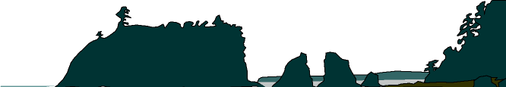

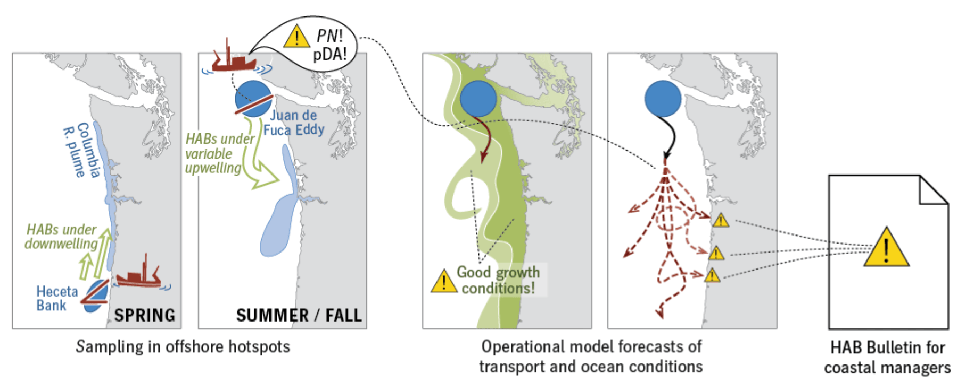

Slide 19
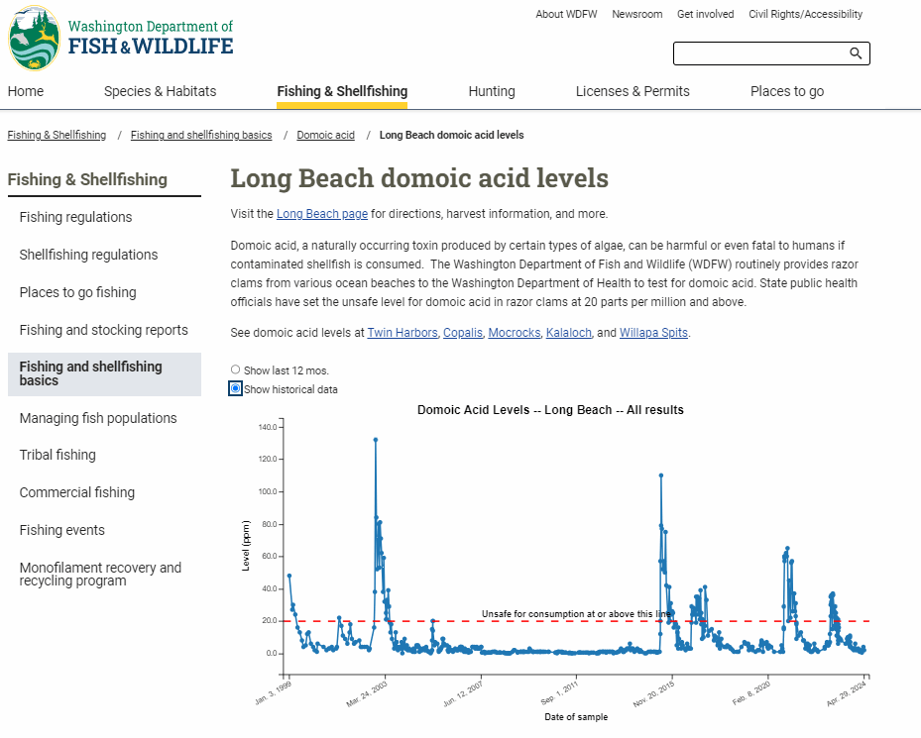

Slide 20
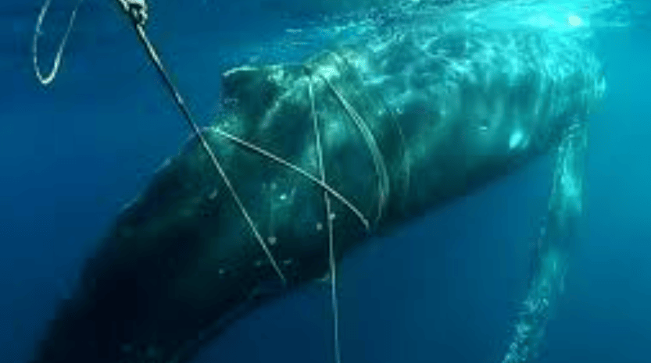
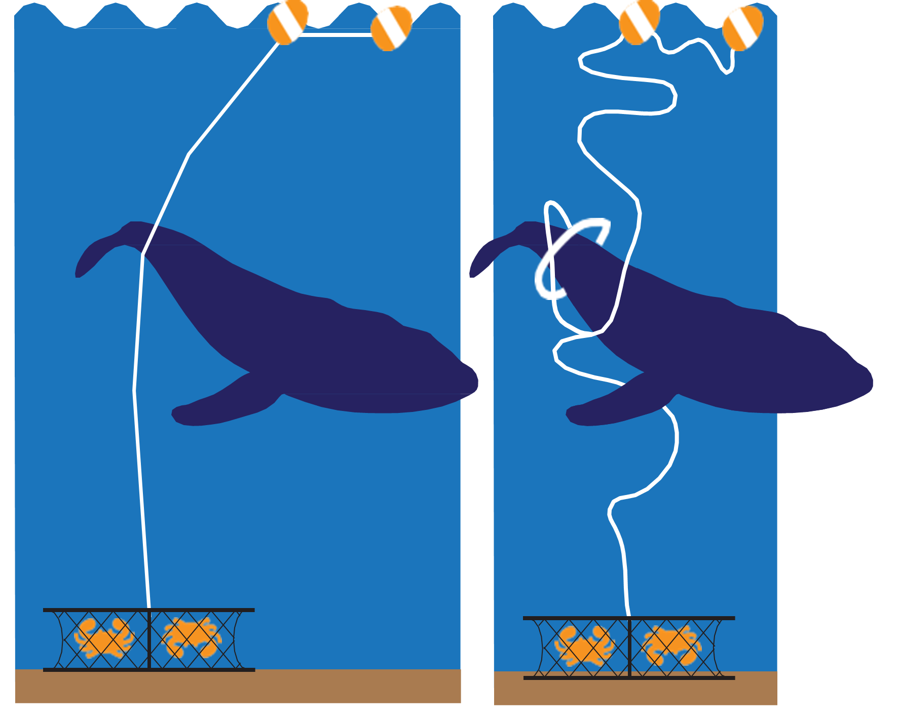
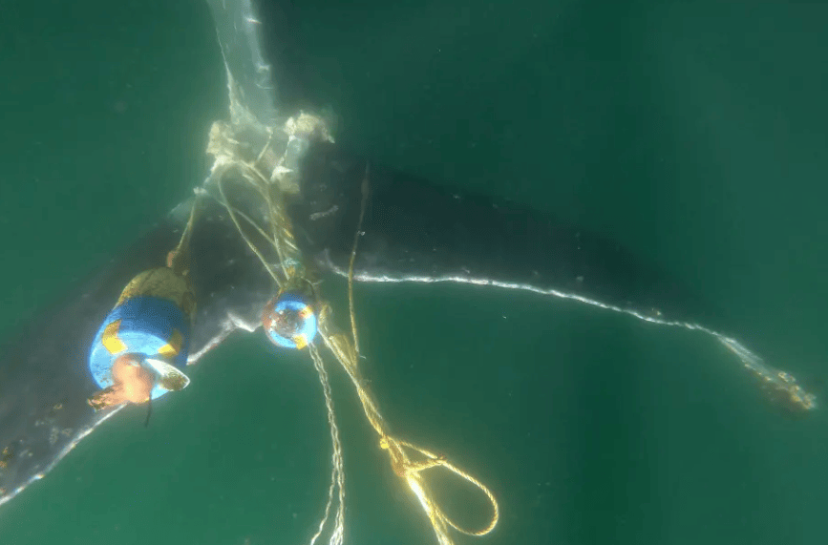
Marine Life Entanglements

Slide 21
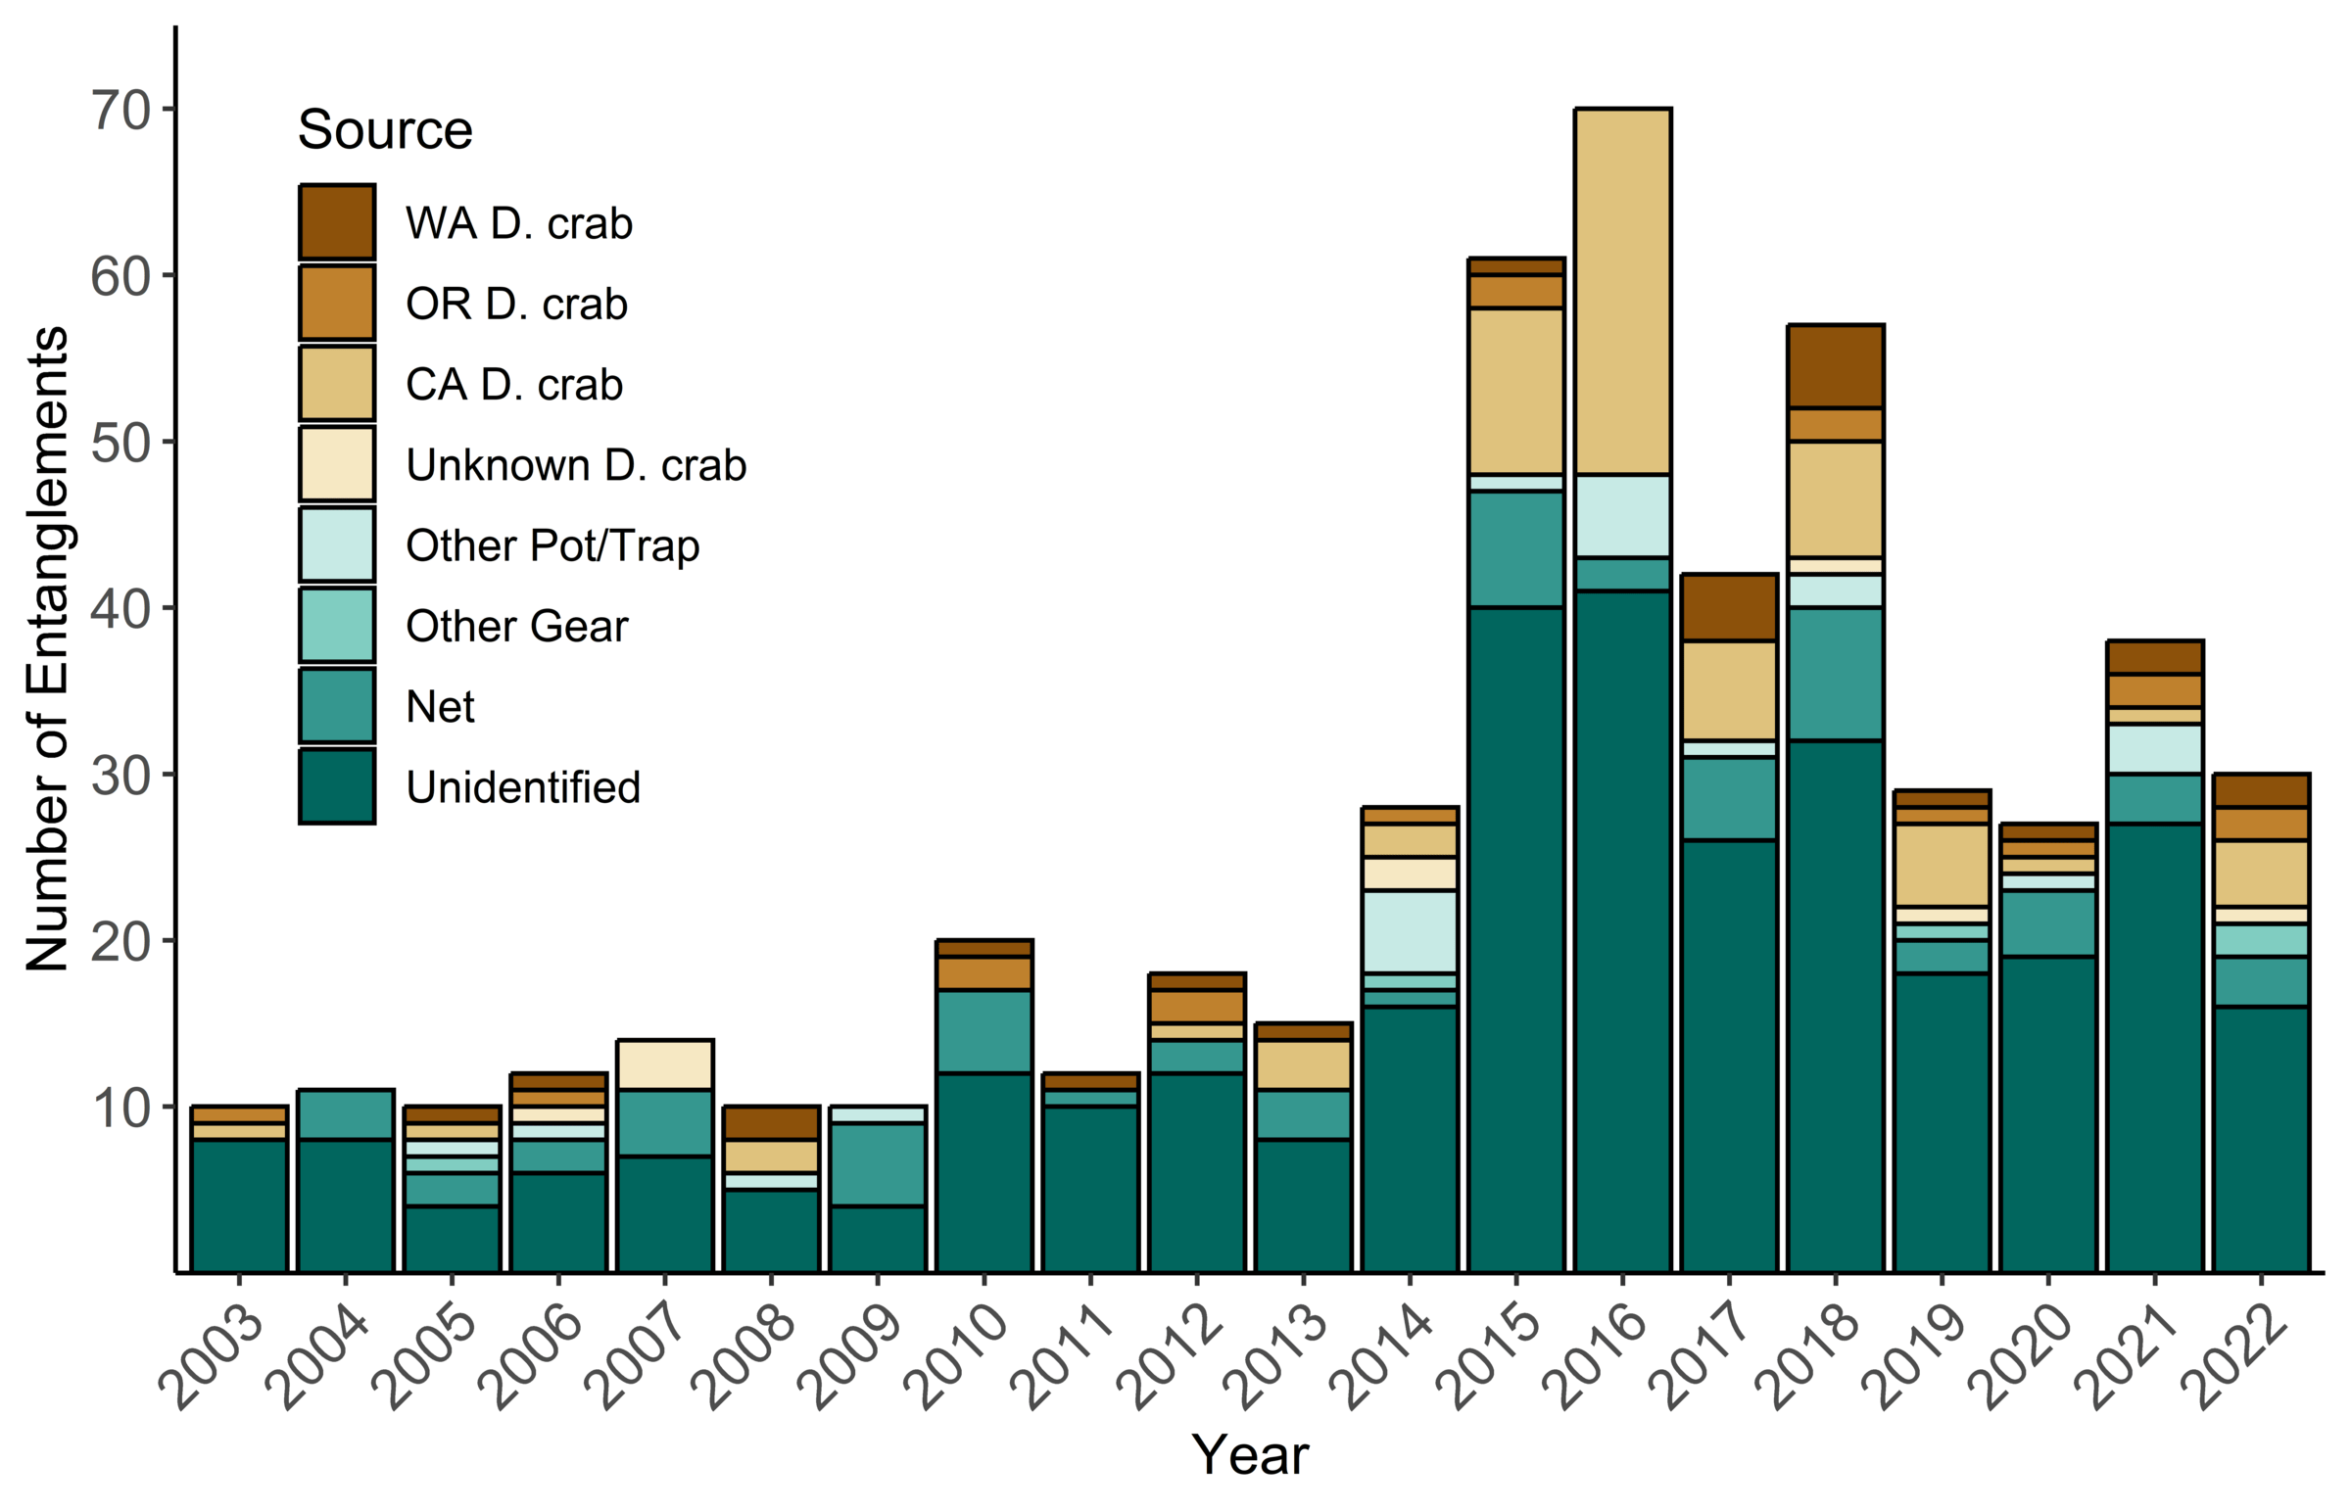
Entanglements are increasing

Slide 22
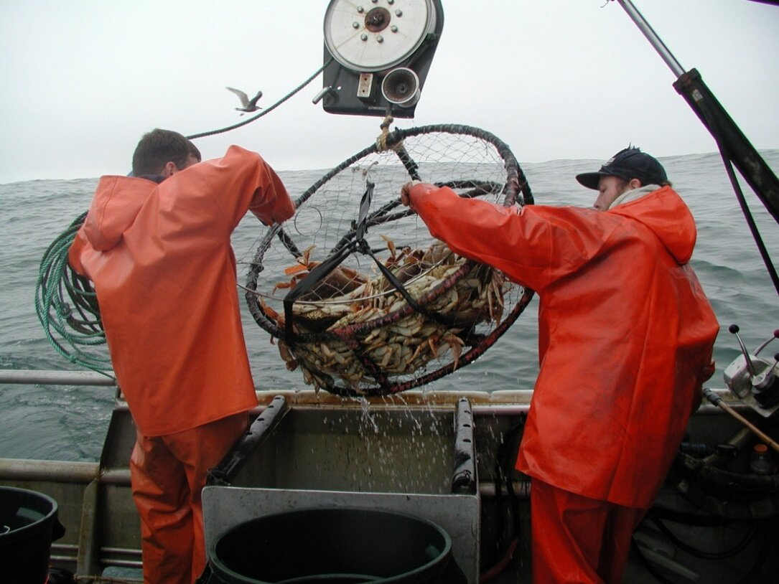
Questions?

