Slide 1
Epigenetic Divergence in Diploid & Triploid Pacific Oysters Following Thermal Stress
Pacific Coast Shellfish Growers Association Conference
September 10, 2025
Matthew George, Ph.D.
mngeorge@uw.edu

Slide 2
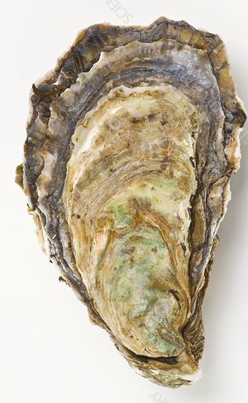
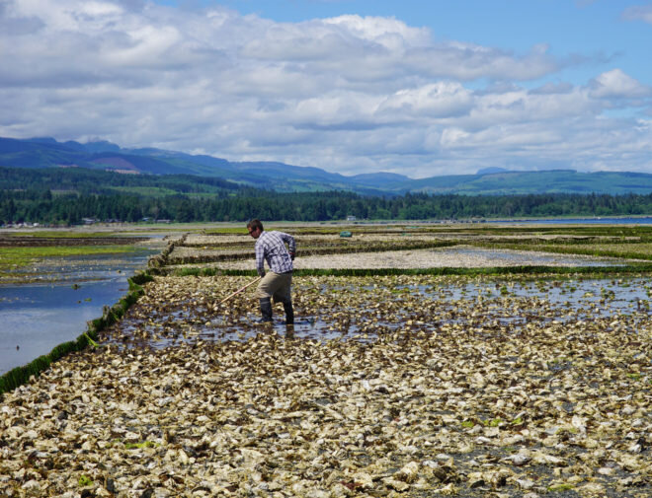
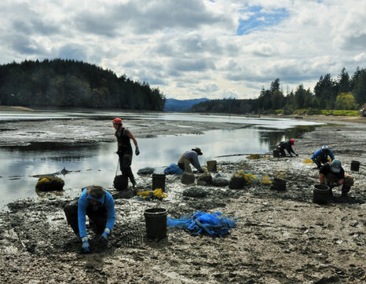
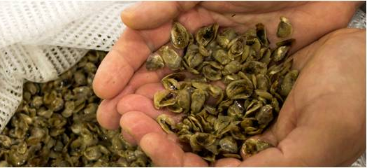
Pacific Oysters – tolerance is survival
Introduction
Pacific Oyster

Slide 3
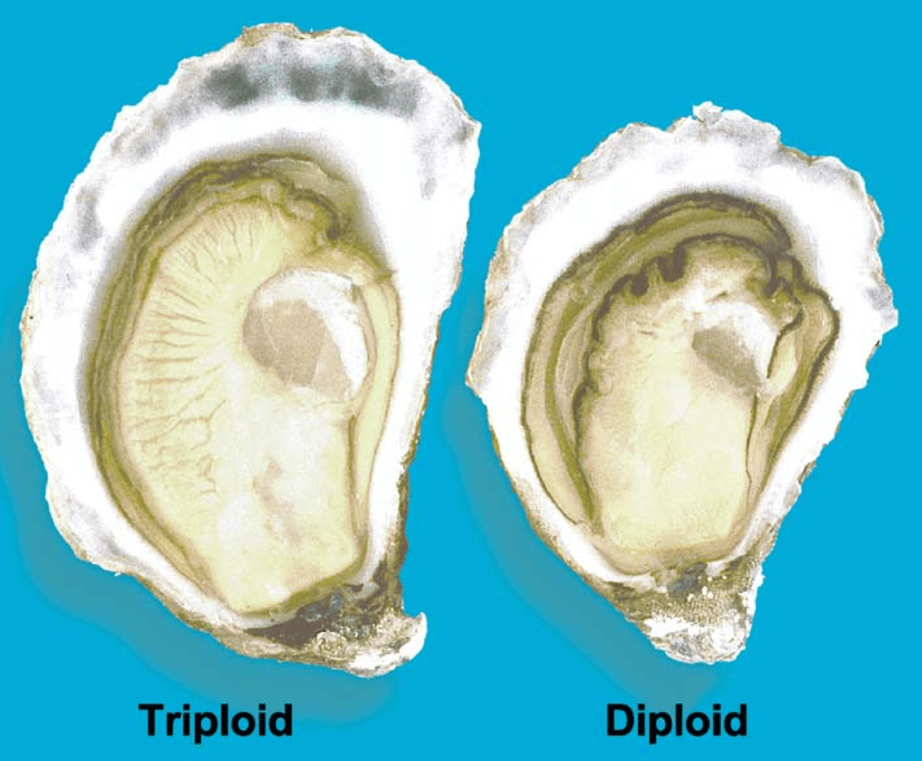
Reproductive control in Pacific oysters
Introduction
Various methods used to induce triploidy (tetraploid cross, heat-shock, pressure, etc.) developed in the late 1970’s.
Triploid oysters have an extra chromosome set (3n).
Triploidy significantly reduces energetic investment in gonad production.
Triploid oysters have superior growth rates.
Harvesting triploids in the summer avoids the unpleasant taste of ‘spawny’ oysters.
Figure credit: Nell 2022; doi: 10.1016/S0044-8486(01)00861-4

Slide 4
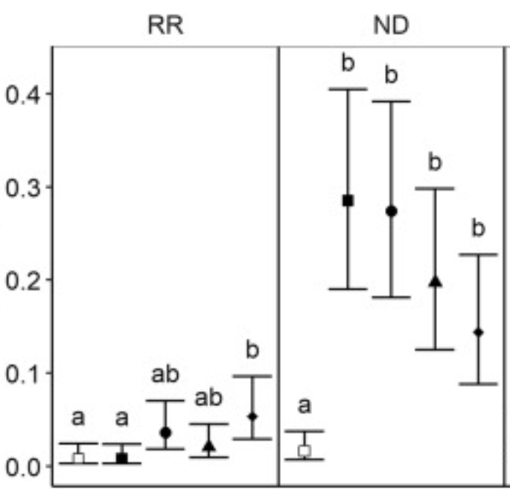
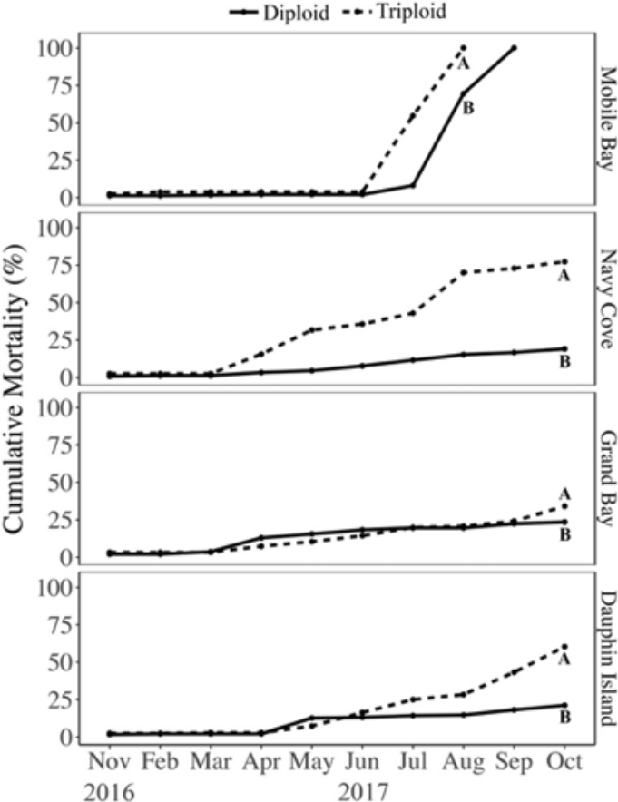
Diploid vs.
Triploid mortality in the field
Introduction
Gulf of Mexico
Chesapeake Bay
Triploid
Cumulative mortality (%)
Probability of mortality
Triploid mortality extending through the summer
Diploid
Wadsworth 2018; http://hdl.handle.net/10415/6074
Matt et al. 2020; doi: 10.1016/j.aquaculture.2020.735375

Slide 5
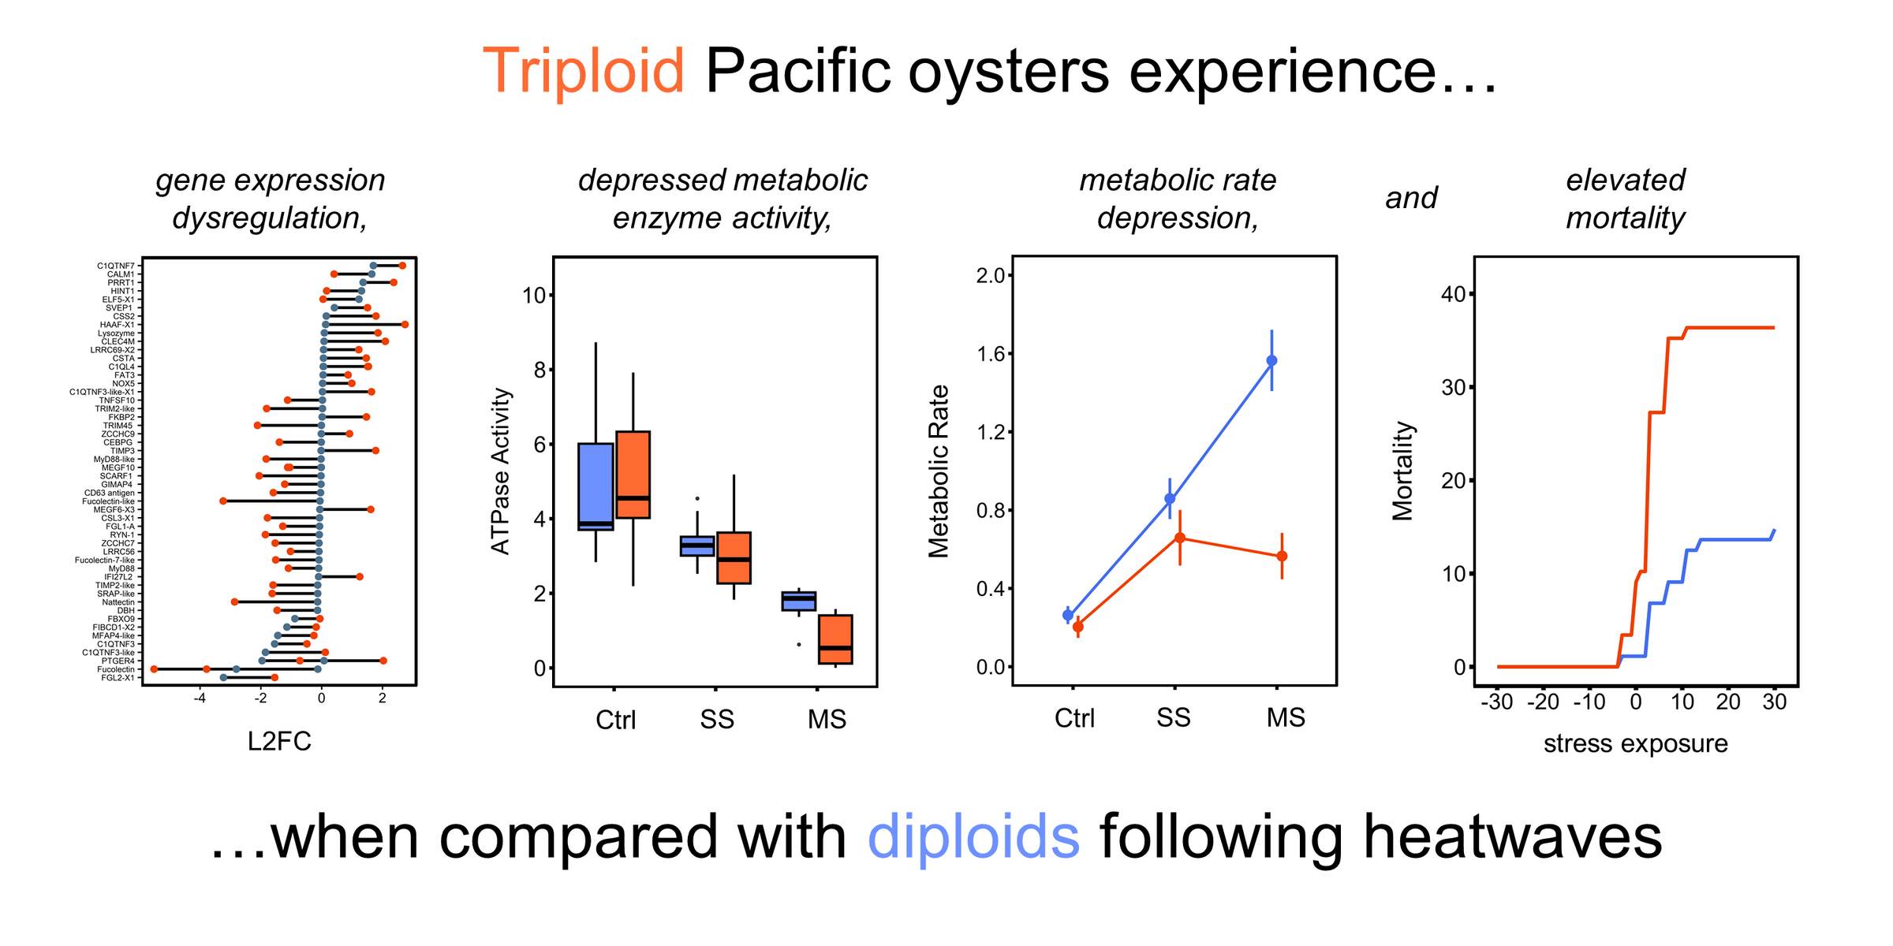
Gene expression is different across ploidy following heatwaves
Introduction
George et al. (2023). Global Change Biology 29.24: 6969-6987.

Slide 6
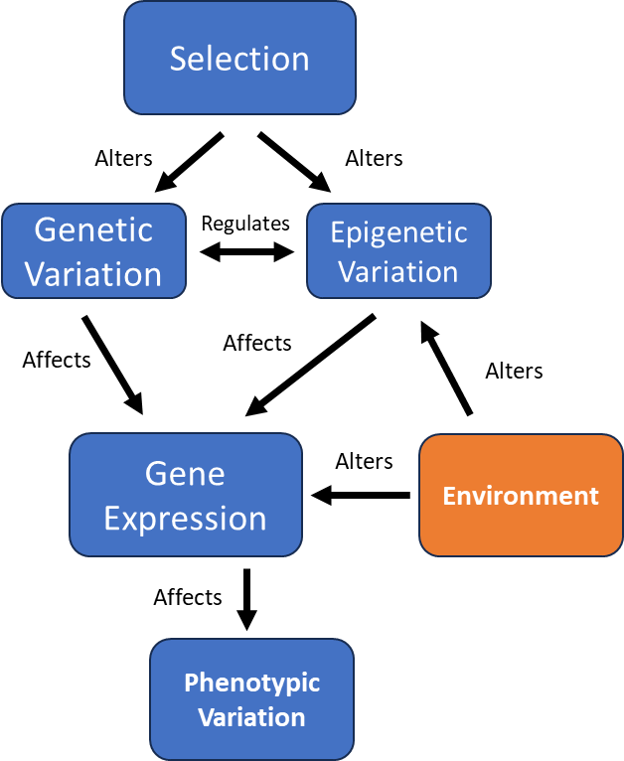
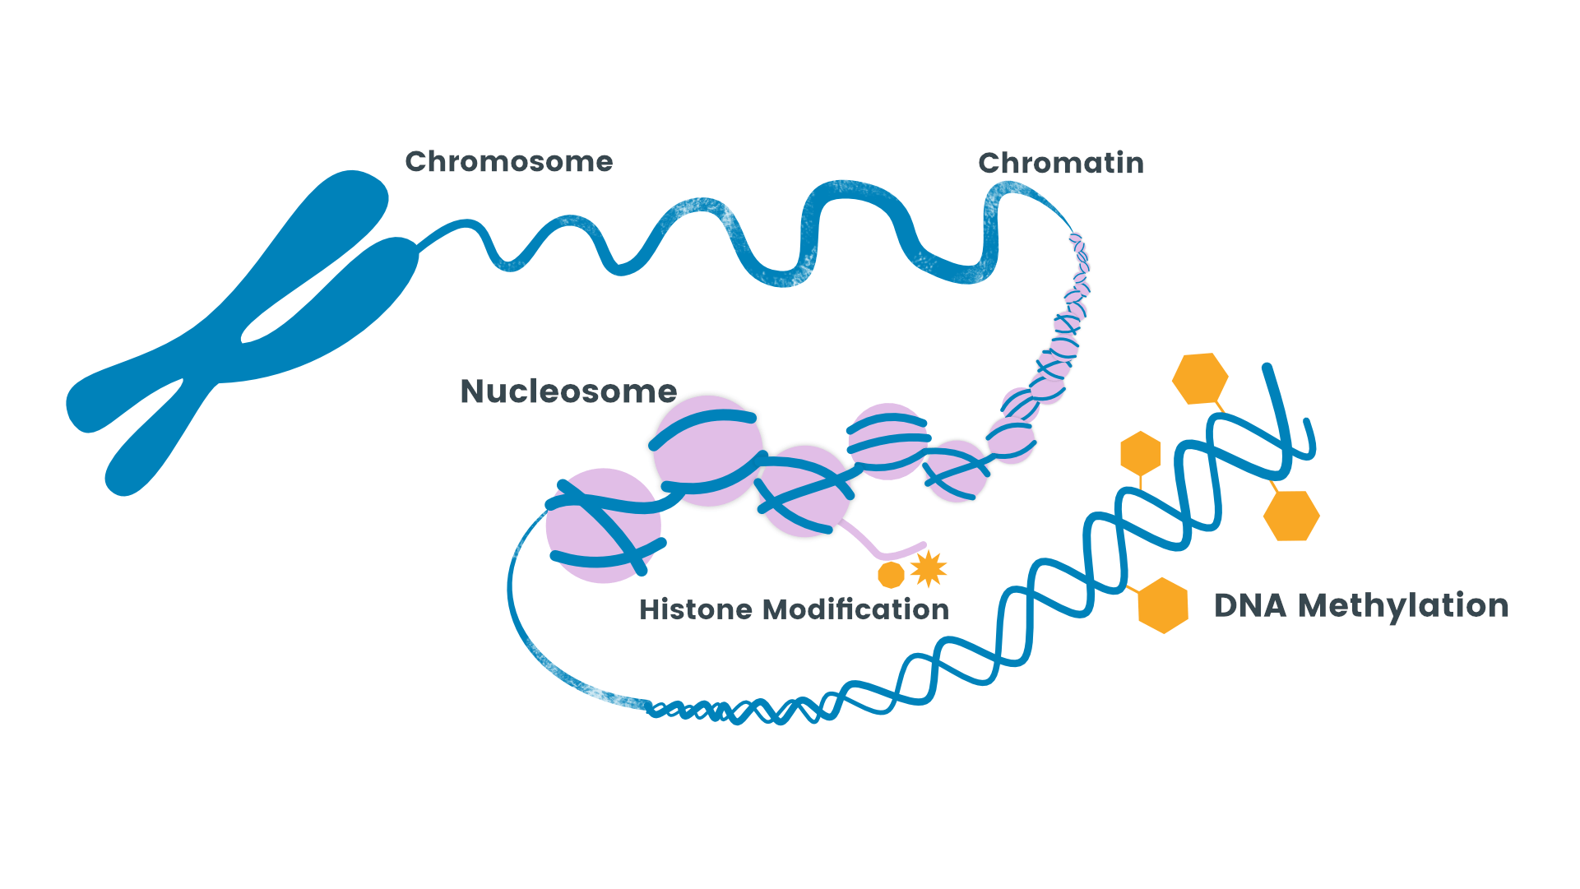
Does DNA methylation respond differently across Diploids and Triploids following heatwaves?
Introduction
If genes are the "words" of a cell's instruction manual, then DNA methylation acts like punctuation or highlighting that tells the cell which words to read, and how often to read them.

Slide 7
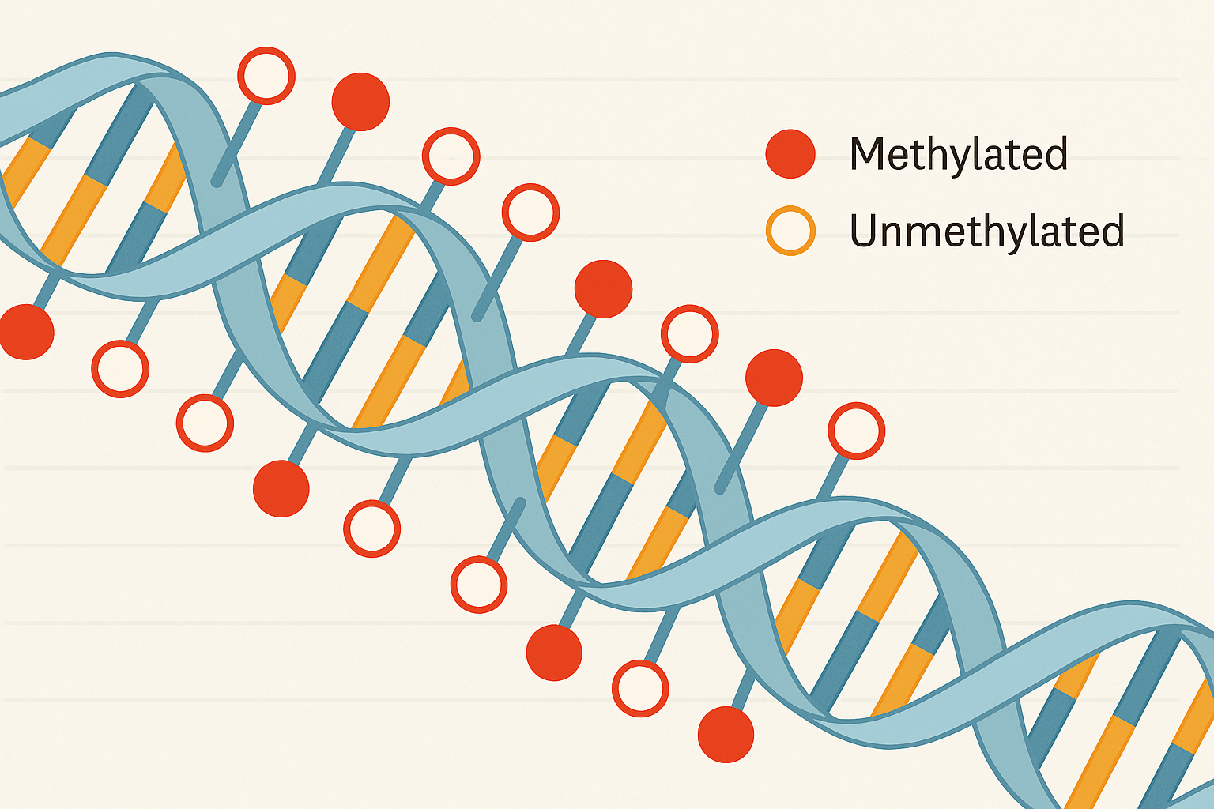
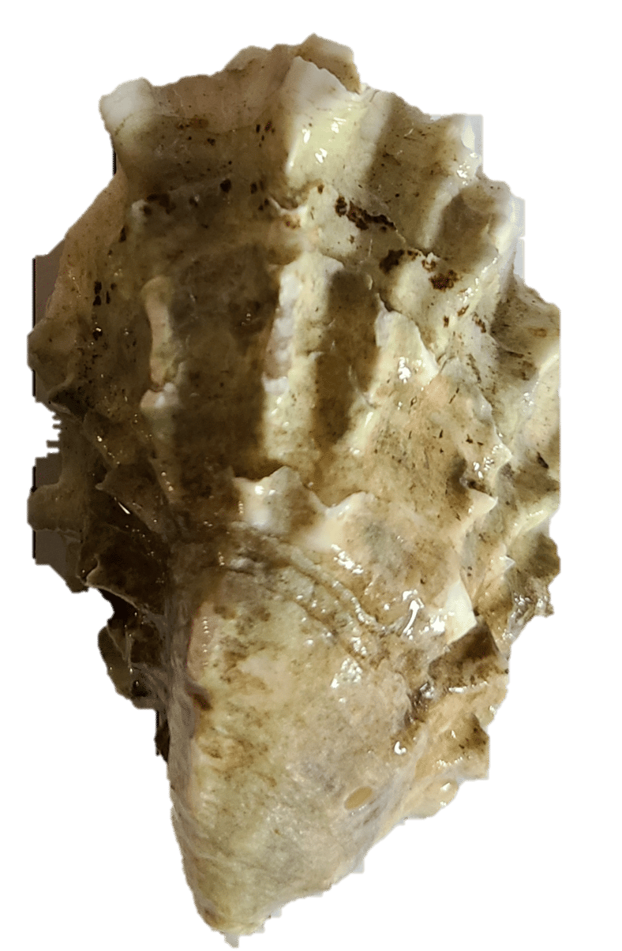
Experimental Design
Methods
  (1) Stress Exposure
  (2) Bisulfite Sequencing
  (3) Analysis
  Identify
  Differentially Methylated Loci (DML) associated with ploidy and treatment.
  Control
  Heat Stress
  (aerial emersion at 27°C for 24 hours)
  Bisulfite Sequencing identifies where epigenetic marks on DNA are. Locations are known as loci.
  DML are defined as loci that display at least a 20% difference in the frequency of methylation between groups.
  n = 5 oysters per ploidy within each treatment. Oyster were acclimated to 13°C.

Slide 8
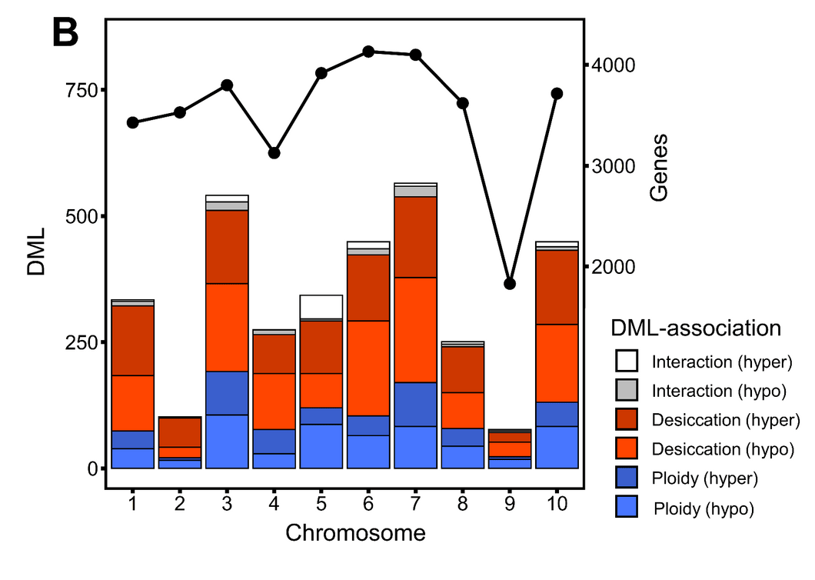
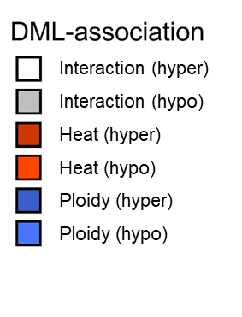
Differentially Methylated Loci (DML) associated with ploidy, heat treatment, and their interaction
Results
  Number Identified (after filter):
  1038 ploidy-DML
  2351 heat-DML
  200 interaction-DML*
heat
  CpG coverage filtered to 10x.
  DML difference threshold of 20%.
  *Interaction-DML are at least 20% different following heat exposure and across ploidy

Slide 9
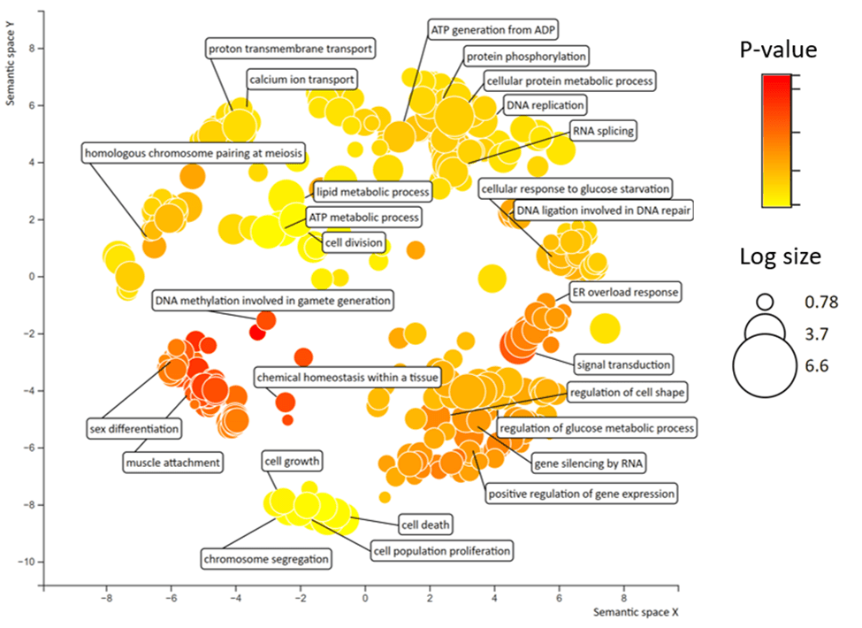
Methylation in triploids differs from diploids before stress
Results
  cell cycle, chromosome segregation, and gamete-related DNA methylation are consistent with the challenges of maintaining an odd ploidy level.
  chemical homeostasis, ER overload response, and metabolic regulation suggest triploids may re-tune cellular physiology at baseline, potentially as compensation for altered genome dosage

Slide 10
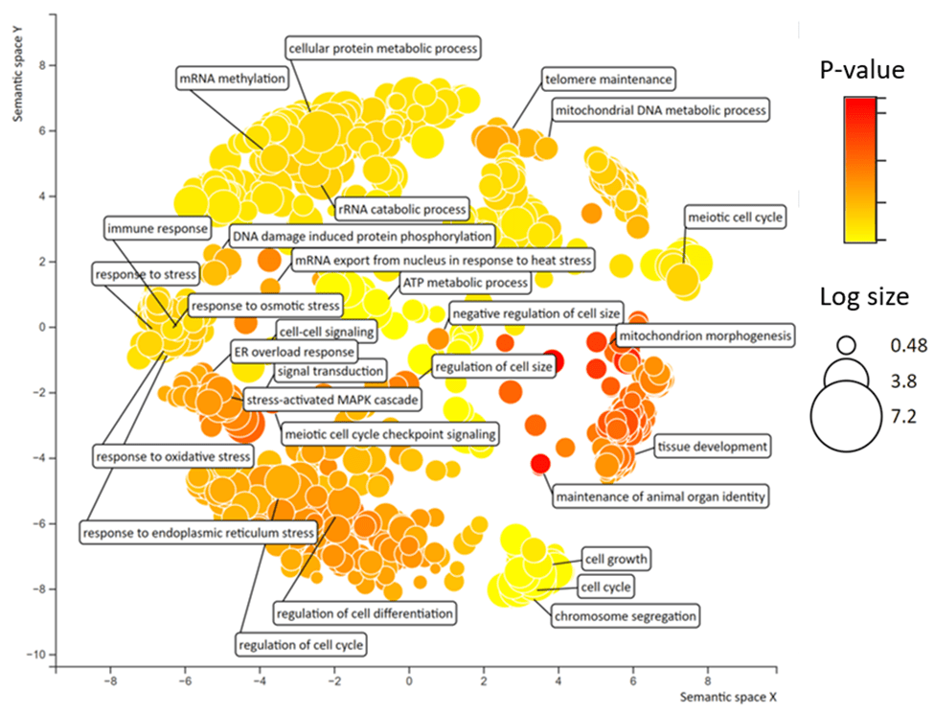
Heat changes the methylation patterns across a suite of stress response pathways
Results
  Heat stress induces methylation differences related to
  cell oxidative damage, protein folding, mitochondrial stability, and DNA repair, across both diploids and triploids

Slide 11
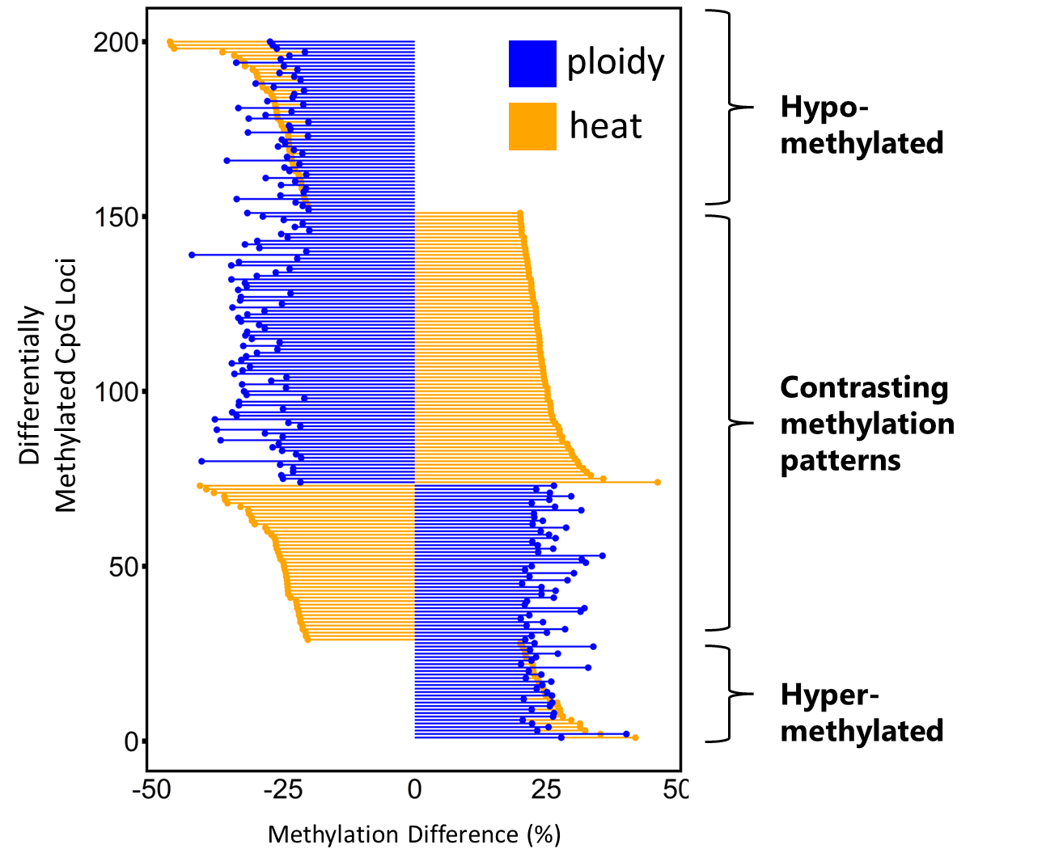
What can we learn from differences between ploidy following stress?
Results
Triploids had less methylation
The methylation pattern present across ploidy reversed
Triploids had more methylation

Slide 12
What can we learn from differences between ploidy following stress?
Results
Stress Adaptation:
Phosphatidylinositol-binding clathrin assembly protein (LAP)
Stress accentuates differences already present across ploidy

Slide 13
What can we learn from differences between ploidy following stress?
Results
Stress reverses differences already present across ploidy
Apoptosis:
CAD Protein
DNA Damage Response:
Nesprin-1
Stress Response:
Dihydropyrimidinase
ATP/AMP Homeostatis:
Adenylate kinase 9

Slide 14
Why is it useful to understand how epigenetics respond to heatwaves?
Conclusion
Selection
Epigenetic variation influences what traits an oyster displays.
Epigenetic variation can be altered during an oyster's life by changing their environment.
Alters
Alters
Genetic Variation
Regulates
Epigenetic Variation
Affects
Affects
Alters
Gene Expression
Alters
Environment
Affects
Phenotypic Variation
Affects
Desired Traits

Slide 15
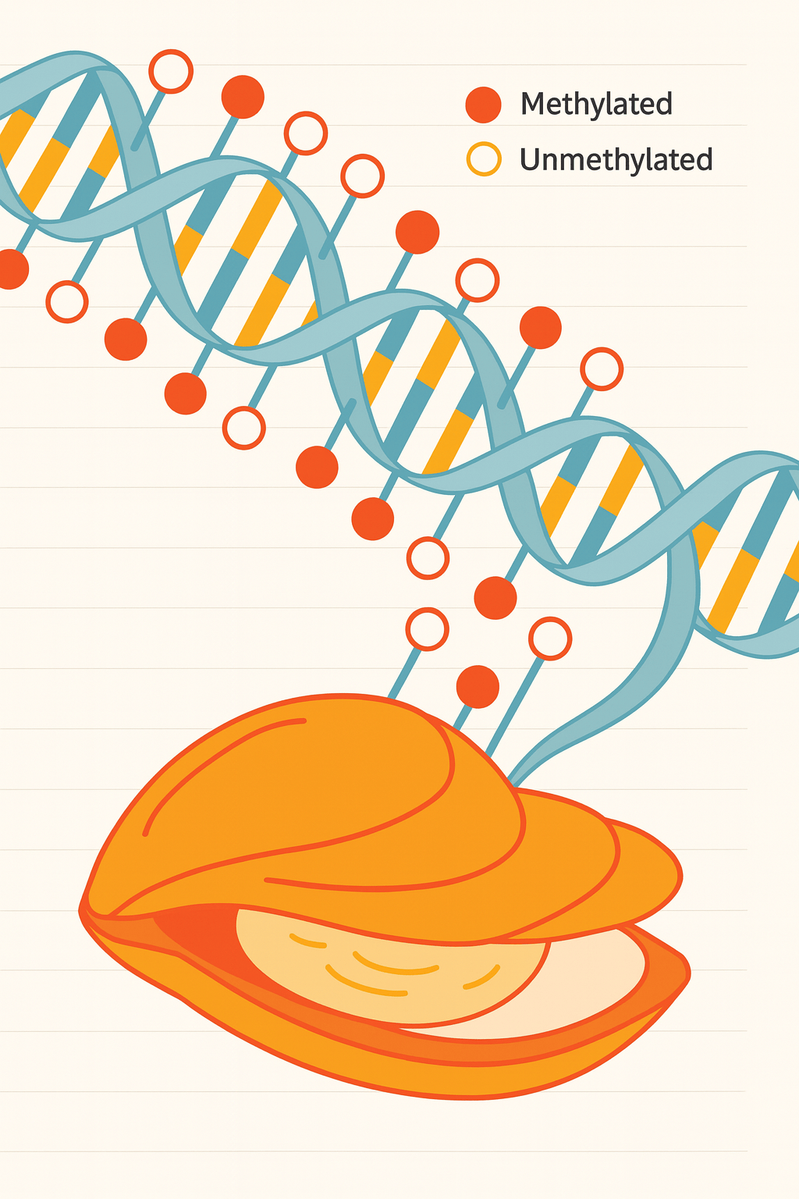
Implications for Aquaculture
Conclusion
Methylation differences in stress and metabolic genes is consistent with triploids facing higher risk under heat stress compared to diploids
Understanding methylation pattern differences across ploidy (e.g., DNA repair, apoptosis, stress signaling) can be used to
Identify resilient methylation landscapes, and
Select/induce methylation landscapes within selectively bred lines

