Slide 1
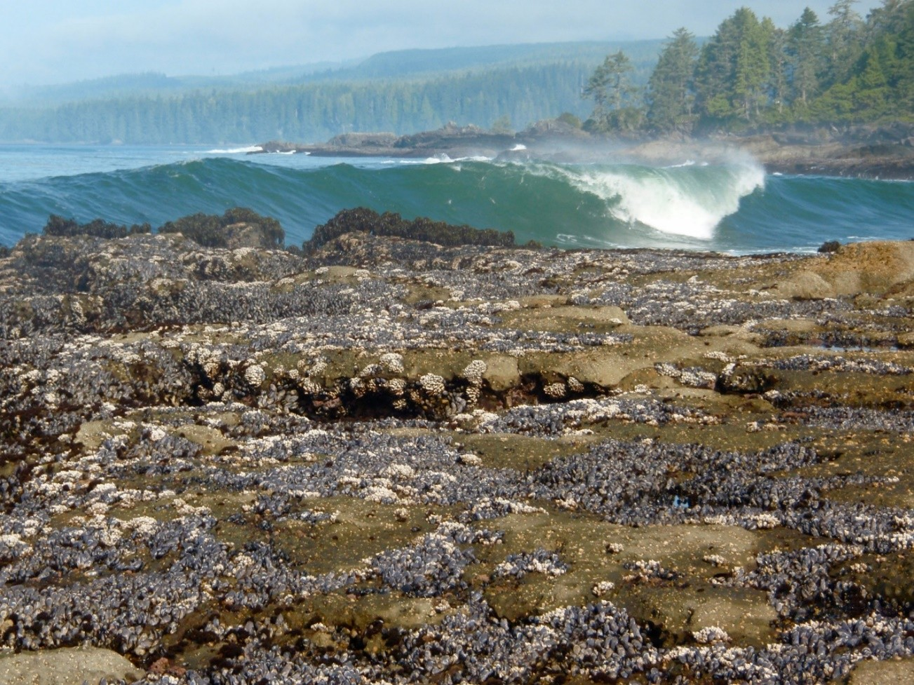
Weakened attachment and transcriptomic shifts in a marine mussel following exposure to ocean acidification, warming, and hypoxia.
Matthew George, Grace Leuchtenberger, Henry Berg, Eric Essington, Steven B. Roberts, and Emily Carrington
October 6, 2026
2026 International Conference on Shellfish Restoration

Slide 2
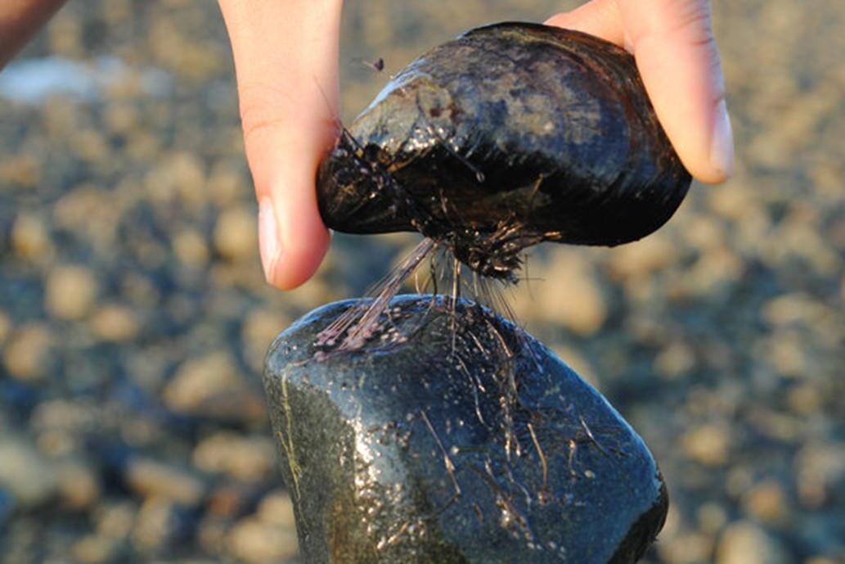



Mussels are foundation species and a valuable crop
Ecosystem engineers
Mussel beds build habitat and raise the number of species living on rocky shores.
A valuable crop
Mussel farming is worth more than $2.9 billion worldwide (FAO 2024)
On a changing coast
Upwelling already brings acidified, low-oxygen water onto the NE Pacific shelf (Feely et al. 2008), where Mytilus trossulus is native.
Photo: Jonathan Wilker
Borthagaray AI, Carranza A (2007) Acta Oecologica 31:243-250. FAO (2024) Fishery and aquaculture statistics yearbook 2014. Feely RA et al. (2008) Science 320:1490-1492. Zhao X et al. (2017) Mar Ecol Prog Ser 565:67-77.

Slide 3
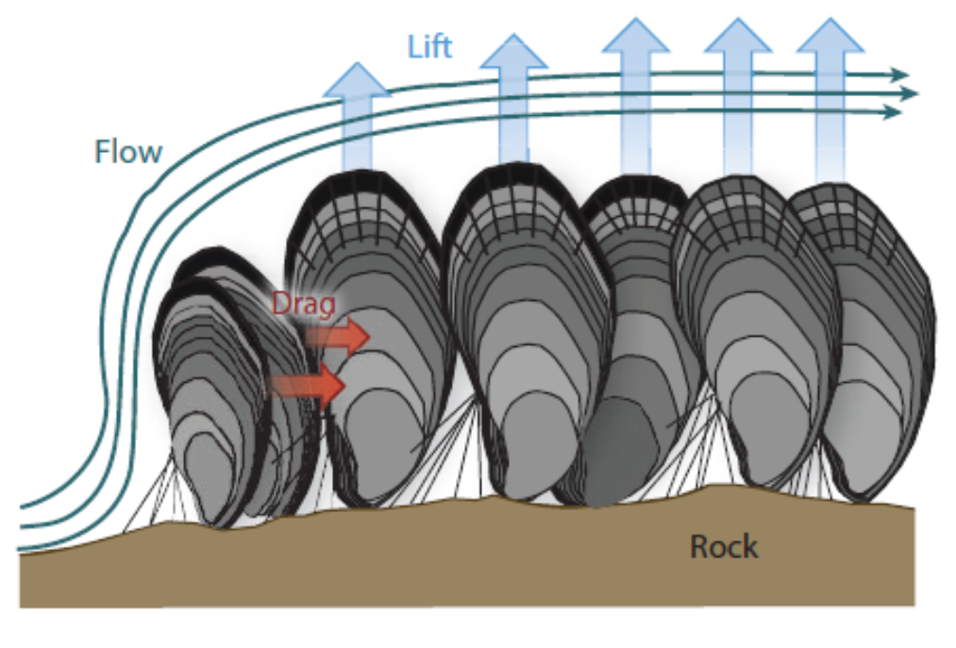
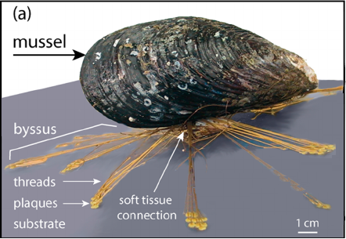
Attachment is survival: waves pull, and byssal threads hold
Lift and drag on a mussel bed. Figure: Denny & Gaylord 2010
The byssus: threads and adhesive plaques. Figure: Herb Waite; Meghan Rock
Each thread is a collagen core inside a protective cuticle, glued down by an adhesive plaque, all secreted by the foot. A mussel that lets go is lost to the bed, or to the harvest.

Slide 4
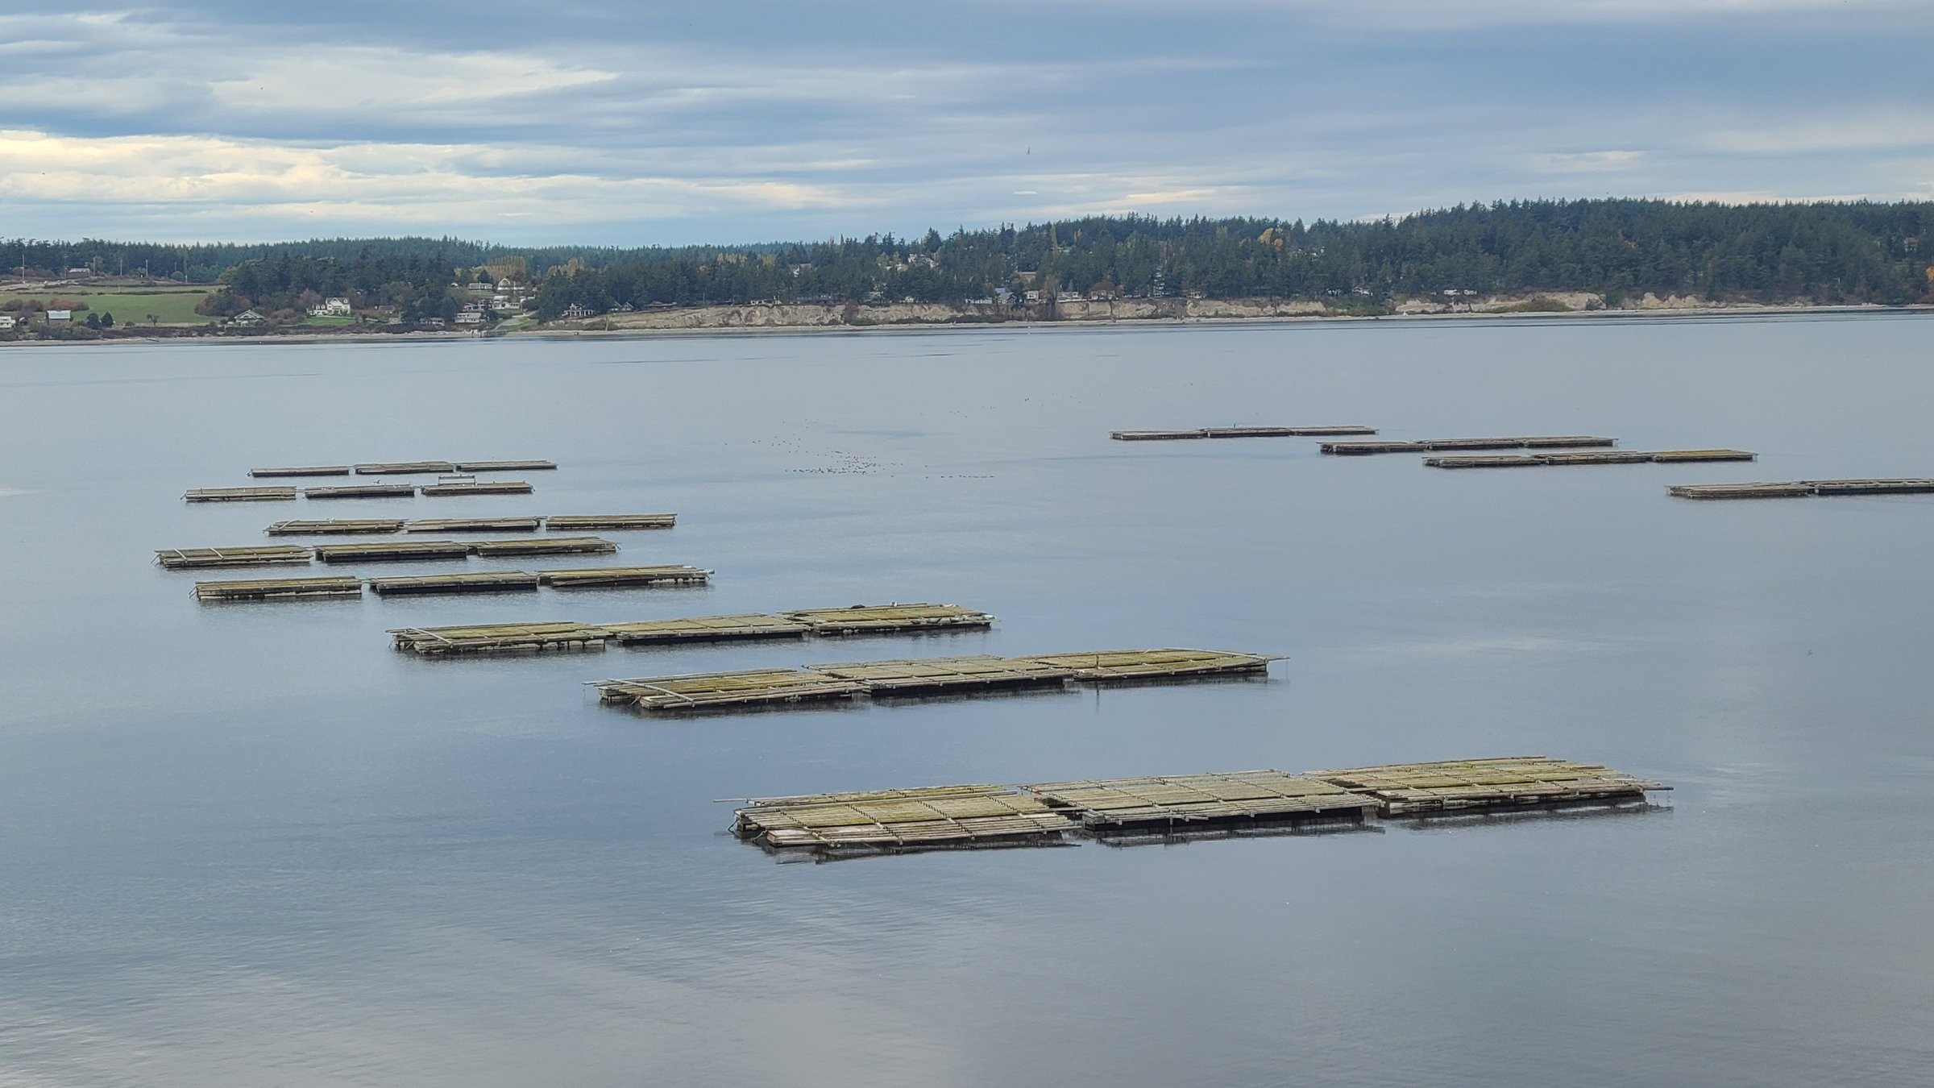
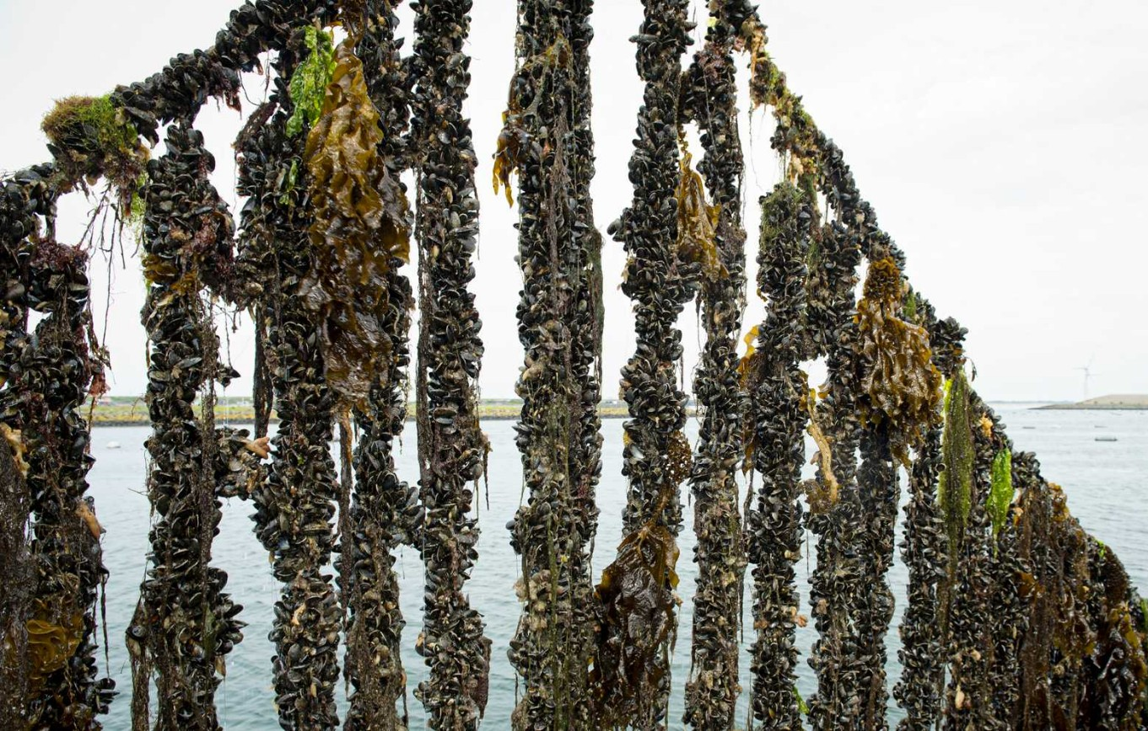
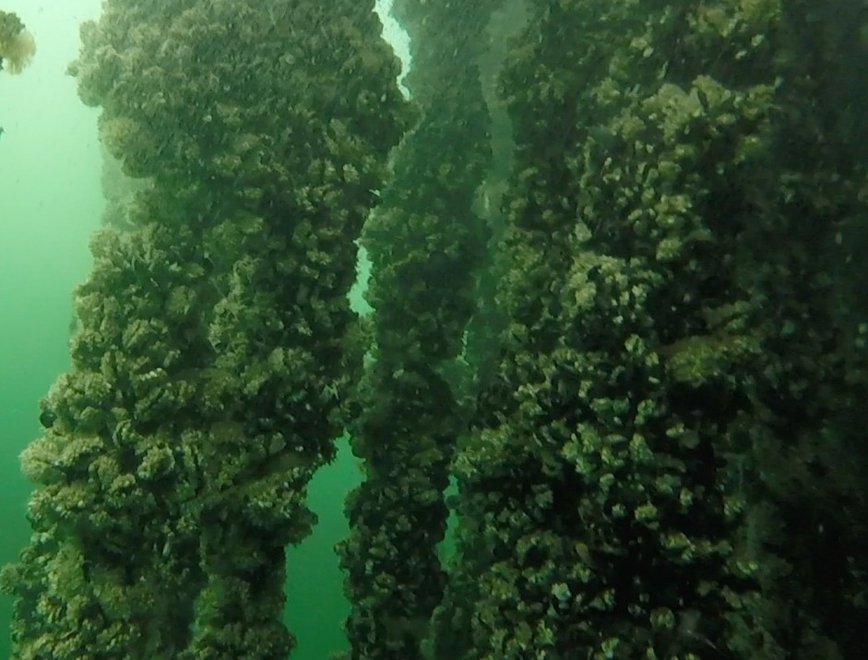
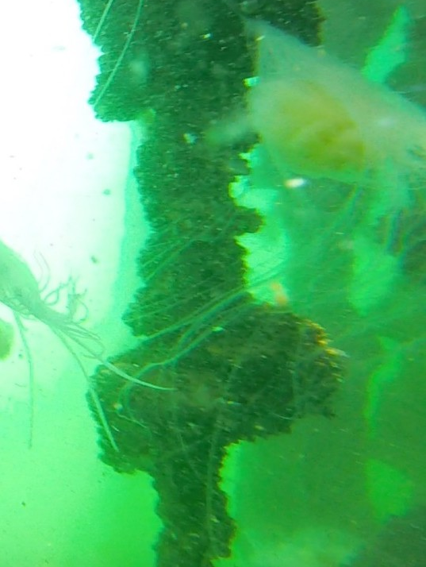
Mussel mariculture depends on strong attachment
Mussels are grown on ropes hung from rafts and longlines, and stay on the rope only as long as their threads hold. When attachment weakens, mussels fall off and the crop is lost.

Slide 5



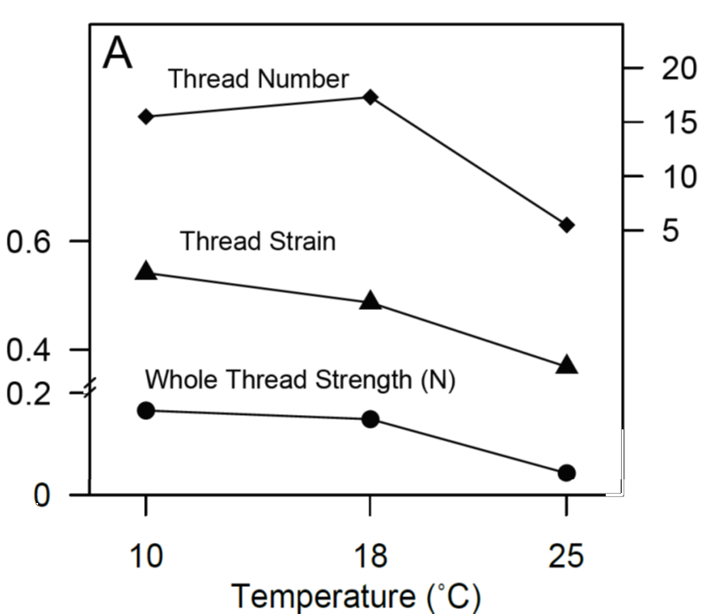
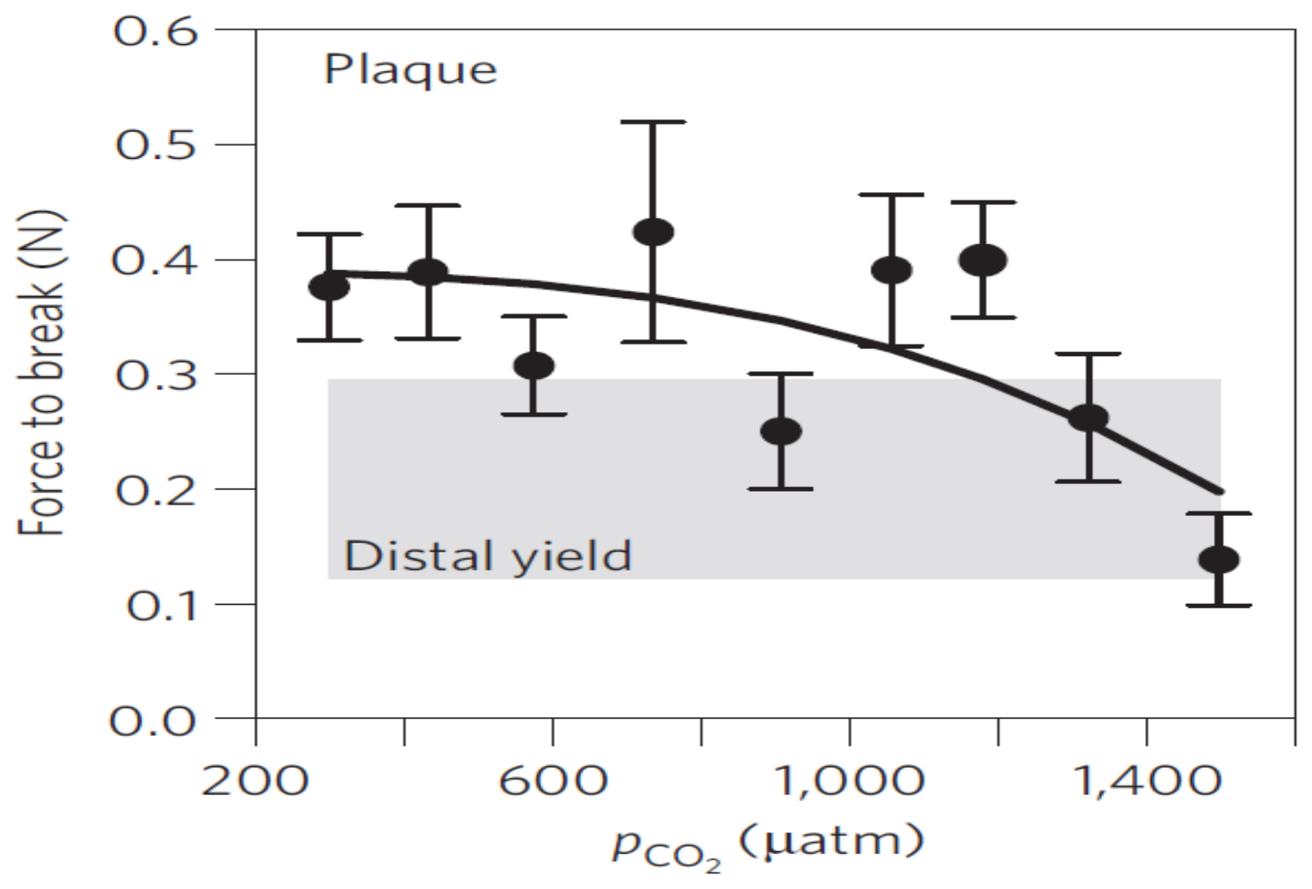
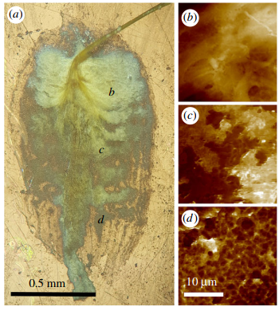
Warming, acidification and low oxygen each weaken byssal attachment
Warming
Acidification
Low oxygen
Fewer, weaker threads at 25 °C. Figure: Newcomb 2015 (dissertation)
Threads break at lower force above about 1,200 µatm pCO2. Figure: O'Donnell, George & Carrington 2013
George MN et al. 2018, J R Soc Interface
Our question: what are the tissues doing while attachment weakens, and can expression tell strong attachers from weak ones?

Slide 6
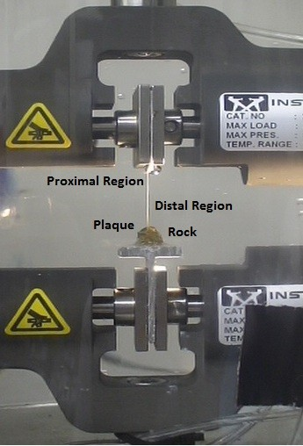
Experimental Design: threads and tissue are collected from stressed mussels, using naïve threads as a baseline
Day 0
Days 0-3
Day 3
Tag-seq
Baseline threads collected and pulled on a tensometer.
Byssus removed to stimulate thread production.
Mussel placed in one of four treatments.
New threads sampled and aged to maturity in control conditions.
Foot and gill tissue sampled.
3' RNA-seq run on foot and gill tissue.
RNA aligned to Mytilus trossulus genome and Iso-seq de novo transcriptome.
Treatment | Temperature (°C) | pH (NBS) | O2 (mg/L) | Animals
Control | 12.2 | 7.94 | 8.3 | 12
Acidification (OA) | 12.3 | 7.01 | 8.4 | 12
Warming (OW) | 20.1 | 7.93 | 8.3 | 12
Hypoxia (DO) | 12.4 | 7.88 | 2.8 | 12
Repeated measures: each animal's day-3 threads are compared with its own day-0 threads (ANCOVA), and each stressor with day-3 controls.

Slide 7
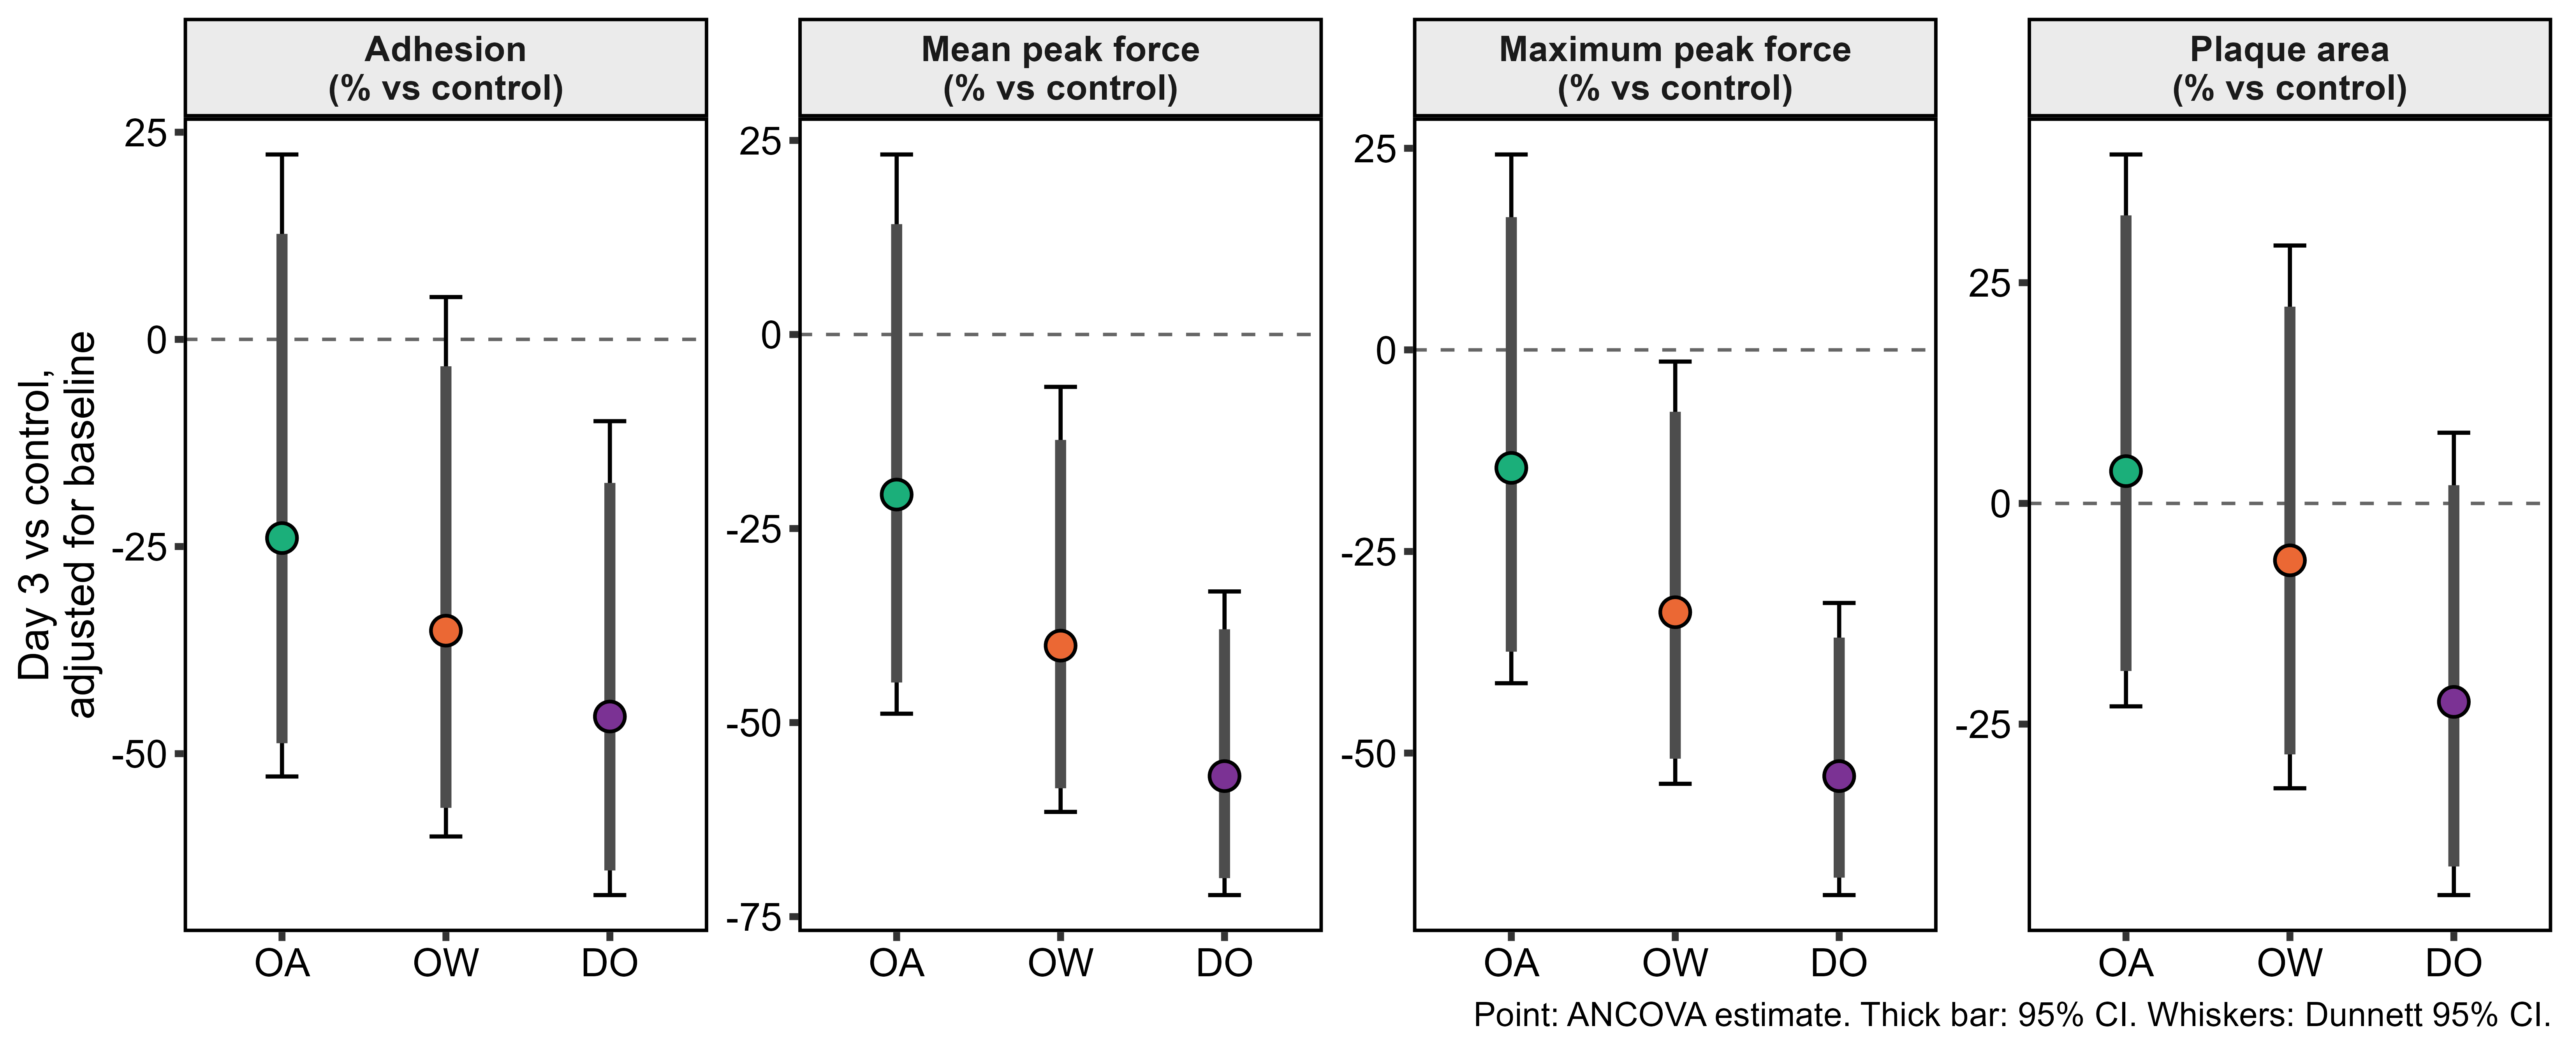
Warming and hypoxia decreased attachment strength; acidification was not significant
−21%
−39%
−57%
Acidification (not significant)
mean peak force, p = 0.61
Warming
mean peak force, p = 0.039
Hypoxia
mean peak force, p = 4e-5
Plaque area did not change detectably
(OW −7%, DO −22%, both ns): threads failed at lower force rather than being anchored by smaller plaques.
Per-animal ANCOVA, log scale, day-3 level adjusted for the animal's baseline; 12 animals per arm; Dunnett-adjusted p and intervals. Acidification 95% CI −47% to +18%.

Slide 8
Every stressor changed gene expression; hypoxia moved the foot most, acidification the gill
678
genes in the foot under hypoxia, 59% of them down
584
genes in the gill under acidification
227
genes in the gill under warming
DESeq2 with apeglm fold changes, padj < 0.05; 7,800 to 10,800 genes tested; 10 to 12 animals per treatment and tissue

Slide 9
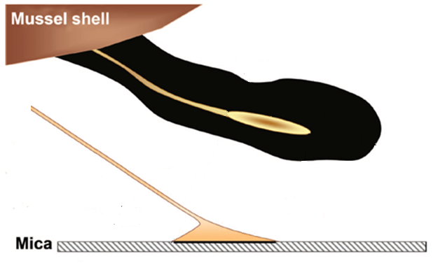
Gene Ontology (GO) analysis: Foot tissue
Foot · Acidification ▲ up
Foot
Protein synthesis
Secretory Glands
tRNA aminoacylation (13 of 21 genes) and translation initiation
Foot · Warming ▼ down
Severe ER Stress & Unfolded Protein Response (UPR)
ERK1/2 signalling regulation; Golgi and ER membranes
Foot · Hypoxia ▼ down
Impaired byssogenesis, thread secretion
Axoneme, dynein arms, cilium movement (19 process, 20 component terms)
topGO weight01, p < 0.01, up- and down-regulated genes tested separately against each contrast's tested genes; cards show only terms also at BH < 0.05 in goseq or clusterProfiler. GO release 2026-01-23.

Slide 10
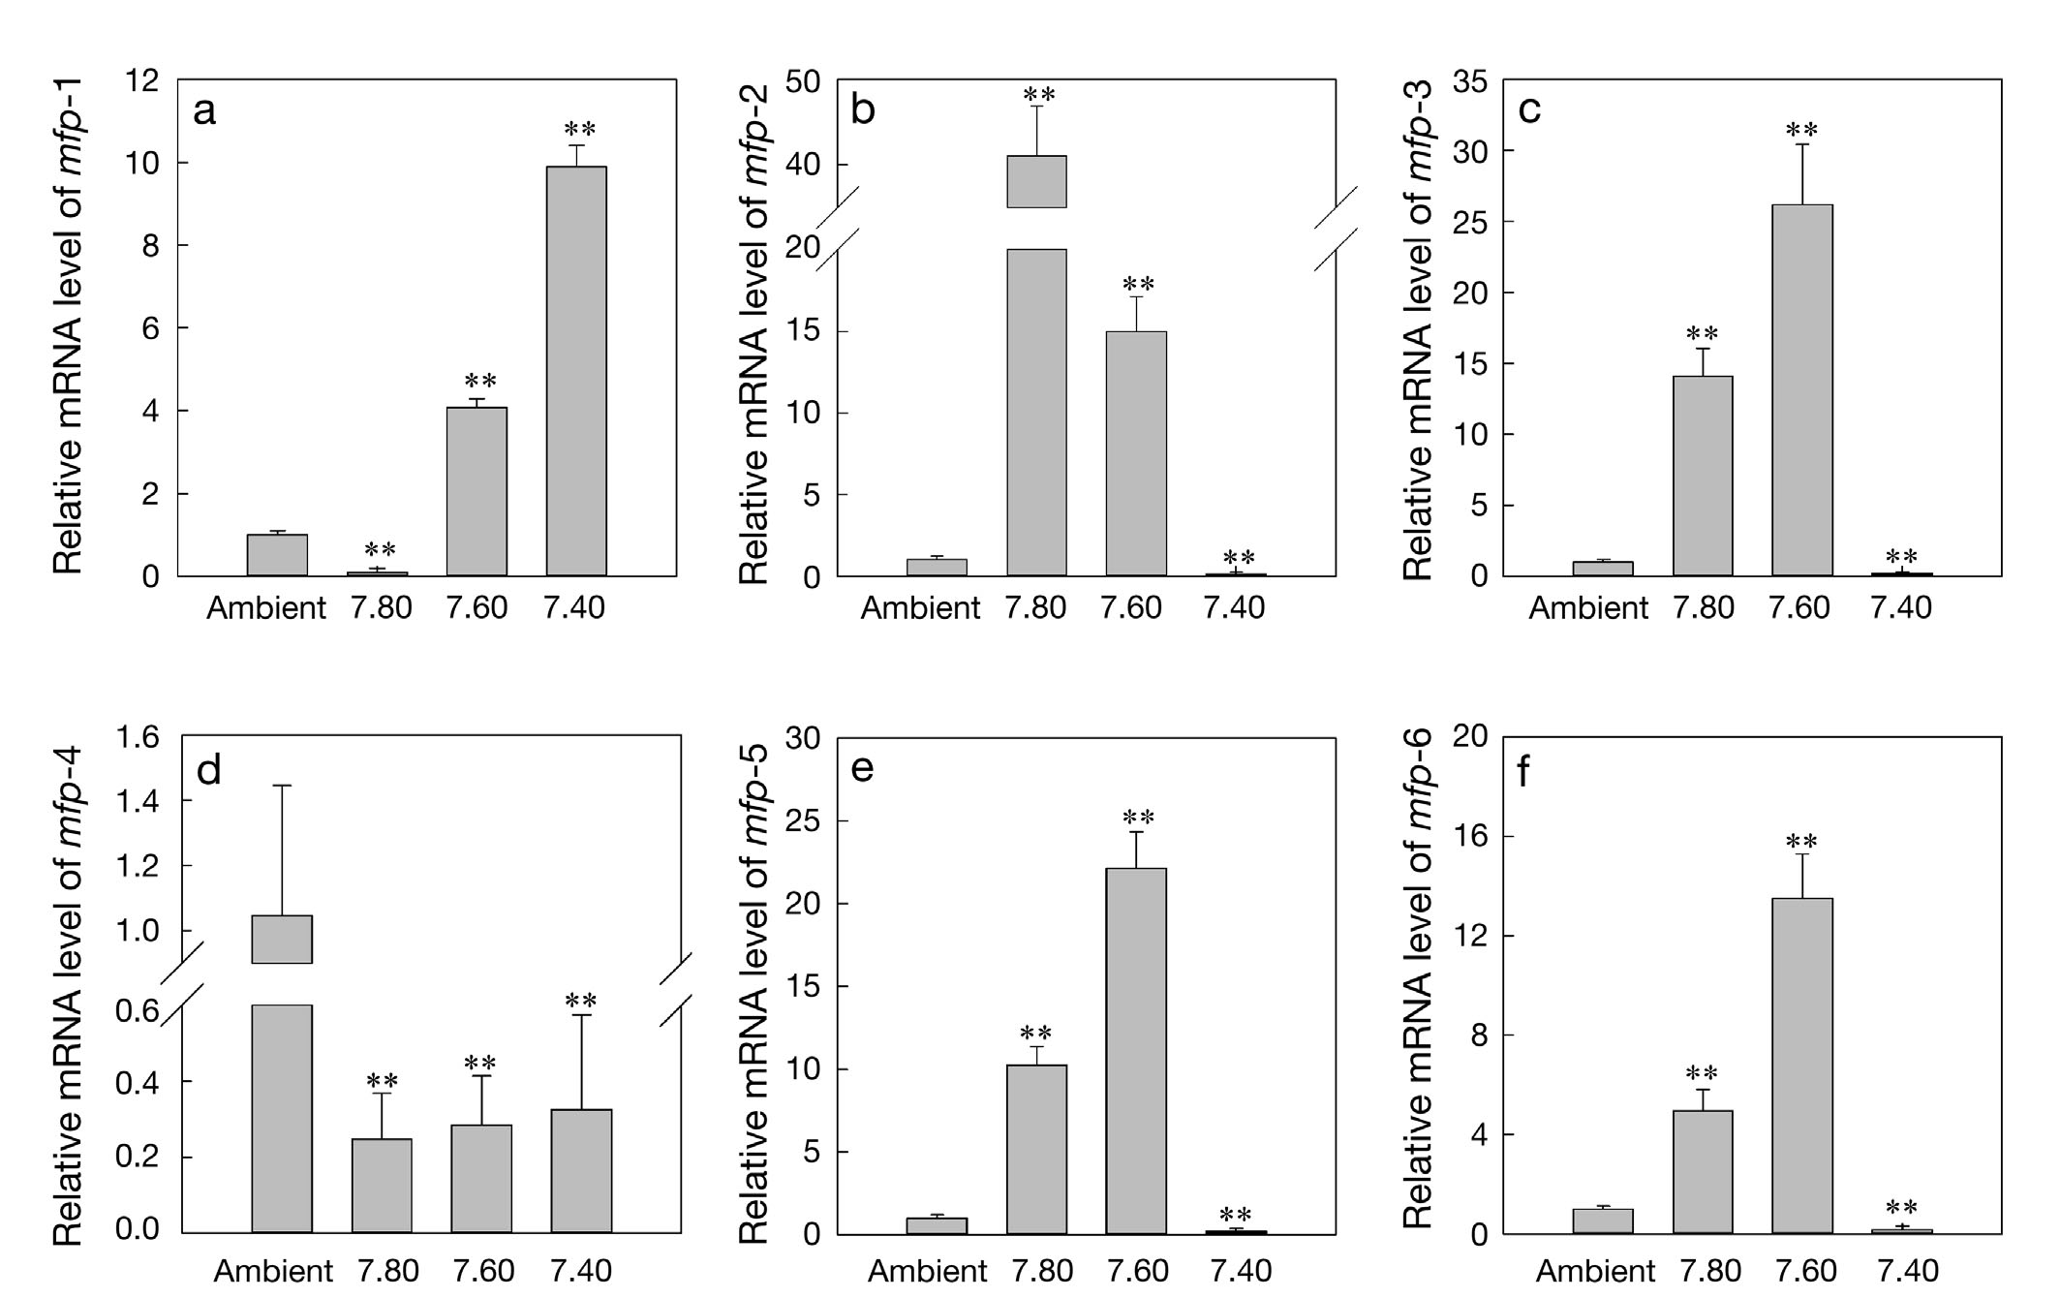
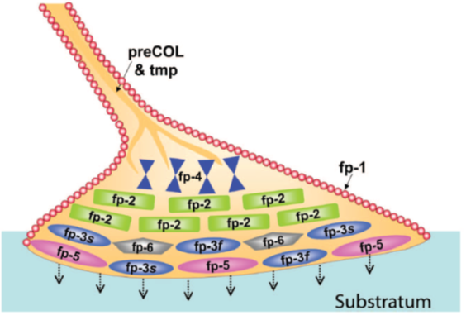
Each thread is built from foot proteins made in the foot
mfp-1
protective cuticle over the whole thread
preCOL-P, -D, -NG
collagen core of the thread
mfp-3 & mfp-5
adhesive plaque; rich in DOPA
Plaque proteins at the surface. Figure: Hwang et al. 2010
The expectation: if a stressor changes attachment, the foot should change how much of these proteins it makes, and their mRNA should track thread strength.
Zhao X, Guo C, Han Y, et al. (2017) Ocean acidification decreases mussel byssal attachment strength and induces molecular byssal responses. Mar Ecol Prog Ser 565:67-77. Figs 4e and 6 (a-f); qPCR relative to 18S rRNA, t-test against ambient (** p < 0.01).

Slide 11
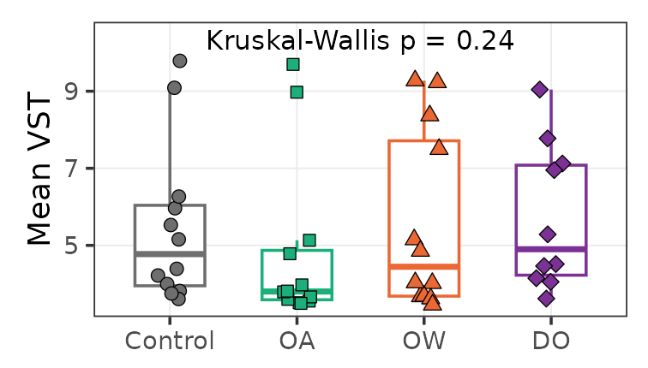
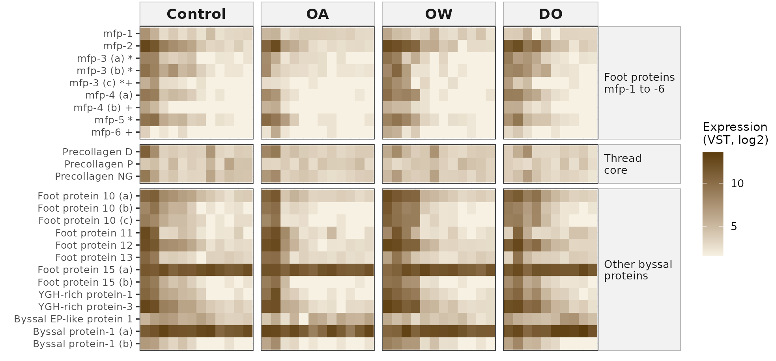
Foot-protein mRNA did not vary with treatment in this study
No treatment effect
VST: DESeq2 variance-stabilised log2 expression. Kruskal-Wallis across treatments per gene: lowest BH q 0.65. DESeq2 vs control: 1 of 19 at padj < 0.05 (foot protein 11, Foot DO), with a shrunk fold change near zero (log2 −0.05).

Slide 12
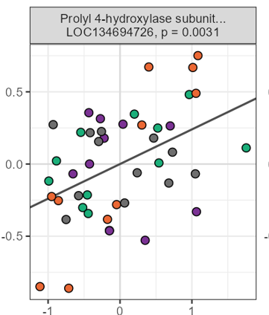
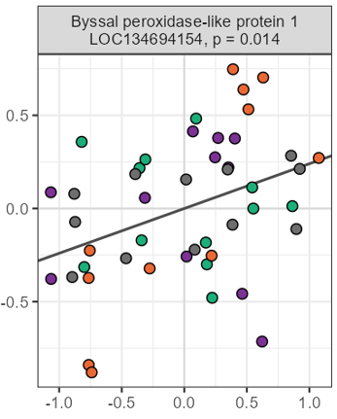
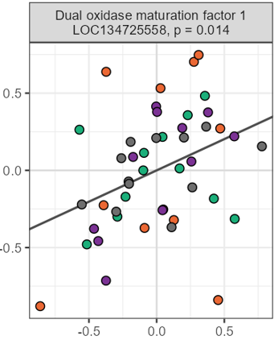

Looking across treatments revealed expression profiles associated with weak and strong attachment
A suite of byssus production enzymes track attachment strength
Gill top 9 of 326 candidates
 | Mean force | Plaque area | Max force | Adhesion
HSP70, HSPA12A-like b (32%) | −0.23 | −0.56* | −0.10 | 0.15
Glutathione peroxidase 7-like (45%) | −0.36* | −0.14 | −0.52* | −0.21
Aminoacylase-1-like (56%) | −0.45* | 0.17 | −0.35* | −0.52*
Met-tRNA ligase, mito. (49%) | −0.48* | −0.07 | −0.45* | −0.36*
Ile-tRNA ligase, mito. (46%) | 0.47* | 0.00 | 0.43* | 0.42*
HSP70, HSPA12A-like a (34%) | −0.13 | −0.46* | −0.14 | 0.12
HSP70, HSPA12A-like c (32%) | 0.36* | −0.21 | 0.16 | 0.45*
Ficolin-like (54%) | 0.20 | 0.45* | 0.12 | −0.12
Byssal HSP-like protein 1 (82%) | −0.08 | −0.44* | 0.10 | 0.18
Log mean peak force (N)
VST expression (baseline adjusted)
Conclusion: mussels that produce strong attachments under environmental stress have expression profiles that maximize metabolic efficiency and maintain the production of thread processing enzymes.

Slide 13
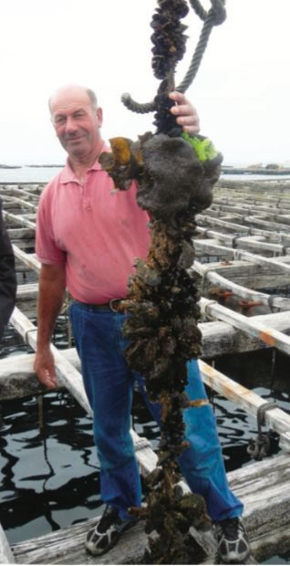
Implications for restoration and aquaculture
1
Hypoxia is the biggest threat to attachment
Hypoxic mussels made 40% fewer threads, they were on average 57% weaker. Restoration efforts and aquaculture should avoid hypoxic sites and stocking densities that decrease local oxygen supply.
2
Robust attachment profiles exist across stressors
Mussels that produce strong attachments under environmental stress have expression profiles that maximize metabolic efficiency and maintain the production of thread processing enzymes.
3
Mussel foot proteins (MFP) aren’t marker genes
Neither the number of genes that responded nor foot-protein mRNA tracked thread strength.

Slide 14


Thank you
Questions?
Partner: Penn Cove Shellfish
Funding Source: Pacific States Marine Fisheries Commission Pilot Program
Code and data: github.com/mattgeorgephd/PSMFC-mytilus-byssus-pilot

