Slide 1
Coastal Razor Clam Harvest Monitoring
Methodology, uncertainty, and options for 2026-27
Internal staff discussion · Coastal Shellfish Unit, WDFW
Matthew George
Notes:
Framing meeting for razor clam harvest monitoring: history, gaps, budget impact, and a re-imagined framework.

Slide 2
Agenda
1. History of razor clam harvest monitoring and estimation
2. Data gaps and uncertainty
3. Impact of budget reduction
4. Data needs; a re-imagined harvest monitoring framework
5. Plan for the 2026-27 season
6. Follow-up: the 2027 stock assessment
Notes:
The six agenda items. This deck is organized to follow them.

Slide 3
1. History of harvest monitoring and estimation

Slide 4
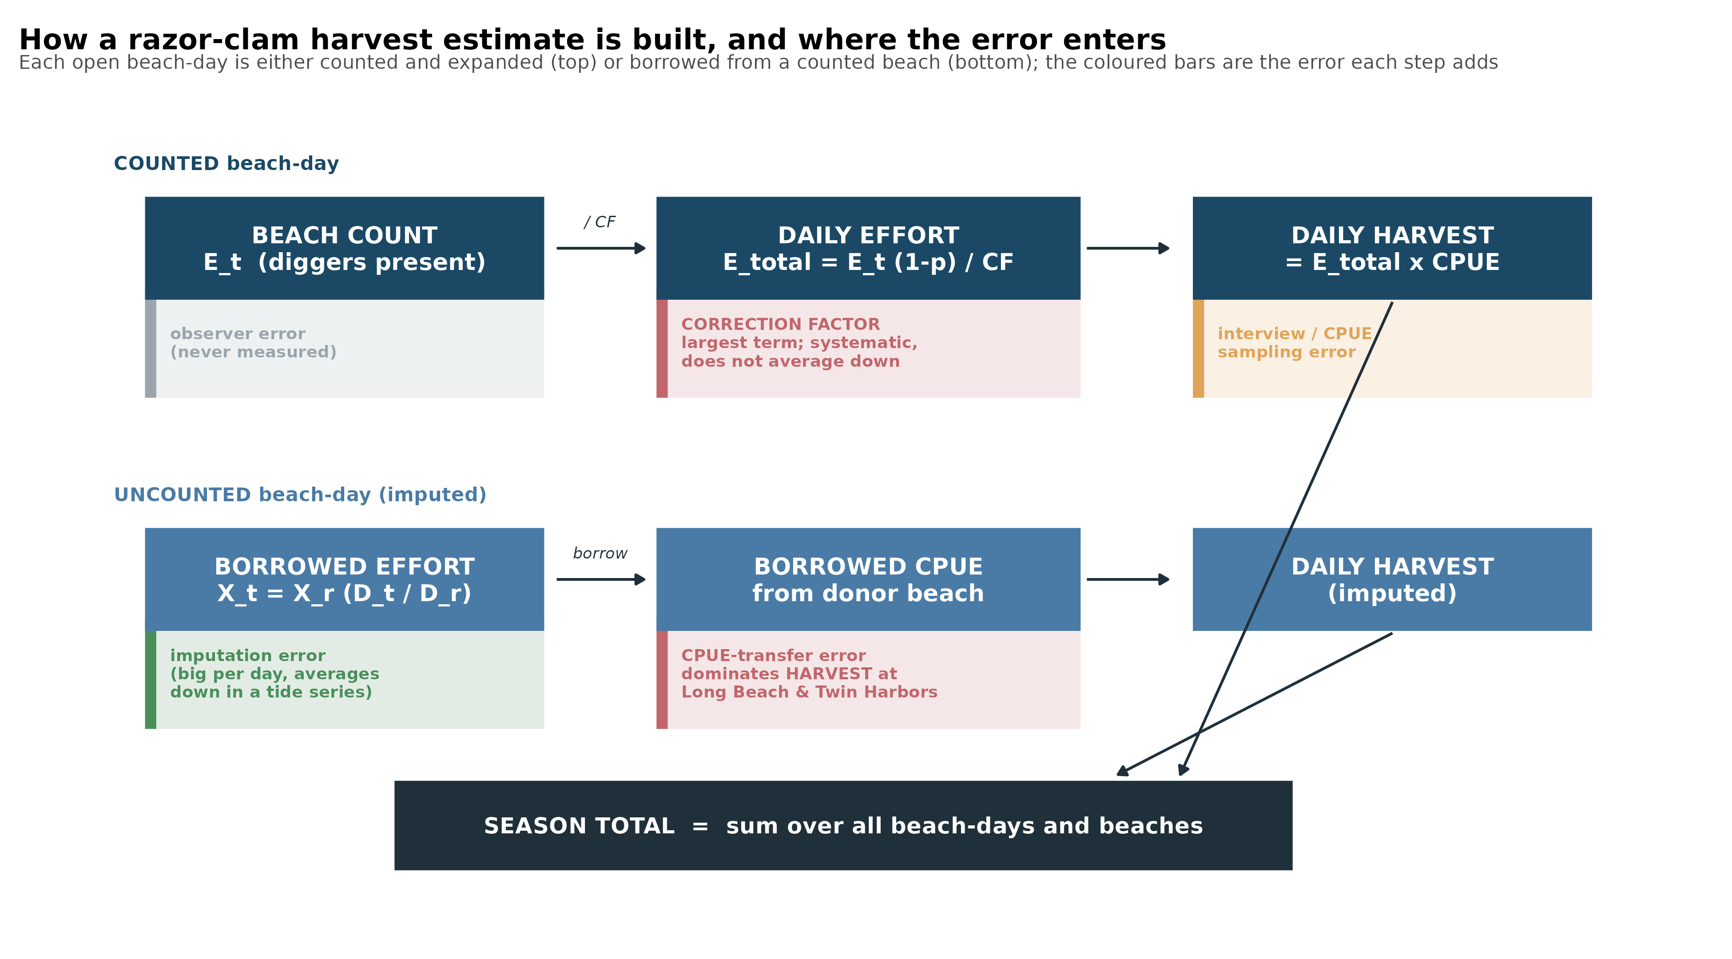
How a harvest estimate is built
In plain terms: count the diggers once; divide by the correction factor for the whole day; multiply by catch-per-digger for harvest. On uncounted days both are borrowed. The red step never averages away.
Notes:
Sec 4 chain + Sec 10 budget.

Slide 5
The estimate in four equations
CPUE = clams / diggers catch per digger, from the creel interviews
E_total = E_t (1 - p) / CF expand the count E_t to the whole day; CF ~ 0.5 is the share present at count time
Harvest = E_total x CPUE effort times catch rate, summed over segments, days, and beaches
X_today = X_ref x ( Donor_today / Donor_ref ) uncounted day: borrow a neighbour's day-over-day change
In plain terms: the whole method is one measured count expanded by a correction factor and a catch rate. When a beach is not counted, the first three lines are replaced by the fourth, and the day is inferred from a neighbour.
Notes:
Section 4.1-4.5.

Slide 6
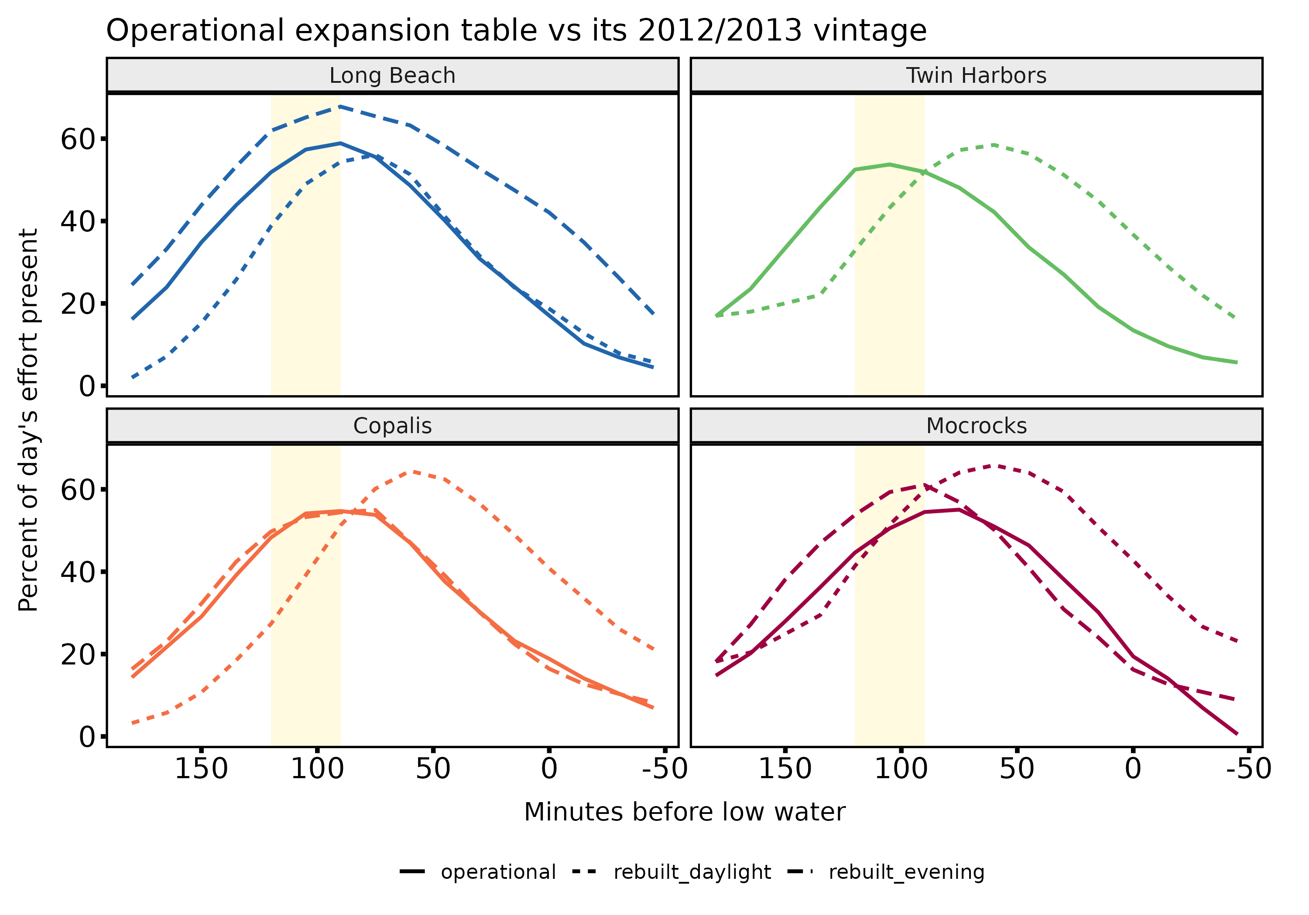
The method has moved: the May 2013 correction
May 2013 correction: the old arithmetic underestimated harvest by ~16%; re-estimated day-by-day back to 1997-98.
The correction factor, the share of a day's effort present at the count, is the load-bearing number.
Long Beach's table was reshaped after 2013: +33% expanded effort for the same count.
Comparing Long Beach effort across that change compares two different instruments.
Notes:
Sec 6.2-6.3.

Slide 7
2. Data gaps and uncertainty

Slide 8
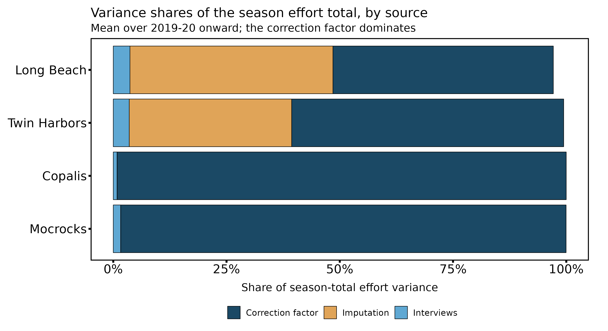
The correction factor dominates, and it does not average down
71-96% of season effort variance at every beach is the correction factor.
It is systematic: one table scales every beach-day, so counting more days cannot shrink it.
Imputation is large on a single day but cancels within a tide series (lag-1 autocorrelation -0.68).
The lever is surveys, not crew days for the term that dominates effort.
Notes:
Sec 10.1 / Table 14.

Slide 9
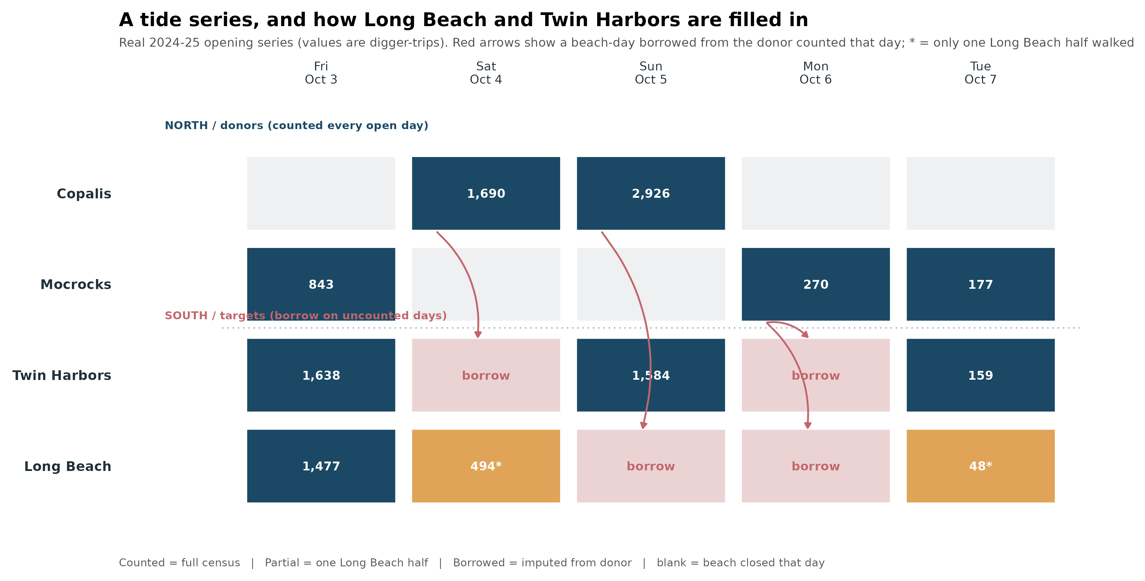
Most southern beach-days are borrowed, not counted
In plain terms: Copalis and Mocrocks are counted every day they open; the southern beaches often are not, so their effort is borrowed from a counted neighbour. In 2025-26, 57% of Long Beach effort is borrowed from another beach.
Notes:
Sec 4.5.

Slide 10
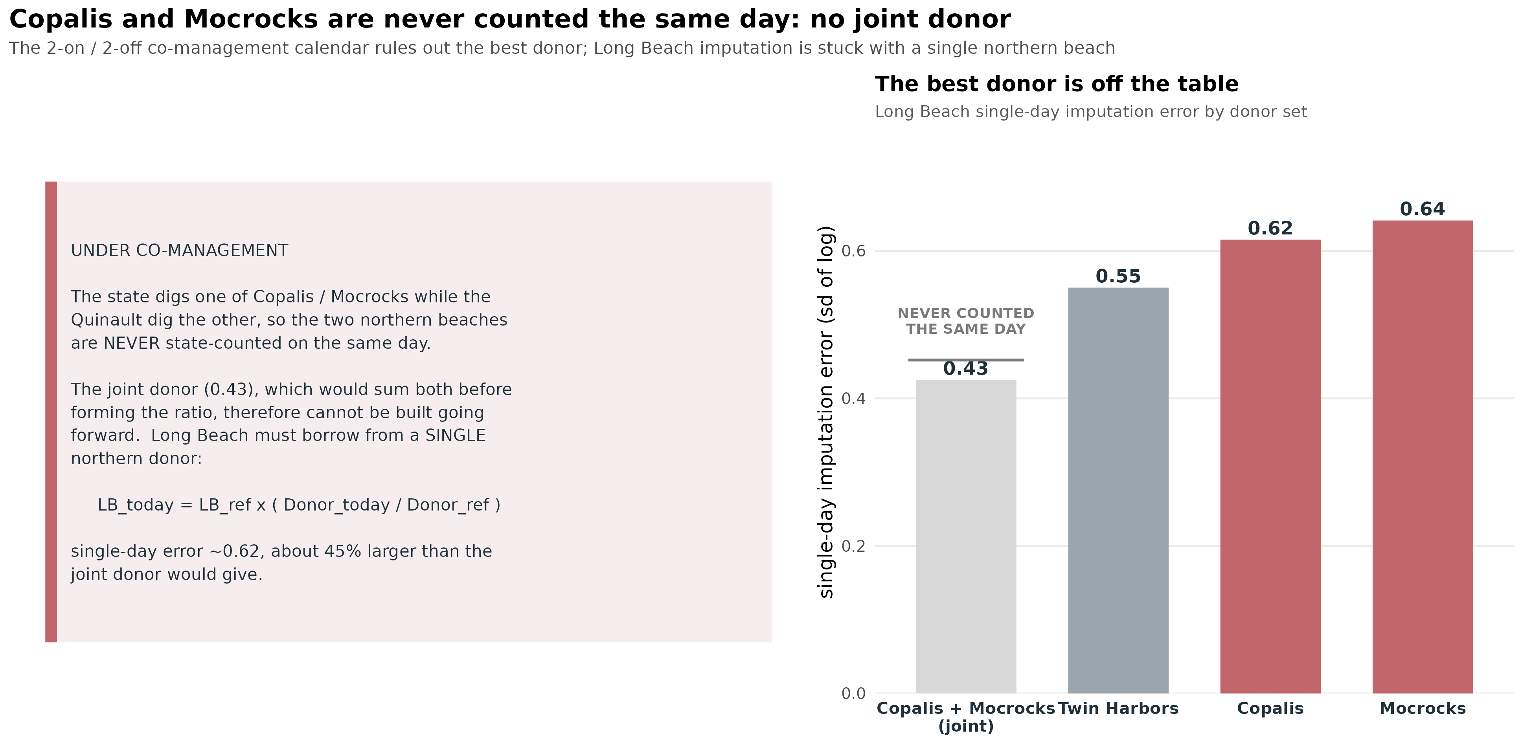
No joint donor under co-management
In plain terms: co-management means the state counts only one northern beach per day, so the best (joint) donor cannot be built. Long Beach must borrow from a single northern beach, single-day error about 0.62, roughly 45% worse than the joint donor.
Notes:
Sec 4.5 / 11.7. Correction: joint donor unavailable going forward.

Slide 11
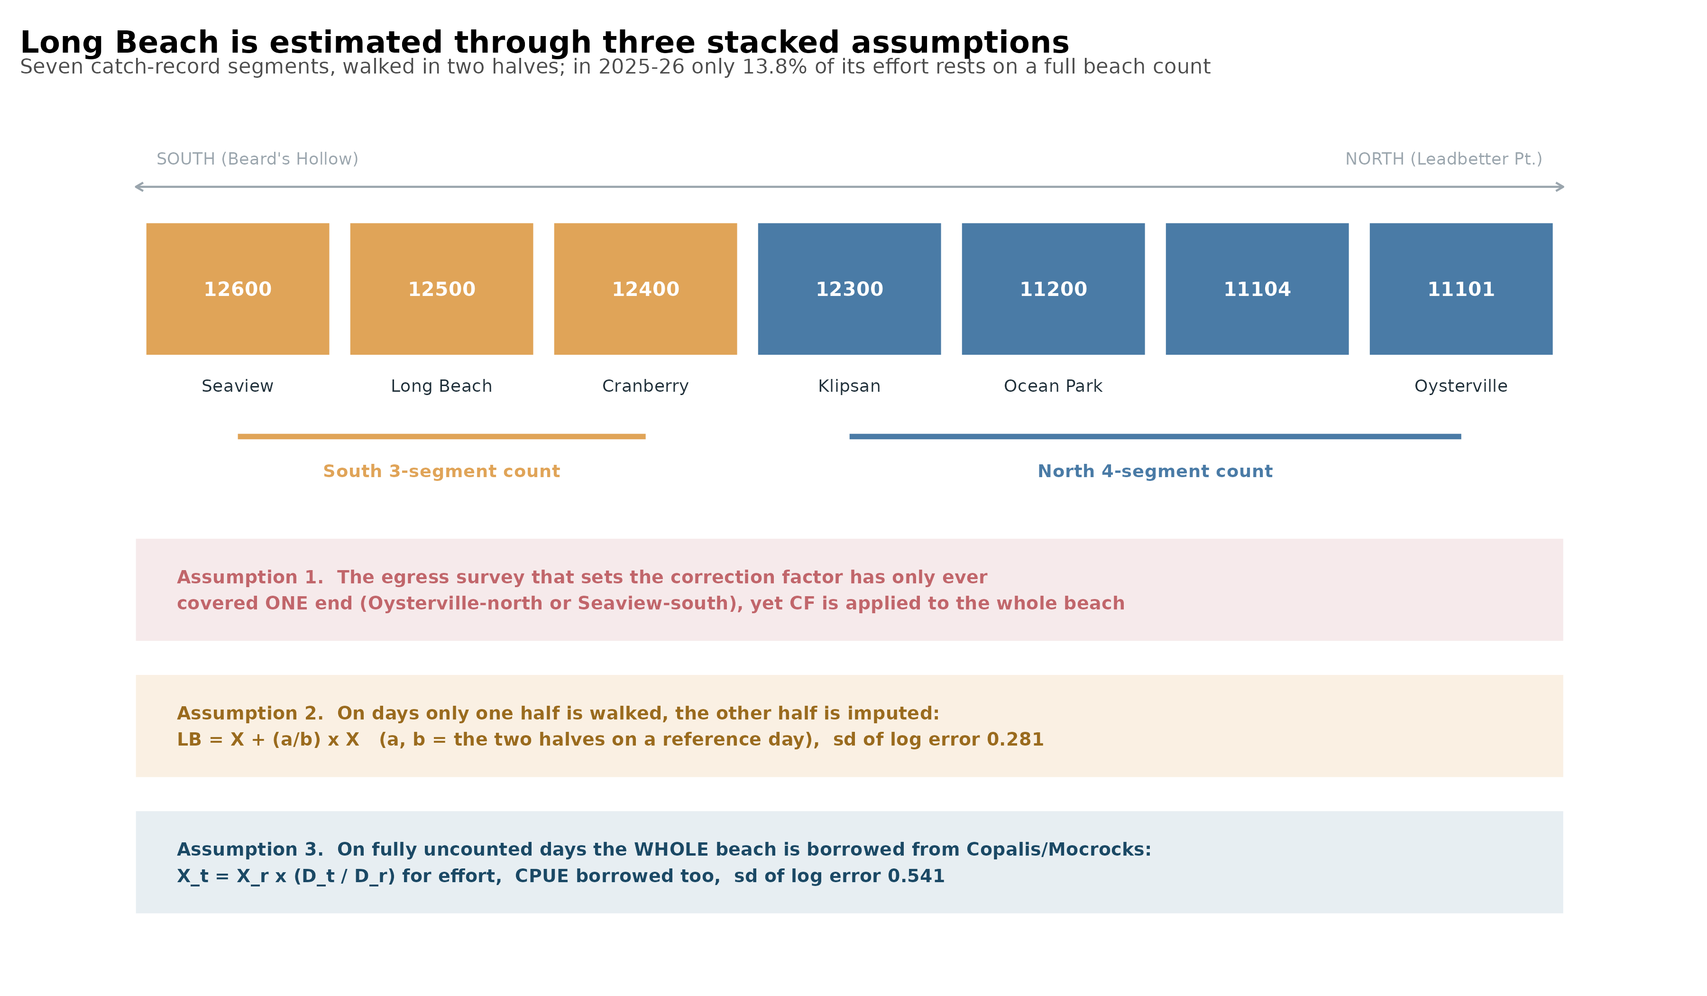
Only 14% of Long Beach rests on a real count
In plain terms: 28 miles walked in two halves; only 13.8% of 2025-26 effort rests on a full count. The correction factor, the section split, and the whole-beach total are each assumed, not measured.
Notes:
Sec 5.4.

Slide 12
3. Impact of budget reduction

Slide 13
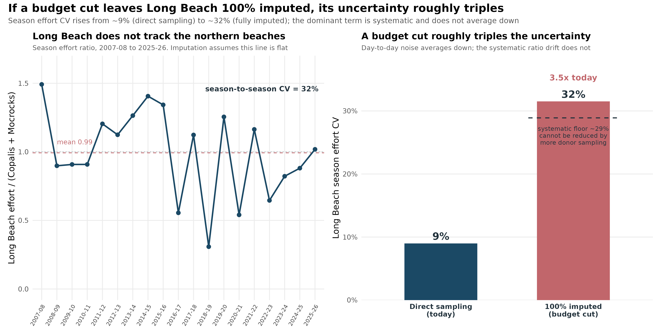
What a budget cut does to Long Beach
In plain terms: if cuts leave Long Beach 100% imputed, its season effort CV rises from about 9% to about 32%. Most of that increase is systematic: Long Beach does not track the northern beaches (ratio swings 31%), and no amount of donor sampling fixes it.
Notes:
New Section (Fig 21). The headline budget-impact result.

Slide 14
What a reduction actually costs
The cheap beaches are already efficient. Copalis and Mocrocks are counted every open day and sit near 6-9% CV; cutting them saves little and loses the donor the south depends on.
The expensive uncertainty is at Long Beach and Twin Harbors, the two beaches already most imputed. Cutting them is where a budget reduction bites hardest.
Imputation is not a free substitute for counting. At 100% imputation Long Beach's uncertainty is dominated by a systematic term that more donor sampling cannot reduce.
A reduction is therefore a choice about which beach's estimate to weaken, not a uniform trim. The next section is where a smaller budget should go.
Notes:
Frame the budget decision: reductions are not uniform; they concentrate cost on the already-weak southern beaches.

Slide 15
4. Data needs; a re-imagined framework

Slide 16
A re-imagined monitoring framework, in one page
Survey the term that dominates. The correction factor is the largest error everywhere; egress surveys, not more counted days, are the lever. Priority: Long Beach and Twin Harbors, whose tables are the oldest and thinnest.
Count enough days, and the right days. About 45% of a beach's open days, largest-effort first, meets a published precision standard; below that, imputation error grows.
Protect the donor. Keep one of Copalis or Mocrocks counted every dig day (the co-management floor); the joint donor is gone, so the single donor must at least be current.
Anchor the imputed beaches with their own data. A whole-beach Long Beach pilot replaces three stacked assumptions with one measurement and calibrates cheap partial surveys for later.
Notes:
The synthesis slide: given the gaps and the budget, here is where effort should go.

Slide 17
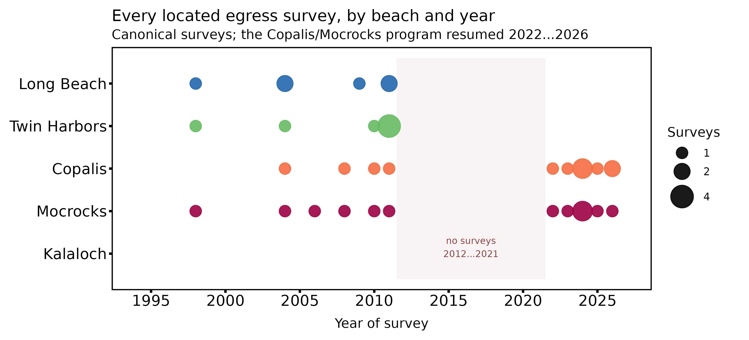
Run egress surveys at Long Beach and Twin Harbors
The correction factor is the largest term, and these two beaches now carry the worst of it.
Newest survey: 2011. Twin Harbors evening rests on just two surveys.
Copalis and Mocrocks were resurveyed 2022-2026 and no longer need egress effort.
The single most valuable unpurchased input in the program.
Notes:
Sec 10.3 / Table 4.

Slide 18
The Long Beach pilot: whole-beach egress across six approaches
Vehicle approach (south to north) | Historical egress coverage | Pilot role
Seaview | 2004 only (south to Beards Hollow) | Counter
Long Beach (Bolstad) | never counted | Counter
Cranberry | never counted | Counter
Klipsan | never counted | Counter
Ocean Park | never counted | Counter
Oysterville | 1990, 1998, 2004, 2011 (north to Leadbetter) | Counter
One counter per approach records cars on and off in 15-minute bins across the tidal window. Four of the six approaches have never been counted, and no survey has ever counted all six on the same day. This is the first whole-beach measurement, and it retires the section-ratio and CF-from-one-end assumptions.
Notes:
Sec 11.8. Sources: INGRESSPLAN98, consolidated IE inventory, wdfw02656.

Slide 19
Staffing: eight for Long Beach, thirteen with a paired northern beach
Role | Staff | Basis
Approach counters | 6 | one per drivable approach (1998 field model)
Roving beach-count / interview crews | 2 | 28-mile beach, up to ~5,200 trips on a 90th-percentile day
Long Beach core, per survey day | 8
Paired northern egress (Copalis or Mocrocks) | +5 | same-day donor truth on a subset of days
Peak, on a paired day | 13
Counters are stationary and low-skill; the roving crews are the program's regular samplers, on the beach that day regardless, so the marginal cost is mainly the six counters. On a subset of days, add a whole-beach egress at whichever northern donor the state is digging, to measure the imputation transfer directly.
Notes:
Sec 11.8.

Slide 20
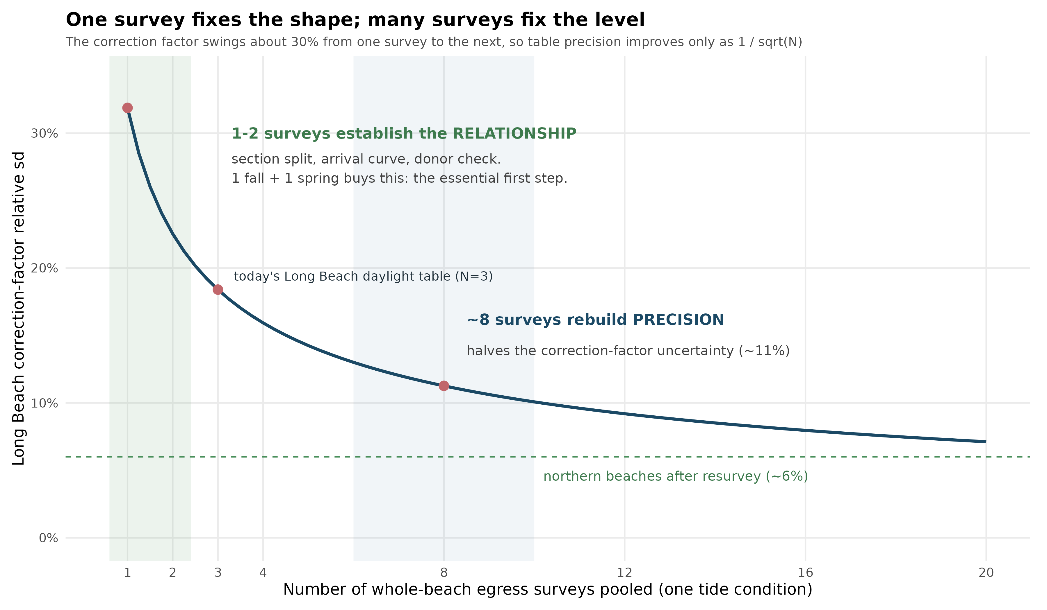
Why not just one fall and one spring survey?
In plain terms: one survey per condition pins the shape and is worth doing; but the correction factor swings about 30% per survey, so precision improves only as 1 over root-N. About eight surveys halve today's uncertainty.
Notes:
Sec 10.3 / Fig 16. Start with 1 fall + 1 spring; 8 is the target for a halved table, not a threshold.

Slide 21
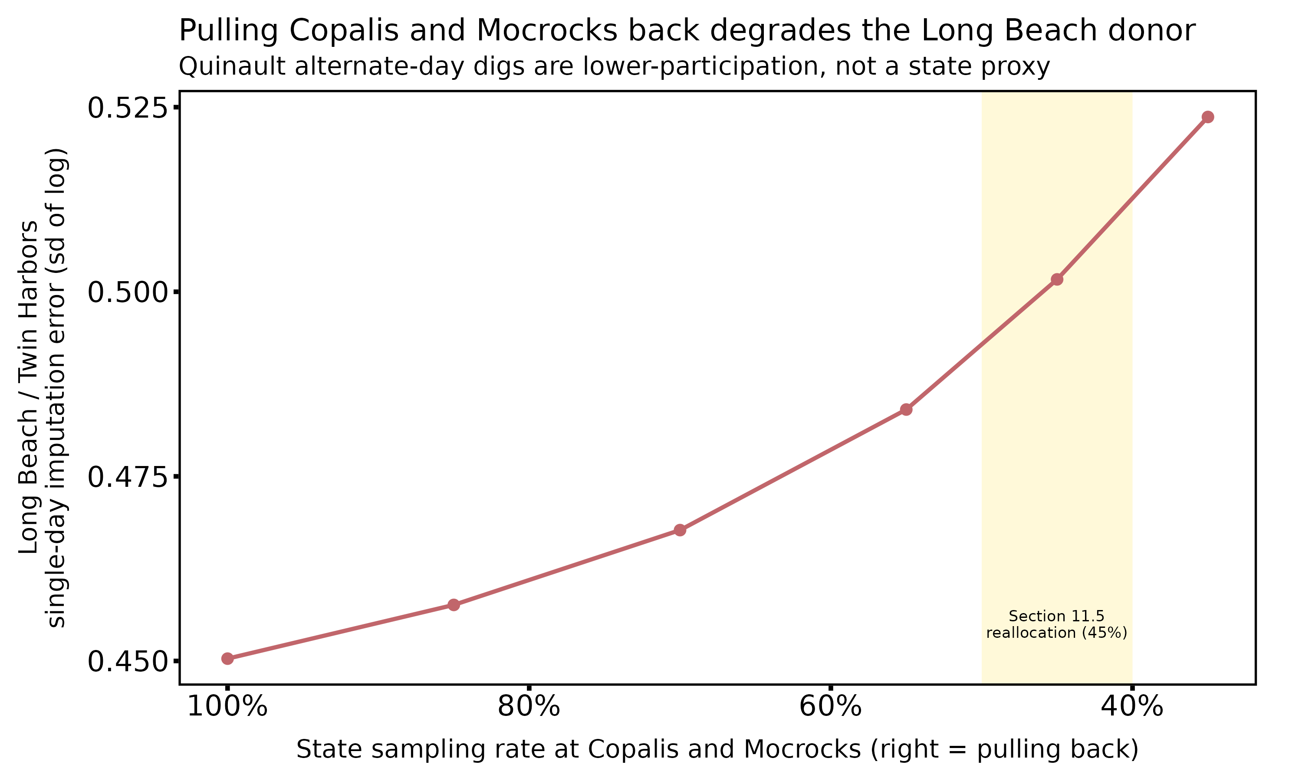
Hold the southern donor at its co-management floor
In plain terms: pulling Copalis and Mocrocks back raises the southern imputation error with no tribal offset, because the Quinault alternate-day fishery is not a state proxy. Keep one of the two counted every dig day.
Notes:
Sec 11.7. The corrected co-management trade-off.

Slide 22
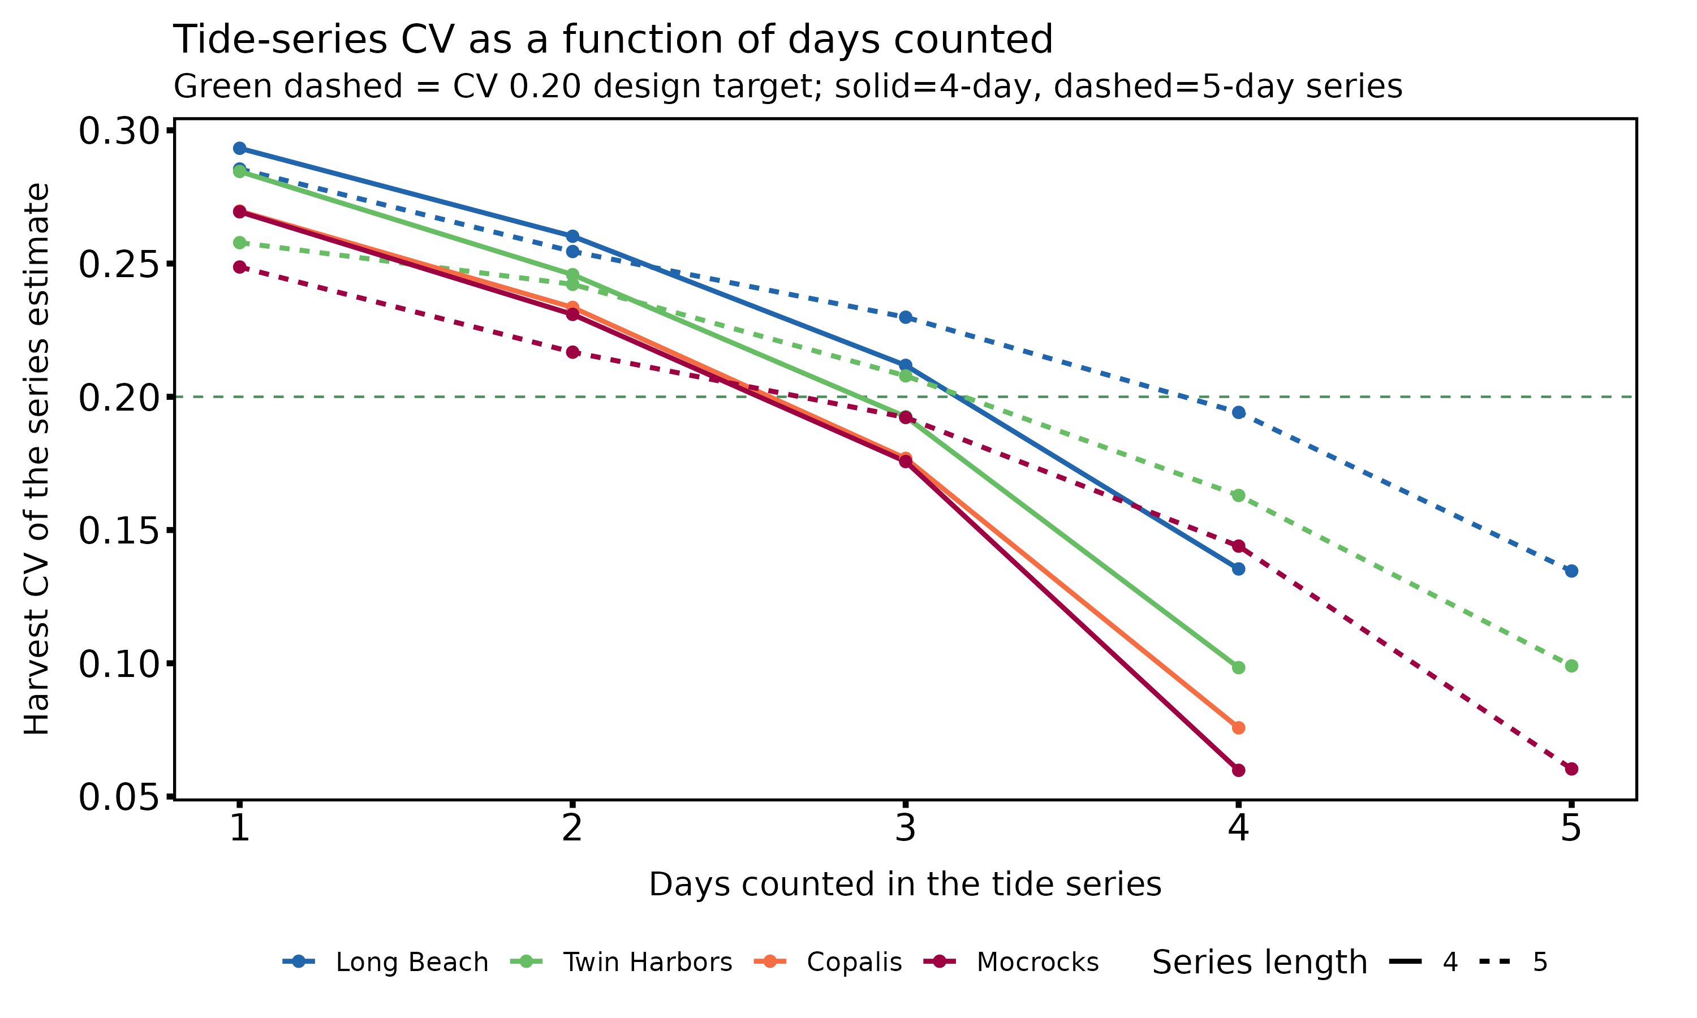
How many days per tide series: about 45%, floor of two
Count 2 of a 4- or 5-day series; 3 of a 6- or 7-day series.
Counting one day per series never meets the CV 0.20 design target.
Read it as 45% of open days, floor of two, largest-effort days first.
Copalis needs all three of a three-day series, its floor, not sampling, binds.
Notes:
Sec 11.2-11.3 / Tables 19-20.

Slide 23
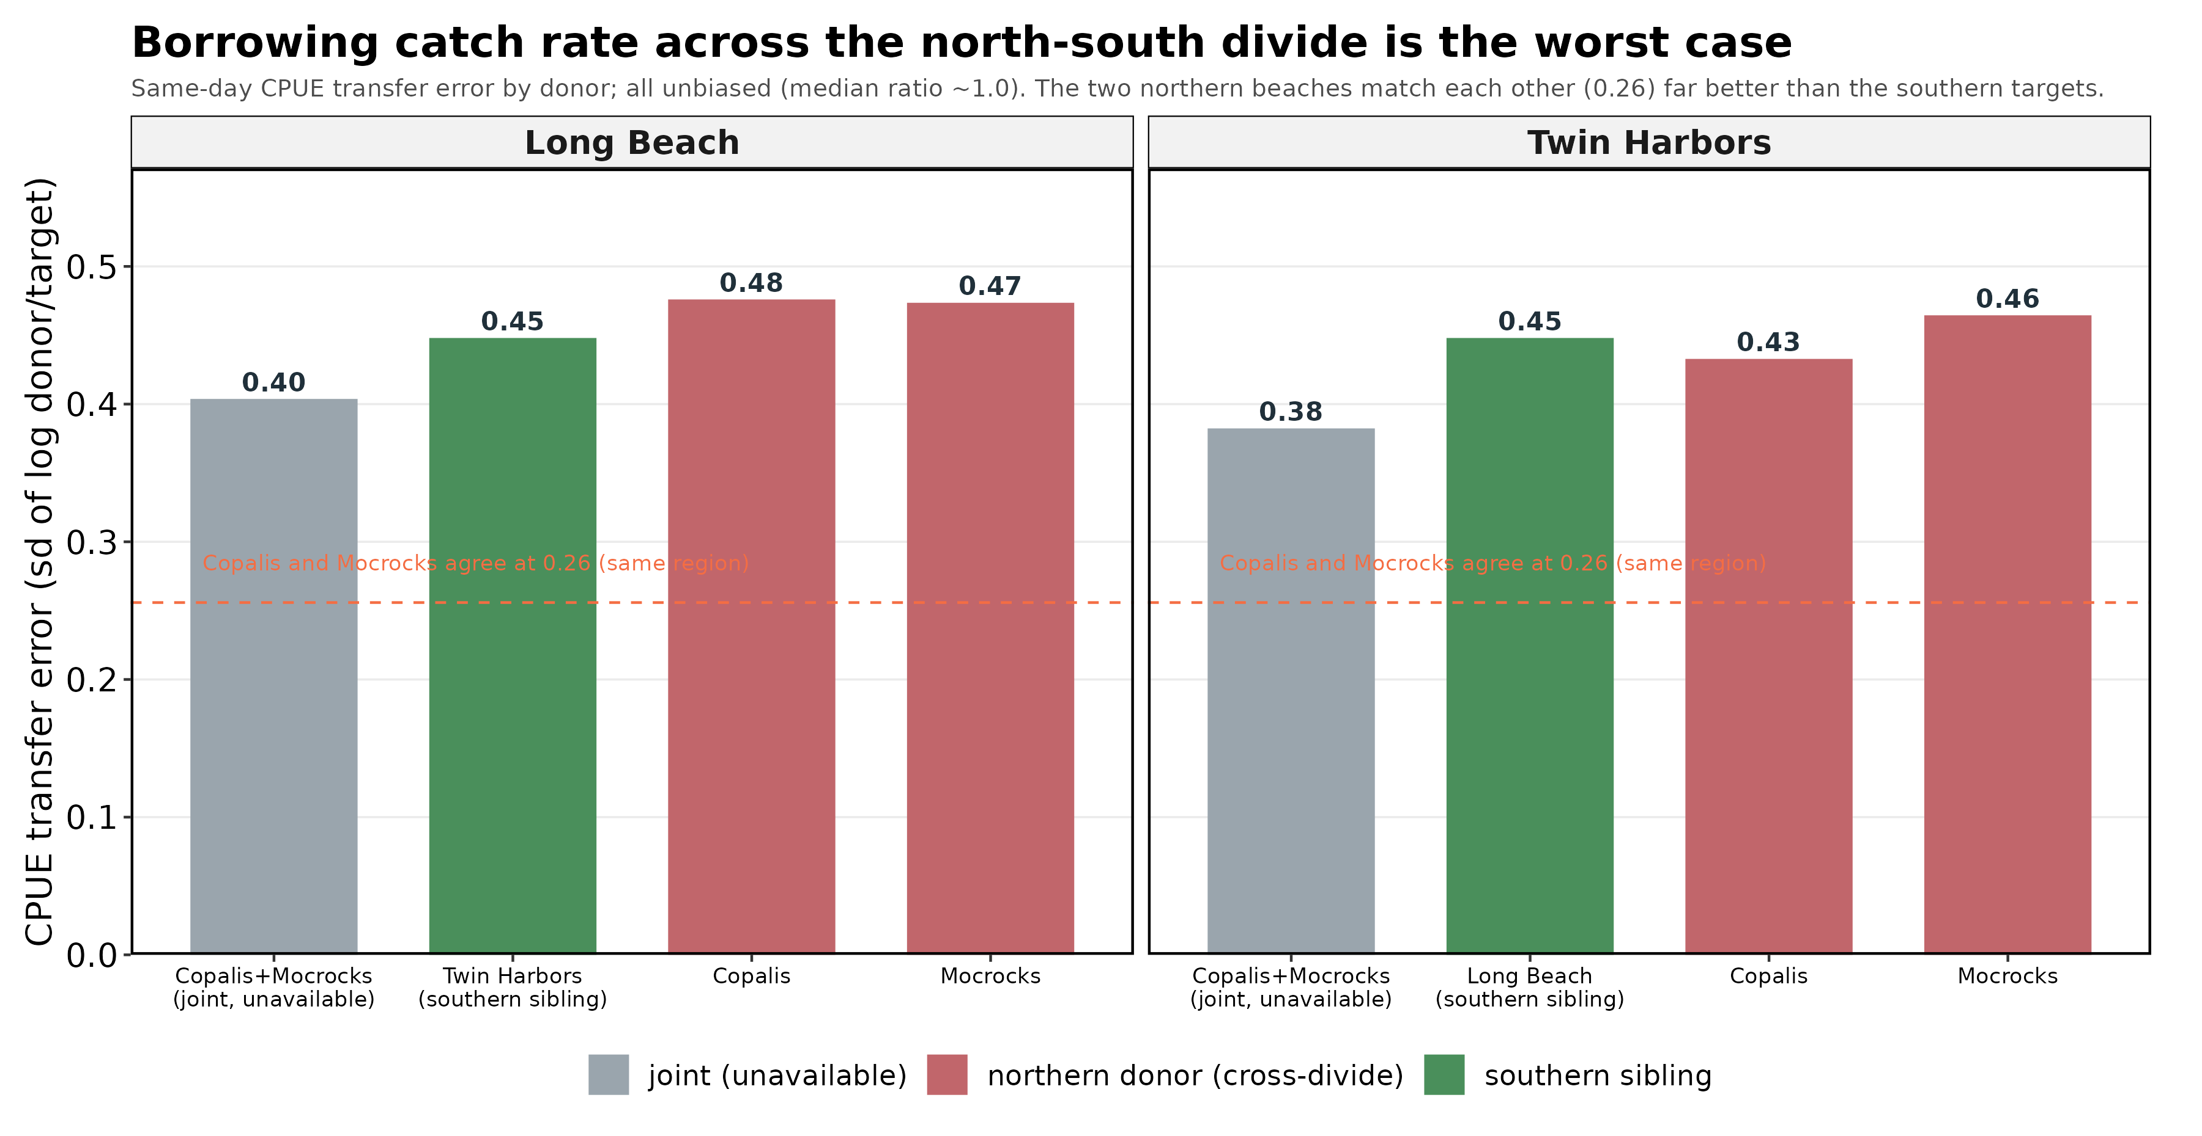
Borrowing catch rate across the north-south divide is the worst case
In plain terms: on days both beaches were interviewed, a northern donor's catch rate matches Long Beach or Twin Harbors only at ~0.45 in the log (unbiased). The two northern beaches match each other at 0.26; catch rate is regional, and the imputation borrows it across the divide.
Notes:
New CPUE study (Fig 22-23). Confirms the doc's 0.448 and resolves it by pair; degrades to ~0.65 at 1-day lag.

Slide 24
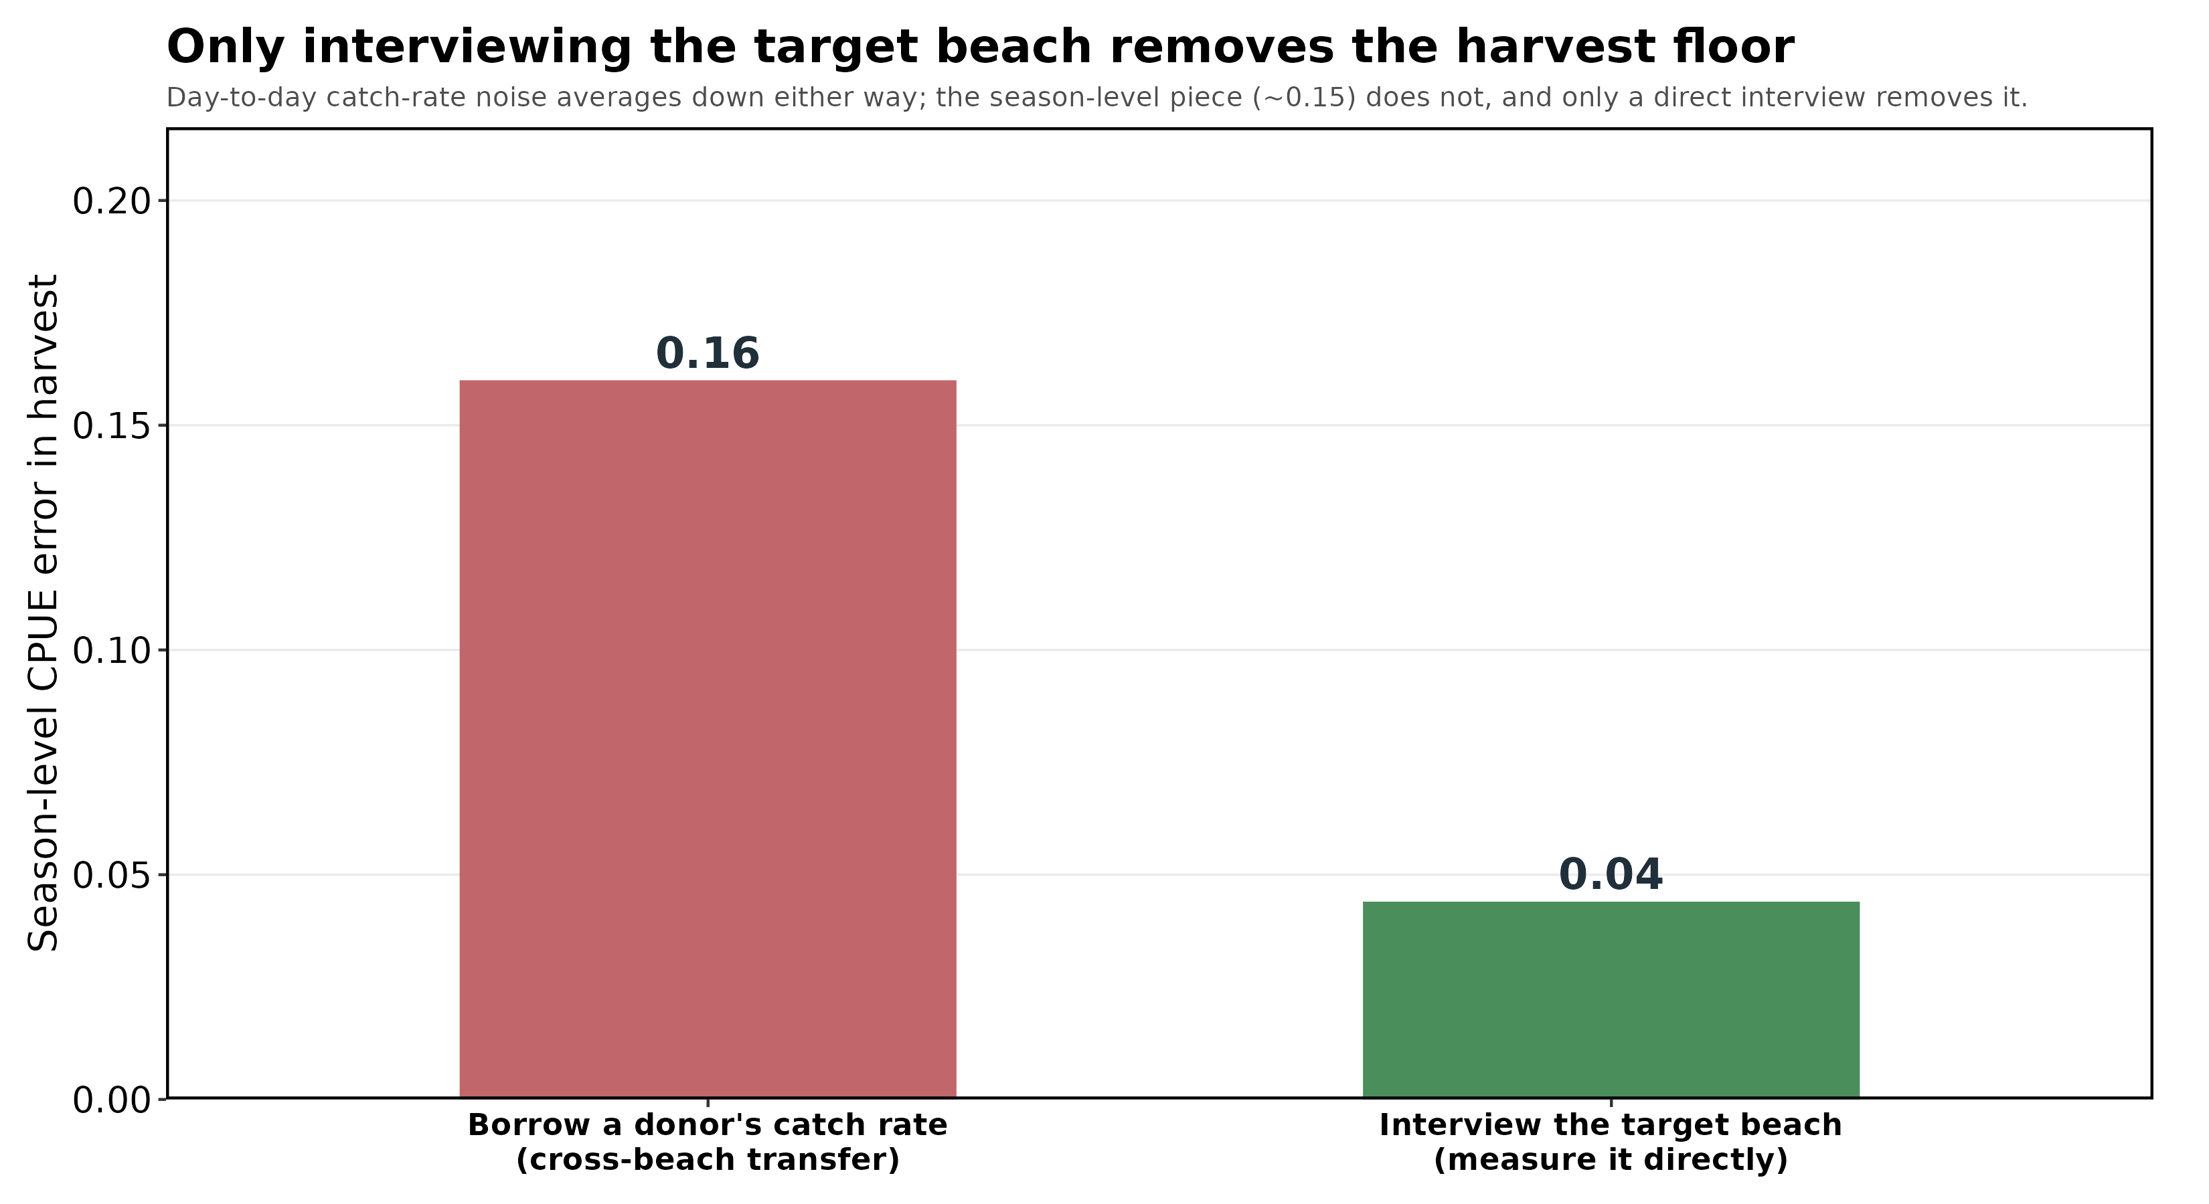
The lever on harvest is interviewing the target, not counting the donor
In plain terms: day-to-day catch-rate noise averages down over a season either way; what remains is a season-level floor (~0.16) that donor sampling cannot remove. Interviewing Long Beach / Twin Harbors directly drops it toward the interview sampling noise (~0.04).
Notes:
New CPUE study (Fig 24-25). The season-level CPUE component is the harvest floor; only measuring the target removes it.

Slide 25
What each ingress/egress pilot needs, and its goal
Four data streams, run on the same day: a counter at every drivable approach (cars on/off in 15-min bins); an instantaneous beach count taken BY SEGMENT; a full-beach creel; and tide/condition metadata.
The egress count alone gives only the correction factor. It retires the section ratio only if the beach count is by segment, and grounds catch rate only if the creel is worked.
Long Beach goal: retire three stacked assumptions at once (whole-beach CF, section ratio, and a modern table; newest survey 2011) by counting all six approaches and seven segments.
Twin Harbors goal: refresh a thin, old table (the evening table rests on two surveys); it is already whole-beach walked, so no section-ratio problem.
Notes:
Sec 11.11. The pilot's product is the CF table; ~8 whole-beach surveys halve it (Fig 20).

Slide 26
How often to ground-truth a largely-imputed beach
Effort fails by lag. Imputation error grows with the gap to the nearest counted day (0.49 at 1 day to 0.74 at 4-5). Keep it short: at least one counted day per tide series, spread across fall / winter / spring to catch the ratio drift.
Harvest fails by a season-level catch-rate floor. Removed not by counting the donor but by interviewing the target beach across the season.
One cadence does both: one fully-sampled day, a beach count AND a creel, per tide series at Long Beach and Twin Harbors, on the largest-effort opener.
That is more than the staffing model's aggressive imputation implies, and far less than full counting. It is the cadence a reduced budget should protect first.
Notes:
Sec 11.11. Answers 'how often + when to sample to ground-truth'. The lag caveat is why the staffing model's low-counting frontier is optimistic.

Slide 27
5. Plan for the 2026-27 season

Slide 28
The reallocation is cost-neutral, but not free
Beach | Open days | Counted now | At 45% | CV now | CV at 45%
Copalis | 51 | 51 (100%) | 23 | 0.129 | 0.192
Mocrocks | 52 | 52 (100%) | 23 | 0.099 | 0.171
Twin Harbors | 103 | 52 (50%) | 46 | 0.164 | 0.164
Long Beach | 103 | 9 (9%) | 46 | 0.294 | 0.175
Total crew-day units |  | 203 | 184 |  | -19
Long Beach's series CV falls from 0.294 to 0.175, crossing the design target for the first time; the northern beaches rise but stay inside it. Nineteen crew-day units move south. But those units are not truly free once the donor role is counted (see item 4): read the reallocation as a trade, not a surplus.
Notes:
Sec 11.5. Cost-neutral in crew-days; donor cost is real.

Slide 29
Recommendations, in priority order
1. Survey Long Beach first. Run the whole-beach egress pilot, six approaches and about eight staff, with the beach count by segment and a full creel. Start with one survey per tide condition, build toward eight.
2. Keep one full-sample day per tide series at Long Beach and Twin Harbors. A count plus a creel on the largest-effort opener controls the effort lag AND removes the harvest catch-rate floor. This is the cadence to protect first.
3. Hold the southern donor at its co-management floor. Keep one of Copalis or Mocrocks counted every dig day; there is no joint donor and the Quinault's counts are not a state proxy.
4. Do not treat imputation as a free substitute. At full imputation Long Beach uncertainty roughly triples (effort), and the harvest catch-rate floor is removed only by interviewing the target, not by counting the donor.
5. Sample ~45% of open days, largest-effort first, and accept the Copalis floor (a harvest CV of 0.10 is infeasible there at any rate).
Notes:
Priority recommendations, updated for the no-joint-donor, budget-impact, and CPUE-transfer findings.

Slide 30
6. Follow-up: the 2027 stock assessment

Slide 31
Toward the 2027 stock assessment
Harvest is one input to the assessment. The pumped-area population estimate and the exploitation-rate policy set the TAC that harvest is measured against; a follow-up meeting should connect the two.
Carry a defensible uncertainty forward. This review now propagates five of nine error sources; the assessment should inherit the harvest interval, not a point estimate.
Decide the survey investment before the season is set, so the Long Beach pilot and the egress refresh can be scheduled into 2026-27 fieldwork.
Open questions for the group: survey crewing and timing, the co-management data conversation, and how a reduced budget is allocated across beaches.
Notes:
Bridge to the stock-assessment follow-up meeting; list the decisions needed.

Slide 32
Discussion

