Slide 1

Visualisation Tools
Making Pretty Movies With Chaste, CMGUI, VTK And Paraview

Slide 2

Talk Outline
Generating data with Chaste
Visualising with KitWare: ITK, VTK and Paraview
Visualising with Meshalyzer and Cmgui
How do I get these tools?

Slide 3
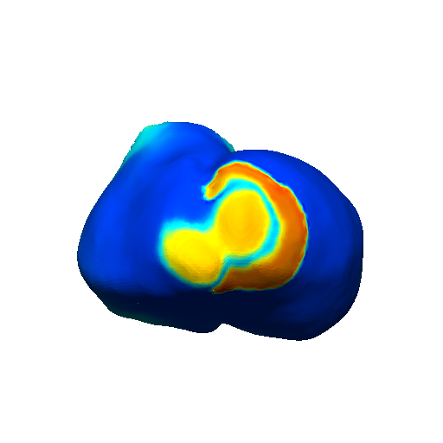
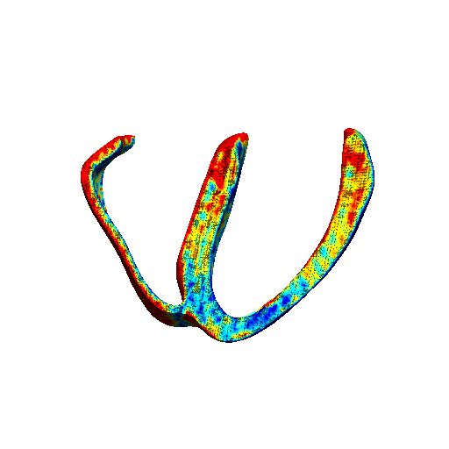

Generating Data with Chaste
Chaste can generate output in 3 formats:
  meshalyzer: good for having a quick look at outcome of a simulation. Visually a bit rough compared to VTK or Cmgui.
  VTK: Well-established standard with lots of available tools (as we’ll see soon…).
  Cmgui: Alternative to VTK, probably not so widely used but well known by the biomedical engineering community. Currently, only way of visualising electro-mechanic simulations in Chaste.

Slide 4
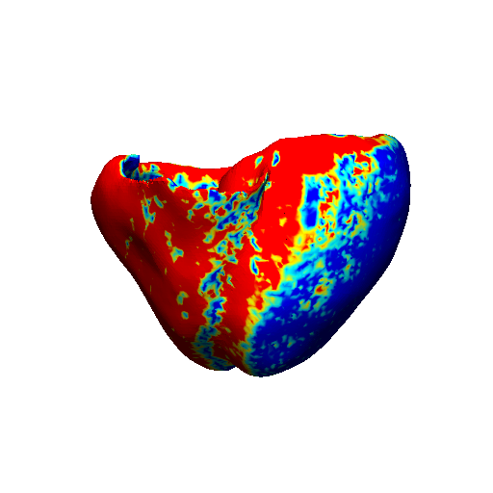
Generating Data with Chaste (ii)
Chaste outputs the following data:
  Transmembrane potential for monodomain simulations.
  Transmembrane and extracellular potential for bidomain simulations.
  (Optionally) your choice of ionic currents and gating variables as defined in your CellML file.

Slide 5
Generating Data with Chaste (iii)
XML configuration file example.

Slide 6









Slide 7
Notes:
CMake can compile to pretty much any hardware and any OS, including embedded systems with no OS, any major supercomputer, and the Nintendo DS.
Here are a few things I found on the SCons website...

Slide 8
CMake is the best build generator for c++
CMake is used to build all of Kitware’s products and our converters.
“CMake is a principal competitor to both GNU Autotools and SCons”
“Off-the-shelf build capabilities are comprehensive and proven for large scale software development”
“The implementation architecture is far more unified than GNU Autotools and it runs much faster”
“When compared to SCons, CMake is faster, requires less code for common tasks, arguably more stable,…”
“To sum up...SCons is a better idea, but CMake has a stronger implementation.”
Notes:
CMake can compile to pretty much any hardware and any OS, including embedded systems with no OS, any major supercomputer, and the Nintendo DS.
Here are a few things I found on the SCons website...

Slide 11
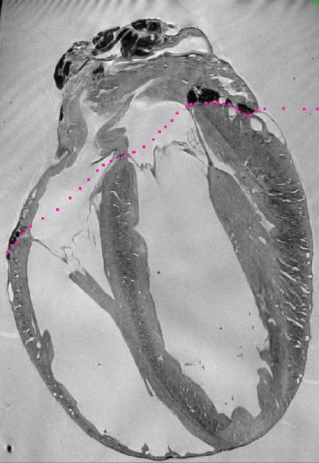

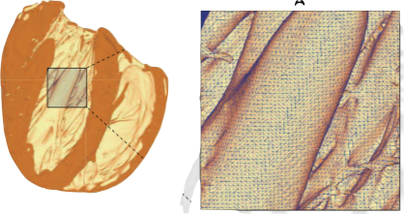
The Insight ToolKit is used to work with images, or rectilinear grid data
Performs image filtering, registration, segmentation and statistical analyses

Slide 14
Paraview is an IDE for making pretty movies
A powerful, user-friendly platform for both visualisation and data analysis
Works on any OS, including supercomputers

Slide 15
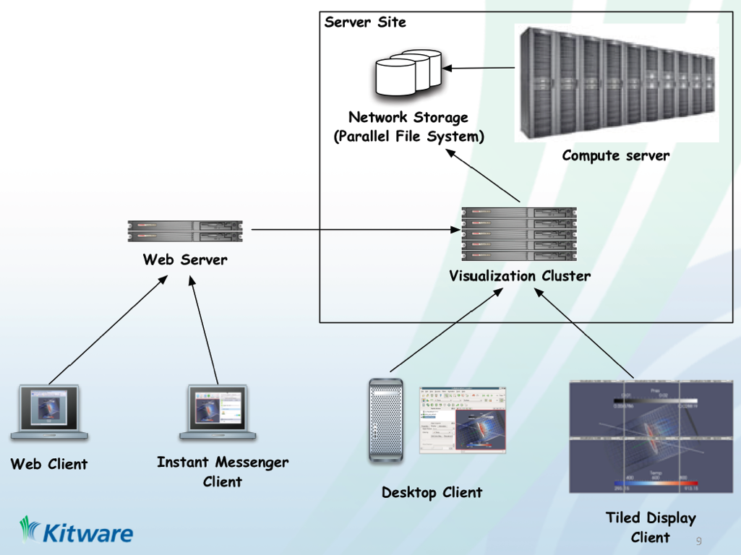

Slide 16
These are the problems we’re trying to solve for our own research
Visualising large datasets such as generated by Chaste
Growing tubes around 1-D structures
Visualising vector and tensor fields
Animating multiple superposed data types e.g. fibres, segmentation surfaces, action potentials...

Slide 17
Paraview IO Formats
Paraview Data (.pvd)
VTK (.vtk, .vtu, .vti, .vts)
VTK Multiblock (.vtm)
Parallel VTK (.pvtu, .pvti, .pvts)
VTK Legacy (.vtk)
Exodus/Exodus II (.ex2)
XDMF (.xmf, .xdmf)
VRML (.wrl)
Stereo Lithography (.stl)
LS-DYNA
SpyPlot
EnSight (.case, .sos)
BYU (.g)
Protein Data Bank (.pdb)
XMol Molecule
PLOT3D
Digital Elevation Map (.dem)
Meta Image/Raw (.mhd, .mha, .raw)

Slide 18
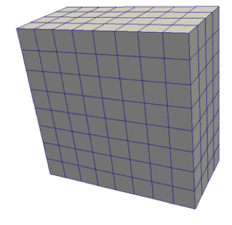
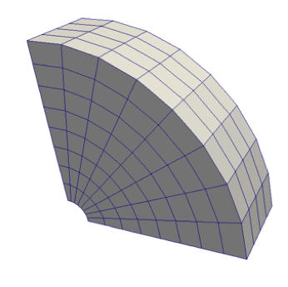
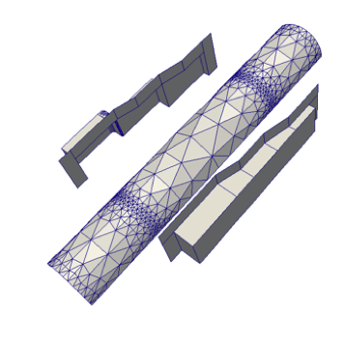
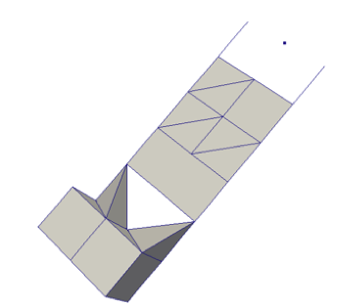
VTK Dataformats
Rectilinear Grid
Structured Grid
Polydata (2D polygons)
Unstructured Grid (3D polydata)

Slide 19
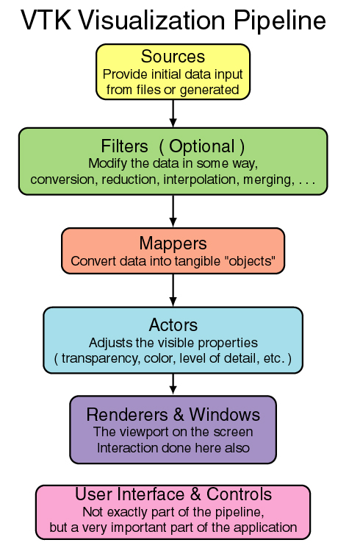

Slide 20
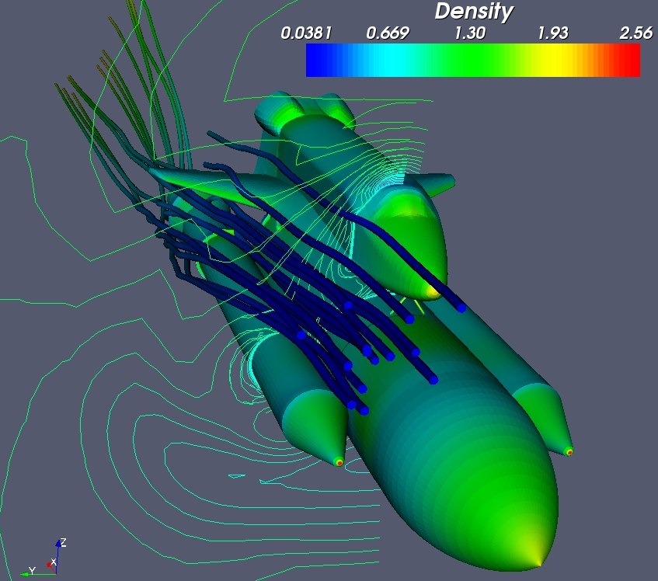
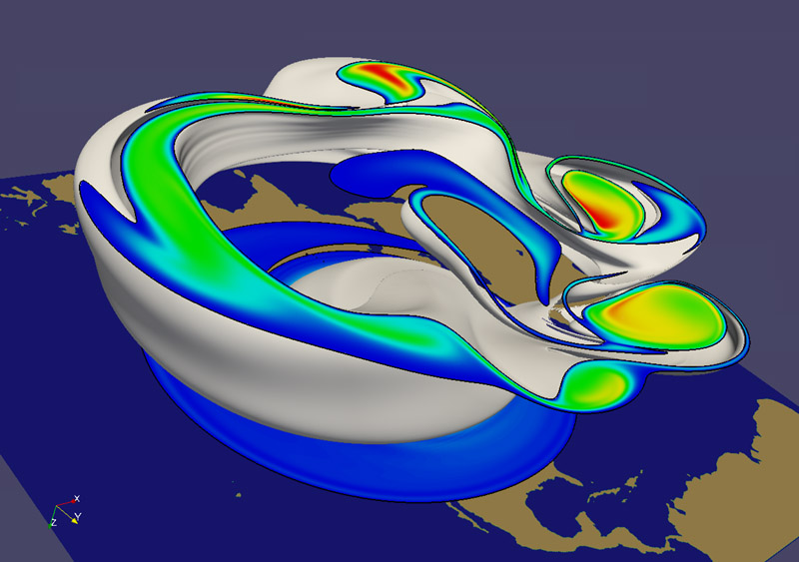
Paraview Filters
Over 80 built in filters.
Easy to add existing VTK filters
Python Programmable filters
Custom Filter Pipelines

Slide 21
We’ve only scratched the surface of ParaView...
Fully scriptable: filters, animation etc.
Vector, tensor, stream visualisation.
As the name implies, it is parallelised. Can perform rendering on a remote server or supercomputer, such as Hector.
ParaViewWeb facilitates server-side rendering for remote 3D/4D interactive viewing through any modern browser (even Internet Explorer!)
Plus much more...
Notes:
WebParaview: works through javascript or ActionScript API, anyone with a browser can view your beautiful datasets! Great for PR, no more transferring huge datasets.
Parview Python scripting (if not covered in talks).

Slide 22
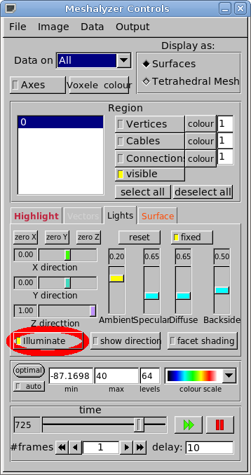
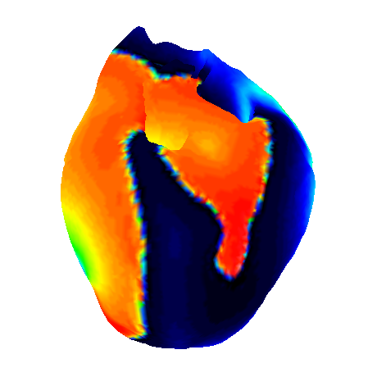
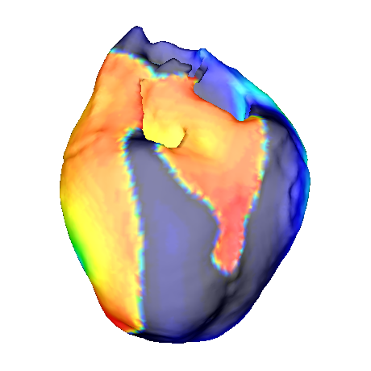
meshalyzer
Nobody likes it, everybody uses it. IMO, it is useful for having a quick look at your results.
A couple of tricks:

Slide 23
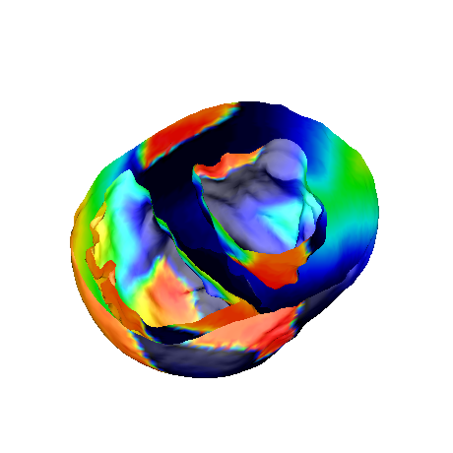
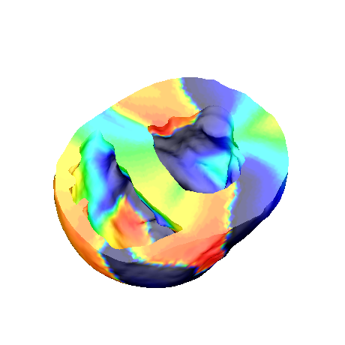
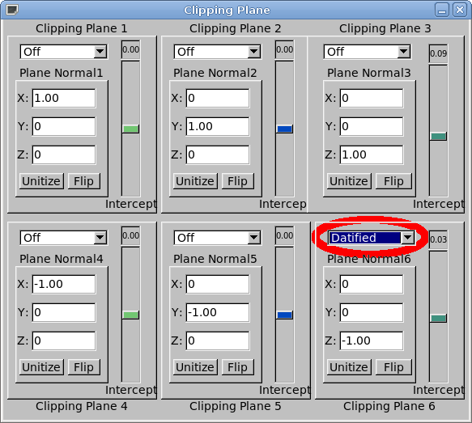
meshalyzer
Nobody likes it, everybody uses it. IMO, it is useful for having a quick look at your results.
A couple of tricks:

Slide 24
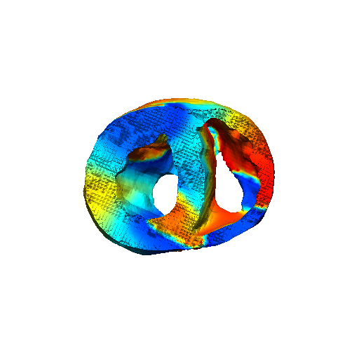
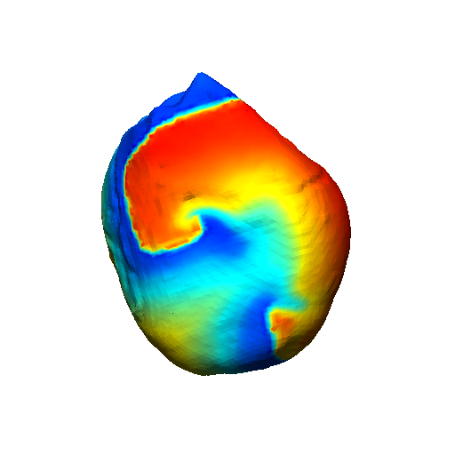
Cmgui
Cmgui is a very well established tool with plenty of tutorials and an active community.
Visually, it is neater than meshalyzer and very configurable.
It is scriptable!
gfx read nodes Reentry.exnodegfx read elem Reentry.exelem generate_faces_and_lines$number_of_frames = 900;for ($file_number = 0; $file_number<=$number_of_frames; $file_number++){ gfx read nodes Reentry_$file_number.exnode time $file_number}

Slide 25
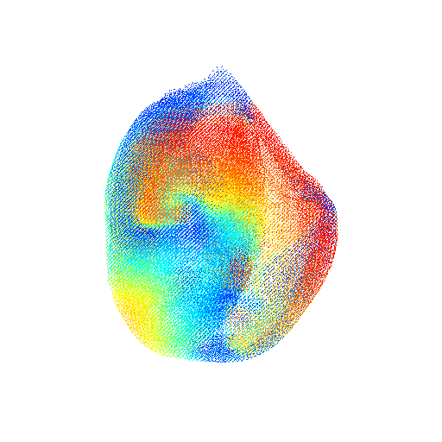
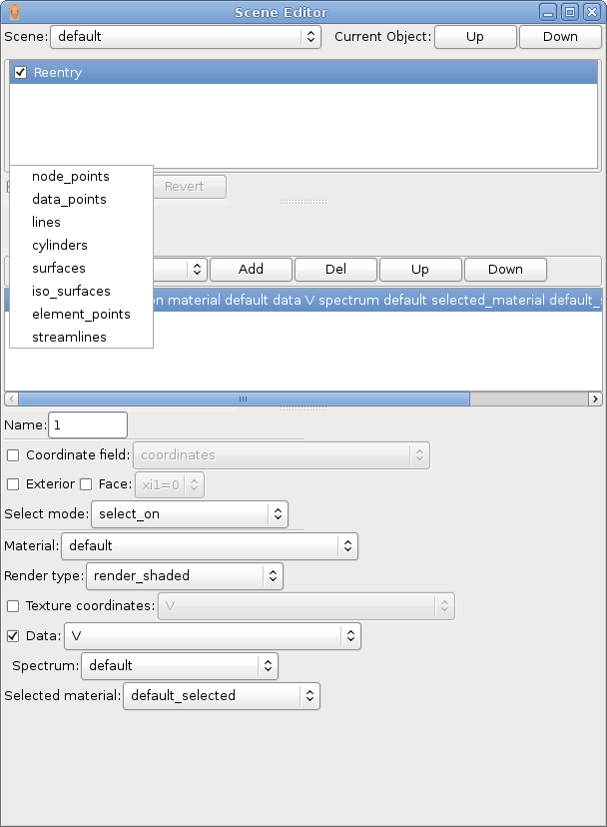
Cmgui
Do ALWAYS display data on surfaces (even if you don’t have surfaces)
gfx read nodes Reentry.exnodegfx read elem Reentry.exelem generate_faces_and_lines$number_of_frames = 900;for ($file_number = 0; $file_number<=$number_of_frames; $file_number++){ gfx read nodes Reentry_$file_number.exnode time $file_number}

Slide 26
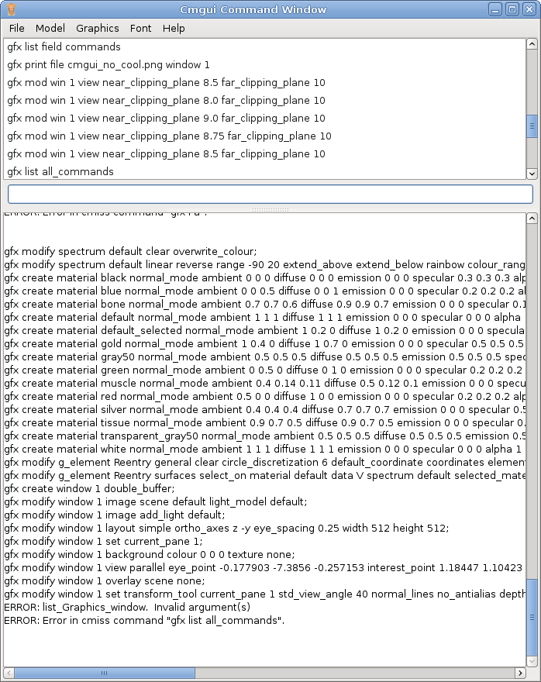
Cmgui
Most Cmgui options can controlled from the graphical user interface.
Once you get the right perspective, colours, clipping planes, etc. you can print the configuration out and stick it in your script.
gfx list all_commands

Slide 27
We’ve developed a few tools you can use to make life simpler
http://github.com/mattgibb/visualisation/
Build with CMake, test with CxxTest and CTest
A few dependencies: Boost, VTK, ITK
<PUT IN SUMMARY OF WHAT TOOLS DO>
Feature requests - let us know if you’d find something useful
Bug fixes and contributions - fork us on GitHub!
Notes:
github - Instructions are on the site, documentation in the README and on the wiki
Feature requests - e.g. .vox ImageIO class to be registered with the ITK read/write factory, better explanations in docs etc.
Bug fixes and contributions - Fork us on GitHub and submit a pull request, or just send us the files and we’ll add them to the repository; ideally, but not necessarily, with an accompanying test suite.

Slide 28
Structured mesh/Volume Image Converter
Formats: BioRad, GDCM, MHA/MHD, PNG, VTKImage, Gipl, LSM, Analyze, Nifti, Stimulate, JPEG, TIFF, Nrrd, BMP, DICOM, and now VOX
3 ways to use VoxImageIO, explicit attachment to writer, register with IO factory at compile time, or load as plugin at runtime. Awesome!

Slide 29
Carp to vtk unstructured mesh converters
Converts .pts, .elem, .lon file into a vtu file for viewing in ParaView
All tools are easy to use, with command-line help

Slide 30
Where do I get these Visualisers?
SCIRun: www.sci.utah.edu/cibc/software/106-scirun.html
Meshalyzer: carp.meduni-graz.at/03_visualization/03_meshalyzer.htm
ParaView: paraview.org
CMGui: http://www.cmiss.org/cmgui

Slide 31
What problems/solutions do you have?

