Slide 1
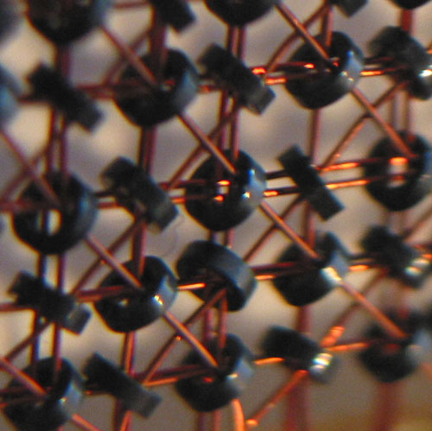
Memory & Caches
How it works, and how it affects performance
Matt Godbolt
@mattgodbolt

Slide 2
Outline
Types of memory and their characteristics
  Warning: some hairy hardware details
Caches and how they work
Measuring performance
Virtual memory
Multiprocessing

Slide 3
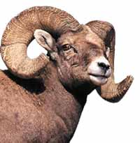
Types of RAM
Static RAM
Dynamic RAM
  SDRAM
  Rambus
Non-volatile
  ROM/PROM/EPROM/EEPROM
  Flash RAM

Slide 4
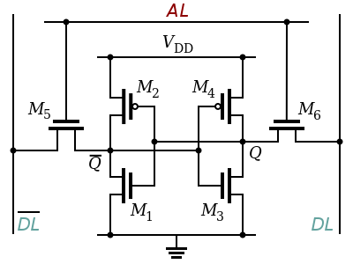
1 Bit of Static RAM

Slide 5
Static RAM
6 transistors per bit
Requires constant power VDD
Logic-level inputs and outputs
Regular repeating layout good for chip layout
<1ns access times
So why not make all RAM this way?
COST!

Slide 6
1 Bit of Dynamic RAM
AL
DL
C

Slide 7

Dynamic RAM
One transistor per bit
Leaks charge
  Requires regular refresh
Output is analogue
  Requires external logic to tell 0 from 1
  Needs time to charge/discharge
Used in external chips
  Need to minimise pin count (DDR3 240pins)

Slide 8
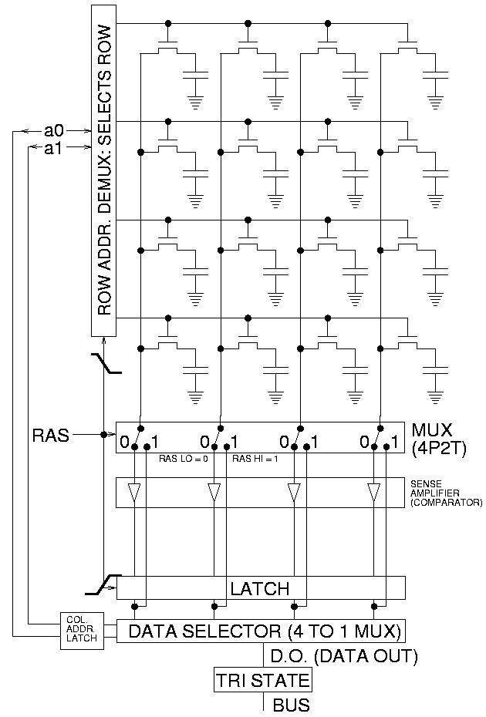
Dynamic RAM

Slide 9
Reading DRAM (short version)
Precharge bit-lines (tRP ~2 memory cycles)
Select row (tRCD ~3)
Sense & latch row data (~8192 bits)
  Feedback starts recharging cells
Select column (CL ~2)
  Data finally available
Need tRAS (~8) cycles before next precharge

Slide 10
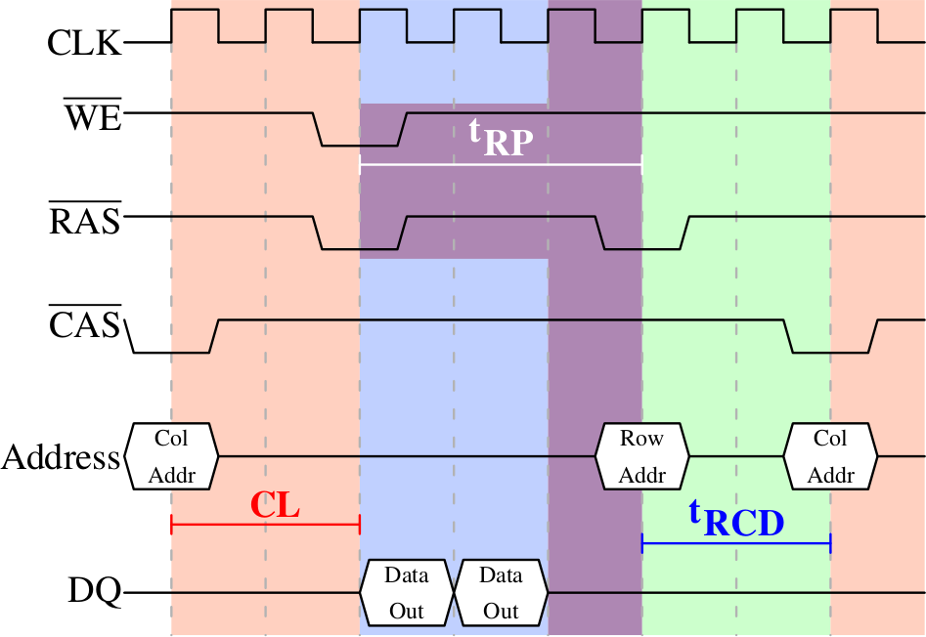
DRAM timings

Slide 11
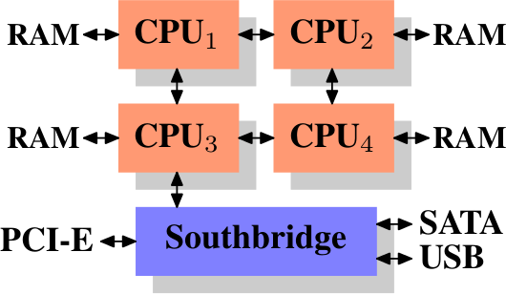
Memory Controller
Used to be in North Bridge
  Now in CPU
  Implications for SMP
Opens/closes rows
Reorders load/store
Schedules refreshes
  Every 64ms
Handles DMA

Slide 12
Getting DRAM data out
Memory bus runs at ~200MHz
64 bits transferred at a time
Bits selected by column
Bus 1x, 2x, 4x, 8x etc times per “clock”
  DDR3 1600 = 200MHz bus x 8x pump x 64 bit
  = 12,800MB/sec
Access times can dominate over data rates

Slide 13
Caching
Static RAM is small and expensive
Dynamic RAM is cheap, large, slow
Use Static RAM as cache for slower DRAM
But how to do this in hardware?
Break into “entries” that can be cached

Slide 14

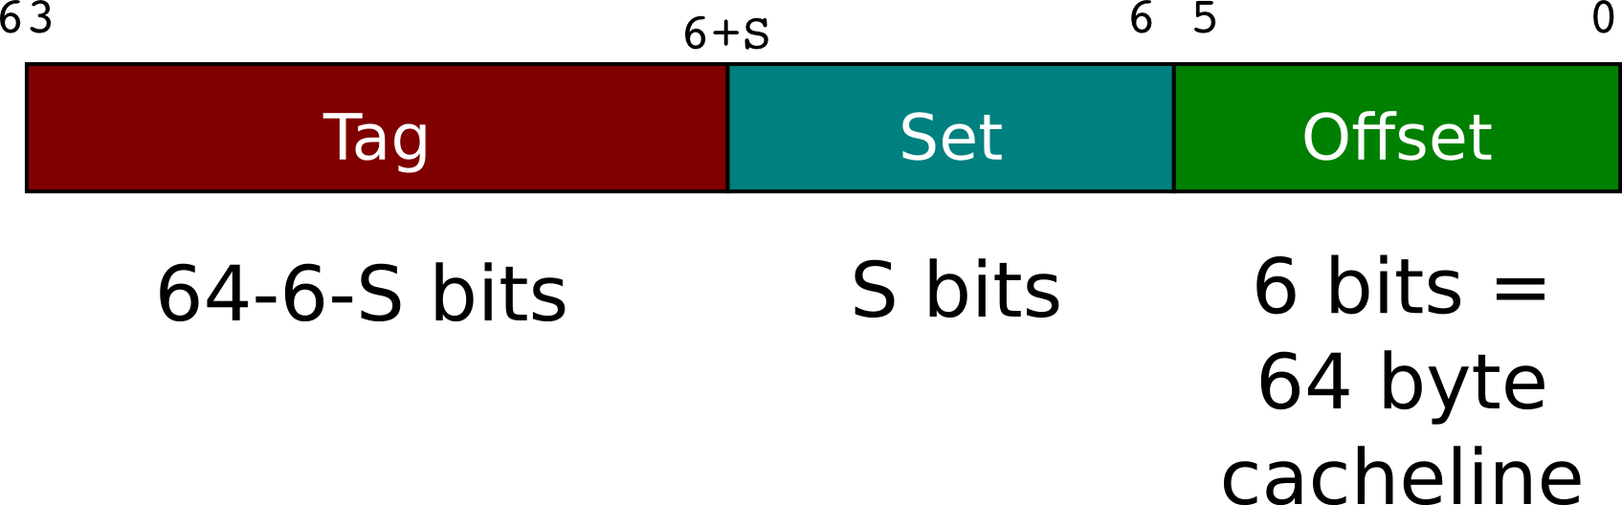
Finding a cache entry
Organise data in “lines” of 64 bytes
  Bottom 6 bits of address index into this
Use some bits to choose a “set”
  5 bits for L1, 11 bits for L2, ~13 bits for L3

Slide 15

Finding a cache entry
Search for cache line within set
  L1: 8-way, L2: 8-way, L3: 12-way
Remaining bits (“Tag”) used to find within set
Why this way?

Slide 16
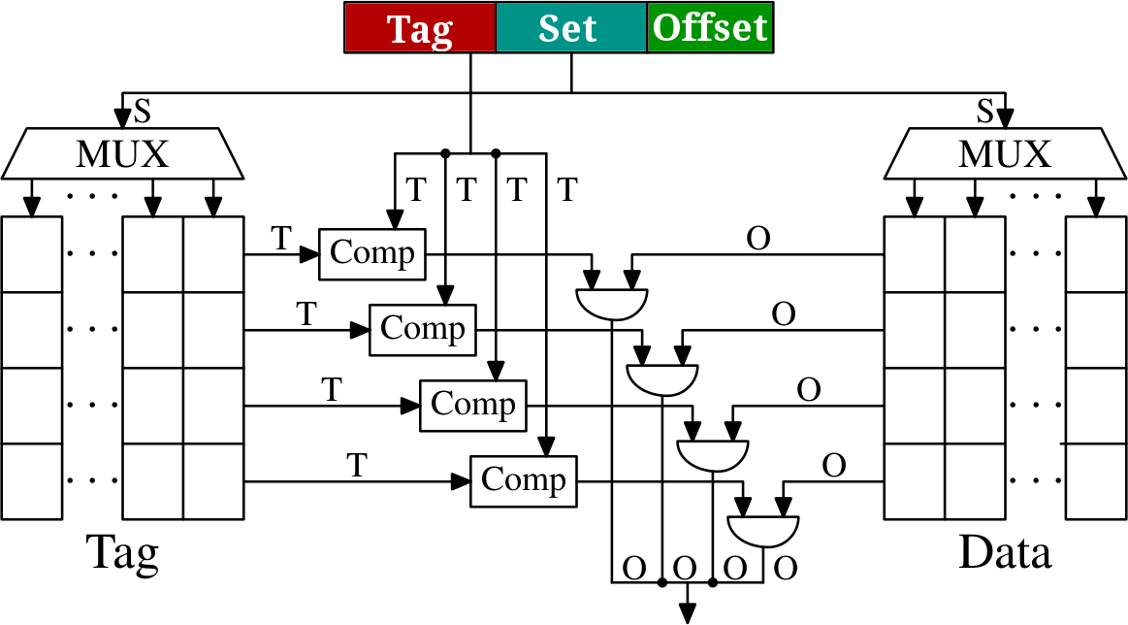
Caching

Slide 17
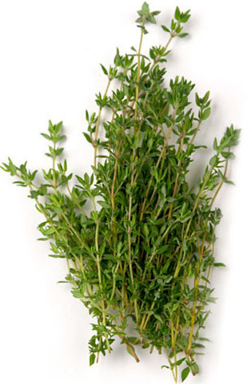
Timings and sizes
Approximate timings for Sandy Bridge
L1 32KB ~3 cycles
L2 256KB ~ 8 cycles
L3 10-20MB ~ 35 cycles
Main memory ~ 250 cycles
  Depends on all the things we spoke
  of earlier

Slide 18
Real-world measurements
Measured on Westmere X5690
  32KB / 256KB / 12MB
  Hope for similar timings to SB
Time cost per access of pointer chasing
Vary size of element and total working size

Slide 19
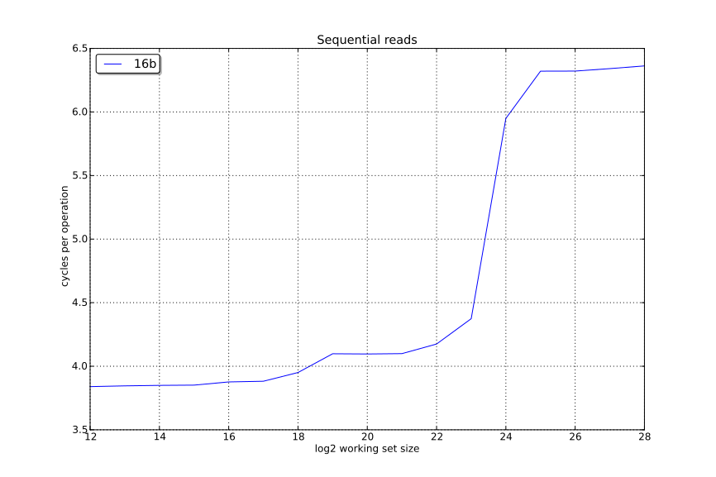
Results: Sequential Reads

Slide 20
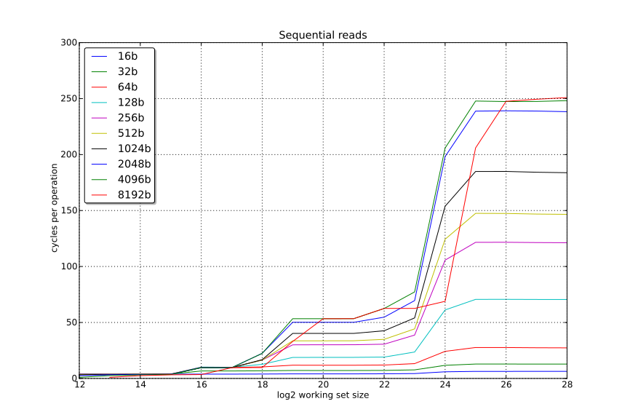
Results: Sequential Reads

Slide 21
Discussion
Automatic prefetching
  Processor looks for patterns of cache misses coming from same instruction
8192 byte stride – what's going on there?
  L3 cache is 12-way 12288-set associative
  1024, 2048, 4096 all divide into # of sets
  8192 does not divide into 12288

Slide 22
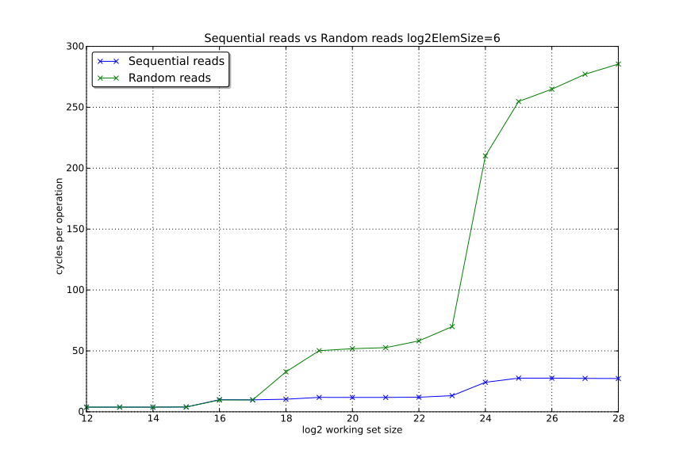
Sequential vs Random Reads

Slide 23
Random access measurements
Why worse than worst-case RAM times?
  Prefetching can hurt us
Linear scan over data >5x better even for “small” data sets
Program can prefetch
  Hard to get right
  Overrides Critical Word Load

Slide 24
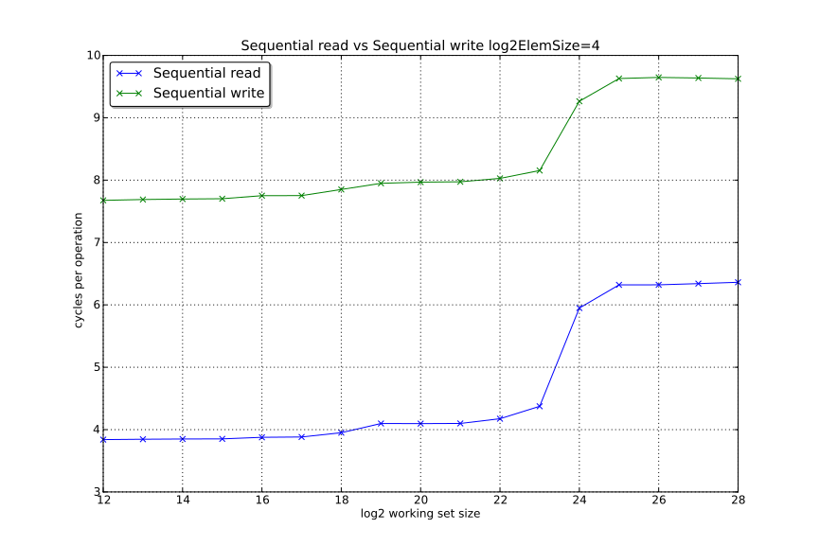
Writes vs Reads

Slide 25
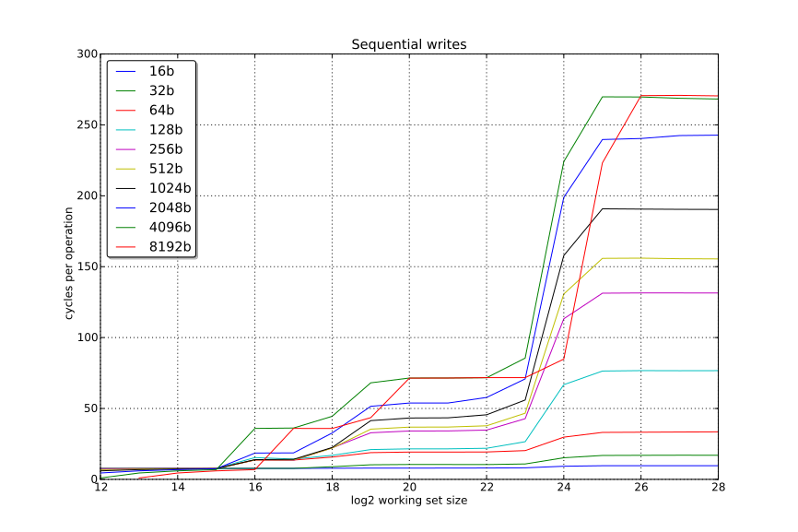
Write

Slide 26
Virtual Memory
How do virtual addresses fit into this?
Page tables require 4 reads to walk
Level 4 Index
Level 3 Index
Level 2 Index
Level 1 Index
Offset
Page
L1 Directory
L2 Directory
L3 Directory
L4 Directory

Slide 27
TLBs
Cache for translation, two-level 4-way
  L1: 64 4KB page entries; 32 2MB page entries
  L2: 512 4KB page entries
Flushed on context switch
  Although entries contain 12-bit “process” ID
  Not needed for transition in/out of kernel

Slide 28
Virtual Memory and Caching
L1 fast & small
  Physically tagged, virtually indexed
  64 sets: bits 11:6 of address
  DTLB read in parallel with cache fetch
L2 and above larger and not so fast
  Caches physical address

Slide 29
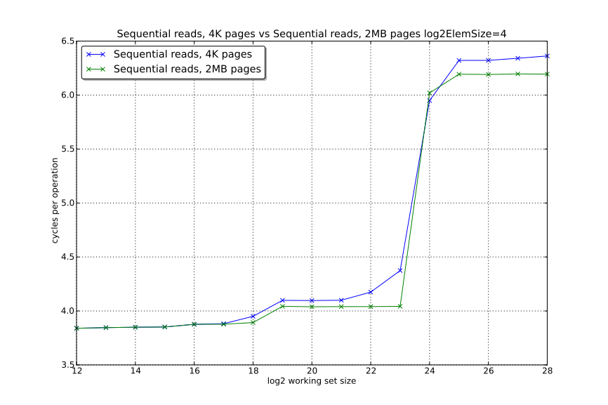
Example with Huge Pages

Slide 30
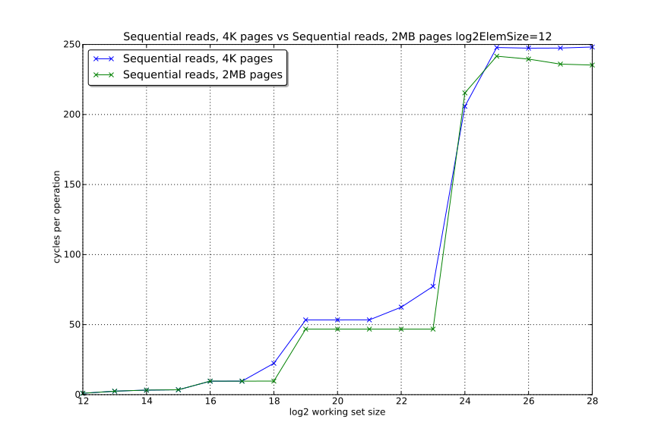
More on Huge Pages
← ~15cycles

Slide 31
Multiprocessing
Bus between CPUs too slow to share all caches
TLBs, L1 and L2 shared by hyperthreads on same core
L3 shared by all cores on a socket
How to achieve consistent view across all CPUs in a system?

Slide 32
MESI
Modified
  Exclusive, dirty
Exclusive
  Exclusive, non-dirty
Shared
  Possibly shared, non-dirty
Invalid

Slide 33
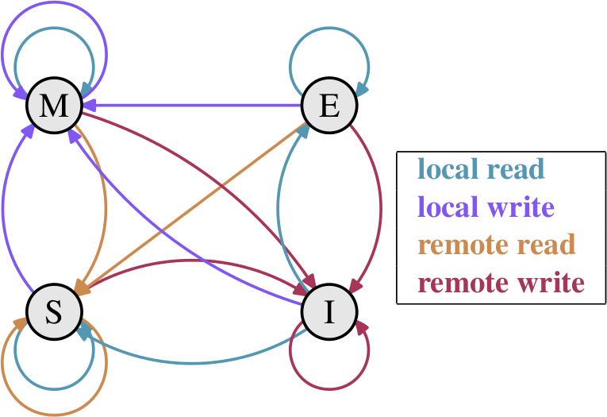
MESI transitions
Almost free
Pretty expensive
Somewhat expensive

Slide 34
MESI
Try to avoid Request For Ownership (RFOs)
Minimum transaction is an entire cache line
Pad data structures to a 64 bytes as needed

Slide 35

NUMA
Most high end machines are NUMA
Each socket has its own local RAM
Accessing RAM on other sockets is slower
Critical processes should allocate their own RAM

Slide 36
What can we do?
Make good use of the cache
  Keep data small
  Try and scan linearly
  Avoid pointer chasing
Prefetch
  Tricky to get right
Bypass cache when appropriate
  Non cache-polluting stores

Slide 37
Last slide
Questions?
Email: matt@godbolt.org
Twitter: @mattgodbolt
Based heavily on:
“What every programmer should know about Memory”
by Ulrich Drepper
http://www.akkadia.org/drepper/cpumemory.pdf

