Slide 1
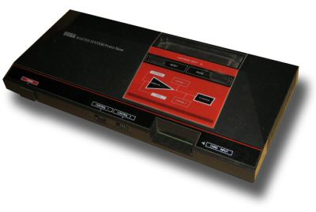
Emulating a Sega Master System in Javascript
Matt Godbolt

Slide 2
Why?

Slide 3
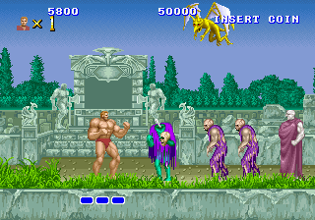
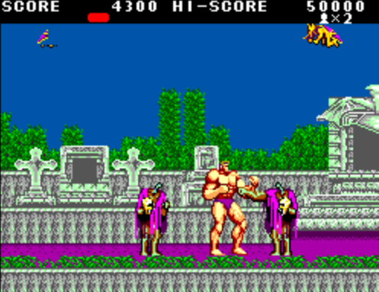
Back story

Slide 4
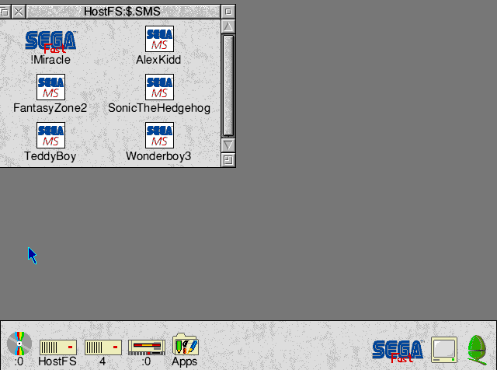
Back story

Slide 5
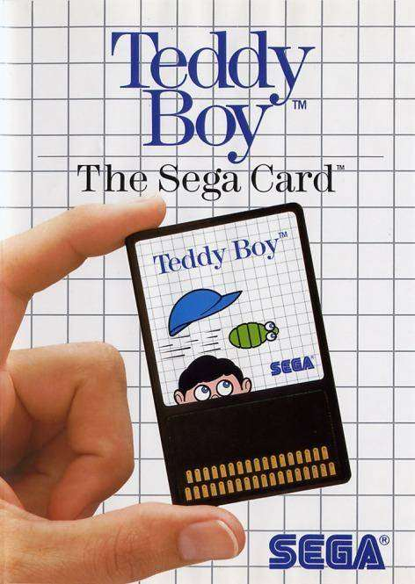
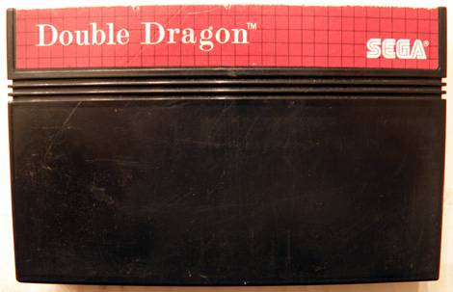
What's inside
8-bit Z80 CPU
8KB RAM
Custom Video Chip
  based on Texas Instrument part
SN76489 Sound Chip

Slide 6
Memory Map
0x10000
0xfffc
Mirror of 8KB on- board RAM
0xffff : Page 2 RAM
0xfffe : Page 1 RAM
0xfffd : Page 0 RAM
0xfffc : ROM/RAM sel
8KB on-board RAM
0xc000
16 KB of ROM Page 2
or
Cartridge RAMs
0x8000
16KB of ROM Page 1
0x4000
15KB of ROM Page 0
0x0400
NMI/IRQ handlers
“RST” handlers
1KB of ROM Bank 0
0x0000

Slide 7
Memory Map
function readbyte(address) {
if (address < 0x0400)
return romBanks[0][address];
if (address < 0x4000)
return romBanks[pages[0]][address];
if (address < 0x8000)
return romBanks[pages[1]][address - 0x4000];
if (address < 0xc000) { ...cartridge ram stuff here }
if (address < 0xe000) { return ram[address - 0xc000]; }
return ram[address - 0xe000];
}

Slide 8
Z80
CISC chip
  900 instructions
  no multiply or divide
Separate I/O bus
  peripherals e.g. VDP, sound
3.53 MHz (approx)
  4 cycles/1us minimum
  7 cycles for LD/ADD
18 8-bit registers
  A, B, C, D, E, H, L
  A', B', C', D', E', H', L'
  Flags, IRQs, R register
  Pairable
    AF, BC, DE, HL
4 16-bit registers
  Index registers: IX, IY
  SP, PC

Slide 9
Z80 – Decoding
Optional prefix (cb, dd, ed, fd)
Opcode byte
Operand bytes (0, 1 or 2)
Examples
  XOR A, A → af
  LD A, 0xff → 3e ff
  LD B, (IX + 0x0f) → dd 46 0f
  LD DE, (0xd019) → ed 5b 19 d0

Slide 10
Z80 - Executing
switch (readbyte(z80.pc++)) {
case 0xaf: // XOR A, A
z80.a ^= z80.a; break;
case 0x3e: // LD A, constant
z80.a = readbyte(z80.pc++);
break;
… but not quite that easy

Slide 11
Z80 – Executing
Flags?
  overflow, parity
  carry, half-carry
  add/subtract
  zero, sign
Interrupts?
Undocumented opcodes?

Slide 12
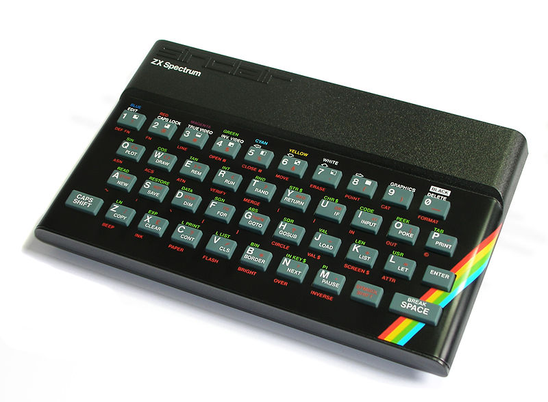
Z80 – Executing
Complex!
Borrow open source code from JSSpeccy
  which was based on Speccy (written in C)

Slide 13
Z80 – ADD A, c
var result = z80.a + c;
var lookup = ((z80.a & 0x88) >> 3)
| ((c & 0x88) >> 2)
| ((result & 0x88) >> 1);
const sz53_table = [...computed elsewhere...];
const hc_add_table = [0, H, H, H, 0, 0, 0, H];
const oflo_add_table = [0, 0, 0, V, V, 0, 0, 0];
z80.a = result & 0xff;
z80.f = (result & 0x100 ? C : 0) // Carry
| hc_add_table[lookup & 0x07] // 1/2 carry
| oflo_add_table[lookup >> 4] // overflow
| sz53_table[z80.a]; // sign, zero, “undef” bits

Slide 14
Z80 – Execution
Code generation from opcode tables:
0x00 NOP
0x01 LD BC,nnnn
0x02 LD (BC),A
CPP Preprocessed to javascript
Avoids lots of repetitive code
  938 instructions
  1241 lines of perl
  5400 lines of javascript generated

Slide 15
VDP
16KB of RAM
  accessible by the IO bus only
8x8 pixel “tiles”
  4 bits per pixel
2 x 16 entry palettes of 6-bit colour
Background table
Sprite table

Slide 16
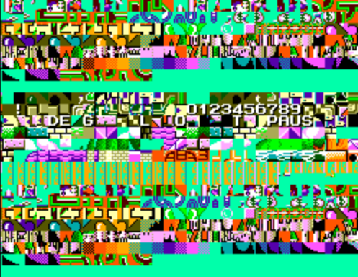
Tiles

Slide 17
Tiles
Planar
describe?

Slide 18
Background
32 x 24 background map of tiles
Two bytes per tile
  9 bits tile index (max 512)
  2 bits vertical, horizontal flip
  1 bit palette select
  1 bit sprite overwrite
  3 user bits

Slide 19
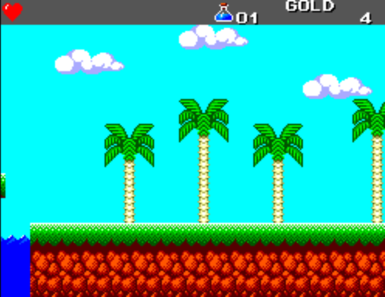
Background

Slide 20
Background
200212202020202020202020202020202020061620202020474f4c4420202020
2003132020202020202020202020202020200717303120202020202020203420
0000000000000000000000006a7a829284940000000000000000000000000000
0000000000000000000000006b7b839385950000000000000000000000000000
00006a7a82928494000000000000000000000000000000000000000000000000
00006b7b83938595000000000000000000000000000000000000000000000000
000000000000000000000000000000000000000000006a7a8292849400000000
000000000000000000000000000000000000000000006b7b8393859500000000

Slide 21
Sprites
64 sprites
8x8 or 8x16
256 byte table sets X, Y and tile index
  Can only be one of first 256 tiles
  All use palette 2
  64 bytes “spare” … some games pack more tiles in here

Slide 22
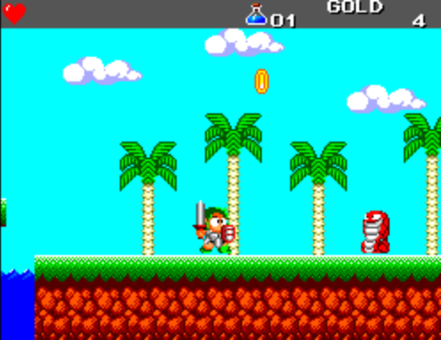
Sprites

Slide 23
Sound!

Slide 24
Putting it all together
Timings
Debugging
Optimization

Slide 25
Future direction
  YM2413
  GameGear
  Save games
  BBC Emulator...

