Slide 1

Matt Gorelik, Tuvia Lerea, Carlo Olcese, Joshua You

Slide 2
Idea
You get to control a car
Missions based around car storyline
Levels, bit of a free world

Slide 3
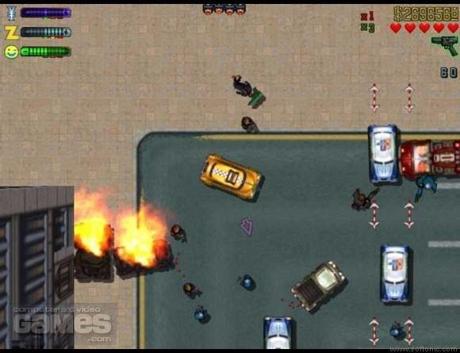
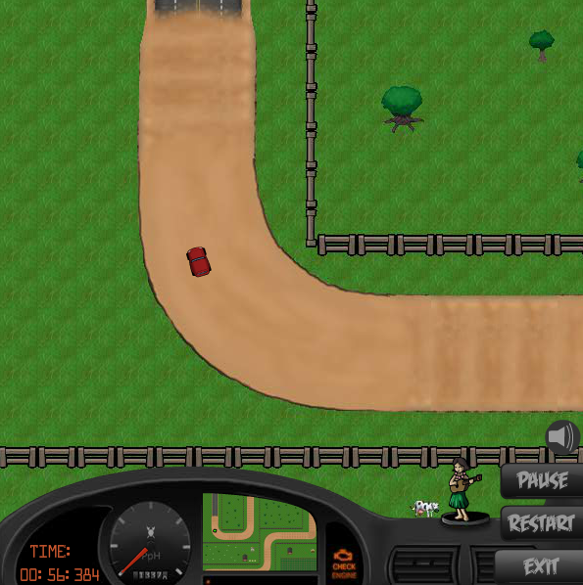
Influences
Manic Rally Go!
Grand Theft Auto 2

Slide 4
Demo

Slide 5
Improvements
Create markers for race
Minimap / Map menu
Items in HUD
Implement shooting
Sound FX

