Slide 1
MattGraham_RedfinInterview
File created on: 4/15/2022 7:58:01 PM

Slide 2
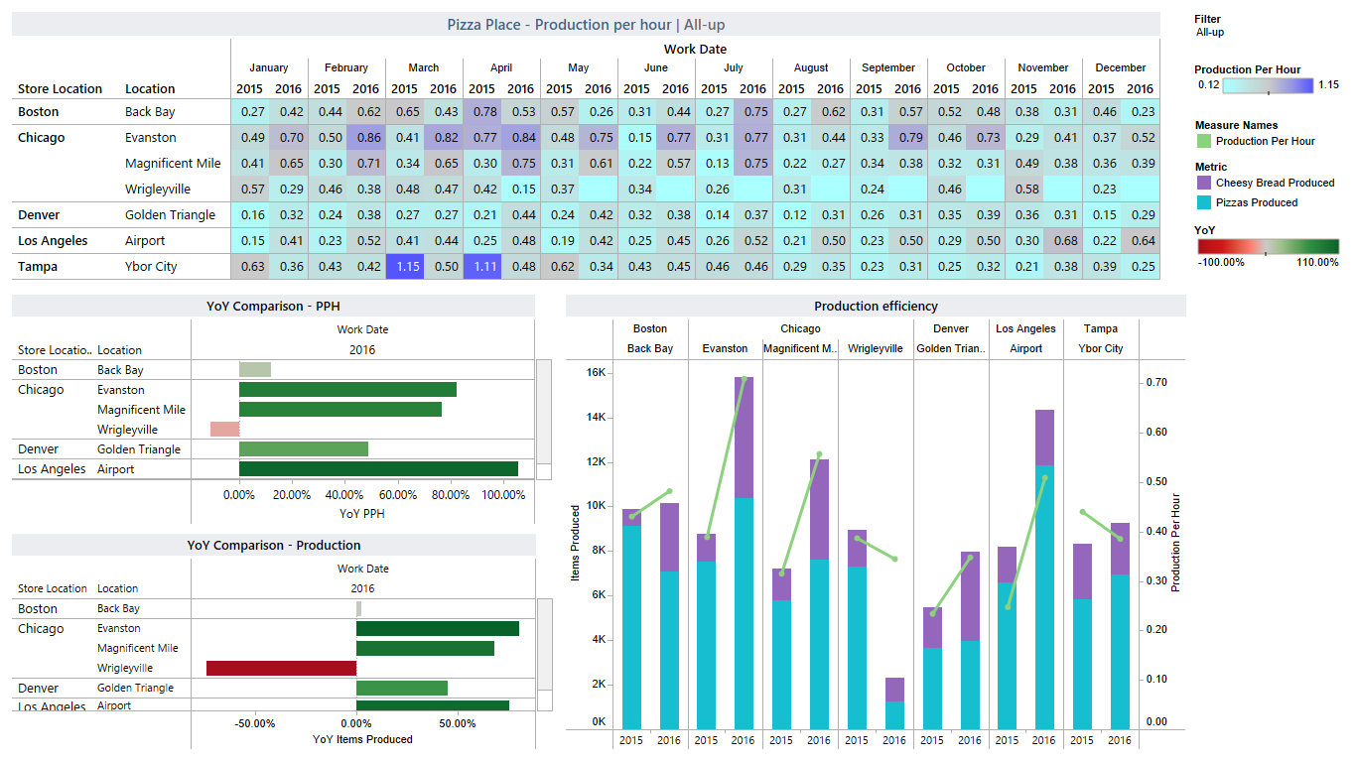

Slide 3


Slide 4
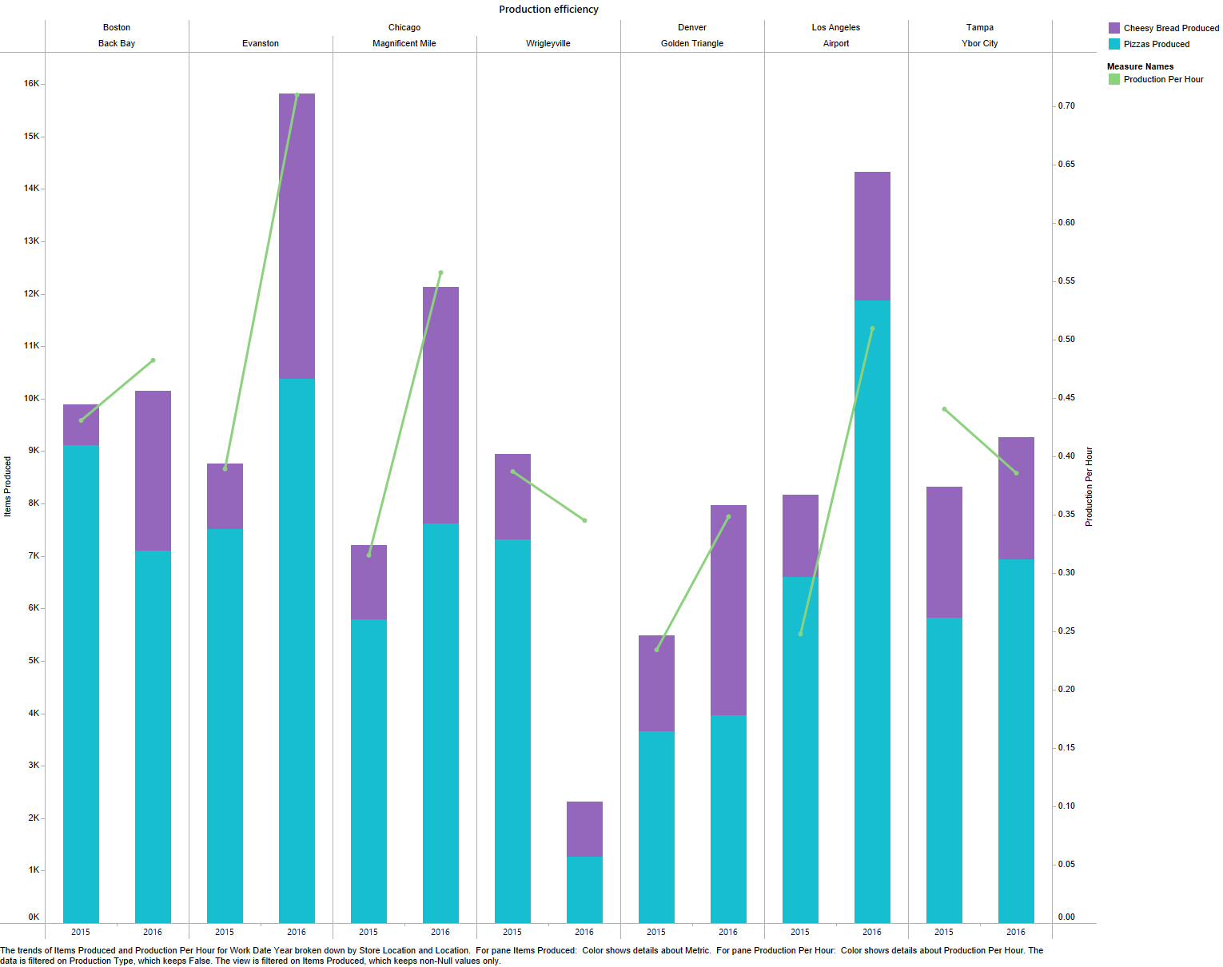

Slide 5
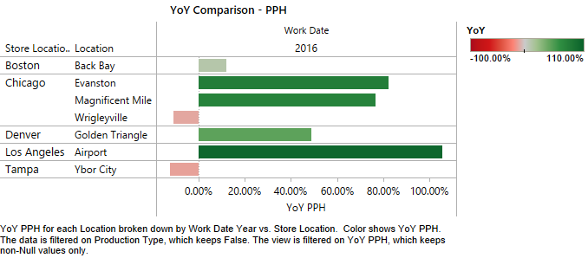

Slide 6
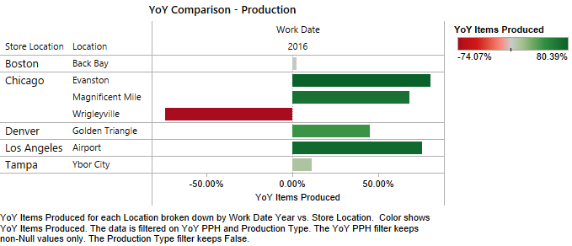

Slide 7
