Slide 1
Hovercrafts
By: Hunter Bergstrom, Matthew Gu, Evan Hu, Adhvayith Sriram

Slide 2
QUESTION & HYPOTHESIS
Question: How does the weight of a hovercraft affect the speed of it?
Hypothesis: If the weight of the hovercraft increases, then the speed will decrease.

Slide 3
MATERIALS
Props
Weights
Tape
Meter stick
Data Tables
Item Name | Quantity | Size | Type
Hovercraft | 1 | 34 cm long | 4M
Weights | 3 | 1, 2,3 grams | Coin
Tape | 1 | Unknown | Adhesive tape
Meter stick | 1 | 1 meter | Metric

Slide 4
Variables
Independent Variable | Weight applied to hovercraft
Levels of IV | Og(control), 1g, 2g 3g
Dependent Variable | Speed of hovercraft
# of trials | 4 for each level
Controlled Variables | Type of Hovercraft Cool Down Time (5 min) Distance

Slide 5
PROCEDURES
Build hovercraft with steps
Test to check for flaws
Set up the course with a start and a finish 3 meters away.
Do the trial for the 0 gram weight.
Record Data for 0 gram weight.
Do the trial for 1 gram weight.
Repeat step 6 for the rest variables (2, 3)
Repeat step 5 for the 1,2,3 gram weights.
Analyze the data.

Slide 6
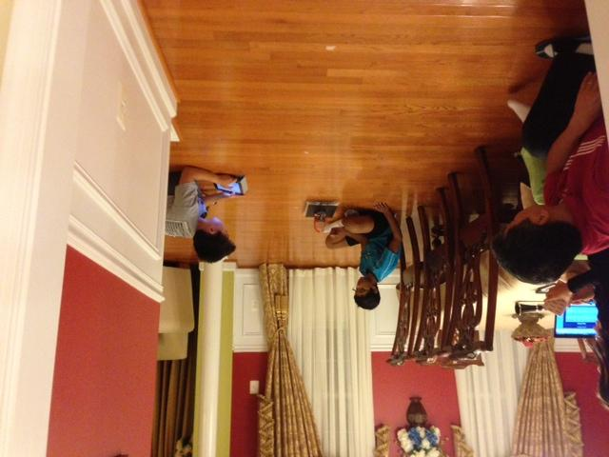
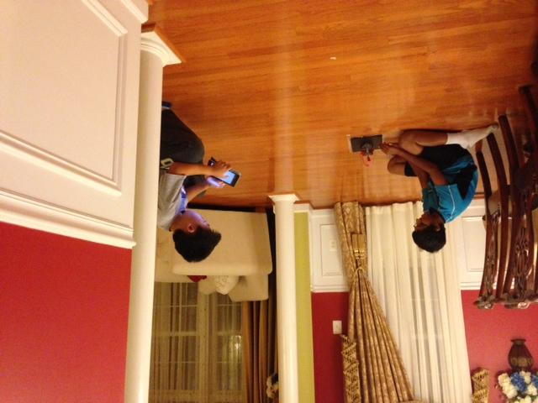
Photos

Slide 7
DATA TABLE
Weight | Trial 1 | Trial 2 | Trial 3 | Trial 4 | Average time | Average speed
0 grams | 3.06 s | 2.57 s | 3.17 s | 3.03 s | 2.9575 s | 1.014 m/s
1 gram | 3.09 s | 3.73 s | 3.37 s | 3.19 s | 3.345 s | .897 m/s
2 grams | 3.07 s | 3.31 s | 3.39 s | 4.14 s | 3.4775 s | .863 m/s
3 grams | 3.27 s | 3.69 s | 3.18 s | 3.51s | 3.4125 s | .879 m/s

Slide 8
GRAPH

Slide 9
Summary Of Results
The more weight there was on the hovercraft, mainly, the slower it went. The results of our 2 gram trials were surprisingly slower than the 3 gram trials.

Slide 10
Conclusion
Question: How will the weight of a hovercraft affect the speed of it?
Hypothesis: If the weight of the hovercraft increases, then the speed will decrease.
During the process of the experiment, we were nearly right about our hypothesis. We did find out that the more weight the hovercraft carried, the slower it traveled. For example the graph showed that in the control group it had an average time of 2.9575 seconds. In the 1 gram trial its average time was 3.345 seconds. The weight pushed down the air cushion slowing its speed down. We faced some technical difficulties along the way but we fixed it. Next time we could try with two motors and build our own customized hovercraft.
Problems and solutions: One problem we encountered was when we were testing the hovercraft, it would veer off in to a random direction. We fixed this by having a person lightly push it in the right direction, if needed. Another problem we faced was that the batteries in the hovercraft sometimes died, so we fixed that problem by inserting new batteries that were the same kind.

Slide 11
Better Science
One way this project could have been better science is by controlling the cool down time slightly better as well as controlling the material of the weights because the cool down time is crucial to the speed and distance of the hovercraft. The weights were a rubber band for the 1 gram trial, a dime for the 2 gram trial, and a penny for the gram trial.

Slide 12
Other Related Questions
How does a hovercraft work?
How does the hovercraft insert a certain amount of pressure in the air to push it up?

Slide 13
Real World Applications
The heavier a vehicle is, the harder it is to get it going and keep it going at the same speed.

Slide 14
Reference Links
http://www.youtube.com/watch?v=A_cftvNTxKA
http://www.youtube.com/watch?v=jsFVhGlATAA
http://www.youtube.com/watch?v=Iqe2B10tiY0
http://www.youtube.com/watch?v=UCEn6bjZ8A8
http://www.youtube.com/watch?v=InzE4poKjnU

Slide 15


THANKS FOR WATCHING!

