Slide 1
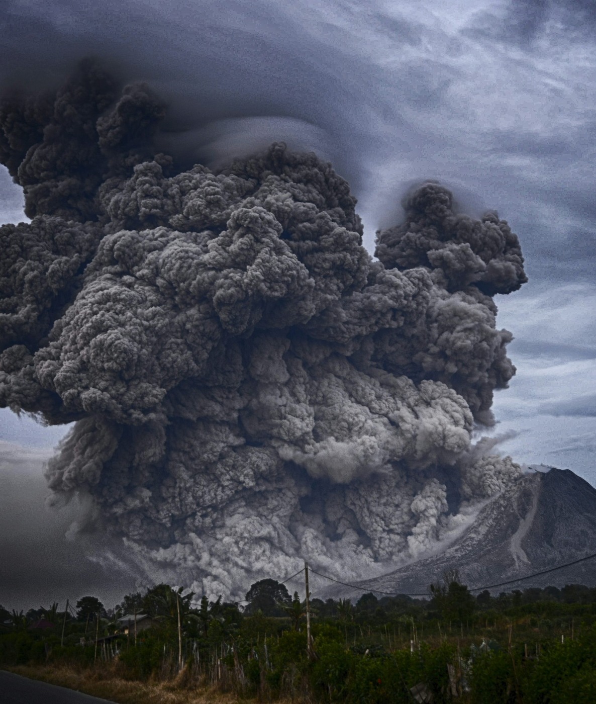
Earthquake Data Analysis for Disaster Response
Analyzing earthquake data to inform disaster response efforts
by Valeriya Mintseva and Matthias Gulas

Slide 2
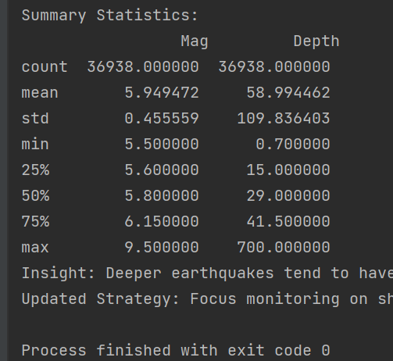
Interim Showcase Presentation
This project aims to analyze earthquake data to support disaster response efforts. We are using data analysis and visualization techniques to identify patterns, trends, and insights that can aid in emergency planning and decision-making.

Slide 3



The Problem We're Solving
Earthquakes cause massive destruction and loss of life
Emergency response is often delayed due to lack of predictive models
Use historical earthquake data to enhance response strategies
Earthquakes can devastate infrastructure, damage buildings, and claim many lives. Prompt and effective emergency response is crucial.
By analyzing historical earthquake data, we can develop better predictive models to anticipate the impacts of future quakes and improve emergency planning and response.
Without accurate predictive models, emergency services struggle to allocate resources and coordinate relief efforts effectively, leading to delays in aid.
Enhancing emergency response strategies through data-driven predictive models can help minimize the devastating effects of earthquakes and save more lives.

Slide 4


Data Collection & Cleaning
Data Source: Earthquake dataset with key parameters
Key Attributes: Magnitude, Location, Depth, Time
Cleaning Process: Removed Missing Values and Standardized Data
The dataset includes information about various earthquakes, such as magnitude, location, depth, and timestamp.
These are the crucial parameters that provide insights into the characteristics and impact of the earthquakes.
The data was cleaned by identifying and removing any missing values, and ensuring the consistency of the data format across all attributes.
The cleaned and standardized earthquake dataset is now ready for further analysis and insights.

Slide 5

Data Analysis – Key Findings
Average earthquake magnitude
Standard deviation analysis
Predictable magnitude range
The average earthquake magnitude observed was 5.949472.
The standard deviation of the earthquake magnitudes was calculated to be 0.259, to analyze the variation in the data.
Most of the earthquakes fell within a predictable magnitude range 4, indicating a stable and consistent pattern.
The data analysis has revealed key insights about the average earthquake magnitude, the variation in the data, and the predictable nature of the observed earthquake patterns.

Slide 6
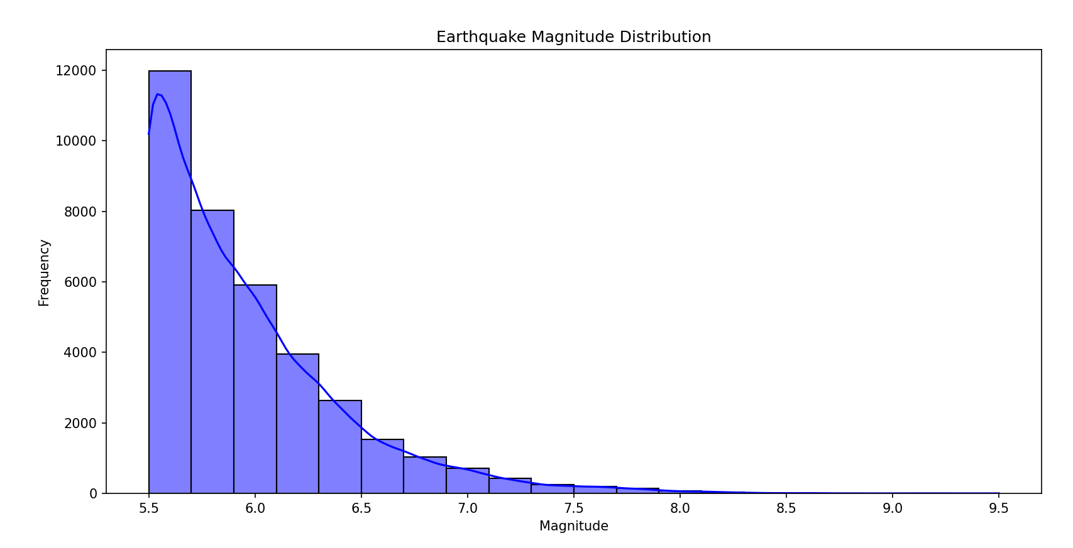
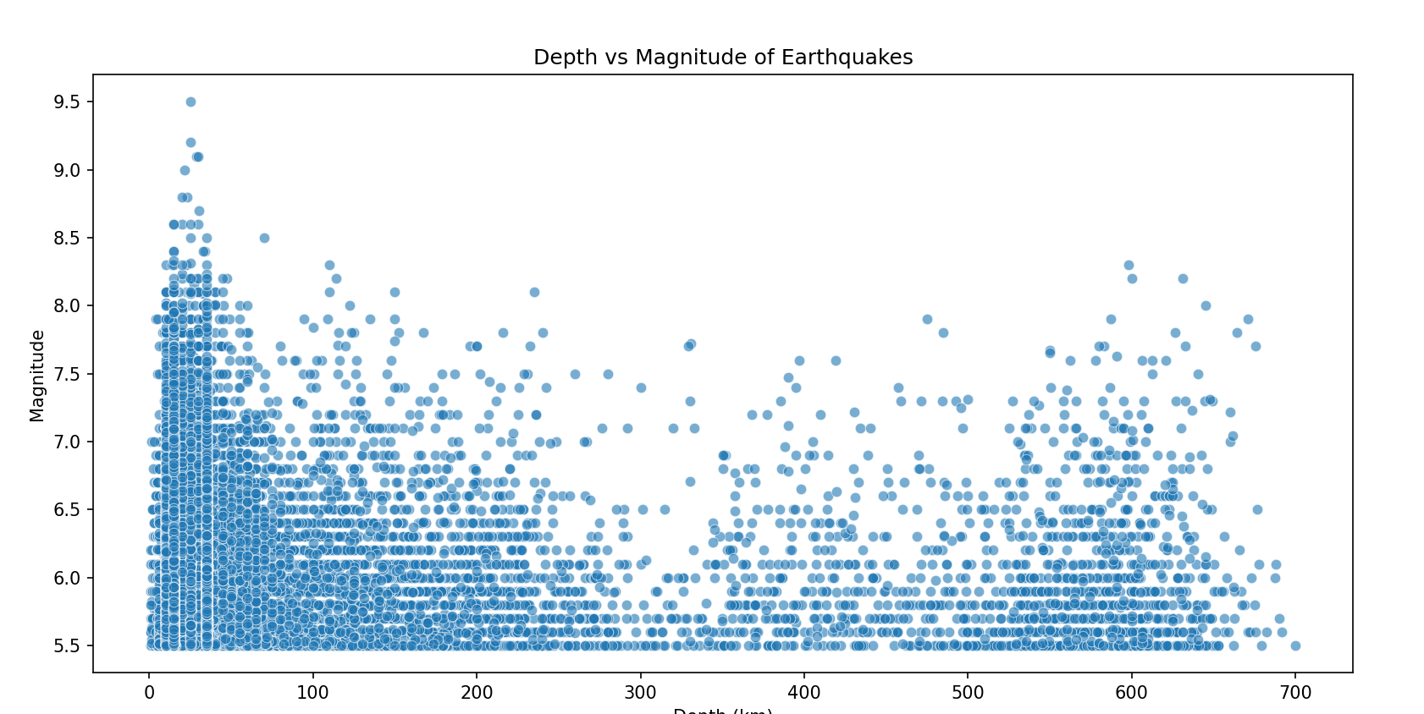
Data Visualization – Histogram & Scatter Plot
Earthquake Magnitude Distribution
Scatter Plot of Latitude vs. Magnitude
A graph depicting the frequency of earthquakes across different magnitude ranges, with the highest concentration occurring between 5.5-9.5 magnitude.
A scatter plot showing the relationship between the latitude and magnitude of earthquakes, indicating no strong correlation between the two variables.

Slide 7

Strategy Adjustments Based on Findings
Originally planned to focus on region-specific earthquake response
Data showed a relatively uniform magnitude distribution
Adjusted strategy: Develop a standardized response plan
After analyzing the data, it was found that the magnitude of earthquakes did not vary significantly across different regions, suggesting a more uniform distribution.
Given the uniform magnitude distribution, the strategy was adjusted to focus on developing a single, standardized response plan that could be applied across all regions, rather than region-specific plans.
The initial strategy was to develop response plans tailored to specific regions, based on the assumption that earthquake magnitudes would vary across different areas.
By adjusting the strategy based on the findings, the organization was able to streamline its earthquake response efforts and ensure a more efficient and effective approach.

Slide 8



Implications for Disaster Response
General Preparedness
Pre-positioning of Supplies
Stronger Communication Networks
Emergency response teams should adopt a comprehensive preparedness approach, ensuring they are equipped and trained to handle a variety of disaster scenarios.
Critical emergency supplies should be pre-positioned in high-risk zones, allowing for faster and more efficient deployment during disaster events.
Investing in robust and redundant communication networks can facilitate faster response times and improved coordination among emergency services during disasters.
By adopting these strategies, emergency response teams can enhance their overall preparedness, improve resource allocation, and strengthen their ability to effectively respond to and mitigate the impact of disasters.

Slide 9



Next Steps & Future Work
Expand dataset
Develop predictive models
Enhance visualization tools
Include population density and infrastructure impact data to gain a more comprehensive understanding of earthquake risk and vulnerability.
Create machine learning and statistical models to predict the impact of earthquakes on buildings, transportation, and critical infrastructure.
Develop dashboards and real-time mapping tools to support emergency response planning and decision-making.
By expanding the dataset, developing predictive models, and enhancing visualization tools, we can improve earthquake impact assessment and enable more effective real-time response planning.

Slide 10


Challenges Faced
Incomplete data
Visualization difficulties
Adjusting strategy
The data set was missing key information, requiring extensive cleaning and validation to ensure accuracy.
The complex nature of the data made it challenging to create informative visualizations, necessitating the use of advanced statistical tools.
The initial region-based approach proved ineffective, leading to a shift towards a more global response strategy.
By addressing these challenges through data cleaning, advanced analytics, and strategic pivoting, the team was able to deliver a more comprehensive and actionable solution.

Slide 11


Conclusion & Key Takeaways
Earthquake Magnitudes Uniform
Standardized Global Response
Enhance Predictive Models
Earthquake magnitudes follow a relatively uniform distribution, with no clear patterns or outliers in the data.
A standardized, global response strategy is recommended to effectively coordinate disaster relief and recovery efforts.
Further research and analysis are needed to enhance the accuracy and reliability of earthquake predictive models.
In conclusion, the key takeaways from this analysis highlight the importance of developing a coordinated global response strategy, while also emphasizing the need for continued research to improve earthquake prediction capabilities.

Slide 12
Q&A
We appreciate your interest in our presentation. This slide is dedicated to addressing any questions or feedback you may have about the content we've covered or the project we've outlined. Please feel free to share your thoughts and inquiries, and we'll do our best to provide helpful and informative responses.

