Slide 1
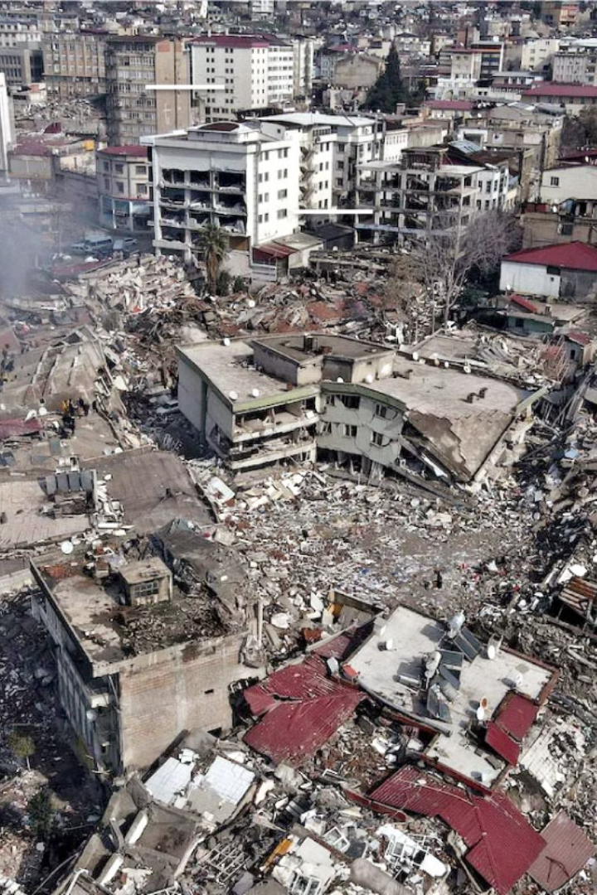
Natural Disaster Allert System
Welcome! Our team has been analyzing earthquake data to help improve disaster response strategies.
By Valeriya Mintseva & Matthias Gulas

Slide 2
The Challenge: Time is Critical
Widespread Destruction
Response Delays
Earthquakes can cause significant damage and loss of life.
Emergency teams face delays due to a lack of predictive models.

Slide 3
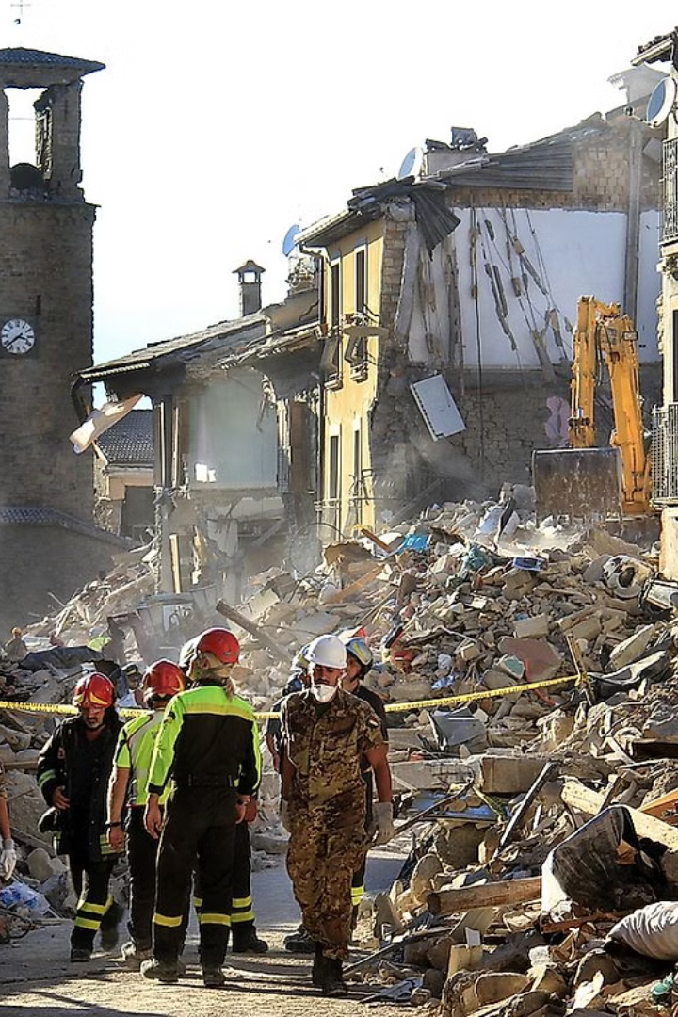
Our Solution: Predictive Insights
1
Analyze Earthquake Data
2
Improve Preparedness
Identify trends to enhance disaster preparedness strategies.
We analyze historical earthquake data to find patterns and trends.
3
Data-driven Response
Develop a data-driven response strategy to guide emergency teams.

Slide 4

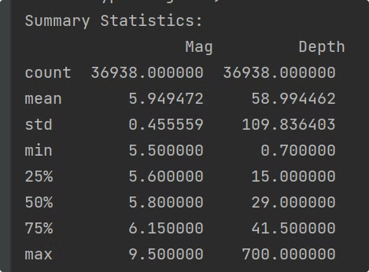
Progress: Data Collection & Analysis
1
Global Earthquake Data Collection
2
Data Cleaning and Processing
3
Key Trend Identification: Magnitude & Location

Slide 5






Key Insights: Predictable Patterns
Seismic Activity
Some regions experience more frequent seismic activity.
Magnitude Range
Patterns for Preparedness
Most earthquakes fall within a predictable magnitude range.
Identified patterns can guide disaster preparedness plans.

Slide 6
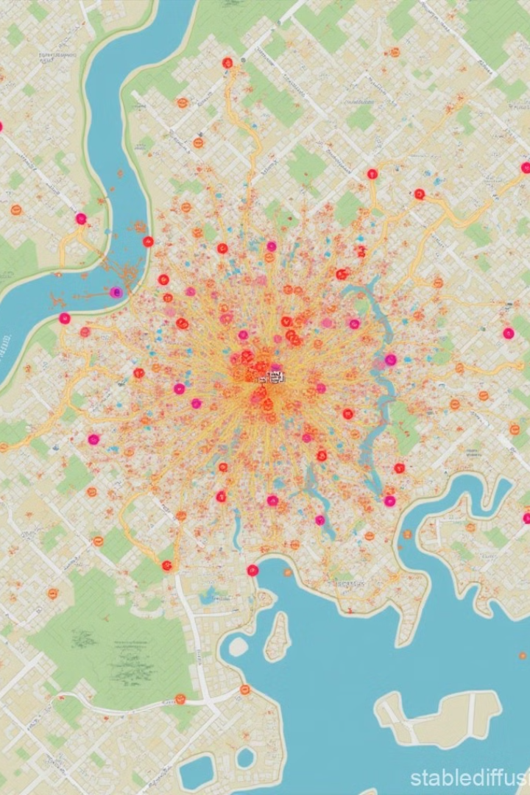




What else can be done?
Incorporate More Variables
Develop Predictive Models for Impact Assessment
Improve Visualization Tools for Real-time Decision-making
Work on allerts about other disasters like tsunamis or volcanoes

Slide 7

Conclusion: Preparedness is Key
Data-driven Strategies
Evidence-based Planning
Future Work: Faster Response
Data-driven strategies can enhance disaster response.
Preparedness plans should be based on patterns, not guesswork.
Future work: Improve models for faster response.

Slide 8
Thank You For Your Time!

