Slide 1
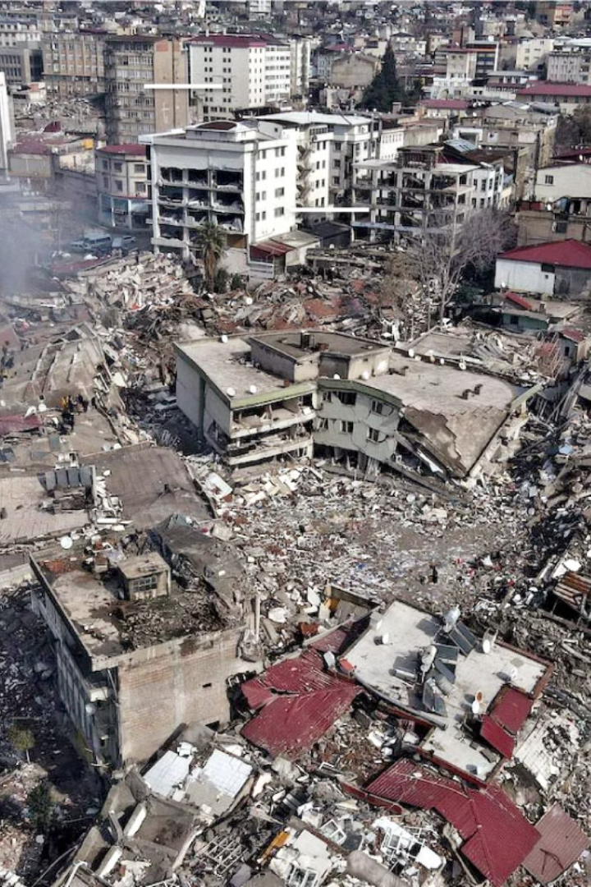
Natural Disaster Alert System
Welcome! Our team has been analyzing earthquake data to help improve disaster response strategies.
By Valeriya Mintseva & Matthias Gulas
1

Slide 2
The Challenge: Time is Critical
Widespread Destruction
Response Delays
Earthquakes can cause significant damage and loss of life.
Emergency teams face delays due to a lack of predictive models.
2

Slide 3
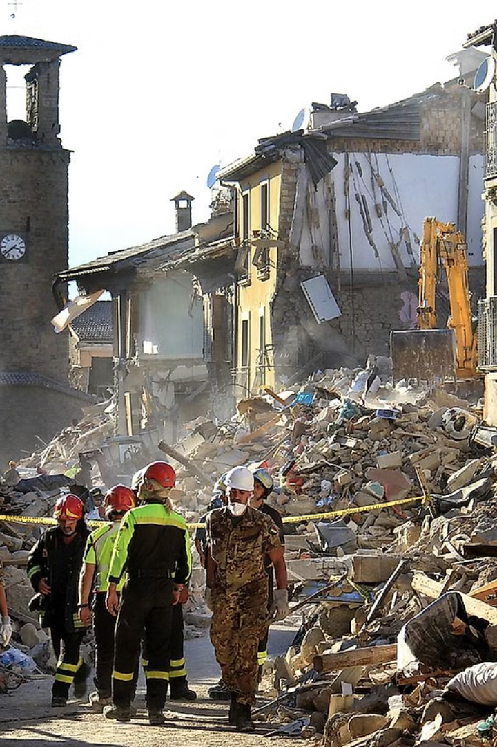
Our Solution: Predictive Insights
1
Analyze Earthquake Data
2
Improve Preparedness
Identify trends to enhance disaster preparedness strategies.
We analyze historical earthquake data to find patterns and trends, aiming to predict magnitude and location of the next disaster.
3
Data-driven Response
Develop a data-driven response strategy to guide emergency teams.
3

Slide 4

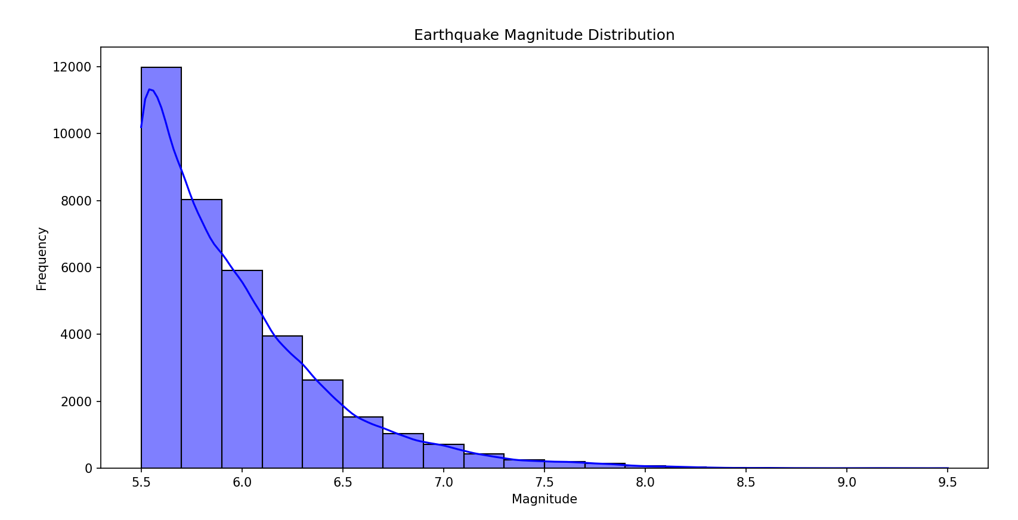
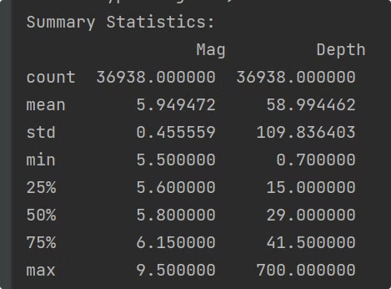
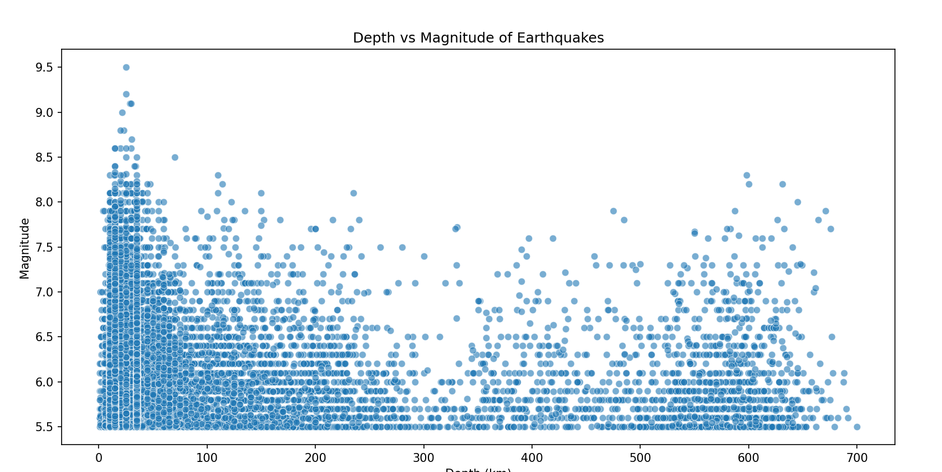
Progress: Data Collection & Analysis
1
Global Earthquake Data Collection
2
Data Cleaning and Processing and visualization
using Pandas and Matplotlib
3
Key Trend Identification: Magnitude & Location
4

Slide 5
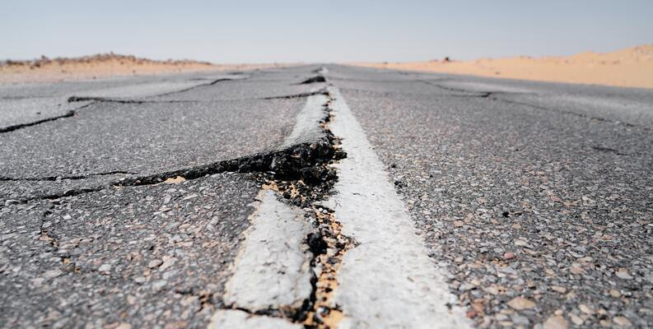
Our Dataset
Earthquake dataset: Seismic Research Dataset
Datasets contain records of 782 earthquakes from 1/1/2001 to 1/1/2023
Contains 13 different columns
Most important to us:
Date
Time
Magnitude
Location (continent and country)
5
https://www.kaggle.com/datasets/warcoder/earthquake-dataset?resource=download

Slide 6






Key Insights: Predictable Patterns
Seismic Activity
Some regions experience more frequent seismic activity; such as Turkey, Japan and some regions in California
Magnitude Range
Patterns for Preparedness
Most earthquakes fall within a predictable magnitude range
Between 5.5 and 9.5.
Identified patterns can guide disaster preparedness plans.
6

Slide 7
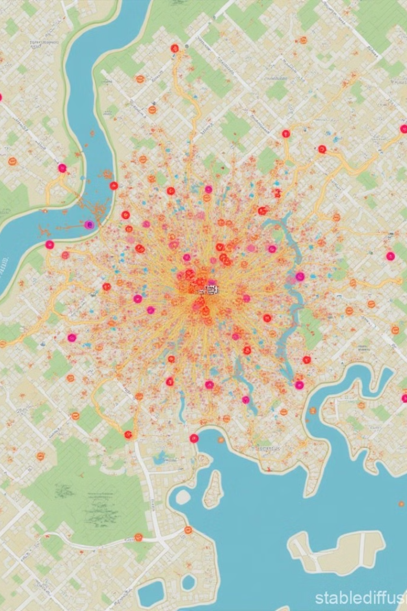




What else can be done?
Incorporate More Variables
Develop Predictive Models for Impact Assessment
Improve Visualization Tools for Real-time Decision-making
Work on allerts about other disasters like tsunamis or volcanoes
7

Slide 8
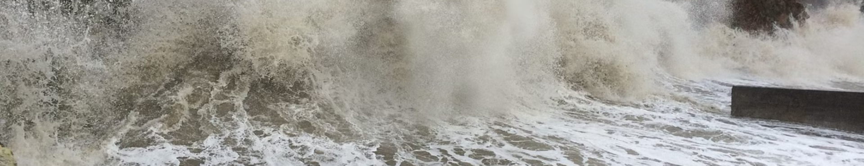
Conclusion: Preparedness is Key
Data-driven Strategies
Evidence-based Planning
Future Work: Faster Response
Data-driven strategies can enhance disaster response.
Preparedness plans should be based on patterns, not guesswork.
Future work: Improve models for faster response.
8

Slide 9
Thank You For Your Time!
9

