Slide 1

Baseline Modeling for Earthquake Magnitude Prediction
Predicting earthquake magnitude is critical for disaster preparedness. This presentation evaluates baseline models using geographic and depth features. We will cover our models, their performance, and key learnings.
By Valeriya Mintseva and Matthias Gulas

Slide 2
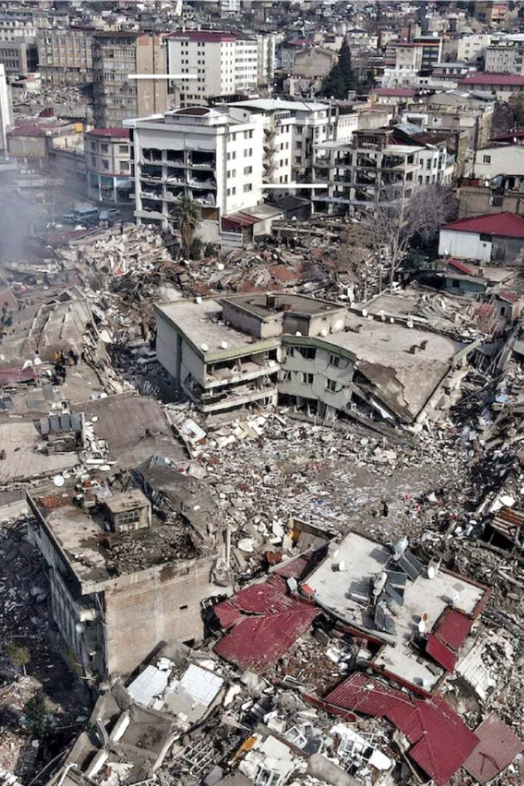



Why Predicting Magnitude Matters
Impact Severity
Slow Response
Earthquake magnitude directly affects damage severity.
Lack of predictive tools slows emergency response efforts.
Faster Aid
Better predictions lead to faster aid and fewer casualties.

Slide 3




Our Modeling Strategy
Features
Objective
Models
Using Latitude, Longitude, and Depth.
To set a performance benchmark.
Mean, Median, and Linear Regression.

Slide 4

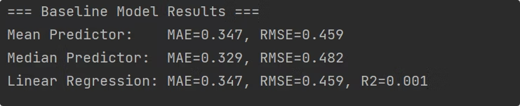
Baseline Models
Mean Predictor
Median Predictor
Linear Regression
Always outputs the average magnitude from the training set.
Always predicts the median value, robust to outliers.
Uses features to predict magnitude based on a linear relationship.

Slide 5
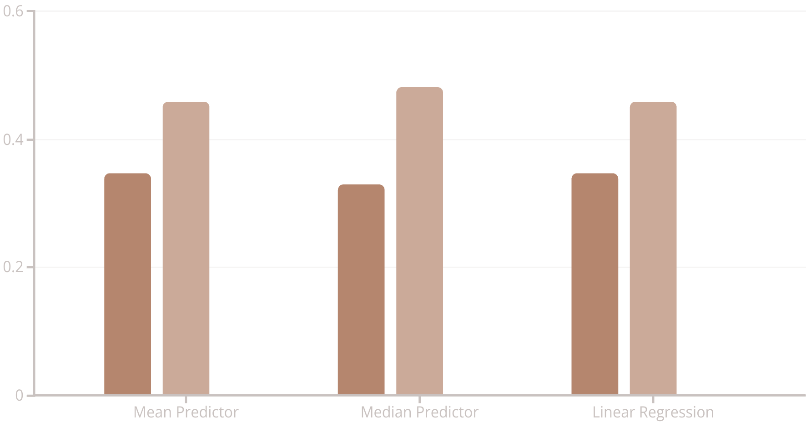
How Did the Models Perform?
MAE
RMSE
R²
The linear regression model showed only a slight improvement over naive baselines. Its R² score was very close to zero.

Slide 6
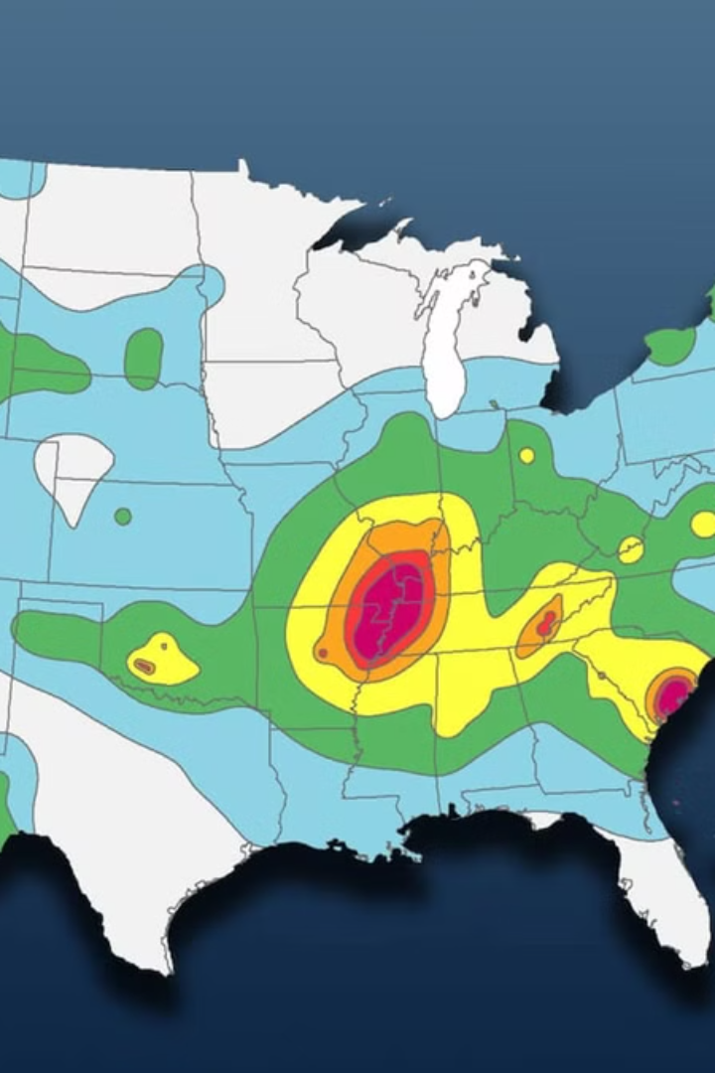



What We Learned
Limited Predictive Power
Spatial features alone do not strongly predict magnitude.
Low R² Score
Confirms minimal variance explained by these variables.
Seismological Alignment
Magnitude relates more to fault energy, not just location.

Slide 7

Next Steps
Expand Features
Incorporate seismic moment, fault type, and historical data.
Advanced Models
Explore Random Forests or Gradient Boosting for better performance.
Feature Engineering
Critical for improving predictive accuracy.

Slide 8
Conclusion & Deliverables
Baseline Established
Simple models with basic spatial data set a reference point.
Guidance for Future
Results inform the next phase of our work.

Slide 9

Thank You!
We are excited to continue building from here. We look forward to improving our models with better data and deeper insights. Any questions?

