Slide 1
Geometric Approaches to Reconstructing Time Series Data
Project Update
29 March 2007
CSC/Math 870 Computational Discrete Geometry
Connie Phong

Slide 2
Objectives and Motivations
To reconstruct a time ordering from data without explicit time indices
Unordered or poorly ordered sets of observations are common in biological experiments such as DNA microarray experiments

Slide 3
Implementing a MST based algorithm
Input weighted graph constructed from samples
Calculate MST
Find diameter path of the MST
Compute diameter path statistics
Output diameter path as the estimated ordering
Yes
No
Create PQ-Tree from diameter path and MST
Low noise and high sampling intensity?
Output PQ tree showing uncertainties in the ordering

Slide 4
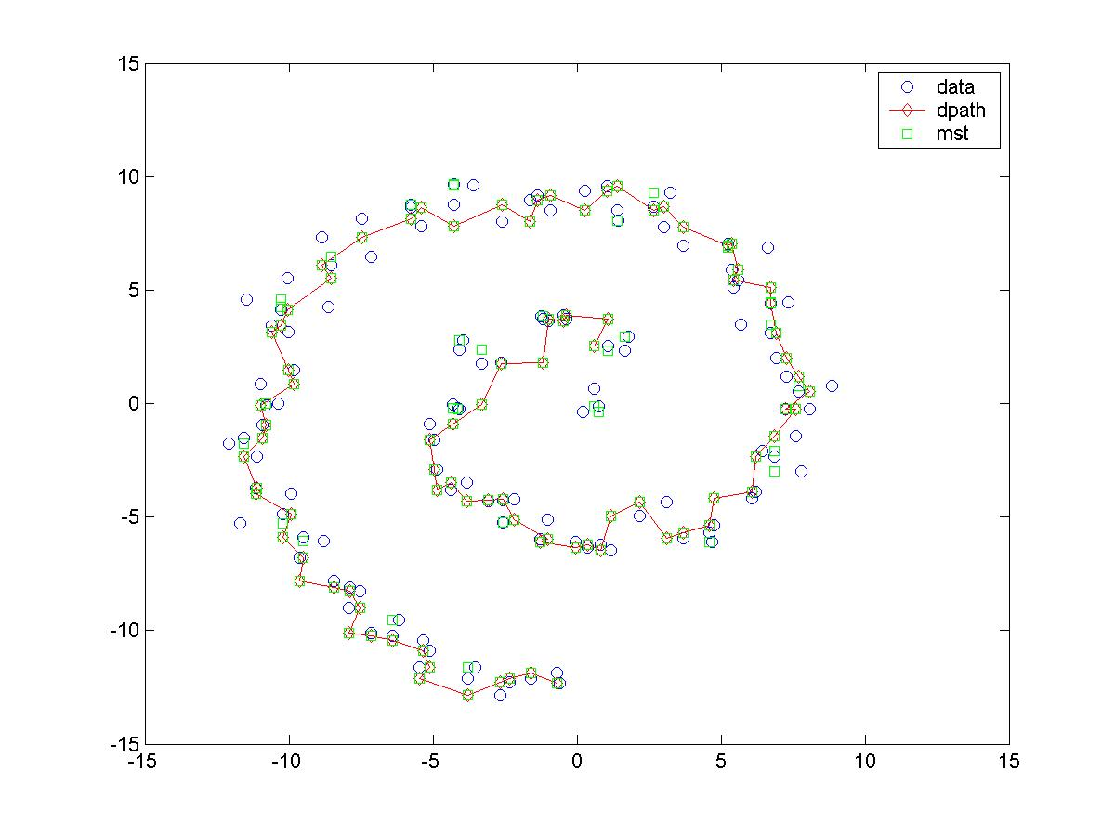
Artificial Dataset: Jelly roll

Slide 5
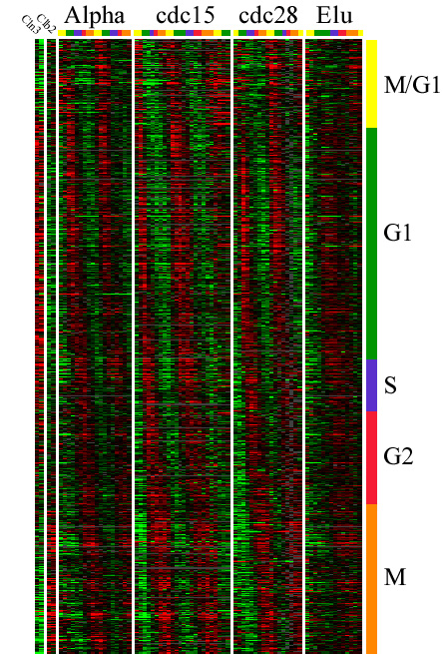
Yeast Microarray Dataset
Rows – genes
Columns – time points
Magnitude of the ratio of induction to repression is indicated by color intensity: red indicates an increase in mRNA abundance and green indicates a decrease in mRNA abundance
Spellman et al.’s original dataset contains 6177 open reading frames
  18 time points, 7 min intervals
  reduced to 5541 genes
  ran algorithm on 500 genes exhibiting the most sample variation synchronized by treatment with alpha factor
http://genome-www.stanford.edu/cellcycle/

Slide 6
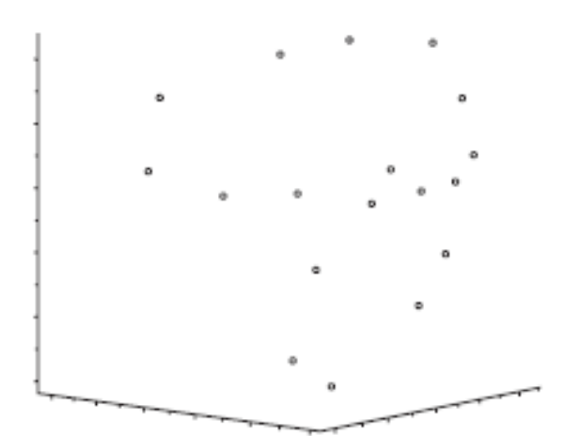
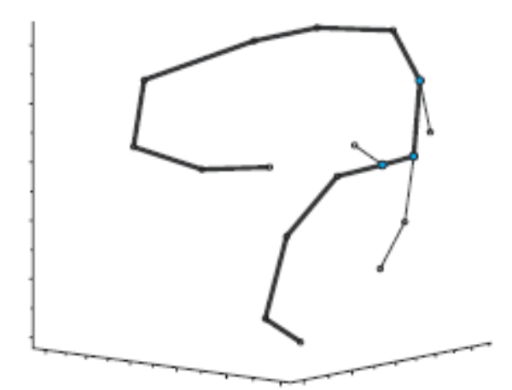
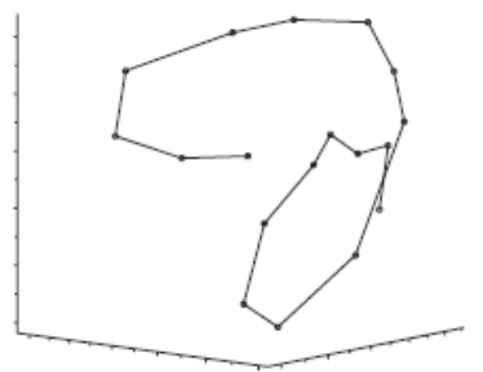
Yeast Microarray Dataset
Figure 3a: sample points in the space of the three largest principle coordinates
Figure 3b: mst for the data with diameter path shown in bold
noise = 0.2222
intensity = 0.0769
Figure 3f: known ordering and path

Slide 7
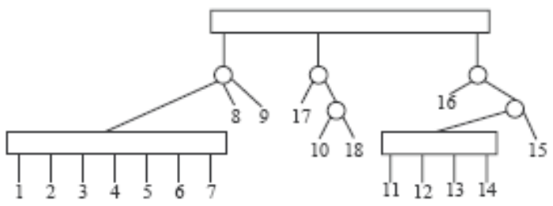
Yeast Microarray Dataset
Create PQ-tree
[ {(1, 2, 3, 4, 5, 6, 7), 8, 9}, {17, 18, 10}, {16, 15, (14, 13, 12, 11)} ]
Costs of known ordering: 211.8194
  No relationship between cost of particular ordering and accuracy of the ordering
    [1, 2, 3, 4, 5, 6, 7, 8, 9, 17, 18, 10, 11, 12, 13, 14, 16, 15] = 209.5083 [1, 2, 3, 4, 5, 6, 7, 8, 9, 10, 18, 17, 17, 15, 14, 13, 12, 11] = 208.0588

Slide 8
Current Work
Researching principle curves
Researching Kalman filter
Compiling other datasets
  A little bit of research on the implications of certain preprocessing steps
Overall objective: develop an algorithm for reconstructing time orderings that is more theoretically rigorous and addresses error and noise more succinctly

