Slide 1
Geometric Approaches to Reconstructing Time Series Data
Final Presentation
10 May 2007
CSC/Math 870 Computational Discrete Geometry
Connie Phong

Slide 2
Recap
Objective: To reconstruct a time ordering from unordered data
This representative dataset is mRNA expression levels in yeast: it has 500 dimensions and includes 18 time points

Slide 3
Recap
Estimated a time ordering from a MST-diameter path construction (Magwene et al. 2003)
A PQ tree represents the uncertainties and defines a permutation subset that contains the true ordering
8
9
17
16
1
2
3
4
5
6
7
10
18
15
11
12
13
14

Slide 4
Recap
The MST-diameter path construction is not satisfactory.
  The approach is not really rooted in theory
  Outputs a large number of possible orderings without providing a means to sort through them
Refined objective: To develop a rigorous algorithm/heuristic to reconstruct a temporal ordering from unordered microarray data

Slide 5
The Kalman Filter
Given: A sequence of noisy measurements
Want: To estimate internal states of the process
The Kalman filter provides an optimal recursive algorithm that minimizes the mean-square-error.
The Kalman filter assumes:
  The process can be described by a linear model.
  The process and measurement noises are white.
  The process and measurement noises are Gaussian.
x_{k} = Ax_{k-1} + Bu_{k-1} + w_{k-1}
z_{k} = Hx_{k} + v_{k}
p(w) ~ N(0, Q)
p(v) ~ N(0, R)

Slide 6
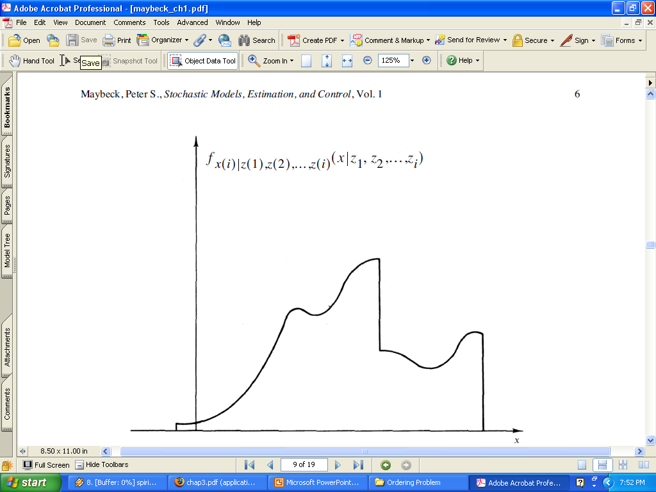
A Conceptual Explanation
Consider the conditional probability density function of x
  x(i) conditioned on knowledge of the measurement z(i) = z₁
The assumption
that process and
measurement noises
are Gaussian imply
that there’s a unique
best estimate of x.

Slide 7
Discrete Kalman Filter Algorithm
Time-Update: “Predict”
Measurement-Update: “Correct”
Initial estimates
The Kalman gain term K is chosen such that mean square error of the a posteriori error is minimized

Slide 8
Implementing the Kalman Filter
Consider a particle with initial position (10, 10) moving with constant velocity 1 m/s through 2D space and trajectory subject to random perturbations
The linear model:
  x_{k} = Ax_{k-1} + w_{k-1} z_{k=}Hx_{k} + v_{k}

Slide 9
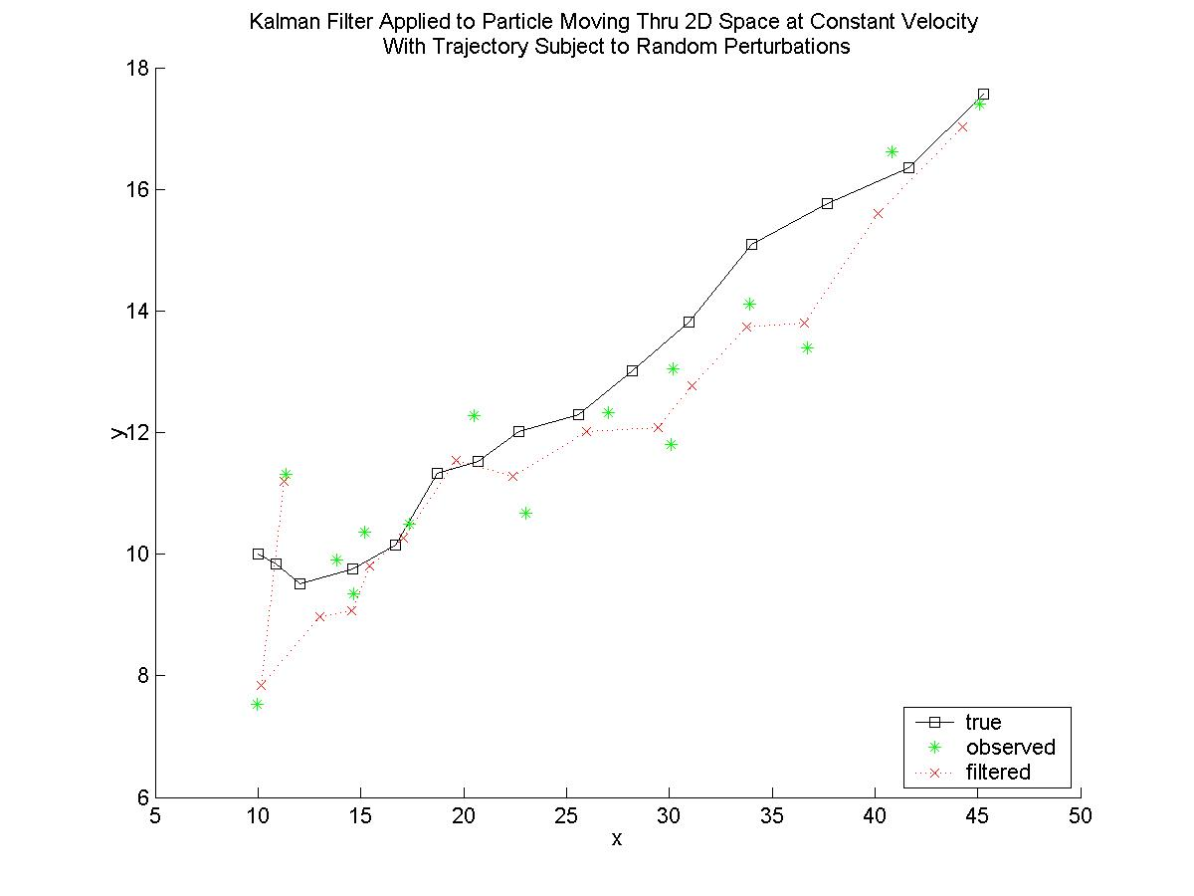

Slide 10
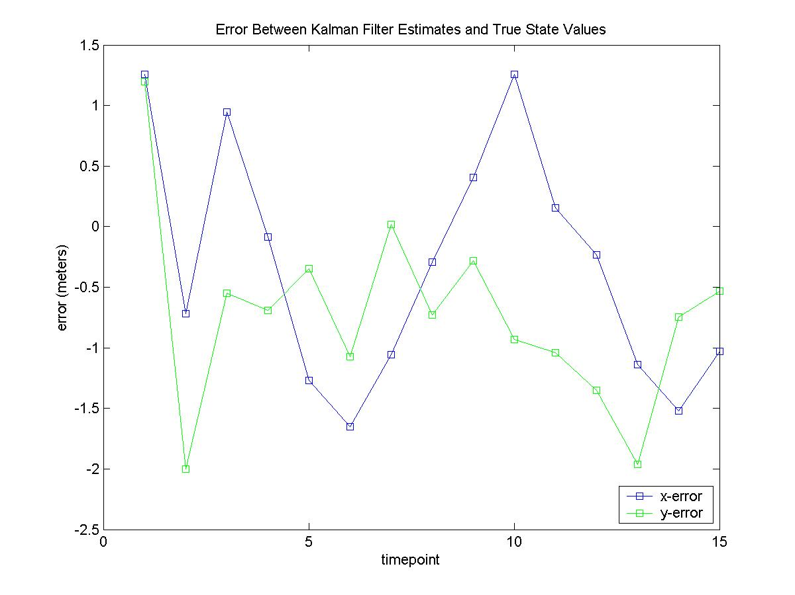

Slide 11
Implementing the Kalman Filter
Consider a sinusoidal trajectory with linear model:
  x_{k} = Ax_{k-1} + w_{k-1} z_{k=}Hx_{k} + v_{k}

Slide 12
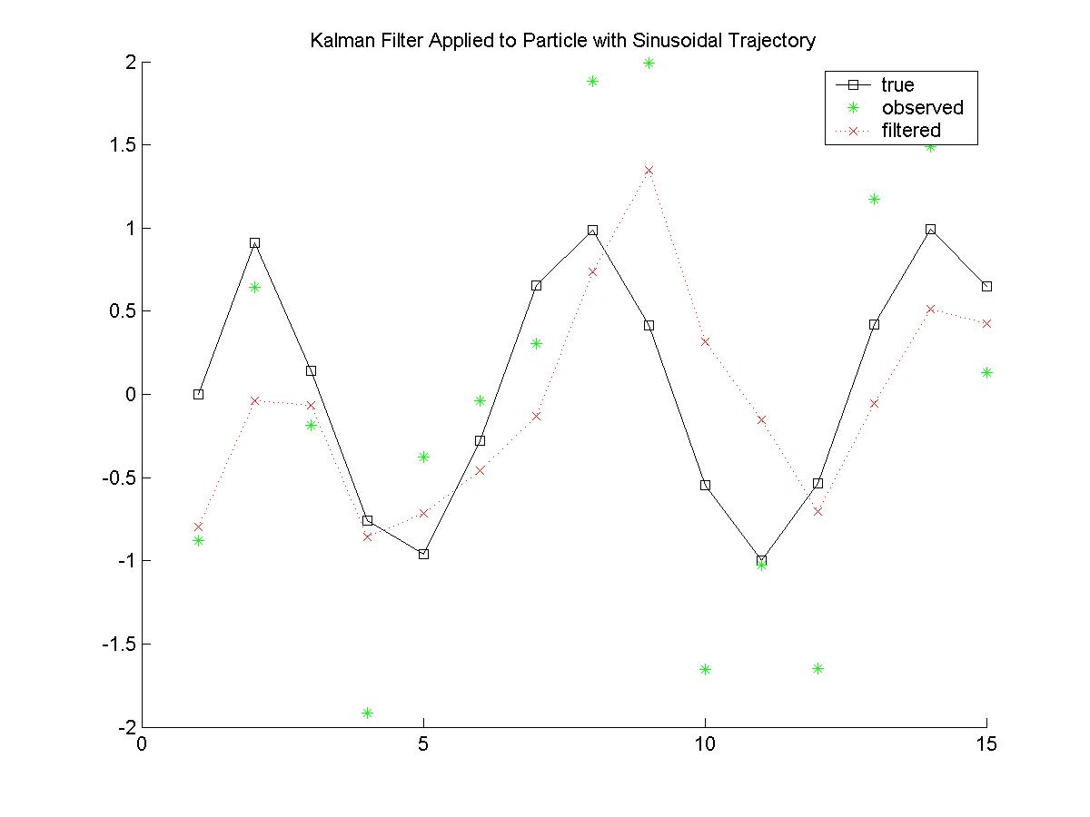

Slide 13
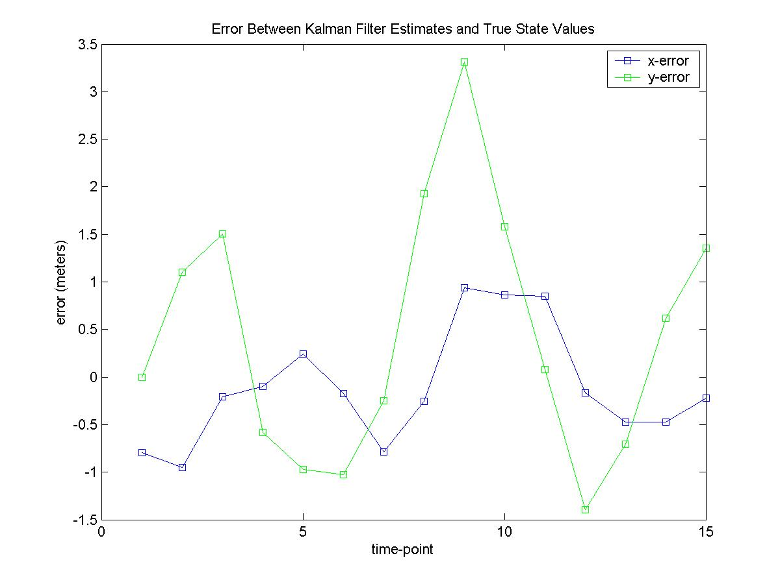

Slide 14
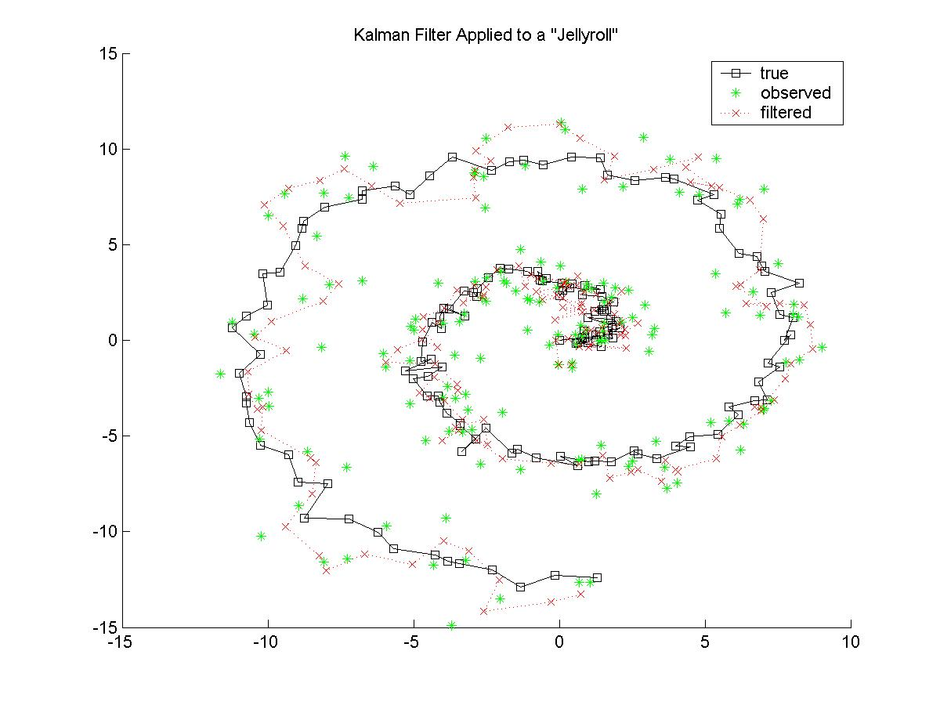

Slide 15
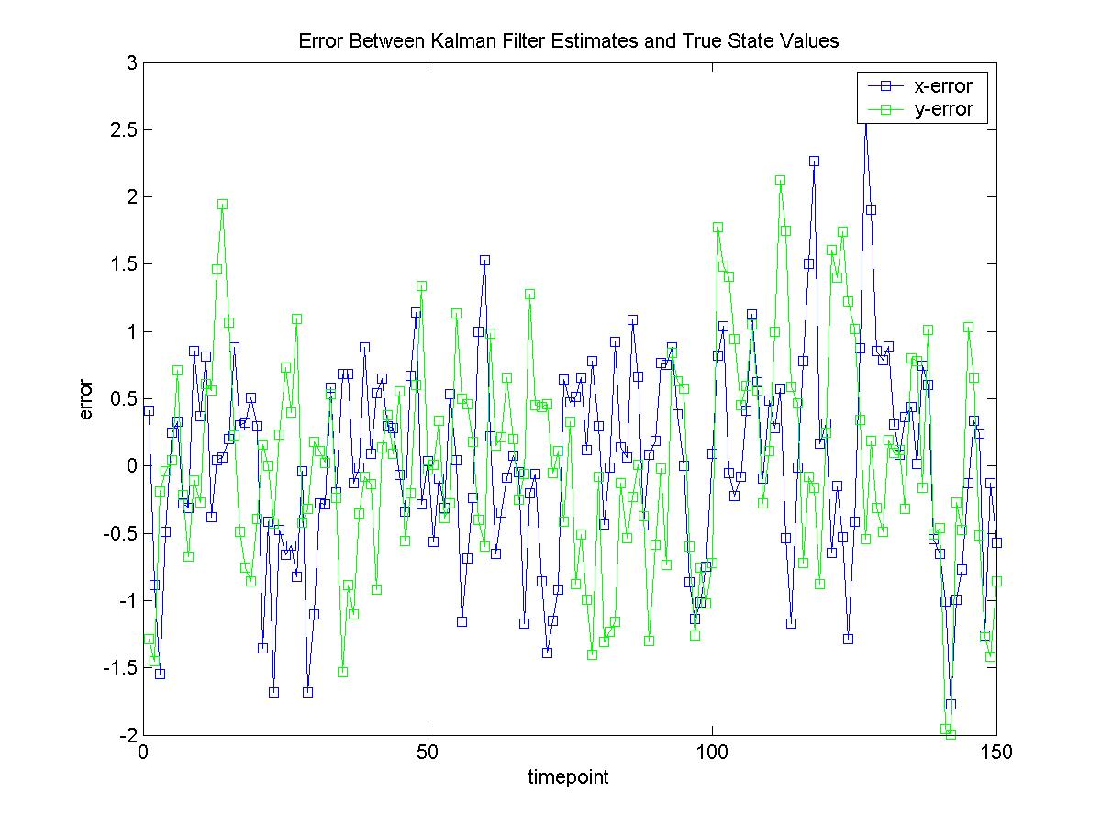

Slide 16
Apply the Kalman Filter to Microarray Data
General Idea:
  Estimate the expression profile x_{k}
  Compare x_{k} to raw data to find the best match
  The matching data point takes time k
The obstacle now is finding a linear model
  For example, what should the n x n matrix A be?
    In the yeast data set n = 500; what are implications of reducing dimensions?
    Want the simplest way to represent overall induction level and change in induction level over time.
  Assumptions of white, Gaussian noise are reasonable

Slide 17
Proposed Scheme
Start Kalman filter from the most well-defined subsequence of the MST-diameter path estimated ordering
Want Kalman filter to “filter” through this partial ordering but “smooth” and/or “predict forward” from its bounds
  Compare these estimated past/future states with the actual measurements

