Slide 1
An Introduction to 3D Geometry Compression and Surface Simplification
Connie Phong
CSC/Math 870
26 April 2007

Slide 2
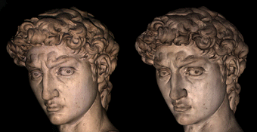
Context & Objective
Triangle meshes are central to 3D modeling, graphics, and animation
  A triangle mesh that accurately approximates the surface of a complex 3D shape contain million of triangles
  This rendering of the head of Michelangelo’s David (left) at 1.0 mm resolution contains 4 million triangles
Transmitting 3D datasets over the Internet can therefore be costly and methods are needed to reduce costs/delays.
  An overview of some basic techniques will be described.
Source: Digital Michelangelo Project

Slide 3
Some Mesh Preliminaries
Geometry
  vertex₁ = (x₁, y₁, z₁)
  vertex₂ = (x₂, y₂, z₂)
  . . .
  vertex_{v} = (x_{v}, y_{v}, z_{v})
Incidence
  Triangle₁ = (vertex₁, vertex₂, vertex₃)
  Triangle₂ = (vertex₁, vertex₂, vertex₄)
  . . .
We limit the discussion to simple meshes—those that are topologically equivalent to a sphere.
An uncompressed representation uses 12v bytes for geometry and 12t bytes for incidence
  Given that t ≈ 2v, 2/3 of the total representation costs goes to incidence
v₄
v₁
t₂
(x₁,y₁, z₁)
(x₂,y₂, z₂)
t₁
v₂
v₃
Notes:
More generally we can say that a mesh has a vertex description if we were to consider the additional information of colors, associated normals, and textures.

Slide 4
Corner Table: A Simple Mesh Data Structure
A naïve approach to storing a triangulated surface is as a list of independent triangles as described by 3 floating point coordinates.
Corner Table explicitly represents triangle/vertex incidence and triangle/triangle adjacency.
G
V O
v₁
v₂
v₃
v₄
x
x
x
x
y
y
y
y
z
z
z
z
t₀ c₀
t₀ c₁
t₀ c₂
t₁ c₃
t₁ c₄
t₁ c₅
1
2
3
2
1
4
7
8
5
9
6
2
2
1
3
3
2
t₀
t₁
5
4
0
4
1
Notes:
These relations are stored to accelerate algorithms that visit the surface in a systematic manner and access the neighbors of each vertex or triangle.

Slide 5
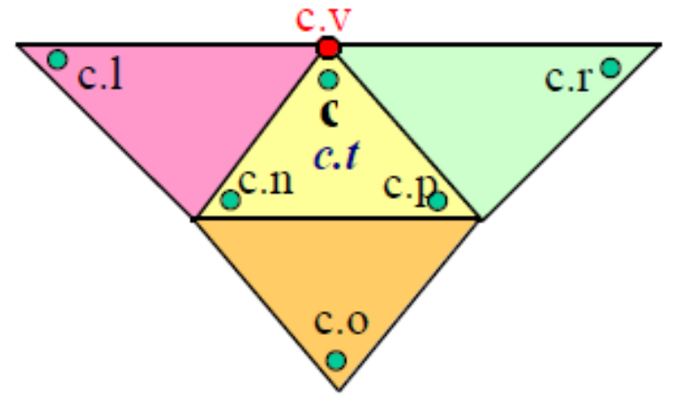
Corner Table: O-table
Corners associate a triangle with one of its vertices.
  Cache the opposite corner ID in the O-table to accelerate mesh traversal from one triangle to its neighbors.
The O-table does not need to be transmitted because it can easily be recreated:
    For each corner a
    do For each corner b
    do if (a.n.v == b.p.v && a.p.v == a.n.v)
    O[a] = b
    O[b] = a
Source: [2]
Notes:
These relations are stored to accelerate algorithms that visit the surface in a systematic manner and access the neighbors of each vertex or triangle.

Slide 6
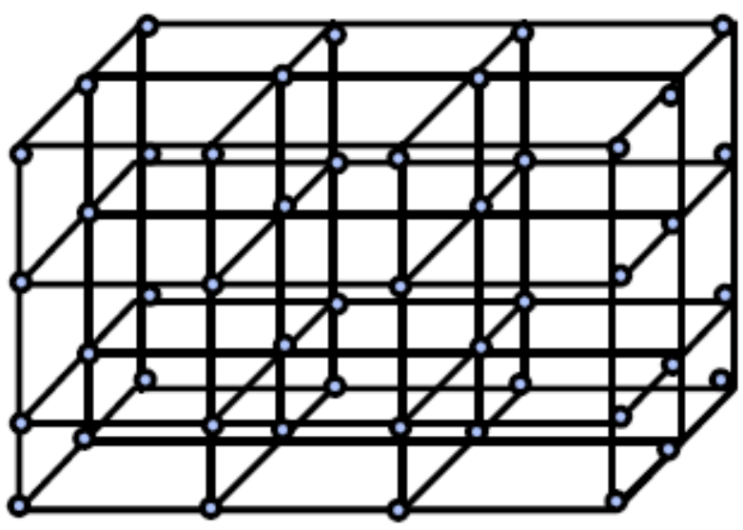
Geometry Compression: Quantization
Vertex coordinates are commonly represented as floats.
  3 x 32 bits per vertex → geometry costs 96v bits
  Range of values that can be represented may exceed actual range covered by vertices
  Resolution of the representation may be more than adequate for the application.
Truncate the vertex to a fixed accuracy:
  Compute a tight, axis aligned bounding box
  Divide the box into cubic cells
  of size s
  The vertices that fall inside a
  given cell are snapped to the
  center
  Resulting error is bounded by the
  diagonal
s
s*2^{B}
Notes:
Quantization addresses the disadvantages of using floats by truncating the vertex to fixed accuracy and thus reducing the storage size while preserving an acceptable geometric accuracy.

Slide 7
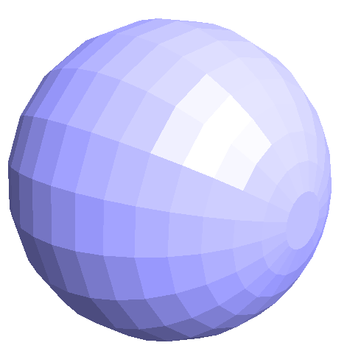
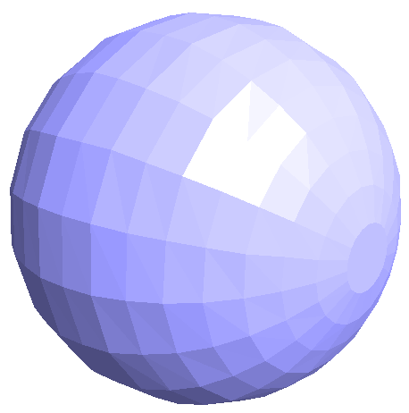
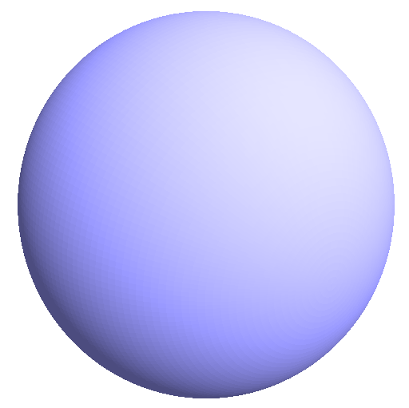
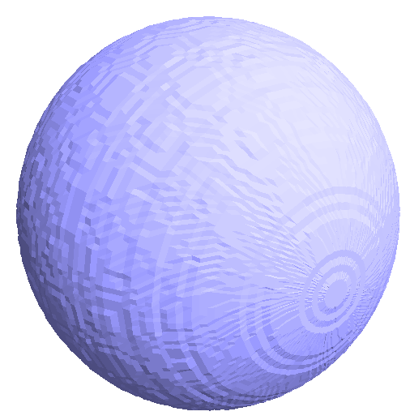
Geometry Compression: Quantization Gains
  The number of bits required to encode each coordinate is less than B.
  Empirically found that choosing B=12 ensures a sufficient geometric fidelity.
Simple quantization step thus reduces storage cost from 96v bits to 36v bits.
original
8 bits/coordinate
original
8 bits/coordinate
Notes:
Quantization addresses the disadvantages of using floats by truncating the vertex to fixed accuracy and thus reducing the storage size while preserving an acceptable geometric accuracy.

Slide 8
Geometry Compression: Prediction
Use previously decoded positions to predict the next positions
  Store only the residue/offset between the predicted and actual positions to cut costs.
  (1008, 68, 718) – (1004, 71, 723) = (4, -3, -5)
  position prediction residue
The parallelogram construction for prediction is the most popular construction for single-rate compression.
  Predict the next vertex’s position based on the previous triangle.
d’
d
d’ = a + b - c
a
b
c

Slide 9
Connectivity Compression: Edgebreaker
Encodes connectivity using at most 2t bits:
  Input: Triangulated mesh
  Output: CLERS string
  Initially define as the active boundary some arbitrary triangle
    Boundary edges are initially those of the triangle
      Uses a stack to temporarily store boundaries
    The gate is defined to be one of the boundary edges
    Both are directed counterclockwise around the triangle
  Then visit every triangle in the mesh by including it in into an active boundary.
Notes:
Connectivity refers to incidence along with adjacency and related order relations.

Slide 10
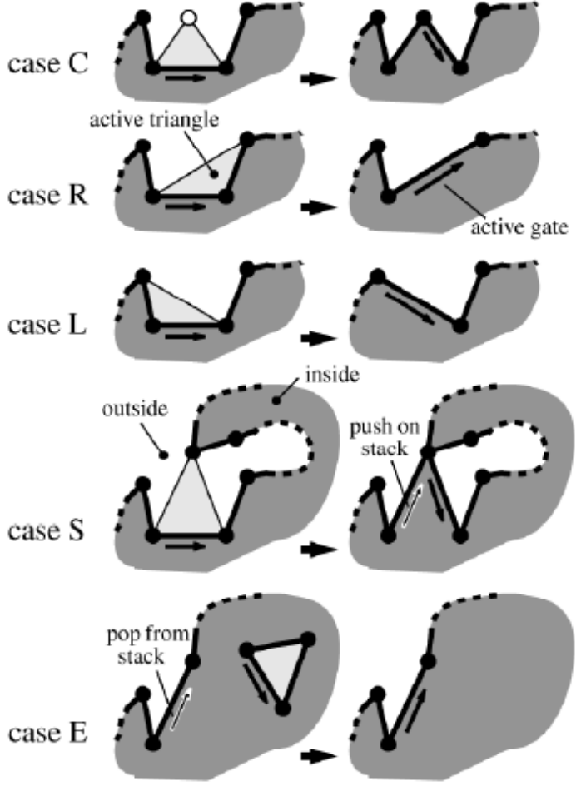
Edgebreaker Operations
5 different operations are used to include a triangle into the active boundary
Source: [3]

Slide 11
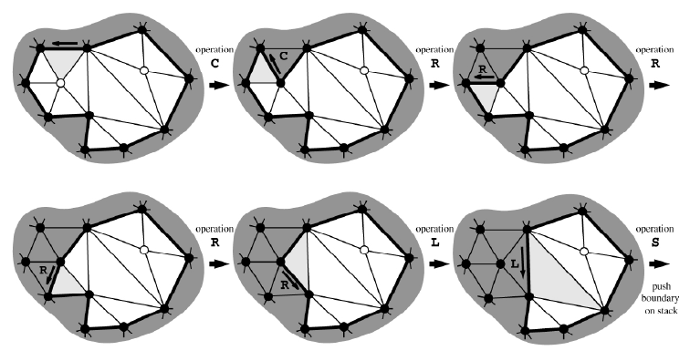
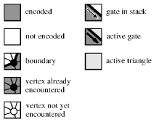
12 Final Operations of Edgebreaker Encoding
Source: [3]

Slide 12
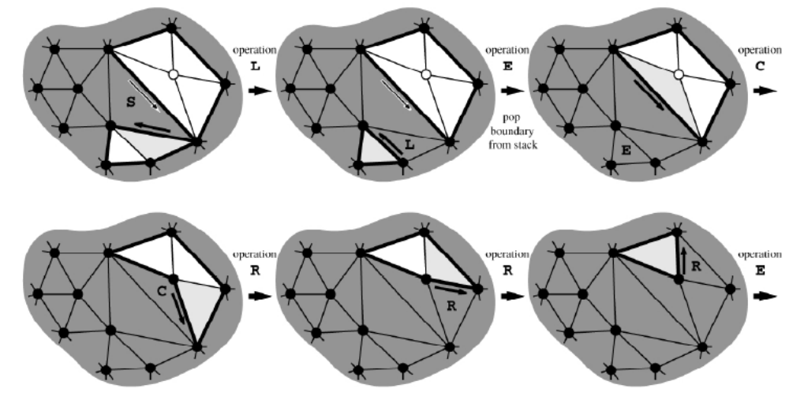
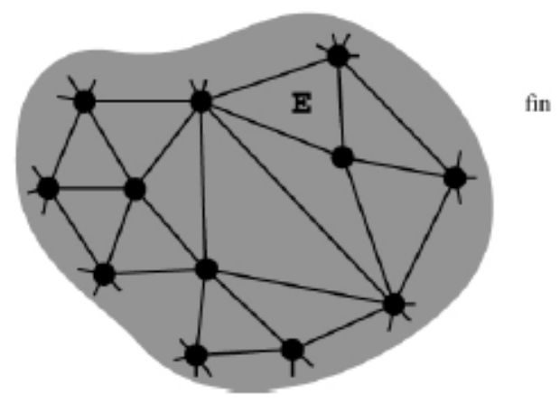
CRRRLSLECRE
Source: [3]

Slide 13
Edgebreaker Encoding: Bottom Line
t = 2v – 4 → 2x more triangles than vertices
  Half of all operations will be of type C
  Thus encode C with one bit and the operations with 3 bits
    C = 0
    L = 110
    E = 111
    R = 101
    S = 100
Thus a simple CLERS string compression guarantees no more than 2t bits for storing the triangle mesh connectivity

Slide 14
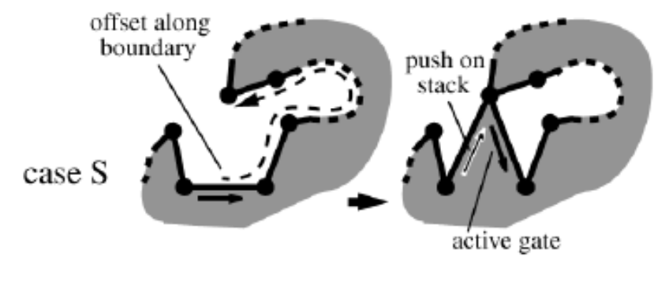
Edgebreaker Decoding
Input: CLERS string
Output: Triangulated mesh
Requires two traversals of CLERS string
  Preprocessing: Compute offset values
  Generation: Re-create triangles in the encoding order
Worst Case: O(n²)
Source: [2]

Slide 15
Surface Simplification
Level-of-details (LODs) refer to simplified models with a reduced number of triangles.
  LODs can be sent initially to avoid transmission delays.
  Refinements that upgrade fidelity can be sent later if needed.
Simplification techniques that reduce the triangle count while minimizing the introduced error are desired.

Slide 16
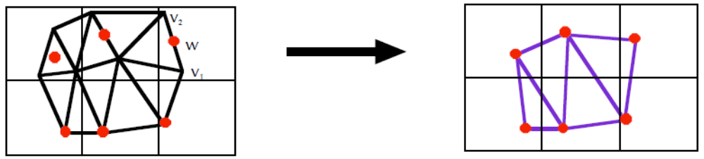
Surface Simplification: Vertex Clustering
Impose a uniformed, axis aligned grid on the mesh and cluster all the vertices that fall in the same cell.
  Render all of the triangles in the original mesh with vertices replaced by a cluster representative
Choosing a representative vertex is non-trivial.
  Preferable to use one of the actual vertices in the cluster.
  Choosing the vertex closest to the average tends to shrink objects.
  Empirically better to choose vertex furthest from the center of the bounding box.
Notes:
Vertex clustering can be thought of as a crude sort of vertex quantization.
More expensive schemes include weighing the vertices based on local curvature and then select the closest vertex to the weighted average.

Slide 17

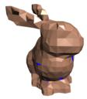
Surface Simplification: Vertex Clustering
The maximum geometric error between the original and simplified shapes is bounded by the diagonal of each cell
Rarely offers the most accurate simplification for a given triangle count
  Grid alignment may force 2 nearby vertices into different clusters and replace them with distant representatives
34,834 vertices
769 vertices
Source: Image- Driven Mesh Optimization
Notes:
Vertex clustering can be thought of as a crude sort of vertex quantization.
More expensive schemes include weighing the vertices based on local curvature and then select the closest vertex to the weighted average.

Slide 18
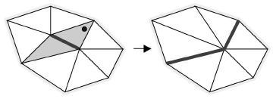
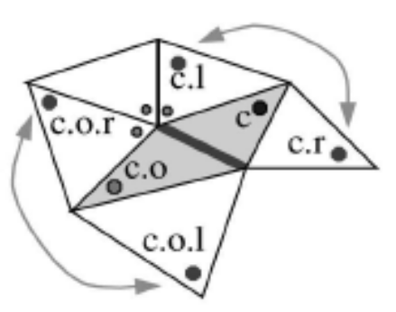
Surface Simplification: Edge Collapsing
Collapsed triangles are easily removed from connectivity graph
Avoid topology-changing edge collapses
Select the edge whose collapse will have the smallest impact on the total error between the resulting mesh and the original surface
  Error estimates must be updated after each collapse
  Use priority queue to maintain list of candidates
Source: [1]

Slide 19
Surface Simplification: Errors
Most simplification techniques are based on a view-independent error formulation.
  E(A, B) = max. distance from all points/vertices p on A to B.
  Yet this is not sufficient since that maximum error may occur inside a triangle and not at the vertices or edges.

Slide 20
Recap
Mesh geometry can be compressed in two steps: quantization and prediction.
The corner table data structure for meshes explicitly represents adjacency relations which can be exploited by algorithms that traverse a mesh.
Edgebreaker is a simple technique that can be used to compress mesh connectivity.
Simplification can further reduce file size, and the two main techniques are vertex clustering and edge collapsing.
All the techniques discussed are “barebones”—there are several optimizing variants.

Slide 21
References
[1] J. Rossignac. Surface Simplification and 3D Geometry Compression. In Handbook of Discrete and Computational Geometry, 2nd edition, Chapman & Hall, 2004.
[2] J. Rossignac, A. Safonova, and A. Szymczak. Edgebreaker on a Corner Table: A Simple Technique for Representing and Compressing Triangulated Surfaces. Presented at Shape Modeling International Conference, 2001.
[3] M. Isenburg and J. Snoeyink. Spirale Reversi: Reverse decoding of the Edgebreaker encoding. Computational Geometry, 20: 39-52, 2001

