Slide 1
Computing the Characteristic Polynomials of Hyperplane Arrangements
CSC 870: Computational Geometry
Eric Etu and Alex Plotitsa
Monday, 11/28/05

Slide 2
Table of Contents
Some definitions
An example in R²
A definition of the problem
Some history
Our implementation
Another example, in R³
Runtime Complexity
Remaining work
What we’ve Learned
References

Slide 3
Definitions
Hyperplane – divides a space in half
Intersection Properties – how the hyperplanes intersect with each other
Meet Semi-Lattice – a graphical representation of the int. properties
Möbius Values – (in a moment)
Characteristic Polynomial – a polynomial that aggregates the Möbius values

Slide 4
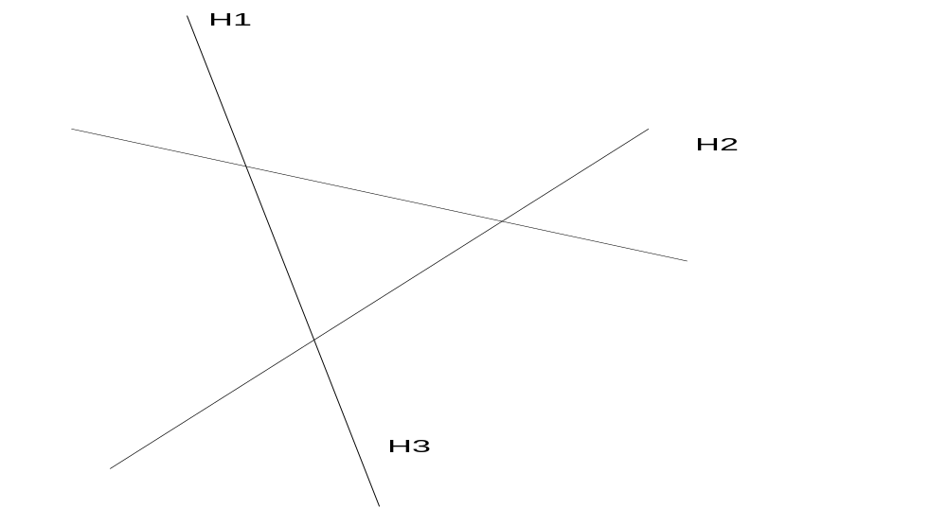
An Example
A common R² hyperplane arrangement:

Slide 5
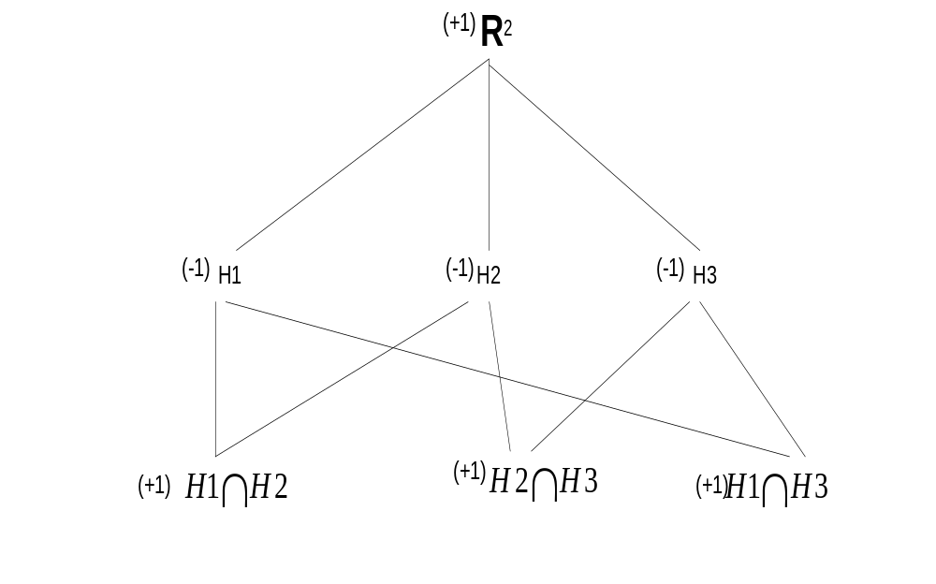
How to create a meet semi-lattice
Computing Möbius values
Computing the characteristic polynomial
Computing the total regions and bounded regions
A (reverse) meet semi-lattice representing the intersection properties of the arrangement, with the Möbius values noted.
Characteristic Polynomial:
X(λ) = t² - 3t + 3
X( -1 ) = 7 total regions
X( +1 ) = 1 bounded region

Slide 6
Definition of the Problem
We have devised an algorithm for computing the characteristic polynomial for any hyperplane arrangement.
Assume: no duplicate hyperplanes
Inputs: the space and the arrangement
Outputs: the characteristic polynomial and the numbers of total regions and bounded regions

Slide 7
History / Background
Jacob Steiner (1826) began researching how to count the number of regions in R2 and R3 hyperplane arrangements.
Thomas Zaslavsky (1975) was able to prove that, that for a characteristic polynomial X, X(-1) = the total number of regions and that X(+1) = the number of bounded regions.

Slide 8
Our Implementation
Equation Vector [2y + 4x – 6 = 0] → (2,4,-6)
Finding the intersections
  Normalizing the equations (2,-4,6) → (1,-2,3)
  Detecting parallel hyperplanes (1,-2,3) & (1,-2,5)
  Solving the equations (1,-2,3) - (1,4,5) = (-6,-2)
Building the semi-lattice
  Arrays of Vectors
  Lots of For loops

Slide 9
Implementation (con’t)
Computing the Möbius values
  Recursing up and down
  “Dirty bits” / Backtracking, using DFS
Calculating the characteristic polynomial and the numbers of total and bounded regions
  (Trivial)

Slide 10
Characteristic Polynomial: t³-4t²+6t-4
Number of Total Regions (t = -1): 15
Number of Bounded Regions (t = +1): 1
µ = -1
µ = -1
µ = -1
µ = -1
µ = 1
µ = 1
µ = 1
µ = 1
µ = 1
µ = 1
BLACK
GREEN
PURPLE
YELLOW
µ = -1
µ = -1
µ = -1
µ = -1
R³
µ = 1

Slide 11
Runtime Complexity
The number of intersections
  An upper bound: There are at most N(N-1)/2, or O(N²) intersections of any N hyperplanes.
  There are D levels of intersections, where D is the number of dimensions.
  The top level contains at most O(N²^{(D-1)}) intersections.
  For each of these (in the worst case), we need to traverse the entire tree, which is O(N²^{D-1}) steps to compute the Möbius values… clearly the rate-limiting step.

Slide 12
Remaining Work
Dealing with 0-coefficients
  Normalization fails… we can’t solve the equations.
  The solution: rotate the entire arrangement!
  Example: [0,1,5] → [sin(Ө),cos(Ө),5]
Skew lines – they don’t intersect in 3-space, but they do intersect when those lines are projected down into 2-space…
Are there actually fewer intersections after the first level? (Can we find a tighter upper bound?)

Slide 13
What We’ve Learned
The actual intersections aren’t important – just the intersection properties. This is why we can rotate.
Even though we chose to eliminate the first variable (the same variable) of each equation when we solved the equations, each new level of intersections cannot be treated as its own hyperplane arrangement. This is the “skew lines” problem.

Slide 14
References
J. Steiner, Einige Gesetze “über die Theilung der Ebene und des Raumes”. J. reine angew. Math. 1 (1826), 349–364.
Matthias Beck, Thomas Zaslavsky, “Inside-out polytopes & a tale of seven polynomials” (UC Davis Combinatorics & Representation Theory Seminar, 2/18/05; University of Kentucky Algebraic Combinatorics Seminar, 4/4/05

