Slide 1

Cutting complete weighted graphs
Math/CSC 870
Spring 2007
Jameson Cahill
Ido Heskia

Slide 2
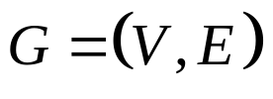

Let be a weighted graph with an
Adjacency weight matrix
Our goal: Partition V into two disjoint sets
A and B such that the nodes in A (resp. B)
are strongly connected (=“similar”) to each other, but we would also like to have that the nodes In A are not strongly connected to the
Nodes in B. (Then we can continue partition A and B in the same fashion).

Slide 3
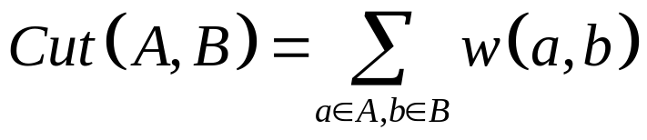
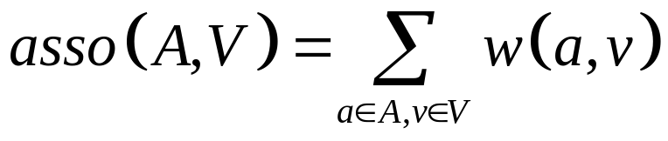
To do this we will use the normalized cut
Criterion:
(We normalize in order to deal with the cuts which favor small isolated sets of points.)

Slide 4
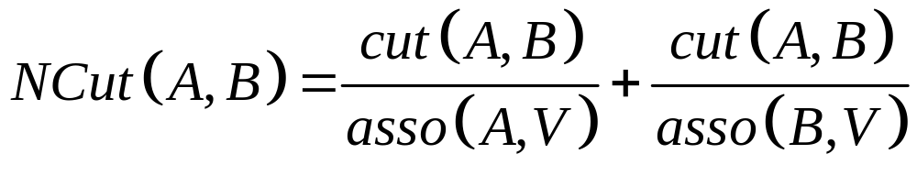

Normalized Cut Criterion:
We wish to minimize this quantity across all
Partitions

Slide 5
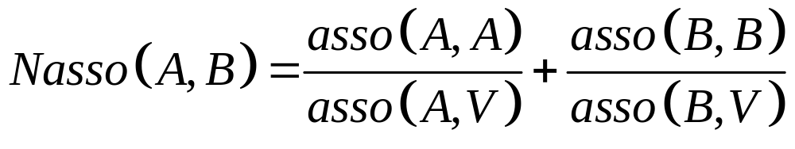
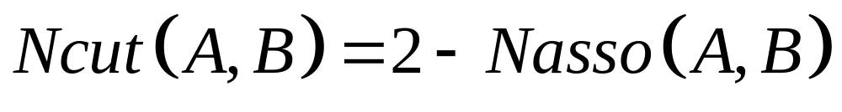
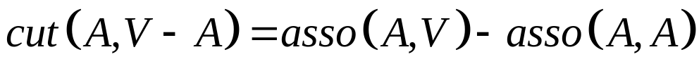
If we let:
Then a straightforward calculation shows
that
(since )
So Minimizing Ncut(A,B) simultaneously
Maximizes Nasso(A,B)!

Slide 6
Bad News:
Prop. (Papadimitrou, `97): Normalized
Cut for a graph on regular grids is NP hard!!
However, good approximate solutions can
be found in O(mn)
(n=# of nodes, m=max # of matrix-vector computations required)
(Use Lanczos Algorithm to find eigen vectors)
(linear programming vs. integer programming)

Slide 7
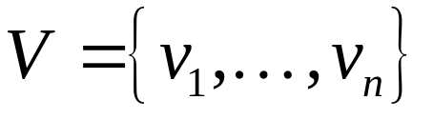
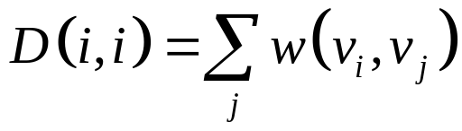

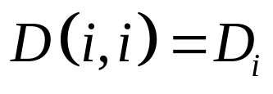
Algorithm:
Input: Weighted adjacency matrix (or data file to weigh into an adjacency matrix).
Suppose
Define a diagonal matrix D by
(the degree Of node i)
For notational convenience we will write

Slide 8
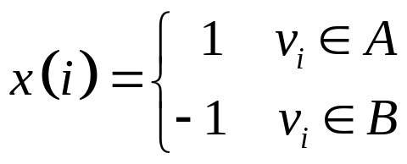
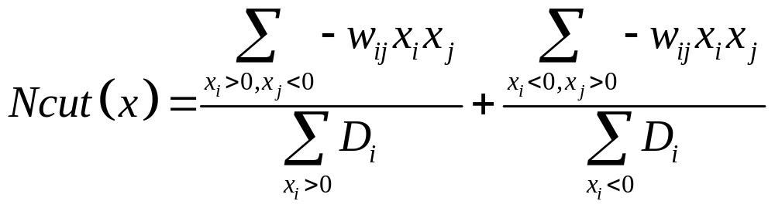
Let x be an nx1 vector where
Now define:
So we are looking for the x vector that
minimizes this quantity.

Slide 9
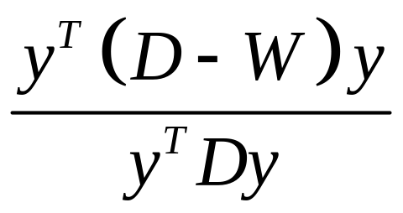
Through a straightforward (but hairy)
calculation, Shi and Malik show that this
Boils down to finding a vector y that
minimizes:
Where the components of y may take on real
Values. This is why our solution is
Only approximate (and not NP hard).

Slide 10
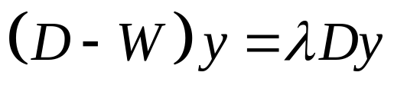
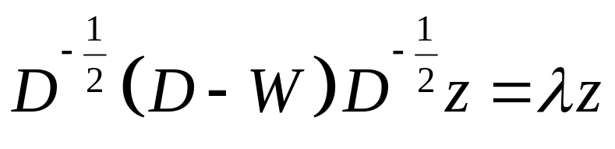
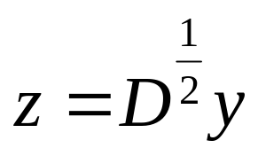
The above expression is knows as a
Rayleigh quotient and is equivalent to finding
a y that minimizes:
Which we can rewrite as:
Where
(Makes sense, since diagonal & pos. entries)

Slide 11
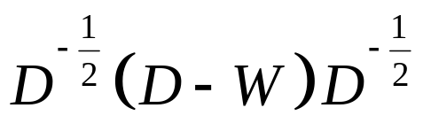
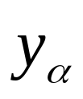

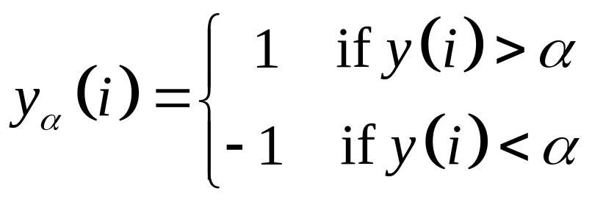
Thus, we just need to find the eigen vector
Corresponding to the smallest nonzero
Eigen value of the matrix
“Thresholding”:
For each we have where

Slide 12
We are using this code for the Normalized cut:
function [NcutDiscrete,NcutEigenvectors,NcutEigenvalues] = ncutW(W,nbcluster);
% [NcutDiscrete,NcutEigenvectors,NcutEigenvalues] = ncutW(W,nbcluster);
%
% Calls ncut to compute NcutEigenvectors and NcutEigenvalues of W with nbcluster clusters
% Then calls discretisation to discretize the NcutEigenvectors into NcutDiscrete
% Timothee Cour, Stella Yu, Jianbo Shi, 2004
% compute continuous Ncut eigenvectors
[NcutEigenvectors,NcutEigenvalues] = ncut(W,nbcluster);
% compute discretize Ncut vectors
[NcutDiscrete,NcutEigenvectors] =discretisation(NcutEigenvectors);

Slide 13
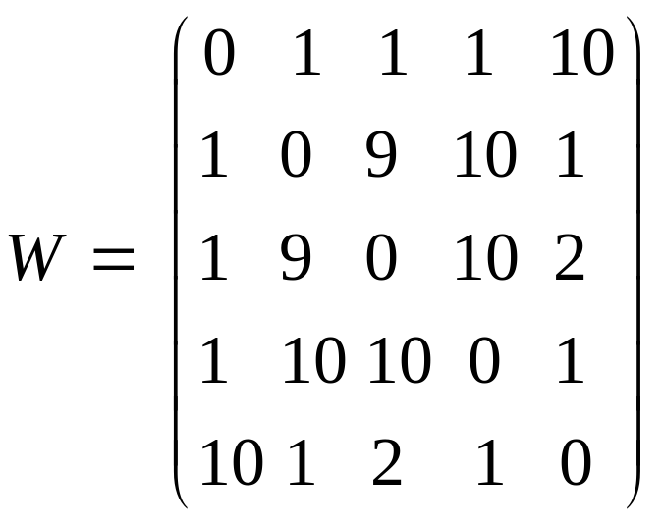
Example: Cutting a K5 graph.
W: Pair-wise similarity matrix
Change all weights into 0 and 1 in order to Draw the graph (for matlab). – but bad output for large number of nodes) – drawgraph(garden).bmp ← only 400 vertices
Transform indicator matrix into adjacency matrix in order to graph. (adjancy_2.m)
Load: Desktop\cluster\cluster\matgraph\matgraph\
\example.fig
run: load Example.txt; drawgraph(Example); drawgraph_2(Example)

Slide 14
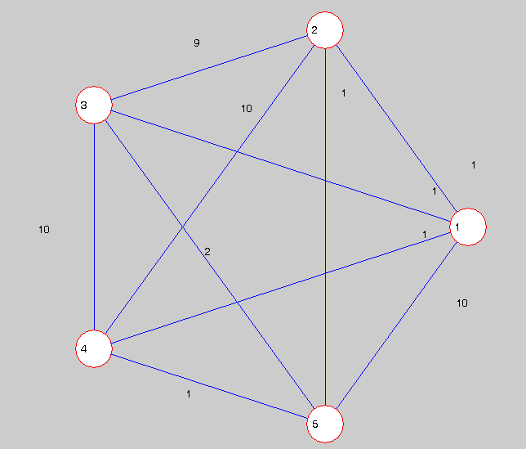
Example.fig

Slide 15
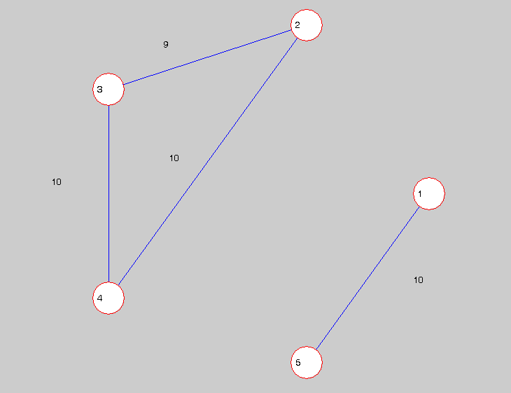
Cut Example:

Slide 16
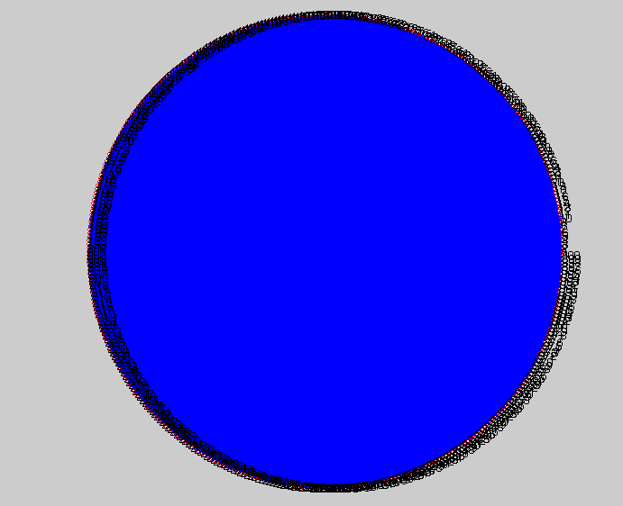
Bad output format for many nodes (here’s example for just 400 nodes and 79,800 edges):

Slide 17
Let’s Cut the Forest…
Tropical Rain Forest
Pasoh Forest Reserve, Negeri Sembilan, Malaysia.
Complete survey of all species of trees for each 5x5 meter square.

Slide 18
The Data File: (cluster\bci5\bci5.dat)
20,000 rows, 303 columns.
1st 2 columns are x,y coords.
301 columns of species.
Every 100 rows, x incremented.
200x100 squares each is a 5x5
meters. (1000x500 meter forest)

Slide 19
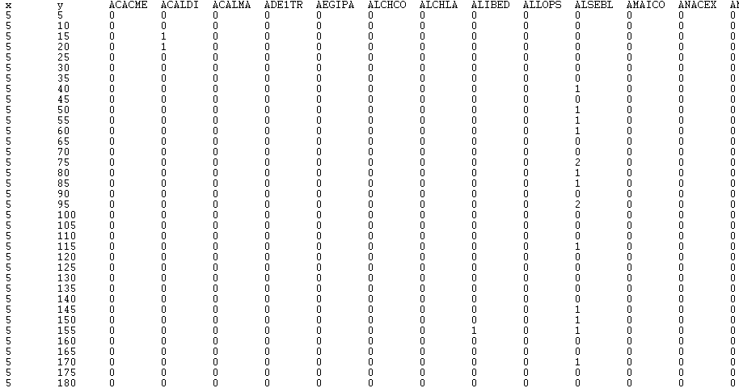
A piece of the data file:

Slide 20
Model
Each square is a node (vector of coords and 301 species).
Create an adjacency matrix and the
weight w(i,j) Quantifies how “similar”
the nodes are.

Slide 21
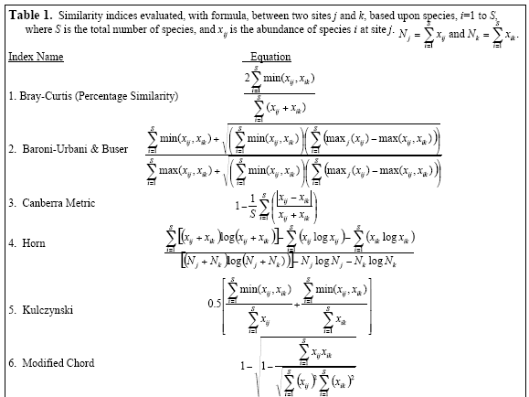
Similarity indices
Pick your favorite weighting function:
Weight_1.m
Weight_can.m
Source: [7]

Slide 22
Trying to weigh a 20,000x20,000 matrix
takes a really long time!!!
So we decided between 2 options
(until finding a REAL machine):
Cut a much smaller piece.
+(learn about presenting output)
2) Change the “resolution”.
+(cut the whole thing)

Slide 23
Cutting a smaller piece (a garden)…
Change the original data file to 400 rows
(nodes) instead of 20000.
By the way the rows are ordered can’t
just take the first 400 rows (otherwise
you get a thin strip of 100X4 squares).
Take 20 rows and jump by 80 rows until
you get 400 rows). (littleforest.dat)

Slide 24
Result:
(load garden.txt) or littleforest+weigh+diagonal
cut_garden = Ncutw(garden,2)
[p1,p2]=firstcut(garden) (coords vector 400x2)
[v1,v2]=vector(p1)(1 vector rep. row, 2nd vector rep. column)
[v3,v4]=vector(p2)
Scatter(v1,v2,’b’), hold on, scatter(v3,v4,’m’)

Slide 25
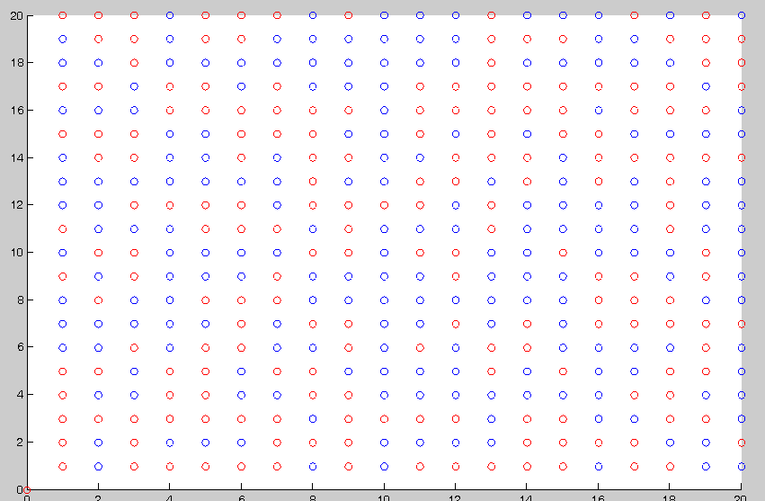
2 regions:

Slide 26
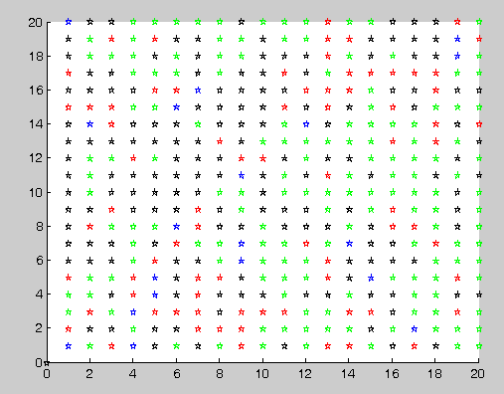
Four regions (using different weighting function):

Slide 27
reweigh_3(cut_garden,garden) – 4 regions
[a1,a2,a3,a4,a5,a6,a7,a8] = reweigh_3(Cut,weighted_matrix)
So we can make it work for 20x20.
Quite easy to generalize it, so number
of regions is a parameter. Now we
wanted to cut the whole forest and
analyze our results.

Slide 28
2) Change of resolution
In-stead of looking at 5x5 squares, we
can look at a 10x10 meter square (not
so bad resolution) and cut the whole
forest?
So we’ll have a 5,000x5,000 matrix.
From original file: add any 2 consecutive
Rows and basically jump by 100 to add next row (resolution.m)

Slide 29
Weighting takes only a few hours now, but the RAM fails to deliver!
Can’t keep the 5,000x5,000 matrix
and do operations on it.
(just changing diagonal to 0 takes a
long time). (A.txt)
Still can’t cut it – get memory errors!!!
(can’t even perform the check for symmetry of matrix)

Slide 30
Sensitivity analysis/other stuff to do
Somehow cut the whole forest.
Compare the cuts we get with the
original data.
Do the regions indeed consist of similar nodes?
Which weight function gave us
the “best” cut (compared to the actual data)?

Slide 31
Average out the regions, and see if
they are really different than the other
Regions.
After deciding what was the best cut, we want to start “throwing off data” (change resolution for example)
And see how far from the desired cut
we get (next survey, how accurate should it be?)

Slide 32
Assuming our results are “good”:
Take another look at the data file.
Anything special about it that made it
Possible to apply image segmentation
Techniques on it?
What properties of the data file made it
“segmentable” using this method?

Slide 33
References:
[1] IEEE Transactions on patterns analysis and machine intelligence vol. 22 no. 8
Normalized cuts and Image Segmentation.
By Jianbo Shi and Jitendra Malik
[2] Fast Multiscale Image Segmentation.
By Eitan Sharon, Achi Brandt and Ronen Basri.
[3] Nature
Hierarchy and adaptivity in segmenting visual scenes.
By Eitan Sharon, Meirav Galun, Dahlia Sharon, Ronen Basri and Achi Brandt

Slide 34
[4]Tutorial Graph Based Image Segmentation
Jianbo Shi, David Martin, Charless Fowlkes, Eitan Sharon
http://www.cis.upenn.edu/~jshi/GraphTutorial/Tutorial-ImageSegmentationGraph-cut1-Shi.pdf
[5]Normalized Cut image segmentation and data clustering MATLAB code
http://www.cis.upenn.edu/~jshi/
[6]Scale dependence of tree abundance and richness in a tropical rain forest, Malaysia.
Fangliang He, James V.LaFrankie Bo Song
[7] Choosing the Best Similarity Index when Performing Fuzzy Set Ordination on Abundance Data
Richard L. Boyce

