Slide 1

Finding Reduced Basis for Lattices
Math/Csc 870
Ido Heskia

Slide 2
Introduction
Due to:
A.K. Lenstra
H.W. Lenstra
L. Lovasz
LLL Algorithm

Slide 3

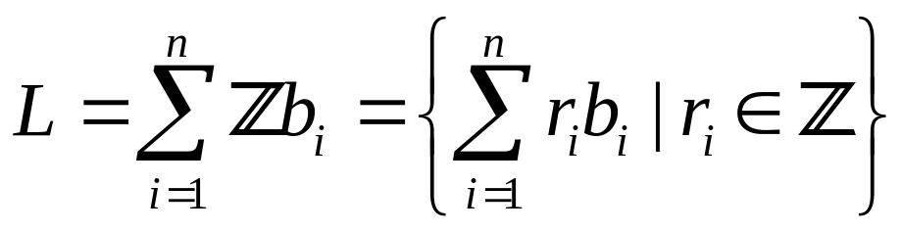
A Lattice
1.
2.

Slide 4


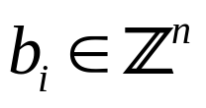
Let n be a positive integer. A subset L of the n-dimensional real vector space is
called a lattice if there exists a basis b1,b2,…,bn of such that
The bi’s span L.
n is the rank of L.
We will consider only

Slide 5
Constructing lattices:

Slide 6
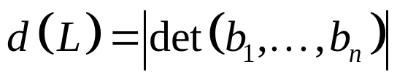
Determinant of L:
The bi’s are written as column
vectors. Apparently, this positive
real number doesn’t depend on the
choice of the basis.

Slide 7
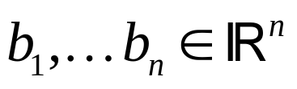





Let be linearly independent. Suppose it is a basis for
We perform the Gram-Schmidt process:
b2
b2
0
0
L
b1
0

Slide 8
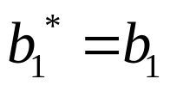

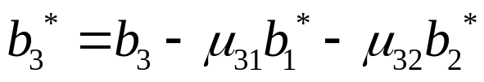
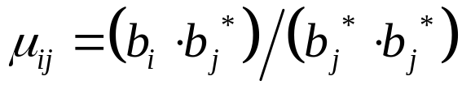

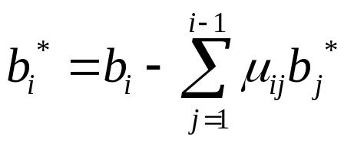
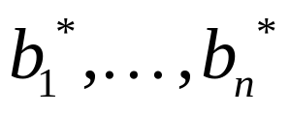
Similarly, define:
Dividing by shortens our vectors.
Forms an orthogonal basis of L

Slide 9
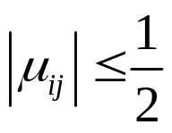
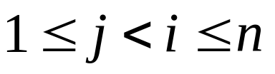
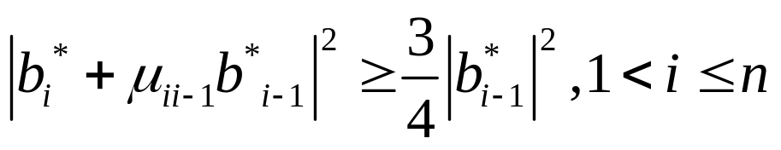
A basis b1,..,bn of a lattice is called reduced if :
for
* ¾ can be replaced by any ¼<y<1
* | | is Euclidean length.

Slide 10
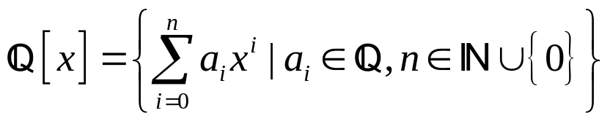
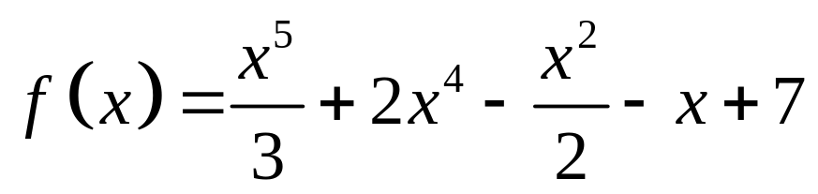
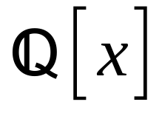
Applications
Factoring polynomials with rational coeffecients
For example:
Lives in

Slide 11

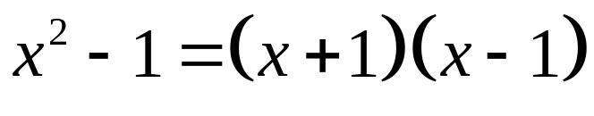
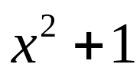
An irreducible polynomial over a field is
non-constant and cannot be
represented as the product of at-least 2
non-constant Polynomials.
Reducible (over ):
Irreducible:

Slide 12

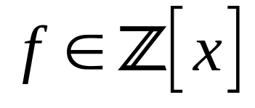
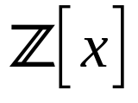
How to find, for a given non-zero
polynomial in its decomposition into
Irreducibles?
Factor primitive polynomials
(gcd of all coeffecients of f is 1)
Into irreducible factors in
Use LLL

Slide 13





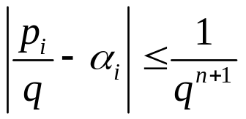
Simultaneous Diophantine approximations
Given , and
Find such that:
Or

Slide 14

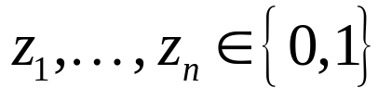
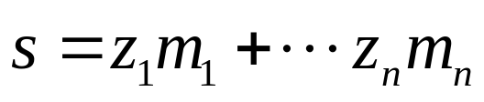
Cryptography
For given positive
Do there exist such that:
(is s a subset sum of the mi’s)?

Slide 15
Sums of squares
Every prime that is 1mod4 can be
written as sum of two squares.
Those squares are found using LLL

Slide 16

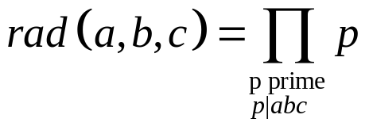
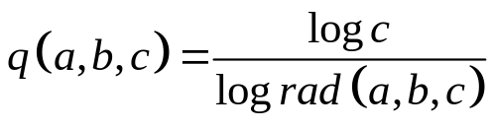
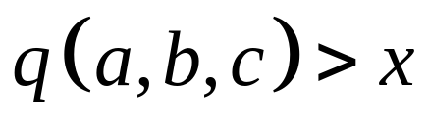
abc Conjecture
For define the radical
(That’s the product of distinct prime factors of a,b,c). suppose gcd(a,b,c)=1.
abc conjecture: For every x>1 there exists only finitely many a,b,c with gcd(a,b,c) = 1 and a + b = c such that
The search for examples uses LLL

Slide 17

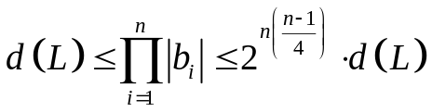
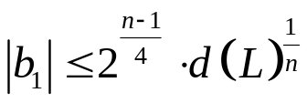
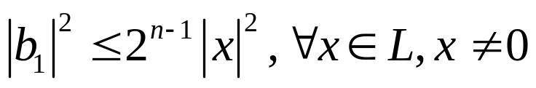
Reduced basis, what is it good for?
Proposition:
B1,bn are reduced basis for a lattice L in b1*, bn* defined as before. Then:
1.
2.
3.
4.
(i.e. the 1st vector is “reasonably” short).

Slide 18
Algorithm.doc
Example.doc

Slide 19
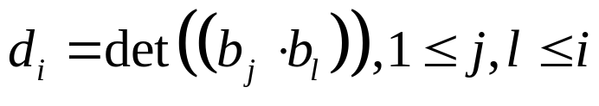
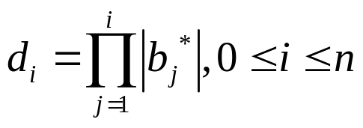
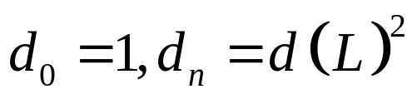
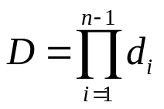


Algorithm terminates:
so each is a pos. real number
D changes only if some bi* is changed, which only occurs at case 1 of the algorithm. The number is reduced by a factor of ¾ since is, while the other
di’s are unchanged. Hence D reduced by factor of ¾ .

Slide 20
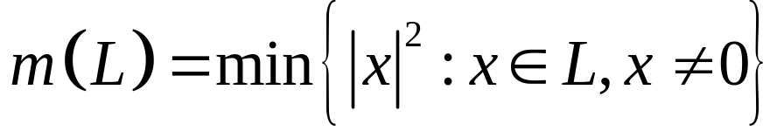
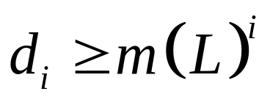
di’s are bounded from below which bounds D from below.
So there’s an upper bound for # of times we pass through case 1.

Slide 21

In end of case 1, k = k-1
End of case 2, k = k+1
Start with k = 2, and
So # of times we pass through case 2
Is at most n-1 more than the # of times we pass through case 1,
Hence the algorithm terminates.

Slide 22

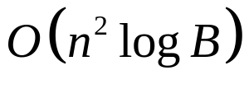



Complexity:
Initialization step with rationales:
# of times pass through case 1:
# of times pass through case 2:
Case 1 requires operations
Case 2 we have values of p
Each requires operations

Slide 23
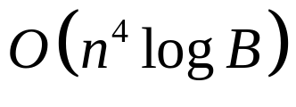
Hence we get a total of
Operations.
Polynomial Time.

Slide 24
References:
Factoring Polynomials with Rational Coeffecients
-- A.K. Lenstra, H.W. Lenstra, Jr. and L. Lovasz
A Course in Convexity
-- Alexander Barvinok
Lattice Basis Reduction Algorithms and Applications
-- Matthew C. Cary
Some Applications of LLL
-- http://www.math.ru.nl/~bosma/onderwijs/voorjaar07/compalg8.pdf
Linear Algebra with Applications
-- Otto Bretcher
Lattices
-- www.cs.tau.ac.il/~safra/ACT2/Lattices.ppt

