Slide 1
Cutting complete weighted graphs
Math/CSC 870
Spring 2007
Jameson Cahill
Ido Heskia

Slide 2
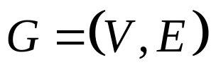
Cutting Complete Weighted Graphs
In image segmentation in computer vision the goal is to divide the image into regions which are similar in the properties of the pixels.
Image is a weighted graph
Nodes are the pixels. Each pixel has a vector associated to it
Containing the data about the properties of the pixel (texture, color, intensity, etc).

Slide 3
Image segmentation: basic model
We start with a complete graph (an edge between every 2 nodes)
The weight of the edge w(i,j) corresponds to the similarity
between nodes i,j. The more the nodes are “similar” the higher
the weight that is associated to the edge joining them.

Slide 4
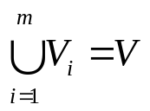
Goal:
Partition V into disjoint sets of nodes V₁,…, V_{m}
In such a way that the similarity between the nodes in each set V_{i} is high and across different sets Vi,Vj is low.
We partition the nodes, so that
However, we are about to lose edges, since we are cutting our graph.

Slide 5
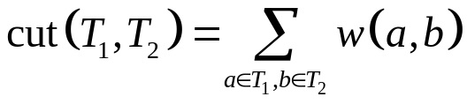
Cutting graphs
T₁
T₂
A
7
X
5
1
2
6
4
B
3
C
4
Z
Y
We could cut this graph by removing the edges (A,X)
and (C,Y) whose weights are 7 and 4 respectively.
The
In this case it is
+
=11

Slide 6

So we can partition by removing edges that connect 2 components.
To make sure the regions are indeed different we’re looking for edges
whose weight is low, so we wish to minimize the total weight of the
edges that have been removed.
Minimize the cut
Unfortunately, it is not that simple.
Example:

Slide 7
Imagine that there are weighted edges between each pair of nodes.
Assume that the similarity between nodes in this case is simply their
Euclidean distance from each other so the weights of the edges between
close nodes is high. We want to bipartition this graph.
Bad cut
Best cut
Since we are simply minimizing the cut, we will actually pick the bad cut in this case since any edge we add on to the cut increases it.
We must Normalize this cut!

Slide 8
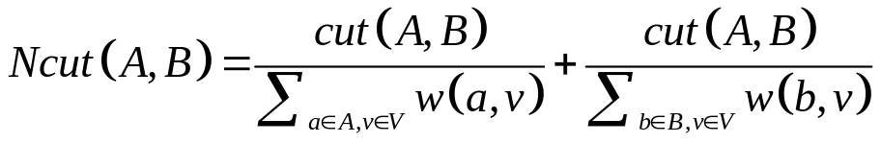
Normalized cuts
Calculate the cut as a fraction of the total edge connections from the
set to the rest of the graph to exclude cuts of small isolated
Components, called the Ncut.
→ disassociation measure.
Now the previous cut which favors small isolated sets won’t have low
Ncut value since it will be a large percentage of the total connections
From that set to all other nodes (in the previous example it will be 100%).

Slide 9
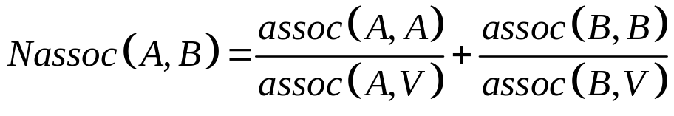

Normalized association
The measure for similarity between sets of nodes (Nassoc):
Where
This gives us the measure of how closely related (on
average) nodes within the set A are, relatively to their
similarity to the rest of the nodes in the graph.

Slide 10
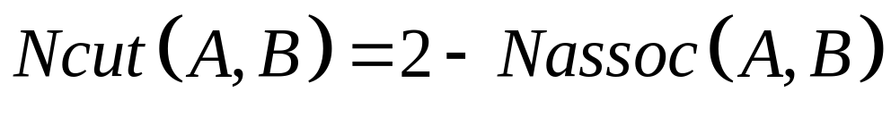
We have this relationship between these measures:
Thus, when we try to minimize the Ncut we also
maximize the Nassoc and we indeed make sure that
the two requirements we imposed on our partition of
the nodes will be satisfied.
Now we could apply this to our complete graph, and
continue recursively on each component until we get
Our desired m components.

Slide 11
What’s the plan
We plan to study an algorithm inspired by algabraic multi-grid which involves the normalized cuts.
Basics of the segmentation by weighted aggregation (SWA) algorithm:
We are treating our graph as a grid graph, starting from the most
Refined grid, and we coarsen it at each step.
First choose ½ your nodes as representatives (called seeds).
Choose those so that each node in your graph is “strongly”
connected to at-least one seed adjacent to it.

Slide 12
Aggregation
Now we will aggregate all the nodes which are strongly
coupled to a seed, to that respective seed, so that we
eliminate a big amount of the nodes. Now each node
Corresponds to an aggregate of pixels, not just a single one.
Recalculate the aggregate properties.
Recalculate the edges weight accordingly.
Now apply the same to the seeds.

Slide 13
This process only keeps tracks of what are the different regions.
In order to find the actual boundaries, we will have to retrace our steps.
So what do we want to do?

Slide 14
First we want to understand the SWA algorithm and write a Matlab
Code which performs it.
We will test our code trying to segment images.
If we can make that happen then we would really like to
Segment a Forest
Each node corresponds to a square of land, and the vector
Associated with it records which species of plants are in this
square.
Similarly to image segmentation, we want to partition the forest
into regions which our similar in the species of plants which they
consist of.

Slide 15
Refrences:
IEEE Transactions on patterns analysis and machine intelligence vol. 22 no. 8
Normalized cuts and Image Segmentation.
By Jianbo Shi and Jitendra Malik
Fast Multiscale Image Segmentation.
By Eitan Sharon, Achi Brandt and Ronen Basri.
Nature
Hierarchy and adaptivity in segmenting visual scenes.
By Eitan Sharon, Meirav Galun, Dahlia Sharon, Ronen Basri and Achi Brandt

