Slide 1
Periods of Degree-2 Ehrhart Quasipolynomials
Christopher O’Neill and Anastasia Chavez

Slide 2
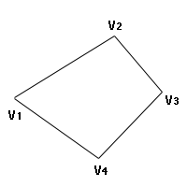
Polytopes
Vertex Description: P = conv{v1, ... , vn}
Hyperplane Description: P = P(A, z)
These two definitions are equivalent
P is integral if vertices are integers
P is rational if vertices are rational

Slide 3
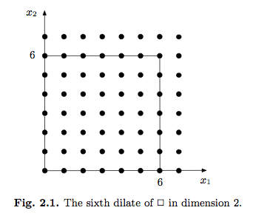
Counting Lattice Points
Lattice Points = Integer Points
Counting integer points inside a polytope

Slide 4
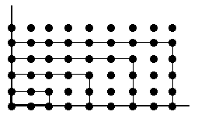
Dilates of Polytopes
Dilate: scale each vertex
P = conv{(0,0), (0,2), (2,1), (0,1)},
2P = conv{(0,0), (0,4), (4,2), (0,2)},
3P = conv{(0,0), (0,6), (6,3), (0,3)}, ...
Lp(t) = # integer points in tP

Slide 5
Properties of Lp(t)
P is integral => Lp(t) is a polynomial
P is rational => Lp(t) is a quasipolynomial
Lp(t) = C2(t) * t^2 + C1(t) * t + C0(t)
In both cases, deg(Lp(t)) = dim(P)

Slide 6
Our Project
Consider rational polygons (dim(P) = 2)
Fact: for rational polytopes, C2(t) = C2
Consider the periods of C1(t), C0(t)
Which period combinations (p1, p0) can happen?

Slide 7
Steps to Take
Study the paper “The Minimum period of the Ehrhart Quasi-polynomial of a Rational Polytope” by T. McAllister and K. Woods
Learn to use LattE
Implement an algorithm that calculates Lp(t) for rational polygons

