Slide 1
Site Recognition on Protein Structures using Alpha Shapes
Research Project Midterm Report
CSC 870, Spring 2007
Philipp Richter
Undergraduate Student

Slide 2
Alpha Shapes - Recap
What is an Alpha Shape?
  It is a Triangulation of a Point Set (here: 3 dimensional)
  It is used to model the surface of a point set
  APPLET

Slide 3
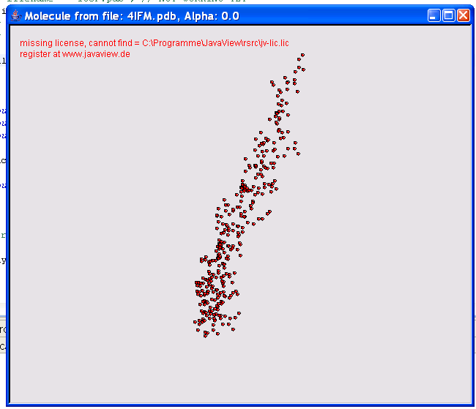
Alpha = 0.0 (no triangulation)

Slide 4
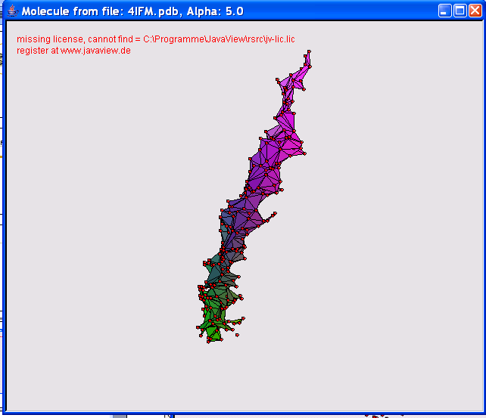
Alpha = 5.0

Slide 5
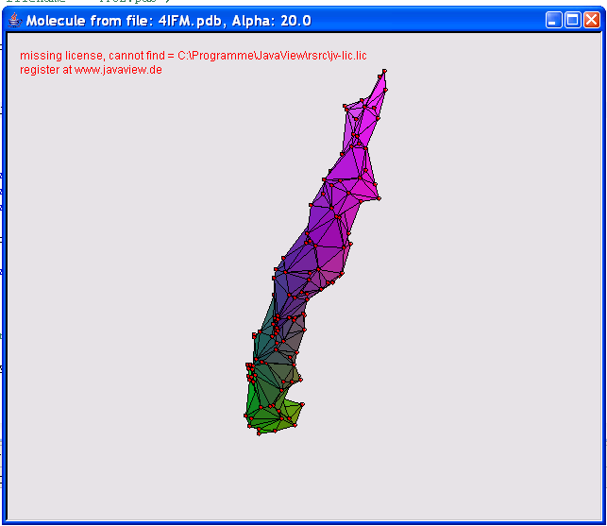
Alpha = 20.0

Slide 6
Site Recognition - Introduction
What is a site on a protein?
  A 3 dimensional region on the surface of a protein with a functional role
Why are sites important?
  Because a lot information about the function of the protein can be derived from its sites

Slide 7
Site Recognition - Introduction
So what exactly do we like to recognize?
  Binding sites that look like pockets or clefts in the surface of the protein

