Slide 1
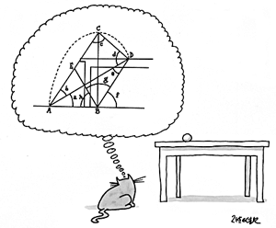
Quadtrees and Mesh Generation
Student Lecture in course MATH/CSC 870
Philipp Richter
Thursday, April 19th, 2007

Slide 2
Content of Lecture
Motivation
Introduction to Meshes
Introduction to Quadtrees
Generating Meshes using Quadtrees
Looking further

Slide 3
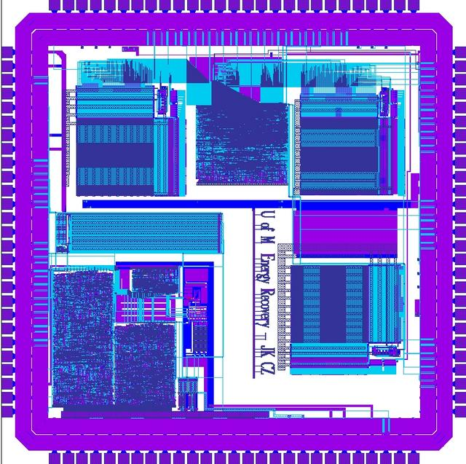
Motivation
We will start in the context of VLSI layouts
Definition: Very-large-scale integration (VLSI) is the process of creating integrated circuits by combining thousands of transistor-based circuits into a single chip.
A VLSI layout of a chip

Slide 4
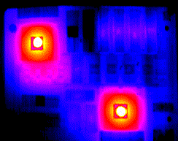
Motivation
We will start in the context of VLSI layouts
Common Problem in VLSI layout design:
Because components are very close together and emit heat, there is the possibility that they influence each other. This can be very hazardous to the function of the chip and can even result in its destruction.
Infrared thermal image of a chip

Slide 5
Motivation
We will start in the context of VLSI layouts
There are different ways to solve the problem:
Earlier, engineers built a prototype of the chip and then measured the heat emission. Of course, this takes time and money.
Today, given modern computing power and knowledge, we can simulate the heat process using finite-element-methods.

Slide 6
Motivation
We will start in the context of VLSI layouts
Finite-element-methods involve subdividing the chip surface in small elements and then assigning a heat emission value to each. It is assumed to be known how neighboring elements influence each other.
It is a numerical process that requires the elements to have a triangular shape with angles not below 45° to provide a fast convergence.

Slide 7
Introduction to Meshes
In our application we seek a triangular mesh.
We limit our discussion to the following input:
It is a square with disjoint polygonal components inside (called the domain)
The square has vertices at (0,0), (0,U), (U,0), (U,U), where U is a power of 2
Coordinates of the components are integers between 0 and U
Orientation of component edges is limited to 0°, 45°, 90° and 135°

Slide 8
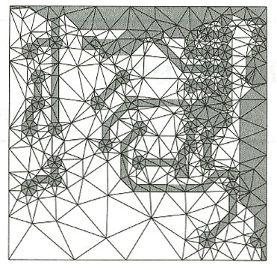
Introduction to Meshes
In our application we seek a triangular mesh.
A mesh on some input data

Slide 9
Introduction to Meshes
In our application we seek a triangular mesh.
Now our goal is to compute a triangular mesh of the input with the following properties:
Mesh must be conforming: a triangle must not have vertices of other triangles in the interior of one of its edges
Mesh must respect the input: edges of the components must be contained in the mesh
Mesh triangles must be well-shaped: angles of the triangles must be between 45° and 90°
Mesh must be non-uniform: it must be fine near the edges of the components and coarse far away

Slide 10
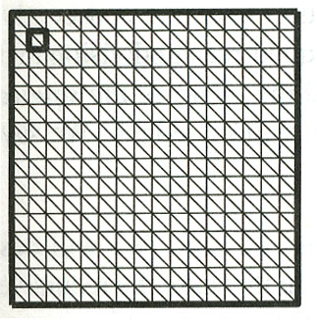
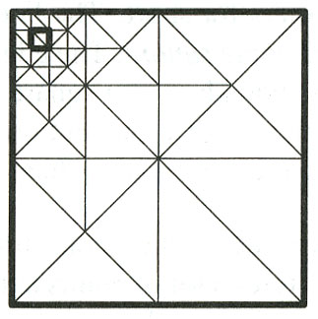
Introduction to Meshes
In our application we seek a triangular mesh.
uniform mesh
non-uniform mesh

Slide 11
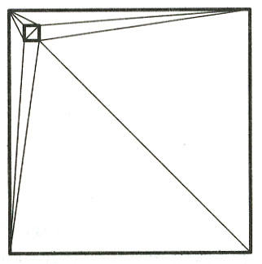
Introduction to Meshes
In our application we seek a triangular mesh.
Why not use a Delaunay Triangulation? It could yield triangles that are not well shaped because in a triangulation we are only allowed to use the input vertices. In a mesh, we can add so called Steiner Points that help us getting a mesh with our desired properties.
delaunay triangulation

Slide 12
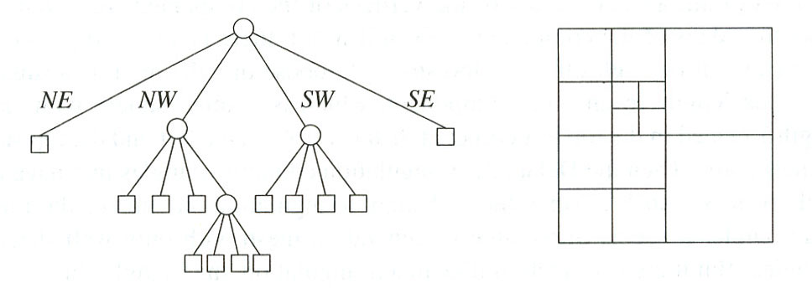
Introduction to Quadtrees
We will see later that these are at the very heart of our Mesh generation method.
Definition: A Quadtree is a tree data structure in which each internal node has up to four children. Every node in the Quadtree corresponds to a square. If a node v has children, then their corresponding squares are the four quadrants of the square of v.
Quadtree

Slide 13
Introduction to Quadtrees
We will see later that these are at the very heart of our Mesh generation method.
Definition: The leaves of a Quadtree form a Quadtree Subdivision of the square of the root.
Definition: The children of a node are labelled NE, NW, SW, and SE to indicate to which quadrant they correspond; NE stands for the north-east quadrant, NW for the north-west quadrant, and so on.
Definition: The four vertices at the corners of each square are called corner vertices or corners.

Slide 14
Introduction to Quadtrees
We will see later that these are at the very heart of our Mesh generation method.
Definition: Line segments connecting corners are called sides of the square
Definition: Line segments contained in the boundary of a square are called edges of the square.
Therefore each side contains at least one edge.

Slide 15
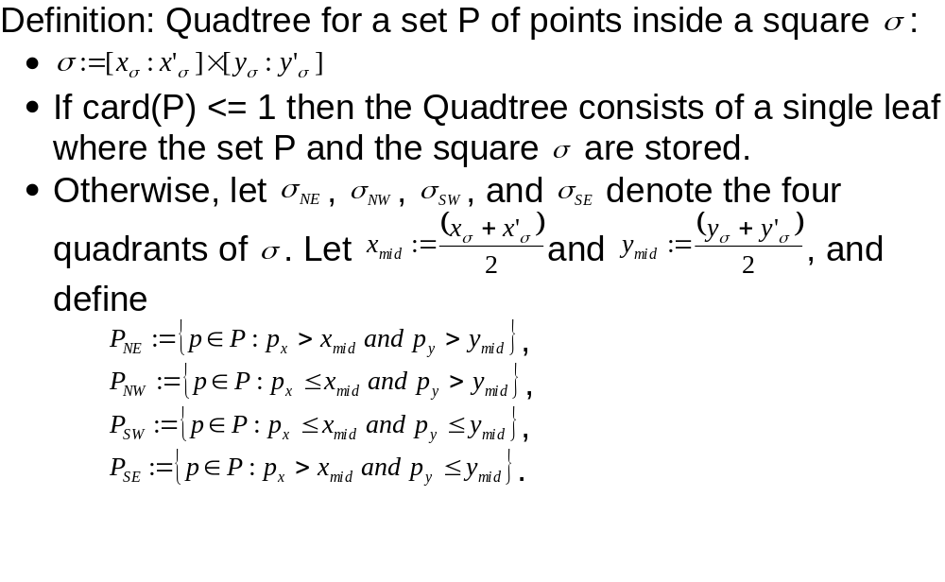
Introduction to Quadtrees
We will see later that these are at the very heart of our Mesh generation method.

Slide 16
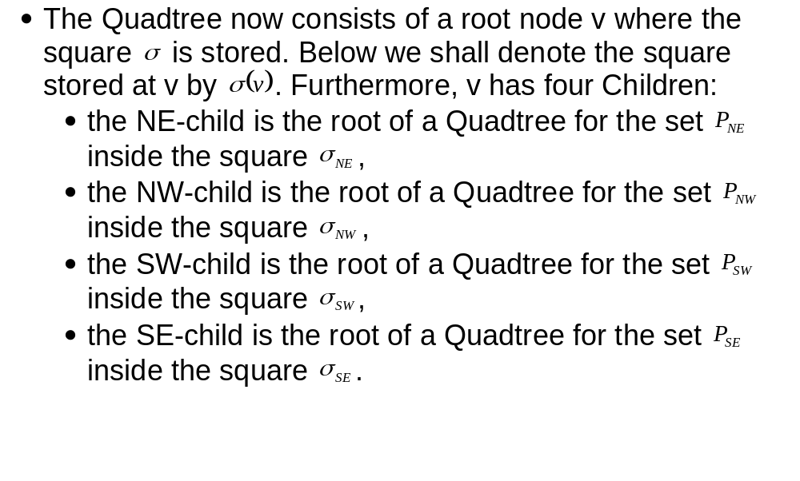
Introduction to Quadtrees
We will see later that these are at the very heart of our Mesh generation method.

Slide 17
Introduction to Quadtrees
We will see later that these are at the very heart of our Mesh generation method.
A recursive algorithm is immediately given by the definition: split the current square into four quadrants, partition the point set accordingly, and recursively construct Quadtrees for each quadrant with its associated point set.
http://www.cs.wustl.edu/~suri/cs506/projects/quad.html

Slide 18
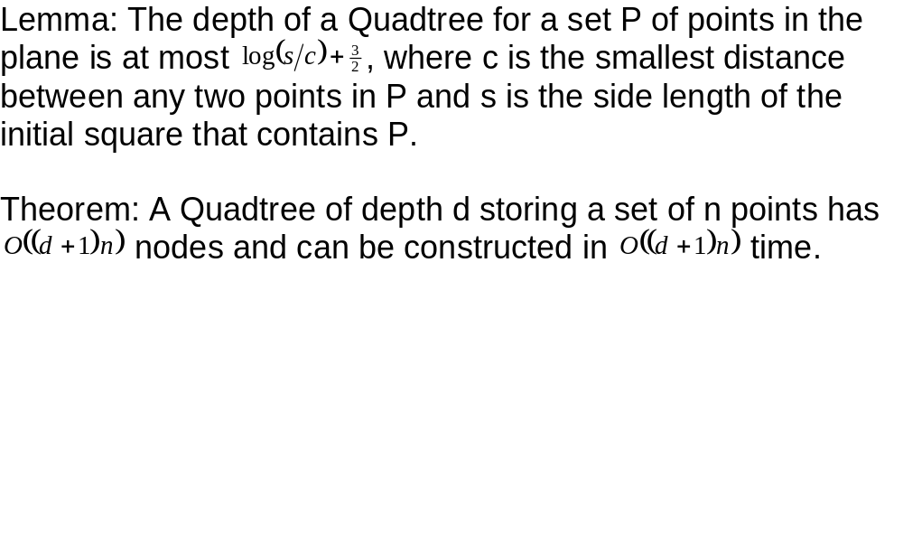
Introduction to Quadtrees
We will see later that these are at the very heart of our Mesh generation method.

Slide 19
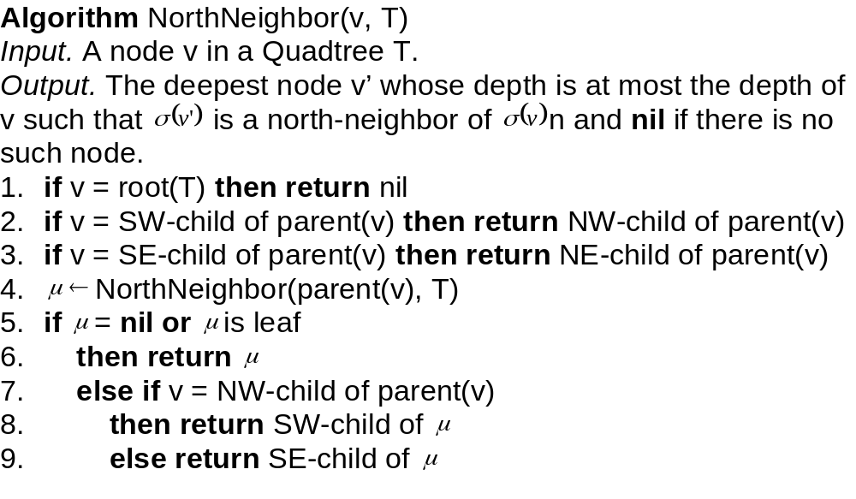
Introduction to Quadtrees
We will see later that these are at the very heart of our Mesh generation method.

Slide 20
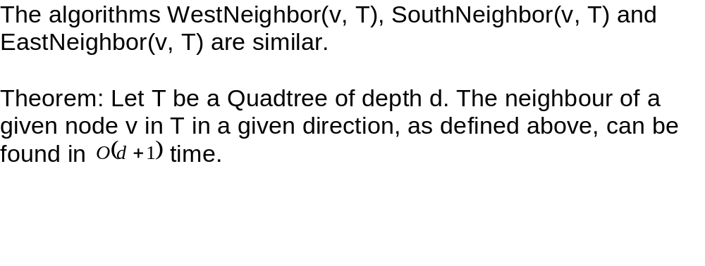
Introduction to Quadtrees
We will see later that these are at the very heart of our Mesh generation method.

Slide 21
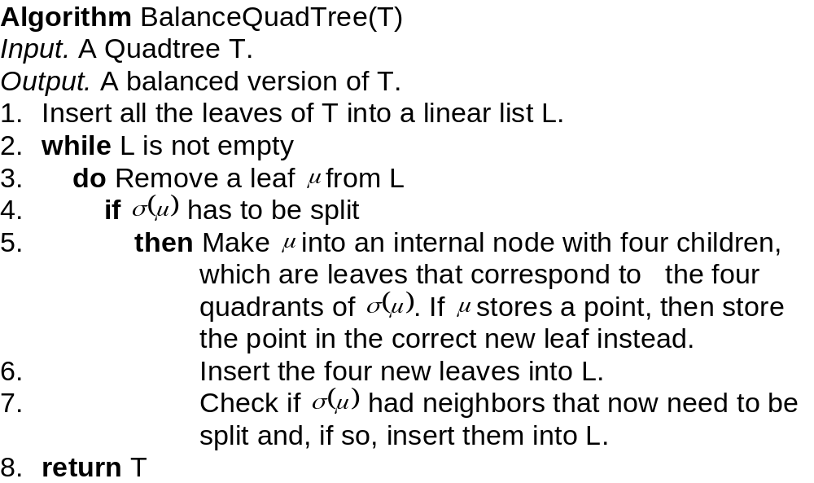
Introduction to Quadtrees
We will see later that these are at the very heart of our Mesh generation method.

Slide 22
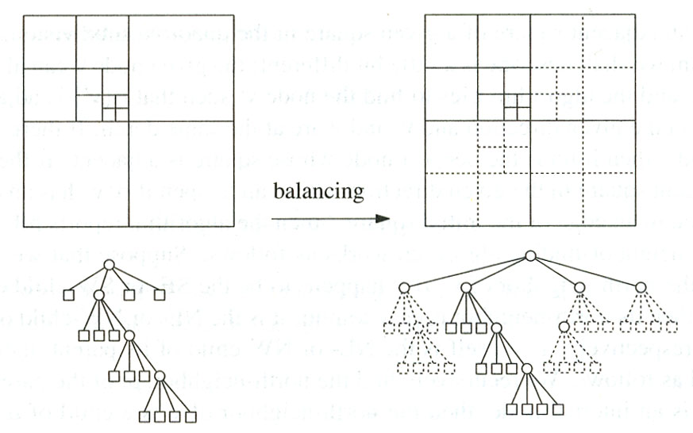
Introduction to Quadtrees
We will see later that these are at the very heart of our Mesh generation method.

Slide 23
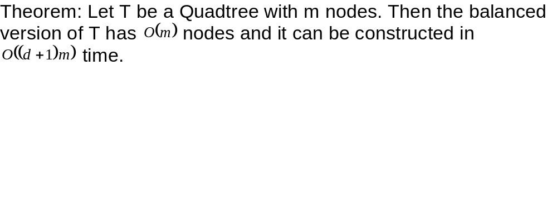
Introduction to Quadtrees
We will see later that these are at the very heart of our Mesh generation method.

Slide 24
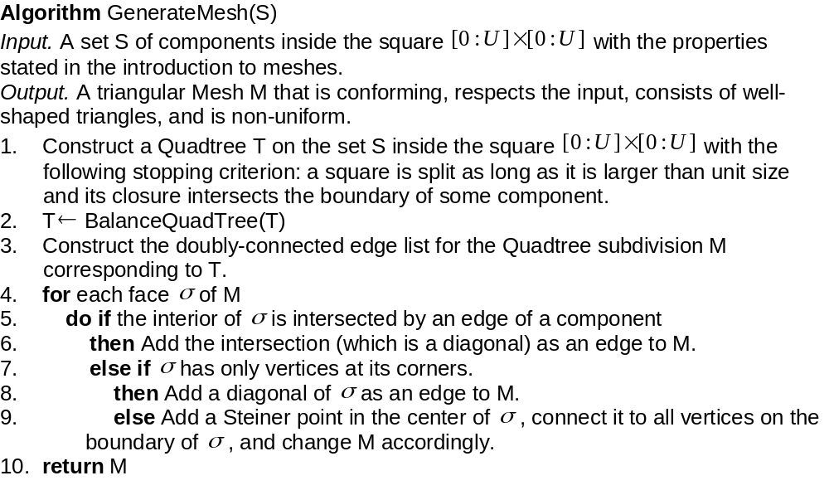
Generating Meshes using Quadtrees
Now we can apply what we learned about Quadtrees.

Slide 25
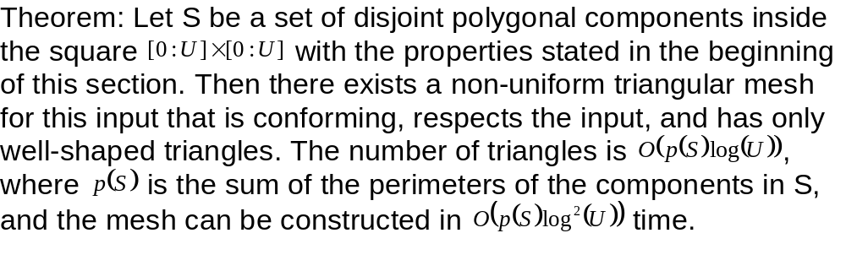
Generating Meshes using Quadtrees
Now we can apply what we learned about Quadtrees.

Slide 26
Looking further
There is more than Mesh generation for Quadtrees
Mesh generation is but one application of Quadtrees. They are also used in computer graphics, image analysis, geographic information systems, and many other areas. Typically they are used to answer range queries, but they can be used for other operations as well. Quadtrees have also been applied to hidden surface removal, ray tracing, medial axis transforms, map overlay of raster maps, and nearest neighbour finding.

Slide 27
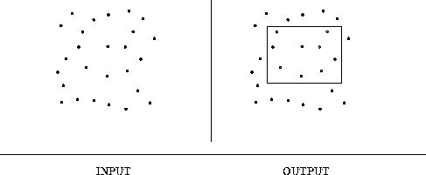
Looking further
There is more than Mesh generation for Quadtrees
What is a Range Query?
Input description: A set S of n points and a query region Q.
Problem description: Which points from S lie within Q?

Slide 28
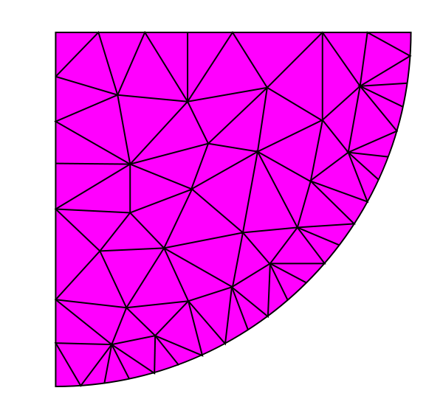
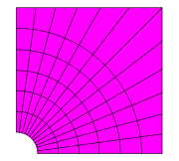
Looking further
There is more than Mesh generation for Quadtrees
There is a distinction between unstructured and structured Meshes. From a mathematical perspective, Meshes are called grids. An unstructured grid is a tessellation of a part of the Euclidean plane or Euclidean space by simple shapes, such as triangles or tetrahedra, in an irregular pattern. A structured grid is a tessellation of the Euclidean plane by congruent quadrilaterals or a space-filling tessellation of rectilinear cuboids.
unstructured grid
structured grid

Slide 29
Looking further
There is more than Mesh generation for Quadtrees
The generalization of the Quadtree to 3 dimensions is the so called Octree, where each node has 8 children.
Minimizing the number of triangles in the mesh under certain conditions is relevant and was subject to recent research.
There has been work done on the control of the density of triangles in the mesh.

Slide 30
Bibliography
de Berg, M., M. van Kreveld, M. Overmars, and O.Schwarzkopf.Computational Geometry. 2nd ed. Eindhoven (NL), Utrecht (NL): Springer-Verlag, 2000.
"Quadtree." Wikipedia. 17 Apr 2007 <http://en.wikipedia.org/wiki/Quadtree>.
"Very-large-scale integration." Wikipedia. 17 Apr 2007 <http://en.wikipedia.org/wiki/Very-large-scale_integration>.
"Unstructured grid." Wikipedia. 17 Apr 2007 <http://en.wikipedia.org/wiki/Unstructured_grid>.
"Regular grid." Wikipedia. 17 Apr 2007 <http://en.wikipedia.org/wiki/Regular_grid>.

Slide 31
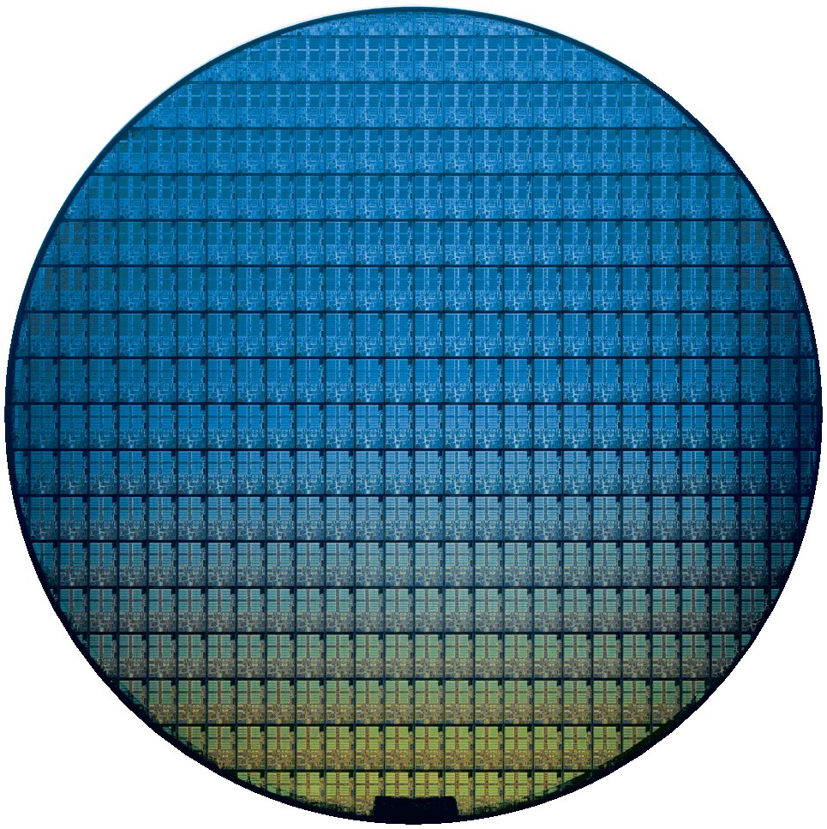
Thank you!

