Slide 1
Alpha Shapes and molecular Representations
Research Project
CSC/MATH 870 SPRING 2007
Philipp Richter

Slide 2
Introduction
Motivation for Alpha Shapes
  Researcher in structural biology need to know the shape of molecules, like proteins, that consist of possibly thousands of atoms
  But why proteins? “prota” is Greek and means “of primary importance”. They are essential to all living organisms and were first mentioned in 1838 by Jöns Jakob Berzelius, a Swedish researcher

Slide 3
Introduction
  Proteins are assembled from amino acids using information encoded in genes
You should now be able to smell some of the applications
  Try to fit molecules together
  Calculate volume or area of molecule

Slide 4
Introduction
Structural data about molecules is publicly available
  Protein Data Bank www.rcsb.org/pdb
  General: www.ChemDB.com
  others

Slide 5
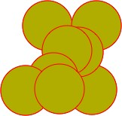
Introduction
This data only describes the participating atoms / molecules and their relative location in space

Slide 6
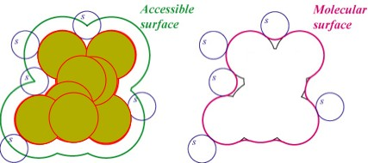
Introduction
But researchers need more:
  Solvent Accessible Surface
  Molecular Surface

Slide 7
Introduction
Here is how we do it:
  We use Alpha-Shapes, which are a generalization of Convex-Hulls
  They take the “working environment” of the molecule into account
Applet: http://cgm.cs.mcgill.ca

Slide 8
The Project
Study available algorithms and implementations
Apply to different point sets in 2D and 3D
Explore the problem of applying these to data from public databases (as mentioned before)

Slide 9
Progress by now
Studied background theory
Looked for libraries and applets that compute alpha shapes
Looked at file format of PDB

Slide 10
To be done
More studying of background theory
Study implementations
Determine interesting point sets
  Related to real molecules
Apply available implementations
Determine how data from public databases can be processed using current implementations
Comment on how an ideal implementation using those public databases would need to look like

Slide 11
References
[1] Protein Wikipedia 02/14/07
http://en.wikipedia.org/wiki/Protein
[2] Lydia E. Kavraki, Molecular Shapes and Surfaces
[3] Molecular Shapes & Surfaces 02/14/07
http://cnx.org/content/m11616/latest/

